Slide 1
Object Category Detection: Sliding Windows
03/29/11
Computer Vision
CS 543 / ECE 549
University of Illinois
Derek Hoiem

Slide 2
Administrative
Remember to e-mail project descriptions (by Thurs) and talk to Ian or me (by Fri)
Clarifications about the homework?

Slide 3
Today’s class: Object Category Detection
Statistical template matching with sliding window detector
Schneiderman Kanade detector
Viola Jones detector
Broader overview of object category detection

Slide 4
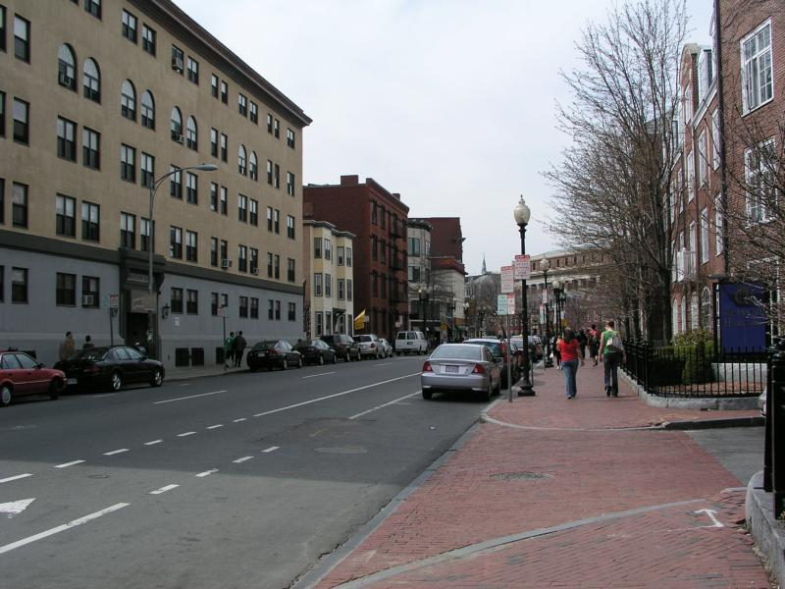
Object category detection in computer vision
Goal: detect all pedestrians, cars, monkeys, etc in image

Slide 5
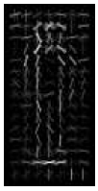
Basic Steps of Category Detection
Align
E.g., choose position, scale orientation
How to make this tractable?
Compare
Compute similarity to an example object or to a summary representation
Which differences in appearance are important?
Aligned
Possible Objects
Exemplar
Summary

Slide 6
Sliding window: a simple alignment solution
…
…

Slide 7
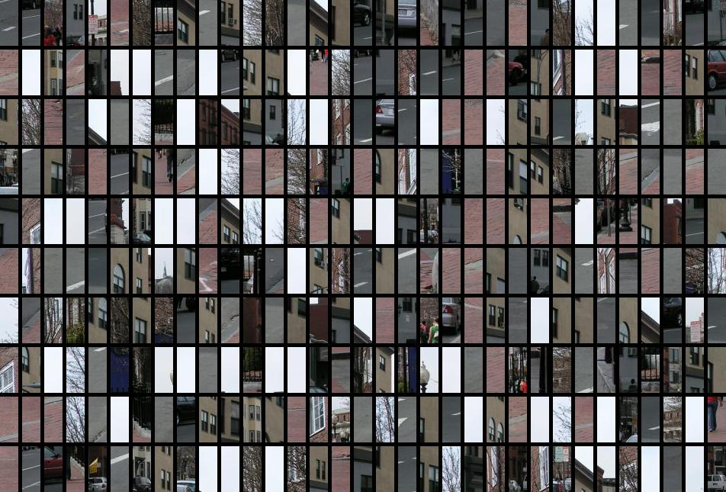
Each window is separately classified

Slide 8
Statistical Template
Object model = sum of scores of features at fixed positions
?
+3
+2
-2
-1
-2.5
= -0.5
> 7.5
Non-object
?
+4
+1
+0.5
+3
+0.5
= 10.5
> 7.5
Object

Slide 9
Design challenges
How to efficiently search for likely objects
Even simple models require searching hundreds of thousands of positions and scales
Feature design and scoring
How should appearance be modeled? What features correspond to the object?
How to deal with different viewpoints?
Often train different models for a few different viewpoints
Implementation details
Window size
Aspect ratio
Translation/scale step size
Non-maxima suppression

Slide 10
Schneiderman and Kanade
Schneiderman and Kanade. A Statistical Method for 3D Object Detection. (2000)

Slide 11
Schneiderman and Kanade
Decision function for statistical template matching:

Slide 12
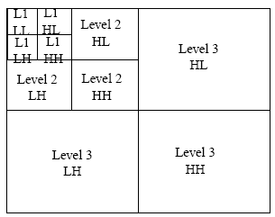
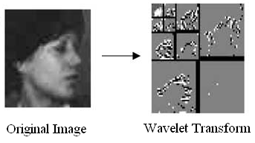
Appearance model
Each feature is a group of quantized wavelet coefficients that are statistically dependent

Slide 13
Learning to classify (feature likelihoods)
Class-conditional likelihood ratio
Estimate P(pattern|object) and P(pattern| non-object) by counting over examples
Tune weights discriminatively using Adaboost

Slide 14
Training
Create training data
Prepare each image: pre-process (optional), compute wavelet coefficients, discretize
Extract positive windows and sample of negative windows
Compute feature values for each example window
Learn scores for all possible feature values
Compute ratios of histograms by counting for positive and negative examples
Reweight examples using Adaboost
Get high-scoring negative examples (bootstrapping)

Slide 15
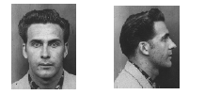
Training multiple viewpoints
Train new detector for each viewpoint.

Slide 16
Testing
Processing:
Lighting correction (optional)
Compute wavelet coefficients, quantize
Slide window over each position/scale (2 pixels, 2^{1/4} scale)
Compute feature values
Look up scores
Sum scores over features
Threshold
Use faster classifier to prune patches (cascade…more on this later)
Non-maximum suppression

Slide 17
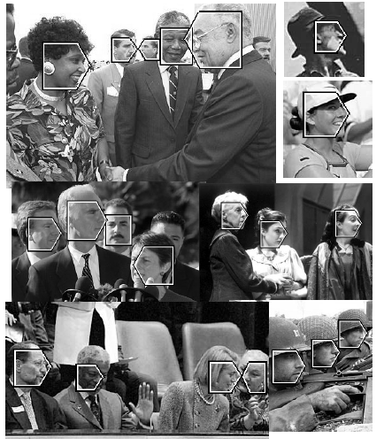
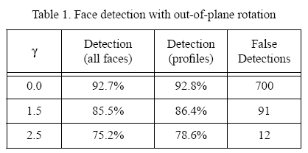
Results: faces
208 images with 441 faces, 347 in profile

Slide 18
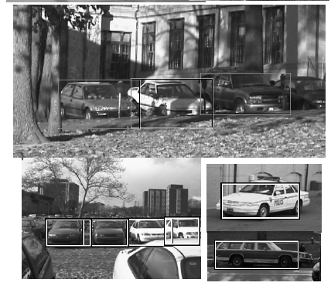
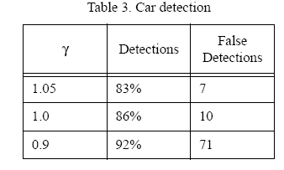
Results: cars

Slide 19
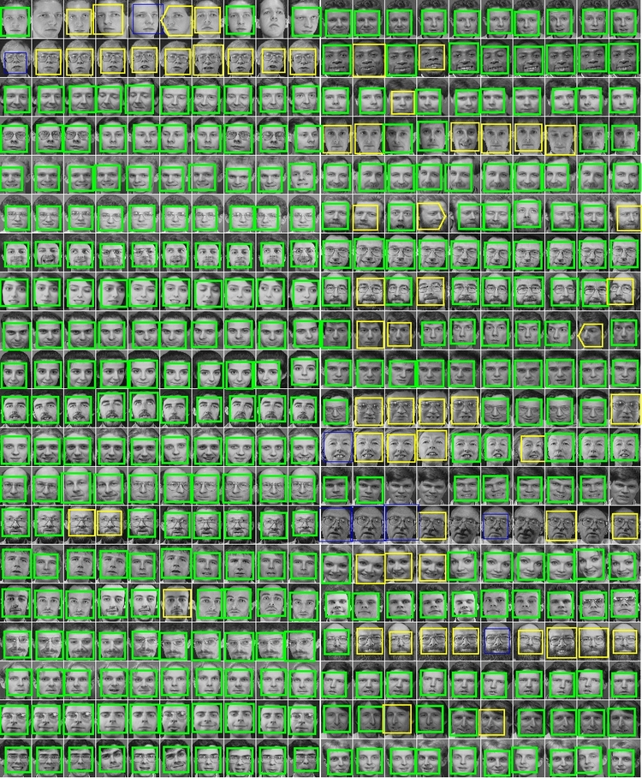
Results: faces today
http://demo.pittpatt.com/

Slide 20
Viola-Jones sliding window detector
Fast detection through two mechanisms
Quickly eliminate unlikely windows
Use features that are fast to compute
Viola and Jones. Rapid Object Detection using a Boosted Cascade of Simple Features (2001).

Slide 21
Cascade for Fast Detection
Choose threshold for low false negative rate
Fast classifiers early in cascade
Slow classifiers later, but most examples don’t get there
Stage 1
H₁(x) > t₁?
Yes
Stage 2
H₂(x) > t₂?
Stage N
H_{N}(x) > t_{N}?
Yes
…
Pass
No
No
No
Examples
Reject
Reject
Reject

Slide 22
Features that are fast to compute
“Haar-like features”
Differences of sums of intensity
Thousands, computed at various positions and scales within detection window
-1
+1
Two-rectangle features
Three-rectangle features
Etc.

Slide 23
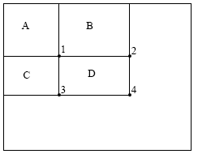
Integral Images
ii = cumsum(cumsum(Im, 1), 2)
x, y
ii(x,y) = Sum of the values in the grey region
How to compute B-A?
How to compute A+D-B-C?

Slide 24
Feature selection with Adaboost
Create a large pool of features (180K)
Select features that are discriminative and work well together
“Weak learner” = feature + threshold + parity
Choose weak learner that minimizes error on the weighted training set
Reweight

Slide 25
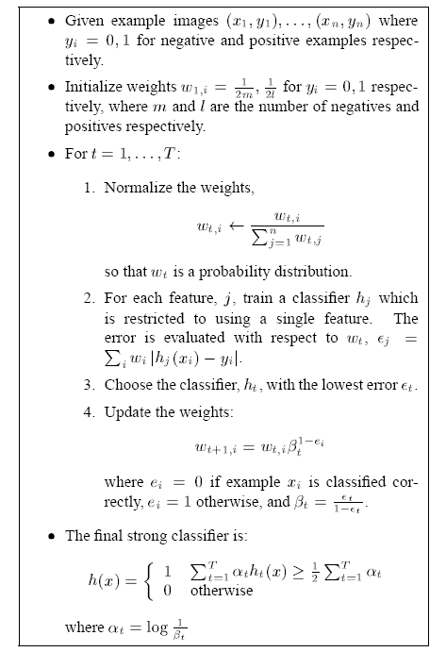
Adaboost

Slide 26
Interpretations of Adaboost
Additive logistic regression (Friedman et al. 2000)
LogitBoost from Collins et al. 2002 does this more explicitly
Margin maximization (Schapire et al. 1998)
Ratch and Warmuth 2002 do this more explicitly

Slide 27
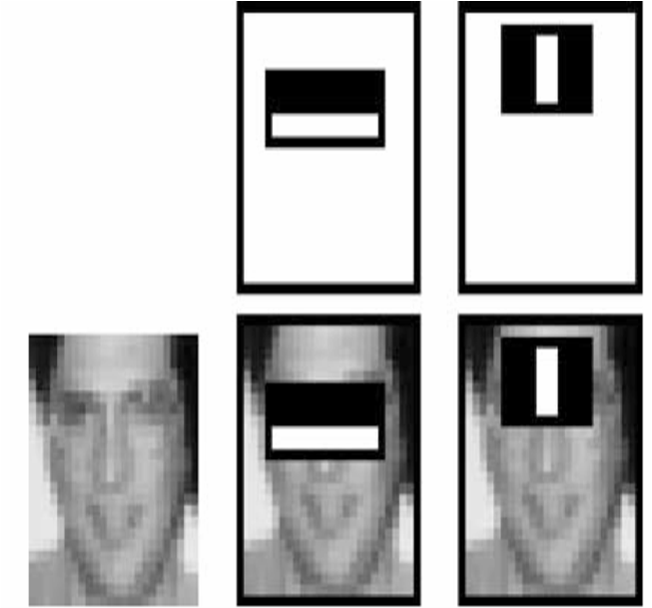
Top 2 selected features

Slide 28
Viola-Jones details
38 stages with 1, 10, 25, 50 … features
6061 total used out of 180K candidates
10 features evaluated on average
Examples
4916 positive examples
10000 negative examples collected after each stage
Scanning
Scale detector rather than image
Scale steps = 1.25, Translation 1.0*s to 1.5*s
Non-max suppression: average coordinates of overlapping boxes
Train 3 classifiers and take vote

Slide 29
Viola Jones Results
MIT + CMU face dataset

Slide 30
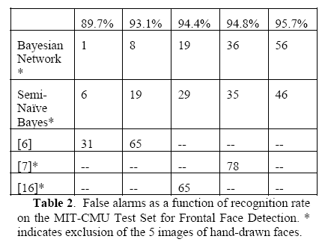
Schneiderman later results
Schneiderman 2004
Viola-Jones 2001
Roth et al. 1999
Schneiderman-Kanade 2000

Slide 31
Speed: frontal face detector
Schneiderman-Kanade (2000): 5 seconds
Viola-Jones (2001): 15 fps

Slide 32
Strengths and Weaknesses of Statistical Template Approach
Strengths
Works very well for non-deformable objects: faces, cars, upright pedestrians
Fast detection
Weaknesses
Not so well for highly deformable objects
Not robust to occlusion
Requires lots of training data

Slide 33
General Process of Object Recognition
Specify Object Model
What are the object parameters?
Generate Hypotheses
Score Hypotheses
Resolution

Slide 34
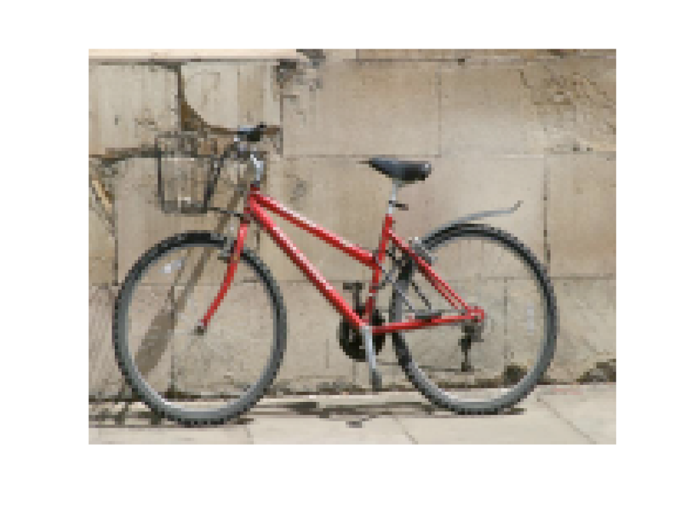
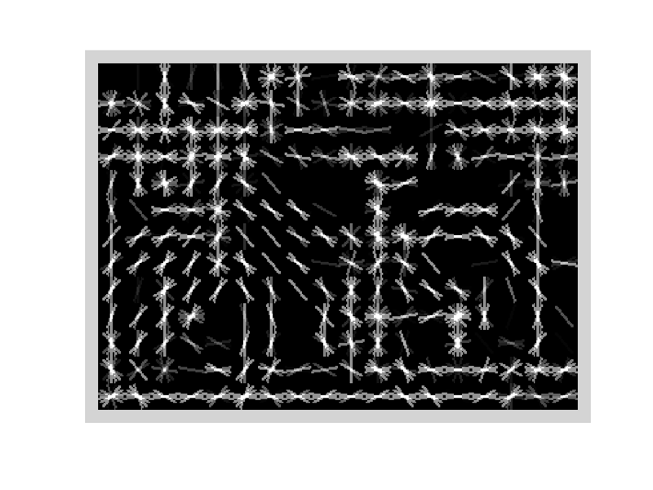
Specifying an object model
Statistical Template in Bounding Box
Object is some (x,y,w,h) in image
Features defined wrt bounding box coordinates
Image
Template Visualization
Images from Felzenszwalb

Slide 35
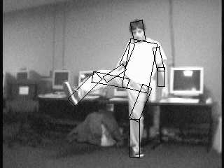
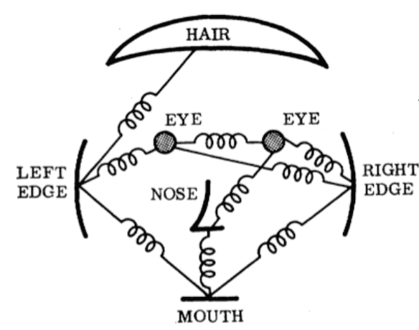
Specifying an object model
2. Articulated parts model
Object is configuration of parts
Each part is detectable
Images from Felzenszwalb

Slide 36
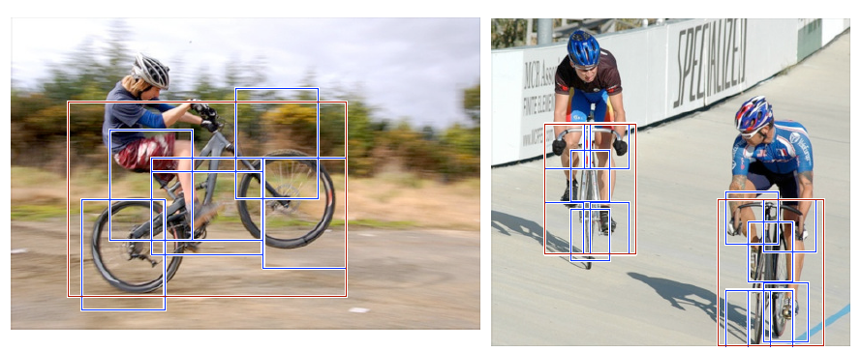
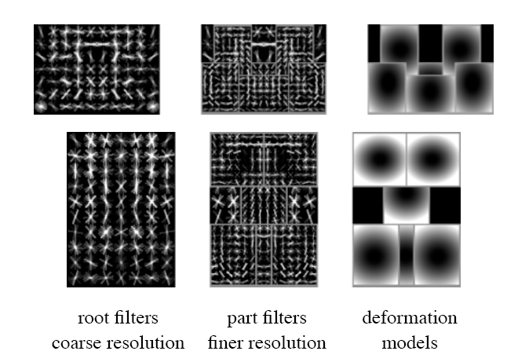
Specifying an object model
3. Hybrid template/parts model
Detections
Template Visualization
Felzenszwalb et al. 2008

Slide 37
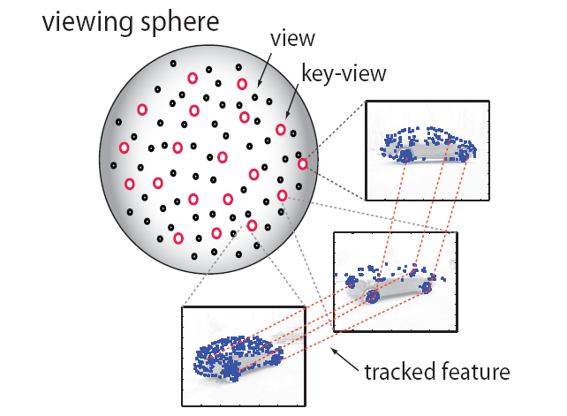
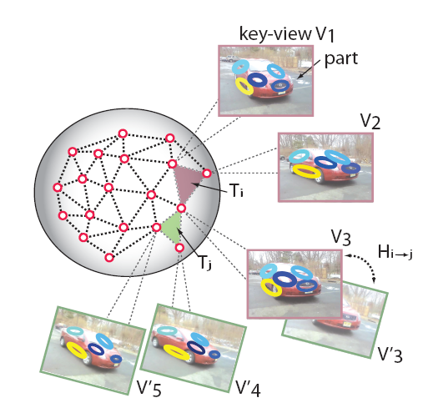
Specifying an object model
3D-ish model
Object is collection of 3D planar patches under affine transformation

Slide 38
General Process of Object Recognition
Specify Object Model
Generate Hypotheses
Propose an alignment of the model to the image
Score Hypotheses
Resolution

Slide 39
Generating hypotheses
Sliding window
Test patch at each location and scale

Slide 40
Generating hypotheses
Sliding window
Test patch at each location and scale

Slide 41
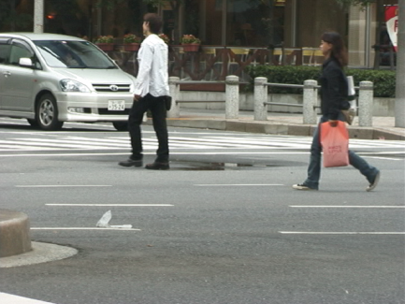
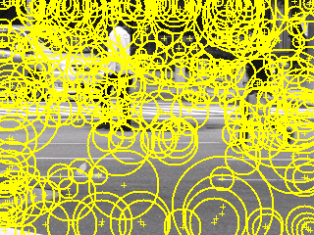
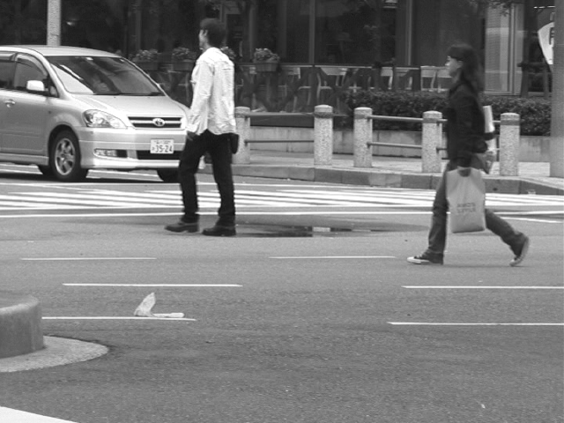
Generating hypotheses
2. Voting from patches/keypoints
Matched Codebook Entries
Probabilistic Voting
Interest Points
y
s
3D Voting Space (continuous)
x
ISM model by Leibe et al.

Slide 42
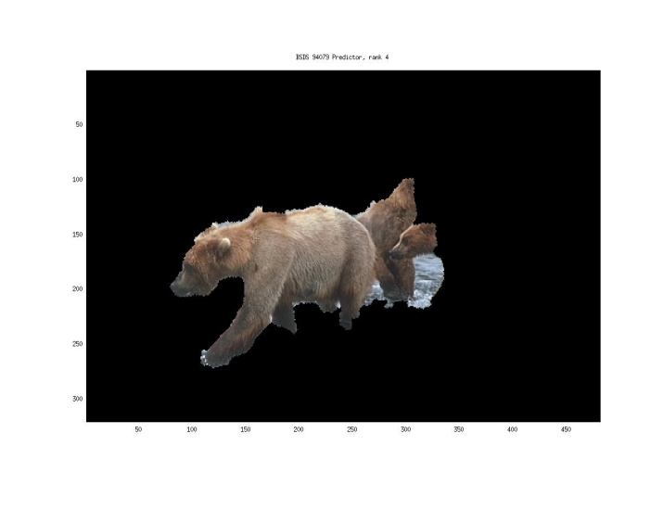
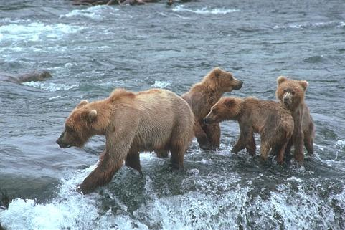
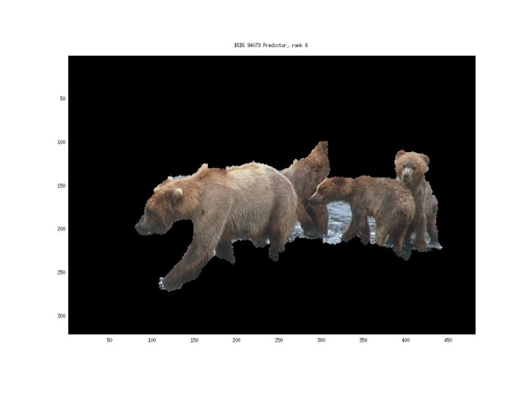
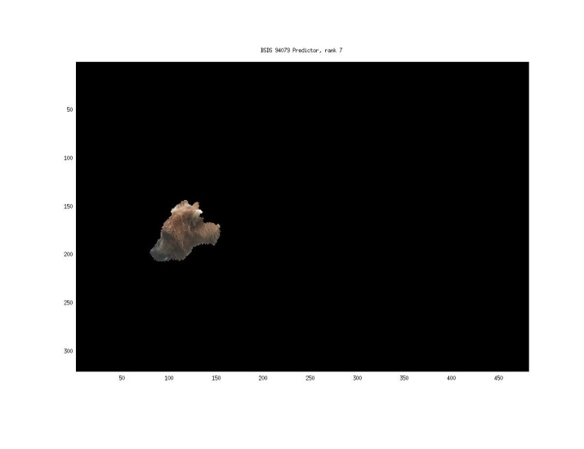
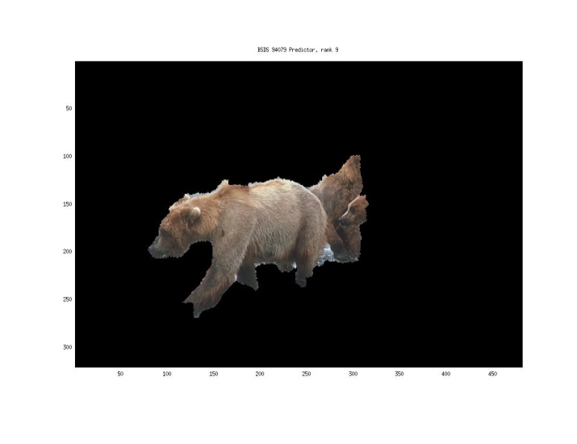
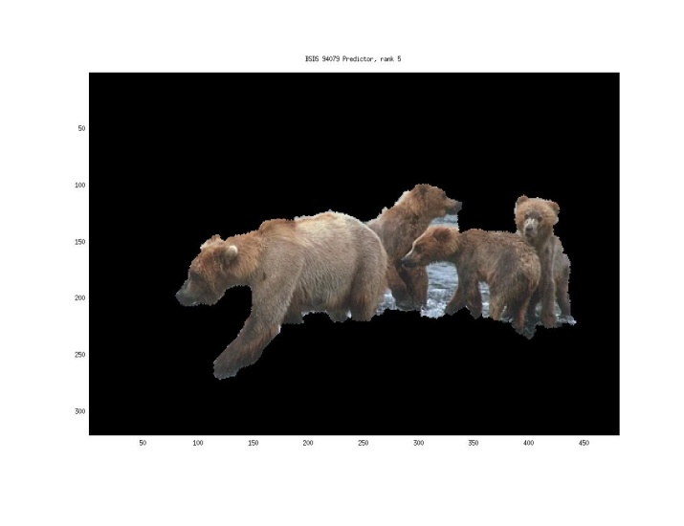
Generating hypotheses
3. Region-based proposal
Endres Hoiem 2010

Slide 43
General Process of Object Recognition
Specify Object Model
Generate Hypotheses
Mainly-gradient based features, usually based on summary representation, many classifiers
Score Hypotheses
Resolution

Slide 44
General Process of Object Recognition
Specify Object Model
Generate Hypotheses
Score Hypotheses
Resolution
Rescore each proposed object based on whole set

Slide 45
Resolving detection scores
Non-max suppression
Score = 0.8
Score = 0.8
Score = 0.1

Slide 46
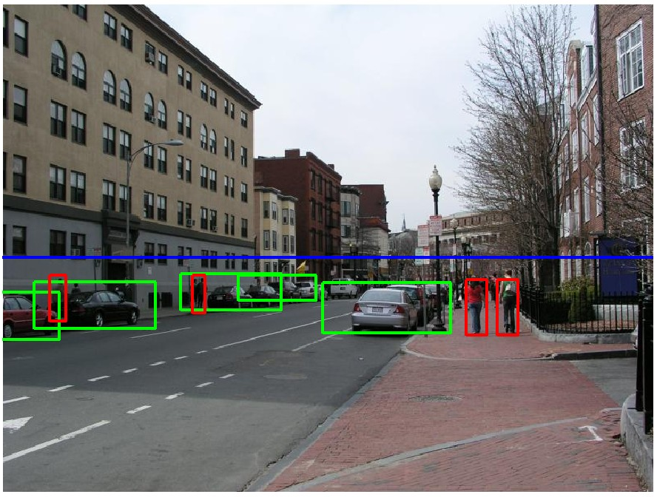
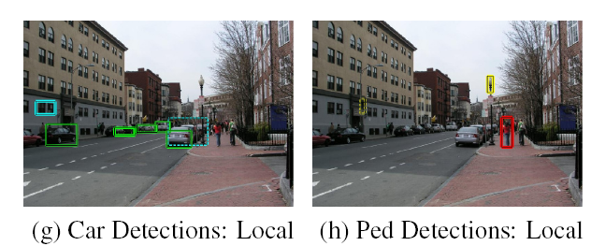
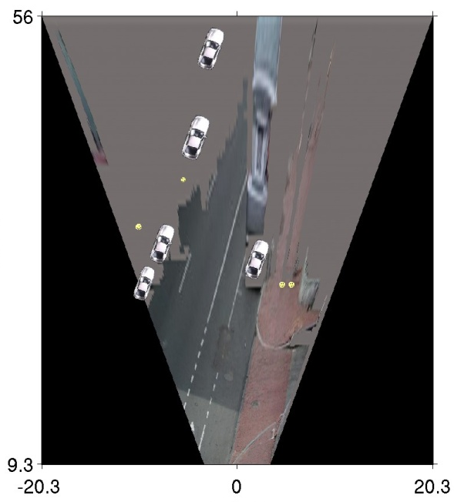
Resolving detection scores
2. Context/reasoning
meters
Hoiem et al. 2006
meters

Slide 47
Influential Works in Detection
Sung-Poggio (1994, 1998) : ~1450 citations
Basic idea of statistical template detection (I think), bootstrapping to get “face-like” negative examples, multiple whole-face prototypes (in 1994)
Rowley-Baluja-Kanade (1996-1998) : ~2900
“Parts” at fixed position, non-maxima suppression, simple cascade, rotation, pretty good accuracy, fast
Schneiderman-Kanade (1998-2000,2004) : ~1250
Careful feature engineering, excellent results, cascade
Viola-Jones (2001, 2004) : ~6500
Haar-like features, Adaboost as feature selection, hyper-cascade, very fast, easy to implement
Dalal-Triggs (2005) : ~2000
Careful feature engineering, excellent results, HOG feature, online code
Felzenszwalb-Huttenlocher (2000): ~800
Efficient way to solve part-based detectors
Felzenszwalb-McAllester-Ramanan (2008)? ~350
Excellent template/parts-based blend

Slide 48
Things to remember
Sliding window for search
Features based on differences of intensity (gradient, wavelet, etc.)
Excellent results require careful feature design
Boosting for feature selection (also L1-logistic regression)
Integral images, cascade for speed
Bootstrapping to deal with many, many negative examples
Stage 1
H₁(x) > t₁?
Yes
Stage 2
H₂(x) > t₂?
…
Stage N
H_{N}(x) > t_{N}?
Yes
Pass
Examples
No
No
No
Reject
Reject
Reject

Slide 49
Next class
Deformable parts models and the distance transform

Slide 50
SK vs. VJ
Schneiderman-Kanade
Wavelet features
Log linear model via boosted histogram ratios
Bootstrap training
Two-stage cascade
NMS: Remove overlapping weak boxes
Slow but very accurate
Viola-Jones
Similar to Haar wavelets
Log linear model via boosted stubs
Bootstrap training
Multistage cascade, integrated into training
NMS: average coordinates of overlapping boxes
Less accurate but very fast

Slide 51
Important Ideas and Tricks
Excellent results require careful feature engineering
Speed = fast features (integral image) + cascade
Adaboost for feature selection
Bootstrapping to deal with many, many negative examples

Slide 52
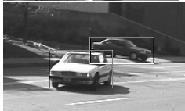
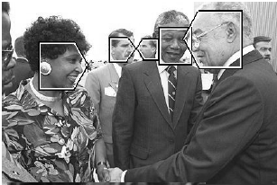
Goal: Detect all instances of objects

Slide 53
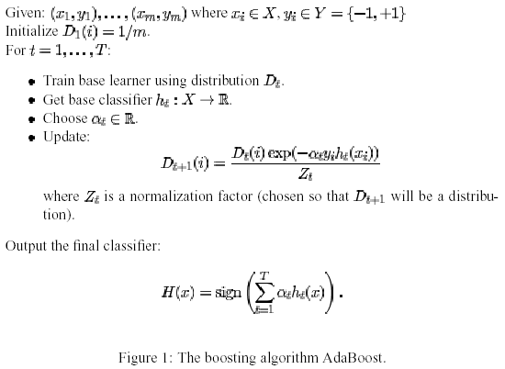
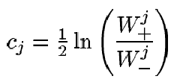
Adaboost
“RealBoost”
Important special case: h_{t} partitions input space:
alpha_{t}
Figure from Friedman et al. 1999

Slide 54
Adaboost: Immune to Overfitting?
Test error
Train error

Slide 55
Adaboost: Margin Maximizer
Test error
Train error
margin

Slide 56
Sidebar: Adaboost

Slide 57
Features: groups of wavelet coefficients
Fixed parts within/across subbands
17 types of “parts” that can appear at each position
Discretize wavelet coefficient to 3 values
E.g., part with 8 coefficients has 3^8 = 6561 values

