Slide 1
MRFs and Segmentation with Graph Cuts
02/24/10
Computer Vision
CS 543 / ECE 549
University of Illinois
Derek Hoiem

Slide 2
Today’s class
Finish up EM
MRFs
Segmentation with Graph Cuts
i
w_{ij}
j

Slide 3
EM Algorithm: Recap
E-step: compute
M-step: solve
Determines hidden variable assignments and parameters that maximize likelihood of observed data
Improves likelihood at each step (reaches local maximum)
Derivation is tricky but implementation is easy

Slide 4
EM Demos
Mixture of Gaussian demo
Simple segmentation demo

Slide 5
“Hard EM”
Same as EM except compute z* as most likely values for hidden variables
K-means is an example
Advantages
Simpler: can be applied when cannot derive EM
Sometimes works better if you want to make hard predictions at the end
But
Generally, pdf parameters are not as accurate as EM

Slide 6
Missing Data Problems: Outliers
You want to train an algorithm to predict whether a photograph is attractive. You collect annotations from Mechanical Turk. Some annotators try to give accurate ratings, but others answer randomly.
Challenge: Determine which people to trust and the average rating by accurate annotators.
Annotator Ratings
10
8
9
2
8
Photo: Jam343 (Flickr)

Slide 7
Missing Data Problems: Object Discovery
You have a collection of images and have extracted regions from them. Each is represented by a histogram of “visual words”.
Challenge: Discover frequently occurring object categories, without pre-trained appearance models.
http://www.robots.ox.ac.uk/~vgg/publications/papers/russell06.pdf

Slide 8
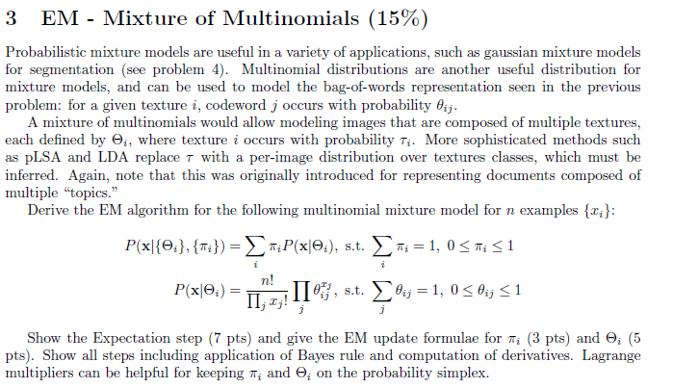
n is the total count of the histogram

Slide 9
Today’s class
Treating the image as a graph
MRFs
Segmentation with graph cuts
i
w_{ij}
j

Slide 10
What’s wrong with this prediction?
P(foreground | image)

Slide 11
Solution
P(foreground | image)
Encode dependencies between pixels
Normalizing constant
Labels to be predicted
Individual predictions
Pairwise predictions

Slide 12
Writing Likelihood as an “Energy”
“Cost” of assignment y_{i}
“Cost” of pairwise assignment y_{i ,}y_{j}

Slide 13
Markov Random Fields
Node y_{i}: pixel label
Edge: constrained pairs
Cost to assign a label to each pixel
Cost to assign a pair of labels to connected pixels

Slide 14
Markov Random Fields
Unary potential
Example: “label smoothing” grid
0: -logP(y_{i} = 0 ; data)
1: -logP(y_{i} = 1 ; data)
Pairwise Potential
0 1
0 0 K
1 K 0

Slide 15
Solving MRFs with graph cuts
Source (Label 0)
Cost to assign to 1
Cost to split nodes
Cost to assign to 0
Sink (Label 1)

Slide 16
Solving MRFs with graph cuts
Source (Label 0)
Cost to assign to 0
Cost to split nodes
Cost to assign to 1
Sink (Label 1)

Slide 17
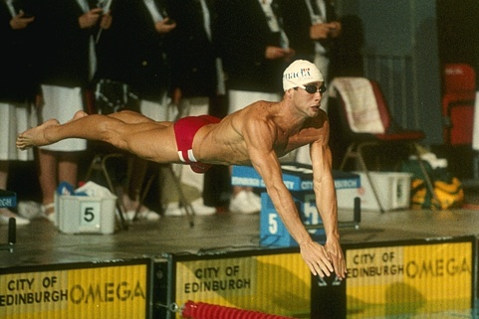
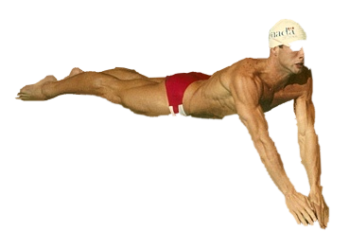
GrabCut segmentation
User provides rough indication of foreground region.
Goal: Automatically provide a pixel-level segmentation.

Slide 18
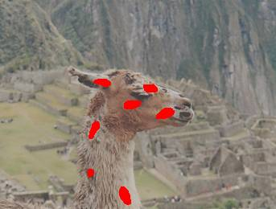
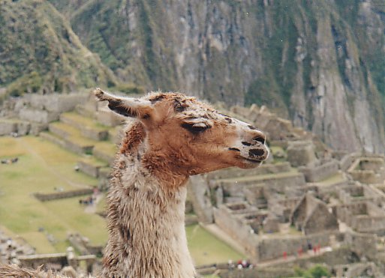
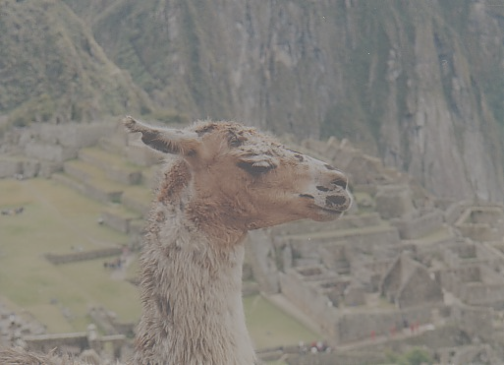
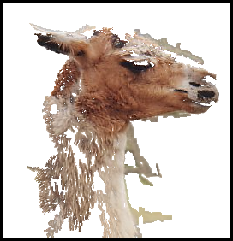
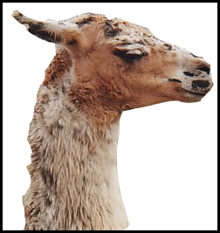
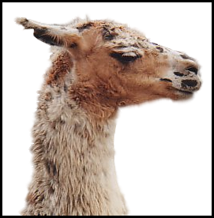
Grab cuts and graph cuts
Magic Wand (198?)
Intelligent Scissors Mortensen and Barrett (1995)
GrabCut
User Input
Result
Regions
Boundary
Regions & Boundary
Source: Rother
Notes:
Basic idea is to combine the information which was used in the 2 well known tools: MW and IS.
MS select a region of similar colour according to your input. Fat pen and the boundary snapps to high contrast edges.
Grabcut combines it. And this allows us to simplify the user interface considerably by …

Slide 19
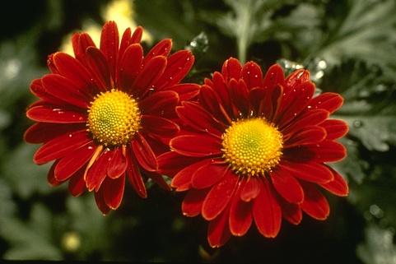
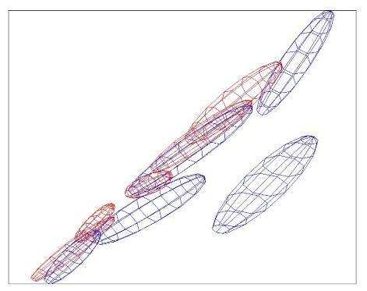
Colour Model
R
Foreground & Background
Background
G
Gaussian Mixture Model (typically 5-8 components)
Source: Rother
Notes:
Color enbergy.
Iterations have the effect of pulling them away;
D is – log likelyhood of the GMM.

Slide 20
Graph cuts Boykov and Jolly (2001)
Foreground (source)
Image
Min Cut
Background (sink)
Cut: separating source and sink; Energy: collection of edges
Min Cut: Global minimal enegry in polynomial time
Source: Rother
Notes:
Optimization engine we use Graph Cuts. By now everybody should know what graph cut is. IN case you missed it here is a very brief introduction.
To image. 3D view. First task to construct a graph.
All pixels on a certain scanline. Just a few of them.
Next step introduce artificial nodes. fgd and background.
Edges – contrast. Boundary is quite likely between black and white.
Min Cut - Minimum edge strength.

Slide 21
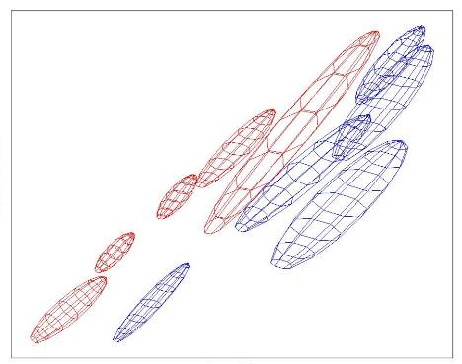
Colour Model
R
R
Foreground & Background
Iterated graph cut
Foreground
Background
G
Background
G
Gaussian Mixture Model (typically 5-8 components)
Source: Rother
Notes:
Color enbergy.
Iterations have the effect of pulling them away;
D is – log likelyhood of the GMM.

Slide 22
GrabCut segmentation
Define graph
usually 4-connected or 8-connected
Define unary potentials
Color histogram or mixture of Gaussians for background and foreground
Define pairwise potentials
Apply graph cuts
Return to 2, using current labels to compute foreground, background models

Slide 23
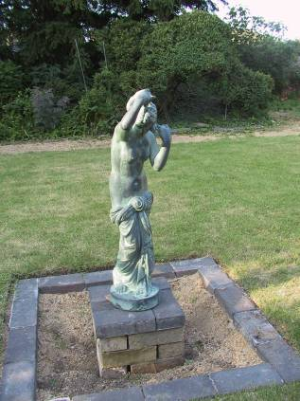
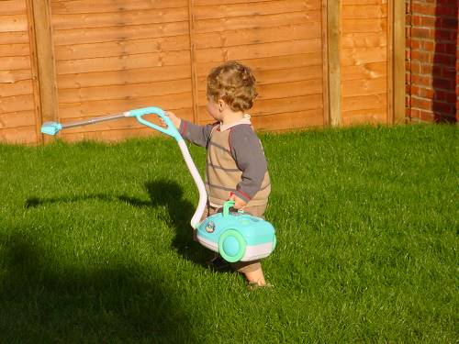
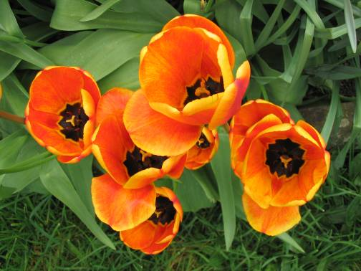
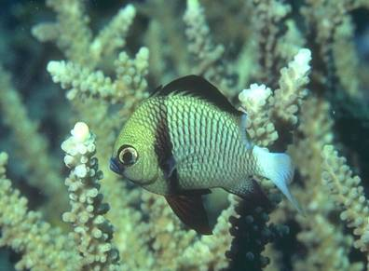
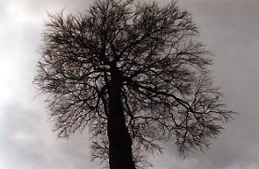
What is easy or hard about these cases for graphcut-based segmentation?

Slide 24
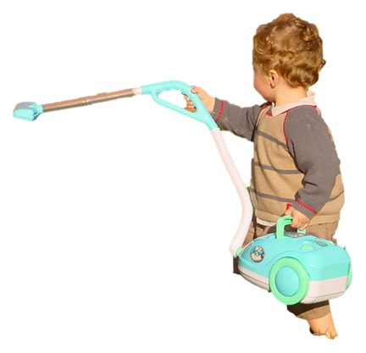
Easier examples
GrabCut – Interactive Foreground Extraction 10
Notes:
Moderately straightforward examples- after the user input automnatically

Slide 25
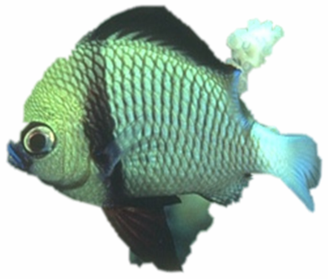
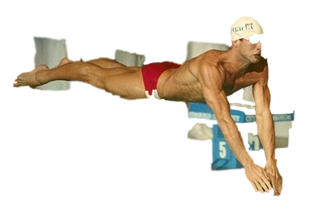
More difficult Examples
Camouflage &
Low Contrast
Fine structure
Harder Case
Initial Rectangle
Initial Result
GrabCut – Interactive Foreground Extraction 11
Notes:
You might wonder when does it fail. 4 cases. Low contrats – an edge not good visible

Slide 26
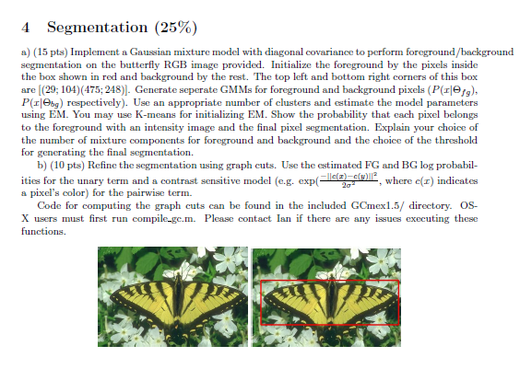

Slide 27
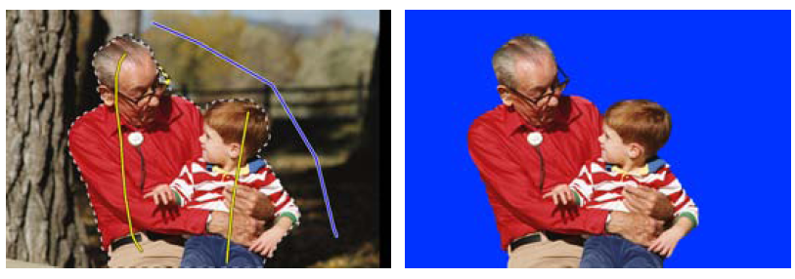
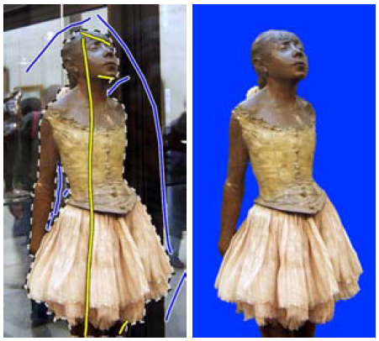
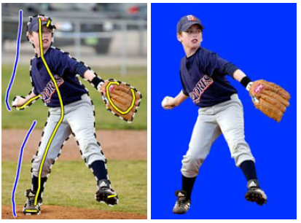
Lazy Snapping (Li et al. SG 2004)

Slide 28
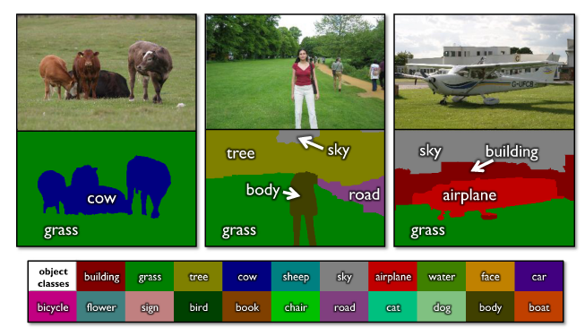
Using graph cuts for recognition
TextonBoost (Shotton et al. 2009 IJCV)

Slide 29
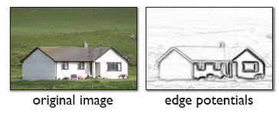
Using graph cuts for recognition
Unary Potentials
Alpha Expansion Graph Cuts
TextonBoost (Shotton et al. 2009 IJCV)

Slide 30
Limitations of graph cuts
Associative: edge potentials penalize different labels
If not associative, can sometimes clip potentials
Approximate for multilabel
Alpha-expansion or alpha-beta swaps
Must satisfy

Slide 31
Graph cuts: Pros and Cons
Pros
Very fast inference
Can incorporate data likelihoods and priors
Applies to a wide range of problems (stereo, image labeling, recognition)
Cons
Not always applicable (associative only)
Need unary terms (not used for generic segmentation)
Use whenever applicable

Slide 32
More about MRFs/CRFs
Other common uses
Graph structure on regions
Encoding relations between multiple scene elements
Inference methods
Loopy BP or BP-TRW: approximate, slower, but works for more general graphs

Slide 33
Further reading and resources
Graph cuts
http://www.cs.cornell.edu/~rdz/graphcuts.html
Classic paper: What Energy Functions can be Minimized via Graph Cuts? (Kolmogorov and Zabih, ECCV '02/PAMI '04)
Belief propagation
Yedidia, J.S.; Freeman, W.T.; Weiss, Y., "Understanding Belief Propagation and Its Generalizations”, Technical Report, 2001: http://www.merl.com/publications/TR2001-022/
Normalized cuts and image segmentation (Shi and Malik)
http://www.cs.berkeley.edu/~malik/papers/SM-ncut.pdf
N-cut implementation
http://www.seas.upenn.edu/~timothee/software/ncut/ncut.html

Slide 34
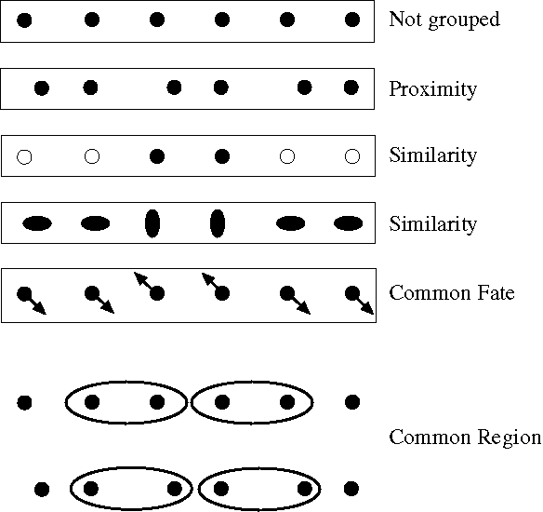
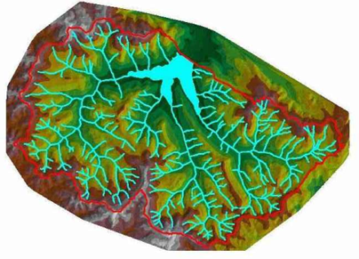
Next Class
Gestalt grouping
More segmentation methods

