Slide 1
Alibi Routing
Dave Levin, Youndo Lee, Luke Valenta, Zhihao Li, Victoria Lai, Cristian Lumezanu, Brendan Rowen, Neil Spring, Bobby Bhattacharjee
Presented by Kirill Varshavskiy

Slide 2
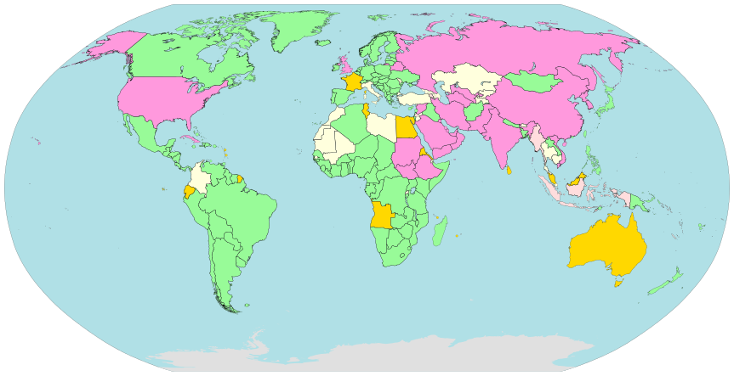

Sniff sniff
State agencies censor and log citizens’ internet traffic
Abundant in certain regions
China
Syria
North Korea
Saudi Arabia
Bahrain
Iran
Vietnam
Notes:
This is a very short list, it’s not actually that short. There is a report by Reporters Without Borders about enemies of the internet as well as nations that are known to engage in traffic surveillance. Most nations are on that list in different ways

Slide 3

Censor-avoidance
Censorship and Surveillance
Dropping packets
Injecting data into packets
Logging packets
Routing protocols often don’t consider intermediate nodes
Traffic can route through geographic region which might inject data into packet
Data integrity
Nations may log routing info + drop packets

Slide 4
Past Approaches
BGP Poisoning (avoidance)
Failure prone regions blacklisted in BGP
Tor (other overlay systems)
Anonymized internet usage
May pass through censored region when going between hops
Geographical routing
Greedy routing, no avoidance
Some systems provide means to monitor regions visited, but no insurance/proof that certain places were not visited
Notes:
Alibi and Tor are complimentary

Slide 5
What Alibi routing is and what it isn’t
Provides
Overlay P2P network for data routing
Proof that sent packet did not enter forbidden region after packet has completed its RTT
Proof per packet as routing can traverse various paths due to packet switching/routing decisions
Does not Provide
Guarantee that data is not delivered to forbidden region
Malicious nodes not in forbidden region might copy and send it elsewhere
Assurance of reliable communication, just a proof that it didn’t enter the region AFTER transmission

Slide 6
Terminology and definitions
Forbidden Region
Geographical location that should not be entered
Represented by a list of <lat, long> coordinates depicting a geo-polygon
Alibi
Relay that can be safely used to divert traffic around forbidden region
Picked such that passing through Alibi AND forbidden region will cause noticeable delay increase
Target regions
Regions in which Alibis might reside
Aid in locating Alibi
δ (delta)
Coefficient to ensure safety under latency fluctuations
Used to determine target regions

Slide 7
Proof of avoidance
Proving something did not happen is difficult
Proving something related cannot possibly happen is less difficult
How do you prove packet did not go through forbidden region?
Consider event x depicting a situation in which a packet traverses through a forbidden region
Consider event A depicting a situation where a packet does not traverse through a forbidden region
A and x are mutually exclusive
Showing x is impossible, authors show A is true

Slide 8
Assumptions
All non-forbidden nodes are trustworthy
Nodes cannot lie about smaller RTTs
Based on various signing schemes, returned packet will show all (trustworthy) nodes it traversed

Slide 9

Relay Guarantees
Given path s -> r -> d with an RTT rtt_time
Calculate RTT through s, r, and d AND the closest possible f to be rtt_forbidden
If rtt_time is a factor of delta smaller than rtt_forbidden, initial path could not have possibly traversed f
d
T
f
r
F
f
s
Notes:
Before I show you hot to find the relay, let me convince you that once I find it, I will be able to avoid the forbidden region

Slide 10

Targeting the target region
Alibi Routing consists of an overlay network of P2P nodes, each with coarse GPS coords
Target region contains Alibi node
Authors partition world into grid of points
For each point, consider it as g, calculate δ threshold
All calculations based on greater-circle distance
d
T
f
F
f
g
$$\left(1+δ\right) ∗Measured RTT≤\frac{3}{c} ShortestDistance(q,F)$$
s

Slide 11
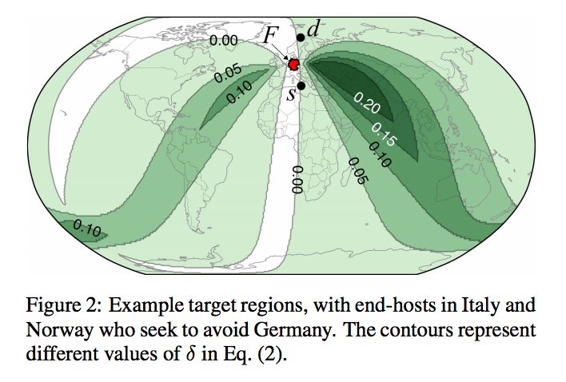
Target region based on δ

Slide 12
Alibi, where art thou?
d
Each node keeps an active peer list and a neighbor list
Occasionally sends out random nonces to get neighbors’ GPS coords
Ping responses come with correct RTT as nonce is random and thus response cannot be pre-constructed
Each hop from source tries to minimize distance to target region
T
f
F
f
s

Slide 13
Security Concerns
Time/distance calculations prevent underselling of RTT from malicious nodes
Eclipse attack: surround node with all malicious nodes
Requires attack nodes to be physically close to trustworthy nodes
Algorithm should route hops away from forbidden regions
Sending data copies to attackers
End to end encryption can solve this, otherwise, nothing would effectively prevent this
Laundering traffic: using relays to attack hosts
Similar approach as to other systems, whitelisting, solutions exist

Slide 14
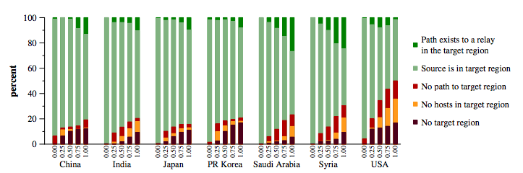
Evaluation
Authors simulated deployment of 20,000 nodes and PlanetLab simulation of 245 hosts
“Enemies of the Internet” labeled as forbidden regions + countries with most Internet users (USA, India, Japan)
Most source-destination pairs successful

Slide 15
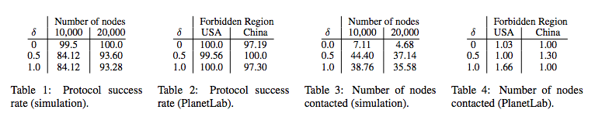
Evaluation
Protocol success using simulation and PlanetLab deployment showed almost 100% success in most δ value cases
Due to limited PlanetLab deployment, at most 2 hops were needed to find relay. Around 40 in simulation.

Slide 16
Conclusion and Comments
Alibi routing can be used as an intelligent P2P network that bypasses unwanted territories in an efficient manner
Current implementation has to be manually configured. Would be interesting to see how system works in a practical deployment with backoff techniques
Does not tackle various downsides of the algorithm, for example being surrounded by forbidden region or having several forbidden regions, or failure cases where alibis incur too much of a latency to be effective
Authors mention Alibi routing can be used in tandem with Tor, which should be very beneficial to both technologies
P2P design requires lots of nodes to be online/active

Slide 17
References
https://en.wikipedia.org/wiki/Internet_censorship
http://conferences.sigcomm.org/sigcomm/2015/pdf/papers/p611.pdf
http://alibi.cs.umd.edu/
https://firemon-firemon.netdna-ssl.com/wp-content/uploads/2014/11/firewall.lgo_.jpg
http://archive.cone.informatik.uni-freiburg.de/people/ruehrup/georouting.png

Slide 18
Discussion
Would you use Alibi routing for your Internet use? (show of hands)
What other cases has Alibi routing not considered?
How does this system handle Internet hubs? If hub for lots of the world’s internet traffic is relayed through a forbidden region, how will the system adapt?
Should this P2P network consider congestion of relay nodes as potential bottleneck?

Slide 19
Questions?

