Slide 1
Energy Consumption in AI Datacenters: Can We Address this Challenge?
Josep Torrellas
University of Illinois Urbana-Champaign
https://iacoma.cs.uiuc.edu/josep/torrellas.html
https://acecenter.grainger.illinois.edu/
EMC2 Workshop, March 2026

Slide 2
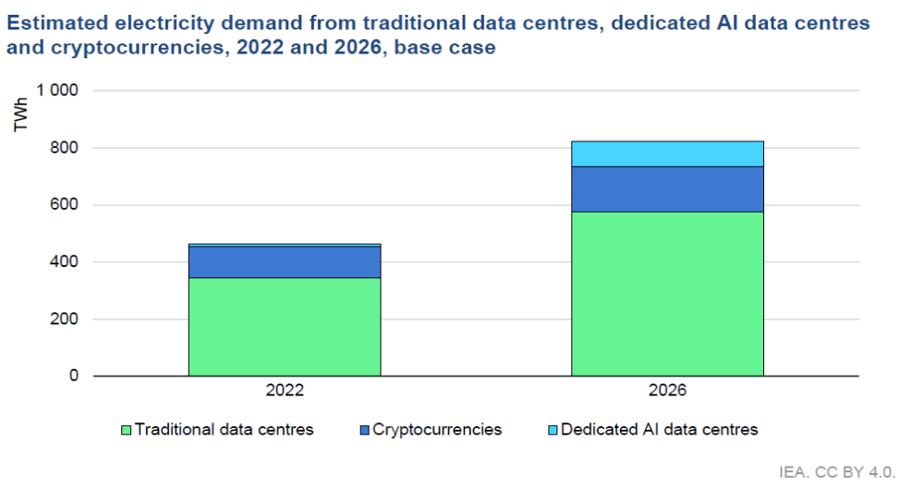
  Data Center Energy Demands Are Increasing Fast
Training a single model already takes 100+MW over many months in a cluster with 100K GPUs
Notes:
1.4 to 2.6x

Slide 3
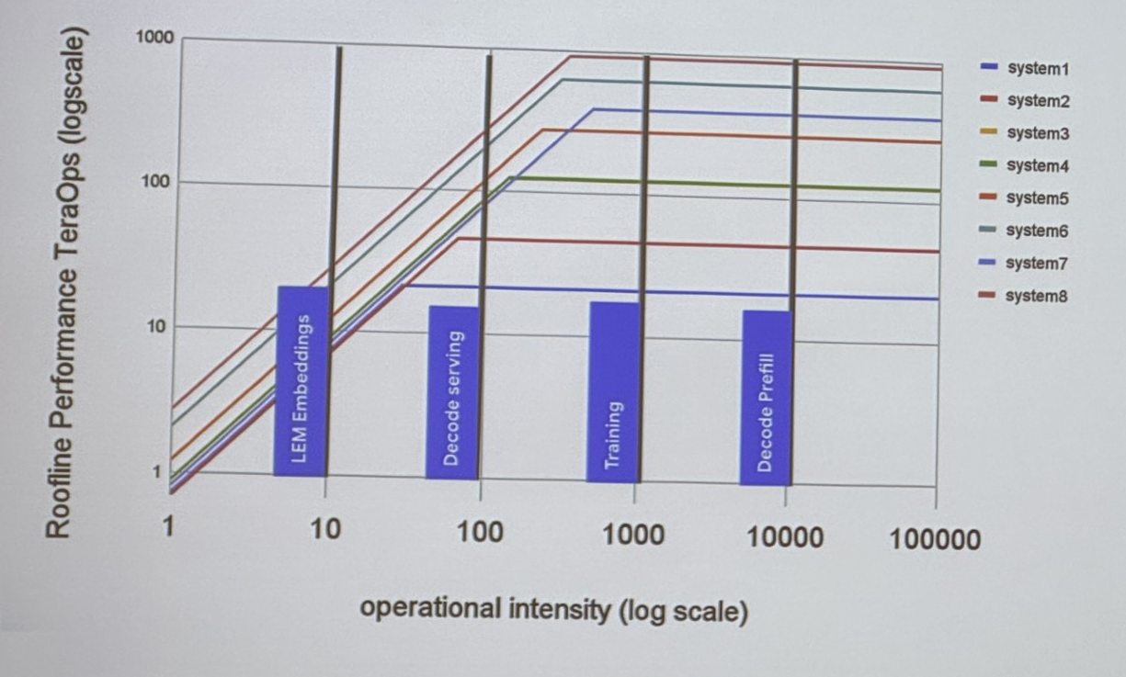
ML Workloads Come in All Sizes and Shapes
Different bottlenecks: compute-, memory-, and network- bound
Single server to multi-cluster jobs
Disaggregated systems

Slide 4
  Principles to Address this Problem
Leverage hardware accelerators and integration
Minimize data movement
Conserve costly memory
Do not leave the hardware unused

Slide 5


How Do We Make Progress?
COMPUTE:
COMMUNICATION:
Many hardware accelerators in datacenters (many heterogeneous)
New methodologies to generate, deploy and reconfigure accelerators automatically
Smart compilers/runtimes
Reconfigurable network topologies
Efficient algorithms and collectives
Accelerators in network switches and SmartNICs
Energy management frameworks
ACE Center for Evolvable Computing
An SRC/DARPA JUMP 2.0 Center
https://acecenter.grainger.illinois.edu/

Slide 6
  Compute

Slide 7
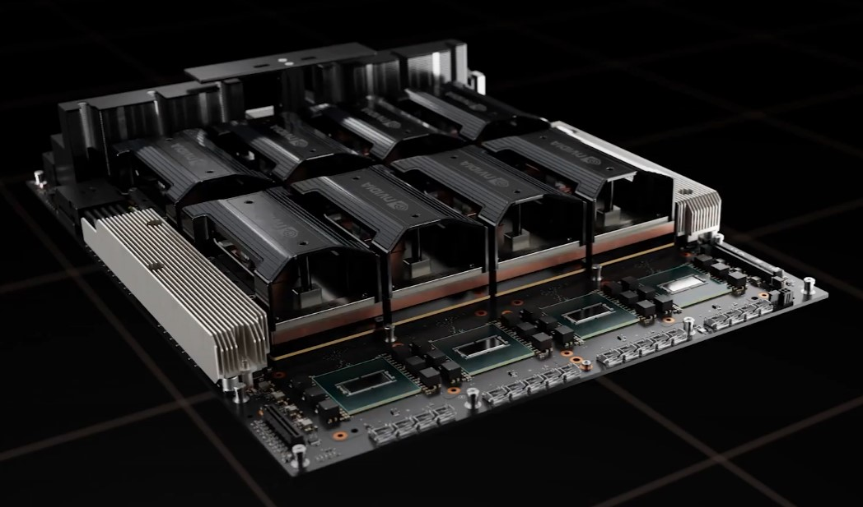
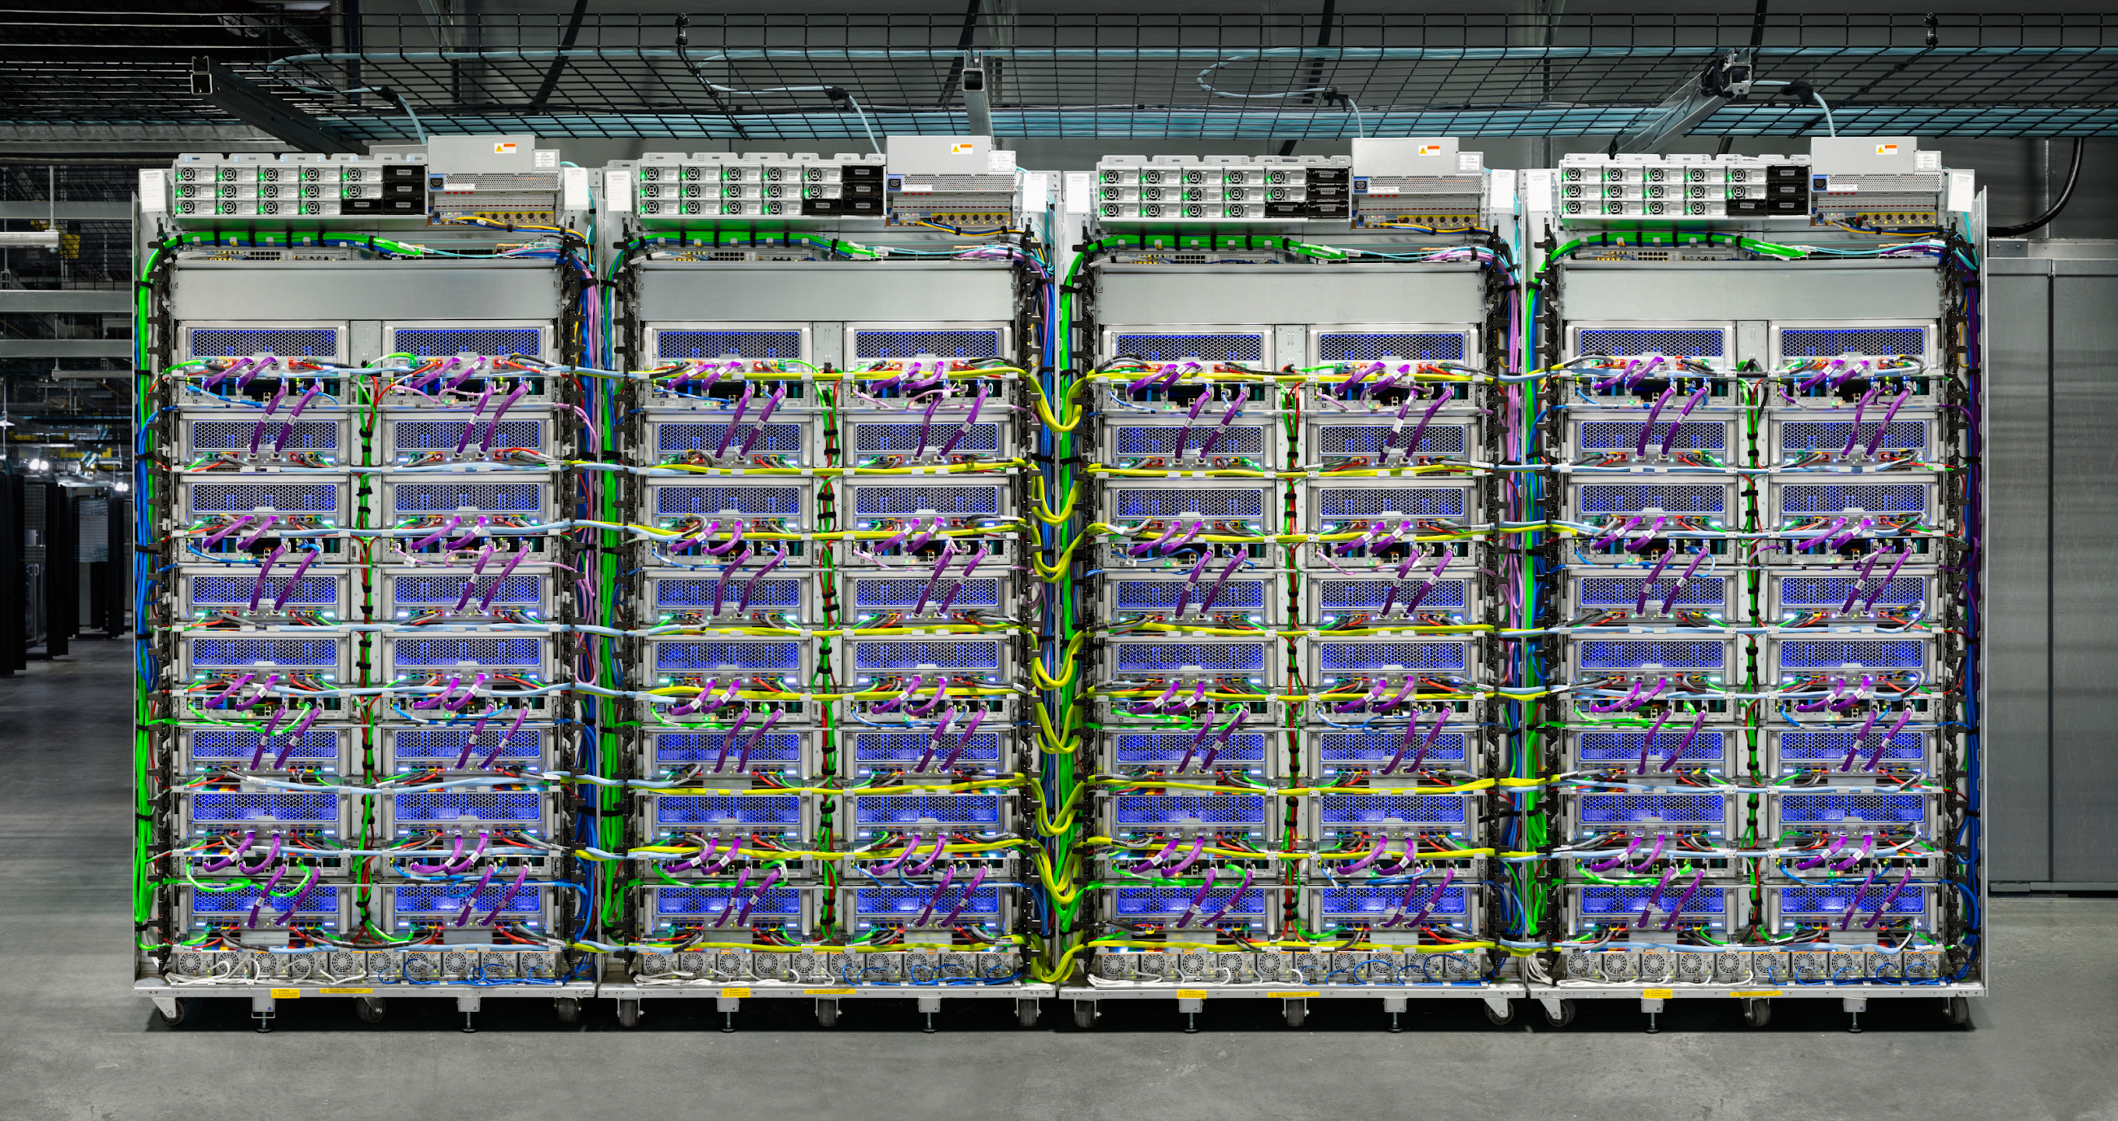
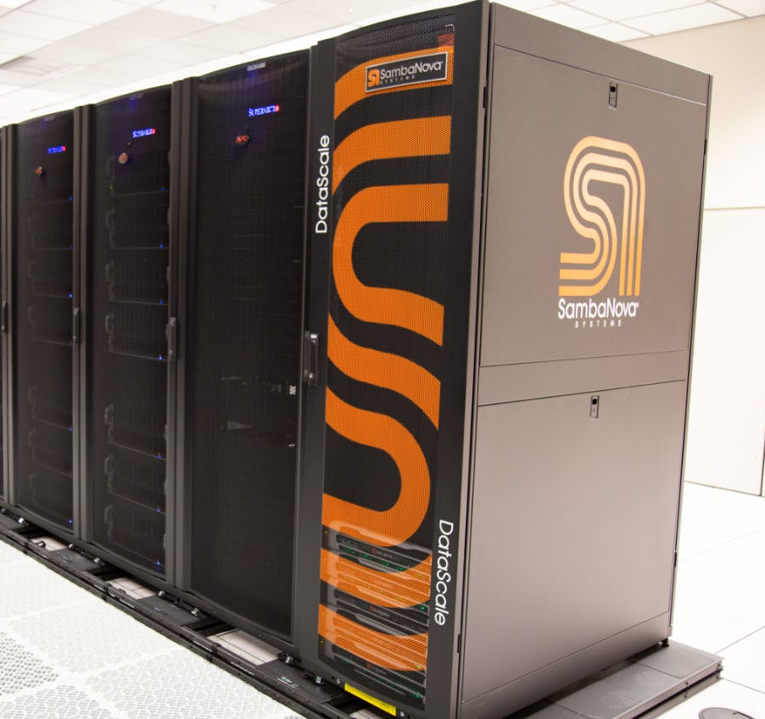
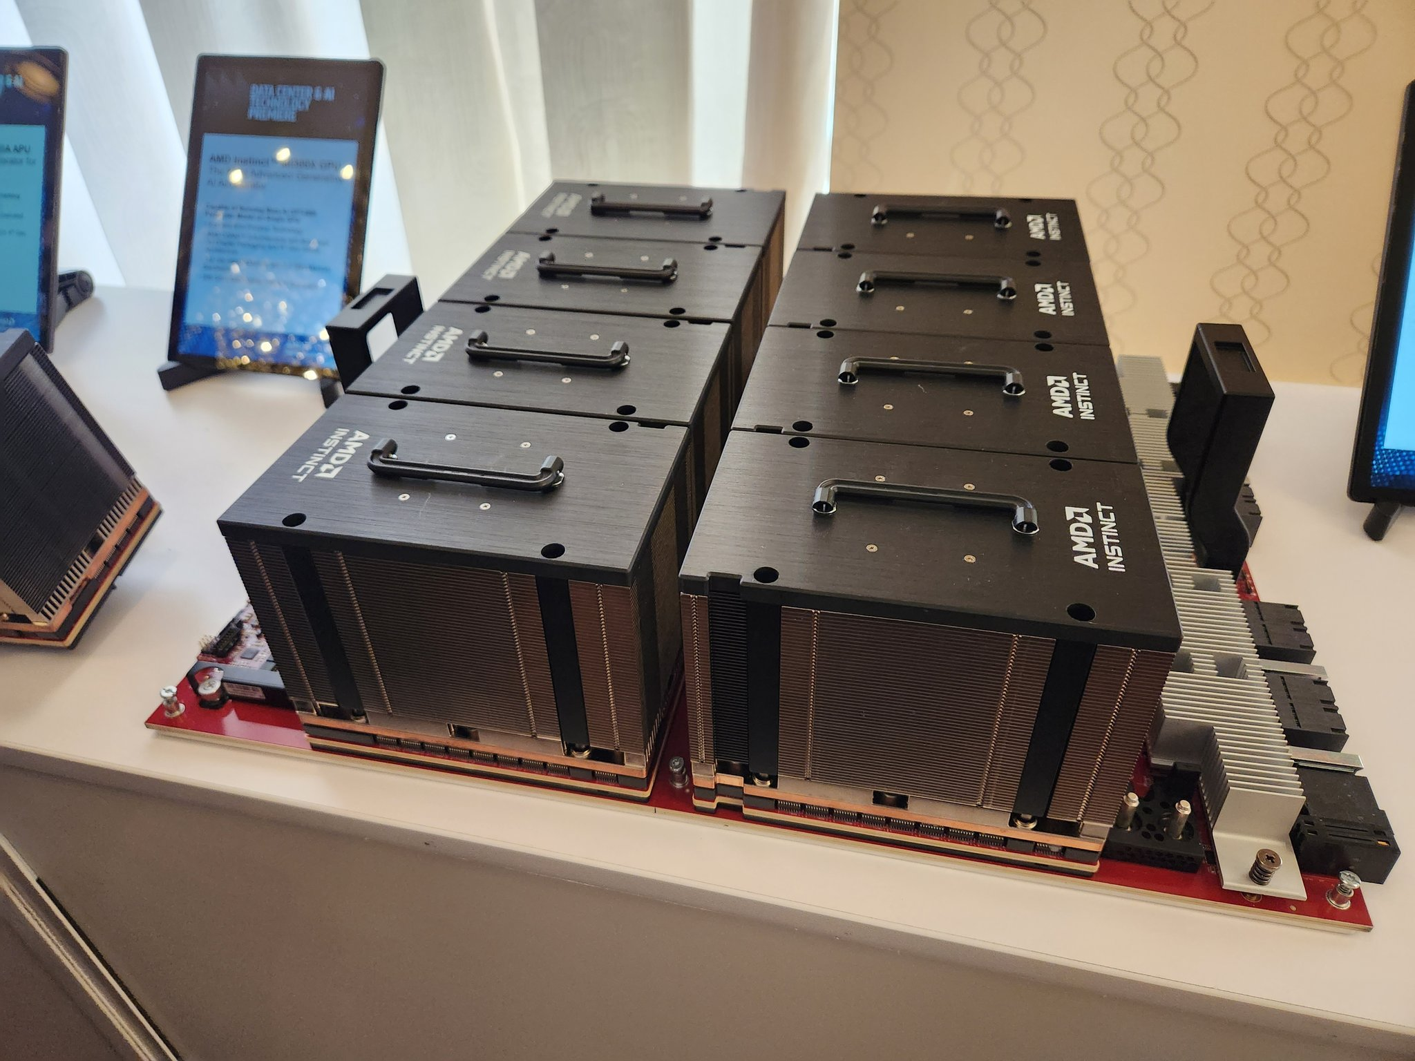
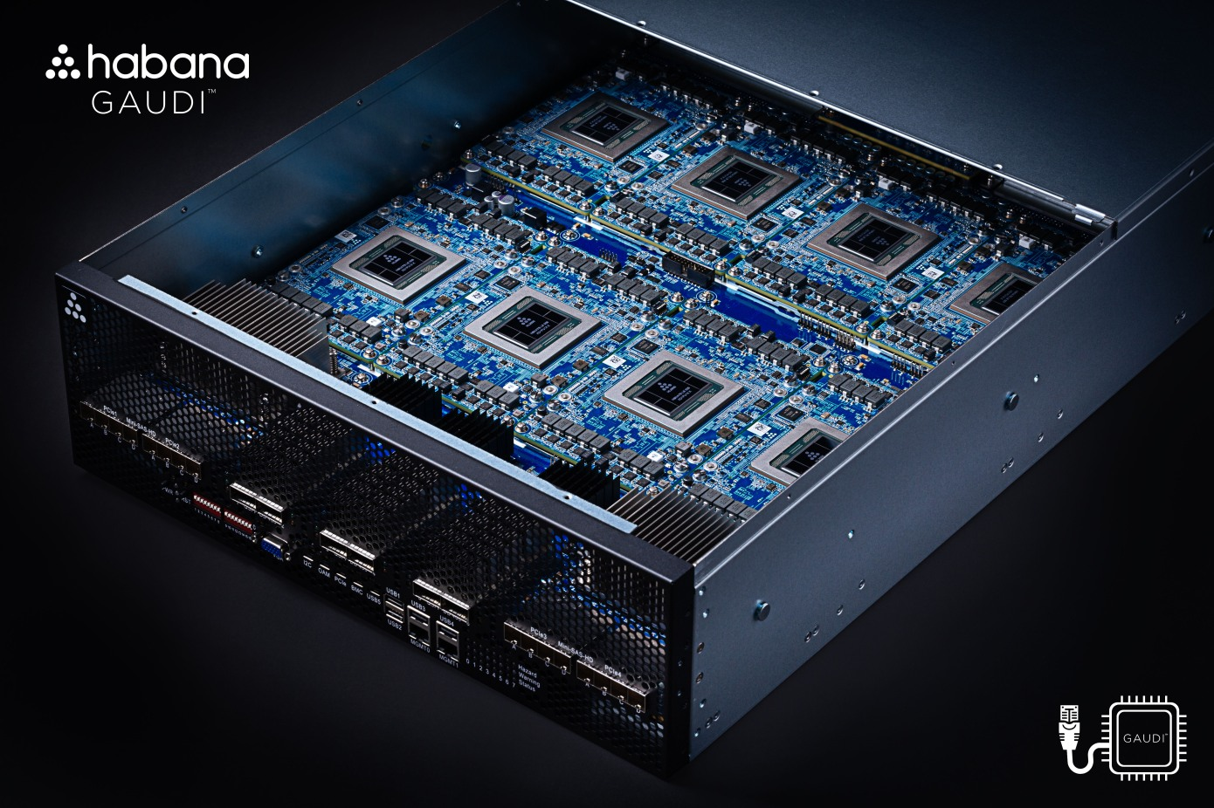

Many Accelerators & More to Come
NVIDIA
HGX
Google
Cloud TPU
SambaNova
SN40L
AMD
Instinct Platforms
Intel
Gaudi
Cerebras
Andromeda
Source: Tushar Krishna (GATech)

Slide 8

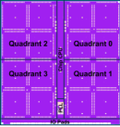
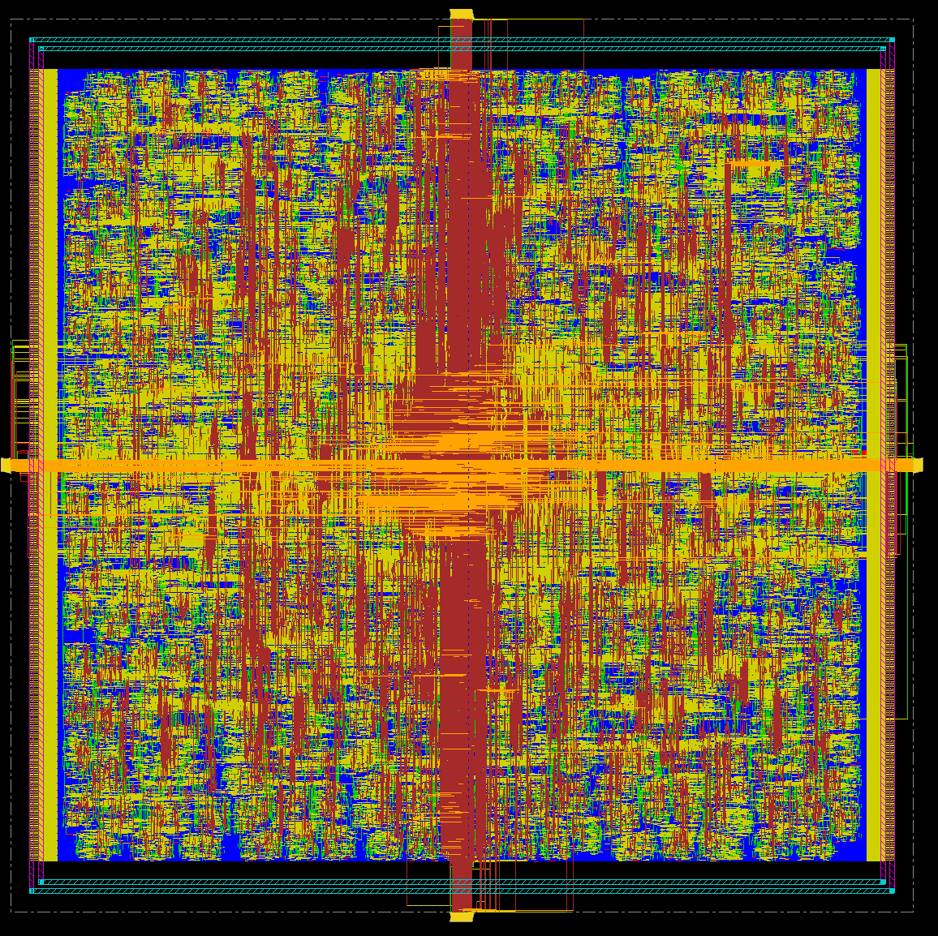
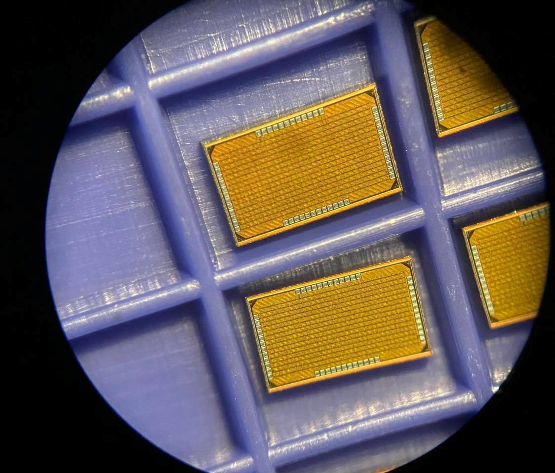
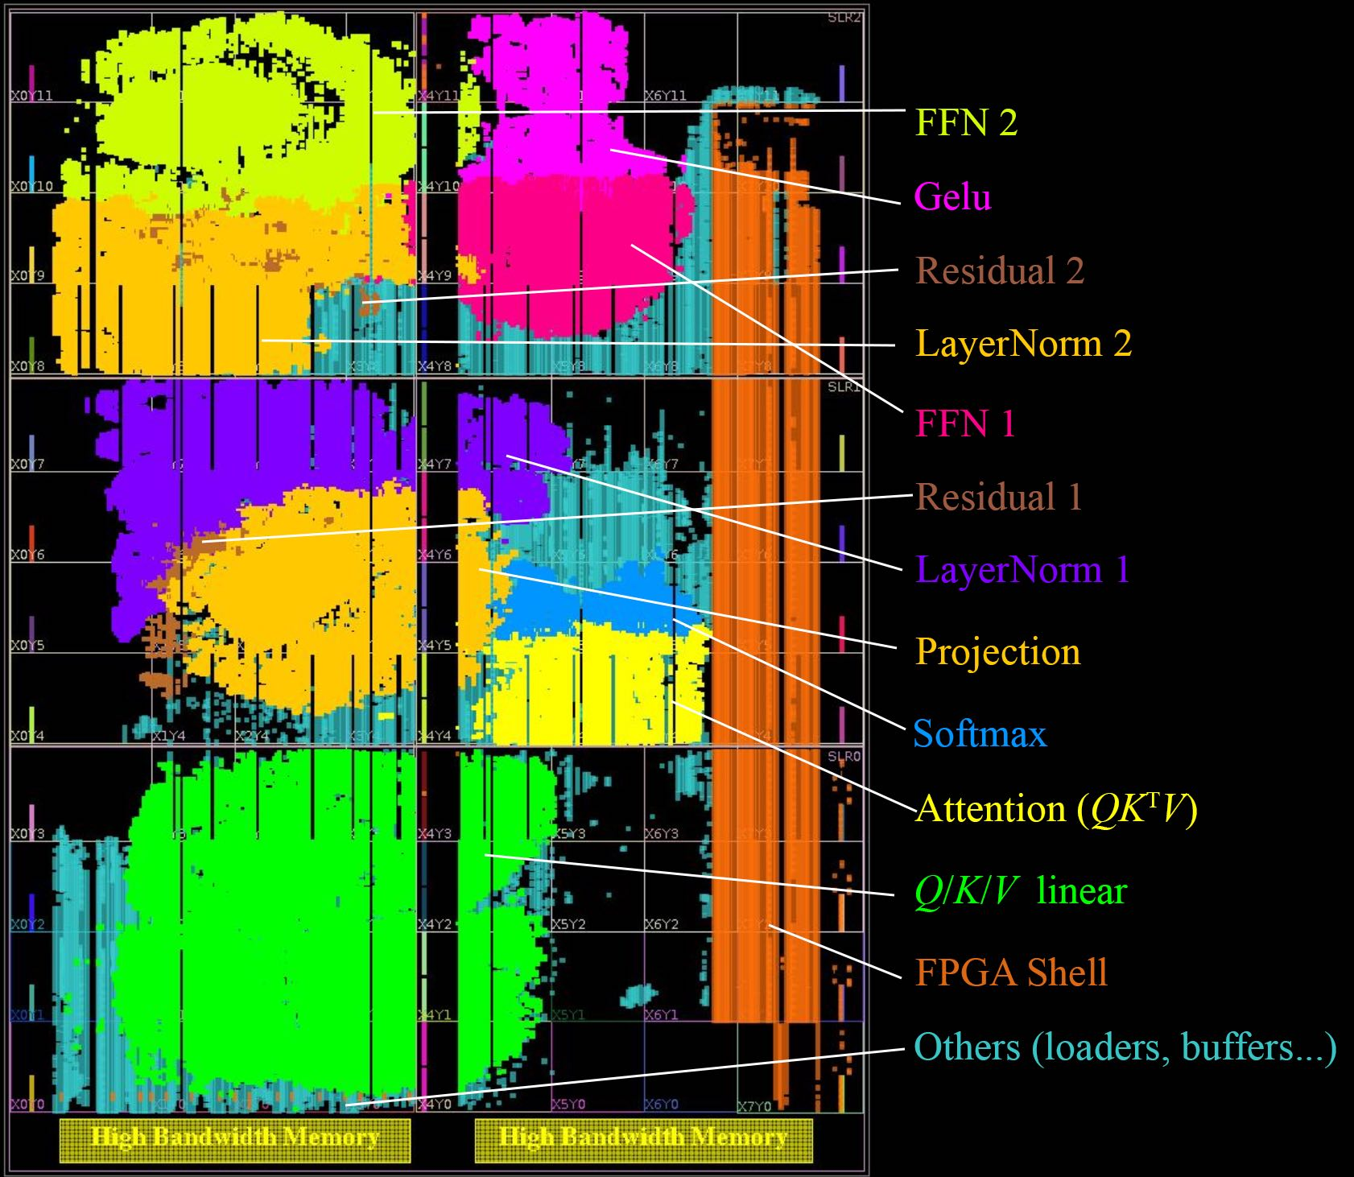
An Ensemble of Accelerators
HBM3
HBM3
HBM3
HBM3
HBM3
HBM3
FPGA
Chiplets
HBM3
HBM3
HBM3
SRAM
CGRA
FPGA
FPGA
ASIC
ASIC
SRAM
CGRA
HBM3
HBM3
HBM3
SRAM
CGRA
Large
package
ASIC
HBM3
HBM3
HBM3
Datacenter
network
HBM3
HBM3
HBM3
Distributed in the datacenter

Slide 9
Automatic Generation of Hardware Accelerators
Python
Accelerator Generator
App-Specific Accelerators (FPGA)
Programmable Accelerators
Evolvable Accelerator Generation

Slide 10
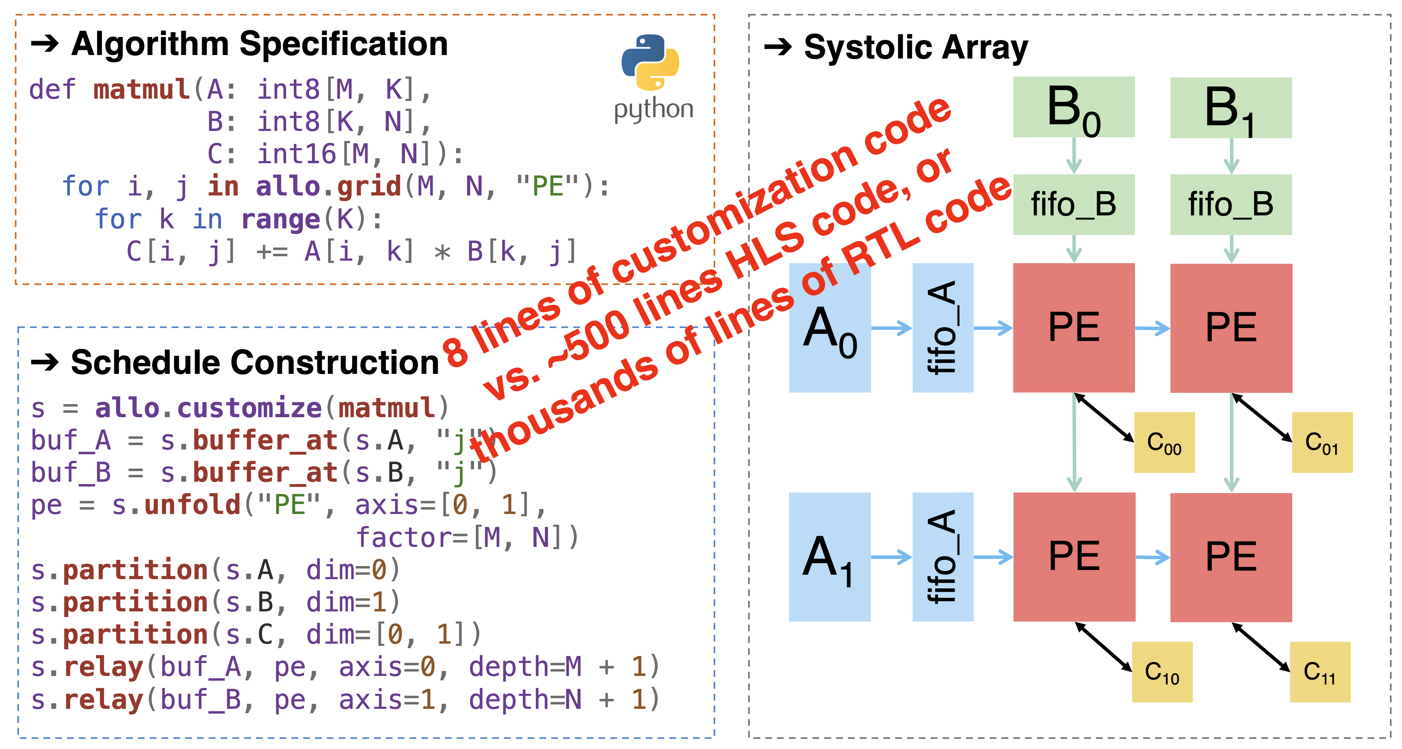
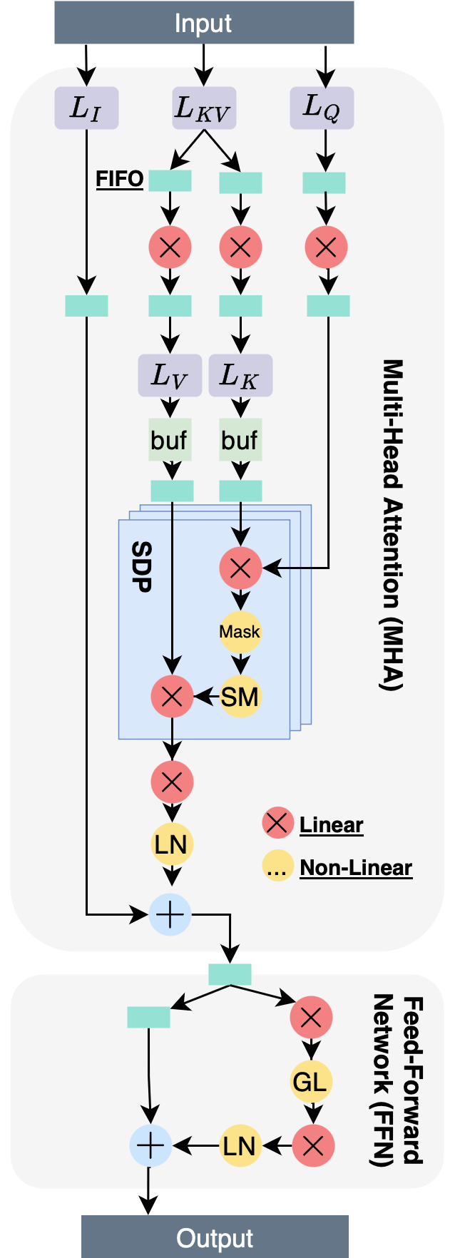
Allo: A Framework to Design Programmable Accelerators
  [Z. Zhang, Cornell]
Takes a Python description and generates a high-performance, programmable accelerator
LLM Dataflow Accelerator
Allo outperforms state-of-the-art Accelerator Design Languages (ADLs) on PolyBench test cases by >30×.
Allo-generated LLM accelerator on FPGA achieves 1.7× faster decode latency and 5.4× higher energy efficiency than the NVIDIA A100 GPU
Notes:
Two levels of complexities
Transform a kernel
Composing kernels
- Allo is a programming model for composable accelerator design.
- The challenge: Productively transform unoptimized kernels and compose th- Allo’s solution: Decoupled, composable, and verifiable hardware customizations in a Python-based DSL and an MLIR-based Compiler.
em into high-performance accelerators (puzzle analogy).
- Enables progressive hardware customizations, transforming vanilla programs into high-performance designs.
- Each customization step is verifiable.
- Supports composable customizations to build modular hardware accelerators.
Dramatically reduces customization code: 8 lines vs. 500 lines of HLS or thousands of RTL lines.
Next: concrete examples on the challenges

Slide 11
Automatic Generation of Hardware Accelerators
And Automatic Generation of Back End Compilers
Python
ACT: Accelerator Compilation Toolkit
Accelerator Generator
Dense
Sparse
Accelerators
App-Specific Accelerators (FPGA)
Programmable Accelerators
Feather
EVA
Spade
Evolvable Accelerator Generation
Evolvable Compiler Generation

Slide 12
  [C. Mendis, Illinois]
ACT: Unified Compiler Infrastructure for ML accelerators
ACT:
Takes the ISA description of the accelerator
Generates a back-end compiler for the accelerator
Currently works for Tensor accelerators (i.e., ML accelerators)
TAIDL:
ISA Definition Language for Tensor Accelerators
Data Model
Instruction Set
  Attributes
  Constraints
  Semantics

Slide 13
An Open-Source Software Framework to Program Multiple Accelerators
Large heterogeneous application
Front end compiler that breaks the code into sections with affinity for different accelerators
Compiler automatically generates a compiler for each new accelerator
Analog Accelerator
EVA Reconfigurable Accelerator
SPADE Sparse Accelerator
FPGA Accelerator
FEATHER Accelerator
Back-end compilers
[ISCA23]
[FCCM24]
[ISCA24]
[DAC23]
Pre-Silicon Verification of Hardware Accelerators
New hardware accelerators
[Intel16 Tapeout 24Q2]
Notes:
Industry is actively building accelerators for AI. But unless they are programmable, they will not be successful. Hence, each company is scrambling to create a software infrastructure and compiler for them. However, this software is not open source: each company closely guards any software they develop as a crown jewel.
A group of ACE PIs funded by JUMP 2.0 have created a multi-tier compiler that can easily be targeted to any AI accelerator. This has attracted the collaboration of many companies. We will make the infrastructure public domain, hoping to democratize the field and catalyze the use of hardware accelerators for AI.
In addition, the ACE PIs have tried their compiler to program various accelerators they developed by themselves.

Slide 14
  Communication

Slide 15





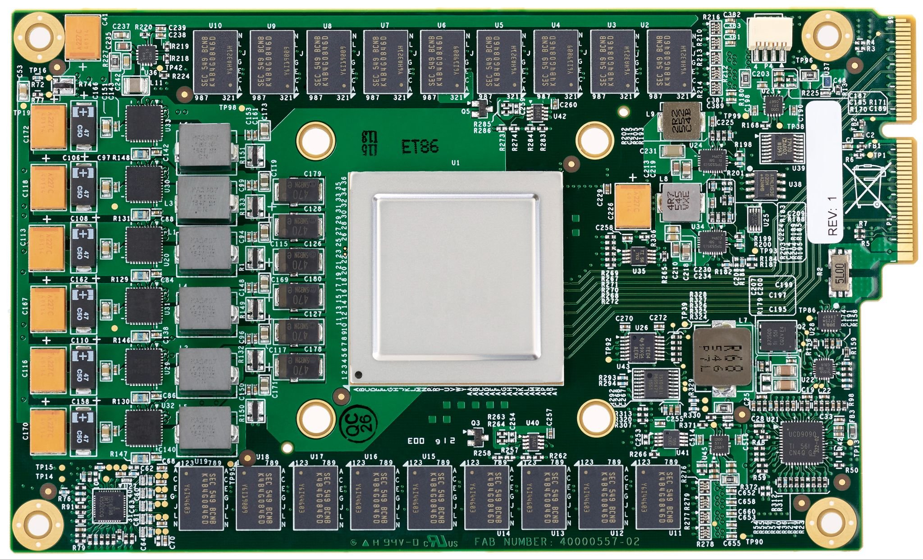
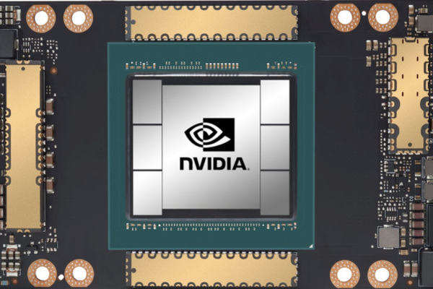


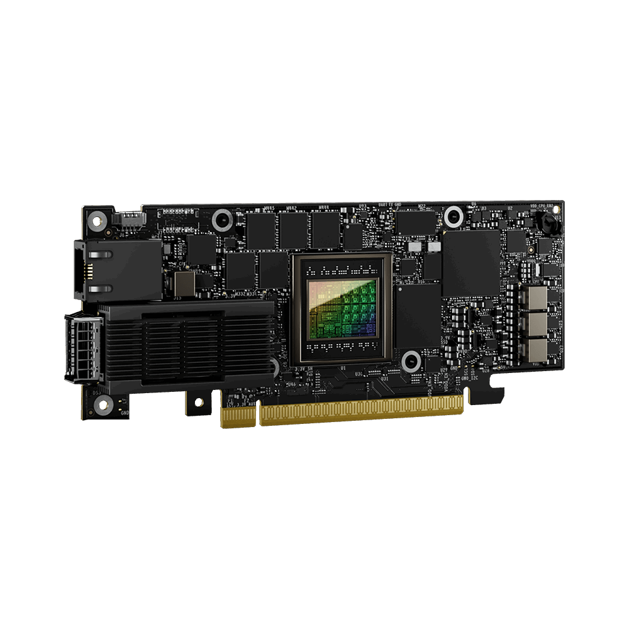
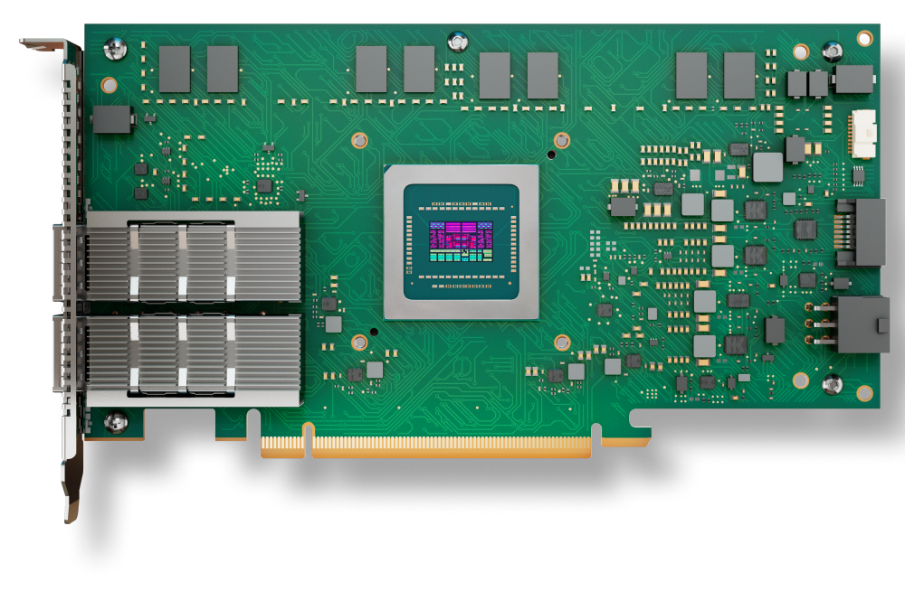
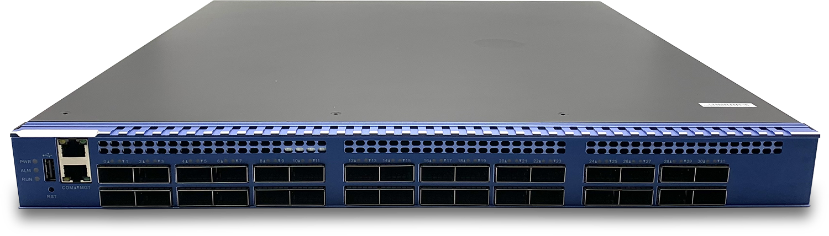
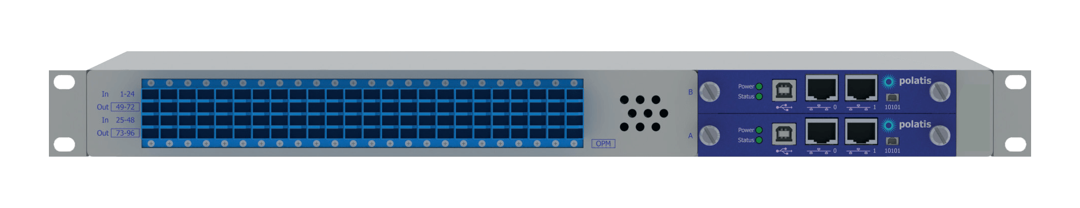
What a Data Center Looks Like
Dataset
Models (LLMs, MoE …)
Storage
Compute
Checkpoint
Data
Accelerators
CPUs
Memory
SmartNIC
SmartNIC
Fabric
Programmable Switches
and Accelerators
Optical Switches

Slide 16
Many Places to Save Energy
Dataset
Models (LLMs, MoE …)
Adaptive Storage
Storage
Runtime for diverse accelerators
Compute
Checkpoint
Data
Accelerators
CPUs
Memory
Data Ingestion & Preprocessing
Adaptive smartNICs
SmartNIC
SmartNIC
Optimizations for Communication Collectives
In-network Compression and Aggregation
Reconfigurable Topologies
Fabric
Programmable Switches
and Accelerators
Optical Switches
Notes:
Adaptive compute (e.g., data ingestion), storage (e.g., checkpointing, data storage), and communication (e.g., topology, smartNICs)
Cross-layer optimizations between ML and accelerators

Slide 17

Efficient Communication Is Crucial
C
C
C
C
Computation task on accels
AR
AR
Communication using collective primitives: AllReduce, AllGather
C
C
AR
C
C
C
Notes:
So hopefully this background shows you that efficient communication is key for
<next>
training on multi-XPU systems
<next>
In general,
the idea of distributed training means I can take any model and <next> split layers of the model <next> into <next> individual compute tasks that I am representing with a node C here. <next>
<next>
Each of these compute tasks can then be worked on by different accelerators <next> and <next> <next> <next>
<next>
But what becomes essential is communication between the XPUs that I have distributed the model over. <next> and this communication comes in many different flavors. I'll show you two flavors of this communication. The first type of communication communication is between a <next> <next>
subset of the XPUs that are training the model and the
<next> next>
second type is called Collective communication which is the focus of this talk.
This graph that you see on the slide is commonly called the compute graph of model training. <next> and hopefully its structure makes it evident that inter-XPU communication is on the critical path to training.
<next> And this communication is collective --- it has a well-defined pattern and a group of XPUs all participate in it. There are a few different collective communication primitives and I'll show you what they do.

Slide 18
Collective Communication
1
2
3
4
State of GPU buffers before the collective
(pre-condition)
{
Data chunks in GPU buffer
AllReduce
State of GPU buffers after the collective (post-condition)
=
+
+
+
Source: Rachee Singh (Cornell)
Notes:
So what are collective communication primitives? There are many of them but I am going to show you the primitive that is the workhorse of distributed ML training and that is called AllReduce
So, when a group of GPUs perform collective communication, they each start with a local memory buffer <next> So I am showing you four GPUs and the
Rectangles that are currently blank <next> represent <next> the state of the GPU buffers before the collective communication happens. Now I populate the buffer of the first GPU with its initial state and this initial state is called the pre-condition of the GPU. <next>
The buffer consists of chunks of data and I am representing each data chunk with a different fil patterns. Similarly <next> I have now populated the pre-conditions for all 4 GPUs. <next>
Now, these gPUs perform an AllReduce communication and after the AllReduce completes <next>, the state of the buffers of all the GPUs is the same <next> where they have summed corresponding data chunks of all GPUs. And this final state of the GPU buffers is called <next> the post condition of collective communication.
<next>
And since communication is crucial, our goal is to find HOW best to go from the precondition of GPUs to the post condition of the gPUs. Or more formally, I want a schedule of data chunk transfers over whatever network the GPUs are connected with to reach the post condition AS SOON AS IS POSSIBLE.

Slide 19
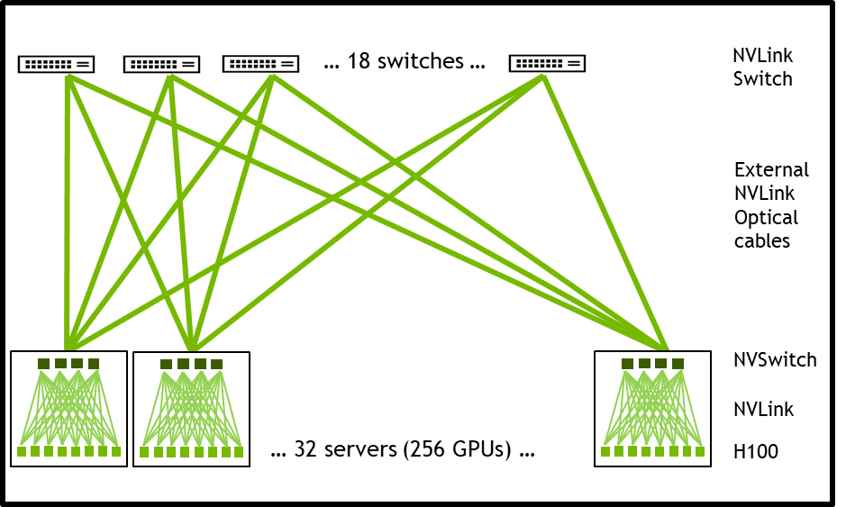
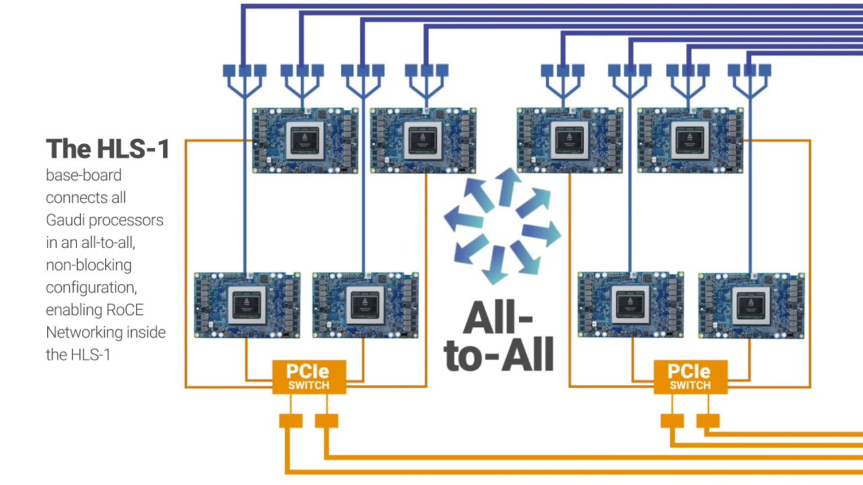
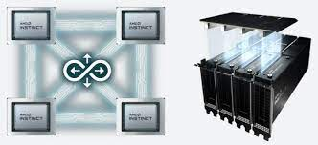
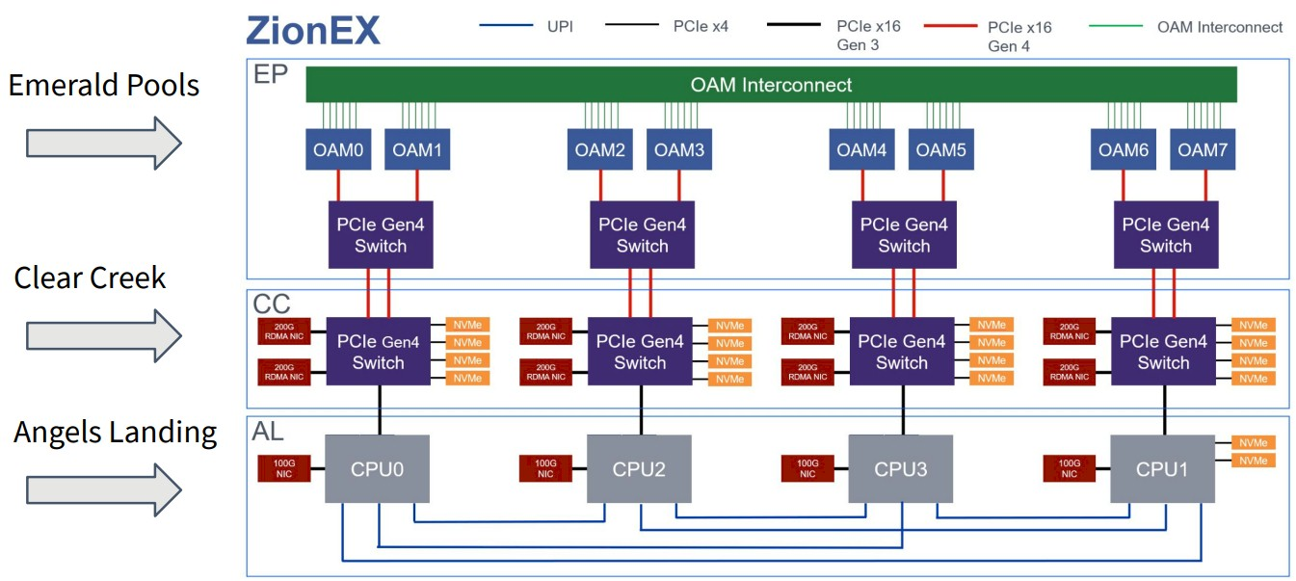
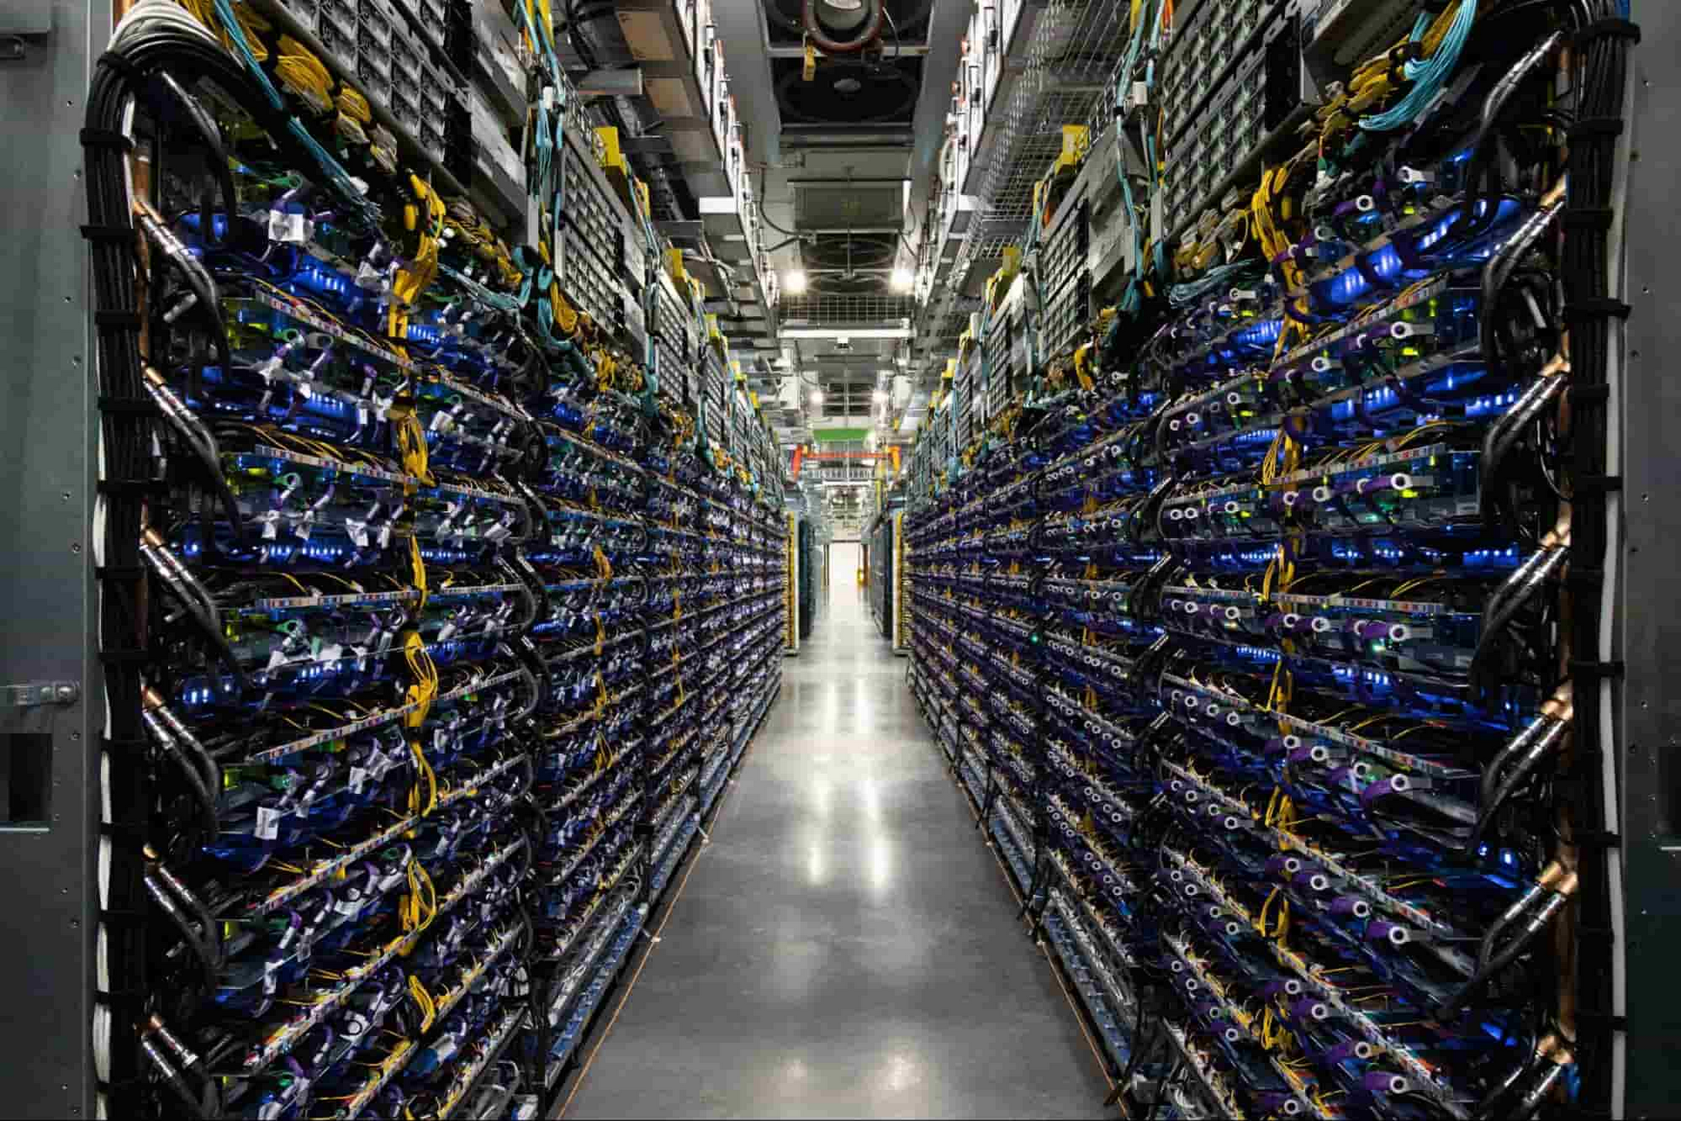
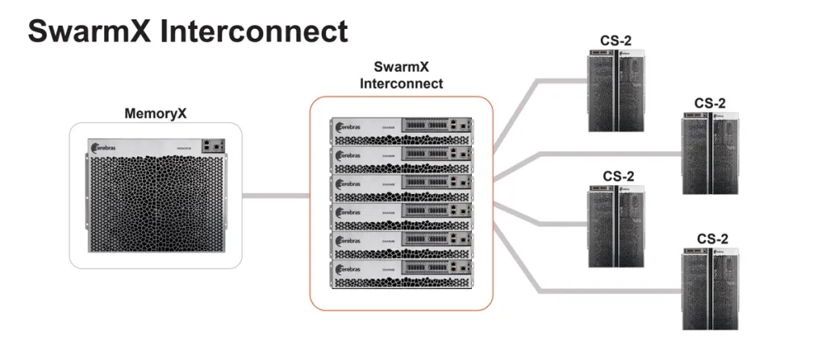
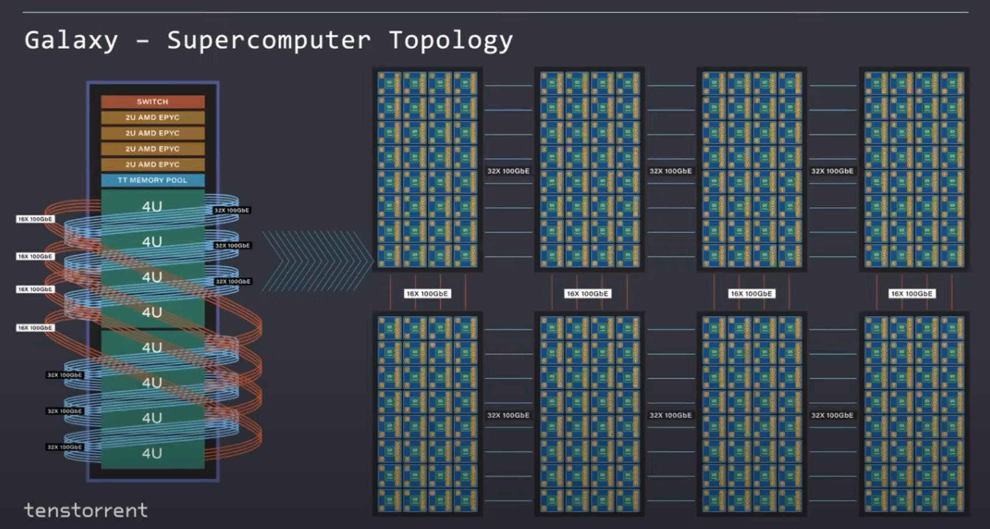
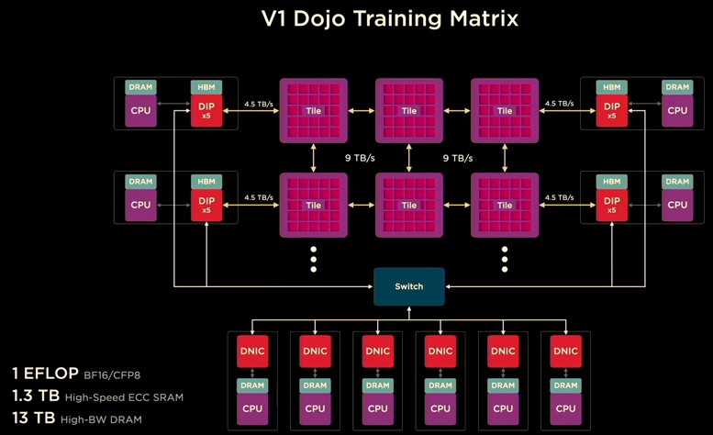
Many Design Choices for Network Fabrics
Scale-up → Scale-out
NVIDIA
Intel
AMD
Meta
NVswitch → Infiniband
Custom NICs → RoCE
Infiniti → Infiniti
NVlink → RoCE
“Classic” Technologies
Google
Cerebras
Tensorrent
Tesla
3D Electrical Torus → Optical
Wafer-scale → SwarmX Tree
On-package Mesh → off-chip mesh
On-package Mesh →Ethernet
“Emerging” Technologies
Source: Tushar Krishna (GATech)

Slide 20
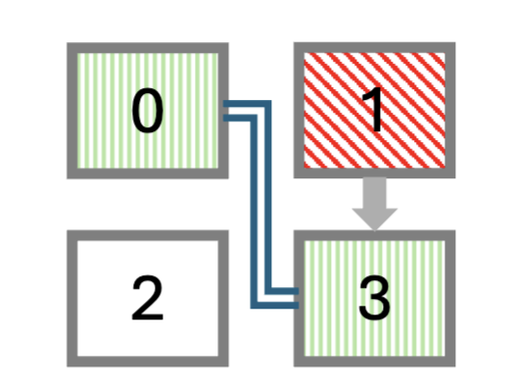
Programmable Photonics in Scale-up Domains
Reconfigurable Topologies
  [R. Singh, Cornell]
Fast reconfiguration of the fabric in the scale up domain (order of microsecs)
Improves bandwidth by 66% in multi-tenant scenarios
Improves fine-tuning throughput for Llama 3.2 by 1.7X
Programmable optical connections
“In-place” replacement of failed accelerators within a second
End-to-end hardware prototype
XPU 4
XPU 3
XPU 1
XPU 2
Server-scale photonic interconnect
SerDes
XPU 1
XPU 2
Tile 1
Tile 2
Optical Tx/Rx

Slide 21
Photonic Domains
  [R. Singh, Cornell]
Spine Layer
Rail 0 OCS
Rail 1 OCS
Rail k OCS
GPU 0
GPU 1
…
GPU k
GPU 0
GPU 1
…
GPU k
Scale-up Interconnect
Scale-up Interconnect
GPU 0
GPU 1
…
GPU k
GPU 0
GPU 1
…
GPU k
Scale-up Interconnect
Scale-up Interconnect
OCS: Optical Routing Switching

Slide 22
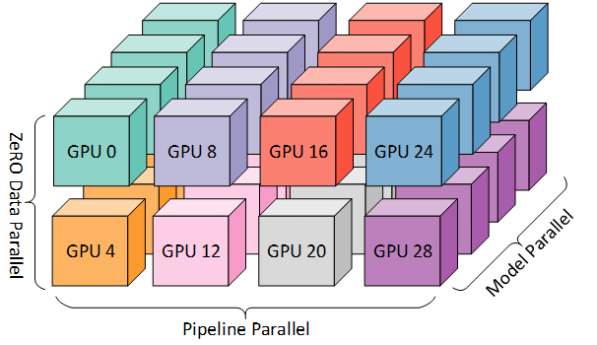
Improving Parallellization of ML Algorithms
Better Algorithms
DNNs are trained with combinations of
  Data parallelism (DP)
  Pipeline parallelism (PP)
  Tensor parallelism (TP)
TP is a bottleneck
  Because of highest communication cost
Notes:
There are three parallelization methods for DNN training
DP, PP, and TP
In large-scale DNN training, mostly LLMs, you need to combine ALL THREE of them.
(anime) TP is the bottleneck as it has the highest communication cost,
This is because we need to communicate input/output at **every** layer
- Hence, TP has the least parallelism (8-way) -- scalability bottleneck
- (anime) Problem: enhance scalability of TP

Slide 23
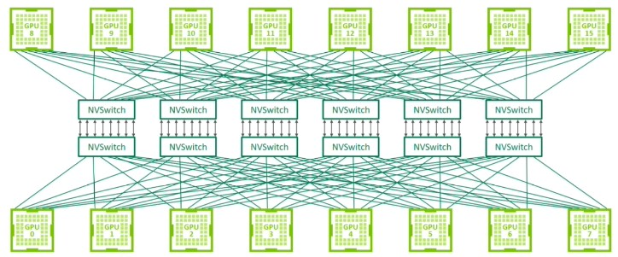
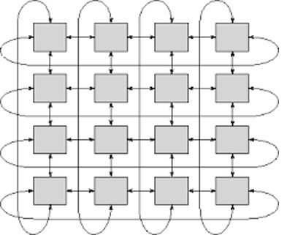
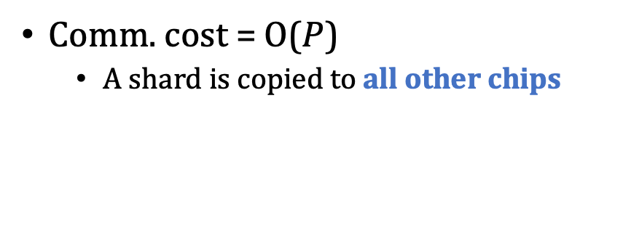
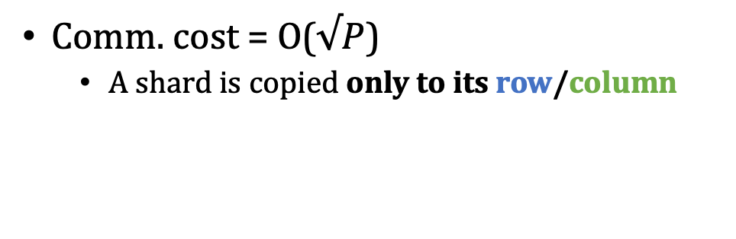
2D Tensor Parallelism
NVIDIA GPU: 1-D (P chips)
Google TPU: 2-D (P=pxp chips)
Comm. cost = O($P$)
  A shard is copied to all other chips
Comm. cost = O($√P$)
  A shard is copied only to its row/column
Notes:
- One solution is using two-dimensional tensor parallelism
- The figures compare 1D and 2D TP approaches.
- (anime) in 1D TP, a shard is communicated to everyone
- (anime) On the other hand, in 2D, the chips are layed out in a device mesh, and a data only moves along its row or column.
- As a result, reduced communication cost.
- (Click) The objective here is to extend to 4D cluster by combining 2DTP with (DP + PP) – better scalability

Slide 24
2D Matrix Multiplication (GeMM)
Accelerator (chip)
Accelerators are linked with inter-chip interconnects (ICI)
The matrices are partitioned into shards (Aij, Bij, Cij)
Dataflows:
  One flows horizontally (inter-col)
  One flows vertically (inter-row)
  One remains stationary
A₀₀
B₀₀
A₀₁
B₀₁
A₀₂
B₀₂
C₀₀
C₀₁
C₀₂
A₁₀
B₁₀
A₁₁
B₁₁
A₁₂
B₁₂
C₁₀
C₁₁
C₁₂
A₂₀
B₂₀
A₂₁
B₂₁
A₂₂
B₂₂
C₂₀
C₂₁
C₂₂
Inter-chip interconnects (ICI)
Notes:
- The core of 2D TP is 2D distributed matrix multiplication, or GeMM
- Let me cover some basics 2D Gemm
- The accelerators (device) are connected using ICIs in 2D torus
- The matrices are partitioned into shards, and locally stored (animation, A,B,C)
- As explained before, one of the matrices flows vertically (anime) and another flows horizontally (anime) and one remains stationary. This defines the dataflow of 2D GeMM
- At the end, each chip holds a shard of the final output C

Slide 25
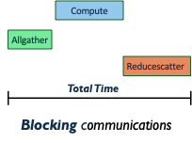













Baseline: 2D GeMM with Collective Communications
Collective 2D GeMM
$$⊤$$
$$⊤$$
A₀₀
B₀₀
B₀₀
A₀₁
B₀₀
$$×$$
$$×$$
B₀₁
Time
$$C=AB^{⊤}$$
B_{*j}= AG_{row}(B_{ij})
C’_{i*}= A_{ij}(B_{*j})^{T}
C_{ij} =RdS_{col}(C’_{i*})
$$=$$
C₀₀
C₀₁
$$=$$
C₀₀
C₀₁
A₁₀
$$⊤$$
A₁₁
$$⊤$$
$$×$$
$$×$$
B₁₀
B₁₀
B₁₁
B₁₀
$$=$$
C₁₀
C₁₁
$$=$$
C₁₀
C₁₁
Want to overlap communication and computation
Notes:
- Google is already using 2D TP with collective communication operations
- This is the timeline of such collective 2D GeMM execution
- Hereby we perform ABT, A stationary, B flow vertically, and C flows horizontally
- (Anime), First, we have to do Allgather B shard vertically as of first green box
- (Anime), Then, Compue the partial outputs A B transpose
- (Anime), Finally, Reducescatter the partial outputs into C shards
- In total, the execution takes this amount of time, there is no overlapping.
- Why?: there are depencies between them.
- This is significant - comm taking up to 40% of LLM training time

Slide 26















3-way Sliced MeshSlice Algorithm (Iteration 0)
  [ISCA 2025]
$$C=AB^{⊤}$$
$$⊤$$
$$⊤$$
$$⊤$$
A₀₀
B₀₀
A₀₁
B₀₀
Time
$$×$$
$$×$$
Iteration 0:
B_{s}= slice_{row}(B_{ij},3,0)
B’= AG_{row}(B_{s})
C’= A_{ij}(B’)^{T}
C_{s}= slice_{col}(C_{ij},3,0)
C_{s}= RdS_{col}(C’)
Compute
Compute
Compute
AG
AG
AG
C₀₀
C₀₁
$$=$$
$$=$$
RdS
RdS
RdS
A₁₀
$$⊤$$
A₁₁
$$⊤$$
$$×$$
$$×$$
3. Compute partial GeMM
B₁₀
B₁₀
1. Slice B among its rows
2. AllGather(AG) B sub-shards
4. ReduceScatter the C shards
$$⊤$$
C₁₀
C₁₁
$$=$$
$$=$$
Notes:
- Let me show you the three-way MeshSlice example.
- This is the same A-stationary algorithm C=AB^T as of Collective
- Hereby A remains stationary, B flows vertically, and C flows horizontally
- The algorithm runs in three loop iterations.
- I am demonstrating the first iteration here
- (anime) The alg begins with slicing B among its rows: we take every third row of B (purple)
- (Anime), Then, we Allgather B sub-shard vertically
- (Anime), Next, we Compute the partial outputs. Because it is ABT, results in a every third column of partial output, which are purple
- (Anime), Reducescatter the partial outputs horizontally, and accumulate the result to the sub-shard of C (every third colum)

Slide 27
3-way Sliced MeshSlice Algorithm (Iteration 1)
t0
$$⊤$$
$$⊤$$
$$⊤$$
A₀₀
B₀₀
A₀₁
B₀₀
Time
$$×$$
$$×$$
Iteration 1:
B_{s}= slice_{row}(B_{ij},3,1)
B’= AG_{row}(B_{s})
C’= A_{ij}(B’)^{T}
C_{s}= slice_{col}(C_{ij},3,1)
C_{s}= RdS_{col}(C’)
Compute
Compute
Compute
AG
AG
AG
C₀₀
$$=$$
$$=$$
RdS
RdS
RdS
A₁₀
$$⊤$$
A₁₁
$$⊤$$
$$×$$
$$×$$
B₁₀
B₁₀
The second iteration of MeshSlice processes the second row slices of B and column slices of C. We can use software pipelining
$$⊤$$
C₁₀
$$=$$
$$=$$
We have overlapped communication and computation
Notes:
- the next iteration processes the next sub-shard, colored in yellow.
- We take every third row of B-shard, shifted by one row
- Also, we accumulate to every third column of C-shard, shifted by one column
- The timeline shows what happens if you apply software pipelining to the three loop iterations,
- (anime) Look at the time interval t0 after the pipelining, here we do AG of the third iteration, compute of the second iteration, and RdS of the first iteration
- They are executed asynchronously at the same time.
- as you can see, most of the communications can be overlapped with the computations. Saving time

Slide 28
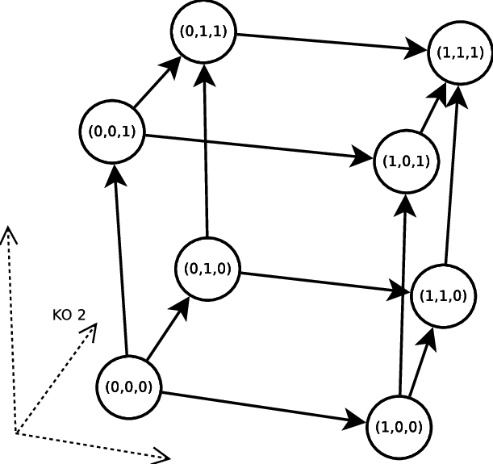
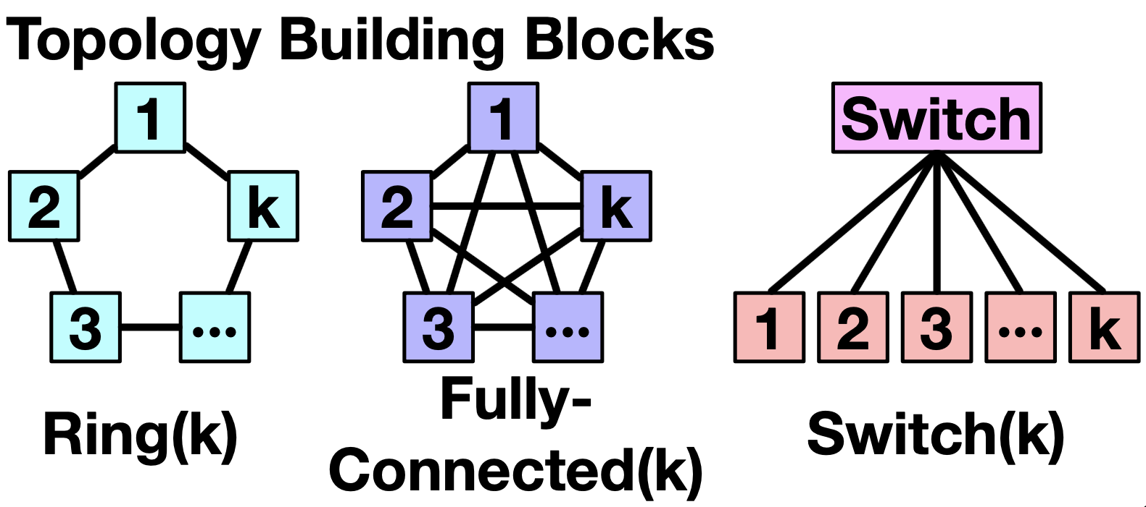
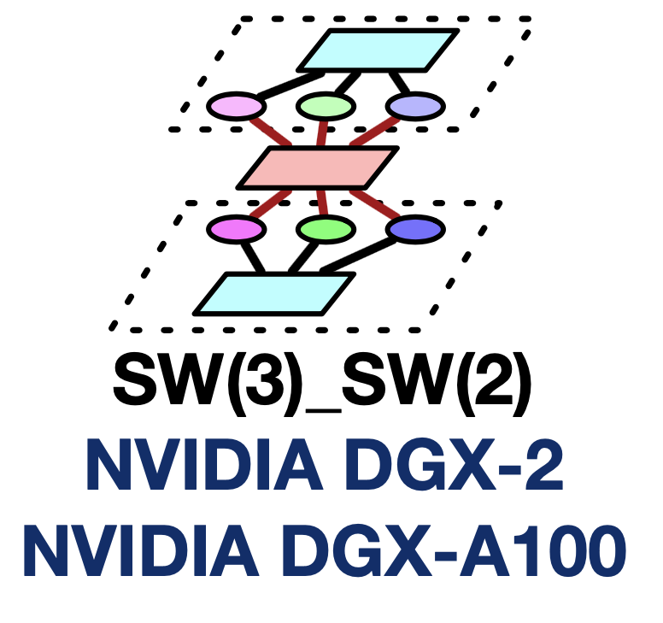
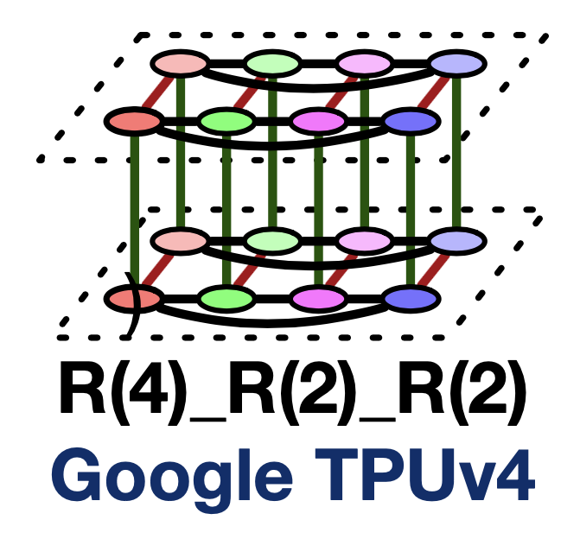
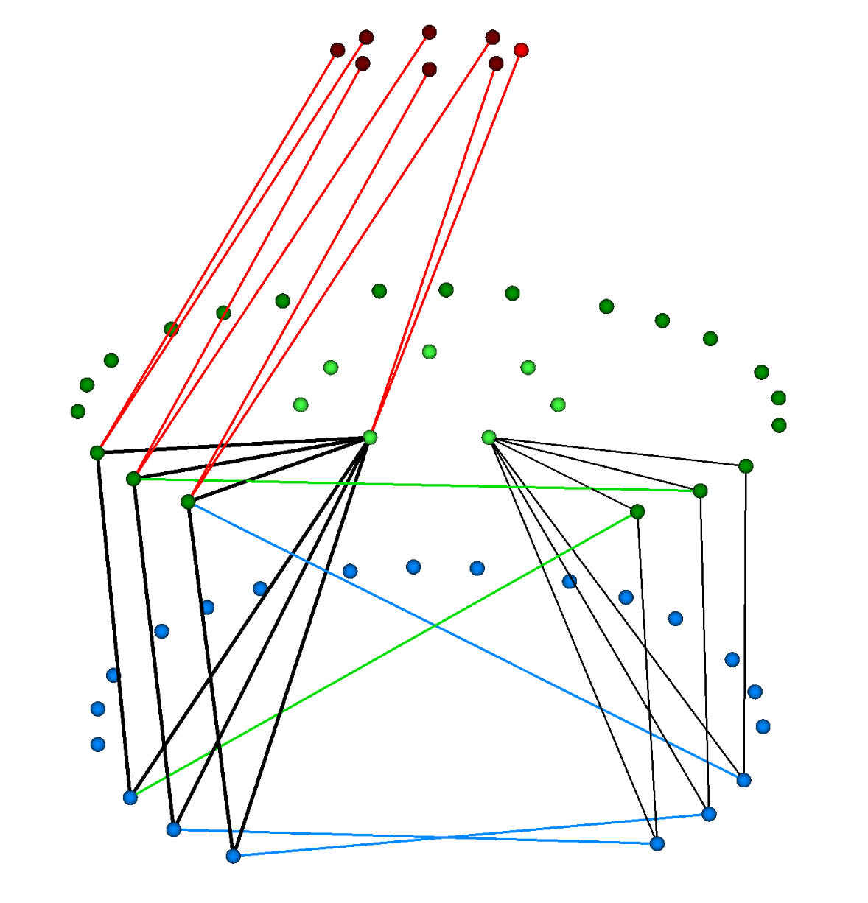
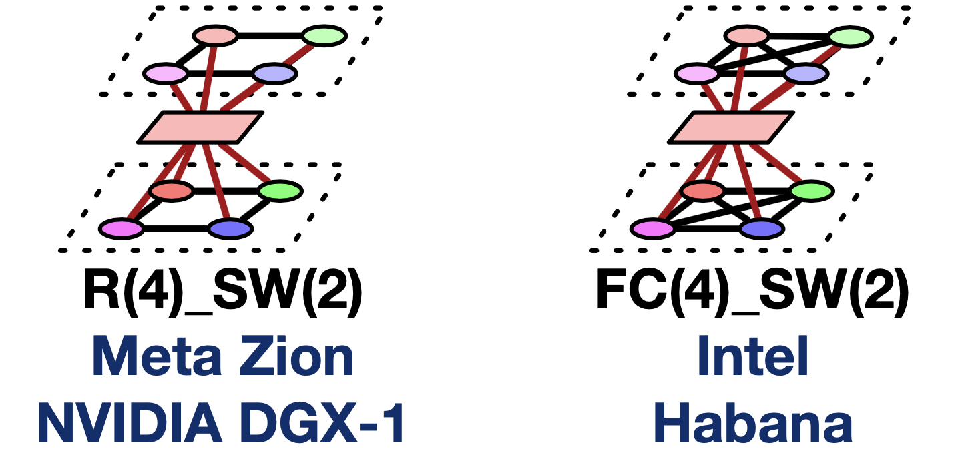
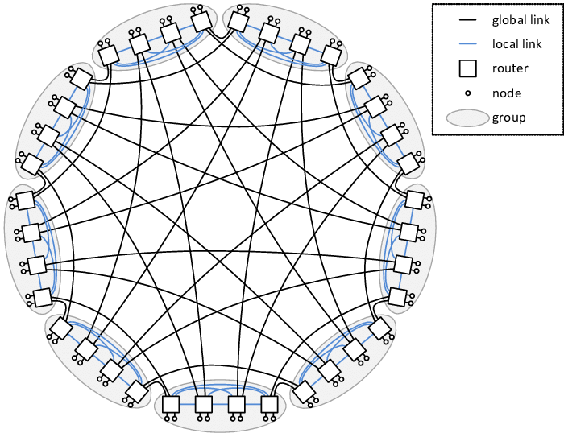
Rich Design-Space of Network Topologies
Optimizations for Communication Collectives
Ring
2D Mesh
3D Hypercube
FullyConnected
Switch
Building Blocks
Multi-dim Networks
DragonFly
PolarFly
Source: Tushar Krishna (GATech)

Slide 29
Emergence of New Collective Algorithms that are “Topology Aware”
Topology Building Block | Topology-aware Collective Algorithm
Ring | Ring
FullyConnected | Direct
Switch | Recursive HalvingDoubling
Today: Topology-aware collective algorithms are designed manually
Challenges
  Involves heavy engineering effort
  Hard to adapt to changing topologies (due to faults or multi-tenancy)
Hierarchical | BlueConnect (2019) Themis (2022)
Mesh | TTO (2024)
DragonFly | PAARD (2021)
…. | …

Slide 30
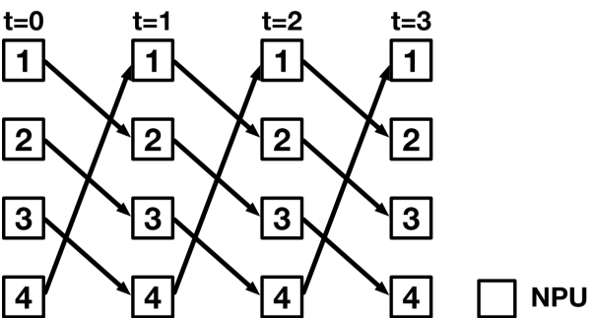
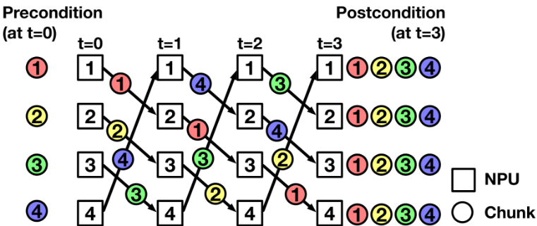
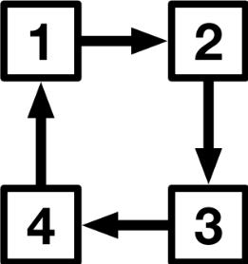
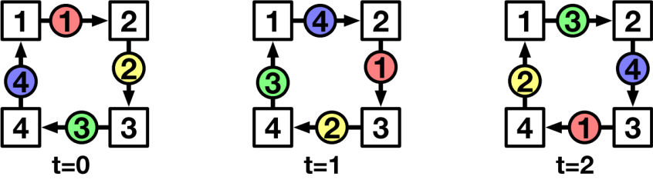
TACOS: Automatically Synthesize Collective Comm
  [T. Krishna, GATech]
  No need for a priori human knowledge/intervention
Algo Synthesis
Topology
Time Expanded Network
Collective-TEN Representation
  Result: High network bandwidth utilization
Collective Algorithm

Slide 31

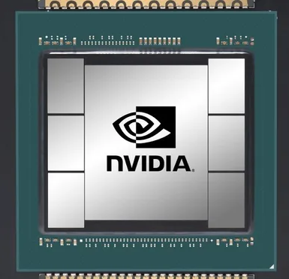

Long-tail Latency of AllReduce
  [M.Shahbaz, Michigan]
The message at the tail delays the AllReduce collective
Node 2
Slow node
Congested link
Currently: Wait until the last packet arrives
AllReduce
Propose: Ignore slow arriving data
Node 1
Bottleneck
Node 3
Network
delays
Node 4
Notes:
This tail is can be direct outcome of a system or network level delay
For example for network there might be a some [click] congestion or [click] slow link

Slide 32
  [M.Shahbaz, Michigan]
OptiReduce: A Tail-optimal AllReduce
ML Models are Resilient Against Gradient Loss:
No need for 100% reliability
The message at the tail delays the AllReduce collective
Node 2
Slow node
Congested link
Currently: Wait until the last packet arrives
AllReduce
Propose: Ignore slow arriving data
Node 1
Bottleneck
Node 3
Network
delays
Node 4
Notes:
We can do this here because models are inherently resilient against gradient data loss and don’t require 100% reliability from the underlying communication
This allows us to safely move forward without waiting for that last bit of data

Slide 33
Existing Ring AllReduce
x
Local Gradient
Data
Node 2
w
y
Node 1
Node 3
Node 4
z
Notes:
To understand the benefit of Transpose AllReduce, we need to see how existing architecture operate
In Ring AR, which is the current default AllReduce algorithm, [click] nodes only talk to their immediate neighbors and aggregation happens in-line
So with these 4 nodes example, lets see how Node 1 will receive the gradients and aggregate them
[click] We start with Node 2 sending its data to Node 3

Slide 34
Existing Ring AllReduce
Local Gradient
Data
Node 2
w
x+y
Node 1
Node 3
Node 4
z
Notes:
node 3 accumulating the gradients and [click] sending to node 4

Slide 35
Existing Ring AllReduce
Local Gradient
Data
Node 2
All the aggregated data lost, not just Node 4’s gradients!
w
Node 1
Node 3
x+y+z
Node 4
x+y+z
Notes:
and node 4 accumulating the data and sending to node 1
But this time [click] you can imagine that there was a drop
Since we’re using unreliable communication, there will be no retransmissions
[click] However this single packet was carrying aggregated data of all nodes that appeared before node 4
Basically x+y+z
So anytime a loss happens during this Ring AllReduce architecture, you also lose the data for all the previous nodes which was accumulated till that point
this becomes an even bigger problem as the system scales because the ring will become larger with more nodes added to it

Slide 36
Transpose AllReduce (TAR)
x
All nodes directly talk to each other!
Local Gradient
Data
Node 2
w
y
Node 1
Node 3
Node 4
z
Notes:
Transpose AllReduce (or simply TAR), solves the loss accumulation problem by implementing [click] direct p2p communication
All nodes directly talk to each other and aggregation happens only at the last node
Lets look at the same aggregation example but now using Transpose AllReduce
So starting with Node 2 sending to Node 1

Slide 37
Transpose AllReduce (TAR)
Local Gradient
Data
Node 2
w+x
y
Node 1
Node 3
Node 4
z
Notes:
followed by Node 3 sending its data

Slide 38
Transpose AllReduce (TAR)
Local Gradient
Data
Node 2
Only a single node’s data lost!
w+x+y
Node 1
Node 3
z
Node 4
z
Notes:
And similarly [click] when node 4 is sending to node 1, we encounter a drop, just as we did in the Ring AR example
But this time [click] we only lose a single node’s data as there was no in-line aggregation
No matter how much the system scales, there will be no loss accumulation as there no intermediate nodes
[click] This has a significant effect in terms of model learning and deviation
In our testing with 8 nodes, Ring’s Mean Squared Error was 7 times higher than TAR, meaning it accumulated much more loss when operating over unreliable links

Slide 39
Frameworks for Energy Efficiency
Orchestrator
  [HPCA 2025]
Knob | Energy | Power | Perf | Quality
Model Size
Quantize
Parallelism
Frequency
Batch size

Slide 40
Challenges To Make LLMs Energy-Efficient
  Request heterogeneity (long/short input/output)
  Workload dynamics (varies with time)
  High reconfiguration overheads (in minutes)
    Scale in/out
    Shard in/out
    Scale up/down

Slide 41


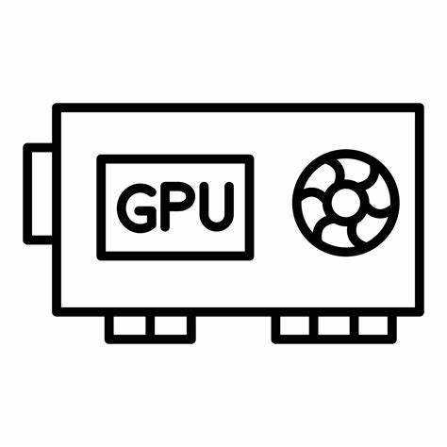
DynamoLLM: Energy-Management for LLM Inference
  [HPCA 2025]
Cluster Manager
Inference Requests
T-put Profile
Out-Len
Prediction
Load
Prediction
Select Number of Instances
Pool Manager
Pool Manager
Perf-Energy Profile
…
Perf-Energy Profile
Instance Pool (SS)
Instance Pool (LL)

Slide 42
DynamoLLM: Energy-Management for LLM Inference
  [HPCA 2025]
Cluster Manager
Inference Requests
T-put Profile
Out-Len
Prediction
Load
Prediction
Select Number of Instances
Profile-driven decisions
Pool Manager
Pool Manager
Perf-Energy Profile
…
Perf-Energy Profile
Hierarchical control for dynamic load
Instance Pool (SS)
Instance Pool (LL)
Different Instance pools for different requests

Slide 43
DynamoLLM: Energy-Management for LLM Inference
  [HPCA 2025]
Cluster Manager
Inference Requests
T-put Profile
Out-Len
Prediction
Load
Prediction
Select Number of Instances
Profile-driven energy configuration setting
Pool Manager
Pool Manager
Perf-Energy Profile
…
Perf-Energy Profile
DynamoLLM reduces
Energy consumption by 35%
Carbon emissions by 38%
Hierarchical control for dynamic load
Instance Pool (SS)
Instance Pool (LL)
Instance pools for diverse workloads

Slide 44
  Conclusions
The community has developed many effective techniques for energy efficiency
There are many more software optimizations
Challenge: Will industry adopt them?
Challenge: Will they make an impact on time, given the crazy course we follow?

Slide 45
  Thanks to Many Contributors
Jovan Stojkovic, UT Austin– Meta
Hyoungwook Nam, AWS
Tushar Krishna, GA Tech
Rachee Singh, Cornell
Minlan Yu, Harvard
Muhammad Shahbaz, U Michigan
Zhiru Zhang, Cornell
Charith Mendis, University of Illinois
Rakesh Kumar, University of Illinois
Esha Choukse, Microsoft
Many more

Slide 46
Energy Consumption in AI Datacenters: Can We Address this Challenge?
Josep Torrellas
University of Illinois Urbana-Champaign
https://iacoma.cs.uiuc.edu/josep/torrellas.html
https://acecenter.grainger.illinois.edu/
EMC2 Workshop, March 2026

Slide 47
Re-start ML jobs within seconds of the failure
Do not need to migrate the job
Do not need to over-provision the datacenter
In-place replacement of the accelerator
Re-build state in the collective comm. library
  Patch in the NCCL communicator
Restart the training job
Addressing a fundamental challenge with hardware/software redesign in the ML stack

Slide 48
Reliable Distributed Training
Dataset
Models (LLMs, MoE …)
Storage
Fault-tolerant runtime for GPU failures/stragglers
Compute
Checkpoint
Data
Accelerators
CPUs
Memory
SmartNIC
SmartNIC
Adaptive Communication Collectives for link failures and congestion
Reconfigurable Topologies that adapt to link and GPU failures
Fabric
Programmable Switches
and Accelerators
Optical Switches
Simulation and emulation testbeds

Slide 49
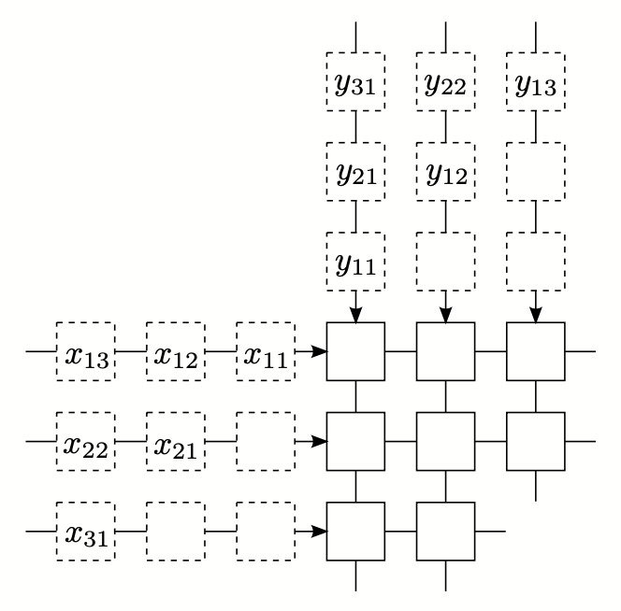
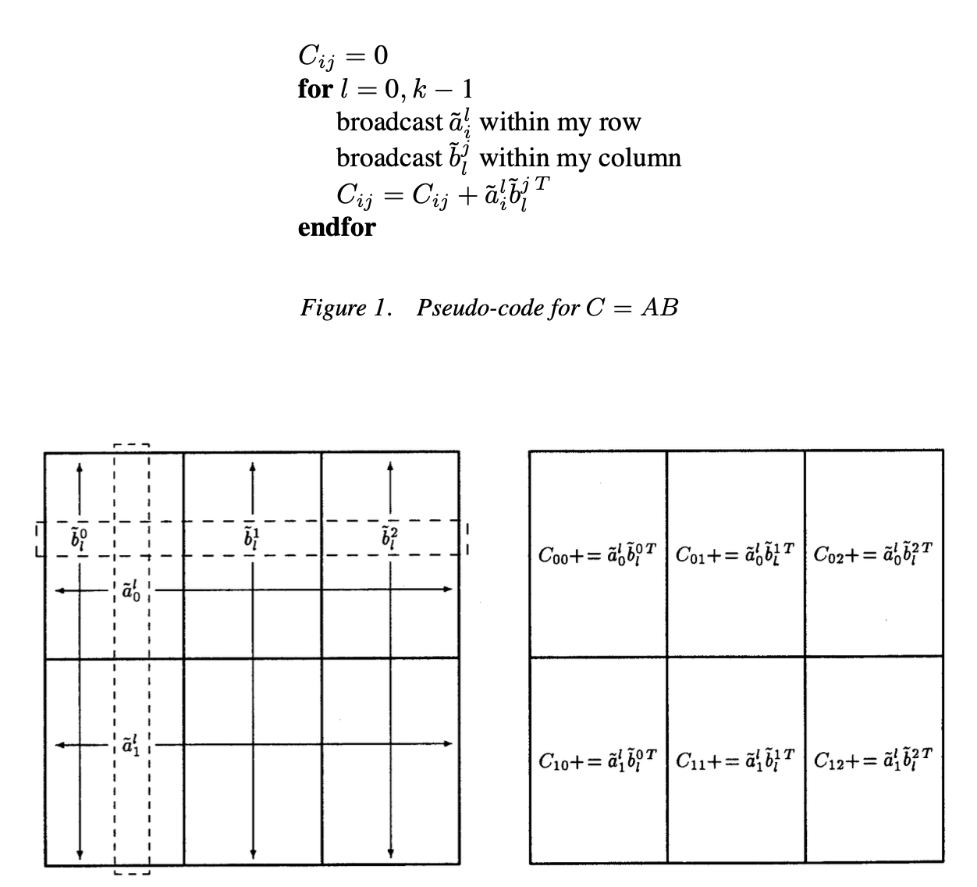
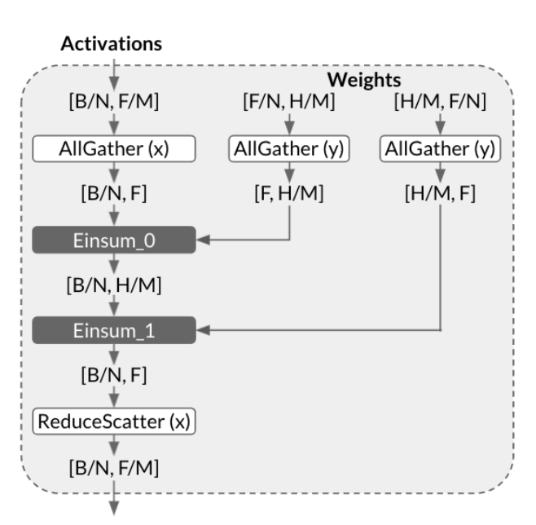

Optimizing 2D GeMM
3. Mesh Shape
1. Algorithm
4X6
Cannon
SUMMA
Collective
2. Dataflow
8X3
6X4
Output Stationary
Left Stationary
Right Stationary
Notes:
- There are three major components that affect the 2D GeMM efficiency
- First is the algorithm itself. (anime) There are multiple 2D distributed GeMM algorithms and the choice is critical
- Second is the dataflow. Three major dataflows depending on what remains stationary. Affects the traffic pattern of 2D GeMM
- Last but not least is the mesh shape (anime). Which is how many rows and columns.
- The mesh shape also affects the amount of traffic.
- Note that square is not always the best for the traffic cost.

Slide 50



New parallelization algorithm enables scalable and faster AI training
Problem: Existing algorithms combining Data (DP), Pipeline (PP), and Tensor (TP) Parallelism to allow bigger AI training jobs are constrained by TP, which is a technique to partition the layers of a large model across multiple GPUs, because TP incurs the most communication.
Impact: Scalable and faster AI training is demonstrated through training GPT-3 (from OpenAI) and Megatron-NLG (from Microsoft and NVIDIA) in a cluster of 256 TPUs.
MeshSlice trains them 12.0% and 23.4% faster, respectively, than the state-of-the-art
MeshSlice maintains high efficiency up to at least 256-way 2D TP
Combining MeshSlice with DP and PP, we can build parallel algorithms that can scale well to 512K-way parallelism.
Existing Tensor parallelism algorithms
New
Higher Performance
FLOP Utilization
Approach: MeshSlice enhances TP with a new algorithm to parallelize General Matrix Multiplication (GeMM) in 2 dimensions (2D; rows and columns in a matrix) that fully overlaps communication with computation in 2D.
The idea is to slice the collective communications (AllGather and ReducedScatter) into multiple partial collective operations in a loop. Then, we apply software pipelining to the loop so that the computation in one iteration overlaps with the communications in the two surrounding iterations.
FLOP Utilization
FLOP utilization under weak scaling
Q2 2025 JUMP 2.0 ACE Center. Task 3134.008.
Notes:
The core of 2D TP is the 2D General Matrix Multiplication (GeMM) algorithm. Existing 2D GeMM are inefficient. Why?
1) Cannon’s algorithm incurs high traffic because it requires skewing the matrix shards, and only supports square meshes.
2) The SUMMA algorithm has less traffic than Cannon by choosing an optimal mesh shape, but relies on fine-grain broadcast and reduce communication operations. These primitives pipeline the communications into small packet transfers, which result in many synchronizations.
3) Google’s TPU clusters compute 2D GeMMs using AllGather (AG) and ReduceScatter (RdS) collective communication operations. This approach combines all partial communications into a single collective communication. As a result, it is not possible to overlap communications with computations via software pipelining.
4) Wang et al. partially solve this problem by partitioning a collective communication into multiple SendRecv operations to overlap communications with computations. Unfortunately, Wang’s partitioning method can only be applied to one direction.
MeshSlice slices the AG/RdS collective communication operations into multiple partial AG/RdS operations in both row and column directions. It overlaps most of the communications with computations with software pipelining, enabling increased scalability.

Slide 51

Result: High Network Bandwidth Utilization
TACOS maximizes network link utilization for all topologies

Slide 52
Other Optimizations for Collective Communications
Tensor Homomorphic Compression (THC) [NSDI’24]
  Compress gradients to reduce collective traffic
  Direct aggregation of compressed tensors
In-network aggregation
  Aggregating (compressed) gradients in programmable switches or smartNICs to further speed up collectives
OptiReduce: A tail-optimal reduce [NSDI’25]
  Time-bounded AllReduce using Transpose AllReduce, unreliable bounded transport, and adaptive timeouts
Notes:
CXL 3 will bring rack-scale shared memory to the data center and this will allow applications to communicate more efficiently by avoid the “data center tax” that arises from serialization/deserialization and other overheads inherent in traditional packet-based networking systems.
The challenge is to leverage the benefits of shared memory without sacrificing the safety and isolation that network-based communication provides. RPCool is a remote proceduce call (RPC) library that balances these two goals: Applications can pass pointers to shared data via an RPC call, avoiding the data center tax, but RPCool also carefully manages program permissions to avoid accidental or malicious data corruption or leakage.
The result in significant speedups for legacy applications (e.g., Memacached) and opens the door for new shared-memory-oriented programming models and services.

Slide 53




OPTIREDUCE: Resilient and Tail-Optimal AllReduce for Distributed Deep Learning in the Cloud. NSDI ‘25
Exploiting the domain-specific characteristic of DDL, OptiReduce introduces (i) mechanisms (e.g., bounded transport, adaptive timeouts, and Transpose AllReduce) to improve the DDL jobs’ tail execution time, and (ii) strategies (e.g., Hadamard Transform) to mitigate the impact of loss on model accuracy; achieving up to 70% faster time-to-accuracy compared to state-of-the-art.
Communication Collectives
Student: Ertza Warraich; PI: Muhammad Shahbaz
Notes:
In Nets4ML, we are developing new communication collectives and domain-specific transports to mitigate tail and minimize the effect of stragglers on model’s training time; completing it orders of magnitude faster.

Slide 54
Distributed Data Parallel: AllReduce
Synchronize and aggregate model gradients:
AllReduce Communication
Forward Pass: Run input through the model
Backpropagation: Update model based on output
Node 2
Gradients
AllReduce
Node 1
Network
Node 3
Node 4
DNN Model
Dataset
Notes:
for each backpropogation step, These gradients need to be synchronized over the network with all other GPUs
[click] This communication is normally done through an AllReduce collective operation which synchronizes and aggregates the model gradients across all these nodes

Slide 55
Distributed Data Parallel: AllReduce
Long-Tail: Worsened in cloud and shared environments!
Node 2
AllReduce Bottleneck:
As much as 65% of training time¹​
Gradients
AllReduce
Node 1
Network
Bottleneck
Node 3
Node 4
¹ "Scaling distributed machine learning with in-network aggregation.” NSDI’21​
Notes:
However, this AllReduce comm is now becoming the critical bottleneck in distributed training
[click] We are seeing as much as 65% of the training time is being spent on the AllReduce op
[click] This is further worsened in the cloud and shared data center environments where many workloads are running in parallel

Slide 56

OptiReduce + THC
Transpose AllReduce (TAR)
AllReduce
Tensor Homomorphic
Compression (THC)
OptiReduce
Unreliable Bounded
Transport (UBT)
Reduces The Amount
of Data to Communicate
W
2. Decompress
1. Compress
Adaptive Timeouts
3. Sum
5. Decompress
4. Compress
PS
Notes:
Usually, compression algorithms compress the data before sending, but it needs to be decompressed at the aggregator when summing it with other data,
Then it again compresses the gradients for faster delivery back to the workers
This extra compression/decompression step adds to the latency,
THC solves this by implementing a homomorphic compression…
[click] so the reduction can happen directly on the compressed data
This saves significant cycles and

Slide 57


DynamoLLM: Designing LLM Inference Clusters for Performance and Energy Efficiency [HPCA’25]
Orchestrator
DynamoLLM: the first energy-management framework for LLM inference clusters
  Automatically reconfigures the cluster to minimize energy while maintaining performance requirements
  Profile-driven energy configuration setting
  Instance pools for diverse workloads
  Hierarchical control for dynamic load
Evaluate DynamoLLM at a large scale
  53% less energy and 38% less carbon emissions

Slide 58


AI Produces Huge Power Demands
Projected increase in AI cluster size
Training a single model already takes 100+MW over many months
With clusters with O(100K) GPUs

Slide 59
Distributed ML Workloads
Challenges:
  Diverse data types; diverse models
  Many heterogeneous accelerators
  High performance demands on compute, network, and storage
Solution
  Adaptive compute (e.g., data ingestion), storage (e.g., checkpointing, data storage), and communication (e.g., topology, smartNICs)
  Cross-layer optimizations between ML and accelerators
  Joint optimization between networking, storage, and compute

Slide 60
In-network Compression and Aggregation
Other Improvements
Adaptive smartNICs
Tensor Homomorphic Compression (THC)
  Compress gradients to reduce collective traffic
  Direct aggregation of compressed gradients
  [M. Yu, Harvard]
SmartNICs: Faster host-NIC communication and offloading computation
Computation in Switches
  Major gains in energy efficiency and performance in training/inference

