Slide 1
Decibel: Isolation and Sharing in Disaggregated Rack-Scale Storage
Mihir Nanavati, Jake Wires, Andrew Warfield
Presented by Sahana Sridhar

Slide 2
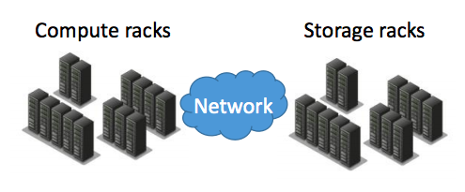
Important Terms
SCM = persistent memory, a recent storage technology innovation where its content is preserved even during crashes and downtime
Tenant = a group of users who share privileges to a software instance
They can also be multiple applications that compete for shared resources.
Rack-Scale Storage Disaggregation = when storage hardware is isolated from computing and other types of hardware
Can utilize storage more efficiently
reduces overall cost of data center
contention = a conflict over access to a shared resource
Image by Sergey Legtchenko

Slide 3
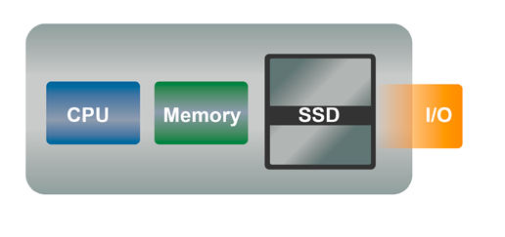
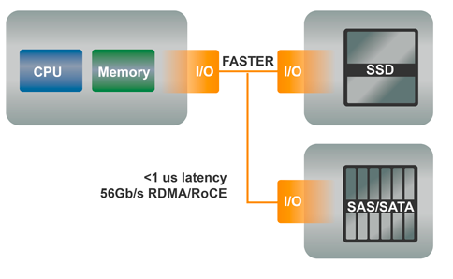
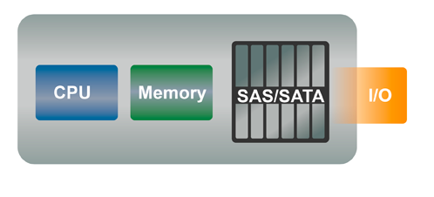
Disaggregated Storage
Initially, storage was bundled into compute servers
called aggregated storage
immediate access to data
costly and wasted storage space
disaggregated storage design
relatively new concept
flexible
can add storage only when needed
image from http://www.datacenterknowledge.com/archives/2013/10/18/storage-disaggregation-in-the-data-center

Slide 4
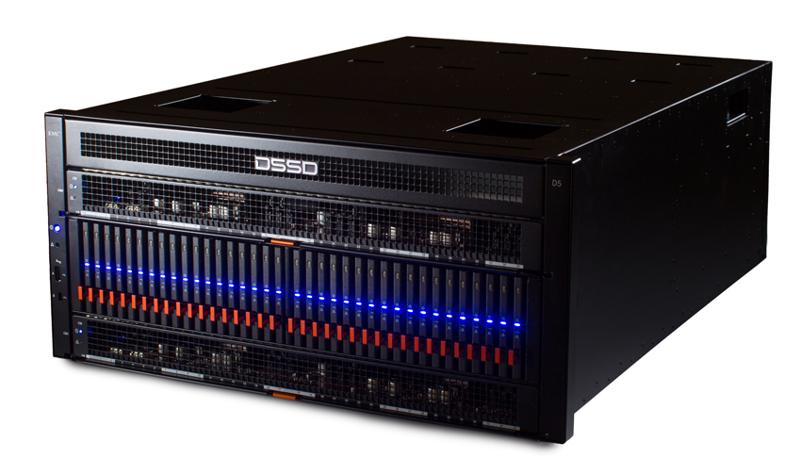
Problem Statement
To efficiently utilize resources, it is required that storage devices are shared amongst tenants.
Typical rack-scale storage architectures (i.e. Facebook’s Lightning) are prone to software overheads due to access latencies of SCMs
Need a way to provide tenants with flexible access to SCMs with low latencies

Slide 5
Introducing Decibel
thin virtualization platform that allows tenants to have access to SCMs at low latencies
designed after a shared-nothing architecture
partitions resources and regulates request scheduling
leads to microsecond-level access latencies
can utilize more storage and more efficiently than direct access to local storage
provides isolation on shared storage
highly scalable

Slide 6
dVols
are schedulable units of the Decibel system that service tenant requests
executed when there are enough resources available to service the requests
provide beneficial properties for storage resources:
extensible hardware-like interfaces
support for operational tasks
visibility of failure domains
elastic capacity
strong isolation and access control
each dVol stored on a single physical device

Slide 7
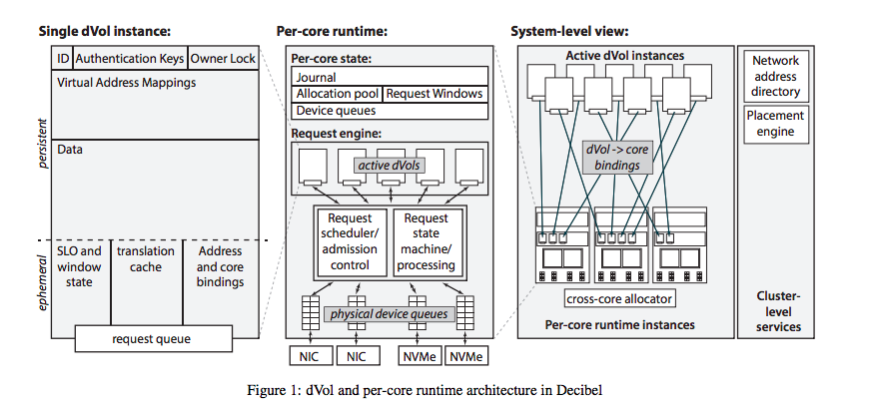
System Design

Slide 8
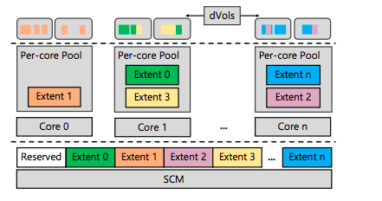
Virtual Block Devices
Uses a virtual-to-physical (V2P) table to map the virtual address space onto physical blocks
dVols provide tenants a virtual address space backed by an SCM
block = 4K (4096 bytes) contiguous regions of physical address space of device
block allocation
SCMs partitioned into multiple extents
extent is a physically contiguous allocation of blocks
extents are reserved by cores once they have space in their local pool

Slide 9
Decibel Scheduler
request windows
each per-core runtime has a private request window
size calculated based on SLOs
requests submitted by dVols to private software queues
per-core runtime selects requests from these queues
selection of these requests dependent on many factors
scheduling policy
number of requests submitted by dVols

Slide 10
Decibel Scheduler
round robin pointer
deficit counter
1
20 750 200
500
2 types of scheduling policies:
strict time sharing
fixed partitioning and assignment of resources to tenants
each dVol has a fixed request quota per scheduling epoch, but unused quota cannot be carried over for later epochs
deficit round robin
guarantees every dVol can submit its fair share of requests
also assigned a fixed request quota per scheduling epoch, but unused quota can be carried over for later epochs
0
2
500 500
200 600 100
0
3
4
50 700 180
0
round robin pointer
1
20 750 200
300
2
500 500
500
3
200 600 100
0
4
50 700 180
0
example taken from “Efficient Fair Queueing Using Deficit Round-Robin” by M.Sreedhar and George Varghese

Slide 11
Experimental Design
Decibel evaluated for multi-core scalability and to quantify overhead of disaggregating SCMs
tests run against 4 devices in the system, with clients evenly distributed across cores:
local
clients run directly on server
remote
clients run separately from server
decibel
SCMs virtualized into per-client dVols
decibel (DPDK)
similar to decibel but bypasses kernel and uses a DPDK-based network stack

Slide 12
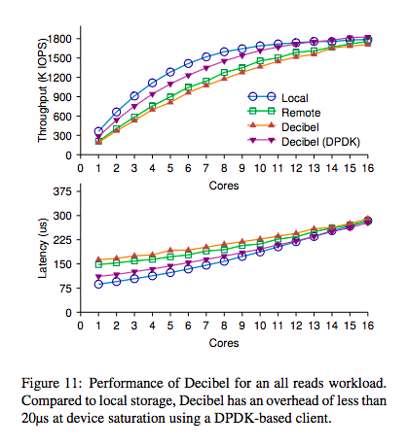
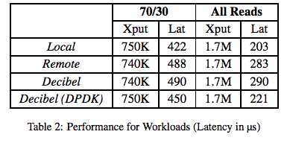
All Reads Workload Performance
performance comparable to local storage!
device saturation

Slide 13
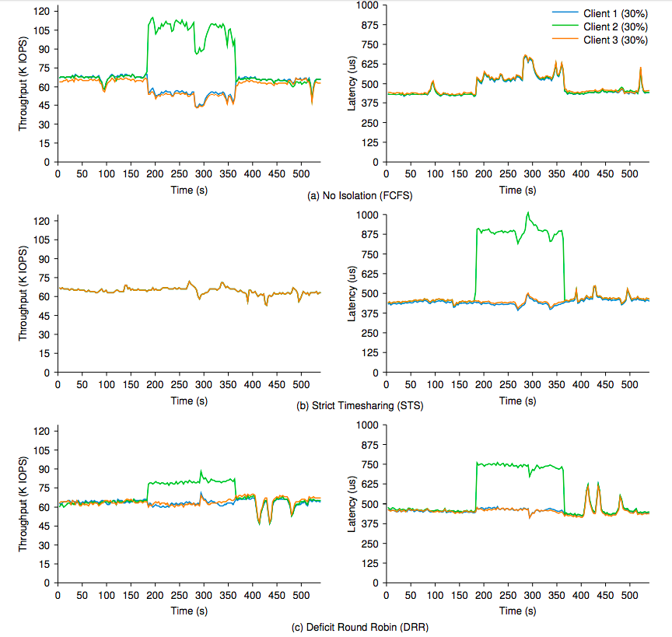
Performance Isolation
see how well device is shared fairly amongst different scheduling policies
no performance isolation implementing FCFS
strict time sharing
deficit round robin
spike in latency for client 2, but does not affect latencies of other clients
throughput preserved for all clients

Slide 14
Takeaways
Decibel achieves a performance similar to that of local storage
high throughput, low latencies
provides tenants with flexible and low latency access to SCMs
provides isolation to tenants
virtualizes the hardware into dVols, which delegate storage to tenants in disaggregated storage architectures
would be interesting to see how the performance is on real-world database applications

Slide 15
Monotasks: Architecting for Performance Clarity in Data Analytics Frameworks
Kay Ousterhout, Sylvia Ratnasamy, Christopher Canel,
and Scott Shenker
Presenter: Cindy Hernandez

Slide 16
Motivations
Data analytics frameworks express computation using simple API
These frameworks generalize the details of breaking the computation into stages and tasks that can be run in parallel
Fine-grained pipelining orchestrated by each task makes reasoning about performance difficult
Tasks have non-uniform resource
Concurrent tasks may contend on same machine
Resource use occurs outside the control of the data analytics framework 1

Slide 17
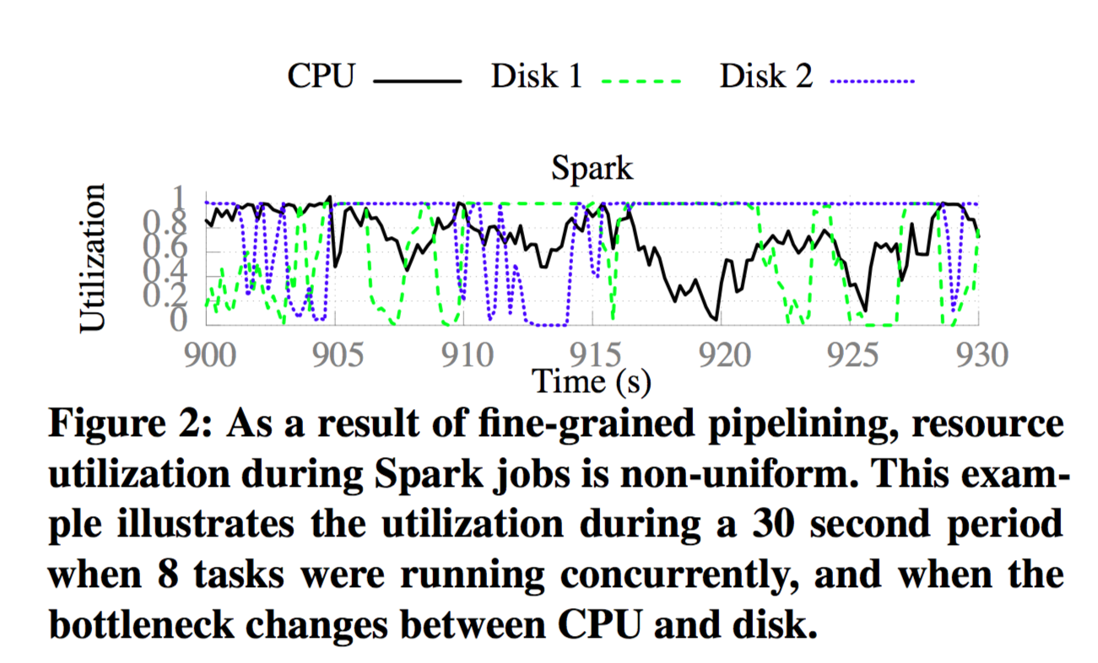
disks
At 920 seconds, all 8 concurrent tasks are blocked waiting on requests from the two disks

Slide 18
Goal
Understand the architect for performance clarity:
Make it easy to understand where bottlenecks lie
Performance implications of various system changes
All should be integrated with a system design

Slide 19
Monotasks
Designed to make it easy for users to reason about performance bottlenecks
Break jobs into monotasks: units of work that each unit consumes a single resource
Separates the use of different resources - this helps not sacrifice performance
Monotasks provides job completion within 9% of Apache Spark for typical scenarios
Computes job completion time which predicts runtime on different hardware and software configurations

Slide 20
Design of MonoSpark
Each monotask uses one resource
Each use exactly one CPU, network, and disk
Monotasks are isolated from each other during execution
Each monotask can fully utilize the resource
Per-resource schedulers controls contention
Each worker has a set of schedulers in which each scheduler is responsible for scheduling montasks on one resource
Per-resource schedulers have complete control over each resource
Avoids optimizations that involve the operating system triggering resource use

Slide 21
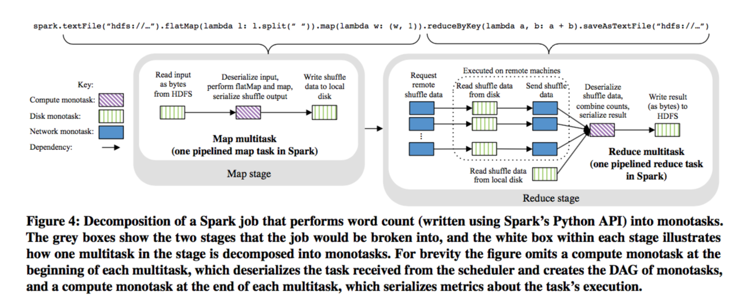

Slide 22
Scheduling Monotasks
Local DAG Scheduler
Manages the directed acyclic graph of monotasks for each multitask
Waits for all dependencies have completed then submits monotasks to the correct per-source scheduler
If monotasks are waiting for resource, monotasks will be queued

Slide 23
Ideal time spent on resources
Monotasks are used to compute the ideal time spent running on each resource
Ideal time spent on CPU:
sum of the time for all of the compute monotasks
number of cores in cluster
Ideal time spent on I/O resources:
sum of data transferred
resource throughput

Slide 24
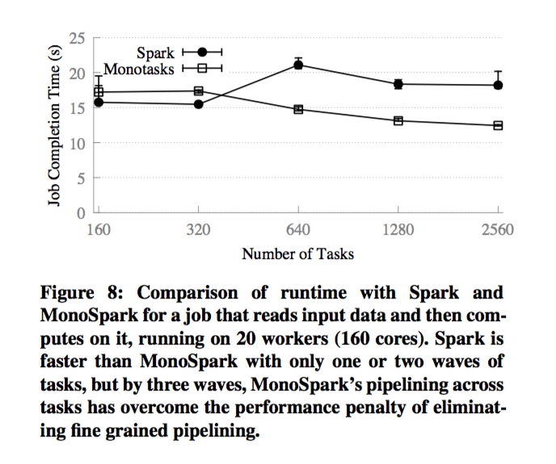
Runtime of Monotask and Spark for a workload in which reads input data from disk
Performs computation over it using different number of tasks

Slide 25
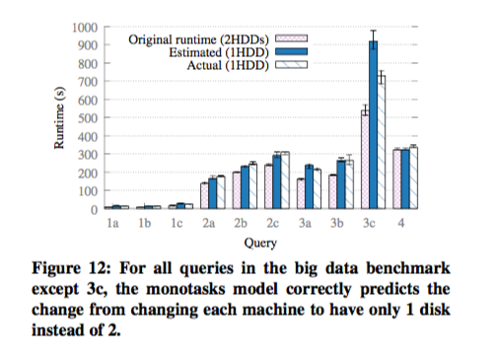
Predictions for all queries except query 3c are within 9% of the actual runtime

Slide 26
Limitations/ Future Improvements
Jobs with few tasks
Jobs with large tasks
Memory usage
Independent access
Cache data
Disk scheduling

Slide 27
Related work
Casual profiling simulates
Measures impact of performance optimizations
Flux
Domain-specific programming language for building high-performance server applications
Disaggregated datacenters
Separating data equipment (in servers) into resource components
replacing traditional server-centric architecture with resource-centric architecture (modular, connected pools of microprocessors, memory, and storage)
Disaggregated networks
Allows choosing software independently of hardware
white-box switching

Slide 28
Pros: Cons:
At most 28% error of runtime prediction
Monotasks can automatically determine the ideal task currency which users are required to specify in existing frameworks
MonoSpark eliminates configuration parameter because concurrency is controlled by each resource scheduler
All jobs have a period amount of time to be up and running where only one resource is in use
Ignore some practicalities
The fact that resource use cannot always be perfectly parallelized

Slide 29
Takeaways of Monotasks
Providing performance clarity (perhaps through monotasks) can be part of a system’s architecture
Performance clarity be a main priority concern in the design of system’s
Performance of Monotasks is comparable to Spark
Using monotasks opens new optimization opportunities that engineers have not yet explored

Slide 30
Decibel Discussion
Are there other scheduling policies we can implement on the scheduler that result in better performance? Or is there a way to improve performance in regards to throughput/latency?
How can we improve the design to better adapt to workload changes?
What would the performance of Decibel implementing RDMA (instead of Ethernet-based messaging look like)? How would it compare to its current performance?
Notes:
1.This is just an open thought, but what if you can move requests across dVols? Like have the per-core runtime move requests between dVols if they did not meet their quota? Maybe this won’t queue requests for bursty clients and there won’t be a spike in latency.
2. The SCM restricts the performance of a dVol to a single core and device, and this drastically reduces performance elasticity. Maybe split the dVol across multiple cores?
3. RDMA - which is remote direct memory access is a way to allow direct access to remote memory without software mediation. this can eliminate network overheads. RDMA can provide better throughput results, but you need lossless networks for good performance. It may lead to some deployment overheads, but I think as new solutions for controlling traffic and lossy networks are being developed, it may be more advantageous to switch to RDMA.

Slide 31
Monotask Discussion
Do you think this model should be merged to other open-source cluster computing frameworks (i.e. Hadoop, Storm)?
Do you think casual-profiling will answer the type of what-if questions focused on for this paper?
Does the system introduce a lot of overheads to job completion?
Notes:
Second bullet - section 9 page 1999
3rd bullet - It does seem there will be some overhead due to cpu, network, and disk scheduler will take up some cpu.

Slide 32
References
[1] Mihir Nanavati, Jake Wires, and Andrew Warfield, Coho Data and University of British Columbia. Decibel: Isolation and Sharing in Disaggregated Rack-Scale Storage
[2] Gilad Shainee, Storage Disaggregation in the Data Center
[3] https://en.wikipedia.org/wiki/Resource_contention

