Slide 1
Unobtrusive Deferred Update Stabilization for Efficient Geo-Replication
Presented by Fengshuang Li

Slide 2
Overview
Motivation
Background
Algorithms
Evaluation
Takeaway

Slide 3
Motivation
Geo-replicated systems pursue low visibility latency and high throughput.
Causal consistency is the strongest consistency level without compromising availability.
State-of-art solutions have different kinds of problems.
Notes:
visibility latency: time interval between the instant in which an update is installed in its origin datacenter and when it becomes visible in remote datacenters.

Slide 4
Background: Geo-replicated systems
For example, imaging facebook datacenters…
Located around the globe to provide low-latency service.
Data are synchronized across the data centers.
Causal consistency needs to be implemented
Bob is in hospital (US) -> Bob is ok (EU) -> That’s great! (CA)
EU server and CA server synchronize data to US server.
Message from CA server may arrive earlier.
US server see: Bob is in hospital -> That’s great -> Bob is ok

Slide 5
Background: Metadata
Metadata is required to achieve causal consistency.
Usually timestamps or vectors
Metadata management produces computation, communication, and storage overhead.
Metadata compressing is commonly used to reduce overhead, but it unavoidably creates false dependencies among concurrent events, increasing visibility latencies.

Slide 6
Background: centralized sequencers
Updates are ordered before being applied at the origin datacenter.
Low visibility latency due to trivial dependency checking.
Sequencer is on the client’s critical path, which significantly penalises throughput (16%).
Usually one sequencer per datacenter. Sequencers can easily be saturated/overloaded for a large cluster.

Slide 7
Background: global stabilization procedures
Updates are propagated concurrently and later ordered at remote datacenters.
Avoids centralized synchronization points (sequencers)
Periodically run a global stabilization procedure to apply updates.
Metadata is over-compressed to avoid impairing throughput, with higher visibility latency as the penalty

Slide 8
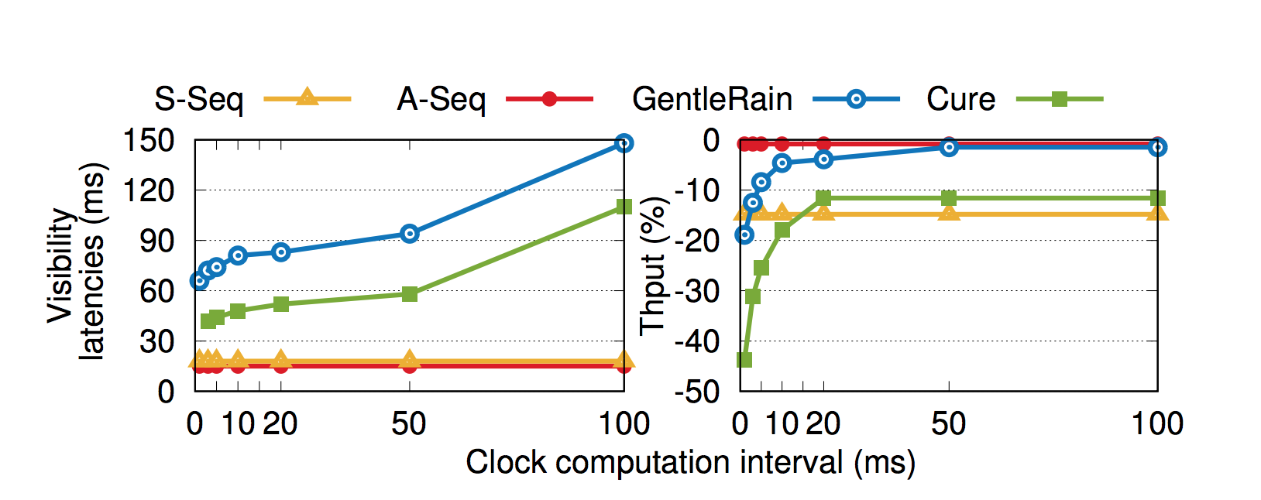
S-Seq: centralized sequencer, uses a vector with an entry per datacenter to track causality
A-Seq: the same as S-Seq but contacts the sequencer in parallel. VIOLATES causal consistency.
GentleRain: use global stabilization, favors throughput by using a single scalar
Cure: use global stabilization, favors visibility latencies by using a vector with an entry per dc.
Notes:
The deployment consists of 3 datacenters. The round-trip-times across datacenters are 80ms between datacenter 1 (dc1) and both dc2 and dc3; and 160ms between dc2 and dc3.
For each solution, we deploy as many clients as possible (not necessarily the same amount for each experiment) without saturating the system.
Ref: https://www.usenix.org/sites/default/files/conference/protected-files/atc17_slides_rodrigues.pdf

Slide 9
Core idea
Goal: roughly achieve the low latency and high throughput of A-Seq with causal consistency ensured.
Ideas:
Avoid throughput loss due to sequencers
Avoid expensive global stabilization
Provide totally orders for trivial dependency checking procedure

Slide 10
Eunomia
Improve sequencer-based solution: remove sequencer from client’s critical path.
Local client send operations to Eunomia in parallel, without synchronous coordination
Site stabilization procedure: in the background, Eunomia establishes a serialization of all updates occurring in the local datacenter in an order consistent with causality

Slide 11
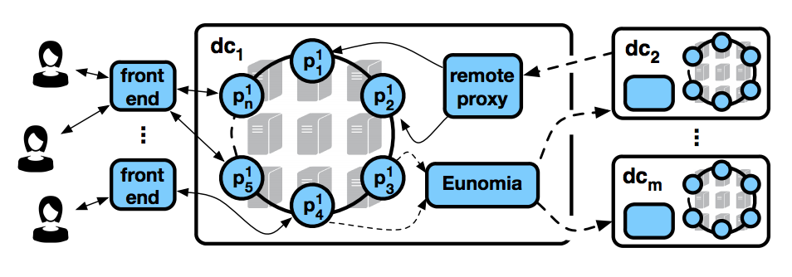
Eunomia
The object space is divided into N partitions distributed among datacenter machines
Reference to slides of the paper: https://www.usenix.org/sites/default/files/conference/protected-files/atc17_slides_rodrigues.pdf

Slide 12
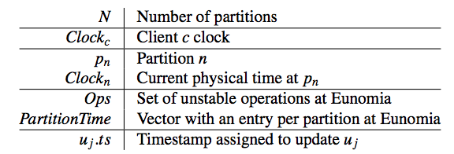
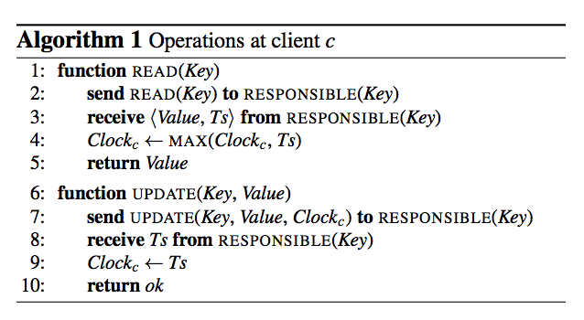
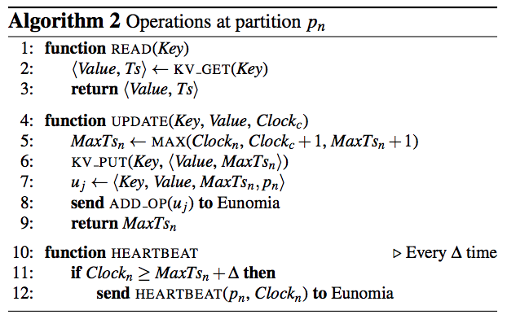
Eunomia
Send requests to the partition that is responsible for the key
Hybrid Clocks: Clockn is physical time and Clockc is logic time(timestamp).
Why? Is it ok to only use logic time clocks?
To next slide
Notes:
Ref: https://www.usenix.org/sites/default/files/conference/protected-files/atc17_slides_rodrigues.pdf

Slide 13
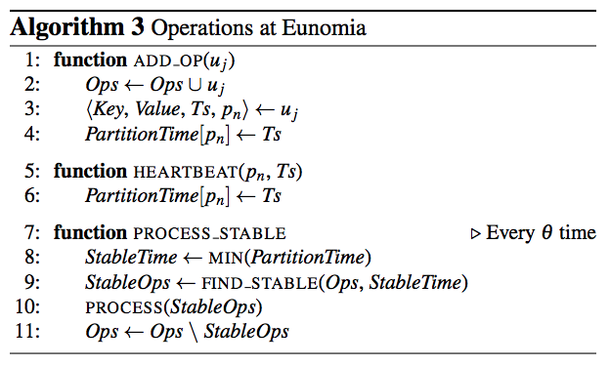
Eunomia
Timestamp Stability: A timestamp Ts is stable at Eunomia when one is sure that no update with lower timestamp will be received from any partition.
Heartbeats. If a partition pn does not receive an update for a fixed period of time, it will send a heartbeat including its current time to Eunomia.
Sent from partitions
Notes:
For two updates ui and uj received by Eunomia from partition pn, if ui is received before uj then uj .ts is strictly greater than ui .ts.
Ref: https://www.usenix.org/sites/default/files/conference/protected-files/atc17_slides_rodrigues.pdf

Slide 14
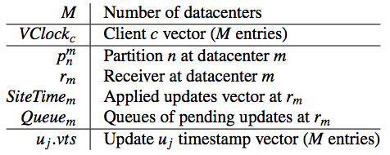
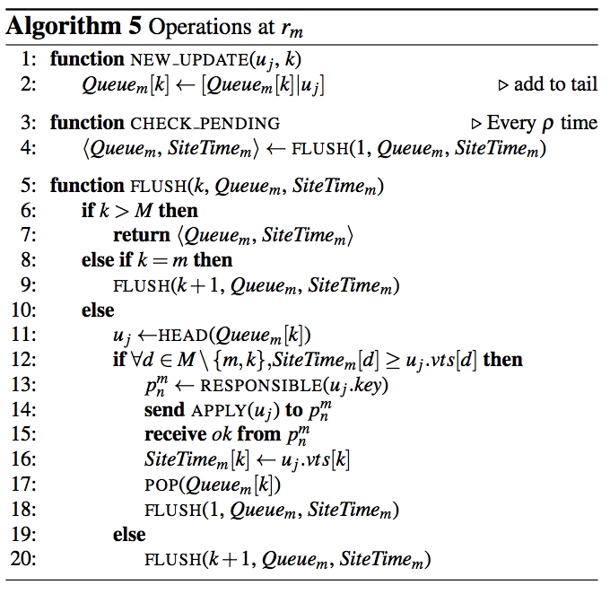
Supporting Geo-replication
Protocol: resemble existing sequencer-based solution.
A receiver coordinates the execution of remote updates.
Updates are tagged with a vector with an entry per datacenter to capture inter-datacenter dependencies.
The client clock is consequently also extended to a vector
Periodically FLUSH
If consistent, apply the update
If not, FLUSH updates from next dc
Notes:
Ref: https://www.usenix.org/sites/default/files/conference/protected-files/atc17_slides_rodrigues.pdf

Slide 15
Resilience to Stragglers
A straggler is a partition or a datacenter that experiences delays in contacting other system components.
Inter-dc stragglers increases visibility latency for Eunomia, as well as sequencer-based approach, GentleRain and Cure.
Intra-dc stragglers have no effect on the remote visibility of updates from healthy partitions for Eunomia and sequencer-based approach. But increases visibility latency for stabilization-based approaches including GentleRain and Cure.
Notes:
stabilization-based approaches: because only stable updates are propagated/applied and the contribution of all partitions is required to achieve stability

Slide 16
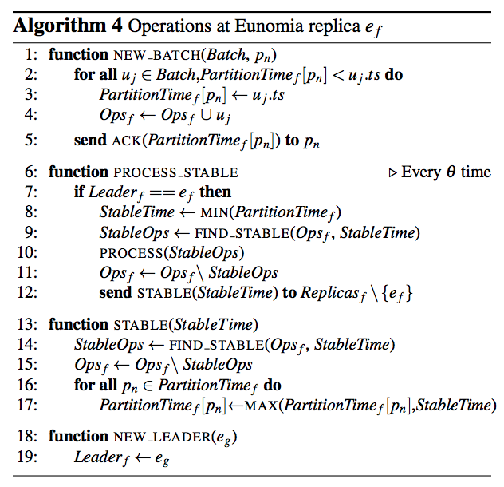
Fault-Tolerance
Run Eunomia service with a set of replicas.
Partitions send operations and heartbeats to the whole set of Eunomia replicas.
A leader replica is elected to propagate information to other DCs.
Notes:
Ref: https://www.usenix.org/sites/default/files/conference/protected-files/atc17_slides_rodrigues.pdf

Slide 17
Implementation
The Eunomia service is approximately 200 lines of C++ code and integrated with Riak KV, a popular weakly consistent datastore.
Augmented Riak KV with geo-replication support as original Riak KV doesn’t support.
At its core, Eunomia is uses a red-black tree for insertions and deletions.
Notes:
Logarithmic time

Slide 18
Evaluation
Experimental Setup:
over 20 physical machines (8 cores and 40 GB of RAM)
a Gigabit switch.
VM: Ubuntu 14.04, 2 (virtual) cores, 10GB disk and 9GB of RAM memory
The deployment consists of 3 datacenters, each with 8 logical partitions balanced across 3 servers.
The round-trip-times across datacenters are 80ms between datacenter 1 (dc1) and both dc2 and dc3; and 160ms between dc2 and dc3.

Slide 19
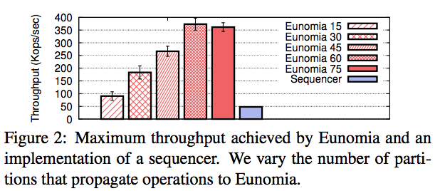
Eunomia Throughput (Non-fault-tolerant)
Eunomia with 60 partitions (maximum load) outperforms sequencer by 7.7 times.
Sequencer is slow due to intra-datacenter concurrency limitation.
Increasing partition number over 60 doesn’t affect the throughput much.
Notes:
The reason is that the bottleneck of our Eunomia implementation is the propagation to other geo-locations rather than the handling of operations.
Ref: https://www.usenix.org/sites/default/files/conference/protected-files/atc17_slides_rodrigues.pdf

Slide 20
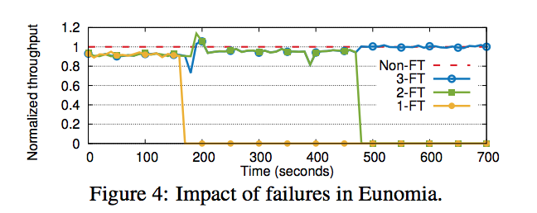
Eunomia Throughput (fault-tolerant)
The fault-tolerant version of Eunomia only adds a small overhead (roughly 9% penalty) independently on the number of replicas. The overhead is 33% for sequencer.
Notes:
Ref: https://www.usenix.org/sites/default/files/conference/protected-files/atc17_slides_rodrigues.pdf

Slide 21
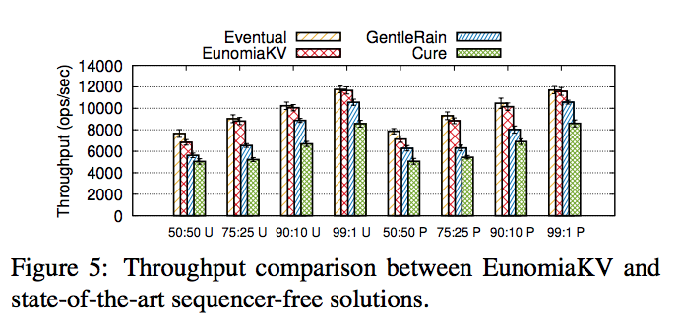
Throughput in Geo-Replication
The throughput of all solutions decreases as we increase the percentage of updates.
EunomiaKV always provides a comparable throughput to eventual consistency
The absolute number of updates per unit of time is the factor that has the largest impact in EunomiaKV, not key contention.
Read:write ratio. E.g. 50:50, 99:1
U: uniform key distribution
P: power-law key distribution
Notes:
Ref: https://www.usenix.org/sites/default/files/conference/protected-files/atc17_slides_rodrigues.pdf

Slide 22
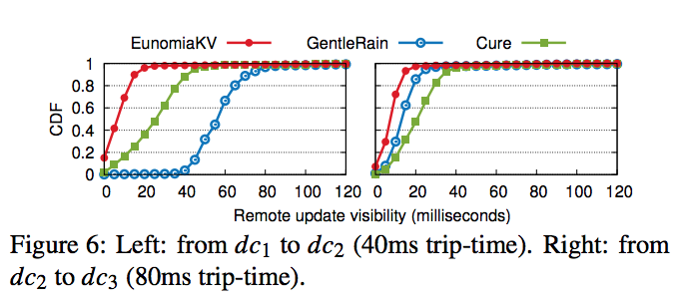
Remote Update Visibility in Geo-Replication
Network latencies among datacenters are factored-out.
The Y-axis is the cumulative distribution of the latency.
GentleRain uses scalar and the minimum delay depends on the travel time to the furthest datacenter.
Notes:
Ref: https://www.usenix.org/sites/default/files/conference/protected-files/atc17_slides_rodrigues.pdf

Slide 23
Takeaway
Eunomia achieves both low visibility latency (as low as sequencer-based solution) and high throughput (higher than global stabilization solution) for geo-replication.
To improve throughput of an operation, optimize on the critical path.
Eunomia remove the contact with sequencer on the critical path of update operations.
Avoid concurrency limit of a single node in a cluster.

Slide 24
Knockoff: Cheap Versions in the Cloud
Xianzheng Dou, Peter M. Chen, and Jason Flinn, University of Michigan
Present by Xiang Li

Slide 25
Overview
Problem & motivation
Related works
Implement details
Evaluation
Conclusion
Discussion!

Slide 26
Problem & Motivation
Cloud -based storage could be significant costs for both storing and communicating data
writing and reading data from remote sites
Keep data with multiple version e.g. Apple’s Time Machine
The cost of versioning also depends on the frequency at which versions are retained.
Reduce cloud-based storage cost
Notes:
Past versions have many uses; e.g., recovery of lost or overwritten data, reproduction of the process by which data was created, auditing, and forensic troubleshooting.

Slide 27
Related works
Reduce cloud-based storage cost
Chunk-based deduplication
Delta compression
Coda File System
operation shipping
Clients log and send user operations (e.g., shell commands) to a server surrogate that replays the operations to regenerate the data.
principle of equivalence
one can represent data generated by computation either by value or by the log of inputs needed to reproduce the computation
New direction!
Representing data as a log of nondeterminism

Slide 28
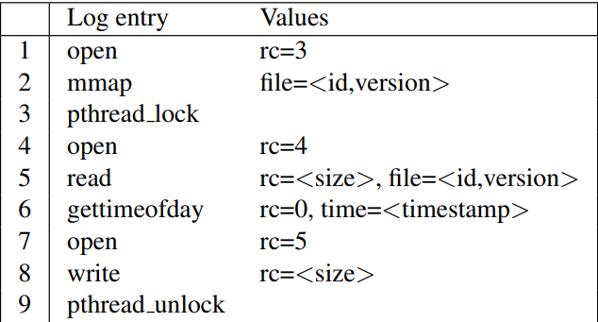
Motivation examples
Consider a simple application that reads in a data file, computes a statistical transformation over that data, and writes a timestamped summary to an output file
output data may be many megabytes in size
the program itself can be reproduced given a small log of determinism

Slide 29
Version Policy
No versioning
Knockoff retains only the current version of all files. For durability, a client sends a modified file to the server on close.
Version on close
Knockoff retains all past versions at close granularity; for past versions, Knockoff may store the actual data or the logs required to regenerate the data.
Version on write
Knockoff retains all past versions at write granularity. Every system call that modifies a file creates a new version, and Knockoff can reproduce all such versions.
Eidetic
Knockoff retains all past versions at instruction granularity. It can reproduce any computation or file data and determine the provenance of data via Arnold.

Slide 30
Files: values or operations?
Files that are large and generated by programs that are mostly deterministic (e.g., photo-editing software) are best represented by operation.
files that are small and generated by programs that use a lot of nondeterministic data (e.g,. cryptographic key generation) are best represented by value.

Slide 31
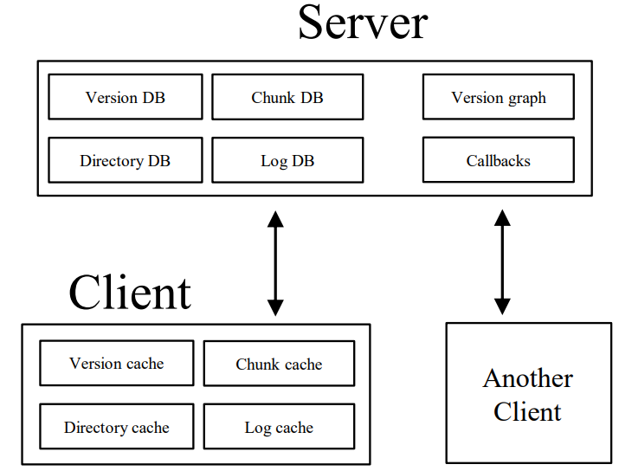
Notes:
ref:https://www.usenix.org/system/files/conference/fast17/fast17-dou.pdf

Slide 32
Architecture
Knockoff is a client-server distributed file system
Client
stores file system data in four persistent caches to hide network latency.
The chunk cache stores the chunks generated by chunk-based deduplication for each file in the version cache
All client caches are managed via LRU eviction
Server
The server maintains analogs of these client stores.
the server maintains the version graph which relates file versions with the computation that produced the data.
Notes:
Knockoff assigns clients a unique identifier; every time a client performs a system call that modifies a file (e.g., write), it increments an integer in the version vector associated with its identifier. Thus, every past version of a file has a unique version vector that can be used to name and retrieve that version.

Slide 33
Writing Data
Write by value or by logs?
Let’s first do some calculation!
cost(log) = size(log) ∗ cost(comm) +time(replay) ∗ cost(comp)
cost(data) = size(chunks) ∗ cost(comm)
Then we can choose

Slide 34
Writing Data
for long running applications
Knockoff predicts this by looking at a history of cost(data)/cost(log) ratios for the application
Different policy

Slide 35
Storing Data
Same method as writing data? However
storing files by operation delays future reads of that data
Knockoff currently stores the current version of every file by value so that its read performance for current file data is the same as that of a traditional file system.
Knockoff may store past versions by operation
Maximum materialization delay
Time bound for reconstructing any version
Notes:
Knockoff also has a configuration parameter that sets a maximum materialization delay, which is the time to reconstruct any version stored by operation. The default materialization delay is 60 seconds.

Slide 36
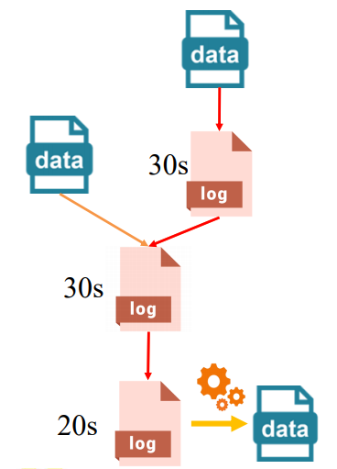
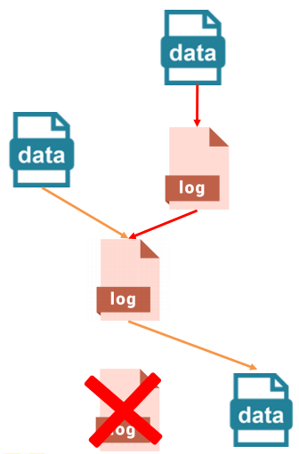
Regeneration time vs Materialization delay
the recomputation time is unbounded due to recursive dependencies.
To limit the time to reproduce past versions, Knockoff selectively stores some past versions by value
Materialization
Delay = 60s
Notes:
It uses the server’s version graph to decide which versions to store by value. The version graph shows the relationships between file versions and logs of nondeterminism. File versions and replay logs form the vertexes of the graph
ref:https:https://www.usenix.org/sites/default/files/conference/protected-files/fast17_slides_dou.pdf

Slide 37
Optimize (log compression)
Chunk-based deduplication is effective for file data, it can be also applied to logs?
33% reduction!
Delta encoding
42% reduction!
Notes:
Similar files tend to have large contiguous chunks that are the same, whereas similar logs often lack such regions. Instead, most of the bytes within two log regions might be the same, but there exist in each region a smattering of values such as timestamps that differ. So, even very similar log chunks hash to different values.
Knockoff first identifies a reference log that it expects to be similar to the current log. It then generates a binary patch via xdelta [45] that encodes the difference between the current log and the reference log. Given both the reference log and the patch, Knockoff can reconstruct the original values in the log.

Slide 38
Evaluation
evaluation answers the following questions:
How much does Knockoff reduce bandwidth usage compared to current cloud storage solutions?
How much does Knockoff reduce communication and storage costs?
What is Knockoff’s performance overhead?
How effective is log compression?

Slide 39
Experimental setup
User study
8 participants performed several simple tasks in one hour
20-day study
A single-user longitudinal study
A variety of programs used
Various Linux utilities, text editors and programming languages

Slide 40
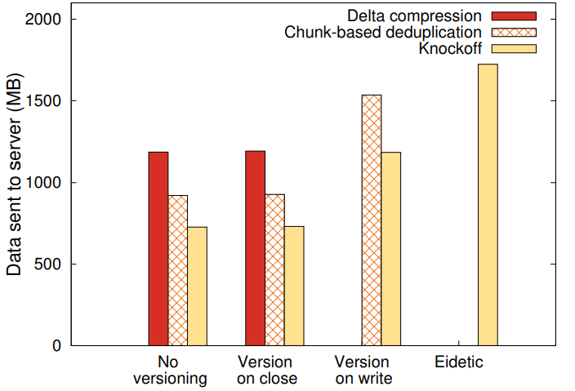
Bandwidth savings
20 days study
Notes:
ref:https://www.usenix.org/system/files/conference/fast17/fast17-dou.pdf

Slide 41
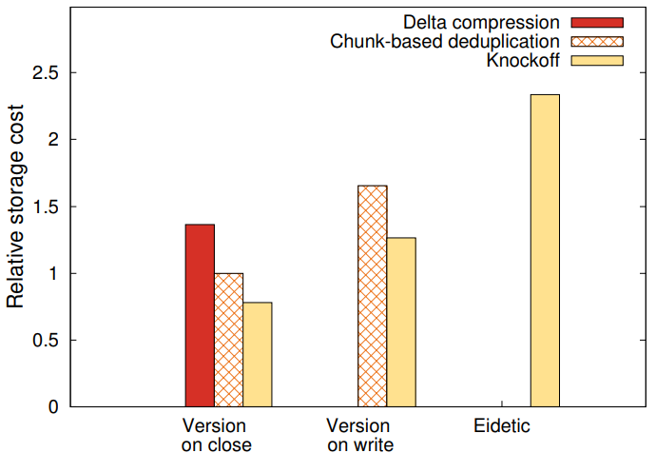
Storage savings
20 days study
Notes:
ref:https://www.usenix.org/system/files/conference/fast17/fast17-dou.pdf

Slide 42
Communication cost savings
Notes:
ref:https://www.usenix.org/system/files/conference/fast17/fast17-dou.pdf

Slide 43
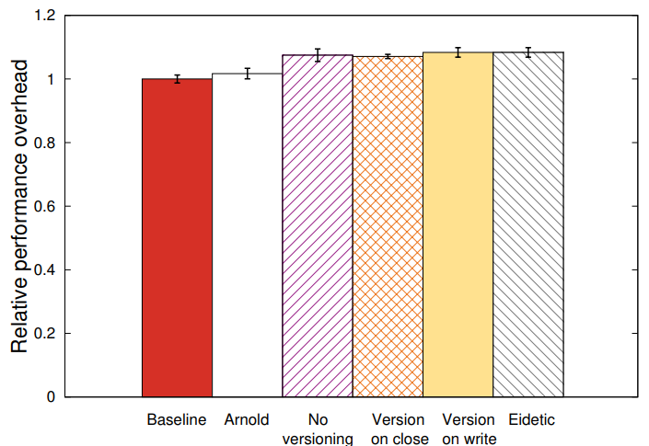
Performance overhead
measured this overhead by compiling libelf-0.8.9
with all source files, executables,
and compilation outputs stored in Knockoff
7-8% performance overheads.
Notes:
ref:https://www.usenix.org/system/files/conference/fast17/fast17-dou.pdf

Slide 44
Conclusion & takeaway
A new dimension for reducing costs
Selectively substitute computation for data
A general-purpose system for deterministic recomputation

Slide 45
Discussion
Present by Zhuang Zuo

Slide 46
Eunomia
How nodes work in each partition?
Synchronized? Performance drop?
ASynchronized? Timestamp problem?
Notes:
Not mentioned in paper

Slide 47
Eunomia
What will happen if one partition failed?
All System halt?
Solutions?
Notes:
All system halt
Because there is no method to detect fail nodes
Have to compare timestamps of each partition, if fail, there will be one partition remains same.

Slide 48
Eunomia
Will there be bottleneck?
One/multiple Eunomia in each datacenter, capacity limitation?
Notes:
Yes, kind of single point failure.
Capacity problems

Slide 49
Knockoff
Ubuntu or Arnold? Multi-platform support?
“Knockoff uses the Arnold system, which meets these requirements” -- [Design]
“All platforms run the Ubuntu 12.04LTS Linux kernel” -- [Evaluation]
Any method to implement on other platforms?

Slide 50
Knockoff
SHA verification failed, how to reroll?
“If the replay does not produce matching data, Knockoff switches to representing the file by value.”
Possibility of failed operations
Is it possible to rebuild failed operations
Notes:
(76 top-right)

Slide 51
Knockoff
Privacy problem?
“ They used Web browsers to visit different Web sites such as Google and StackOverflow, as well as sites unrelated to the assignment (e.g., Facebook and CNN News)” -- [User Study]
Notes:
(76 top-right)

Slide 52
One More Thing
Which one would you choose?

