Slide 1
Verified
Yuanshan Zhang
Wesley Ma
Gaunnan Guo
1

Slide 2
Ironfleet: proving practical distributed systems correct
Chris Hawblitzel, Jon Howell, Manos Kapritsos, Jacob R. Lorch, Bryan Parno, Michael L. Roberts, Srinath Setty, Brian Zill
Presented by Wesley Ma

Slide 3
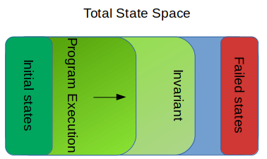
Verification
“Program verification is the task of analyzing the correctness of a program… [It] cannot come too soon: software and hardware are becoming ever more ubiquitous and thus ever more the source of failure.” - Calculus of Computation (Bradley, Manna)
Specification written in logic, code written in a programming language
Manually checking code is tedious and error-prone, paper proofs are insufficient, so we want the computer itself to have some sort of proof of correctness
Overarching idea: program starts in some set of states, define transitions based on program code, use invariants to establish that a bad state is never reached
1

Slide 4
Why Verification is Important
Implementation introduces new conditions on your design and can introduce subtle bugs
Testing only as good as tests – infeasible to test every single case
Effects and behaviour of code is completely captured by the spec (don’t have to read code)
Spec is a formal document, no ambiguity
With right spec, can:
Categorically eliminate security issues
Guarantee liveness and eliminate deadlock, livelock, etc.
Static checking can make sure your programs are bug-free before even running
Runtime verification can make sure programs don’t go awry while running
SAGE, a tool based on symbolic execution, found 1/3 of bugs during Windows 7 development (SAGE: Whitebox Fuzzing for Security Testing, Godefroid, 2012)
1

Slide 5
Verifying Distributed Systems
Much larger state space to reason over: want properties over both local and global state
Networks are hard to reason about
Some work in checking protocols, but don’t extend to implementations
Many works don’t prove guarantees about liveness
Overall relatively unexplored, most work in verification limited to a single machine
Verification in concurrent programs lags by a decade, in distributed systems, more
1

Slide 6
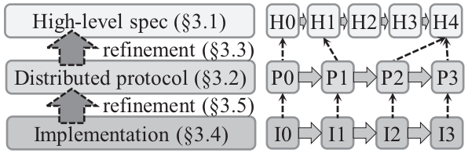
Ironfleet
Part of Ironclad project, methodology to build verified distributed systems
3 layers: High-level spec, Distributed Protocol, and Implementation
High-level spec: spec over entire system
Protocol: spec on a local machine
Implementation: code on a local machine
Each level encoded, verified in Dafny
Common library to use Ironfleet to build new systems
1

Slide 7
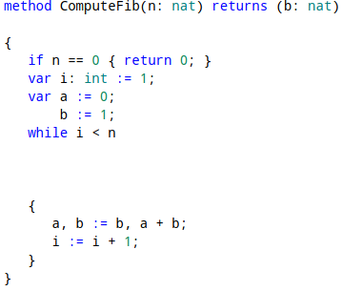
Dafny
Programming language with built-in support for formal specification
Translates to Boogie targets and uses Z3 theorem prover as backend
Tends to be more automatic (compared to Coq)
Verified code compiles to C#
Available at rise4fun.com, Visual Studio, Emacs
1

Slide 8
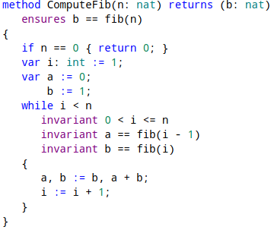
Dafny
Programming language with built-in support for formal specification
Translates to Boogie targets and uses Z3 theorem prover as backend
Tends to be more automatic (compared to Coq)
Verified code compiles to C#
Available at rise4fun.com, Visual Studio, Emacs
1

Slide 9
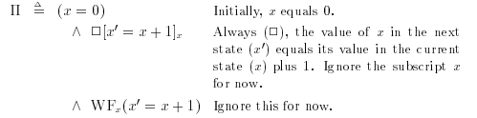
TLA (Temporal Logic of Actions)
Developed by Leslie Lamport
First order predicates
Temporal quantifiers: ◊ eventually, and □ always
TLA+ specification language for describing (distributed) systems in TLA
Not natively supported in Dafny, so Ironfleet created an embedding of TLA in it
Introduction to TLA (Lamport, 1994)
1

Slide 10
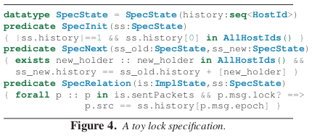
High-level Spec
Final word on system behaviour
SpecInit: acceptable system starting state
SpecNext: acceptable transitions between states
SpecRelation: restrictions on implementation of spec
1

Slide 11
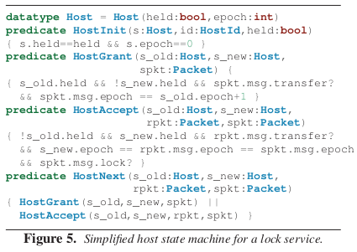
Distributed Protocol
Refinement of High-Level Spec, checked with TLA
Steps aren’t 1-to-1 with Spec steps
Invariant quantifier hiding
HostInit: acceptable local starting states
HostNext: acceptable transitions between local states
Steps are atomic
Abstract local specification
1

Slide 12
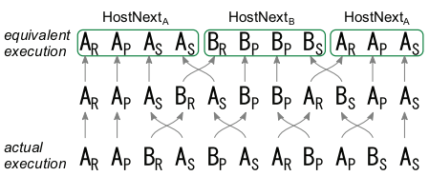
Implementation Layer
Actual code conforming to Protocol Layer
Since Protocol refines Spec, Implementation follows Spec
Dafny (with UDP extension) compiled to .NET
Reduction to connect implementation to atomic steps
Reorder actual execution to an equivalent one that can be refined to protocol layer
If receives are performed before sends, this is a safe transformation
1

Slide 13
Assumptions in Ironfleet
Trust in Dafny
Small amount of code to be hand-checked
Main loop on local host
High-level spec
Fair network that faithfully delivers packets
Main loop runs (infinitely) often
1

Slide 14
IronRSL
Verified implementation of Paxos
Has batching, log truncation, reply cache, state transfer for recovery
Invariants capture safety: no 2 learners decide on different results for round
Invariants can guide optimization: keep track of maxOpn instead of recomputing
Liveness: if a request is repeatedly sent to replicas, eventually a reply is sent
Modulo bounded scheduler frequency, network delay, clock error, etc.
1

Slide 15
IronKV
Dyanmically sharded key-value store
Local subset of DHT + delegation map
Initially 1 host has all the keys
An administrator can send order for a host to “give” keys to another
Key invariant: Each key either claimed by one host or in-flight packet
Enforced by sequence-number-based reliable transmission over a fair network
1

Slide 16
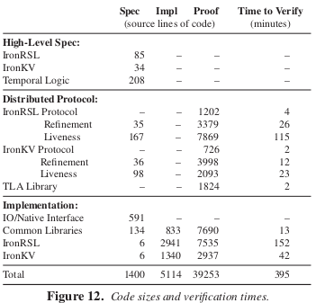
Developer Experience
Dafny provides real-time IDE feedback
During development a few seconds to verify, a few minutes to build whole system
Proof to code ratio is 8:1
Implementation layer it is 3.6:1
Lots of work: 3.7 person-years to build 2 systems
High barrier to entry
Works on first try
1

Slide 17
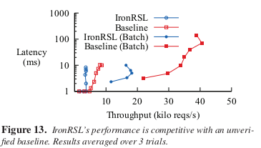
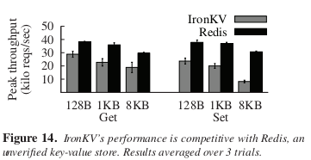
Performance
IronRSL: 3 machines over 1 Gbps network
~2.4x less throughput than EPaxos
IronKV: 2 machines over 10 Gbps network
Comparable with Redis
Optimizations need to be proved, C#
1

Slide 18
Related Works
ExpressOS (from UIUC) verified mobile OS
EventML verifies Paxos implementation
Just the consensus protocol, and modulo some assumptions
Ridge persistent message queue
Verdi: building verified distributed systems with Coq
Build system with simplifying assumptions, then use system transformers to convert to an equivalent distributed system with different assumptions (ie adding fault tolerance)
1

Slide 19
Pros
Cons
Novel 2-step refinement blending Hoare logic and TLA-style verification
Formally proven guarantees including safety and especially liveness
Libraries (refinement, marshalling, parsing, collections) will significantly reduce future work
Dafny is a nicer environment to work in than Coq
High overhead in learning how to write proof annotations as well as development time
Only Dafny, which only compiles to C# and has few standard libraries
Doesn’t match unverified systems’ performance
IronRSL and IronKV lack features
Reduction and main loop remain unproven
1

Slide 20
Verifying Reachability in Networks with Mutable Datapaths
Aurojit Panda et al.
1

Slide 21
Background: Stateful vs. Stateless
Stateless
Uses static rules
Doesn’t depend on previous traffic
Changes slowly
Stateful
Also depends on previous traffic/state
Makes datapaths mutable
Contains middle boxes such as Firewall, Cache, IPS, IDS
1
Notes:
Stateful vs statless
Forwarding behavior depend on rule
Rules change slowly in response to:
Changes in topology. Changes in policy
In stateful network, the forwarding behavior depends on states
Every time a connection is established. Every time packet is forwarded.
For example a stateful firewall may decide to whether forward or drop a packet depend on wheter the connection has already be established
<number>

Slide 22
Motivation & why should we care
Network are becoming more stateful
Misconfigurations of middle boxes are causes of many network failure
43% of network failure involves middleboxes
States of the network can impact invariants
E.g. a stateful firewall may effect reachbility
Today’s verification tools:
Mostly not support verifying network with mutable datapaths
1
Notes:
and stateful devices are common Most datacenter would have some stateful devices such as IDS or stateful firewall
and between 4% and 15% of these incidents were the result of middlebox misconfiguration
Invariants such as can packet from A reach B
Only verify Static forwarding rules in switches. E.g. Veriflow
Test network with mutable datapaths by generating traffic E.g. Buzz
Mostly not support verifying network with mutable datapaths
Such as veriflow
<number>

Slide 23
VMN: Verify mutable networks
Model each type of middle boxes
Build the network
Specify invariants
Input to SMT solver (Z3)- whether the invariants hold
Invariant holds
Violated - with example
Unknown - timeout
1
Notes:
No real traffic is generated
The paper’s approach
First model each middle box
Combine them togrhter to form the entire networks. Basically that is where it takes the topology into account
Specify the invariants and transform to a format (first order logic) that’s acceptable to the SMT svoler, in this case Z3.
Then the whole thing will be input to the smt sovlver which would tell whether there is a problem or not
I will talk about each of those parts
<number>

Slide 24
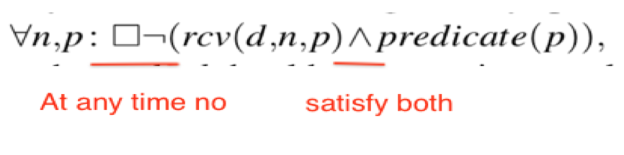
Invariants
Focus on checking isolation invariants
Simple isolation invariants
Flow isolation invariants
Data isolation invariants
Pipeline invariants
1
Notes:
VMN focuses on checking isolation invariants, which are of the form “do packets (or data) belonging to some class reach one or more end hosts, given certain conditions hold?
Variant can to classify packet or data using (a) header fields (source address, destination address, ports, etc.); (b) origin, indicating what end host originally generated some content; (c) oracles e.g., based on whether a packet is infected, etc.; or (d) any combination of these factors,
Invariants can also specify temporal conditions for when they should hold, e.g., it can require that packets (in some class) are blocked until a particular packet is sent.
“do packets of class reach destination node d?” This is the class of invariants supported by stateless verification tools
This one adds temporal constraints to the invariants. Can a receive a packet from b without previously opening a connection
Can data originating at server s be accessed by end host b
Do all packets marked as suspicious by a light IDS pass through a another device before being delivered to end host b?
The predicate can be expressed in terms of packet-header fields, abstract packet classes and past events,
<number>

Slide 25
Middle boxes
Infeasible to directly verify source code/abstraction of middle boxes
This paper’s purpose:
A Middle box can be splited into two parts
Forwarding
Classification – whether is done correctly is not in our concern
A Model: a forwarding model, a set of abstract packet classes, and a set of oracles
1
Notes:
Current verification tools are still far from able to automatically analyze the source code or executable of most middleboxe
Middlebox code does not always work with easily verified abstractions. For example, it is very hard to define what is suspicious for a IDS or firewall.
Forward: e.g. drop suspicious packets but output normal packet to port 1
Classification: hether a packet is suspicious or not
And although there exist a large number of different middleboxes, most of them belong to a relatively small set of middlebox types – firewalls, IDS/IPSes. Middleboxes of the same type can uses the same model.
that automatically determine whether a packet belongs to an abstract class – so, the oracle abstracts away the implementation of packet classification.
<number>

Slide 26
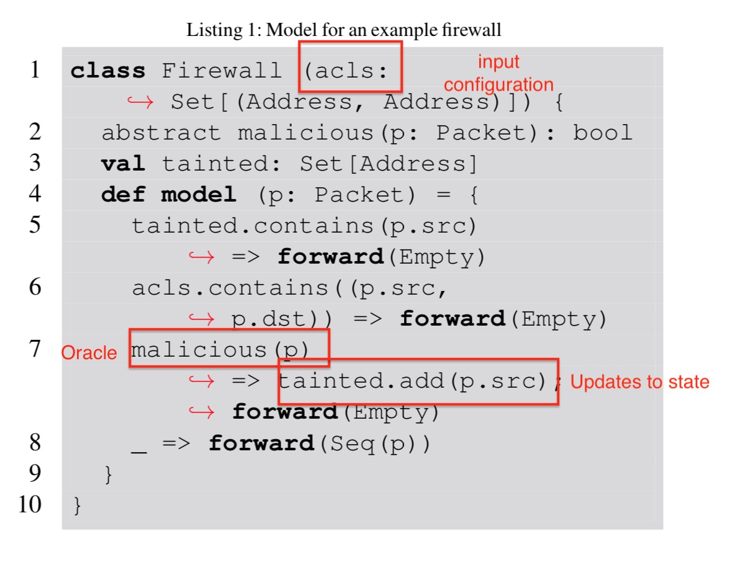
Middle box example
1
Notes:
At the end, the model will be translated to format that is acceptable by the SMT solver.
<number>

Slide 27
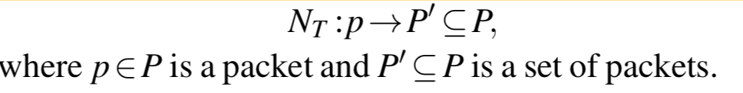
Model networks
Glue end hosts and middle boxes together by network transfer functions
from a located packet to a set of located packets indicating where the packets are next sent.
1
Notes:
The network works as a state machine whose state is defined by the set of packet that have been delivered
<number>

Slide 28
Scaling to large network
EXPSPACE-complete to check reachability property in network with mutable datapath
Observed traffic often affects only a well-defined subset of future traffic
A lot of symmetries
Explore Slice and Symmetry properties to reduce and verify invariants arbitrarily large networks
1
Notes:
Now we have the basic components to model the network
Point 2 packets from the same TCP connection would probably only affect traffic between the same source and destination
Point 3: a bunch of hosts belongs to one tenants and share the same set of forwarding rules
Slicing makes the network size smaller and symmetry make the number of invariant you have to check smaller
<number>

Slide 29
Scaling: Slice
Slice: A smaller subnet that can help verify an invariant
Close under forwarding and states
Invariant is evaluable on it
How to identify a slice? If all middle boxes are:
Flow-Parallel Middle boxes -- handling a packet is independent of other flows
Origin Agnostic Middle boxes – behaviors only depend on current state
1
Notes:
The idea behind slicing is that for a network can we find a smaller but equivantlent subnet of it that the verification result carries over
Close under forwarding, a packet is not forwarded outside of the subnet
Close under states, all states reachable by the middle box in the network is also reachable in the subnet
works as a state machine whose state is defined by the set of packet that have been delivered
one can establish a bisimulation between the slice and the network N;
informally this implies that one can find a relation such that when we restrict ourselves to packets in p ∈ P|Ω then all transitions in N have a corresponding transition in Ω, corresponding here implies that the states in N are the same as the states in Ω after projection.
invariant is evaluable on a subnetwork Ω, if the corresponding predicate refers only to packets and middlebox state contained within Ω
include firewalls, NATs, IPSes, and load balancers. For analysis, such middleboxes can be decomposed into a set of middleboxes, each of which processes exactly one flow without affect network behavior.
Cache : only depend on whether a content is cached share state across flows, their behavior is often dependent only on the state of a middlebox not on the sequence of transitions leading up to that state
Find a slice on which invariant I is evaluable by picking the smallest subnetwork Ω on which I is evaluable (which always exists) and adding the minimal set of nodes from network N required to ensure that it is closed under forwarding and states
In both casese, the size of slices in this case is also independent of the size of the network
icrosoft’s Chicago Datacenter [8] contains over 224,000 servers running virtual machines connected over virtual networks. In such an environment, each server typically acts as a middlebox, resulting in a network with several 100,000 middleboxes, e.g., firewalls, load balancers, SSL proxies, etc.. We want to be able to check invariants in such large networks within a few minutes, however, typically verifying such large instances is infeasible or takes several days
<number>

Slide 30
A
B
Firewall
cache
server
C
No a -> server
No server -> a
D
1

Slide 31
Scaling: Symmetry
Still need to check for each invariants which increase runtime
number of invariants needed to check grows with the size of the network
Networks have a large degree of symmetry
two invariants are symmetric when they are always both holds or violated
Symmetry can be determined by comparing the smallest slices in which each invariant can be evaluated
yes - if the graphs are isomorphic up to the type and configuration of individual middle boxes
<number>
Notes:
The network tends to have a lot of duplicated component and symmetries. For example, a bunch of hosts belongs to one tenants and share rules and you don’t have to verify the invariant for each of the host.
Have 2 hosts A and B connect to a server through a same firewall and have exactly same rules applied to them. In that case, A can reach the server if and only if B can reach the server
<number>

Slide 32
Check reachability
VMN focuses on checking whether the sequence of middle boxes encountered by a packet can enforce the reachability
Use SMT solver (Z3) looks for a set of oracles behaviors that result in the violation of invariants.
Output
Whether the invariants hold or unknown (when exceeds time limit)
<number>
Notes:
Middle box models and invariants are all translated to a format acceptable to the SMT solver.
Even though the fragment of first-order logic VMN uses is decideable. It could still timeout when the input is large.
Oracles in VMN are modeled as uninterpreted function, i.e., Z3 can assign any (con- vinient) value to a given input to an oracle. It looks for a set of assignment to oracle can satisfy the negation of the invariant.
VMN’s verification procedure builds on Z3 [9], a modern SMT solver. Z3 accepts as input logical formulae (written in first-order logic with additional “theories” that can be used to express functions, integers and other objects) which are expressed in terms of variables, and returns whether there exists a satisfying assignment of values to variables, i.e., whether their exists an assignment of values to variables that render all of the formulae true. Z3 returns an example of a satisfying assignment when the input formulae are satisfiable, and labels them unsatisfiable otherwise.
<number>

Slide 33
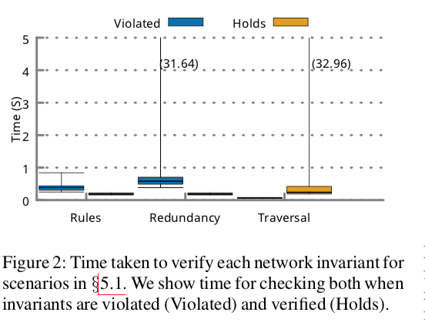
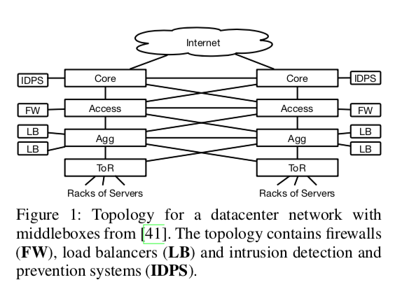
Evaluation: Real networks
•Incorrect firewall rules
•Misconfigured redundant firewall rules
•Misconfigured Redundant Routing
<number>
Notes:
The first evaluation is about how VMN can detect and prevent the three most common classes of configuration errors, including errors affecting fault tolerance
The evaluation uses datacenter topology (Figure 1) containing 1000 end hosts and three types of middleboxes: stateful firewalls, load balancers and intrusion detection and prevention systems (IDPSs).
They use load balancers to model the effect of faults (i.e., the load balancer can non-deterministically choose to send traffic to a redundant middlebox
pNote that all middleboxes in this evaluation are flow-parallel, and hence the size of a slice on which invariants are verified is independent of both policy complexity and network size
IFW: assigning each end host to one of a few policy groups. And add firewall rules to prevent end hosts in one group from communicating with end hosts in any other group. Then introduce misconfiguration by deleting a random set of these firewall rules.
RFW: introduced misconfiguration by removing rules from some of the backup firewall. In this case invariant violation would only occur when middleboxes fail
MRR misconfigura- tion is if routing (after failures) allows packets to bypass the middleboxes specified in the pipeline invariants
We changed a randomly selected set of routing rules so that some packets would be routed around the redundant IDPS when the primary had failed
). VMN correctly detects invariant violations, and does not report any false positives.
<number>

Slide 34
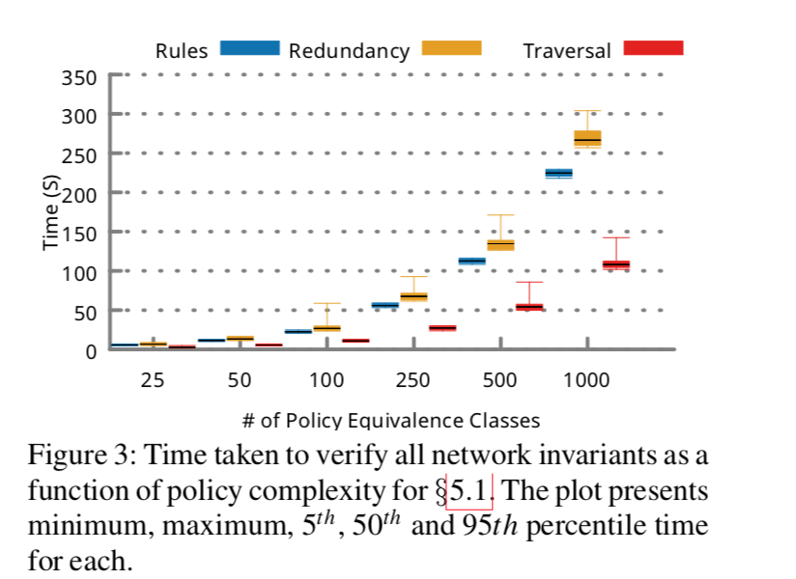
<number>
Notes:
Moreover, the verification time scales linearly with the number of policy equivalence classes
<number>

Slide 35
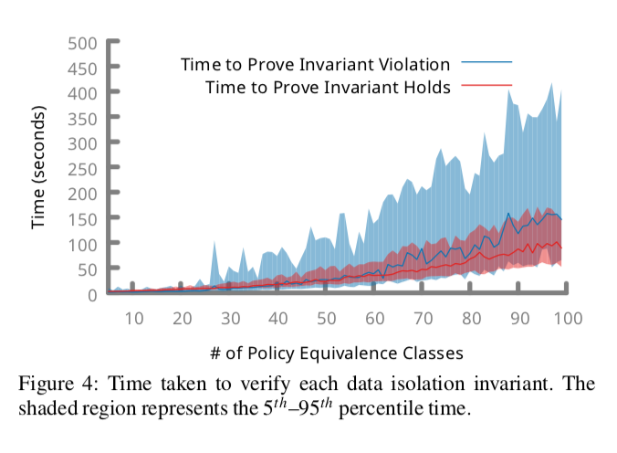
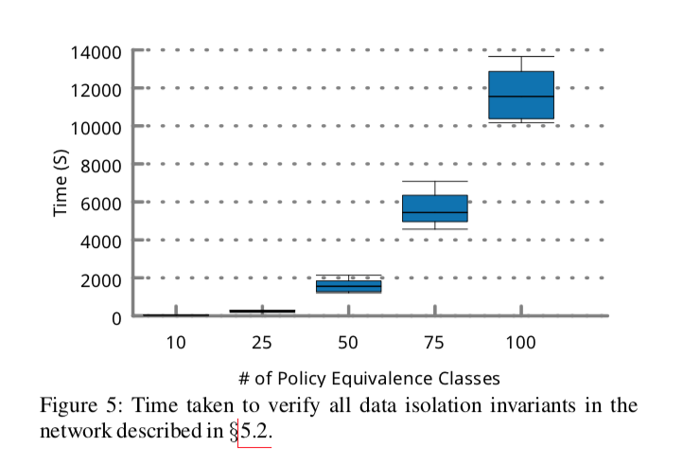
Evaluation: Data isolation
Topology: same as the previous one but a few content cache are added to the ToR
<number>
Notes:
caches to these services to improve performance
aches are misplaced or misconfigured then the access policies could be violated. VMN can verify these data isolation invariants
The content cache is configured with ACL entries
introduce configuration errors by deleting a random set of ACLs from the content cache and firewalls.
VMN correctly detects invariant violations, and does not report any false positives.
shows how time taken for verifying each invariant varies with the number of policy equivalence classes.
Those two graphs show that the time it takes grows with the size of slices used. This why the ability to use slices and minimize the size of the network on which an invariant is verified is important.
<number>

Slide 36
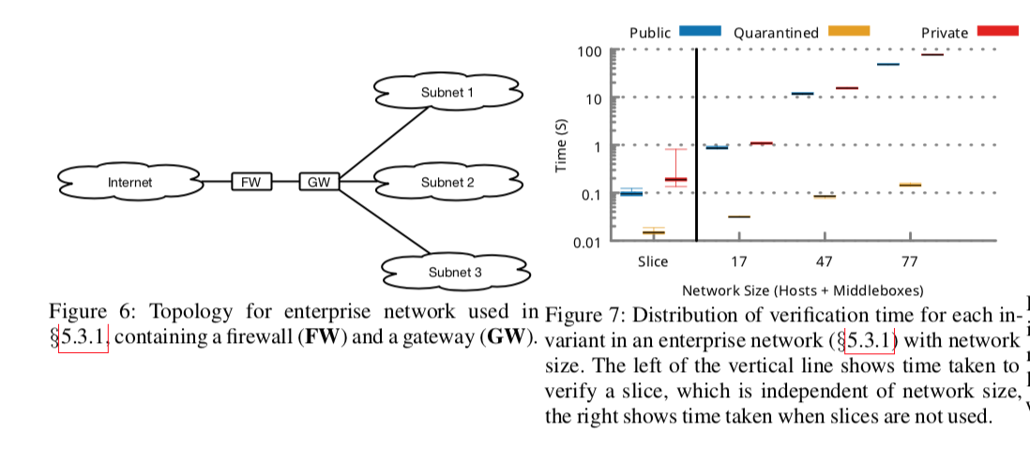
Evaluation: Enterprise with firewall
<number>
Notes:
typical enterprise or university network protected by a stateful firewall
using slices we can verify invariants on a slice whose size is independent of network size and policy complexity. We can also leverage the symmetry in both network and policy to reduce the number of invariants that need to be verified for the network.
<number>

Slide 37
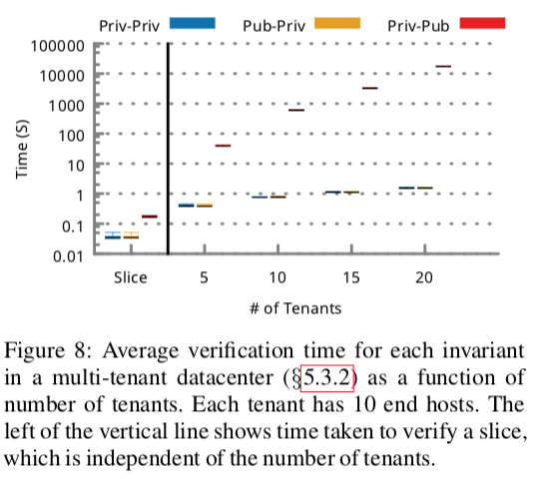
Evaluation: Multi-Tenant Datacenter
datacenter with 600 physical servers (which each run a virtual switch) and 210 physical switches (which implement equal cost multi-path routing)
VMs that belong to the public security group are allowed to accept connections from any VMs.
VMs that belong to the private security group are flow-isolated
<number>
Notes:
firewall configuration is specified in terms of security groups
These rules result in flowparallel middleboxes, so the slice size is fixed
Exponentially growth of time even thought the # of tenant grows linearly
Slice is essential to the performance and scalling
<number>

Slide 38
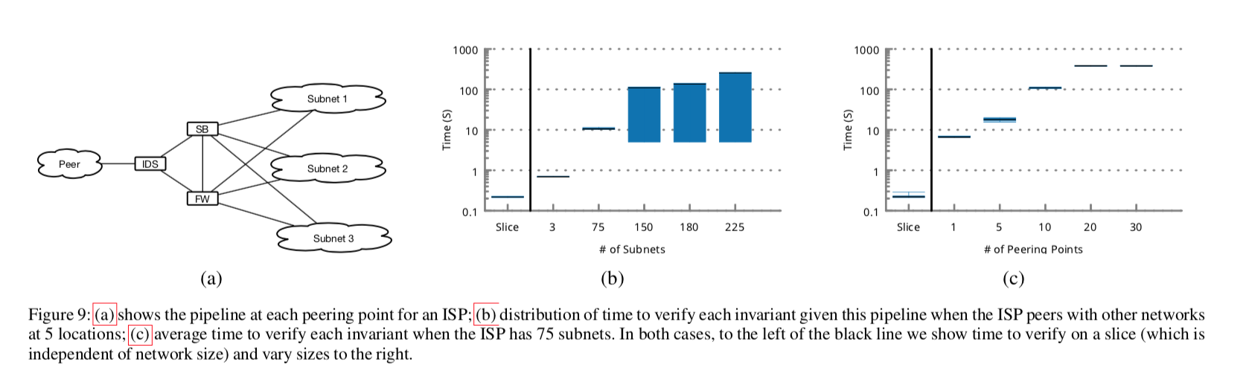
Evaluation: ISP with Intrusion Detection
<number>
Notes:
all inbound traffic must go through at least one stateful firewall. We consider a misconfiguration where traffic rerouted by a given IDS box to the scrubbing box bypasses all stateful firewalls. As a result, any part of this rerouted traffic that is not discarded by the scrubbing box can reach private or quarantined subnets, violating the (simple or flow-) isolation of the corresponding end hosts.
firewalls and IDSes are flow-parallel.
each subnet, we can verify invariants in a slice containing a peering point, a end host from the subnet, the appropriate firewall, IDS and a scrubber.
all subnets belong to one of three policy equivalence classes, and the network is symmetric, only need run verification on three slices.
<number>

Slide 39
Conclusion
Could verify network with mutable datapaths
No disruption to the network – only need to verify the model
Run time is undeterministic – SMT solver uses randomized search algorithm
Cannot check middle box implementations – need to pair with tools that actually tests the network
<number>

Slide 40
Piazza Questions
Guannan Guo

Slide 41
IronFleet
Question 1
Requires significantly more developers’ effort and impacts performance drastically.
Do you want to verify your CS 525 project with this system?

Slide 42
Question 2
Part of IronFleet is based on assumptions and cannot be proven, do you believe in the effectiveness of this tool?

Slide 43
Question 3
Is there any uniform standard to verify the correctness of different distributed application?
Establish invariants: predicates that should hold throughout the execution of the distributed.
protocol
Identifying the right invariants for a given protocol requires a deep understanding of the protocol, but it is a skill one develops with experience

Slide 44
Verifying Reachability in Networks with Mutable Datapaths
Question 1
How do we identify bugs or errors in the middlebox implementation?
VMN Model: Verifying Mutable Networks

Slide 45
Question 2
If middle box can be verified with predefined rules, why can’t developers implement functionality of middlebox by simply using these rules instead of sophisticated algorithms?
Analogy: Satisfactory(SAT) Problem, CSP Problem, or any NP problem
The middlebox configuration that determines which semantic labels are attached to each packet is typically not written by network operators
(Verifying Reachability in Networks with Mutable Datapaths P.701)

Slide 46
Question 3
What if the error lies in middlebox but VMN abstract it away?

Slide 47
How does it handle SDN and ISP network? How do they interact?

