Slide 1
OCCULT
Observable Causal Consistency Using Lossy Timestamps
Presented by: Arvind Kouta

Slide 2
Consistency Models
Strict Consistency: operations are executed in order of wall-clock time (NTP)
Sequential Consistency: operations are executed in some global ordering (Total Ordering)
Causal Consistency: operations are executed in an order that reflects their causality
Eventual Consistency: Allows stale reads but ensures that reads will eventually reflect latest written values
Eventually Consistent Systems tend to scale the best out of these 4 models and is the most popular in industry for that reason

Slide 3
Why Causally Consistent?
Ensures causal dependencies are maintained
Example:
Alice is mad at Bob
Alice deletes Bob as a friend on Facebook
Then she posts something bad about Bob
With Causal Consistency, we can be ensured that Bob never reads the Alice’s message about him

Slide 4
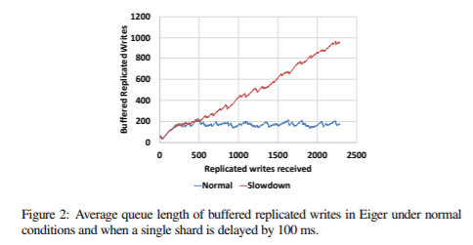
Slowdown Cascade
A slow shard slows down other shards in the system
Huge bottleneck when it comes to implementing most Causally Consistent Systems
From just 1 slow shard, the average buffered writes at a shard increases linearly with writes received
Eiger has a constant amount of replicated writes buffered when there is no slow shard

Slide 5
Slowdown Cascade Example
Datacenter 1
Datacenter 2
Client 1
Write(a)
Write(a)
Shard A
Delayed
Shard A
Read(a)
Write(b)
Shard B
Shard B
Client 4
Client 2
Write(b)
Read(b)
Read(b)
Write(c)
Read(c)
Client 3
Shard C
Shard C
Client 5
Write(c)

Slide 6
OCCULT Overview
Goal of OCCULT
Architecture of OCCULT
Causal Timestamps at the clients rather than at the data store to achieve Causal Consistency and avoid Slowdown Cascade
Causal Timestamp compression techniques
Read-Write Transactions
Experimental Setup
Evaluation

Slide 7
Goal of OCCULT
Implement a Causally Consistent Key-Value store that has performance similar to Eventually Consistent systems used in industry
Solve the Slowdown Cascade problem most Causally Consistent systems run into

Slide 8
OCCULT Architecture
Clients
Local Causal Timestamps
Can Write to Master shards and read from any shard
Master Shard
Slave Shard
Slave Shard
. . . .
Slave Shard
Master Shard
Slave Shard
Master Shard
Slave Shard
Slave Shard
Datacenter 1
Datacenter 2
Datacenter k

Slide 9
Causal Timestamps
Shardstamp: a count of the number of writes accepted at a shard
Causal Timestamp: a vector of Shardstamps
Every client has its own Causal Timestamp
Causal Consistency is maintained at the clients rather than at the data store
Writing Protocol:
Client sends local Causal Timestamp along with message v to master node
Master stores value, increments its Shardstamp, asynchronously sends v to slaves and immediately returns new Causal Timestamp
Client updates local Causal Timestamp
Reading Protocol:
Ask Master/Slave for object’s value, causal timestamp of object, and shardstamp s
If s ≥ s_{local} value is not stale else retry step 1.) r -1 more times
After successful read, client updates causal timestamp

Slide 10
Causal Timestamp Example
Datacenter A
Datacenter B
Client 1
7
a | 8 | 3 | 2
7
8
a | 4 | 3 | 2
W(a)
a | 8 | 3 | 2
4 | 3 | 2
8 | 3 | 2
Delayed!
Master
Slave
Client 3
8 | 5 | 5
R(a)
5
5
0 | 0 | 0
4
4
R(b)
b | 8 | 5 | 5
b | 8 | 5 | 5
b | 8 | 3 | 5
Master
Slave
5
≥
0
Client 2
8 | 5 | 5
6 | 2 | 5
8 | 3 | 5
W(b)
8
8
Slave
Master
Reproduced from Syed Akbar Mehd’s presentation

Slide 11
Causal Timestamp Compression
Structural Compression: map shards to n values and store max shardstamp at each of the n spots
Ex.) n = 3
Temporal Compression: Notice that recent shardstamps are more likely to create incorrect dependencies so keep track of n-1 most recent shardstamps and group all other shards into the last timestamp
Ex.) n = 3
DC-Isolation: System is still causally dependent if distinct causal timestamps are used at each datacenter
12
972
10
12
9
11
12
972
11
12
972
10
12
9
11
Shardstamp
972
12
12
Shard ID
1
0
*

Slide 12
Transactions
Read Phase: Read data from Master(s)/Slave(s), make updates locally
Validation Phase:
for every pair of objects, check whether causal timestamps indicate that data is not stale
Lock all master nodes that need to be written to (or fail after n trials) and get updated shardstamps from each master node
Commit Phase: update causal timestamp and write back updated values to corresponding master nodes and attach the causal timestamp

Slide 13
Experimental Setup
Redis Cluster is baseline
Evaluated on Cloudlab
20 servers (4 processes each), 20 clients. 10 of each in WI datacenter and SC datacenter
10 million records with keys up to 23B and values up to 1KB
Read-Heavy Workload (95% reads) is used
Goal is to see if OCCULT is able to work just as good as Eventually Consistent systems

Slide 14
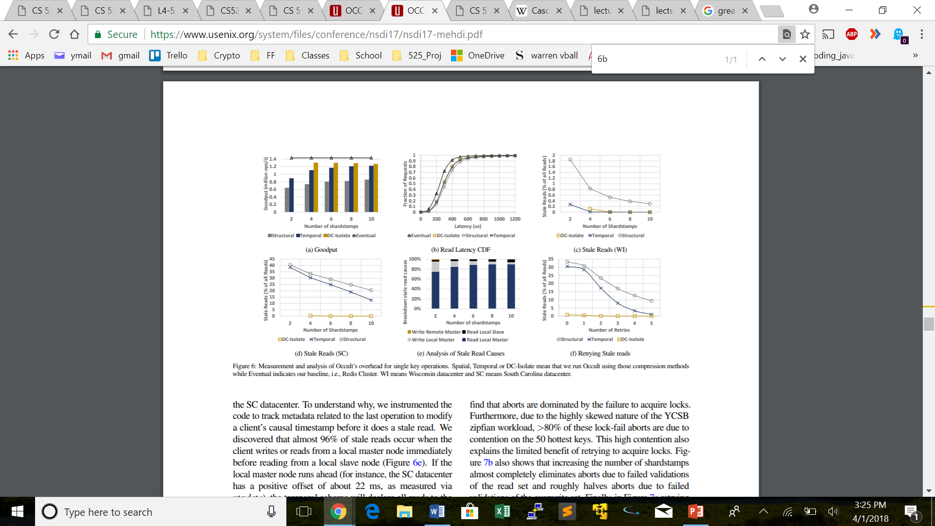
Evaluation – Overall Performance
Goodput: the number of successful operations per second. ie.) if it takes 4 read attempts at a slave node before the read is not stale, that counts as 1 goodput operation
OCCULT has only a 8.7% lower goodput than Redis. This is due to the overhead of sending causal timestamps with every operation
OCCULT had 50 µs higher median latency and 400µs higher tail latency than Redis
DC-Isolation quickly removes the number of stale reads.

Slide 15
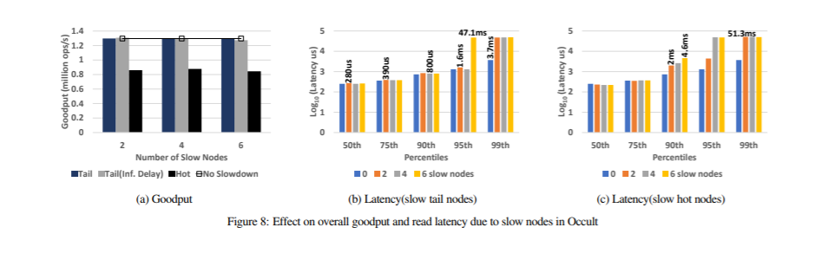
Evaluation – Slowdown Cascade
Slowing down a tail node does not affect Goodput because Master shard is able to absorb the additional load
Master connected to hot node cannot absorb hit since CPU or network is already saturated
Very few operations are slowed down by slow nodes. Hot nodes had a slightly bigger impact on latency but it isn’t horrible

Slide 16
Takeaways
On a read heavy workload, OCCULT only has a 8.7% lower goodput than Redis Cluster but a lot stronger consistency guarantees
OCCULT is for the most part not affected by Slowdown Cascade
It would have been nice to compare OCCULT to other popular Causal Consistency systems
Recall from one of our first lecture, there were a few definitions of distributed systems that defined it to be a collection of computers that appears as one to the client. In OCCULT, clients are aware of replicas and the fact that these replicas can be in an invalid state.

Slide 17
Saturn: a Distributed Metadata Service for Causal Consistency
Presented by Thomas Roush

Slide 18
Motivation
Want to maximize throughput and minimize data staleness
Want to support partial replication for scalability
Causal consistency provides better guarantees than eventual consistency

Slide 19
Overall Idea
Goal: Provide a metadata system that ensures that clients always observe a causal consistent state with minimal overhead
Contributions
Keep metadata size small and consistent to keep latency low in large systems
Support genuine partial replication
Separate the metadata management from the data service
Notes:
Other systems have poor scaling for metadata
-
Easy to implement

Slide 20
Design Overview
Metadata service for existing geo-replicated data services
Stores small pieces of metadata called “labels” about operations
Labels are globally totally ordered and respect causality

Slide 21
Labels
Tuple of <type, src, ts, target> where
type is:
“update” for write requests
“migration” when a client needs to change datacenters
src is a unique ID of the creator of the label
ts is the timestamp as a scalar
target is:
The object be written to for “update”
The datacenter being moved to for “migration”

Slide 22
Labels
The metadata stored in Saturn
Uniquely identify operations
Properties:
Unique – the src-ts combination uniquely identifies operations
Comparable – Comparable by ts with src to break ties

Slide 23
Serializers
Saturn is implemented by a set of cooperating serializing servers
Aggregate and propagate labels from all datacenters
Preserves the order that labels arrive at serializers
Structured as a tree of serializers
Notes:
Tree structure always labels not to be propagated where they aren’t needed

Slide 24
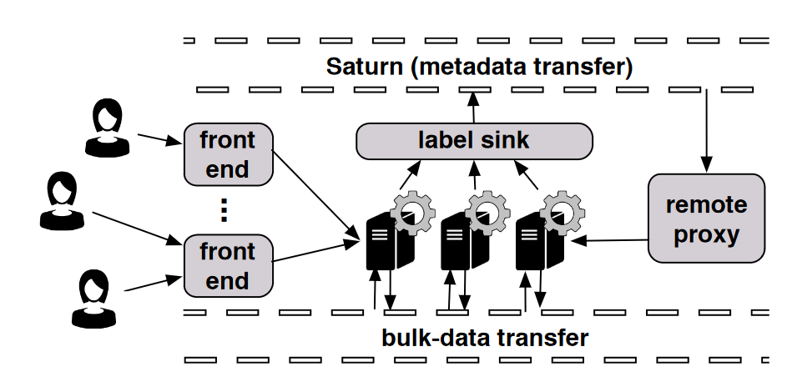
Datacenter Structure: Frontend
Ensure clients observe a causally consistent state
Forward requests to servers and return labels to clients

Slide 25
Datacenter Structure: Gears
Generates labels and propagates data and metadata for updates
Attached to each storage server
Intercepts requests and sends data to datacenters when persistent

Slide 26
Datacenter Structure: Label Sink
Centralized component in a datacenter
Forwards local updates in serial order to Serializers

Slide 27
Datacenter Structure: Remote Proxy
Applies remote operations in casual order using labels from Saturn

Slide 28
Saturn – Update Process
Client attaches to a datacenter – waits until client is causally stable
Client sends a request to frontend, frontend forwards to gear
Gear generates a unique label for the request and sends to Label Sink
Label Sink forwards through the Serializers
Serializers send updates to other datacenters’ Remote Proxies
Remote Proxy adds updates to the local datacenter

Slide 29
Evaluation
Used Amazon EC2 m4.large instances
2 CPU cores, 8 GB RAM running Ubuntu 12.04
Used instances in 7 regions, each simulating a separate datacenter

Slide 30
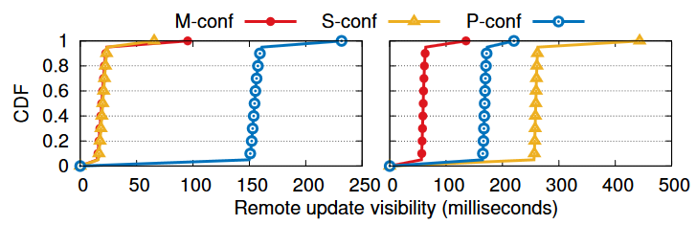
Evaluation
Run with 90% read workload
P has latency of longest network travel time
S has high latency for far datacenters (right)
M has near optimal visibility latency for all locations
Left: Ireland to Frankfurt
Right: Tokyo to Syndey
S-conf – single serializer
M-conf – multiple serializers
P-conf – peer-to-peer

Slide 31
Evaluation
Run with 90% read workload
P has latency of longest network travel time
S has high latency for far datacenters (right)
M has near optimal visibility latency for all locations
P must send message through all datacenters each time
The highest network latency is ~161ms

Slide 32
Evaluation
Run with 90% read workload
P has latency of longest network travel time
S has high latency for far datacenters (right)
M has near optimal visibility latency for all locations
S depends on where the serializer is located
If the serializer is close to the datacenter, latency is low

Slide 33
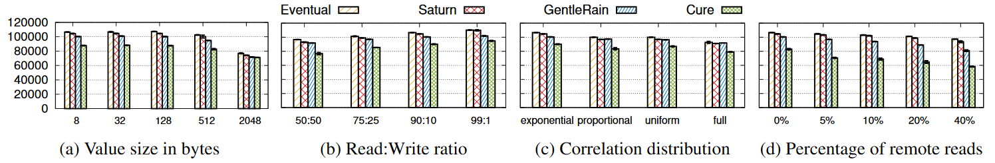
Evaluation
Throughput (op/sec)
Value size – with value larger size, extra overhead in from the other systems is masked
Saturn keeps metadata small, which helps with small value size

Slide 34
Evaluation
Throughput (op/sec)
R/W ratio – Best performance for more reads
All solutions were similarly penalized for more writes

Slide 35
Evaluation
Partial replication
Throughput (op/sec)
Correlation – the amount of data shared between datacenters
Exponential and proportional – correlation depends on distance
Uniform – equal correlation for all datacenters
Full – fully geo-replicated data
Saturn performs better for partial replication

Slide 36
Evaluation
Throughput (op/sec)
Remote read – client must read from a different datacenter
Remote reads – with 40% remote reads, Saturn outperforms GentleRain by 15.7% and Cure by 60.5%

Slide 37
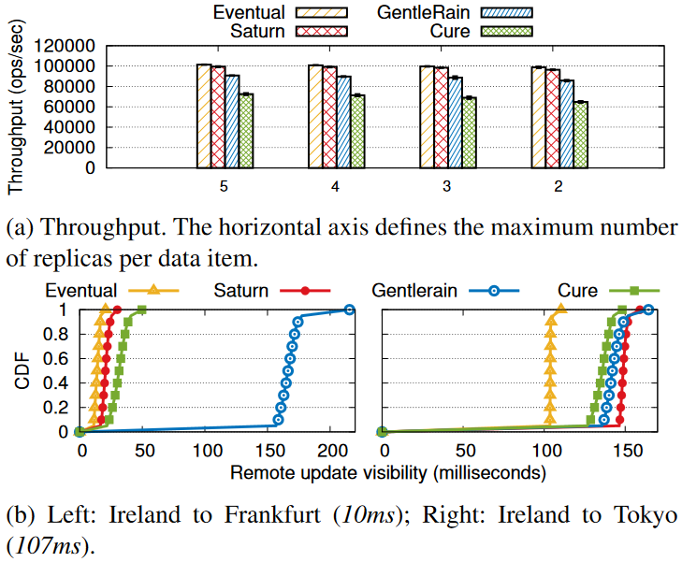
Evaluation
Used Facebook data for New Orleans (61096 nodes and 905565 edges) and simulated user interaction
10.9% better throughput than GentleRain and 41.9% better than Cure on average

Slide 38
Evaluation
Used Facebook data for New Orleans (61096 nodes and 905565 edges) and simulated user interaction
Saturn adds 16.1ms to visibility latency, GentleRain adds 79.2ms and Cure adds 23.7ms on average

Slide 39
Takeaway
Saturn provides causal consistency for full and partial geo-replication
Saturn has a 2% average overhead compared to systems with almost no consistency guarantees

Slide 40
Discussion

Slide 41
OCCULT
Since the metadata is dealt with on the client side. This could allow a malicious client to potentially access data that it should not be able to, by editing its causal timestamps. What are some ideas of ways to prevent this from happening.
Notes:
CheckSum, make the clients another layer of indirection

Slide 42
OCCULT
What do you think the advantages and disadvantages of having the client in charge of maintaining the causal consistency are?
Notes:
Advantage – distributes the work more, directly solves slowdown cascade problem
Disadvantage – sensor data, IOT devices might not enough resources to deal with overhead.

Slide 43
OCCULT
Recall from lecture that there were a few definitions of distributed systems that said a distributed system is a cluster of computers that appear as one to the client, but in the OCCULT system, clients are aware that there are replicas and that data can be invalid.
Do you consider OCCULT a distributed system?
Do you think the definition of distributed systems needs to change?
Notes:
Our class definition was different
OCCULT is still distributed

Slide 44
SATURN
Since SATURN is meant to be easily added to existing eventual consistency structures, do you think the benefits of implementing it outweigh the costs?
If so what type of companies should implement it.
Notes:
Facebook seemed like their main source however, it doesn't’t seem like facebook needs stronger consistency guarantees.
6 out of 1 million reads are not casually consistent

Slide 45
SATURN
Before running each experiment, the physical clocks were synchronized using the NTP protocol, do you think it affects the results in the viability of the system and how do you think SATURN would run in the real world?
Notes:
Since SATRUN relies on physical timestamps it seems like the order could end up messed up

Slide 46
OCCULT vs SATURN
Saturn uses scalar metadata and OCCULT uses vector metadata what do you think the tradeoffs of using each are.
What would happen if Saturn uses vectors and OCCULT uses scalar?
Notes:
Scalar – more false dependencies
Vector – more info but more memory so slower

Slide 47
OCCULT vs SATURN
Which one do you think would be better for industry OCCULT or Saturn?
Notes:
Saturn because putting the burden on the client sounds tough

