Slide 1
Strongly Consistent
Nicholas Chan
Himel Dev

Slide 2
Strong Consistency
Strong consistency ensures that only consistent state can be seen.
All replicas return the same value when queried for the attribute of an object.
This often comes at a cost – high latency.
Reference: Prof. Jean Bacon, University of Cambridge
1

Slide 3
vCorfu: A Cloud-Scale Object Store on a Shared Log
Nicholas Chan

Slide 4
NoSQL
E.g. Cassandra
Favors scalability over consistency
Partitioning makes certain operations difficult (e.g. atomic modifications), need lock server
Writes
Partitions (objects)
Reads
1
2
3
4
6
6
6
5
6
6
Replicas
8
7
8
8
8
8
2
Notes:
0.5

Slide 5
Distributed Shared Logs
E.g. Corfu/Tango
Append-only
SMR (State Machine Replication) to enable strong consistency/global snapshots
Clients must read sequentially, increasing latency
Writes
Partitions (update)
Reads
Mod 1
SMR
1
1
1
1
1
2
3
3
3
2
5
5
5
3
3
7
7
7
4
4
5
Mod 0
5
6
2
2
2
6
4
4
4
7
6
6
6
7
8
8
8
8
8
6
8
3
Notes:
1

Slide 6
Problem Statement
Cassandra: Scalable but not consistent
Distributed Shared Logs: Scalable and consistent, but not efficient
What if we want all three properties in a system?
4

Slide 7
vCorfu
Composable SMR
Virtualized shared log
Materialization – divide log into multiple virtualized logs to support random reads
Writes
Partitions (update)
Partitions (stream)
Reads
1
1
1
1
1
2
3
3
3
3
5
5
4
4
3
7
7
6
6
4
Materialization
5
6
2
2
2
2
4
4
5
5
7
6
6
7
7
6
8
8
8
8
8
8
5
Notes:
1.5

Slide 8
vCorfu Sequencer/Layout
I/O limited by append server
Sequencer issues tokens (addresses) conditionally for log and streams without direct I/O
Layout service maps from log/stream addresses to replicas
Updates written to both log replicas and stream replicas
Allows elasticity, scalability, fault-tolerance
Sequencer
Layout
Request
Token
12.34.56.78
Ok
Ok
Write
Commit
Write
Commit
Global Log
Recovery
Stream Replica
Stream Replica
Stream Replica
6
Notes:
2

Slide 9
Atomic Append
One log token, multiple stream tokens
Write to log, then to each stream replica
Commit sent to each replica
Write represented by one log entry but multiple stream tokens
Abort if any write fails (conditional tokens)
1a. Request tokens
Sequencer
1b. Global token, 3 stream tokens
2a. Write 6a. Commit
Global Log
2b. Ok 6b. Ok
2-5a. Write
7-9a. Commit
Stream Replica
2-5b. Ok
Stream Replica
7-9b. Ok
Stream Replica
7
Notes:
1

Slide 10
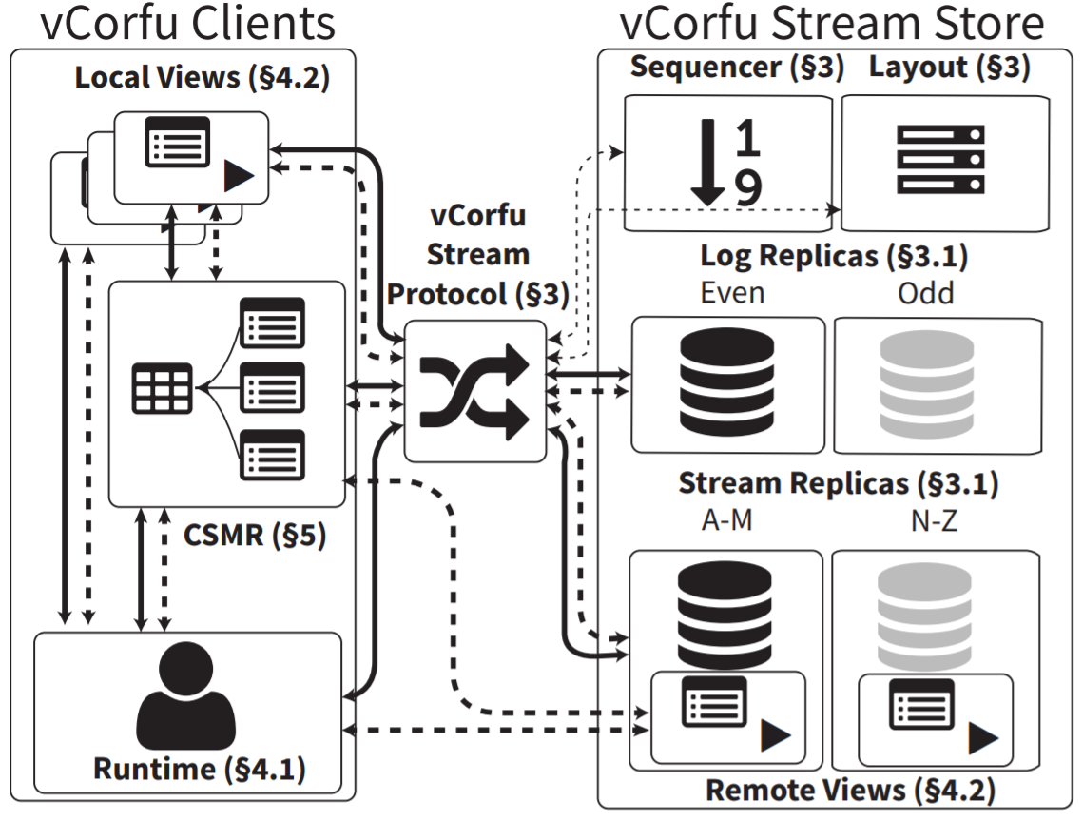
Global Log/Materialized Stream benefits
Global log is scalable, consistent, durable, history
Allows snapshots, long reads, backups, fault tolerance
Materialized streams are truly virtual
Allow random and bulk reads, direct service, simplified garbage collection
8
Notes:
1

Slide 11
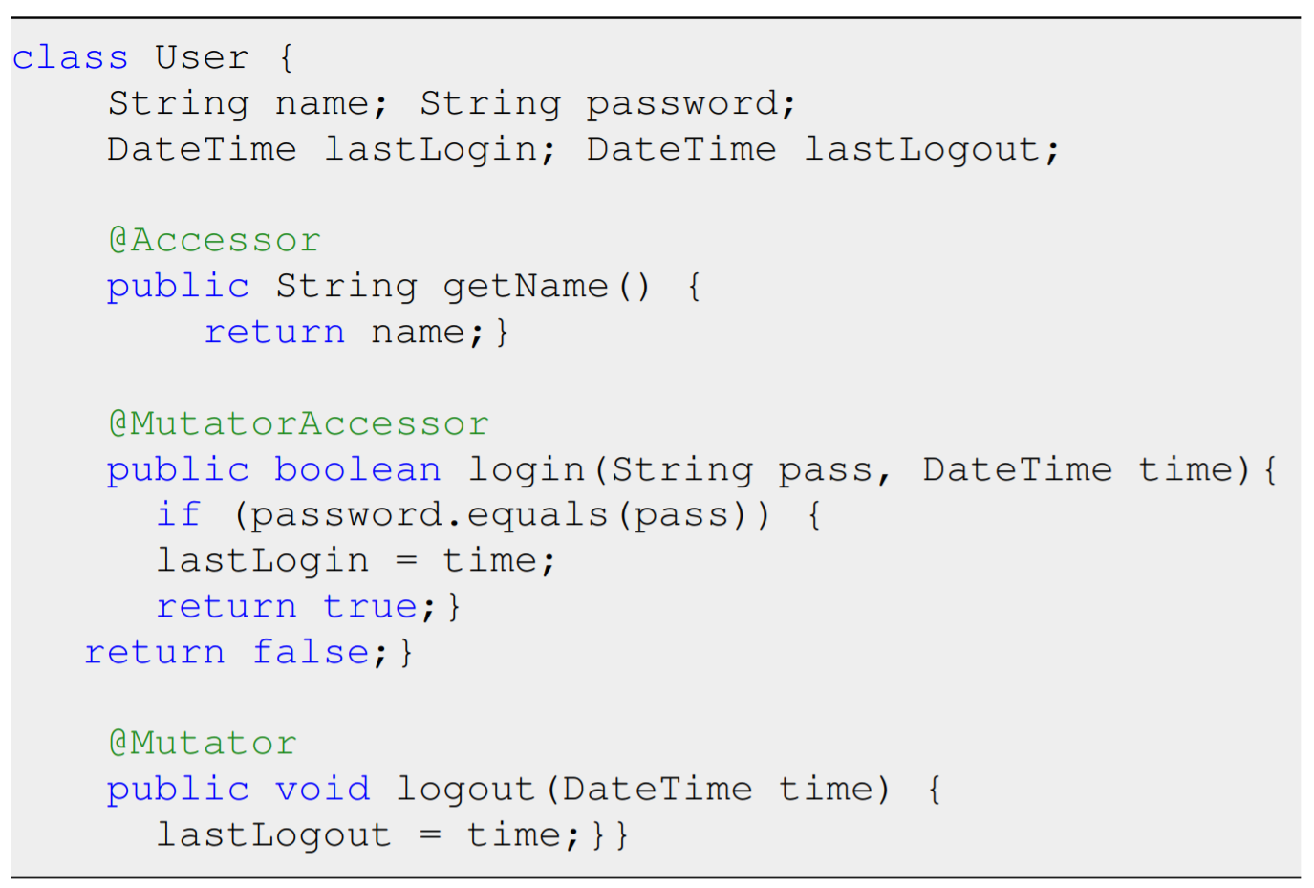
vCorfu Architecture
Runs on Java
Allows storage of arbitrary Java objects
Opacity – Transactions never observe inconsistent state
Read-own-writes – ensures replica is current enough for transaction
9
Notes:
1.5

Slide 12
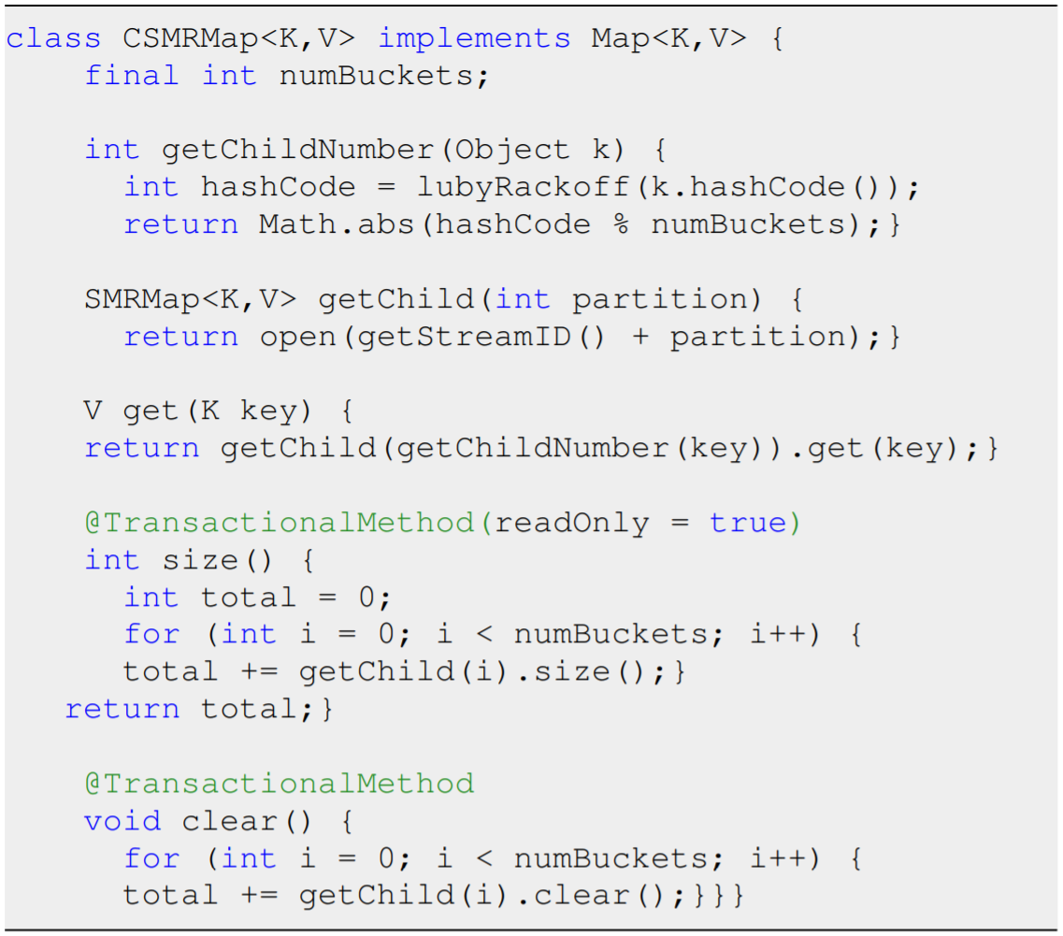
Composable SMR
Nested objects are advantageous – distributes state among streams, increases concurrency, resembles standard data structures
Some changes to child objects result in atomic modifications
10
Notes:
1.5

Slide 13
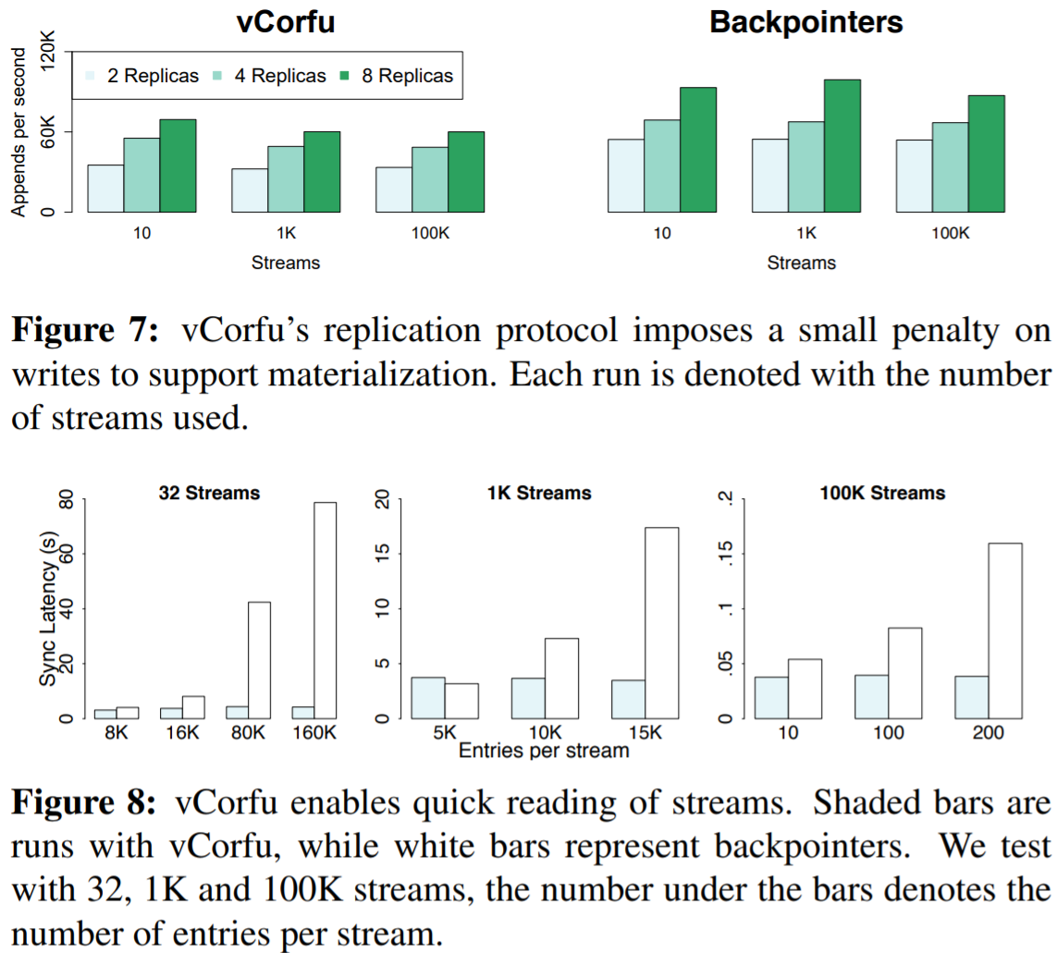
Backpointers
Traditional logs use backpointers to implement SMRs
Backpointers introduce large overhead due to sequential traversal
Materialization requires extra commit message
11
Notes:
1

Slide 14
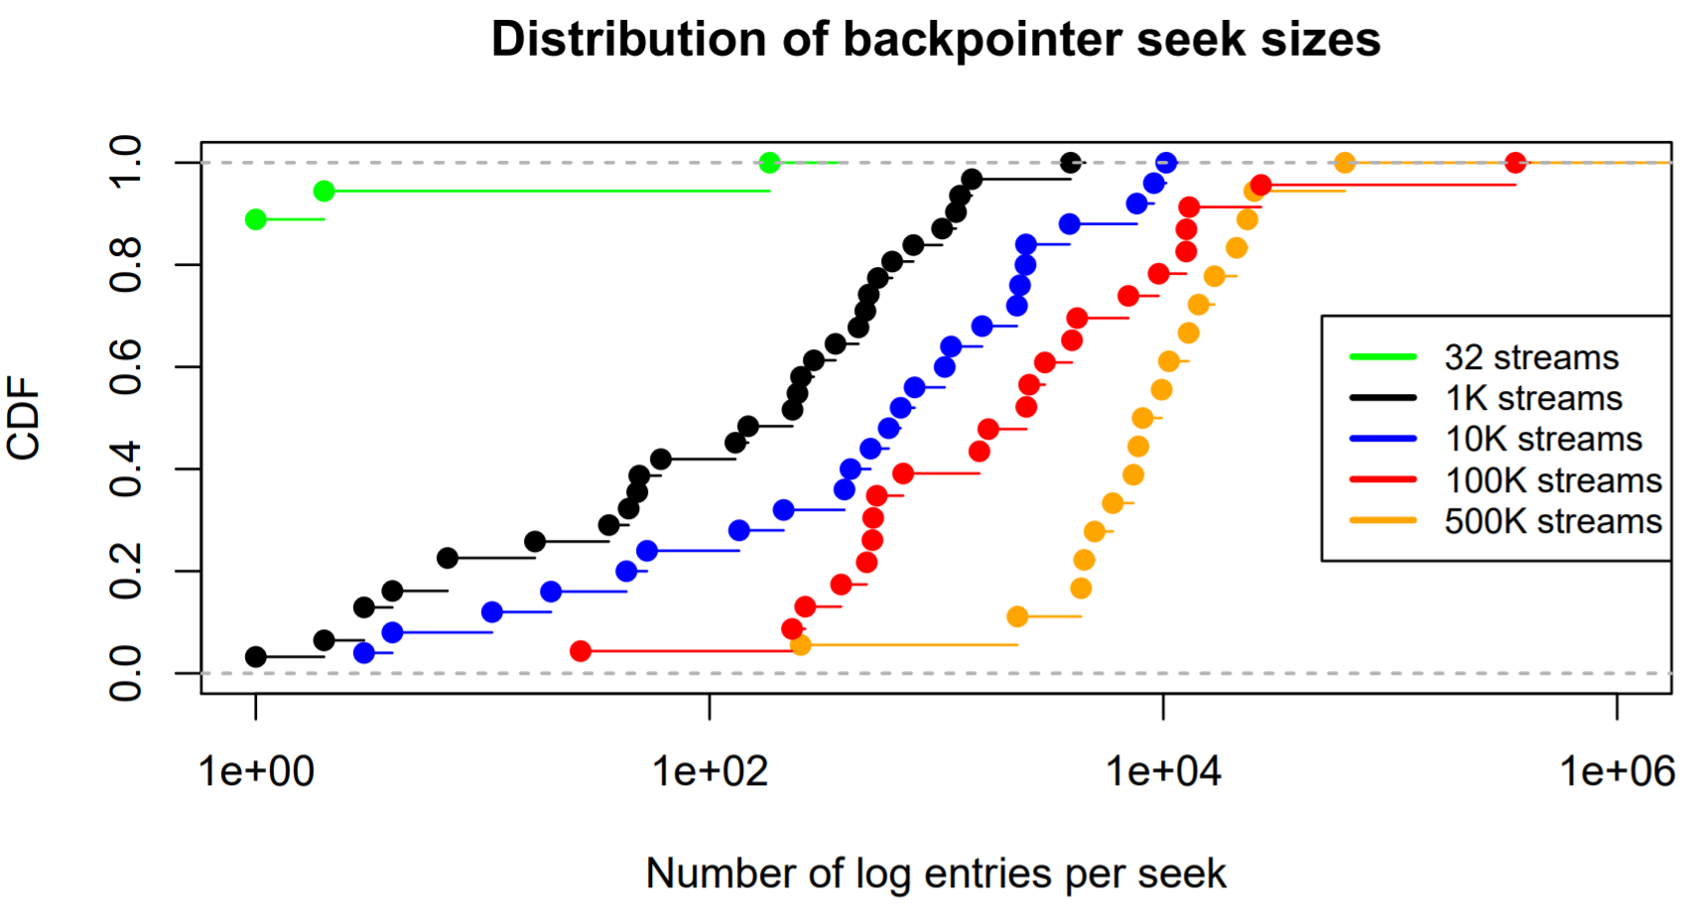
Hole-Filling
May occur as result of concurrent write and timeout
Backpointers have poor hole performance
Must sequentially scan for new backpointer for filled hole
In vCorfu, streams manage hole filling
12
Notes:
1

Slide 15
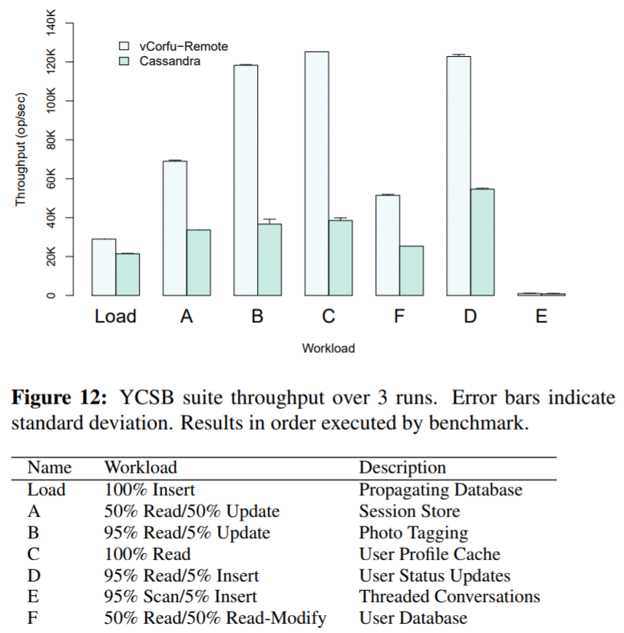
vCorfu vs. Cassandra
Yahoo cloud serving benchmark (key-value) using Cassandra vs. vCorfu CSMR key-value store
Similar write values – both write to two replicas
Improved reads – multiple replicas vs. log replica
13
Notes:
1

Slide 16
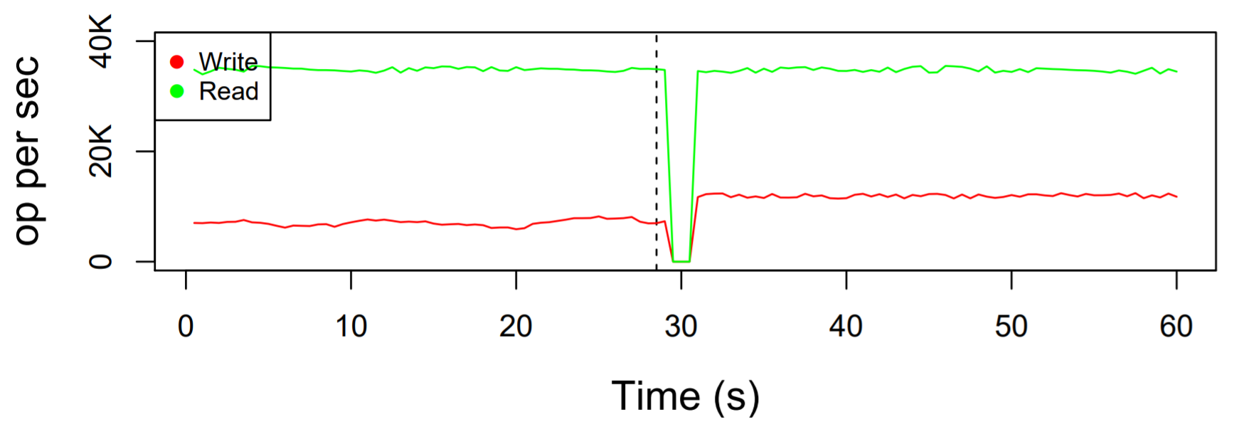
Stream Replica Failure
Single stream replica failed
Carryover to log replica for no read degradation and minimal write degradation
14
Notes:
0.5

Slide 17
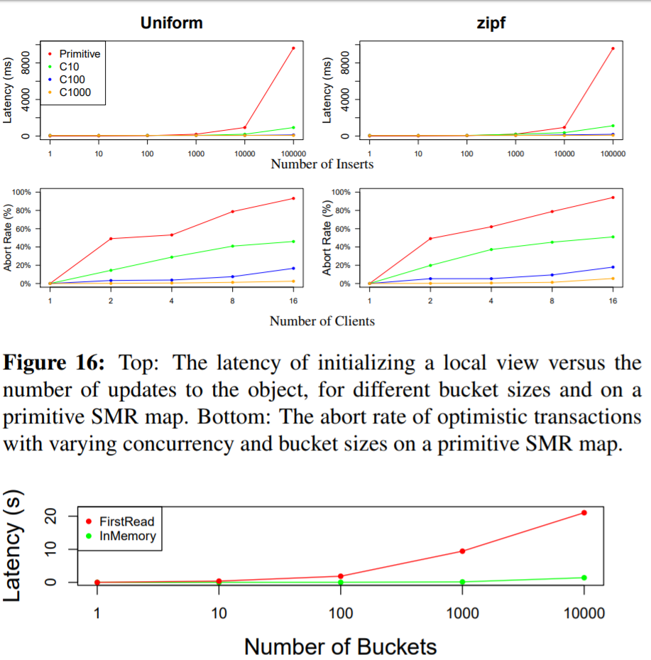
CSMR Performance
Number of updates are reduced, increasing speed nearly 150x
Reduces contention/false conflicts reducing abort rate 25x
Remote views allow CSMR to stay efficient with objects distributed across replicas
15
Notes:
1

Slide 18
Criticisms
Stream replicas referred to as virtual – but they are actual, physical replicas. Feasibility of indirection from log replicas?
Multiple writes and commits suggests higher probability of failure
Sequencer still single point of failure
16
Notes:
1.5

Slide 19
Closing Thoughts
vCorfu’s advantages over Cassandra, distributed logs almost magical
At its core, simply delegates SMRs to servers rather than clients
17
Notes:
0.5

Slide 20
ALOHA-KV: High Performance Read-only and Write-only
Distributed Transactions
Himel Dev

Slide 21
Motivation
Concurrent serializable transactions under read-write or write-write conflicts require costly synchronization
Conflicting writes need not block each other, or violate serializability if read-write conflicts are not present at the same time
18

Slide 22
State-of-the-Art
Process reads and writes in batches for efficiency, but requires atomicity for each batch.
  — Two writes within one batch must both succeed or both fail.
Read-only or write-only transactions in distributed storage systems inherit the costly aspects of conventional transactions.
  — They require concurrency control for transaction isolation since both read-write and write-write conflicts remain possible.
  — They rely on distributed commitment protocols to ensure atomicity in the presence of failures.
19

Slide 23
System Model
In Memory Database
Horizontal Partitioning
Read-Only and Write-Only Transactions
Multi-versioning
  Each write operation creates a new version of a data item.
Unique Timestamp
  To generate a unique timestamp, a server combines its unique server ID and the time from its local clock.
Serializable Isolation
  Committed transactions are serialized according to their timestamps.
20

Slide 24

System Architecture
EM
The epoch manager (EM) communicates with all FEs to control epoch changes, and thus determines when the FEs are able to start executing a given transaction.
FE 1
FE 2
FE 3
A server frontend (FE) accepts transaction requests from clients, and acts as a transaction coordinator.
BE 1
BE 2
A server backend (BE) stores the data items in one partition of the database, and serves requests from FEs to read and write these items.
21

Slide 25
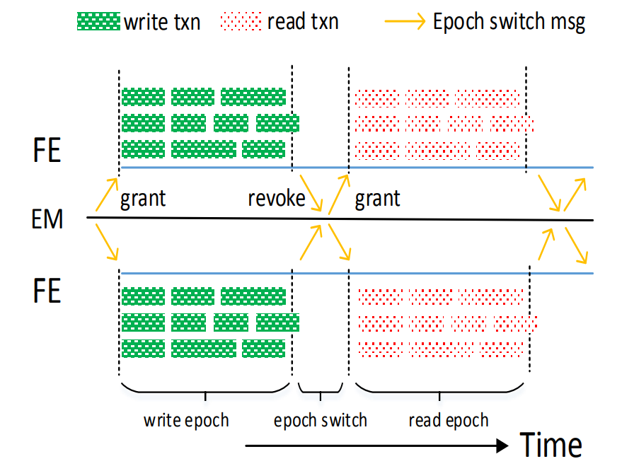
Epoch Based Concurrency Control (ECC)
ECC schedules read-only and write-only transactions into disjoint time slots.
  This eliminates read-write conflicts.
ECC uses multiversioning to resolve write-write conflicts.
  This allows write-only transactions to proceed in parallel even when their write sets overlap.
ECC cannot have “reads-from” dependencies among transactions executing within the same epoch.
  This enables one-phase commitment for write-only transactions.
Figure: Epochs in ECC
22

Slide 26
Data Representation in Storage
A
v₁ 5
v₂ 6
v₃ 5
A
v₁ 5
v₂ 6
v₃ 5
A
C
v₃ 9
v₄ 8
C
v₃ 9
v₄ 8
B
Write(B, 9)
Retrieve(C)
8
C
D
B
v₁ 2
v₂ 7
B
v₁ 2
v₂ 7
v₃ 9
D
v₁ 1
v₃ 3
v₄ 3
D
v₁ 1
v₃ 3
v₄ 3
23

Slide 27
Transaction Protocol for FE
PutAll(Set of key, value pairs)
Generate a new timestamp.
Generate a set of data versions using the timestamp.
Distribute these versions to different partitions (in batch) via Put calls to BE.
If one or more Put calls fail, then invoke Abort on each involved partition.
GetAllLatest(Set of Keys)
Generate a new timestamp.
Retrieve the latest data versions for the given keys via Get calls to BE with the timestamp value.
24

Slide 28
Fault Tolerance
BE Replication
  During write epochs, the FE writes primary BEs as well as backup BEs.
Fast Epoch Switch at FE/EM Failure
  If the primary FE fails during a write epoch, the backup FE is charged with completing all pending transactions and reporting back to the EM.
  When the primary EM fails, the backup first polls the FEs to determine how many of them have not yet acknowledged authorization revocation for the most recent epoch.
Logging and Checkpointing
  The BEs log all the requests they receive from FEs during write epochs.
  To avoid a performance bottleneck, there is an asynchronous form of logging.
25

Slide 29
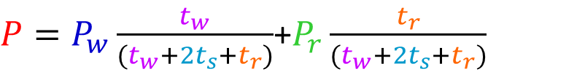
System Throughput
P = overall throughput in the unit
P_{w} = throughput of writes in write epoch
P_{r} = throughput of reads in read epoch
t_{w} = duration of a write epoch
t_{s} = epoch switch time
t_{r} = duration of a read epoch
$P=P_{w}\frac{t_{w}}{(t_{w}+2t_{s}+t_{r})}$+$P_{r}\frac{t_{r}}{(t_{w}+2t_{s}+t_{r})}$
Figure: Epochs in ECC
26

Slide 30
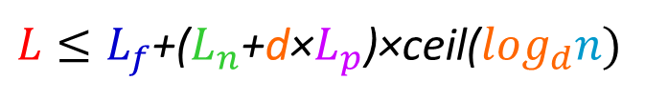
Epoch Switch Scalability under Hierarchy
L = latency of transaction barrier
L_{f} = time for slowest FE to finish pending transactions
L_{n} = round trip network latency between hosts
d = degree of the tree
L_{p} = time for processing a message from one host
n = number of FEs
$L≤L_{f}$+($L_{n}$+d×$L_{p}$)×ceil($\log_{d}n)$
27

Slide 31
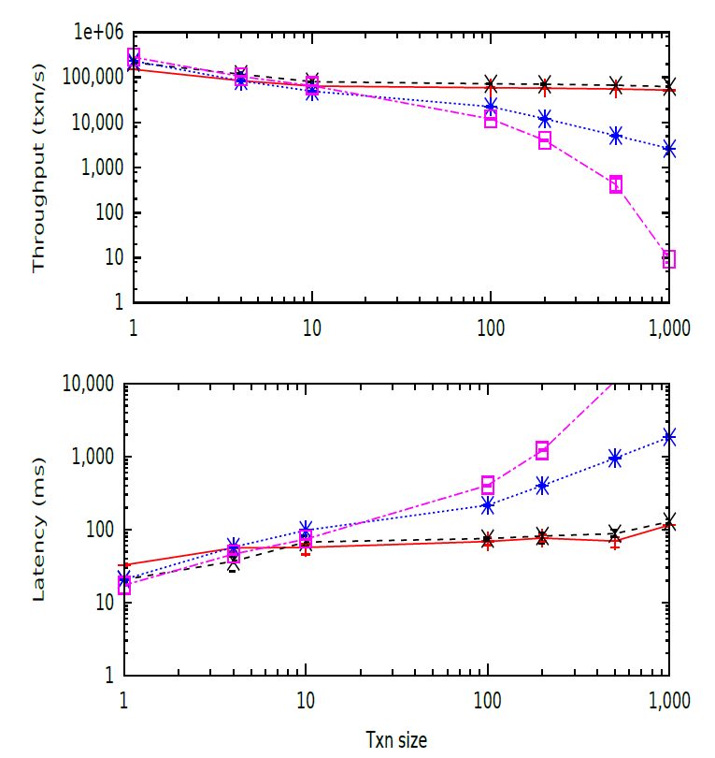
ALOHA-KV vs RAMP
The performance gaps between ALOHA-KV and RAMP grow as transaction size increases.
For transaction size 1000, the system achieves throughput roughly 20× greater than RAMP-S, and over three orders of magnitude greater than RAMP-F.
For smaller transaction sizes, RAMP outperforms ALOHA-KV slightly, because the metadata overhead in RAMP is small and because ALOHA-KV incurs an overhead for epoch switching.
28

Slide 32
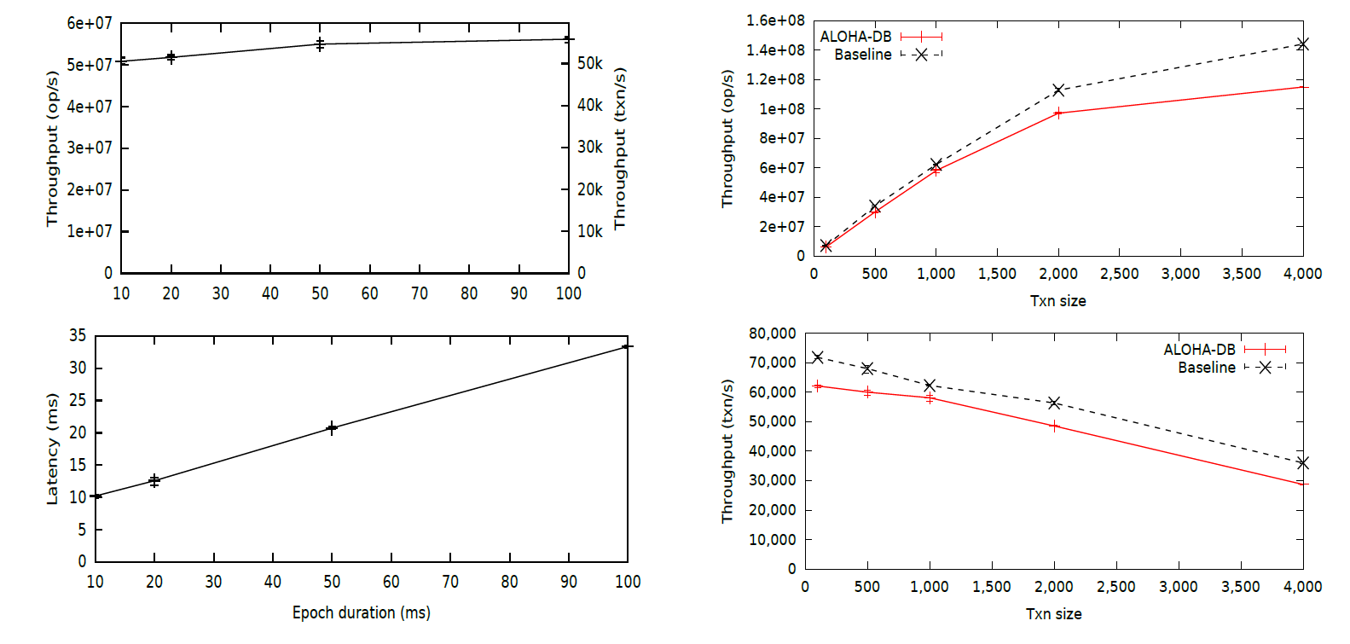
Effect of Epoch Duration and Transaction Size
29

Slide 33
Pros
Wisdom of the crowd
  Strong consistency
  High throughput
  A transaction can be committed within one round trip
  Fault tolerance
  High availability
  Scalability
30

Slide 34
Cons
Wisdom of the crowd
  Single point of bottleneck
  Clock synchronization requires low-latency network
  Unknown read/write mixture can affect system performance
Data resides in memory
Outsourced fault tolerance
31

Slide 35
Discussion
Nicholas Chan
Himel Dev

Slide 36
Discussion vCorfu
For vCorfu, is it possible to use a sequencer cluster?
What are the consequences of byzantine performance on layout manager/anywhere else?
Double the space is required for vCorfu as for distributed shared logs would making streams out of pointers to log entries be an appropriate solution?
Is the experimental data sufficient, especially for comparisons to other distributed systems? Are there more recent distributed systems to rival vCorfu or ALOHA-KV?
32

Slide 37
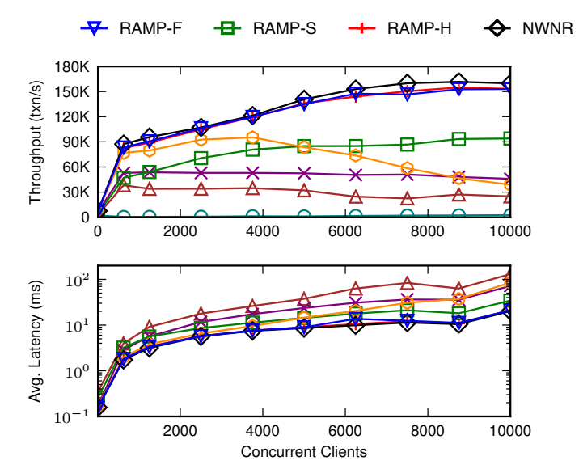
Discussion ALOHA-KV
Is ALOHA-KV scalable?
  Case and point: Visa Inc.
Switching time as overhead
Does ALOHA-KV outperform RAMP?
  Five client hosts and five server hosts
  No comparison with RAMP-H
33

Slide 38
Building Bridges between vCorfu and ALOHA-KV
Nicholas Chan
Himel Dev

Slide 39
Similarities between vCorfu and KV-ALOHA
Both systems respect strong consistency.
There is a single point of downtime in both systems: sequencer and epoch manager.
Both systems support historical queries efficiently.
34

Slide 40
Dissimilarities between vCorfu and ALOHA-KV
vCorfu is database agnostic, whereas ALOHA-KV is based on in-memory database.
ALOHA-KV requires synchronization among severs, vCorfu does not have such requirement.
vCorfu focuses on storing (java) objects, whereas ALOHA-KV focuses on transactions.
35

Slide 41
Combining vCorfu and ALOHA-KV
Can we reuse the idea of epochs in vCorfu?
Can we reuse the idea of stream replicas and distributed shared logs in KV-ALOHA?
36

