Slide 1
RDMA and Clouds
Saurabh Jha, Shivam Bharuka and Bhopesh Bassi

Slide 2
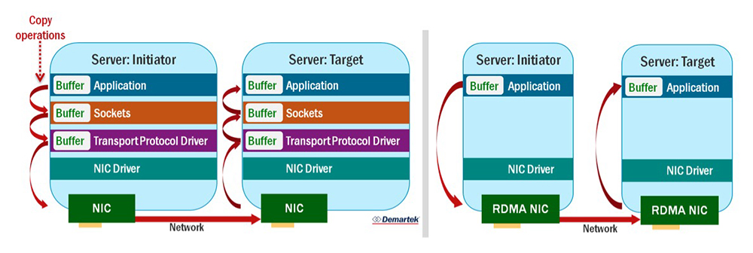
What is RDMA?
Remote Direct Memory Access to move buffers between two applications across a network
Direct memory access from the memory of one computer into that of another - bypass the operating system
Zero-copy networking
NIC can transfer data directly to or from application memory.
Need to copy data between application memory and data buffers in the OS
Standard Network Connection
RDMA Connection
Notes:
No need to use processor, cache or operating system.

Slide 3
APUS: Fast and Scalable Paxos on RDMA
Wang et. al.
The University of Hong Kong
Presented By Saurabh Jha
March 12, 2018

Slide 4
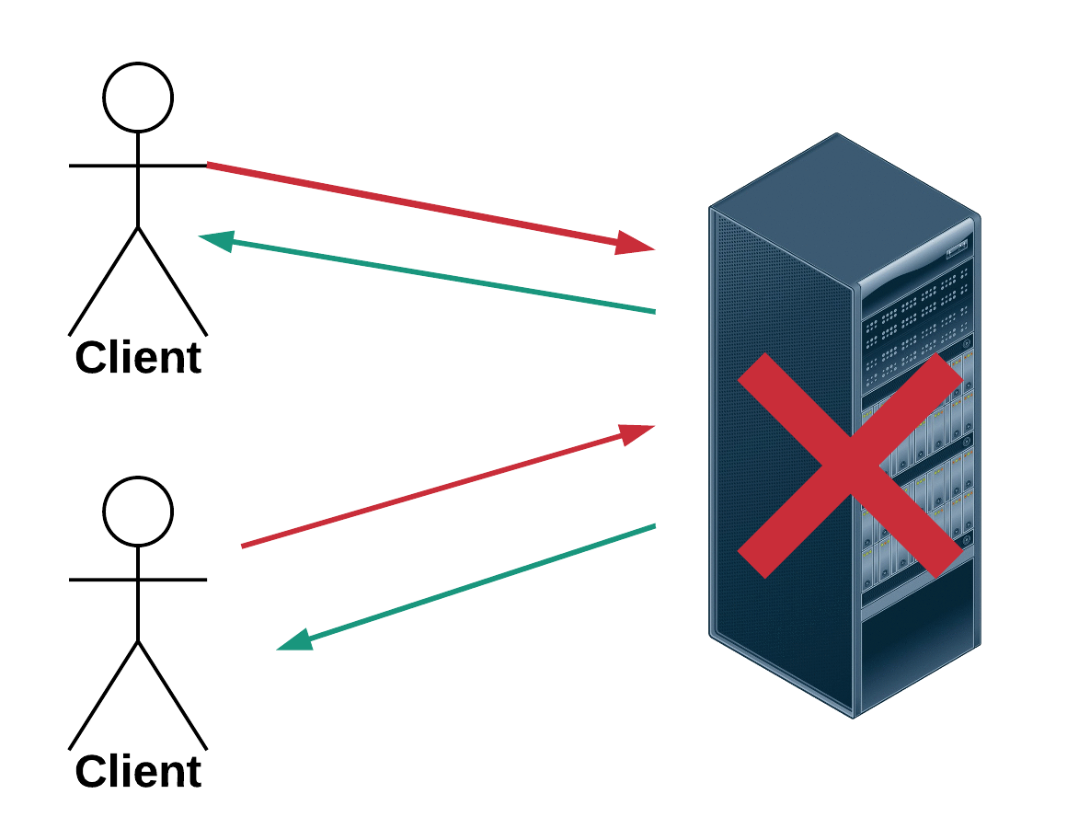
101: Introduction to State Machine Replication
Clients
Server

Slide 5
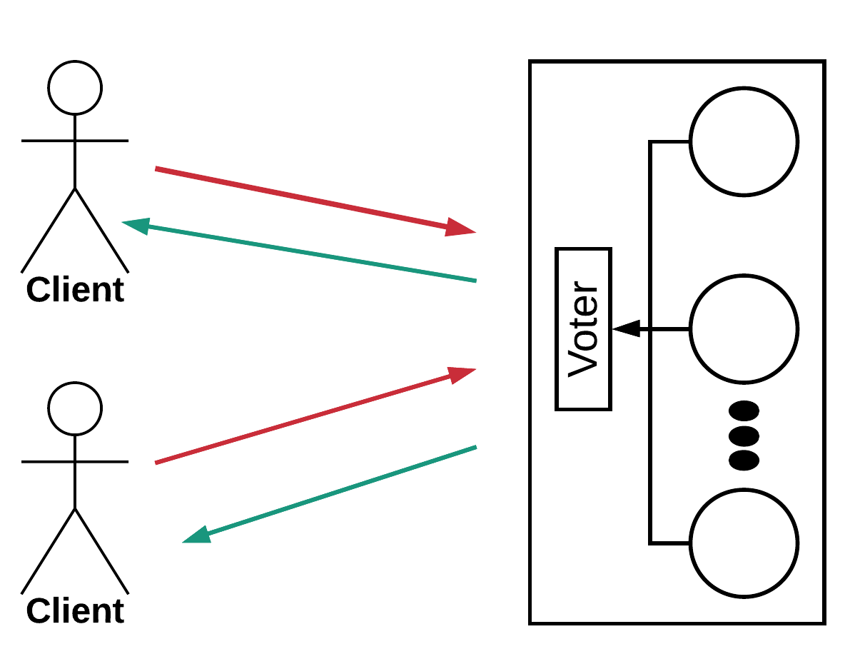
101: Introduction to State Machine Replication
Make server deterministic
Replicate server
Ensure correct replicas step through the same sequence of state transitions
Need to agree on the sequences of commands to execute
Standard approach is to use multiple instances of Paxos for single value consensus
Vote on replica outputs for fault tolerance
E.g., Zookeeper, Chubby
High-availability services
Data Replication
Resource discovery
Synchronization

Slide 6
Challenges of State Machine Replication
Slow, multi-paxos can be bottleneck for performance and availability
Does not scale well with number of servers or number of client requests, E.g. Zookeeper
Consensus latency of increases by 2.6X when the clients increases from 1 to 20 (on 3 replicas)
Consensus latency increases by 1.6X when the number of replicas increases from 3 to 9
Achieving low-latency, high-throughput
Why?
Traditional Paxos protocols go through software network layers in OS kernels which incurs high consensus latency
To agree on an input, at least one round-trip time (RTT) is required between the leader and a backup.
Given that a ping RTT in LAN typically takes hundreds of μs, and that the request processing time of key-value store servers (e.g., Redis) is at most hundreds of μs, Paxos incurs high overhead in the response time of server programs.

Slide 7
Achieving Scalability and High-Throughput in SMR
Hardware accelerated consensus protocol
Unsuitable due to limitation of memory
Hard to deploy and program
E.g., DARE: consensus latency increases with #connections
Leverage the synchronous network ordering
safely skip consensus if packets arrive at replicas in the same order
Unsuitable: requires rewriting application logic for checking the order of packets
Abstraction needed that can work as plug and play library
Proposed Solution APUS: Use RDMA supported networks
Intercepts socket calls
Assigns a total order to invoke consensus
Bypasses OS kernel using RDMA semantics
A one-sided RDMA write can directly write from one replica’s memory to a remote replica’s memory without involving the remote OS kernel or CPU

Slide 8
APUS Architecture
APUS leader handles client requests and runs its RDMA-based protocol to enforce the same total order for all requests across replicas
Key components
Input Coordinator
Consensus log
Guard
Leverages CRIU to checkpoint
Closes all RDMA connection
Output checker
Similar to voter
Invokes every 1500 MTU

Slide 9
APUS Consensus Protocol
Implementation Challenges
Missing log entries (e.g., packet loss):
Backup invokes a learning request to the leader asking for the missing entries
Atomicity on the Leader RDMA WRITES
Leader adds a canary value after the data array
Synchronization-free approach
Leader Election
Backup runs leader election using consensus log and QP

Slide 10
APUS Changes Over PMP
Replicas us faster and more scalable one-sided RDMA WRITE
To replicate log entries and leader elections
To prevent outdated leaders from corrupting log entries,
Backups conservatively close the QP with the outdated leader (i.e., failed leader)
Detection: backups miss heartbeats from the leader for 3*T

Slide 11
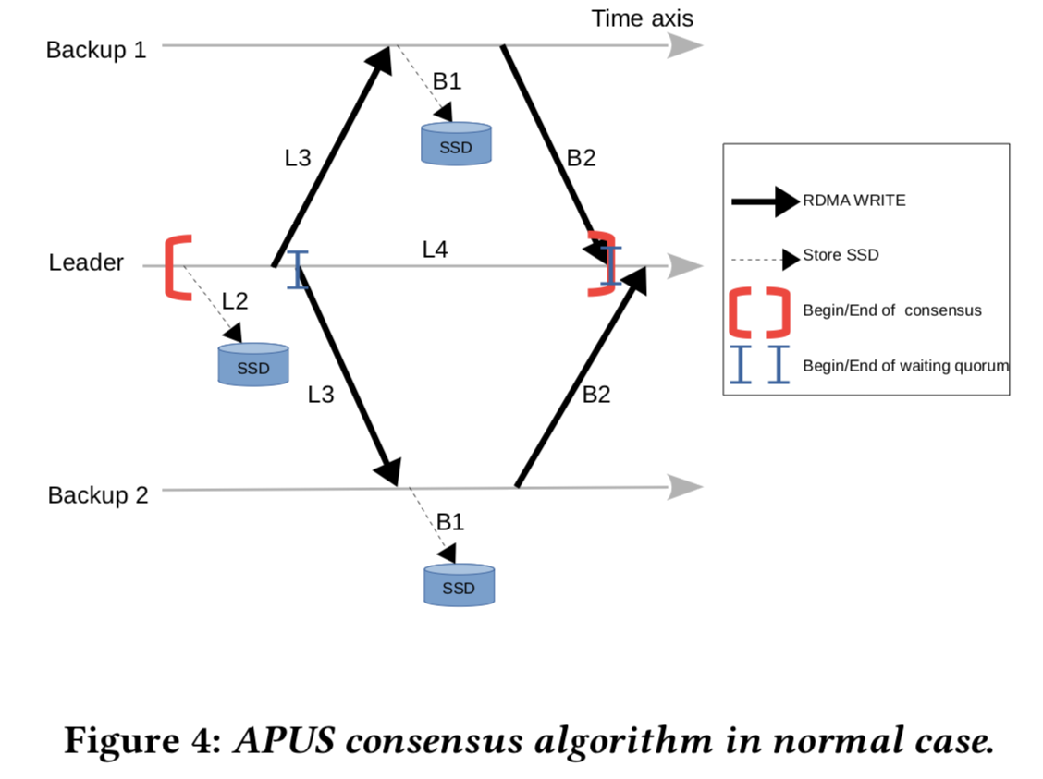
Analytical Performance Analysis
N client connection
N requests (1 request per connection)
Consensus latency given by

Slide 12
Benchmarks & Evaluation
2.6 GHz Intel Xeon CPU
64 GB RAM
1 TB SSD
Mellanox ConnectX-3 (40Gbps)
RoCE

Slide 13
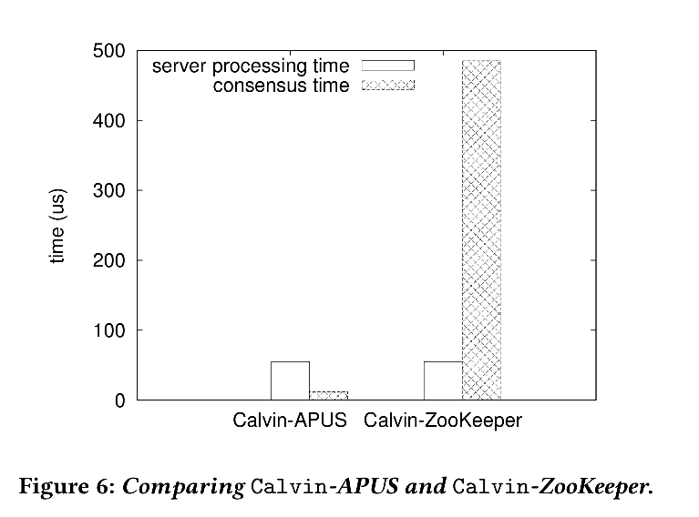
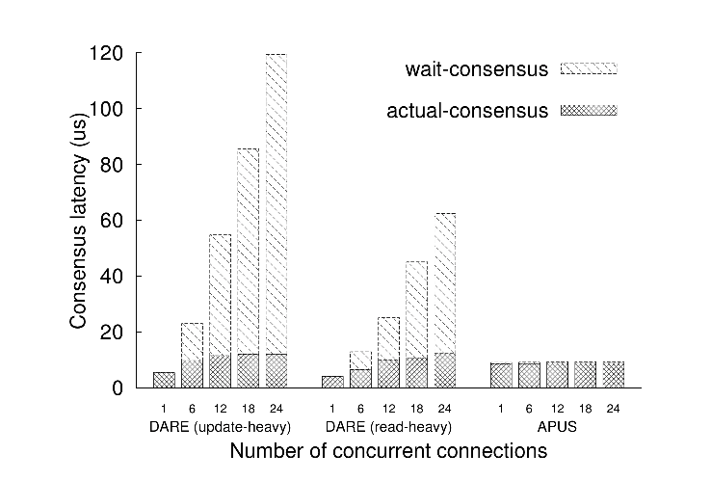
Results
Wait consensus – Time an input request spent on waiting consensus to start
Actual Consensus – Time spent on running consensus
45.7X faster
7.6X more time spent in consensus
APUS is one round protocol whereas DARE is two round protocol
DARE maintains a global variable for backups and thus serializes the consensus requests
Integrating APUS into Calvin required 39 loc
4.1% overhead over Calvin’s non-replicated execution

Slide 14
Throughput Comparison
Small overhead over non-replicated version
@@RDMA rocks @@

Slide 15
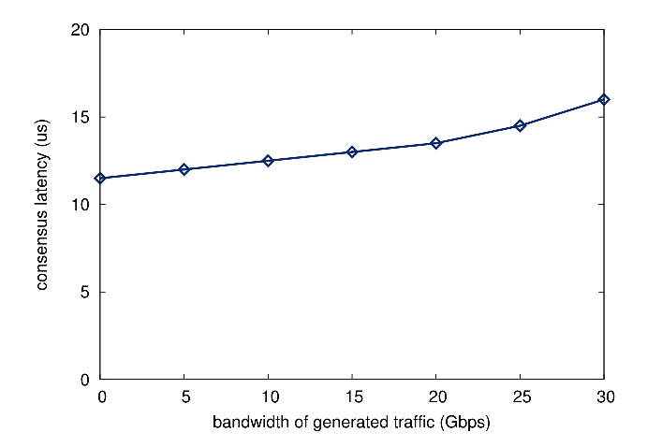
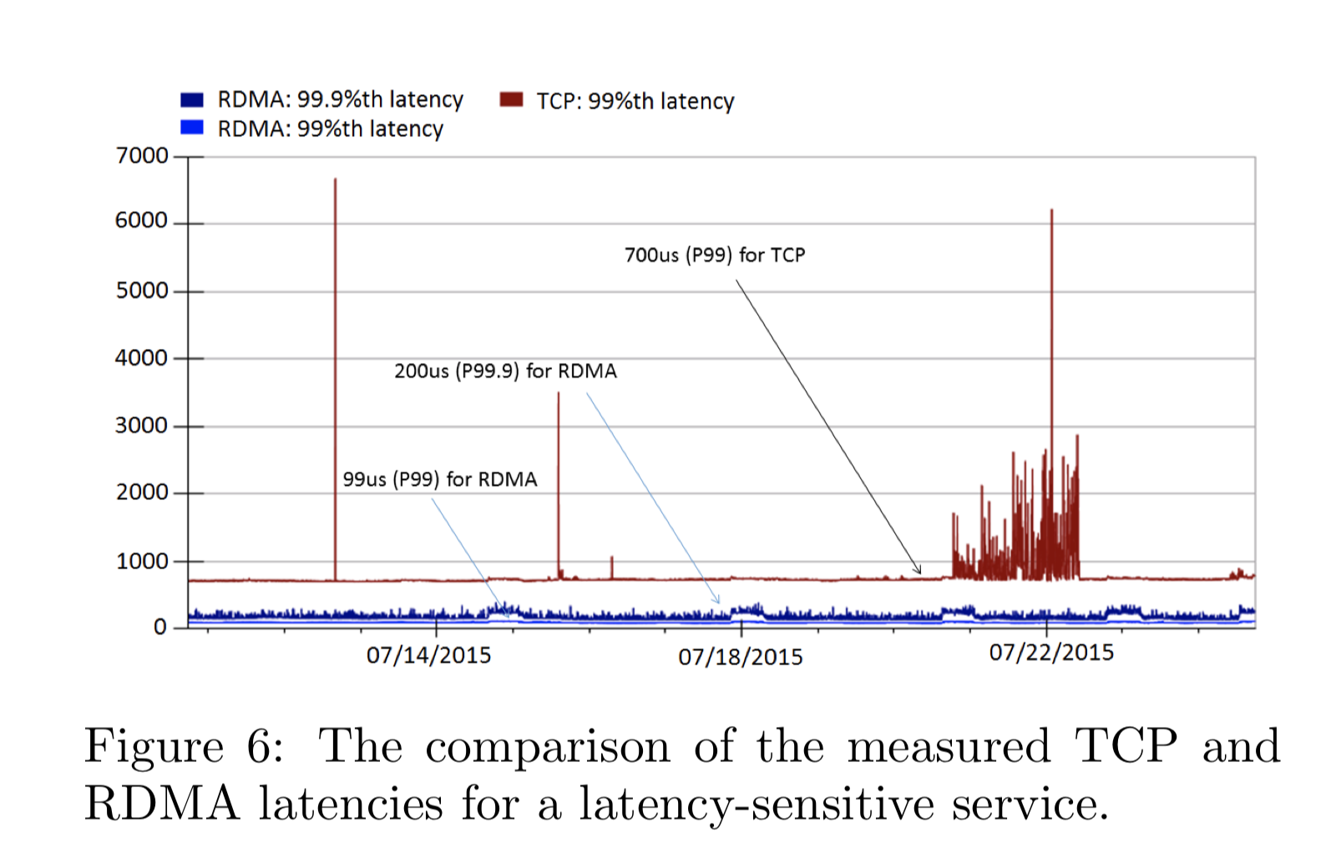
Thoughts
What about congestion
How do you evaluate congestion
RDMA issues
Prone to deadlocks
What happens during checkpointing and leader election
Manifest as failures
Is it really plug and play
RoCE2 Vs Infiniband
Other Issues
C. Guo et. Al. “RDMA over Commodity Ethernet at Scale”

Slide 16
Efficient Memory Disaggregation with Infiniswap
Juncheng Gu, Youngmoon Lee, Yiwen Zhang, Mosharaf Chowdhury, and Kang G. Shin, University of Michigan
Presenter: Shivam Bharuka

Slide 17
101: Paging
VMM
Page is on backing store.
Operating System exposes larger address space than physically possible
Paging-In: When applications addresses a page which is not present in memory then VMM (Virtual Memory Manager) brings that page back into the memory
Paging-Out: VMM may need to page out pages to make space for the new page during page-in
It uses a block device known as the swap space located on disk
Swap Space
Bring in missing page.
Page out to make space.
Physical Memory

Slide 18
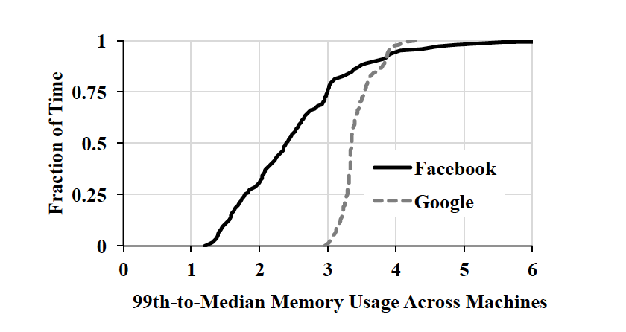
Motivation
Ratio is 2.4 in Facebook and 3.35 in Google more than half the time indicating more than half of the aggregate memory remains unutilized.
A decrease in the percentage of the working set that fits in memory results in a performance degradation due to paging
Memory usage across nodes in a cluster is under-utilized
Notes:
Memory intensive applications are widely popular for low latency services and data intensive analytics.
The data is captured over 10 second at Facebook and Google, a 3000-machine data analytics cluster (Facebook) and (2) a 12,500-machine cluster (Google) running a mix of diverse short- and long-running applications.

Slide 19
Solution: Remote Memory Paging
Utilize remote memory instead of writing to disk when server runs out of memory
Disks are slower than memory and data intensive applications crash when servers needs to page

Slide 20
Solution: Memory Disaggregation
Memory of all the servers in a cluster is exposed as a single memory pool to all the applications running on the cluster
Prior Solution:
Centralized Controller: Serves as a bottleneck when the cluster is scaled
Required new hardware and modification to existing applications
InfiniSwap:
Decentralized structure with no central controller and no modification to hardware or applications
Perform remote memory paging over RDMA

Slide 21
Prerequisites
There must be a memory imbalance so that when a node wants to swap a page then it can find available space in the cluster
Memory utilization at any node must remain stable over short time periods so that there is time to make placement decisions
Notes:
In the Facebook cluster for example, the probability that the memory utilisation at a node will not change by more than 10% in the next 10 seconds is 0.74 (0.58 for 20 seconds, 0.42 for 40 seconds).

Slide 22
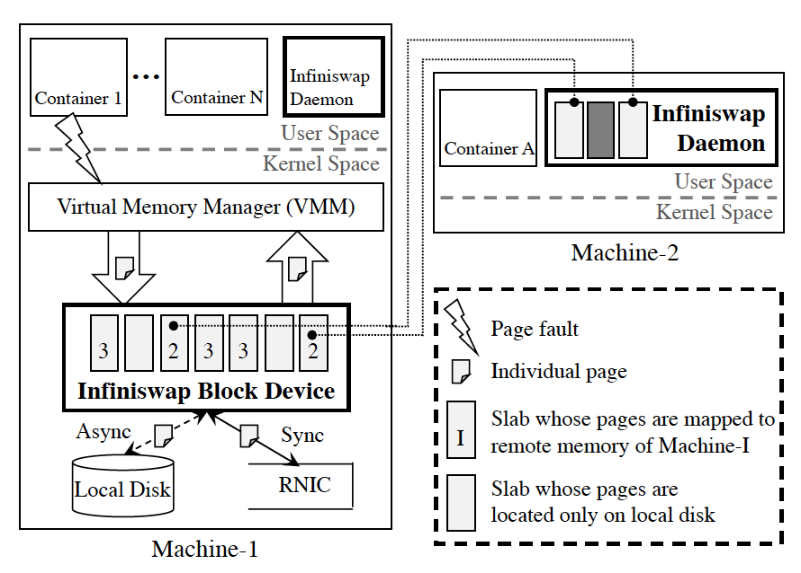
Infiniswap Architecture
Infiniswap Block Device: Kernel module set as swap space
Infiniswap Daemon: User-space program that manages remotely accessible memory
Address space is partitioned into fixed size slabs
Slabs are mapped to multiple remote machines where all pages belonging to the same slab are mapped to the same remote machine
Notes:
A slab is the unit of remote mapping and load balancing in INFINISWAP .

Slide 23
Infiniswap Block Device
Exposes a block device I/O interface to the virtual memory manager (VMM)
Uses remote memory as swap space
Write Operation
If the slab is mapped to remote memory, do RDMA_WRITE to write synchronously to remote memory while writing asynchronously to local disk
If the slab is unmapped then write synchronously to local disk
Read Operation
If the slab is mapped to remote memory, do RDMA_READ to read the data
If the slab is unmapped, read from the disk
Notes:
A slab is the unit of remote mapping and load balancing in INFINISWAP .

Slide 24
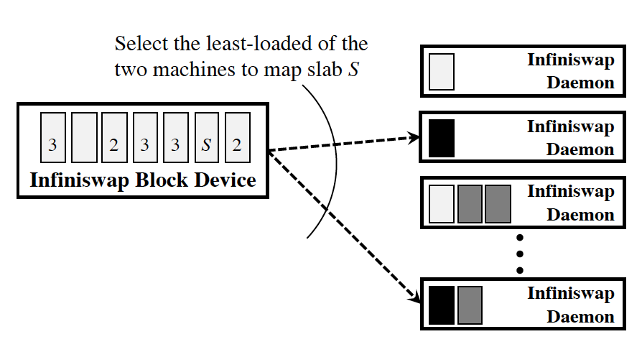
Slab Management
Smoothing factor (default = 0.2)
Exponentially weighted moving average over one second period where A(s) = Page-in and page-out activities for slab s.
Monitor the page activity rate of each slab and when it crosses a threshold (HotSlab), map it to a remote machine
Remote Slab Placement
Minimize memory imbalance by dividing the machines into two sets: those who have any slab of this block device (M_old) and those who don’t (M_new)
Contact two InfiniSwap daemons, choosing first from M_new and then from M_old if needed
Select the one with lower memory usage
Notes:
Goal: Distribute slabs from the same block device across as many remote nodes as possible and balance memory utilization across all the machines.
Distributing slab across as many remote nodes as possible minimizes the impact of future evictions from remote machines.
Balancing memory utilization across the machines reduces the probability of future evictions.

Slide 25
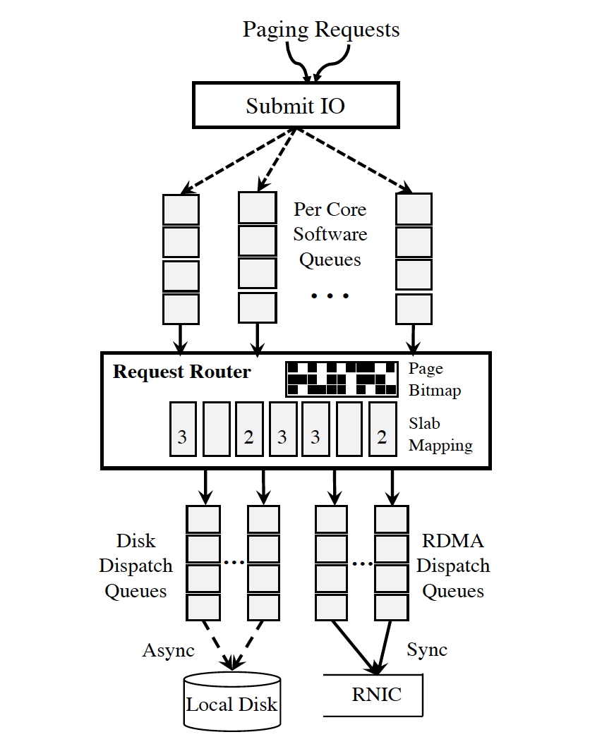
I/O Pipelines
Keeps track of whether a page can be found in remote memory or not.
Software Queues: Each CPU core contains a staging queue where page requests from the VMM are queued
Request router looks at the page bitmap and slab mapping to determine how to forward the request
Write request is duplicated and put into both disk and RDMA dispatch queue
Contents of page is copied into RDMA buffer entry and shared by disk dispatch entry.
Notes:
After the READ_WRITE is completed, the page write is completed and corresponding physical memory is reclaimed by the kernel without waiting for the disk write. RDMA dispatch and its buffer is not released until the completion of disk write.

Slide 26
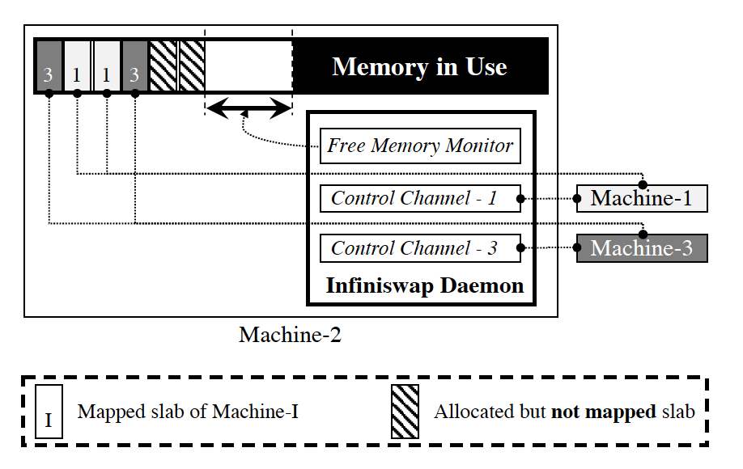
Infiniswap Daemon
Smoothing factor (default = 0.2)
Exponentially weighted moving average over one second period where U refers to total memory usage.
Claim memory on behalf of remote Infiniswap block devices and reclaim them on behalf of local applications
Proactively allocate slabs and mark them unmapped when the free memory grows above a threshold (HeadRoom)
When free memory shrinks below HeadRoom, it proactively releases slabs
To evict E slabs, it communicates with E+E’ slabs where E’<=E and evicts the E least active ones
Notes:
focuses on minimizing the performance impact on the machines that are remotely paging
Challenge: Given S mapped slabs, how do we know which are the E least-active ones which can be evicted to leave more than HeadRoom free memory?

Slide 27
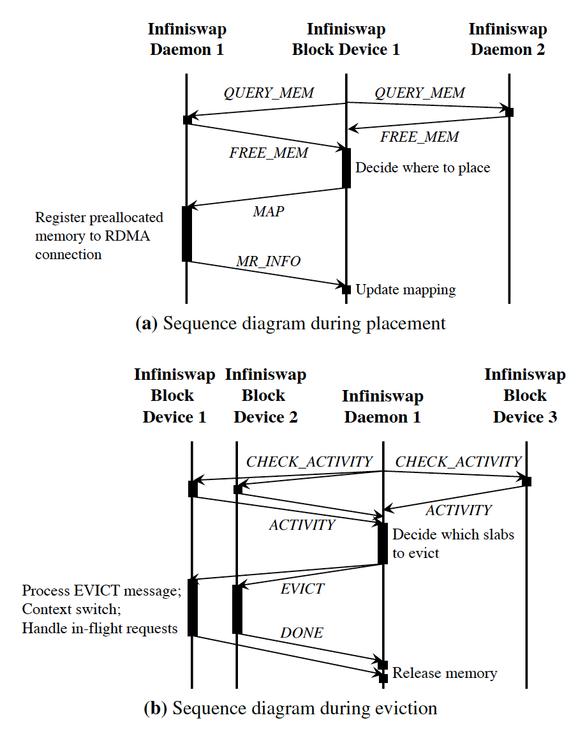
Implementation
Control Messages
Message passing to transfer memory information and memory service agreements
Connection Management
One sided RDMA READ/WRITE operations for data plane activities
Control plane messages are transferred using RDMA SEND/RECV
Notes:
QUERY MEM: Block devices send it to get the number of available memory slabs on the daemon.
FREE MEM: Daemons respond to QUERY MEM requests with the number of available memory slabs.
MAP: Block device confirms that it has decided to use one memory slab from this daemon.
MR INFO: Daemon sends memory registration information (rkey, addr, len) of an available memory slab to the block device in response to MAP.
CHECK ACTIVITY: Daemons use this message to ask for paging activities of specific memory slab(s).
ACTIVITY: Block device’s response to the CHECK ACTIVITY messages.
EVICT: Daemons alert the block device which memory slab(s) it has selected to evict.
DONE: After completely redirecting the requests to the to-be-evicted memory slab(s), block device responds with this message so that the daemon can safely evict and return physical memory to its local OS.

Slide 28
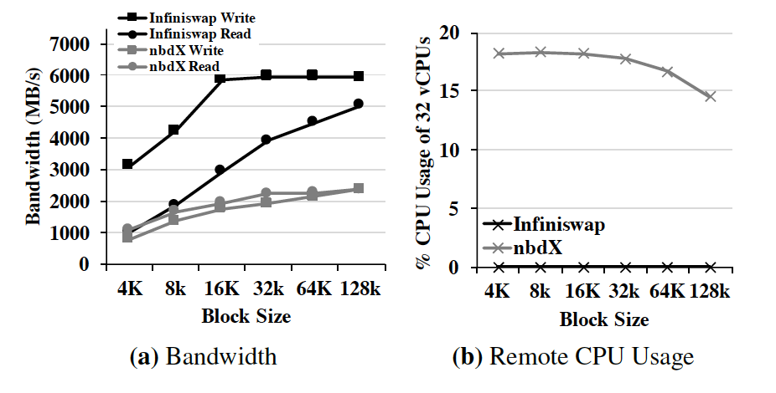
Block Device Evaluation
Provides 2x-4x higher I/O bandwidth than Mellanox nbdX
No remote CPU usage
No remote CPU usage as InfiniSwap bypasses the remote CPU in the dataplane.
Notes:
Nbdx relies on remote RAMdisks, and data copies to and from RAMdisks become CPU bound;
Nbdx saturates the 56 Gbps network at larger block sizes

Slide 29
Remote Memory Paging Evaluation
On a 56 Gbps Infiniband, 32-machine (32 cores and 64 GB physical memory) RDMA cluster using infiniswap, the paper evaluated VoltDB, Memcached, PowerGraph, GraphX and Apache Spark
Using InfiniSwap, throughputs improve between 4x and 15.4x over disk, and median and tail latencies by up to 5.4x and 61x respectively
Notes:
Throughput is the number of operations performed per second and tail latency is the speed of the slowest operation.
SlabSize = 1 GB, HeadRoom = 8 GB, HotSlab = 20 paging activities per second.

Slide 30
Single Machine Performance Evaluation
VoltDB’s performance degrades linearly using INFINISWAP instead of experiencing a super-linear drop.
Single remote machine as the remote swap space
InfiniSwap Performance
Notes:
All plots show single machine performance and median value of five runs.
Peak memory usage of each of these runs were around 10 GB, significantly smaller than the server’s total physical memory.

Slide 31
Cluster Wide Performance Evaluation
Median completion times of containers for different configurations in the cluster experiment.
Cannot emulate memory disaggregation for CPU-heavy
workloads such as Spark.
32 Machine RDMA cluster running 90 containers where 50% used 100% configuration, 30% used the 75% configuration and rest used the 50% configuration.
Notes:
Spark starts thrashing when it cannot keep its working set in memory (i.e., in 75% and 50% configurations), overheads of paging (e.g., context switch) - applications oscillate between paging out and paging in making little or no progress.

Slide 32
Future Improvements
Page swapping adds an overhead due to context switching so, an OS aware design with an Infiniswap conditioned memory allocation can improve the performance
Performance isolation amongst multiple applications using InfiniSwap

Slide 33
Thoughts
Use multiple remote machines as backup for fault tolerance instead of using the local disk
Reduces the overhead of paging from the local disk when the remote memory fails
Provides a higher level of fault tolerance as the current solution doesn’t tolerate failure of both remote machine and local disk
Local machine can store the activity (in metadata) when accessing its remote memory so that the other machine is aware of the least active ones while doing eviction

Slide 34
Discussion

Slide 35
RDMA is used for…
Distributed shared memory. Transactions and strong consistency
https://www.usenix.org/system/files/conference/nsdi14/nsdi14-paper-dragojevic.pdf
https://www.microsoft.com/en-us/research/publication/no-compromises-distributed-transactions-with-consistency-availability-and-performance/
https://www.usenix.org/system/files/conference/osdi16/osdi16-kalia.pdf
https://dl.acm.org/citation.cfm?id=2901349
Faster RPCs
https://www.usenix.org/system/files/conference/osdi16/osdi16-kalia.pdf
Network filesystems
https://dl.acm.org/citation.cfm?id=2389044
https://dl.acm.org/citation.cfm?id=1607676

Slide 36
RDMA is used for… contd..
Key-Value Stores:
https://dl.acm.org/citation.cfm?id=2626299
https://dl.acm.org/citation.cfm?id=2749267
https://www.usenix.org/system/files/conference/nsdi14/nsdi14-paper-dragojevic.pdf
https://www.cc.gatech.edu/~jhuang95/papers/jian-ipdps12.pdf
http://ieeexplore.ieee.org/document/6217427/
https://dl.acm.org/citation.cfm?id=2535475
Consensus:
https://dl.acm.org/citation.cfm?id=2749267
https://dl.acm.org/citation.cfm?id=3128609

Slide 37
Is RDMA a good fit for my problem?
Easy to get carried away with new trending paradigms.
Careful profiling of the overheads in the system necessary.
Do I just want to save CPU? Or..
Do I want to save time spent in OS?
Impact of network congestion
Messages serialized on single QP.
Single datacenter vs multi datacenter?

Slide 38
APUS Discussion
Throughput almost as good as unreplicated execution. Impressive!!
No support for non-deterministic functions e.g. time()
Read only optimization
Dynamic group membership
DARE supports it. RAFT too.
Congestion evaluation.
Only 1 out of 7 replicas congested during test.
CPU overhead at leader

Slide 39
Infiniswap Discussion
Comparison with Distributed Shared Memory
Evaluation under network congestion
Optimal slab size and head room
Performance isolation
Replicate page to multiple remote hosts for fault tolerance.
Data coherence

