Slide 1
Enabling Micro-level Demand-Side Grid Flexiblity in Resource Constrained Environments
Presenter: Zhe Yang

Slide 2
Table of contents
Background
System Concept
Proof of Concept
Deployment
Some thinking on this paper
1

Slide 3
Background
System Concept
Proof of Concept
Deployment
Some thinking on this paper
2

Slide 4
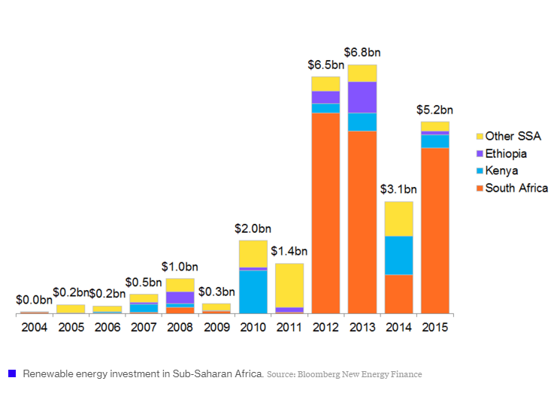
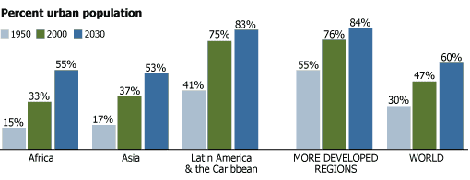
Global trends in Renewable energy and urbanization
Renewable energy investment in Sub-Saharan Africa
Global urbanization trend
3

Slide 5
Global trends in Renewable energy and urbanization
Requiring stable services
Uncertainty
Renewable energy investment in Sub-Saharan Africa
Global urbanization trend
Harvest power info from resource constraint environments to provide value to users and suppliers
4

Slide 6
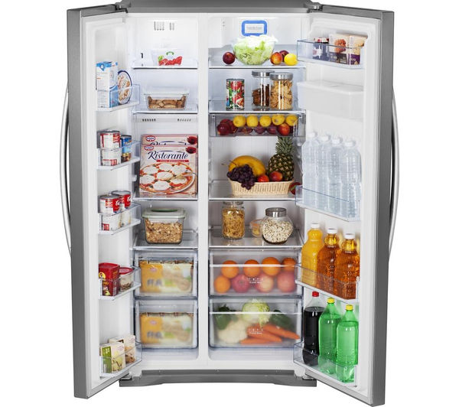
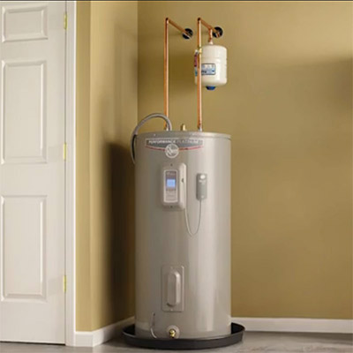
A demand-side solution
Monitor & Control Demand Response of thermostatically controlled loads (TCL)
Demand Response/ Grid flexibility: reduce or shift the power usage of a load in response to a signal (price signal, financial incentive, environmental condition or reliability signal)
5

Slide 7
Background
System Concept
Proof of Concept
Deployment
Some thinking on this paper
6

Slide 8
Survey results on ME cooling systems
Voluntary Load Disruption
71% samples turn refrigerators on and off to save energy
Perceptions on Electricity Service Reliability
70% experience power outage frequently
72% satisfied with service reliability
Perception of Electricity Related Expenditures
60% find bill difficult to pay
7

Slide 9
Survey results on ME cooling systems
Voluntary Load Disruption
71% samples turn refrigerators on and off to save energy
Perceptions on Electricity Service Reliability
70% experience power outage frequently
72% satisfied with service reliability
Perception of Electricity Related Expenditures
60% find bill difficult to pay
These observations confirm that users would probably accept a TLC control system
8

Slide 10
System design principles
Adaptability
Modularity
User needs and acceptance
9

Slide 11
Background
System Concept
Proof of Concept
Deployment
Some thinking on this paper
10

Slide 12
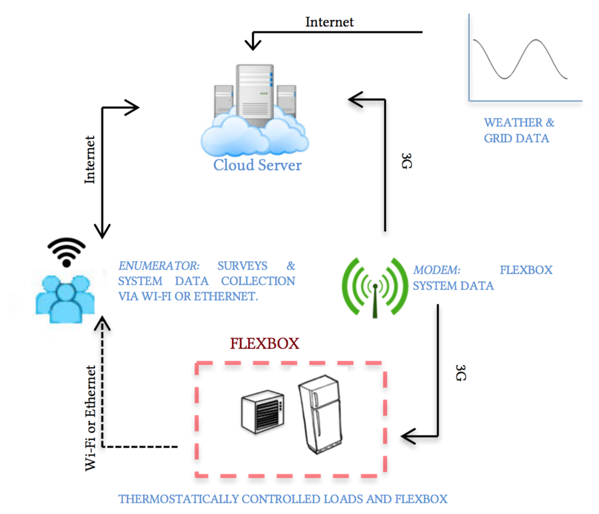
System workflow
11

Slide 13
Flexbox hardware implementation
Raspberry Pi
Sensor Gateway
Collect Wifi and Z-wave signals
Sensors & actuator
Temperature sensor (wired)
Door open monitor (wired)
Fridge control actuator (WiFi)
Energy meter (Z-wave)
12

Slide 14
Flexbox software implementation
Use PostgreSQL for storage
Only store data when output variance detected or one minite passed
One data collection process for each sensor
Independent sensor reads
Evaluate system latency by pinging, evaluate bandwidth by sending fixed-sized TCP packets
13

Slide 15
Background
System Concept
Proof of Concept
Deployment
Some thinking on this paper
14

Slide 16
Results from deployment
In 2015 summer, distribute Flexbox to 20 MEs and 10 households in Managua, Nicaragua
15

Slide 17
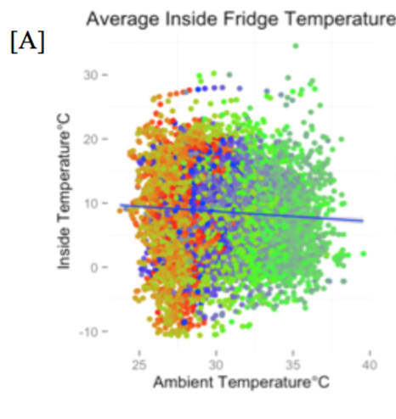
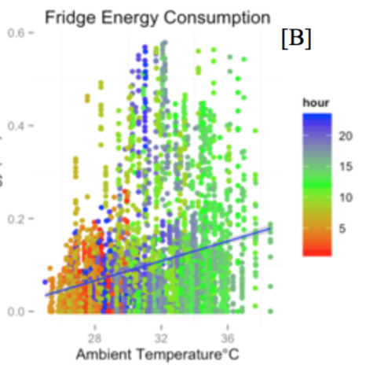
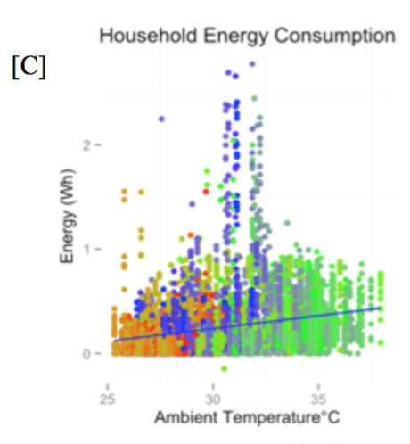
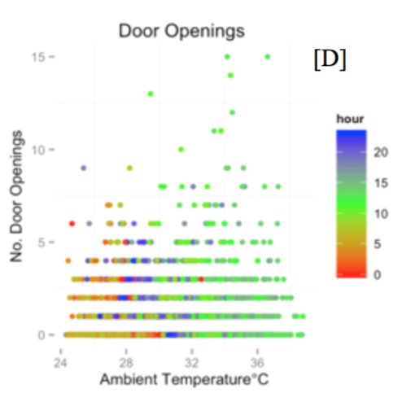
1. Exploratory Data Analysis
Across-cluster correlations between hourly room temperature and Inside Temp, Energy Consumption, Total Energy Consumption, Door opening
16

Slide 18
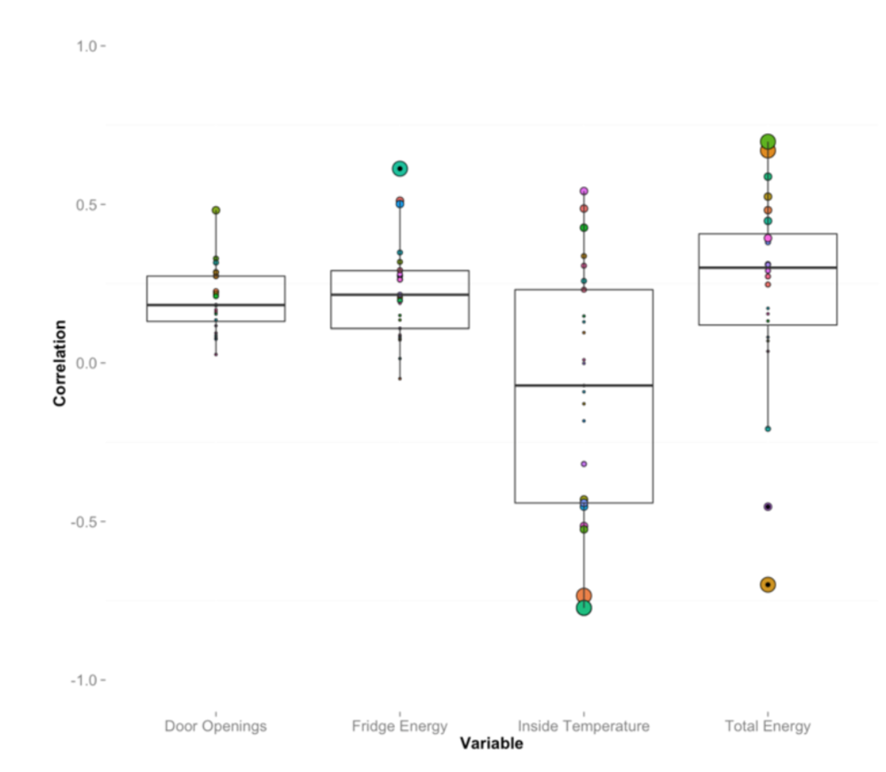
1. Exploratory Data Analysis
Within-cluster correlations between hourly room temperature and …
Within-cluster correlations
17

Slide 19
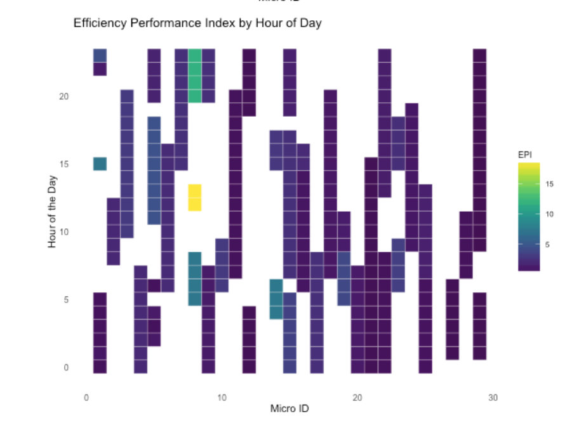
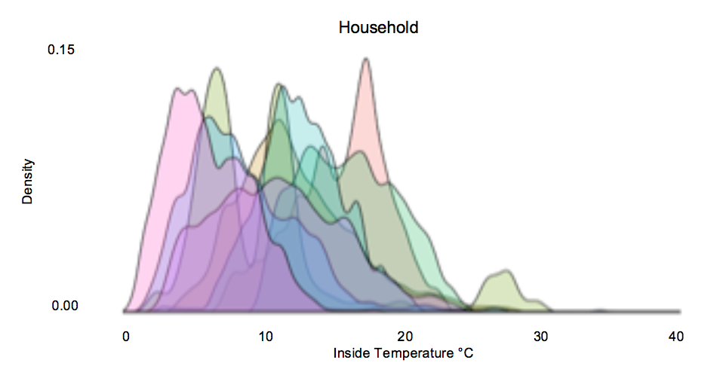
2. TCL parameter EDA
In this part, the authors point out some key parameters that are inadequately designed in previous TCL models
Duty cycles are not constant
Performance efficiencies are not constant
Temperature set points are deviated from manufactural information
Efficiency Performance Index w.r.t. ID
Household fridge inside temperature distribution
18

Slide 20
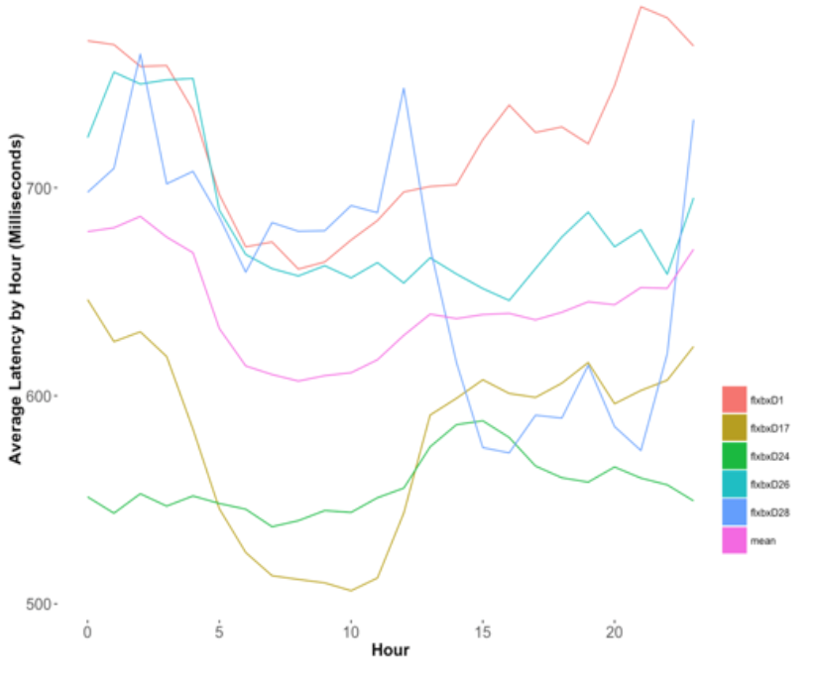
2. Communications Network EDA
In this part, the authors measure latency with five 3G modems distributed in Managua
6 pings every 30 seconds
Latency in ms w.r.t. hours
19

Slide 21
Background
System Concept
Proof of Concept
Deployment
Some thinking on this paper
20

Slide 22
Summary
This paper launches a survey on TCL usages in Managua
puts forward a proof-of-concept system called Flexbox
Statistically examine collected data from Flexbox
21

Slide 23
Limitations of this work
It is a pioneer or primal work, a testbed is implemented, statistical analysis is provided, but lacks elaborate technical details.
21

Slide 24
A²: Agreement in the Air
Network-wide Consensus Utilizing the Capture Effect in Low-power Wireless Networks
Presented by: Hao Yang
Notes:
(0:00 -- 1:30) Hello everybody, my name is Hao Yang. Today, I will present the paper network-wide consensus utilizing capture effect in low power wireless networks. And a system called A square

Slide 25
Outline
Motivation and Background
Core Ideas
Experimental Data
Thoughts and takeaways
Notes:
(0:00 -- 1:30) Today’s presentation gonna follow this outline, start by motivation and background, and then introduce cord ideas of A square with some examples, and then experimental data, and finally some thoughts and takeaways.

Slide 26
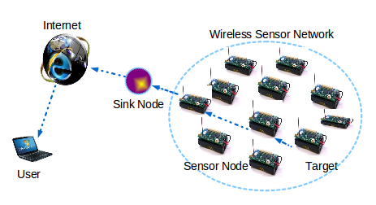
Motivation
Traditional sensor networks:
Data collection
Dissemination
New Demand:
Global configuration(cryptographic setting)
Mission-critical applications(cooperative robots)
Ref: http://careerprojects.in/fault-node-recovery-algorithm-for-a-wireless-sensor-network/
Notes:
(0:00 -- 1:30) In low-power wireless networking, new applications such as cooperative robots or industrial closed-loop control demand for network wide consensus at low-latency and high reliability. Distributed consensus protocols is a mature field of research in a wired context, but has received little attention in low-power wireless settings. This paper present us a system that brings distributed consensus to low-power multi-hop networks.
Different from traditional wireless sensor networks which simply collect and disseminate data, many applications in low-power wireless networks build their operation on consensus. For example, within the network stack, protocols need to agree on which cryptographic keys to use, networked cooperative robots need agreement on what actions to execute. For such applications, one node can not take actions until it knows that all the other nodes share the same agreement.

Slide 27
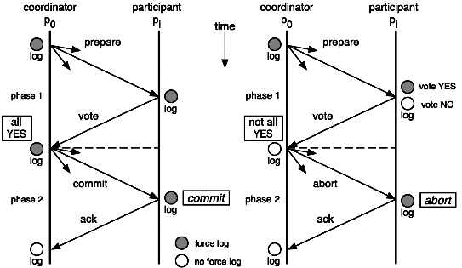
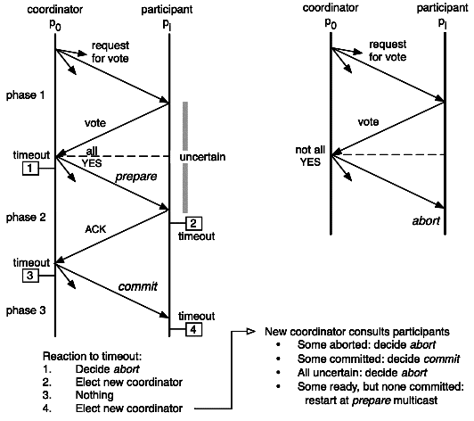
Background: Consensus
Two-phase commit (2PC)
Three-phase commit (3PC)
Ref:http://lig-membres.imag.fr/krakowia/Files/MW-Book/Chapters/Transact/transact-body.html
Ref:http://lig-membres.imag.fr/krakowia/Files/MW-Book/Chapters/Transact/transact-body.html
Notes:
(1:30 -- 4:00) Before introduce A square, let’s build some basic knowledge about consensus protocols first. Consensus is the problem of reaching agreement among several processes about a proposal. Achieve consensus may become challenging in a lossy network or failure on processes. Here, we introduces two consensus protocols which are widely used, which are two phase commit and three phase commit.
Two-phase commit assumes there exist one static coordinator or leader, and some nodes as participants. The first phase is proposal phase, in this phase, leader will broadcasts a proposal to all other participants, each member will reply the leader with yes or no to the proposal. Once the leader collect all the response, it enter into the second phase. If the leader receives all yes from the participants, it will send commit to the participants. Otherwise it will decide to abort and broadcasts the decision. Two phase commit is simple with low communication complexity, but the limitation is known as a blocking protocol. Because if one participant node fails, other nodes need to wait for the next message for a long time, and the protocol may not terminate. If the leader and one participant both fails on the second phase, it is hard to know if a leader election should be executed.
Comparing to two-phase commit, three phase commit tries to eliminate the uncertainty by adding an additional pre-commit phase in between. So, it works the same at first, the leader will make a proposal, wait for the participants to reply. And then enters into second phase, pre-commit, the leader and participants will share the decision but not apply the commit until enter into commit phase. In this way, it eliminate the uncertainty if failure occurs. It is not a blocking protocol because it set up a timeout, once reaches the timeout, every single node will recover independently, commit or abort. But for three phase commit, it is hard to maintain consistency. For example, when a participants times out in pre-commit phase, and it proceeds to commit. While at the same time the coordinator doesn’t receive its reply and ask the others to abort.

Slide 28
Background: The Chaos Primitive
What is Chaos?
Primitive that natively supports all-to-all data sharing in low-power wireless networks
Synchronization with capture effect
Share data which want to be shared, nodes over hearing these transmissions receive packets with high probability, like how radio works
In-network aggregation
Progress flag: bits assigned to each node in the network
Round(One operation time range) and Slot(Smallest unit in a round)
Upon successful reception: 1. merge it own flag 2. transmits in the next time slot
Why Chaos is not a Consensus Protocol?
Progress flag ≠ acknowledgment (no information whether other nodes also reached their final phase)
Reserved for node 2
Reserved for node 4
V
V
-
V: vote
A: abort
- : not vote yet
A
Reserved for node 1
Reserved for node 3
Notes:
(4:00 -- 7:00) Next，let me introduce Chaos, a primitive that natively supports all-to-all data sharing in low-power wireless networks. An important building block for low-power wireless systems is to efficiently share and process data among all devices in a network. However, current approaches typically split such all-to-all interactions into sequential collection, processing, and dissemination phases, thus handling them inefficiently. Chaos is the first primitive that natively supports all-to-all data sharing in low-power wireless networks. Different from current approaches, Chaos embeds programmable in-network processing into a communication support based on synchronous transmissions using capture effect.
In Chaos, nodes synchronously send the data they want to share. Nodes over hearing these transmissions receive packets with high probability due to the capture effect, just like how radio works. Communication will be build on some strong channel, data on other weak channel will be ignored. Upon reception, nodes merge their own with the received data and transmit the resulting packets again synchronously. An leader node triggers this process, which continues in a fully distributed manner until all nodes in the network share the same data to achieve synchronization.
In Chaos, every packet contains a progress flag, which are bits assigned to each node in the network, like the following figure. In this setting, it has 4 nodes in the network, flag V represent vote yes, A means abort, and dash sign means not vote yet. Those information will be shared and updates through nodes to achieve consensus. Round are the time period for one operation, and slot is the smallest unit in a round. Latter we will have a figure clearly introduce the relation between round and slot, so if you are confused, don’t worry about it. Once a participant receive a message, it merge it own flag into the reserved bits, for example, node 3 receive proposal from the leader, it will then put V in its reserved block and transmit.
Although Chaos has progress flag, it can not be considered as acknowledgement flag. What is the difference? With the progress flag only, we could not know if all the other participants receive the bits and if all the other nodes enters into final phase, which doesn’t guarantee reliable reception. In Chaos, one participant may leave a round once they completed their final flood and they have no information whether other nodes also reached their final phase.

Slide 29
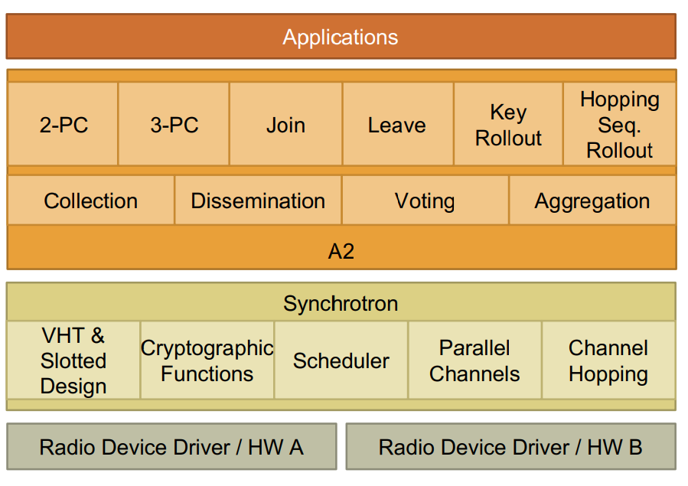
Core Ideas : Architecture layer of A²
Application and services provided by A²
The synchronous transmission kernel of A².
A robust lower layer which handles packets transmissions and receptions, network synchronization, frequency agility and security aspects
Ref: paper figure 5(c)
Notes:
(07:00 -- 07:40) Okay, after some basic knowledge for the consensus protocols and Chaos, let take a closer look at A square. First, let see the architecture layer of A square. On the application level, this paper present us some applications like two phase commit, three phase commit, and some services to maintain membership list for a node join and leave. In a lower level, it also introduced synchrotron, a robust lower layer which handles packets transmission and receptions, network synchronization, frequency agility and some security aspects.

Slide 30
Core Ideas : Goal of A²
Inherited from Chaos , achieve consensus with low-latency and high reliability in low-power wireless networking
Provides basic primitives like dissemination, collection, aggregation
Enables network-wide agreement: Vote, 2PC, 3PC, Multi-phase protocols(Add reliability to Collect and Aggregate)
Maintain consistent membership group: Join, leave
Synchrotron: a robust lower layer of A²
Handle packets transmissions and receptions
Use VHT achieve network synchronization
Frequency agility: Synchrotron transmit in each time slot on a different frequency, and use multiple channels in parallel
Security aspect: avoid corrupted packets(CRC collisions) to propagate
VHT: a virtual high-definition timer, allows Synchrotron to maintain tight synchronization over long periods of network inactivity
Corrupt bytes in the packet that accidentally assemble a correct checksum
Notes:
(07:40 -- 08:50) A square is inherited from Chaos, the goal is to achieve consensus with low-latency and high reliability in wireless networking. It provides basic primitives and enables some network-wide agreement like the one introduced before.
A virtual high-definition timer, which is called VHT is also introduced in A square. It’s a local timer which uses a combination of the stable, low-power low-frequency clock and the high-frequency clock of a sensor node, allows synchrotron to maintain tight synchronization over long periods of network inactivity.
Nodes in Synchrotron transmit in each time slot on a different frequency following a network wide schedule, similar to Bluetooth. This prohibits interference on individual channels from disturbing the operation of Synchrotron and allows A square to co-exist with other wireless technologies. It also use multiple channel in parallel, which improves performance on a density node network. But in a sparse node network, using parallel channel will decrease performance. Just a headup here, the reason will be introduced in the experiment data section.

Slide 31
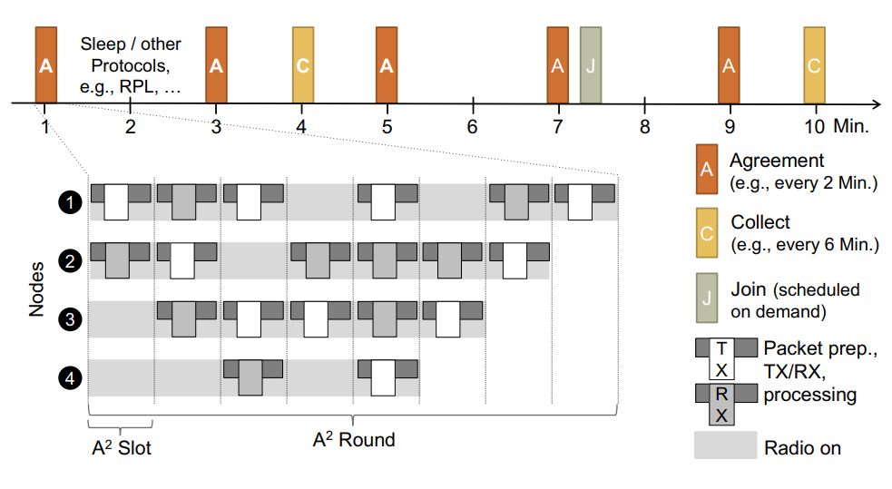
Core Ideas : Operations in A²
Overview: Round and Slot
One operation
One round with multiple slots
Handles: time-slotted operation
Consensus
Dissemination
Join, etc
Ref: paper figure 1
Notes:
(08:50 -- 09:50) A square schedules rounds for network-wide consensus, dissemination, join, etc. as requested by the application. Each round has multiple slots in which nodes transmit, receive or sleep, driven by the transmission policy of the application. Between two rounds, nodes either sleep or are free to run other protocols. Below is one round of agreement running with 8 slot. We got 4 nodes here, and each slot, one node will run a time-slotted operation such as merger its own flag into the reserved blocks, and transmit.

Slide 32
Core Ideas : Consensus in A² (2PC and 3PC )
Two-phase commit (2PC)
Proposal Voting Phase (V)
Commit or Abort Phase (C or A)
Three-phase commit (3PC)
Proposal Voting Phase (V)
Pre-commit or Abort Phase (P or A)
Do Commit Phase (C)
Ref: paper figure 3
A node reaches completion when all votes are set in its local state. It then proceeds to the final flood stage
Timeout
Failure Handling
Recovery
Notes:
(09:50 -- 14:50) Next, let walk through an example of how A square achieve two phase commit. There are two phases here which are voting phase and commit or abort phase. In the first phase, the leader proposes a value and collects vote from all other participants. Second, in the commit phase, the leader will disseminates the outcome of the vote. If all participants agree, leader will disseminate commit, otherwise abort. Building on the concepts of Chaos, all nodes share two important pieces of information in each transmission, which are the proposed value they vote for, and a list of votes representing for each node whether it already voted and whether the vote was agree or against the proposal.
Once a node receive a message, it merges the received information with it own vote and transmit it in the next time slot. Two condition will trigger a node to share their information, either they receive a packet with new knowledge, which means there is a update need to spread, or they receive a packet with fewer vote than it own, it means some nodes doesn’t have the latest information, need help for update. Once a node reach completion, which means all votes are set in its local state, it then proceeds to the final flood stage, repeatedly transmits the final result to share the latest information in the network.
Okay, here goes the example. In this example, we got 3 nodes here. Node A as leader. In the first time slot, Node A propose a value 42 and transmit it to node B.

Slide 33
Core Ideas : Consensus in A² (2PC and 3PC )
Two-phase commit (2PC)
Proposal Voting Phase (V)
Commit or Abort Phase (C or A)
Three-phase commit (3PC)
Proposal Voting Phase (V)
Pre-commit or Abort Phase (P or A)
Do Commit Phase (C)
Ref: paper figure 3
A node reaches completion when all votes are set in its local state. It then proceeds to the final flood stage
Timeout
Failure Handling
Recovery
Notes:
(09:50 -- 14:50) Node B receives the value 42, and accept the value 42, mark A and B has voted and accept, transmit to both node A and node C.

Slide 34
Core Ideas : Consensus in A² (2PC and 3PC )
Two-phase commit (2PC)
Proposal Voting Phase (V)
Commit or Abort Phase (C or A)
Three-phase commit (3PC)
Proposal Voting Phase (V)
Pre-commit or Abort Phase (P or A)
Do Commit Phase (C)
Ref: paper figure 3
A node reaches completion when all votes are set in its local state. It then proceeds to the final flood stage
Timeout
Failure Handling
Recovery
Notes:
(09:50 -- 14:50) Node A receive the information, but found there is no new information, so it won’t transmit to B again. But when node c receive the message, it check its own resources and decide to decline the value 42, so it mark itself as vote against the proposal, and transmit back to B.

Slide 35
Core Ideas : Consensus in A² (2PC and 3PC )
Two-phase commit (2PC)
Proposal Voting Phase (V)
Commit or Abort Phase (C or A)
Three-phase commit (3PC)
Proposal Voting Phase (V)
Pre-commit or Abort Phase (P or A)
Do Commit Phase (C)
Ref: paper figure 3
A node reaches completion when all votes are set in its local state. It then proceeds to the final flood stage
Timeout
Failure Handling
Recovery
Notes:
(09:50 -- 14:50) Node b in this case received a update coming from node C, it then enters into the final flood stage, repeatedly sending the complete information.

Slide 36
Core Ideas : Consensus in A² (2PC and 3PC )
Two-phase commit (2PC)
Proposal Voting Phase (V)
Commit or Abort Phase (C or A)
Three-phase commit (3PC)
Proposal Voting Phase (V)
Pre-commit or Abort Phase (P or A)
Do Commit Phase (C)
Ref: paper figure 3
A node reaches completion when all votes are set in its local state. It then proceeds to the final flood stage
Timeout
Failure Handling
Recovery
Notes:
(09:50 -- 14:50) The leader then reaches the final stage of vote phase, since not all members agree on the proposed value, finish the vote phase and switch to the abort phase, and send it to node B.

Slide 37
Core Ideas : Consensus in A² (2PC and 3PC )
Two-phase commit (2PC)
Proposal Voting Phase (V)
Commit or Abort Phase (C or A)
Three-phase commit (3PC)
Proposal Voting Phase (V)
Pre-commit or Abort Phase (P or A)
Do Commit Phase (C)
Ref: paper figure 3
A node reaches completion when all votes are set in its local state. It then proceeds to the final flood stage
Timeout
Failure Handling
Recovery
Notes:
(09:50 -- 14:50) Node B receives the message, switches to abort phase, mark itself in the reserved block, and send the new information to other nodes.

Slide 38
Core Ideas : Consensus in A² (2PC and 3PC )
Two-phase commit (2PC)
Proposal Voting Phase (V)
Commit or Abort Phase (C or A)
Three-phase commit (3PC)
Proposal Voting Phase (V)
Pre-commit or Abort Phase (P or A)
Do Commit Phase (C)
Ref: paper figure 3
A node reaches completion when all votes are set in its local state. It then proceeds to the final flood stage
Timeout
Failure Handling
Recovery
Notes:
(09:50 -- 14:50) Node c switches to abort phase, and since all the reserved block are marked as finished, it complete. And send back to node B.

Slide 39
Core Ideas : Consensus in A² (2PC and 3PC )
Two-phase commit (2PC)
Proposal Voting Phase (V)
Commit or Abort Phase (C or A)
Three-phase commit (3PC)
Proposal Voting Phase (V)
Pre-commit or Abort Phase (P or A)
Do Commit Phase (C)
Ref: paper figure 3
A node reaches completion when all votes are set in its local state. It then proceeds to the final flood stage
Timeout
Failure Handling
Recovery
Notes:
(09:50 -- 14:50) Node B reaches final flood stage as well and send back to A.

Slide 40
Core Ideas : Consensus in A² (2PC and 3PC )
Two-phase commit (2PC)
Proposal Voting Phase (V)
Commit or Abort Phase (C or A)
Three-phase commit (3PC)
Proposal Voting Phase (V)
Pre-commit or Abort Phase (P or A)
Do Commit Phase (C)
Ref: paper figure 3
A node reaches completion when all votes are set in its local state. It then proceeds to the final flood stage
Timeout
Failure Handling
Recovery
Notes:
(09:50 -- 14:50) And node A is complete. In this example, the final flood stage is reduced into one transmission but it should send the complete message repeatedly. This two phase commit is not guarantee that all nodes contributed to the vote, since a node may fail after voting but before receive vote from other nodes. To handle failure, it has a timeout. When a node fails before vote, the leader will abort the transaction. When the failed node recover, it can safely abort. The important thing to remember is no commit can be made until all failure node are recovered.
Similar to two phase commit, three phase commit works the same for the vote phase and commit phase. But add an extra phase in between. In failure occurs and the node is in pre-commit phase or commit state, it will commit, otherwise abort. In this case, inconsistencies can happen when a participant timeout in pre-commit phase, it didn’t receive any message from the leader. It proceeds to commit. And the leader didn’t receive any confirmation from that node as well and decide to abort. In this case all other node abort and one node commit. Once communication is back, the recovery mechanism will roll back transactions, but the inconsistency will still occur in that period of time.

Slide 41
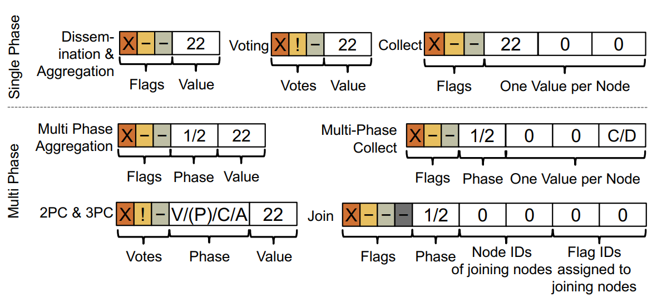
Core Ideas : Multi phase vs Single phase
Ref: paper figure 5 (b)
Each application utilizes a specific set of flags, votes, and fields.
Notes:
(09:50 -- 14:50) This is a graph showing the difference of single phase and multiple phase. Basically, it works the same, but different phases could be defined here. And every node will reserve a spot for itself. Next I will explain another example, which is join. That is the way A square maintain its membership list.

Slide 42
Core Ideas : Membership Service services in A²
Ref: paper figure 4
Join Request
Before join, don’t merge flags
Leave
Ensuring Consistency
Failure detect
Remove from list
Dissemination
Sequence Numbers
assign each configuration a sequence number
Increased number in packet header
Mismatch -> rejoin
Join
Collect Phase
Disseminate Phase
Notes:
(14:50 -- 17:20) In this example, nodes A and B have already joined and node C wishes to join. At the beginning, leader will collect information from other nodes to see if there is new member wants to join.

Slide 43
Core Ideas : Membership Service services in A²
Ref: paper figure 4
Join Request
Before join, don’t merge flags
Leave
Ensuring Consistency
Failure detect
Remove from list
Dissemination
Sequence Numbers
assign each configuration a sequence number
Increased number in packet header
Mismatch -> rejoin
Join
Collect Phase
Disseminate Phase
Notes:
(14:50 -- 17:20) Node b mark itself as participated, and broadcast the information.

Slide 44
Core Ideas : Membership Service services in A²
Ref: paper figure 4
Join Request
Before join, don’t merge flags
Leave
Ensuring Consistency
Failure detect
Remove from list
Dissemination
Sequence Numbers
assign each configuration a sequence number
Increased number in packet header
Mismatch -> rejoin
Join
Collect Phase
Disseminate Phase
Notes:
(14:50 -- 17:20) Node c notice that itself isn’t in the membership list, then add its id into the wish to join list. We notice that before a node is actually join the membership list, it won’t mark itself in the list yet.

Slide 45
Core Ideas : Membership Service services in A²
Ref: paper figure 4
Join Request
Before join, don’t merge flags
Leave
Ensuring Consistency
Failure detect
Remove from list
Dissemination
Sequence Numbers
assign each configuration a sequence number
Increased number in packet header
Mismatch -> rejoin
Join
Collect Phase
Disseminate Phase
Notes:
(14:50 -- 17:20) Node b send the request to the leader.

Slide 46
Core Ideas : Membership Service services in A²
Ref: paper figure 4
Join Request
Before join, don’t merge flags
Leave
Ensuring Consistency
Failure detect
Remove from list
Dissemination
Sequence Numbers
assign each configuration a sequence number
Increased number in packet header
Mismatch -> rejoin
Join
Collect Phase
Disseminate Phase
Notes:
(14:50 -- 17:20) Leader agrees the join request, enter into a new phase, assign a flag 3 for C, and broadcast this message.

Slide 47
Core Ideas : Membership Service services in A²
Ref: paper figure 4
Join Request
Before join, don’t merge flags
Leave
Ensuring Consistency
Failure detect
Remove from list
Dissemination
Sequence Numbers
assign each configuration a sequence number
Increased number in packet header
Mismatch -> rejoin
Join
Collect Phase
Disseminate Phase
Notes:
(14:50 -- 17:20) Node b receives the message, mark itself, disseminate the message.

Slide 48
Core Ideas : Membership Service services in A²
Ref: paper figure 4
Join Request
Before join, don’t merge flags
Leave
Ensuring Consistency
Failure detect
Remove from list
Dissemination
Sequence Numbers
assign each configuration a sequence number
Increased number in packet header
Mismatch -> rejoin
Join
Collect Phase
Disseminate Phase
Notes:
(14:50 -- 17:20) Node c receives the confirmation, mark itself and complete, disseminate the message.

Slide 49
Core Ideas : Membership Service services in A²
Ref: paper figure 4
Join Request
Before join, don’t merge flags
Leave
Ensuring Consistency
Failure detect
Remove from list
Dissemination
Sequence Numbers
assign each configuration a sequence number
Increased number in packet header
Mismatch -> rejoin
Join
Collect Phase
Disseminate Phase
Notes:
(14:50 -- 17:20) And B complete as well.

Slide 50
Core Ideas : Membership Service services in A²
Ref: paper figure 4
Join Request
Before join, don’t merge flags
Leave
Ensuring Consistency
Failure detect
Remove from list
Dissemination
Sequence Numbers
assign each configuration a sequence number
Increased number in packet header
Mismatch -> rejoin
Join
Collect Phase
Disseminate Phase
Notes:
(14:50 -- 17:20) So does the leader, everything complete, the node c is in the list.
For removing a member from the list, if the leader find out a node doesn’t participate for a number of rounds, it then distributes new flag assignment that remove the node from the list of participants and schedule a leave round.
To enhance consistency, in case of some participants fails and rejoin after a new round of operation, a sequence number will be assigned to the configuration. And will increase each time whenever a node is joined or removed. So, when a node receive the package and notice that the sequence number is mismatch, it will tries to rejoin.

Slide 51
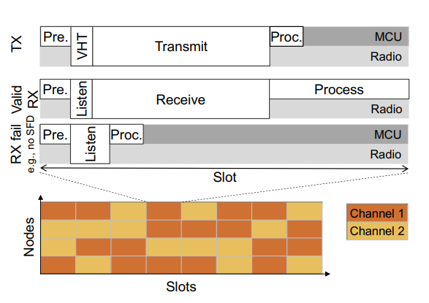
Core Ideas : Synchrotron
Time-Slotted Design and Synchronization
In-Slot Power Saving
Uses slots that last longer than one packet air-time
Nodes turn off radio if fail to receive valid packet at the beginning of the slot
Synchronization with VHT:
maintain tight synchronization over long periods of network inactivity
Improvement from Chaos
Interference will not degrade performance
frequency agility: Nodes in Synchrotron transmit in each time slot on a different frequency following a network wide schedule
Parallel Channels: Use multiple channels in parallel, each node randomly chooses one channel per time-slot to either receive or transmit
p.s. VHT : virtual high-definition timer
Ref: paper figure 5 (a)
Notes:
(14:50 -- 17:20) At last is a introduction to synchrotron, the lower layer of A square in charge of packets transmissions and receptions, network synchronization, frequency agility and security aspects. Synchrotron uses a slot that last longer than one packet transmission time, typically a few milliseconds.
To save some power, it will disable the radio within the slot after it completes the transmission or reception. It will also turn off their radio in early stage if they fail to receive a valid packet.
Synchrotron also uses a VHT which could maintain tight time synchronization over long periods of network inactivity
By using different frequency and parallel channels, Synchronization avoid the interference which will degrade performance as well.

Slide 52
Experimental Data - SetUp
Implementation: implement A² in C for the Contiki OS targeting simple wireless nodes equipped with a low-power radio such as TelosB and Wsn430 platforms which feature a 16bit MSP430 CPU @ 4 MHz, 10 kB of RAM, 48 kB of firmware storage and CC2420
Scenarios: Disseminate, network aggregation, collection, 2PC and 3PC, lightweight dissemination(4-byte value, also called Glossy Mode)
Performance metrics: End-to-End Loss Rate, radio-on time, radio Duty Cycle, latency
Testbeds: Flocklab, Indriya,
Rennes and Euratech
Notes:
(17:20 -- 22:20) Next, let checkout some experiments this paper has done. This group did a good job on testing their system using different scenarios on different testbeds. They also open sources their code so if you guys are interested you can take a look on their GitHub page, the linked is shared in later slides. For the reason of time, I won’t go through all the experiments they made but will go through some experiments I found interesting or useful.

Slide 53
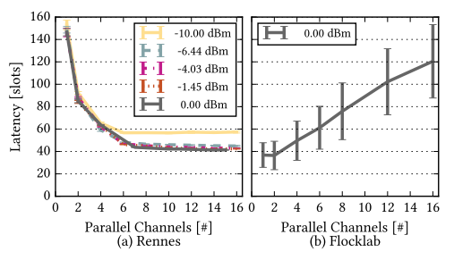
Experimental Data – parallel channels
Evaluation on parallel channels: around 40–60 slots, lower latency, 3.5 × faster also consume roughly 3.5 × less energy
On a sparse testbed, using many channels decreases the performance due to the decreasing probability of finding neighbors on the same channel
Ref: paper figure 8
dBM: a measure of power referenced to one milliwatt
Example: 10 dBM = 10 mW
-10 dBM = 100 µW
Notes:
(17:20 -- 22:20) Let me first introduce dBm here, which is a measurement of power referenced to one milliwatt. The negative sign here doesn’t mean it is generating power instead of using it, it just mean the lower the number is, the less power it consumes.
Lets see the first figure using the test bed Rennes, it uses 180 nodes with parallel channels on a dense node testbed. The latency converges around 40–60 slots. By using one channel to two channels, the latency decreases a half, but the latency won’t continue to decrease after some point of channel number, which means once the node number and transmission power are fixed, we can run experiment to find the optimal setting.
In sparse nodes setting running in Flocklab, in the right figure, we notice that using too many channels will decreases performance. The reason is that in a sparse node set, nodes have a better chance to miss one another which takes extra effort for an operation.

Slide 54
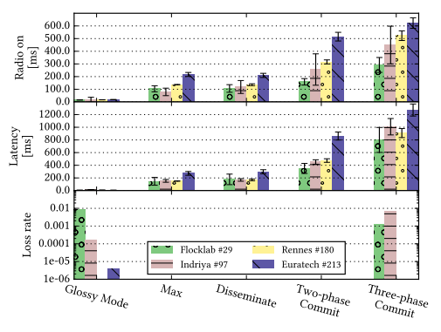
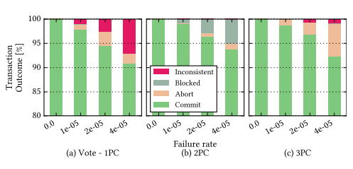
Experimental Data –Consensus
Ref: paper figure 11
Consensus outcome of single-phase Vote, 2PC and 3PC
Cost of consensus
Ref: paper figure 10
The cost increases with the number of nodes, and significantly with the level of consensus. 2PC costs twice as Max and Disseminate, while Glossy Mode is cheap since it does not use flags. Error bars represent the standard deviation
All three primitives result in 100% commit rate in case of no injected failures
Notes:
(17:20 -- 22:20) In the left experiment, they run six applications with increasing degree of consistency, which are glossy mode, meaning one-to-all operation with no flag, max and disseminate with all-to-all delivery and flags, two-phase commit and three-phase commit with all-to-all delivery and flags showing the agreement phase and progress.
With the number of nodes increase, the latency is also increase. However, the cost is not proportional to the testbed size. For example, Rennes is six times larger than Flocklab but only results in about twice the latency. This due to topology differences of testbeds. We now take a look at the performance of each application. Glossy Mode has the lowest cost due to its simplicity, but also a relatively high loss rate. Max and disseminate perform roughly the same since they are very similar. Both achieve zero losses. Two-phase commit shows roughly twice the cost of Max. This is due to the two phases and to the packet overhead of vote flags. Three-phase commit continues the trend and has slightly more than three times the cost of Max. This is due to the number of phase is three times larger.
In the right experiment, they tries to compare liveness and consistency of different phase commit. In two phase commit there may exists block but inconsistency doesn’t occur, while in three phase commit is non blocking but inconsistency occur, as we discussed before. The test bed is Flocklab in this experiment with some injected failures. The x axis represent the probability a given node enter a failure state, become unavailable until the end of a round. We can see that if there is no failure occur, all different phase of commit works perfectly. Although two phases commit eliminate the inconsistency, the price is liveness, as the whole protocol has to block until all nodes are available again for recovery. While at the same time three phase commit provides a better liveness with few inconsistencies. That’s the trade off between liveness and consistency of two phase commit and three phase commit.

Slide 55
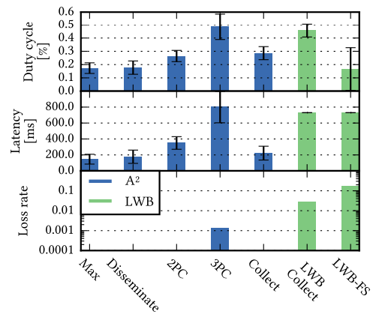
Experimental Data –Consensus
Ref: paper figure 11
Ref: paper figure 12
Comparison with other state-of-art Low power Wireless Bus (LWB)
Notes:
(17:20 -- 22:20) They also make a comparison with other state of art called low power wireless bus with the collect application running on the testbed of Flocklab. The duty cycle is the fraction of one period in which a signal or system is active. We notice that A square doesn’t have any loss rate comparing to LWB, and achieving a lower latency as well. With the duty cycle. LWB with forward selection wins because it can dynamically turn off the node, which makes it more energy-efficient, but the tradeoff is the reliability. In this comparison, we can see that A square could achieve a better reliability while saves more energy comparing to LWB.

Slide 56
Takeaway:
A² : Inherited from Chaos , achieve consensus with low-latency and high reliability in low-power wireless networking
Synchrotron: A robust lower layer of A² . A new synchronous transmission kernel with high-precision synchronization through VHT, time-slotted operation, a network-wide scheduler, frequency hopping and multiple parallel channels and security features
Pros:
Open source on Github: https://github.com/iot-chalmers/a2-synchrotron
High reliability, low power consumption and low latency
Has a very detailed experiment report
Cons:
Inherits the scaling limitation from Chaos, which requires a flag bit for each node in the network
Final flood phase may generate too much traffic in the network
A² ‘s voting primitive is best-effort in nature, only guarantee is that all nodes contributed to the vote, no guarantee that all nodes received the final vote
Notes:
(22:20 -- 25:00) Depends.

Slide 57
Thanks!

Slide 58
Discussion
XuanYao Zhang

Slide 59
A distributed system
Wireless: Zigbee, Z-wave, LAN, Wi,Fi, 3G/4G
Sensors: Temperature, Humidity, Door Status, Amperemeter
Notes:
Consensus problem?
flexbox design, data collection, data analysis
were in easychair, would you accept or reject?

Slide 60
So many sensors
Notes:
Nicaragua, less developed countries, less stringent privacy laws

Slide 61
Latency
“The mean of the average latency is 642 milliseconds (sd: 185 milliseconds) across all devices (Figure 10.A) and the mean of the maximum latency across all devices is 945 milliseconds (sd: 415 milliseconds) with the maximum latency value reaching 38,000 milliseconds.”
Notes:
Usually rage quit a game if perceive too high a latency (100ms)

Slide 62
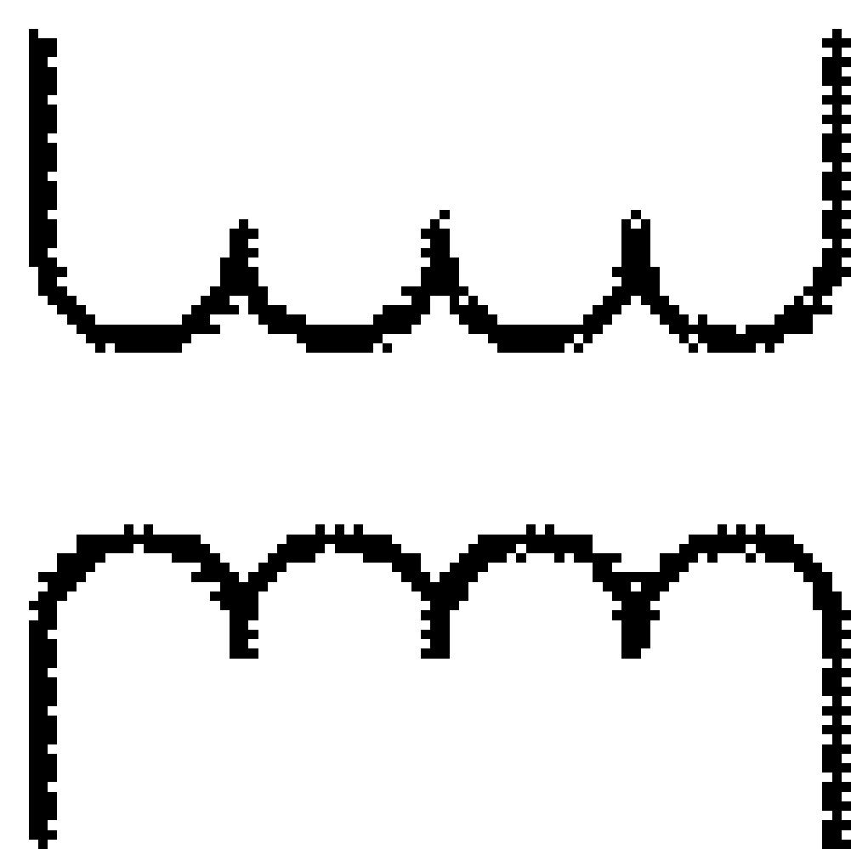
IEC 61850
Substation 1
Substation 2
Power Relays
Default closed
Default open
POI-1
MG1
MG2
POI-2
Motor
ZIP
ZIP
Motor
NG
PV
Critical
Load
ESS
PV
Critical
Load
ESS
Diesel
Notes:
IED: intelligent electronic device (Digital protective relays)
This protocol imposes a 4ms latency restriction

Slide 63
“Upon completing the first phase, nodes in the cohort, i.e., non coordinator nodes, do not leave the round as normal after final flood; instead, they continue to transmit the result at random slots ensuring that it spreads and reaches the coordinator eventually.”
A node reaches completion when all flags are set. “It then proceeds to the final flood stage, i.e., it transmits the final result repeatedly so as to aggressively distribute it in the network, as in Chaos.”

Slide 64
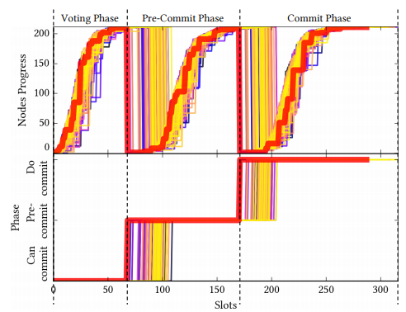
Question
Notes:
In-network aggregation: transmit initially with its own flag. New round transmit only if new info received or neighbor knows less than itself. Until all nodes have all flags set. Once set, flood its message multiple times to signal end of transmission.

Slide 65
Scalability?
IEEE 802.15.4 uses time division for multiple access
“We are limited by the packet size of 802.15.4 of 127 bytes, and typically join up to 10 or 20 nodes per round. However, note that the recent 802.15.4g standard supports packets up to 2kB in certain contexts”
Notes:
What if message cannot fit into the same packet?

Slide 66
Complexity Up/down sides?
Time-slotted operation
Frequency hopping and multiple parallel channels
Notes:
Clock skew and clock drift
What’s the upside of using frequency hopping?
Flying drones in formation

Slide 67
Frequency hopping & Cipher Keys
“For example, after rolling out new cryptographic keys or channel hopping schemes in a network, the new configuration can only be applied once a network-wide agreement has been reached that all nodes are aware of the new data”
Notes:
Author should talk more about How new node can join considering hopping & keys
Falls out of sync

Slide 68
Questions for Discussion
“networked cooperative robots and UAVs agree on maneuvers to execute [3]; wireless closed-loop control applications such as adaptive tunnel lighting [9] or industrial plants [46, 47] agree on set-points for actuators”
Which should use 2PC (blocking) which should use 3PC (inconsistency)?
Also, where is Paxos?

