Slide 1
Live Video Analytics at Scale with Approximation and Delay-Tolerance
Presenter: Kaishen Wang

Slide 2
Outline
Motivation
Core Ideas (Offline + Online, Implementation)
Experimental Data
Thoughts
Take Away Points

Slide 3
Motivation (1)
Video Cameras are pervasive (surveillance, business intelligence, traffic control and crime prevention)
Video analytics can have very high resource demands (the best tracker processes only 1 frame/sec on an 8- core machine, DNN requires 30GFlops to process a single frame)
Resource Management is Important.
Resource-quality trade-off with multi-dimensional configurations
Variety in quality and lag goals

Slide 4
Motivation (2)
Why Resource-quality trade-off with multi-dimensional configurations?
Vision algorithms typically contain various parameters, or knobs
Multiple knobs -> Configuration
Resource demand can be reduced by changing configurations
Find the best configuration
Notes:
Approximation. Example of car tracker and face recognition. Cannot be accurate enough.
other knobs like window size.

Slide 5
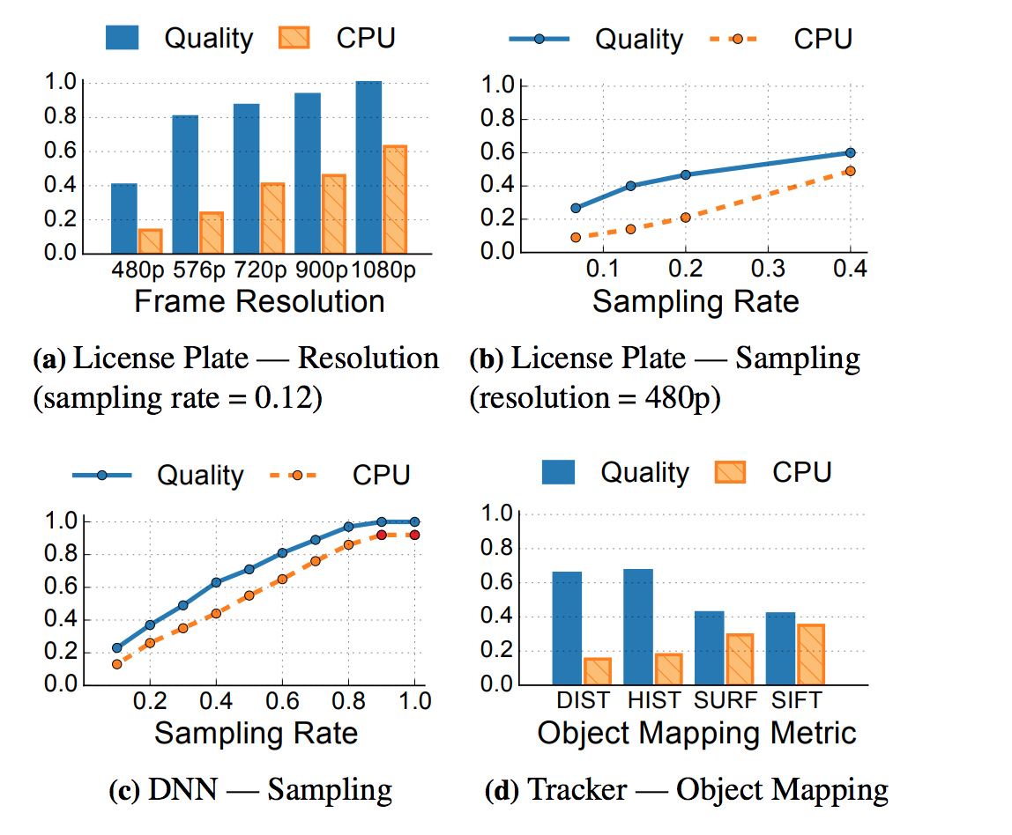
Motivation (3)
Real Word Examples:
License Plate Reader (a&b)
Deep Neural Network (DNN) Classifier (c)
Object Tracker (d)
Ref: https://www.usenix.org/system/files/conference/nsdi17/nsdi17-zhang.pdf
Notes:
Figure 3c profiles a Caffe DNN [54] model trained with the widely-used ImageNet dataset [41] to classify objects into 1,000 categories. We see a uniform increase in the quality of the classification as well as resource consumption with the sampling rate. As DNN models get compressed [45, 46], reducing their resource demand at the cost of quality, the compression factor presents another knob.
we have also profiled an object tracker. This query continuously models the “background” in the video, identifies foreground objects by subtracting the background, and tracks objects across frames using a mapping metric. The mapping metric is a key knob (Figure 3d). Objects across frames can be mapped to each other using metrics such as distance moved (DIST), color histogram similarity (HIST), or matched over SIFT [14] and SURF [15] features

Slide 6
Motivation (4)
Why Variety in quality and lag goals?
Quality VS Lag (temporarily reallocating some resources from the lag-tolerant queries during interim shortage of resources). See the following example:
 | counting cars for traffic control | License plate readers for tolling | License plate readers for amber alert
Quality | moderate quality | high quality | high quality
Lag | No Lag | Tolerate Lag | No Lag

Slide 7
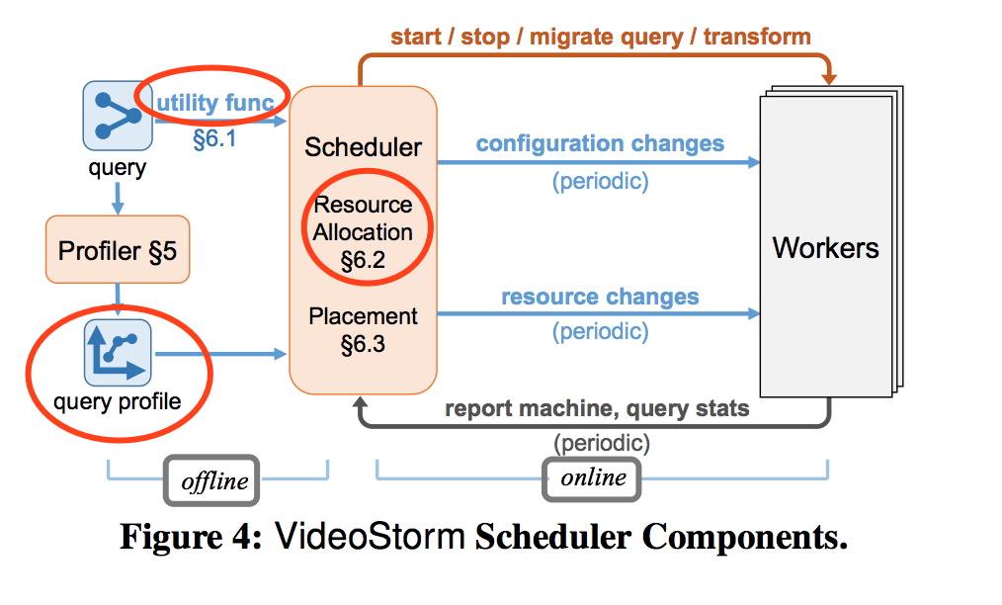
Core Ideas - Overview on VideoStorm
Offline: generate model and reduces config space, solving the first challenge)
Online: optimization, solving the second chanllenge
Ref: https://www.usenix.org/system/files/conference/nsdi17/nsdi17-zhang.pdf
Notes:
When user submits a query to the system, it first go through a profiler to generate a “resource - quality” profile for the query. The user also provides a utility function. Together with the query profile, it then goes to the global manager which schedules the query to on the worker nodes. The scheduler will periodically reschedule the queries, including changing their configurations and reallocating resources among these queries. So we can cut the whole strategy into two phases, the offline (profiling) one and the online one. During offline phase, the profile generates a model that measures the quality and resource impact of different configurations, and also reduce the configuration space significantly. Online scheduler will jointly optimize the quality and lag among multiple queries based on users’ need. the scheduler periodically (e.g., every second) considers all running queries and adjusts their resource allocation, machine placement, and configurations based on their profiles, changes in demand and/or capacity (see Figure 4)

Slide 8
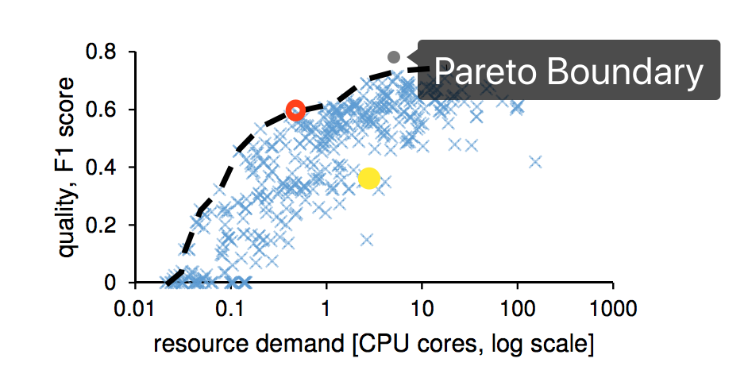
Core Ideas - Offline Profiling
Goal: find mapping configuration -> resource demand & quality
compute against a labeled dataset or a “golden” query configuration (known to produce high-quality results, expensive)
Ref: https://www.usenix.org/system/files/conference/nsdi17/nsdi17-zhang.pdf
Notes:
graph, x and y axis
red point is better than yellow point in both …
given certain resource, red point represents the best quality, and it is called pareto optimal only saves the points on the pareto boundary, and save a lot of space, from thousands to a few
first chanllenge solved

Slide 9
Core Ideas - Online (Utility Function and Scheduling)
for each query, user provides a utility function to scheduler, which encodes the quality and lag requirements of each individual query, the bold part is defined by user
Q_M and L_M: the minimum quality required and maximum lag it can tolerate
U(Q,L) = U (Q=Q_M, L=L_M) + coefficient1 * (Q-Q_M) - coefficient2*(L-Q_L)
scheduling resources
cluster managers like Yarn and Mesos: resource fairness for each query
goal: maximize the minimum utility (max-min fairness) or sum of utilities
tolerate lags (in case of resource shortage)
Notes:
When deployed as a “service” in the public cloud, utility will represent the revenue the cluster operator generates by executing the query; penalties and bonuses in utility translate to loss and increase in revenue. Therefore, maximizing the sum of utilities maximizes revenue. In a private cluster that is shared by many cooperating entities, achieving fairness is more desirable. Maximally improving the utility of the worst query provides max-min fairness over utilities.

Slide 10
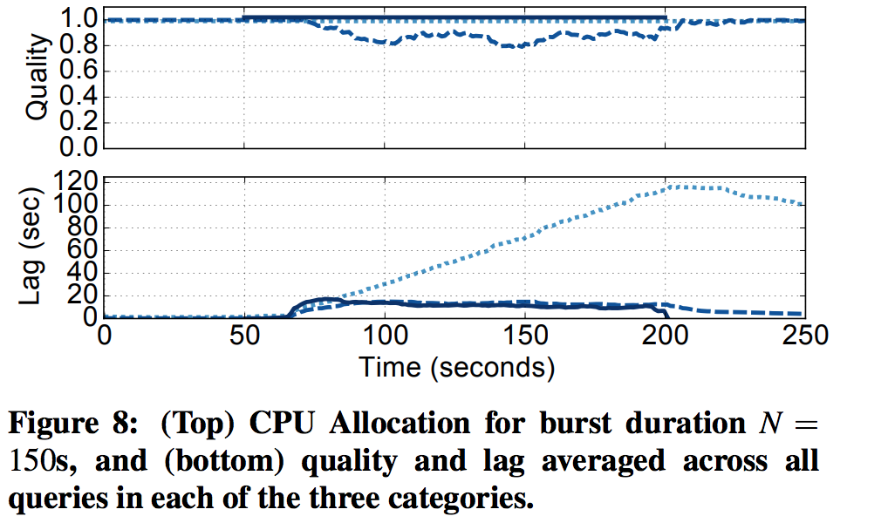
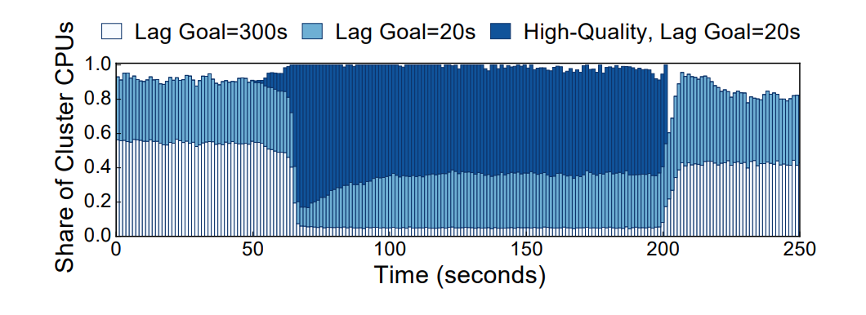
Core Ideas - Online (Example)
Example of how scheduler allocate resources among three different queries, which tolerate some lag and maximize the utility
Ref: https://www.usenix.org/system/files/conference/nsdi17/nsdi17-zhang.pdf

Slide 11
Core Ideas - Implementation
Key points:
input: list of knobs, resource-quality profiles and lag goals
machine-level managers in the cluster frameworks pull work
VideoStorm manager pushes new queries and configuration changes to the machine-managers
machine managers autonomously handle short-term fluctuations
Interfaces:
Processing: byte[] Process(header, data)
Configuration: Update(key, value)

Slide 12
Experimental Data - SetUp
Video Analytics Queries: license plate reader, car counter, DNN classifier, object tracker
Video Datasets: obtained from real and operational traffic cameras in Bellevue and Seattle cities for two months (Sept.– Oct., 2015), stream the recorded videos at their original frame-rate (14 to 30 fps) and resolution (240P to 1080P) to mimic the live video stream
Azure Deployment: One VideoStorm manager+ 100 Workers
Baseline: work-conservative fair scheduler (widely-used scheduling policy for cluster computing frameworks like Mesos)

Slide 13
Experimental Data - Performance Improvements
Deployment on an Azure cluster of 101 machines shows improvement by as much as 80% in quality of real-world queries and 7× better lag
Ref: https://www.usenix.org/system/files/conference/nsdi17/nsdi17-zhang.pdf
Notes:
Not using VideoStrom Placement, i.e., where to place the query and migrate it with eixsiting queries, involves innovations like load balancing and consideration of lags.

Slide 14
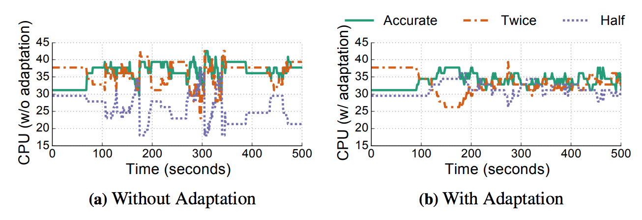
Experimental Data - Accounting for Errors
It can handle errors in profiles with adaptation.
Ref: https://www.usenix.org/system/files/conference/nsdi17/nsdi17-zhang.pdf
Notes:
introduce errors in our profiles, randomly make the profile to be half the actual resource demand for a third of the queries, twice the demand for another third, and unchanged (accurate) for the rest. VideoStorm’s adaptive correction ensures that the quality and lag of queries with erroneous profiles are nearly 99.6% of results obtained if the profiles were perfectly accurate.

Slide 15
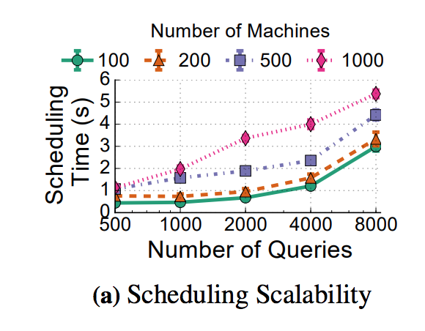
Experimental Data - Scalability
Even with thousands of queries, VideoStorm make its decisions in just a few seconds. This is comparable to the scalability of schedulers in big data clusters
Ref: https://www.usenix.org/system/files/conference/nsdi17/nsdi17-zhang.pdf
Notes:
Even with thousands of queries, VideoStorm make its decisions in just a few seconds. This is comparable to the scalability of schedulers in big data clusters

Slide 16
Thoughts
Good project + good paper, Innovations at different levels
Criticisms:
Definition of “quality” of video
Improvement on utility function (e.g., non-linear reward and penalty)
Able to drop frames to catch up & approximation
How about performance in lack of resource? (No example)

Slide 17
Take Away Points for VideoStorm
Traditional live video analytics are resource consuming
We can turn knobs to save resources
Offline profiling generates candidates of best configurations
Online Scheduling use utility function and specific goal (sum-max utility or min-max utility) to allocate resources for different queries and tolerate lag
Query placement techniques (e.g. lag spreading)
Single machine can handle some fluctuation in resource demand
VideoStorm outperforms fair scheduler in both quality and lag reduction
VideoStorm can handle erroneous profiles and resource capacity change
VideoStorm has good scalability and low transform overhead

Slide 18
Thanks.

Slide 19
Encoding, Fast and Slow: Low-Latency Video Processing Using Thousands of Tiny Threads
Sadjad Fouladi, Riad S. Wahby, Brennan Shacklett, Karthikeyan Vasuki Balasubramaniam, William Zeng, Rahul Bhalerao, Anirudh Sivaraman, George Porter, Keith Winstein
Presenter: Xiaofo Yu

Slide 20
Outline
Motivation
Interactive video processing application
Parallel supercomputing on commercial cloud
Core Ideas - ExCamera’s Two Major Contributions
Experiments
Takeaways & Discussions

Slide 21
Background & Motivation
Need for interactive video-processing applications. (Google Docs for Videos)
Execute video-processing tasks quickly (low latency).
Make results immediately available online.
Video jobs take lots of CPU hours.
Need thousands of threads up instantly assuming job is parallelizable.
Hard to find suitable cloud service for massive heavyweight parallelism.
Video encoders use only coarse-grained parallelism.
Video processing jobs need efficient video encoding. (70% network traffic are encoded videos)
Video encoding relies on temporal correlations among nearby frames.
The finer the parallelism, the worse the encoding efficiency (Cannot exploit correlations).
Notes:
Motivation is the need of a system that can edit, transform and encoding a video (4K or VR) with low latency. Think about Google Docs for Videos where people can collaboratively edit videos like editing text documents. Such a system requires the execution of video-processing tasks with fast speed so that results can be immediately available online.
However, video jobs will typically take hours to complete. So make it fast would need thousands of threads running in parallel and starting up instantly when the request arrives. But fine-grained parallelism usually means the worse encoding efficiency of videos which makes the compressed output larger and transmission time over the network will increase.

Slide 22
Background & Motivation
Advantages of Cloud Function Service
IaaS provides VMs but takes minutes to boot and bills in hours. (AWS EC2)
Microservice frameworks provides event-driven workers start up instantly. (AWS Lambda)
Drawbacks of AWS Lambda
Microservice frameworks are designed for asynchrounous lightweight tasks.
Target for massive parallel heavyweight computations and communications.
Lambda functions must be installed then invoked. Longer time to install than invoke.
Time of worker invocations. Cold Start vs Warm Start.
Limit on the number of workers. 100 -> 1200 per AWS region.
NAT-traversal needed for worker communications.
Limited worker execution time. 5min.
Notes:
Infrastructure as a Service provides VMs start up in minutes and bills in hours increments. Not suitable for short-lived interactive jobs.
Microservice frameworks provides even-driven workers start up instantly and bills in sub-seconds.

Slide 23
Core Ideas: ExCamera Contributions
A framework that can run thousands parallel jobs on a commercial cloud.
Uses microservice frameworks - AWS Lambda, Google Cloud Functions, Azure Functions.
Starts up instantly(milliseconds). Quicker.
Bills usage in sub-second increments. Cheaper.
Allow arbitrary executables. Flexible.
Starts up thousands of threads in seconds.
Manages communication among threads.
A video encoder for massive fine-grained parallelism.
Encodes tiny chunks of video using many threads together. Slow work done in parallel.
Fast serial pass to stitch chunks together. Fast work done in serial.
Notes:
ExCamera made two major contributions:
A general purpose parallel supercomputing framework based on AWS Lambda. Advantages of AWS Lambda + advantages of this framwork.
A video encoder which supports massive fine-grained parallelism.

Slide 24
Core Ideas: ExCamera’s Execution Engine - mu
mu’s High Level Designs - Address the limitations of AWS Lambda.
Central Coordinator with dependency aware scheduling. No deadlock and faster completion.
Workers use same generic Lambda function guided by Coordinator. Always warm start.
Rendezvous Server to coordinate communications among workers.
Number of worker and execution time limit still unsolved…
Architecture
Workers - short-lived Lambda function invocations
Coordinator - long-lived server controlling executions using per-worker FSM descriptions.
Rendezvous Server - Simple relay server for communication among workers.
Notes:
The first contribution is mu based on AWS Lambda. Overview of its high level designs which address the limitations of AWS Lambda.

Slide 25
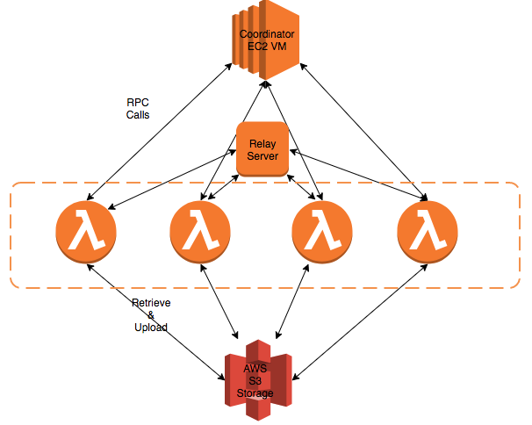
Core Ideas: ExCamera’s Execution Architecture
Lambda functions - thousands of workers/threads

Slide 26
Core Ideas/Background: Video Encoding
Existing Video Encoding Techniques
Exploit temporal similarities among nearby frames.
Key Frame - image which is stored entirely. (Typically first one) Need several MBs storage.
Interframe - only stores the difference from the previous image. KBs of storage.
Serial vs Parallel
Serial: Encode(Image[1:100]) = Key Frame + Interframe[2:100]
Parallel:
Encode(Image[1:10]) = kf1 + Interframe[2:10]
Encode(Image[11:20]) = kf11 + Interframe[12:20]
…
Encode(Image[91:100]) = kf91 + Interframe[92:100]
More key frames => worse compression efficiency => high latency.
Notes:
Background of video encoding and why fine-grained parallelism means worse compression efficiency

Slide 27
Core Ideas: ExCamera’s Video Encoder & Decoder
Mid-stream encoding needs access to intermediate computations.
Formulate this information using state (in Automaton).
Need to import/export state information explicitly.
state = (prob_model, references[3])
Ref: http://www.cs.utexas.edu/~swadhin/reading_group/slides/exCamera.pdf p24
Notes:
-Probability model is a table that tracks which values are more likely to be found in the video and therefore consume fewer bits to compress
-references[3] are 3 reference images that contain the decoded output of previous compressed frames

Slide 28
Core Ideas: Explicit State-Passing Style
Make the state object explicit - Can be transmitted over the network, etc.
decode(state, compressed_frame) -> (state’, image)
decode(*, key_frame) -> (state’, image)
encode-given-state(state, image, quality) -> interframe
Can encode given an external state. Key frame can be replaced with interframe (chunk i-1).
Not as good as Google’s vpxenc
rebase(state, image, interframe) -> interframe’
Transform already compressed frames to a different one based on another state.
No need to redo the slow part. (Better than encode from scratch)
Can work with encode to stitich chunks of compressed videos together. (Serial Work)
Notes:
compressed_frame is a bit string that is either a key frame or interframe
interframe = (prediction_modes, motion_vectors, residue). Encoder spends most time searching for prediction_modes and motion_vectors. Rebasing does not do that again but uses from existing interframe.

Slide 29
Core Ideas: Parallel-Serial Algorithm ExCamera[N,x]
Each threads downloads an N-image chunk of raw video. (11MBs per image for 4K resolution)
Each threads run encoder(vpxenc) => 1 Key Frame + N-1 Interframes.
Each threads run decode N times to find final state and send to next thread.
2...X threads run encode-given-state to encode first image as interframe.
First thread already finishes and uploads videos.
Key frames from 2nd threads are thrown away.
2...X threads run rebase serially to rewrite interframes 2...N in each thread.
Rebase can be done quickly so serial run is fine.
Notes:
ExCamera[N,x]: batches of x threads each handling N frames so entire batch handles N*x frames and will have only one key frame in the end. Batches are run in parallel.

Slide 30
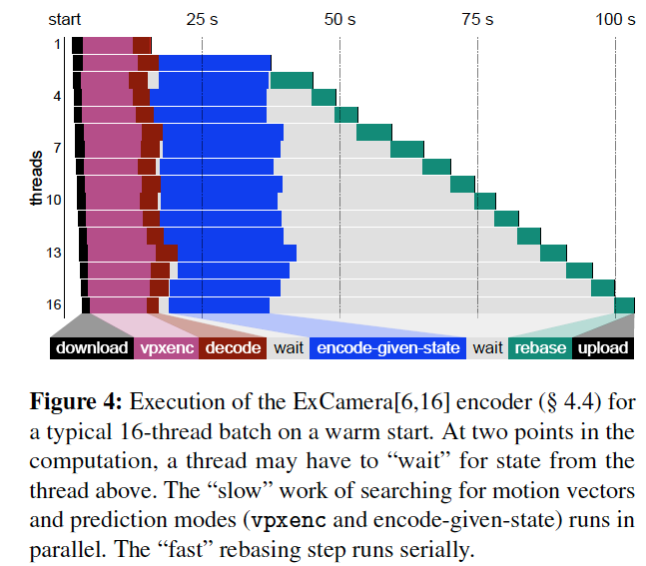
Microbenchmark
Ref: https://www.usenix.org/system/files/conference/nsdi17/nsdi17-fouladi.pdf
encode-given-state takes longer than vpxenc’s encode
Notes:
Microbenchmark is a breakdown of time spend by ExCamera[6,16] of a typical 16-thread batch on warm start.
encode-given-state takes longer than vpxenc.
serial work of rebase makes wait time accounts for most of the end-to-end completion time.

Slide 31
Methods & Metrics
Task: 4K movies of 15-minute animated “Sintel” and 12-minute “Tear of Steel”.
Baselines: vpx(single-threaded), vpx(multi-threaded)
Metrics:
Latency: Time-to-completion
Bitrate: Compressed size / duration
Quality: structural similarity (SSIM)
Cost: $5.4 to encode 15-minute “Sintel”
Notes:
vpx(single-threaded) represents the best possible compression and quality of state-of-art encoder. 7.5h to encode Sintel
vpx(multi-threaded) is a common configuration. It parallelizes compression within each frame. 2.5h to encode Sintel

Slide 32
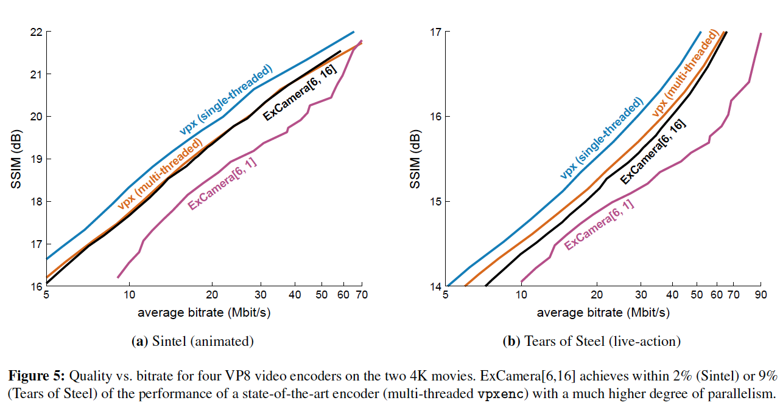
Results
ExCamera[6,16] performs within 2% of the same quality to bitrate compared to vpx(multi)
Ref: https://www.usenix.org/system/files/conference/nsdi17/nsdi17-fouladi.pdf
9% on live-action movie
Notes:
vpx(single) gives the best quality at a given bitrate and naive parallelism [6,1] gives the worst.
[6,16] performs within 2% of the same quality-to-bitrate tradeoff compared to vpx(multi) on animated, 9% on live-action.

Slide 33
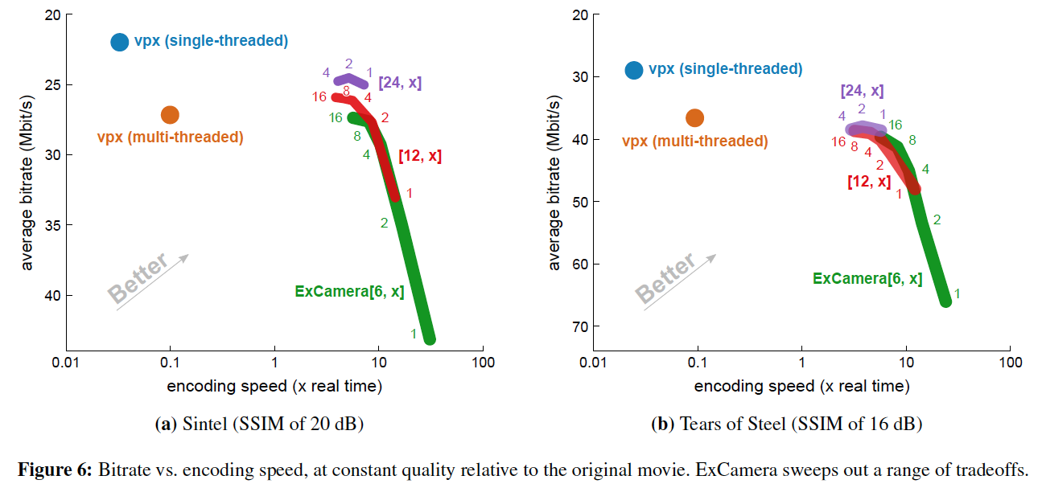
Results
Ref: https://www.usenix.org/system/files/conference/nsdi17/nsdi17-fouladi.pdf
60X to 300X faster than vpx(multi)
Notes:
ran ExCamera with range of settings to produce required quality. Took median of >= 3 runs and linearly interpolate when cannot achieve exact quality
60X to 300X better than vpx(multi) with compressions ranges between 10% better and 80% worse

Slide 34
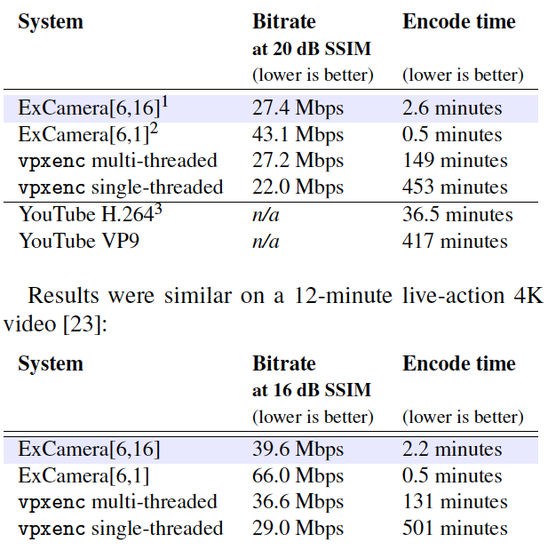
Summary
Ref: https://www.usenix.org/system/files/conference/nsdi17/nsdi17-fouladi.pdf

Slide 35
Summary & Takeaways
Target: low latency video processing application
Major contributions
General purpose parallel supercomputing framework based on AWS Lambda
Fine-grained parallel video encoding which is much faster.
Ideas worth exploring
Single lambda function to ensure warm start on cloud.
Explicit state-passing: useful for midstream computations for video-processing
Rebase technique to avoid redoing slow work serially.

Slide 36
Discussions of Limitations
Experiments with only two videos.
Faster but compression is worse.
Scalability issues if ExCamera’s workload become popular on AWS Lambda.
Encode-given-state is slow and inefficient.
Complex pipeline specifications.
Fault-tolerance: worker failure kills entire job, coordinator failure, etc.
Fine-grained parallelism may not be necessary
Assumes video already in cloud (S3).

Slide 37
Paper Discussion
Scriber: Hyun Bin Lee

Slide 38
VideoStorm: Online Profiling
What kind of things should we consider when constituting a labeled dataset for pre-profiling the queries?
Sophisticated hyperparameter searches for profiler is suggested as a future work.
Notes:
Author cited a paper titled “Practical Bayesian Optimization of ML algorithms” for sophisticated hyperparameter searches

Slide 39
VideoStorm: The Quality-aware Scheduler
Greedy Algorithm
Starvation: what about non-low latency tasks?
Maximize “total” utility
Evaluation only against fair scheduler
What kind of scheduling algorithm can we use as an alternative?

Slide 40
VideoStorm: USENIX Q&A
“Soft” Real-time system:
User Interaction with the Utility Function Configuration
→ no hard deadline, but “penalty” imposed when deadline is missed
→ four parameters (only allow users to choose pre-defined values)
→ may not support all objectives since configuration combinations are limited
→ only provide high level goals and adjust during online phase

Slide 41
ExCamera: Dependence on the Amazon Lambda
“Use AWS Lambda as a supercomputer” (Sadjad Fouladi from USENIX NSDI 17 presentation)
Pros
Cheap (compared with other alternatives like EC2)
Fast (56x faster than existing state-of-the-art Google encoder)
Cons
Lack of sufficient evaluation due to limitations imposed by Amazon Lambda
May need to change parameters (number of Lambda workers, size of each chunk and etc.) depending on how Lambda is being used by others
“May cause Amazon to change how lambdas work”

Slide 42
ExCamera: No Failure Recovery
Lack of fault-tolerance is pointed out by many students.
Acceptable?

Slide 43
ExCamera: USENIX Q&A
Q: Storage System for ExCamera?
A: Raw Video stored in S3
Q: This can be a bottleneck for the system. What is your opinion?
A: Did not experience performance issue regarding storing and loading the video
Q: Is this really “cheap”?

