Slide 1
Machine Learning for Systems:
OtterTune and CherryPick
Presenters: Tarique Siddiqui and Yichen Feng

Slide 2
Machine Learning for Systems
High-Performing low cost Systems critical for Big Data applications!
Large variety of workloads and applications.
Data-driven learning instead of “thumb-rules”!
Goal: Automatically finding the best configuration for: High Throughput, Low Latency, Low Cost
OtterTune: Tuning Databases
CherryPick: Finding Best Cloud Configurations
Tasks:
How to identify workload and application characteristics?
How to model and predict expected performance for different configurations?
How to “quickly” search for optimal configurations?

Slide 3
Automatic Database Management System Tuning Through Large-scale Machine Learning
Presenter: Tarique Siddiqui

Slide 4
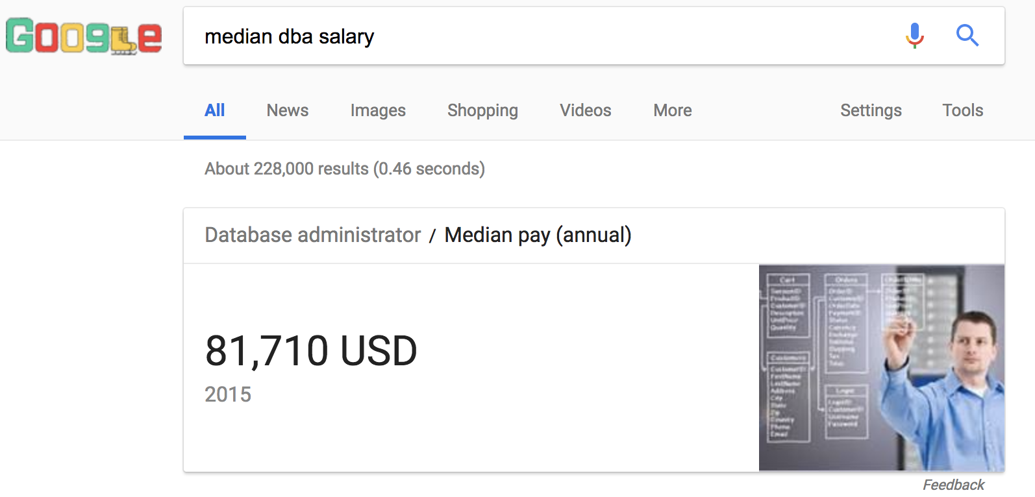
Database Tuning
Finding the right configurations is hard.
.
Modular machine learning pipeline of supervised and unsupervised techniques.
Quickly finds out optimal configurations with performance comparable to DBA configured systems.
OTTERTUNE

Slide 5
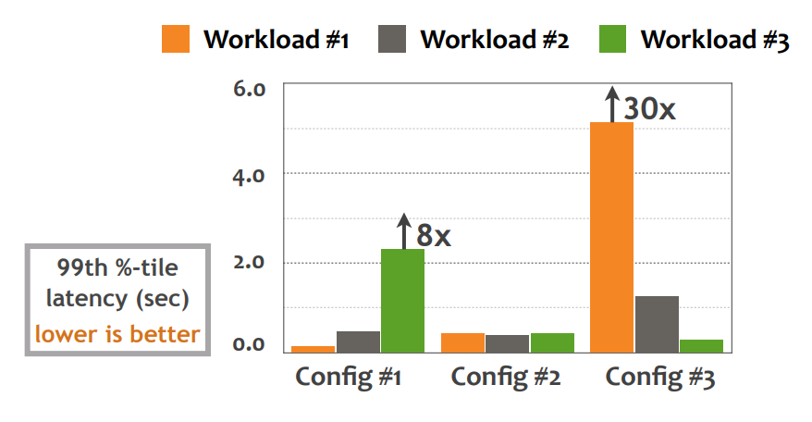
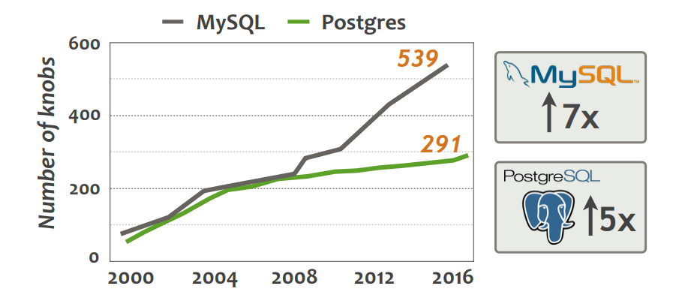
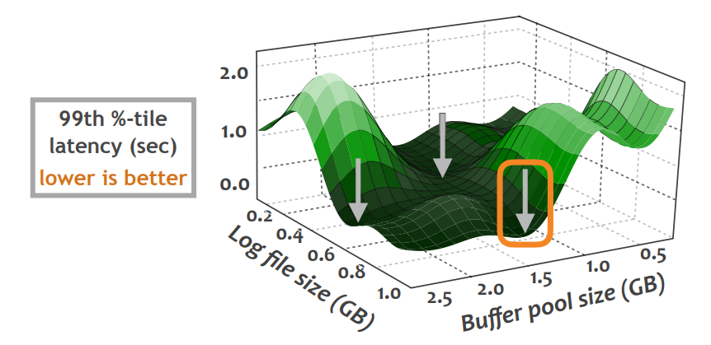
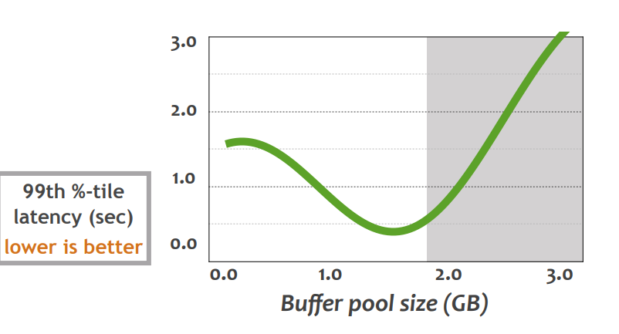
Resource configuration: Challenges!
Non-reusable configs
2) Complexity
3) Dependencies
4) Continuous settings
Notes:
Configurations vary across workload. Best configuration for workload 1 which is config 3 results in poor performance of other two workloads.
The space of configurations has been ever growing as new features and versions are added. This figure shows that over 15 years the number of knobs increased by 5× for Postgres and by nearly 7× for MySQL.
Another key reason is that configurations are interdependent. So far dbms experts suggested changing configuration at a time. This is not only slow but changes in knob affects the benefits of other. Here the authors looked at configurations related to log file size and buffer pool size, and found that the performance of system is best when they both are set to high values, and really bad they are imbalanced.
Finally difference in performance from one setting to next can be irrregular. For example, on changing buffer pool size latency improves but degrades after certain threshold.
The above examples show how tricky it is to configure a DBMS. This complexity is a major contributing factor to the high total cost of ownership for database systems.
A better solution is to develop a tuning tool which can automate the configuration.

Slide 6
Problem Setting
Results:
…...
Target
workload
Performance Metrics
Latency: 50 ms
Throughput: 100 txns/sec
Knob Configurations
shared_buffers: ##
Cache_size: ##
Lru_maxpages: ##
deadlock timeout: ##
………..
………..
Metrics (runtime behaviour):
Pages_used: 80
Cache_misses: 20
Blocks_fetched: 5
………..
………..
What knobs are important?
What values to set?
3) Which previous workloads are similar to target workload?
OTTERTUNE
(Tuning tool)
Knob Configurations
?
Repository
ML Models

Slide 7
ML Pipeline
Workload
Characterization
Knobs Identification
Automatic Tuner
Minimal set of metrics to identify the workload.
What knobs are critical for a particular system?
What values to set for knobs such that performance improves?

Slide 8
Workload Characterization: Features
Logical Features
SELECT C_FNAME, C_LNAME
FROM CUSTOMER
WHERE DEPART=? AND REGION=?
ORDER BY C_LNAME
Pros:
Fixed
Cheap to compute
Cons:
Lacks Execution info
table= {CUSTOMER}
attributes = {C_FNAME, C_LNAME, DEPART, REGION}
order = {C_LNAME}
aggr = {}
Pros:
More descriptive
More related to knobs
Cons:
Large number of features
Redundant
Physical Features
tupleRead= {CUSTOMER}
tuplesWritten = {#,#}
memory = {#,#}
cpu= {#,#}
blocksFetched={#,#}

Slide 9
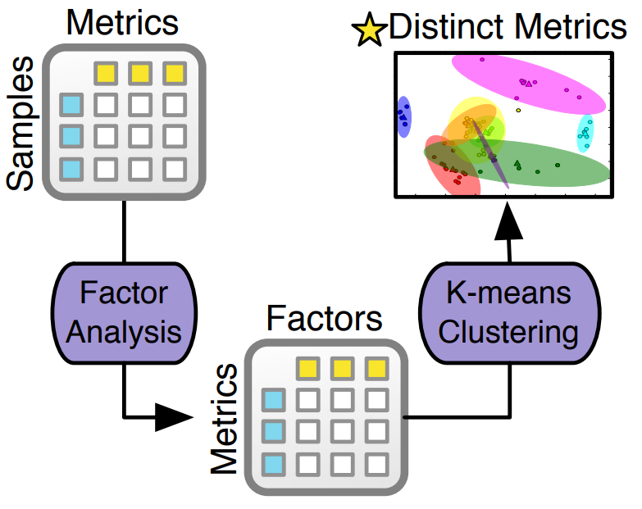
Workload Characterization: Identifying Minimal Set
Phase 1 (Dimensionality Reduction)
Find correlations among metrics using Factor Analysis
M1= 0.9F1 + 0.4F2 + … + 0.01F10
M2 =0.4F1 +0.2F2 + … + 0.02F10
….
M100=0.6F1+ 0.3F2 + … + 0.01F10
Phase 2 (Clustering)
Apply K-Means clustering using a few factors.
Select one representative metric from each cluster
131 metrics for MySQL reduced to 8 and 57 metrics for Postgres were reduced to 9.

Slide 10
ML Pipeline
Workload
Characterization
Knobs Identification
Automatic Tuner
Minimal set of metrics to identify the workload.
What knobs are critical for a particular workload?
What values to set for knobs such that performance improves?

Slide 11
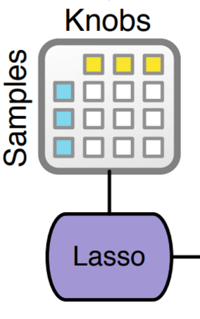
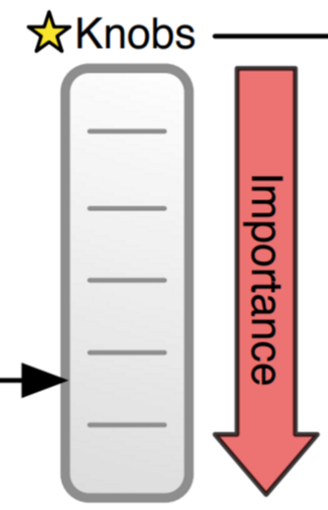
Knobs Identification
DBMS have too many knobs, only subset of them affect performance.
Uses Lasso to identify relevant knobs.
Lasso = L1 regularized linear regression
Often used for feature selection
Assigns zero or extremely low weights to noisy knobs
For capturing nonlinear correlations and dependencies uses polynomial features
Incrementally increases the number of knobs used in a tuning session.

Slide 12
Incremental Knob selection
4 knobs
Fig: The performance of the DBMSs during the tuning session using different configurations generated byOtterTune that only configure a certain number of knobs.
Incremental knob selections: Starts with 4 knobs and adds 2 knobs every 1 hr.
4-8 knobs sufficient in most databases.
Fully optimizing most impactful knobs and then moving on to less impactful knobs is faster.

Slide 13
ML Pipeline
Workload
Characterization
Knobs Identification
Automatic Tuner
Minimal set of metrics to identify the workload.
What knobs are critical for a particular workload?
What values to set for knobs such that performance improves?

Slide 14
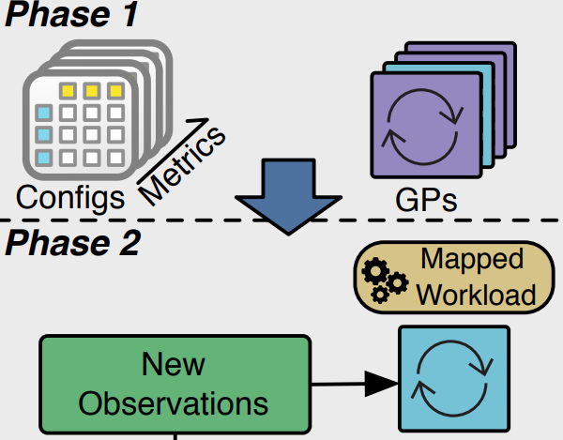
Automated Tuner: Two-step analysis
Recommends knobs configurations to try.
Phase 1: Workload Mapping
Identifies workload from a previous tuning session that is most similar to the target workload.
For measuring similarity between workloads: uses Average Metric Distance

Slide 15
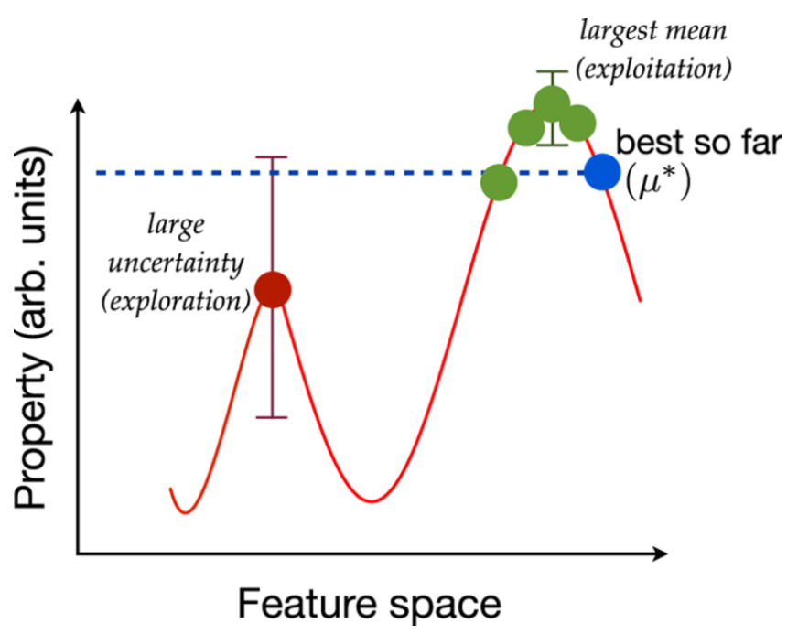
Automated Tuner: Two-step analysis
Phase 2: Configuration Recommendation
Fits Gaussian Process (GP) Regression model to data from mapped and current workload
GP provides a principled framework for Exploration vs Exploitation
Exploitation: Search for configurations near to current best.
Exploration: Search for configurations in unexplored areas.
*Fig from https://www.biorxiv.org/content/biorxiv/early/2016/12/19/095190.full.pdf

Slide 16
Experimental Setup
DBMSs: MySQL (v5.6), Postgres (v9.3), Actian Vector (OLAP)
Training data collection:
15 YCSB workload mixtures
4 sets of TPC-H queries
Random knob configurations
~30k trials per DBMS
Experiments conducted on Amazon EC2

Slide 17
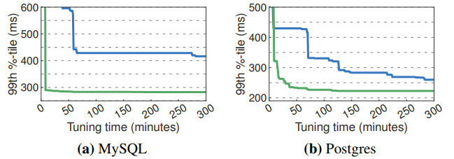
Tuning Time (Training data helps)
25 mins
45 mins
iTuned: Opensource tuning tool.
Both use GP regression for config search.
Both use incremental knob selection
iTuned trained on only 10 different configurations vs OtterTune 30k observation period.

Slide 18
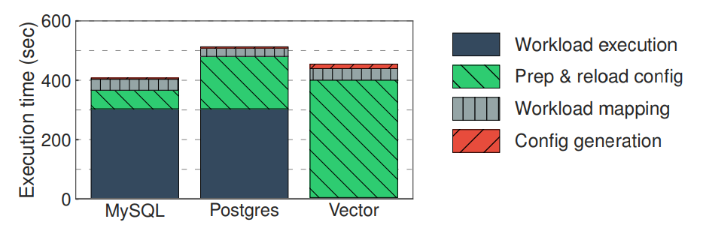
Execution Time Breakdown
Data reload during restart
DBMS Restart
Negligible (2-3 seconds)
Observation period (5 mins)
Figure: The average amount of time that OtterTune spends in the parts of the system during an observation period.

Slide 19
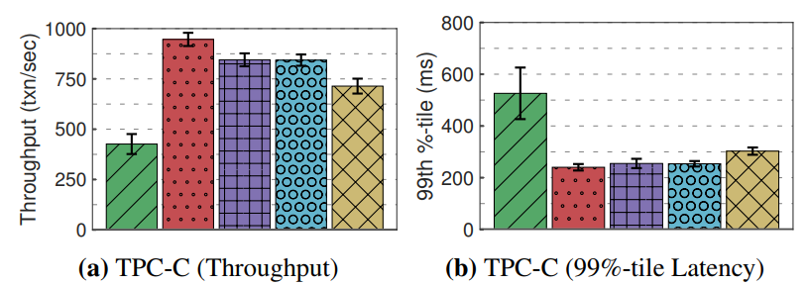
Performance when compared with other approaches
OTTERTUNE
OTTERTUNE
Didn’t compare with db specific tuning tools. (E.g., PgTune for Postgres).

Slide 20
Conclusion
Takeaways
Generic, modular tuning system which doesn’t depend on DBMS type and version.
Automates database tuning in a short time.
Machine learning can simplify complexity to a great extent.
Limitations
Does not support multi-objective optimization --- Tradeoffs always there. (e.g., Latency vs recovery).
Didn’t compare with db specific tuning tools. (PgTune for Postgres, myTune for MySQL)
Ignores physical database design: data model, index.
Agnostic of hardware capabilities
Restarts, not have enough privileges, interacts via REST API (extra latency).

Slide 21
CherryPick: Adaptively Unearthing the Best Cloud Configurations for Big Data Analytics
Omid Alipourfard, Yale University; Hongqiang Harry Liu and Jianshu Chen, Microsoft Research; Shivaram Venkataraman, University of California, Berkeley; Minlan Yu, Yale University; Ming Zhang, Alibaba Group (NSDI 17)
Presenter: Yichen Feng

Slide 22
Motivation
Poorly VM/Cloud configuration can result Performance⬇, Cost⬆
Application | Avg/min | Max/min
TPC-DS | 3.4X | 9.6X
TPC-H | 2.9X | 12X
Regression (SparkML) | 2.6X | 5.2X
TeraSort | 1.6X | 3X
66 Configurations
Compared to Minimum cost of configuration
Large search space
66
AWS Instance
X 10
Cluster Size
= 660
Configuration

Slide 23
Background and Challenges
Cloud Configuration
CPU
Cores
VM #
RAM Size
Disk Size
• • • • •
Representative Work
A selected workload for learning best config.
Complex performance model
Cost model
Heterogeneity of applications
Notes:
Cloud configuration is represented as CPU cores, number of VMs in a cluster, CPU speed, RAM size, DIsk size, Disk speed and so on.
The representative work is used to learn and suggest configuration for similar workloads.
There are three challenges for picking the best cloud configurations for big-data analytic jobs.
Complex performance model: The running time is affected by the amount of resources in the cloud configuration in a non-linear way. For instance, Figure 1 shows a regression job on SparkML sees a diminishing return of running time at 256GB RAM. Some job even increasing their running time slightly. So the improvement of more resources could be marginal.
Cost model: The cloud charges users based on the amount of time the VMs are up. Using configurations with a lot of resources could minimize the running time but it may cost a lot of money. Figure 2 shows the cost is not monotonically increase or decrease when we add more resources.
The heterogeneity of application：Figure 3 shows that different applications have different preferences. For Terasort, low memory instance perforces best because CPU is critical. On the other hand for regression, it prefers more RAM.

Slide 24
Desired properties
Accuracy
Modeling the running time and total cost accurately
Overhead
Adaptivity
CherryPick
Cost of searching the best cloud configuration
Can be used for different big-data analytic jobs
Just accurate enough

Slide 25
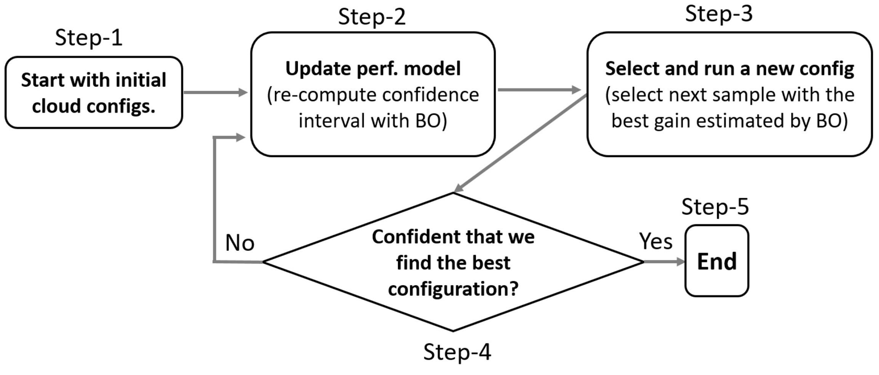
CherryPick
Just accurate enough to separate the near-optimal configuration from the rest through a few runs
Only work for repeating work
System Workflow

Slide 26
Problem formulation
Total cost
Price func.
Time func. (unknown)
Time threshold
Fast CPU, Larger RAM size,...
Configuration vector

Slide 27
Bayesian Optimization
Learn quickly with a few samples
Compute confidence interval of cost model
Select next sample with the best gain
Non-parametric
Suit for variety of applications
Why
BO?
A Few samples
Low overhead
Tolerant uncertainty
Few samples lead to imperfect result
Unstable cloud: e.g. Stragglers
Acquisition Function
Smartly decide the next point to sample based on Expected Improvement (EI)

Slide 28
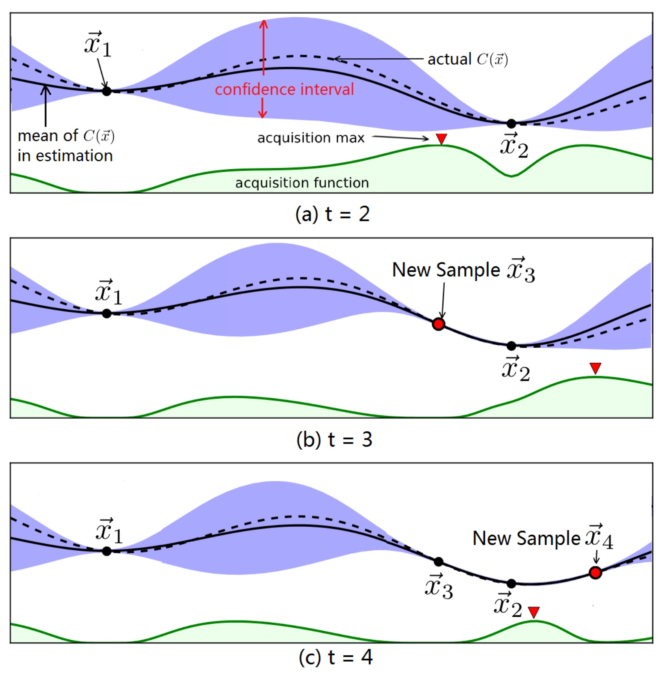
BO in CherryPick
Starting point
Random 2 or 3 samples
Encoding cloud configuration
Slow or fast CPU (Disk speed)
e.g. (fast CPU, 16GB RAM) instead of
( 2.2GHz CPU, 16GB RAM)

Slide 29
BO in CherryPick
Start with 2 random configurations
Select next sample according to acquisition function

Slide 30
BO in CherryPick
Update the confidence interval
Select next sample according to acquisition function

Slide 31
BO in CherryPick
Update the confidence interval
Select next sample according to acquisition function

Slide 32
BO in CherryPick
Starting point
Random 2 or 3 samples
Encoding cloud configuration
Slow (smaller) or fast (larger) CPU (RAM)
e.g. (fast CPU, larger RAM) instead of
(> 2.2GHz CPU, > 16GB RAM)
Stopping condition
Expected improvement < Threshold
AND
At least N (e.g. N=6) trails

Slide 33
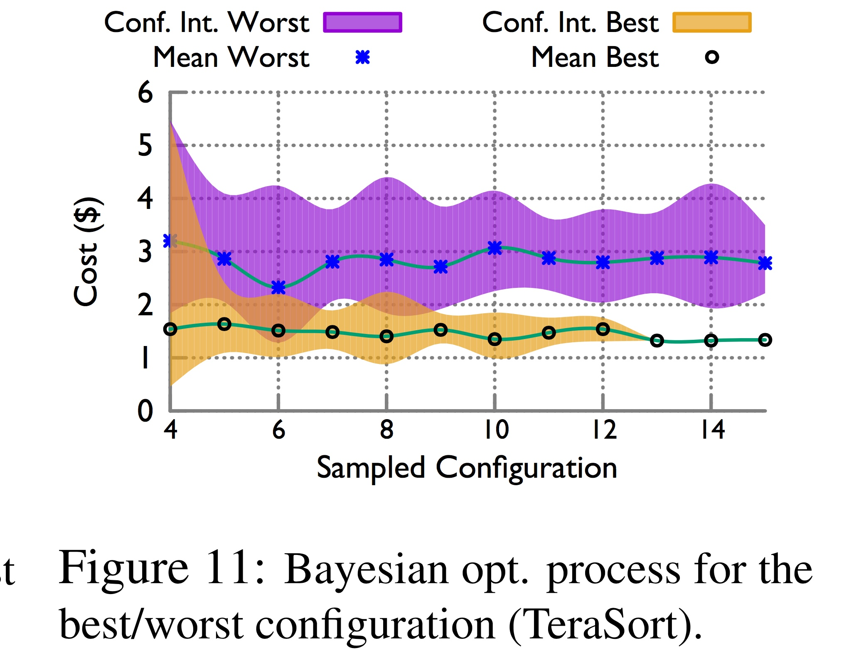
CherryPick’s Decision Process
Worst part
Best part
Focuses on improving the estimation for configurations that are closer to the optimal

Slide 34
Experiment setup
Datasets
TPC-DS | Decision support workload (SQL) | High CPU and IO load
TPC-H | Large date decision support queries (SQL)
TeraSort | Benchmarking big data analytic job | Balance High IO and CPU speed
SparkReg | Machine learning work | High memory space
SparkKm | K-way clustering
Cloud Configurations
Instance family | M4 (General Purpose)
 | C4 (Compute Optimized)
 | R3 (Memory optimized)
 | I2 (Disk Optimized)

Slide 35
Experiment setup
Baselines:
Exhaustive search | Search all possible Configuration
Coordinate descent | Search CPU first, then RAM, then Disk,...
Random search with a budget | Random pick up a number of configurations within the budget
Ernest | Performance model for pre-defined instance type
 | Poor adaptivity, must specify instance type
Metrics:
Running cost | Expense to run a job with selected configuration
Search cost | Expense to run all the sampled configurations

Slide 36
Search Path
RAM is critical
CPU is critical

Slide 37
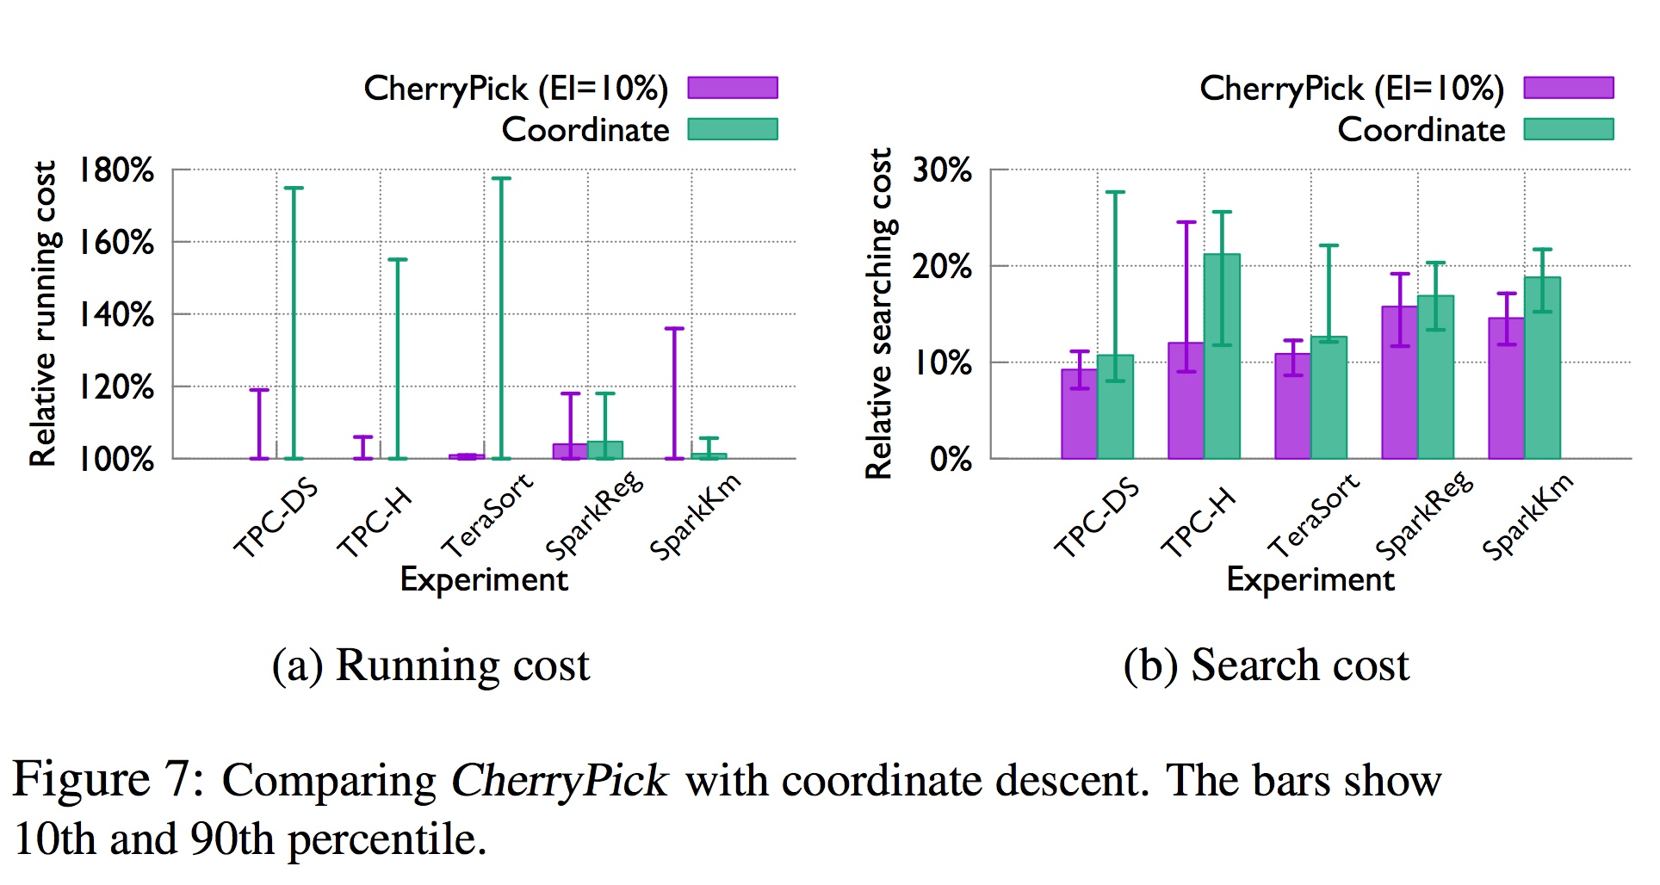
Results
CherryPick finds the optimal configuration in a high chance (45-90%) or a near-optimal configuration with low search cost and time
CherryPick is more stable in picking near-optimal configurations and has less search cost than coordinate descent
Coordinate descent
Search CPU first, then RAM, then Disk,...
Start from all the 66 config.
CherryPick’s Setting (20 times)
EI | 10%
N (least trails) | 6
Initial Samples | 3
Time Threshold | Loose
Less stable than Coordinate for ML job

Slide 38
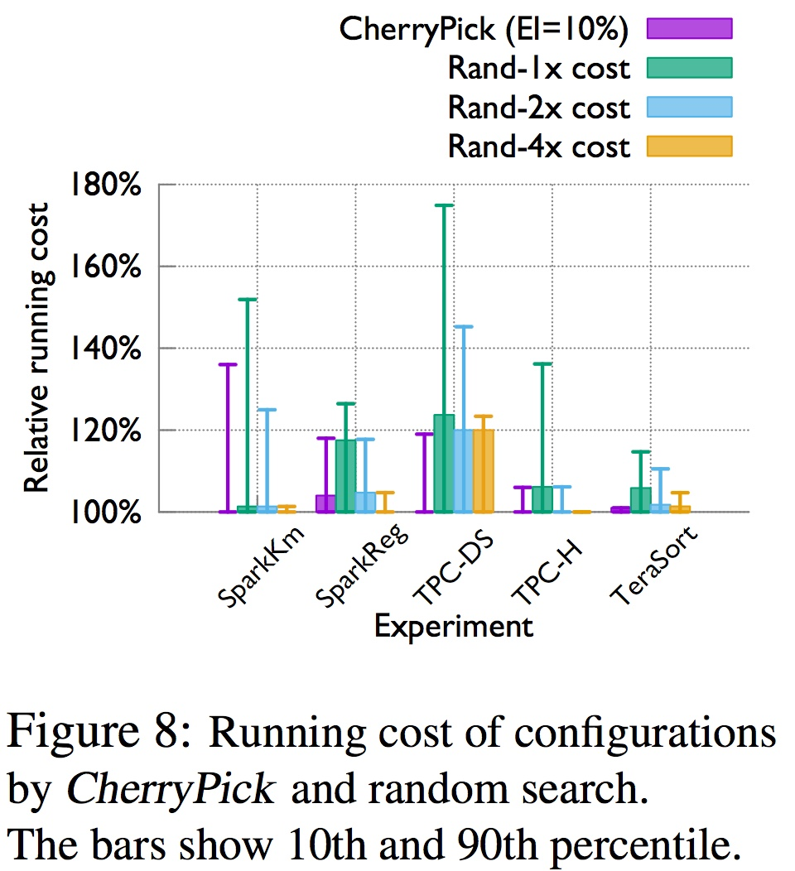
Results
CherryPick reaches better configurations with more stability compared with random search with similar budget
Random search with a budget
Random pick up a number of configurations within the budget
CherryPick’s Setting (20 times)
EI | 10%
N (least trails) | 6
Initial Samples | 3
Time Threshold | Loose

Slide 39
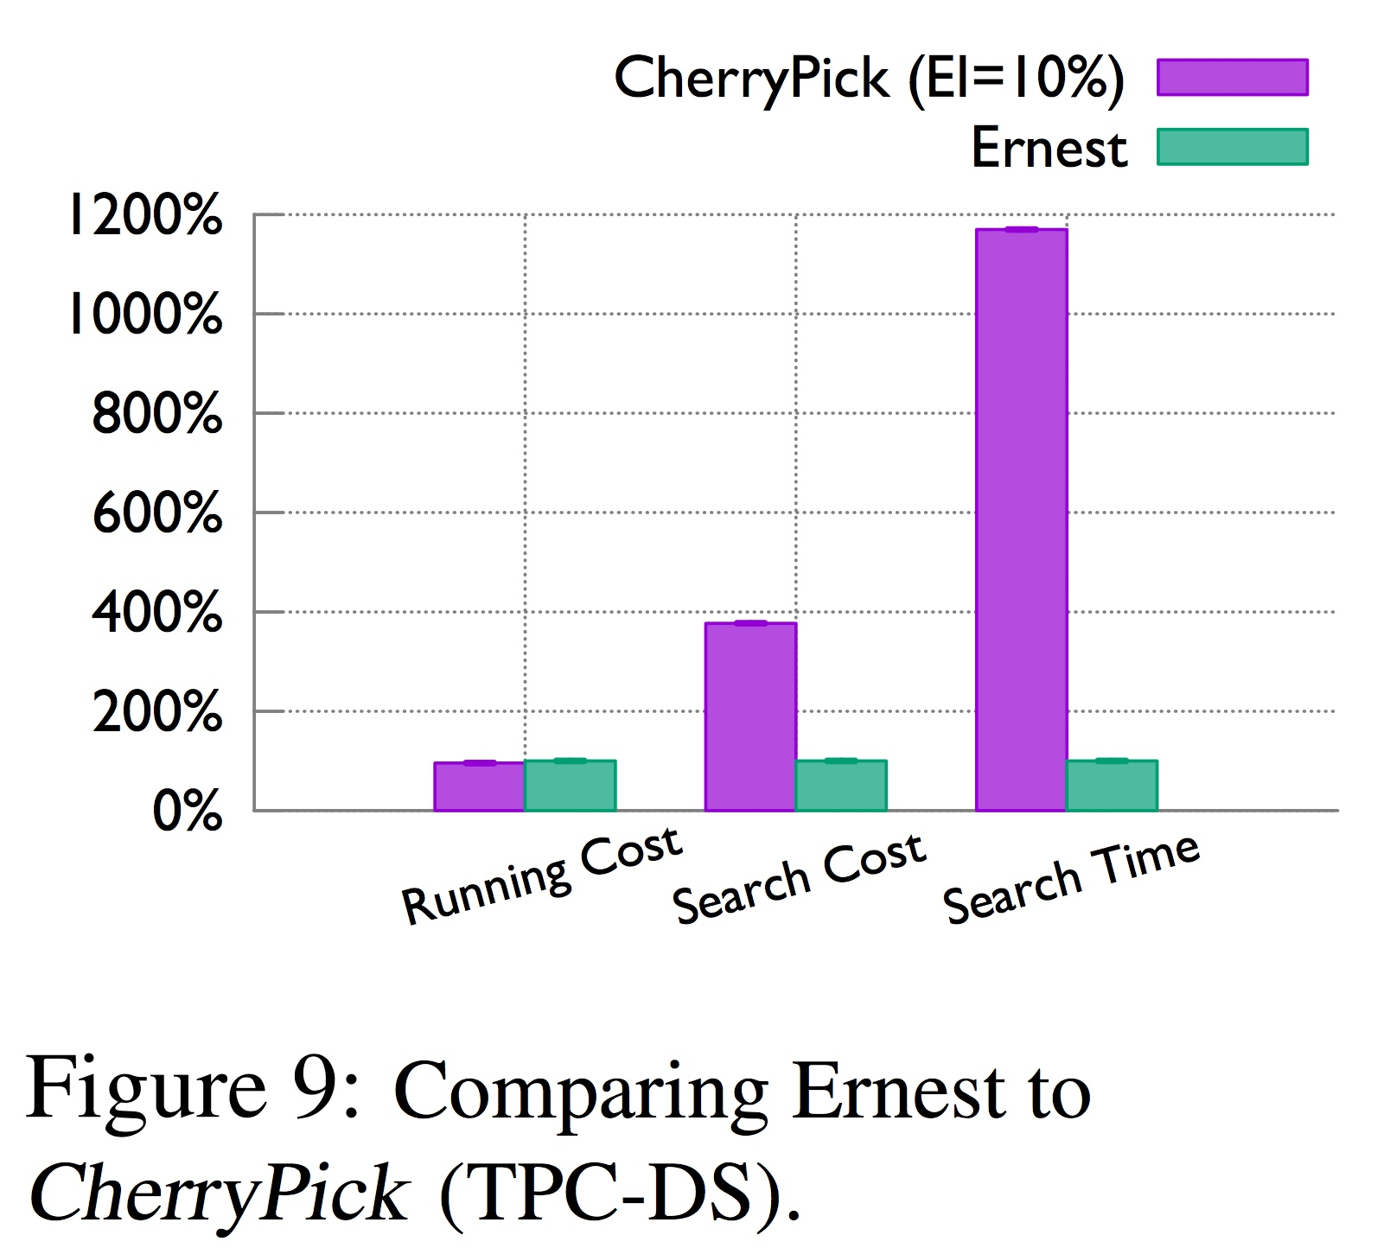
Results
CherryPick reaches configurations with similar running cost compared with Ernest, but with lower search cost and time
Ernest
Performance model for pre-defined instance type
CherryPick’s Setting (20 times)
EI | 10%
N (least trails) | 6
Initial Samples | 3
Time Threshold | Loose

Slide 40
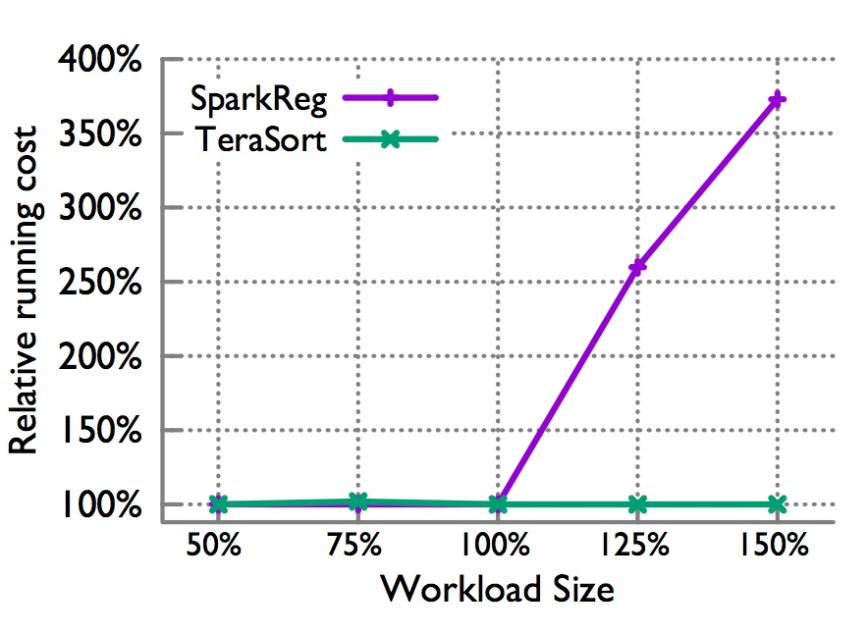
Limitations
Can only work for repeating jobs (40%)
Fixed Representative workload
➔ Low elasticity
Introducing many hyperparameters
No performance guarantee
Lack of precision:
Configuration representation is normalized, fast CPU instead of 2.7GHz CPU

Slide 41
Key-Takeaways
Simultaneously achieving high accuracy, low overhead and adaptivity is hard, we can make a trade-off between these properties
Best cloud configuration is defined by both time and cost of money
Optimal cloud configuration is the right one, not the most powerful one

Slide 42
Discussions

Slide 43
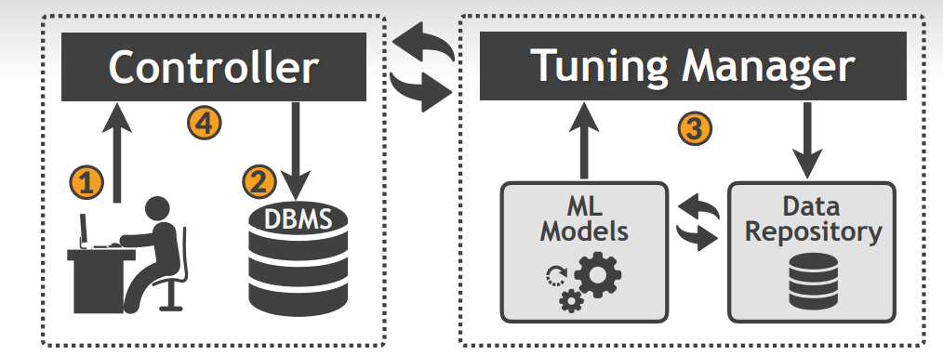
OtterTune
Some issues we observed:
Restart problem
Privileges
More Online
Further reduce latency
Should machine learning based tuning components reside inside (unlike OtterTune which sits outside) Database Management Systems?
Pros / Cons

Slide 44
OtterTune
2. OtterTune doesn’t support multi-objective optimizations. E.g., Latency vs Recovery. If the target is latency, it’s possible that configurations suggested by OtterTune are terrible from recovery point of view.
Similarly, what additional features/aspects can be added to the system to improve it further?

Slide 45
OtterTune
3. Are models used with OtterTune interpretable? Can there be more interpretable models? Can there be a mixed (DBA + ML) approach?

Slide 46
Discussion: CherryPick
In order to find optimal configurations, CherryPick introduces several hyperparameters: (select representative work, initial samples, stopping criteria (Expected improvement) and least trails). What’s your thought on this?

Slide 47
Discussion: CherryPick
In what situation, you will think CheeryPick is a better choice (compared to exhaustive search, human expertise..) for selecting cloud configuration?

Slide 48
Discussion: CherryPick
Since some applications are sensitive to workload size and CherryPick is limited by representative workload, do you have any ideas about how to select the best cloud configuration while adaptively accepting the workload change?

Slide 49
Thank you!

