Slide 1
Erasure Coding: Giza + Hyperbolic Caching

Slide 2
Giza
Erasure coding objects across Global Data Centers
Yu Lin Chen, NYU & Microsoft Corporation; Shuai Mu and Jinyang Li, NYU;
Cheng Huang, Jin Li, Aaron Ogus, and Douglas Phillips, Microsoft Corporation
Presented by: Samarth Kulshreshtha

Slide 3
Why the name ‘Giza’?
Image source: news.com

Slide 4
Cross-DC Erasure Coding
n = k + m => m parity fragments for k data fragments
All n fragments are stored in separate DCs
Can tolerate m arbitrary DC failures
Benefits - fault tolerance, security, availability
Parity
DC 1
a = 3
DC 3
Why not just replicate?
a + b = 5
DC 2
b = 2
Notes:
Reed solomon encoding - invertible matrices
More storage vs computation [Spark vs Hadoop]

Slide 5
Important questions to ask
What?
Challenges / Goals?
A strongly consistent, versioned object store that applies erasure coding across global data centers on top of Azure Storage
Achieve single cross - DC round trip latency under contention free workload
Maintain strong consistency even in the presence of conflicting access
Why?
Reduce storage cost
Notes:
Challenges:
Ask for highest version, then increment and then write - 2 RTT

Slide 6
Why even bother about Azure Storage?
>60
>10¹⁸
trillion stored objects ⁺
bytes in size ⁺
38
geographical regions
+ ACM SIGCOMM 2015 Keynote

Slide 7
Building a case for Giza
Deletion not uncommon! Objects worth 26.5% of total capacity deleted after one year
47 % of the bytes read occured on the same day of object creation; 2 % occurred beyond a month
< 0.9 % space occupied by objects < 4 MB
Microsoft OneDrive Characteristics [all reads/writes/updates to all objects for 3 months
Notes:
Use existing replication for objects less than 4 MB since there will be overhead in erasure coding small objects and storing their metadata
Since the temperature of the objects drop quickly - cache objects for short periods in one DC - serve reads from the cache [CACHING ENTIRE OBJECT RAISES STORAGE OVERHEAD to 2x (replication) for a short period of time]
Concurrency in one second
Giza incurs 1x cross DC n/w traffic for writes and 0.5x for reads
Since non trivial amount of bytes were deleted therefore removing the deleted objects from underlining cloud storage and reclaiming capacity is crucial in achieving storage efficiency

Slide 8
Building a case for Giza
58 % never updated. ONLY 0.5% UPDATES ARE CONCURRENT!
Update frequency of objects
2.3x * (0.5x [R] / 1x [W]) = 1.15x (no-caching)
Why does it go down with caching time?
Cross-DC network traffic
Notes:
Use existing replication for objects less than 4 MB since there will be overhead in erasure coding small objects and storing their metadata
Since the temperature of the objects drop quickly - cache objects for short periods in one DC - serve reads from the cache [CACHING ENTIRE OBJECT RAISES STORAGE OVERHEAD to 2x (replication) for a short period of time]
Concurrency in one second
Giza incurs 1x cross DC n/w traffic for writes and 0.5x for reads
All objects that were created in the span of 3 months - their deletion trace were followed up to an year
Since non trivial amount of bytes were deleted therefore removing the deleted objects from underlining cloud storage and reclaiming capacity is crucial in achieving storage efficiency

Slide 9
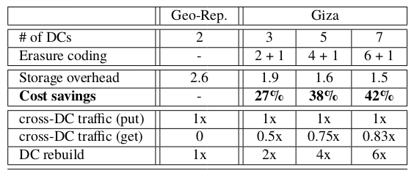
Giza Trade-offs ($$$)
Alternative Approach to handle cross-DC read traffic: Instead of striping individual objects, erasure code “volumes”.
PROBLEM: Deleting individual objects is tedious.
Geo-Rep: Singe DC overhead = 1.3; Why does it decrease as k goes up?
Less storage overhead => more savings.
Geo-Rep: Entire object needs to be sent across.
Giza: Cross DC traffic / object size = k / k = 1x.
Geo-Rep: Entire object on same DC
Giza: Cross DC traffic / object size = (k - 1) / k
Whole DC down, kx overhead to reconstruct
Notes:
Size of parity fragment goes down with an increase in the number of fragments
k+1 fragments, 1 fragment on same DC, need to send other ‘k’ fragments to remote DCs
Need k fragments to rebuild object, 1 fragment on same DC, need to get other ‘k-1’ fragments from remote DCs. So
Ensures entire object stays in one DC thus reducing cross-DC read traffic.
Giza must support deletion. Deleting objects from logical volumes (and canceling them from corresponding parity volumes) would result in complex bookkeeping and garbage collection, greatly in- creasing system complexity

Slide 10
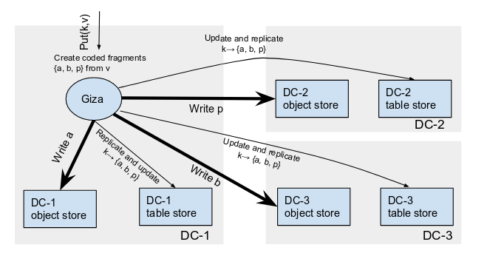
Architecture
Immutable fragments simplify data path
Notes:
Stores mutable versioned objects; each update creates a new version
Data fragments have IDs; metadata store version and fragment IDs
Why on top of Azure Storage
Allows the rapid development of Giza by re-using mature, deployed, and well-tested systems
It simplifies the failure recovery and deployment: Giza runs on stateless nodes and can be readily integrated with the rest of the stateless cloud storage front-ends.

Slide 11
Metadata path: Challenges
Building a strongly consistent, geo-replicated metadata store out of existing single-DC cloud tables. How are the tables consistent across DCs?
Jointly optimizing the data and metadata paths to achieve a single cross-DC round trip for read/write operations. What if one of the paths fails?
Performing garbage collection efficiently and promptly. What if a DC is down during GC?

Slide 12
Metadata Write - No Conflict [Fast Paxos]
Pick the next version number by reading known committed versions
After a Fast Quorum of PreAccept responses the version is committed
One cross-DC round trip
Send PreAccept request to all cloud tables - an atomic conditional update (ACU) which succeeds if the version number isn’t already used (conflict)
Async. send Commit Confirmation to all other tables to update known committed version
Notes:
Use Paxos to handle conflicting writes
Size of fast quorum is 3n / 4
Classic - coordinator proposes a value ; Fast - acceptors are allowed to pick their own values
Commit confirmation is again an atomic conditional update, which only succeeds if the version number is not yet included in the current set

Slide 13
Metadata Write - Conflicts [Classic Paxos]
Concurrent writes from different DCs or cloud table failures
Pick a distinguished ballot number
Send Prepare Request to write the ballot to all the metadata tables
Succeeds only if the highest ballot seen is no more than the ballot in the Prepare request
Wait for a majority of
Responses (each includes entire row)
Send AcceptRequest to all
ACU which succeeds in writing highest accepted ballot and highest accepted value if neither highest ballot seen nor highest accepted ballot is larger
Pick a commit value from the replies:
1. If there is a highest accepted ballot, pick it.
2. If no accepted value, but rather pre-accepted values. Pick the pre-accepted value returned by max responses in the quorum.
3. Neither a pre-accepted nor accepted value => no real impact from contention. Pick current metadata as the value and proceed.
Quorum of AcceptRespone and Commit Confirmation
Notes:
1 and 2 imply the chances of an ongoing Paxos instance, so pick the value so as to complete the Paxos instance first, then start with a new version and follow the fast path to commit its current metadata.

Slide 14
Metadata Read
Read metadata table rows from all DCs which have the fragments. Why?
* If majority rows have matching known committed versions but haven’t accepted any value for a higher version => return the metadata of the highest one
* If replies contain an accepted value with a higher version number than the known committed versions, follow a slow path similar to the one in the write operation. Why?
Notes:
Might not be a part of the write quorum so check with others
This is to confirm whether the higher version has indeed been committed

Slide 15
Joint optimization of data and metadata operations
All operations in parallel. What if one one of the paths fail?
Put operation:
Wait for ack from both data and metadata paths as well as Commit Confirmations
Get operation:
Read metadata table row from local DC to get known committed versions and names and locations of the latest version fragments
Immediately start reading fragments, in parallel validate if this version is indeed the latest one
If validation fails, issue read again for the new version
Notes:
If data path succeeds while the metadata path fails. Now, the fragments stored in the cloud blobs become orphans. Giza will eventually delete these fragments and reclaim storage through a cleaning process, which first executes Paxos to update the current version to no-op , discovers the orphan fragments as not being referenced in the metadata store, and then removes the fragments from the corresponding blob storage in all the DCs.
If metadata succeeds but data fails, then fallback to read the previous version - specified in known committed versions
Validation fails only in the case of concurrent writes

Slide 16
Deletion and Garbage Collection
Execute metadata path to write a new version indicating deletion, once the metadata update succeeds ack deletion
Garbage collection:
Delete objects from blob storage and truncate columns of deleted versions from metadata table row
Steps: 1. Fetch metadata 2. delete fragments 3. truncate columns
Two phase commit for truncating row
What happens when a DC goes down during delete?
Notes:
Delete first and then truncate - in case GC gets interrupted to avoid orphans
First phase : Rows in all the DCs are marked as CONFINED - disable get/put for this object; Second phase: remove row: DISADVANTAGE: All DCs need to be online [CAP]
Contending put request that’s why two phase commit
What if DC is down and now delete? My guess: delete won’t go through

Slide 17
Failure Recovery
Within DC failures resolved by cloud object store and table store
Transient DC failures:
Get/Put operations slow but still work
Upon DC recovery, catch up
Issue read request for each object
If local and committed version match - do nothing
If mismatch - read fragments of all missing versions - reconstruct and store in blob as well as update metadata
Permanent DC failures:
Indirection - Physical DC mapped to a logical name
Mapping stored in an external service
Upon failure remap to another DC and reconstruct
Metadata stores only the logical DC name
Notes:
Transient - [temporary outages of blob/table storage]
Permanent - [long-term outages / catastrophes]
Not enough DCs for fast quorum - but still works
Mapping is similar to DNS - Chubby also did this
Reconstruction may take longer - prioritized and ensure sufficient bandwidth

Slide 18
Implementation
C++
Uses Azure Blob Storage and Azure Table Storage
Atomic Conditional Write - ETags
Read ETag - check condition - issue write request along with ETag - rejected if incoming ETag mismatches with the one in the table service
Minimize latency by delegating write requests to remote nodes in same DC as the tables
Notes:
Unique etag generated by table service
Remote node act as proxies for reading ETag and writing local table row

Slide 19
Experiments
On top of Microsoft Azure platform in 11 DCs
Giza nodes are Azure VMs with 16 cores, 56 GB of RAM, and Gigabit Ethernet
Stateless nodes
For each Giza storage account locally redundant blob and table storage accounts are provisioned
Metadata Latency:
Query version latency: latency in reading the possible highest version from the proposer’s local table
Transfer latency: amount of time spent on network communication between the proposer and the furthest Giza proxy in a Paxos quorum
Table latency: latency for a Giza proxy to conditionally update its local DC table

Slide 20
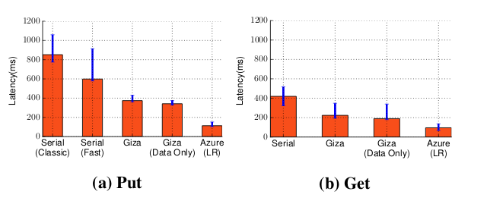
Exactly twice always
Transfer latency dominates
Not exactly twice even though 2 vs 1 round trip
Dominated by Table latency
Fast Paxos and Classic Paxos Comparison
Run both paths in parallel (erasure coding latency)
Baseline: Time it takes a proposing data center to issue a blob request to the farthest data center in the quorum
Slower because read table, decode fragments
Faster because Fast Paxos (1 RTT)
2x faster when reading directly (erasure coding cost)
SERIAL: Run data path and the metadata path sequentially
Local Replication: 3x fast
Giza Overall Latency
Notes:
Giza parallelizes metadata path with data path, which can results in extra metadata or data clean up if either path fails to complete.
the latency for storing the 4MB data directly to Azure storage, which is locally replicated
Discussion: Erasure coding can be CPU intensive [ NO ]

Slide 21
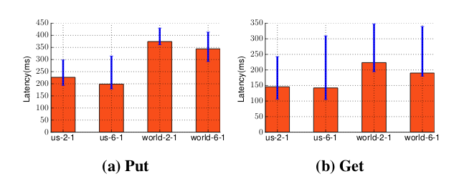
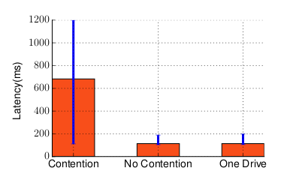
Giza vs CockroachDB:
Put: Giza is better (333 ms vs < 100 ms)
Get: CockroachDB is better since it reads from local HDD, upon substituting HDD latency to Azure latency Giza performs better
Latency dominated by data path.
Larger k => smaller fragments => fewer bytes in each DC => reduces data path latency
Performance for Giza in different setups
* Contention: classic paxos - 2 cross DC RTT
* No contention: fast paxos - 1 cross DC RTT
* One Drive - similar to no contention since only 0.5% updates are concurrent
Contention vs No contention
Notes:
This is because the latency in Giza is often dominated by the data path. Erasure coding with a larger k results in smaller fragments and fewer bytes stored in each DC’s blob storage. This reduces the data path latency and in turn the overall latency.

Slide 22
Thoughts
Very well written and easy to follow
Thorough performance and workload analysis (system driven by One Drive workloads)
Performs well and provides significant cost benefits (works only with Azure Storage)
Garbage collection process is not described in detail - how often does it run? Overheads? Can GC impact performance?
Does not talk about how cache consistency is maintained (they do present caching benefits)?
What modifications are needed to make this work in an untrusted environment?
Is there any way to optimize cross-WAN repair bandwidth?

Slide 23
Key Takeaways
Makes a strong case for conducting workload analysis in order to improve system performance
For a workload with archival properties Erasure Coding seems to provide significant cost benefits
Giza provides an interesting example for how choosing an appropriate consensus algorithm can help achieve lower cross-DC latency
Provides a technique for achieving globally consistent put and get with versioning support

Slide 24
Hyperbolic Caching
Flexible Caching for Web Applications
Aaron Blankstein, Siddhartha Sen, Michael J. Freedman
Presented by: Sanchay Javeria

Slide 25
Motivation
Web apps have become increasingly popular (Reddit, Medium, Twitter etc.)
Users expect performance but app ecosystem diversity makes improving performance non-trivial
Solution? Deploy caches; but can we improve hit rates?
Notes:
Web apps have become increasingly popular (Reddit, Medium, Twitter etc.)
Users expect performance but app ecosystem diversity makes improving performance non-trivial
Solution? Deploy caches; but can we improve hit rates?

Slide 26
Caching is important to the internet
https://www.keycdn.com/support/dns-cache/
Browser cache: stores static content (JS, fonts, image resources etc.)
Server cache: Take results of popular requests, cache them, and return these results to save computational cycles.
reduces bandwidth consumption
Reduces access latencies:
Fetch documents from nearby cache and hence transmission delay is diminished
Reduced network traffic, uncached items are retrieved faster
Notes:
Browser cache: stores static content (JS, fonts, image resources etc.)
Server cache: Take results of popular requests, cache them, and return these results to save computational cycles.
reduces bandwidth consumption
Reduces access latencies:
Fetch documents from nearby cache and hence transmission delay is diminished
Reduced network traffic, uncached items are retrieved faster

Slide 27
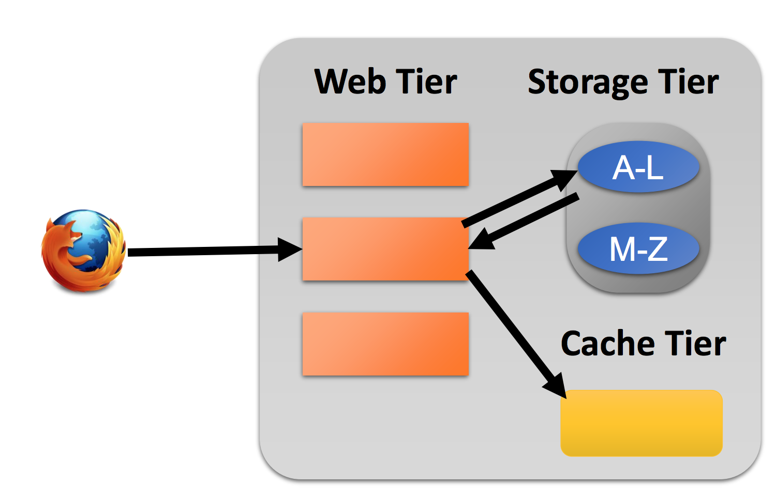
A simple web architecture
Web caching often works differently than traditional cache (Disk/CPU based)
We have web-like request patterns and furthermore…
Item cost
Expiration time
Windowing
Notes:
Client -> HTTP reqs. To a multi-tiered DC -> storage tier -> lookaside cache
More probabilities to loads far from the median (long-tailed workloads)
There’s so much data, can’t put everything in cache -> Hit/miss depends heavily on what you kick out of the cache; ideal world -> least likely requested data should be evicted
We have web-like request patterns and furthermore…
Item cost
Expiration time
Windowing
Two goals of a tailored eviction strategy: • Tailor to web-specific request distributions • Tailor to the varying needs of different app settings

Slide 28
What’s with existing strategies?!
Two common eviction strategies are LRU and LFU (Redis uses LRU and random sampling).
LRU
Evict the least recently used item
Consider the items A, B, C, A, A, A, A, A, A, A, A, A, A, A, B, C, D with cache size 3
[A]
[A, B]
[A, B, C]
[B, C, A]
[C, A, B]
[A, B, C]
[B, C, D] <- here, we evict A, we can do better!
LFU
Evict the least frequently used item
A - 12
B - 2
C - 2
D - 1
Problems? Any change to underlying DS incurs high churn
New items die
Old items persist
Notes:
A has a higher expectancy of being requested in future

Slide 29
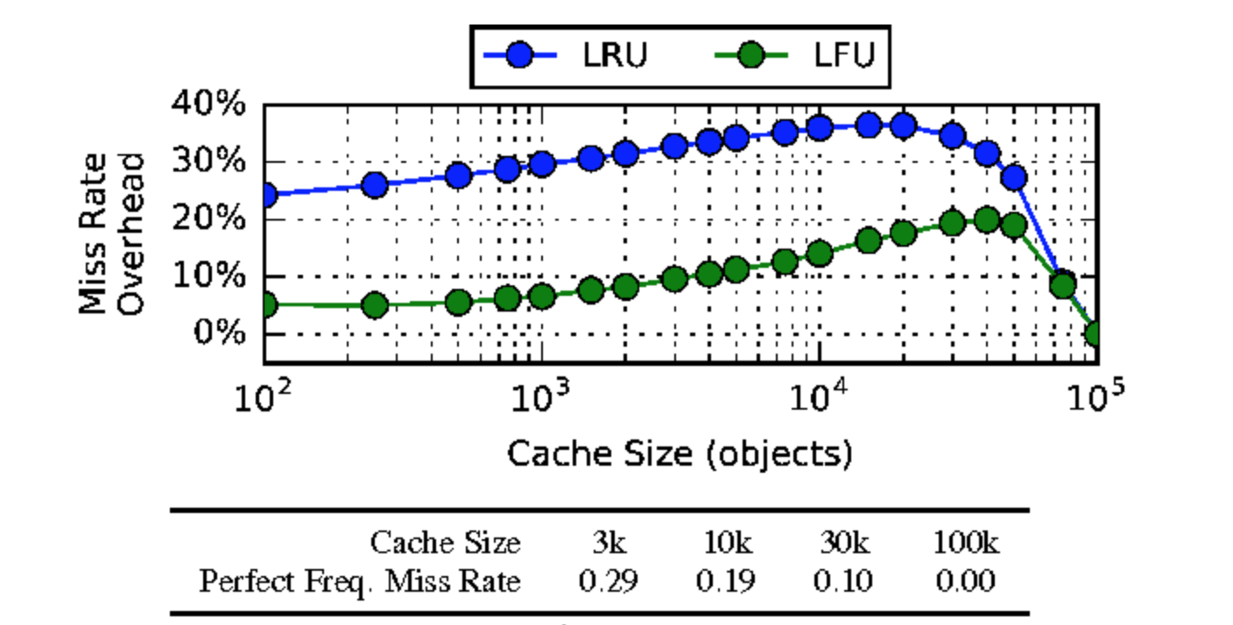
LRU vs LFU
Higher % means worse performance, we see that LFU incurs 5~20% overhead (better than LRU)
Converges to 0 because cache size is large enough to never incur a miss
Comparison of LRU and LFU’s miss rates with an ideal model aware of each item’s popularity
Both have large overhead but LFU still fares better (LRU has 25~30% higher miss rate)

Slide 30
Other improvements...
GreedyDual: Improvement to LRU, where each item has an associated value (= c(p)/s(p) + L)
LRU-k: Holds priorities using k priority queues (each adhere to LRU)
COMMON PROBLEM: All approaches are limited by the use of an eviction data structure and thus limiting how they are prioritizing items
Notes:
P is the document, L is lower threshold
If not in cache; L=minimum cost; evict and set new pri to L + c/s

Slide 31
Main idea
Decouple item priorities from eviction data structures!
How?
Random sampling
Now, item priorities do not necessarily need to be tied to a particular data structure
This opens up the design space for prioritization
Lazy evaluation
Don’t evaluate priorities on every GET/PUT operation
Instead, evaluate only when an item is considered for eviction
Notes:
If no DS, need some way to do eviction based on priorities
In random sampling, randomly sample items, eval their pri. And kick the lowest pri. Item; not tied to a DS and systems like Redis already uses random sampling but no theoretical model has been proposed to leverage it for eviction

Slide 32
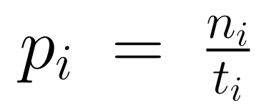
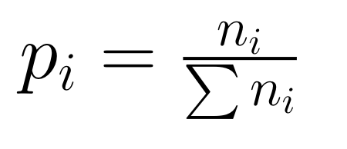
Priority function
Captures independent draws prop. Of workload
We want to prioritize items and not data structures!
Where n is the number of accesses and t is the time since it entered cache
LFU assumes
Priority function this solves the two problems with LFU by providing initial immunity to an item
Capture relative popularity

Slide 33
Priority function
T = 1, P(A) = 1
Traditional eviction uses data structures for ordering
In HC, items are reordered when unrelated items are requested?
WHAT? Example:
Consider stream of requests:
A A B C C
A and B actually reordered when C was requested; in traditional approaches we’ll encounter a lot of churn if we try to incorporate this as requests happen
Possible because of random sampling!
T = 2, P(A) = 1
T = 3, P(A) = ⅔ , P(B) = 1
T = 4, P(A) = ½, P(B) = ½ , P(C) = 1
T = 5, P(A) = ⅖, P(B) = ⅓ , P(C) = ½
Notes:
Explain stream of reqs. With monotonically increasing time

Slide 34
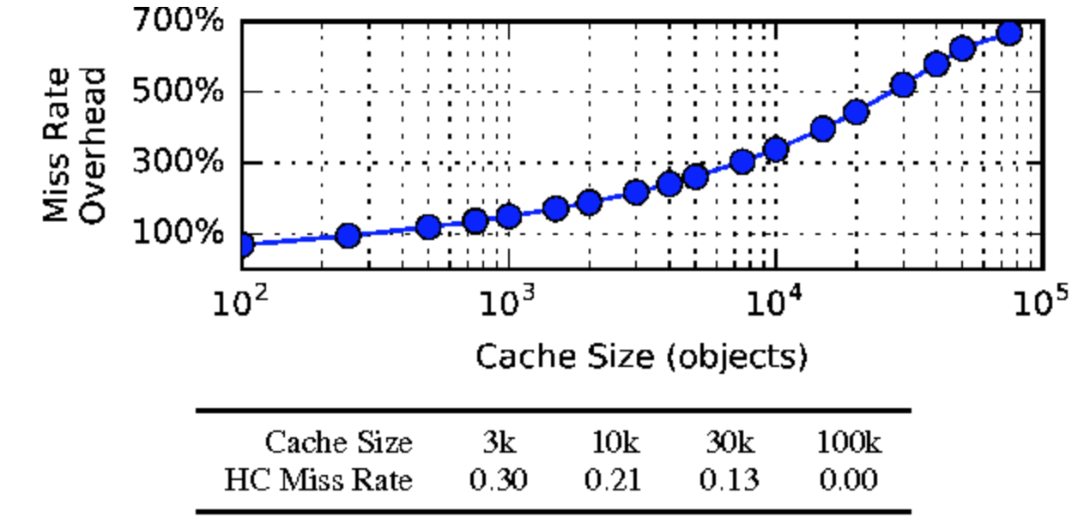
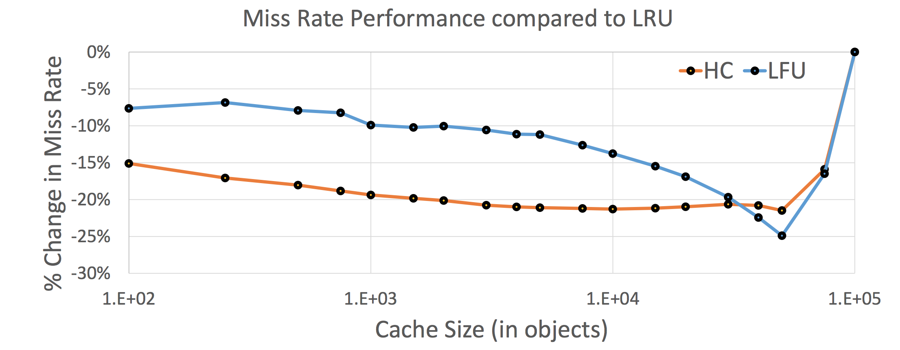
How does HC fair with LFU?
Miss rate overhead increases as cache size increases, new items are introduced every 100 requests and are penalised heavily
Courtesy: Usenix
LFU miss rates compared to HC as the baseline on a dynamic zipfian workload where a new PUT occurs at every 100 requests
Sample size is 64 objects
Baseline is LRU
We observe better performance already (without tuning)
Notes:
The “Pareto principle”: 80% of the wealth owned by 20% of the population, etc.
1/lambda ^ alpha (curve’s tail heaviness is controller by the alpha value)

Slide 35
One problem...
Initial priorities can be too high (an overestimate)
Example: an item which has a true popularity of, say, 1% can be overvalued for several time steps to follow
Experiments on dynamic workloads show that evicted items tend to have similar priorities
Calculate revised priorities based on evicted item’s priority -
Using this equation we can solve for n and after n accesses, discard the extension
Evicted item’s priority
Parameter (requires tuning; 0.1 works fine)
Notes:
Beta will require tuning

Slide 36
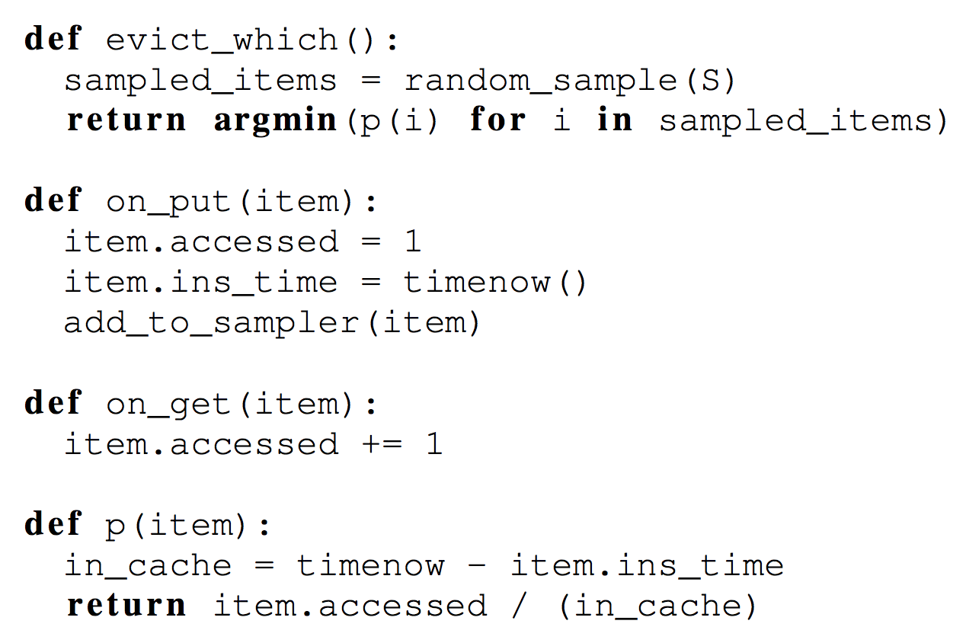
Implementation
Leverage Redis’ random sampling to include support for per-item cost along with tunable extensions
Made a middleware for caching web pages using Django; each page is cached using a view function based on the request URL
Use the view as the cost class for each item
Cost is measured as the CPU time between initial miss and a subsequent SET operation along with all database queries (if any)
Notes:
Implement their framework on top of Redis in about 380 lines of code, pretty much looks like this <explain code>
Besides, made a caching middleware for Django and added cost information for each webpage. Views are functions which take HTTP request and outputs web response. Use view as cost classes.

Slide 37
Customizing Hyperbolic Caching
Item costs
Expiration times
Item classes
Tailoring HC to application needs

Slide 38
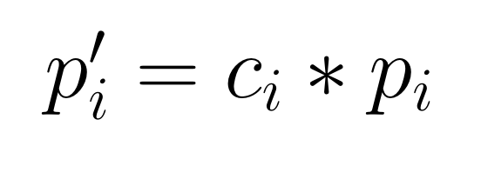
Cost aware caching
All items have an associated cost that reflect the penalty for a miss on that item
Goal is to minimize total cost, unlike traditional OS, cost of fetching items can vary greatly in web applications (size variations, originate from different data stores, complex joins etc.)
Prior work focuses on adapting recency based strategies to cost settings which, typically, requires a new design and suffer on web workloads
Hyperbolic caching requires changing one variable!
Original priority
New priority
Cost imposed by item
Notes:
fixed size disk blocks, instruction lines
Use implicit priorities and metrics like time-of-access (LRU-K, greedyDual) and are difficult to augment with cost
HC -> HC+Cost just adds metadata and redefines priority function
items may impose different CPU or database load when they miss, they can be result of a db join instead of simple indexed lookups) so if cache is aware of the cost, it can use it to efficient the eviction.

Slide 39
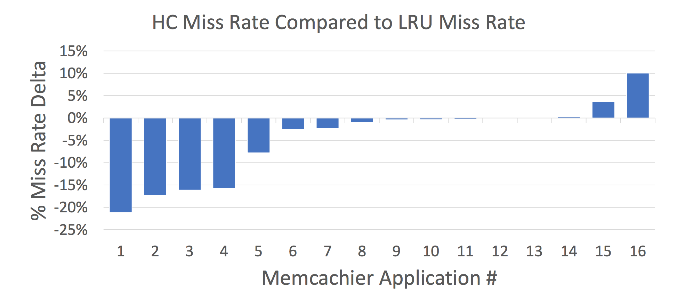
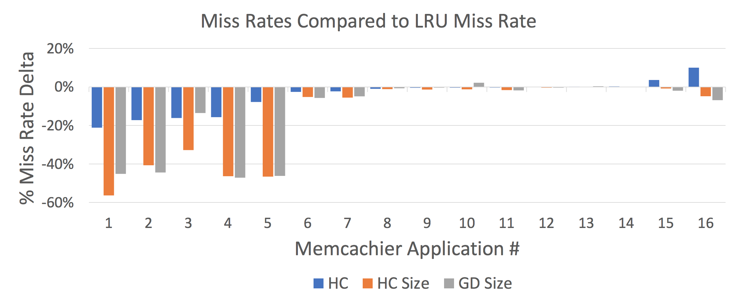
Cost aware caching
Improvement! Cost here is measured by size of the item
HC performs worse than LRU on some applications
Cache sizes chosen by app developers
We see that HC performs worse in certain applications but HC-cost helps mitigate that

Slide 40
Expiration-aware caching
To ensure items are not stale, developers specify expiry time (EX/PX option in redis)
If an item is going to expire, it is less costly to evict than a similarly popular item that expires later
Hence, rather than evicting the item which is less likely to be requested next, evict one which is least likely to be requested during its lifetime.
Thought: multiply priority by max((t_{exp} - t_{cur}), 0); but this equally weighs all requests over time…
Idea: Use a decaying function!

Slide 41
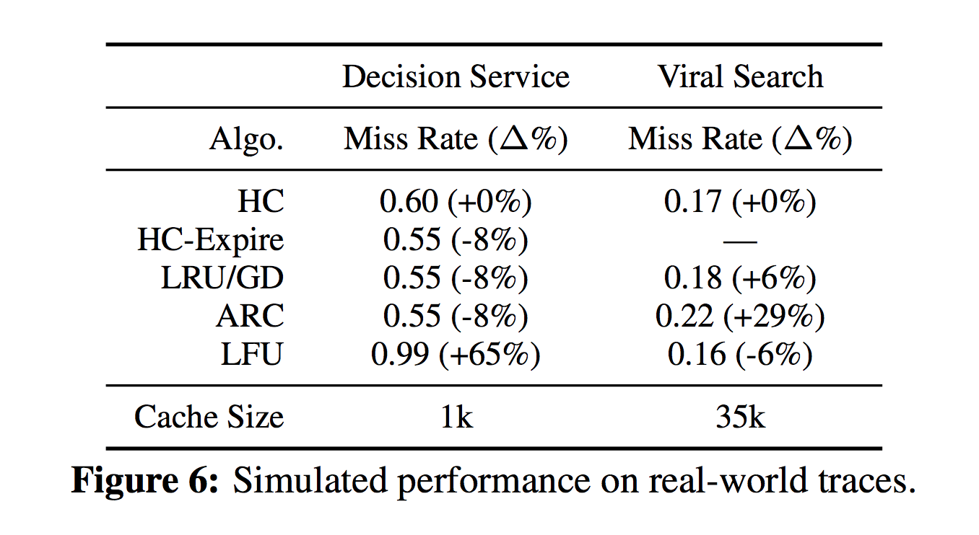
Expiration-aware caching
HC-expire performs just as well as LRU (recency is roughly equal to time-until-expiration)
LFU performs the best, virality is the measure of number of hits a tweet receives
In these workloads, since items have same expiration time and are accessed only once after insertion (to join the reward information), recency is roughly equal to time-until-expiration
Therefore, LFU and HC perform poorly compared to recency based approaches
HC-Expire performs just as well
Notes:
In these workloads, since items have same expiration time and are accessed only once after insertion (to join the reward information), recency is roughly equal to time-until-expiration
Therefore, LFU and HC perform poorly compared to recency based approaches
HC-Expire performs just as well

Slide 42
Cost classes
Some cache items can be related (indexed lookups, result of a single join etc.)
Store reference to class in the item’s metadata
Simplifies long-term changes to cost, replica failure or workload changes can affect the cost of fetching a whole class of item one-by-one. With cost classes, a change to class’s cost will be applied to newly and existing cached items

Slide 43
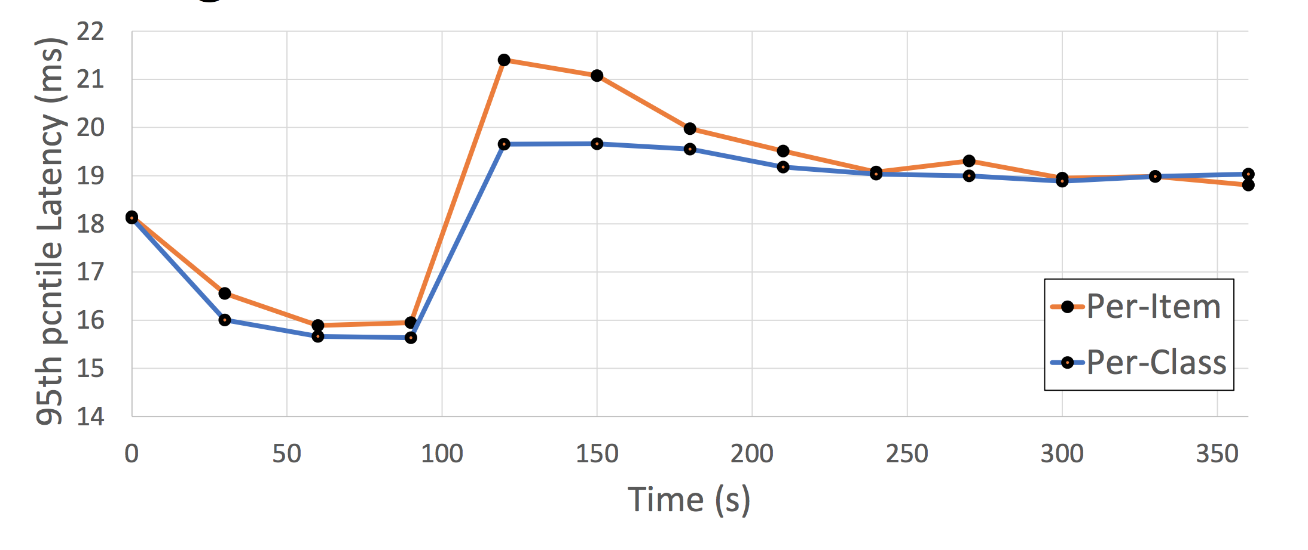
Cost classes
One server is stressed at 120s
We see that per-item cost computation incurs a higher spike than per-class because costs are updated only when an item is inserted and hence takes longer to settle to steady state performance
Per-class quickly adjusts to one class being more costly
Items are requested from two different backing datastores
At t = 120s, one server is stressed
Notes:
We see that per-item cost computation incurs a higher spike than per-class because costs are updated only when an item is inserted and hence takes longer to settle to steady state performance
Per-class quickly adjusts to one class being more costly

Slide 44
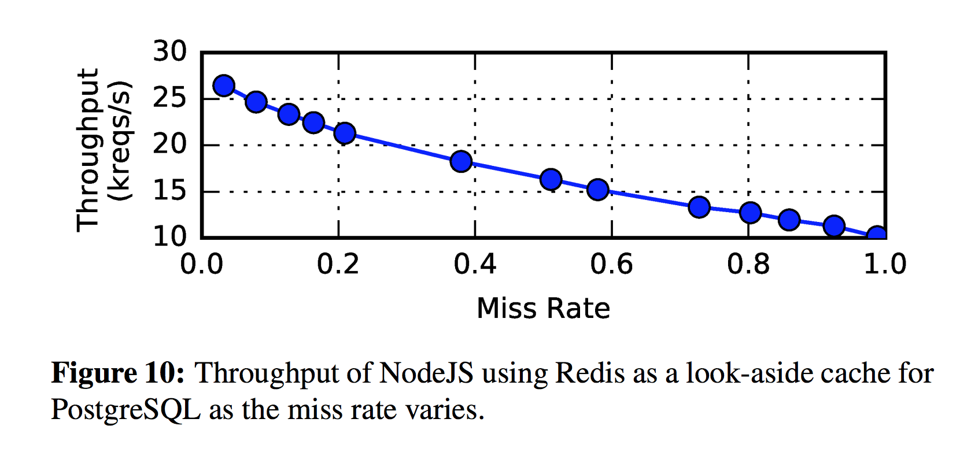
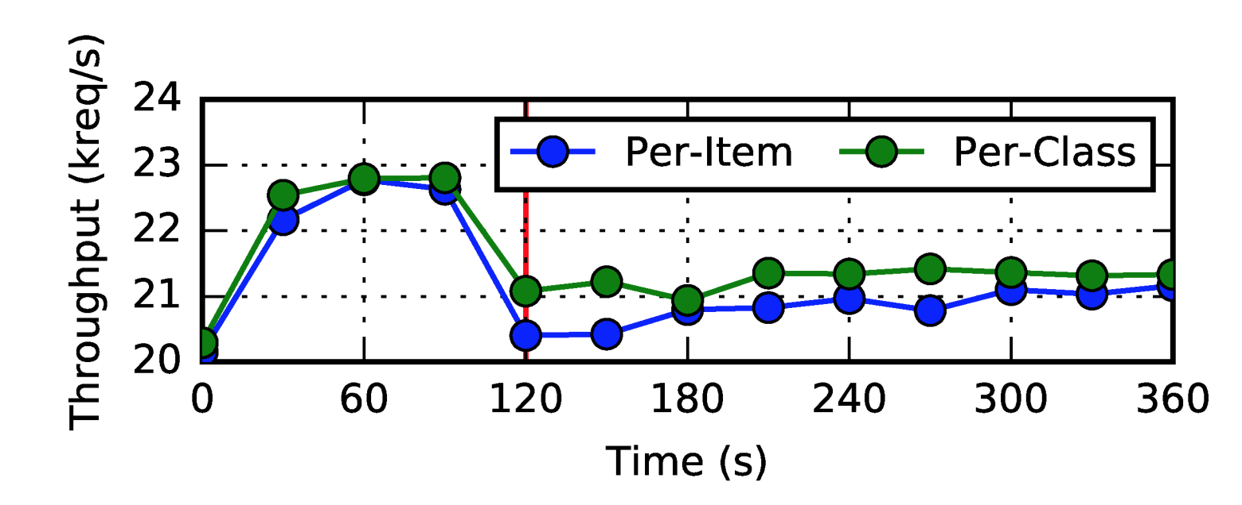
Throughput analysis
Throughput measured with items originating from two different datastores

Slide 45
Potential problems
How to determine cost classes? Incorrect assignment can degrade caching performance; same item can belong to multiple cost classes
Optimization was proposed to retain samples between evictions, this can boost accuracy of random sampling but was not considered.
As compared to LRU, HC stores more metadata in item cost, request count, and time of entry (roughly ~96bits on a 32bit machine and 192bits on a 64bit machine). Although, no significant performance overhead was observed
Notes:
How to determine cost classes? Incorrect assignment can degrade caching performance; same item can belong to multiple cost classes
Optimization was proposed to retain samples between evictions, this can boost accuracy of random sampling but was not considered.
As compared to LRU, HC stores more metadata in item cost, request count, and time of entry (roughly ~96bits on a 32bit machine and 192bits on a 64bit machine). Although, no significant performance overhead was observed

Slide 46
Key takeaways
Easy to read paper proposing a simple caching strategy which can yield great performance benefits in production-level web applications
Simplifies tuning the priority function based on varying workloads as compared to other strategies which incur high churn due to the use of an underlying data structure
Hit rate improvements under both synthetic and real-life workloads over long-standing strategies like LRU, LFU etc. while serving upto 10M requests
Notes:
Easy to read paper proposing a simple caching strategy which can yield great performance benefits in production-level web applications
Simplifies tuning the priority function based on varying workloads as compared to other strategies which incur high churn due to the use of an underlying data structure
Hit rate improvements under both synthetic and real-life workloads over long-standing strategies like LRU, LFU etc. while serving upto 10M requests

Slide 47
What’s the most CPU intensive task here? Random sampling or computing the per item priority?

Slide 48
How well would Hyperbolic caching work with hyperscale applications?

Slide 49
As compared to native Redis, will the computational cost to compute the lowest priority item for eviction affect performance?

Slide 50
How often should the Garbage Collection happen? How would you design it to minimize performance impact?

Slide 51
How often do workloads have similar characteristics to those of OneDrive?
Notes:
Specially designed for low contention scenarios [ NO ]

Slide 52
What do you think of a storage solution based on the similar idea which provides availability over consistency?

