Slide 1
RDMA and NVM
Jacob Trueb
Justin Loew
Rahul Mahadev
Distributed (File / Persistent Memory) Systems

Slide 2
Octopus
Presented by Rahul Mahadev
Notes:
I will be presenting Octopus which is a reimagined DFS, combining new technology like nvm and rdma to provide low latency and high throughput. Octopus was originally presented at Usenix 2017

Slide 3
Outline
Background and Motivation for Octopus
Design and Architecture
Shared Persistent Memory Pool
Self-Identified MetaData RPC
Client Active Data I/O
Collect-Dispatch Transaction
Evaluation
Conclusion
Notes:
This will be a brief outline of today’s presentation, we will go through the background and motivation first and then the design followed by the results.

Slide 4
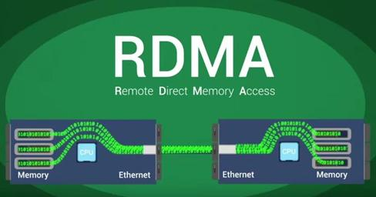
Background
What is RDMA ? : It is the direct memory access of memory on a remote machine without involving it’s operating system.
What is Distributed File System ?
A Distributed File System is a file system that aggregates file storage on multiple hosts and allows access to files from multiple clients as a single entity.
Source:Google images
Notes:
We learnt about RDMA earlier this semester, there were a couple of papers that used RDMA. I’ll do a quick recap of RDMA. RDMA has been used in HPC formerly and recently used in Data Centers as well,

Slide 5
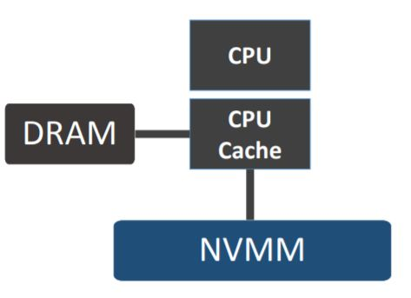
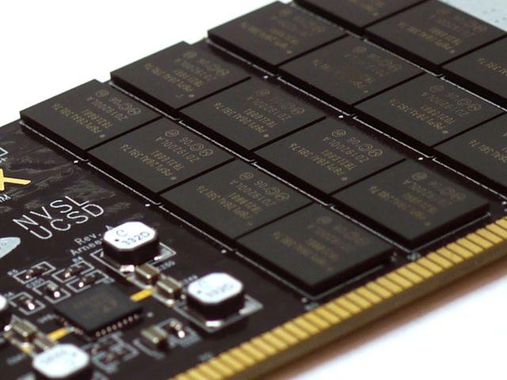
Background - NVM (and NVMM)
Byte Addressability
Low Latency
Persistence
Capacity
Source : nvsl.ucsd.edu
Notes:
Non-volatile memory like phase changing memory can provide persistence like Hard disks but at the same time they provide byte addressability and low latency like DRAM.

Slide 6
Background - Modular DFS
Traditional Distributed File Systems follow Modular design.
Network, Storage and Processing independent of each other.
modules can be swapped out.
Inefficient with high speed networks/storage.
Software Bottleneck
GlusterFS popular DFS with various flavours.
Notes:
We will see some evaulation based on GlusterFS where Disk based FS is swapped for a In memory RDMA based system. We will see the comparison between latency and bandwidth

Slide 7
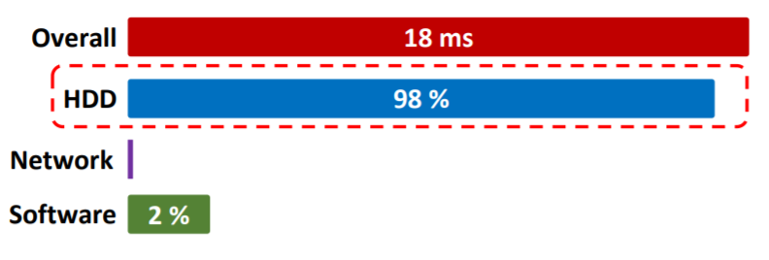
Motivation from Modular DFS - GlusterFS
DiskGluster
Hard Disk for storage.
Gigabit Ethernet for communication.
MemGluster
Memory for storage.
RDMA for communication.
Latency :1KB write + sync
Source:Octopus slides
Notes:
Current Distributed file systems storage, network and other modules are strictly isolated, RDMA and NVMM can be directly used by swapping out the existing network and storage modules. But the following experiments show that the performance is not optimal. Even though the overall latency reduced to 384 micro seconds from 18 ms while using rdma and memory, it was shown that the software latency(the overhead caused by having multiple layers of software) causes 99.7% of the latency.
GlusterFS is a popular Distributed File System which has many flavors
Two of which are DiskGluster and MemGluster

Slide 8
Design - Overview
Background and Motivation for Octopus
Design and Architecture
Shared Persistent Memory Pool -> Reduce data copies
Self-Identified MetaData RPC -> Reduce response latency
Client Active Data I/O -> Rebalance CPU/Network overhead
Collect-Dispatch Transaction -> Efficient concurrency control
Evaluation
Conclusion

Slide 9
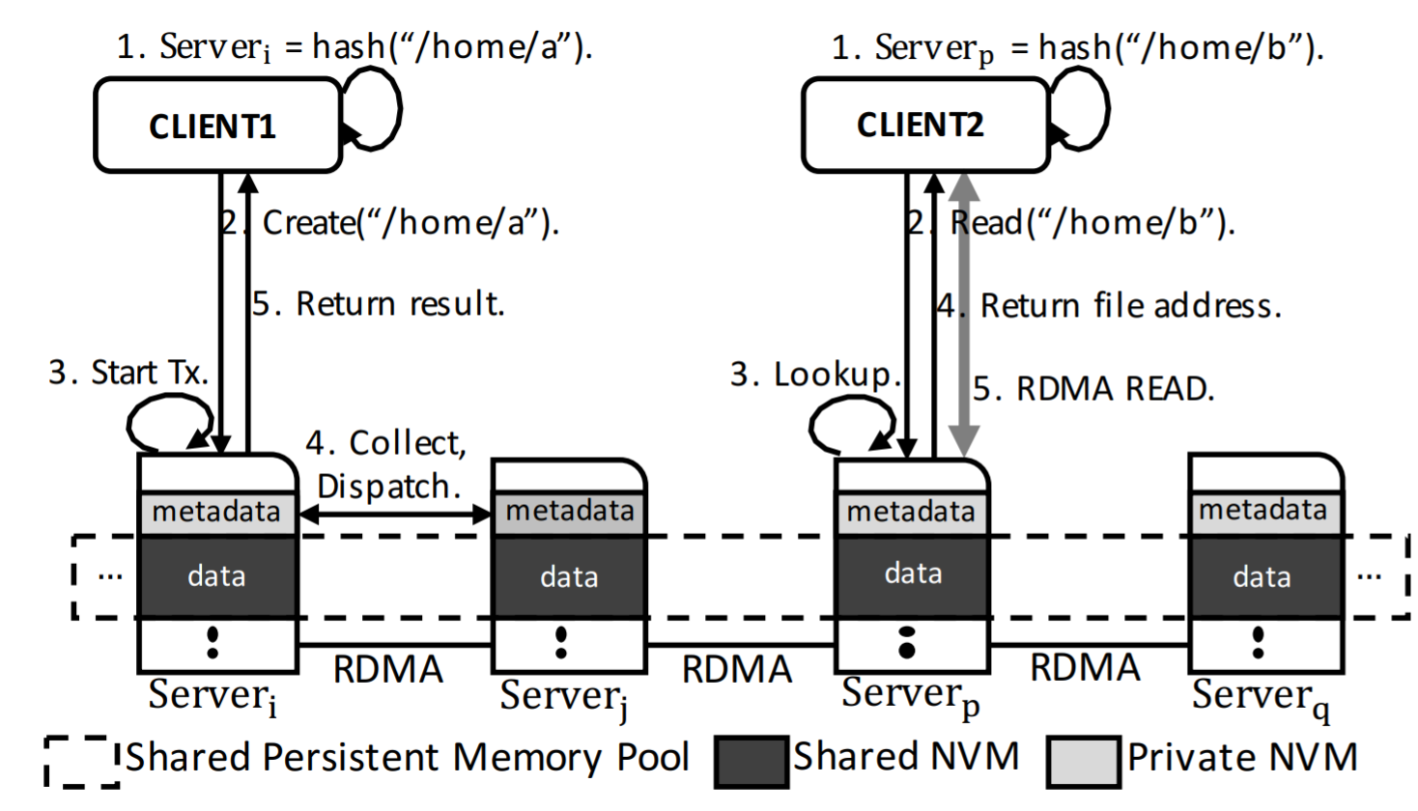
Design - Architecture
Nodes equipped with NVM
Nodes connected via RDMA forming shared pool
Files hashed by filename
Distributed metadata.
Files are exported and shared
Metadata kept private.
Source: Octopus paper
Notes:
This is the design of octopus, Each node is equipped with NVM for data storage and interconnect with RDMA, shared memory pool is built on top of this. For meta-data operations, client hashes the filename send self identified RPC , server modifies mdata using collect dispatch. For file data operations, server returns the address of the file data and client uses rdma read.

Slide 10
Design - Data Layout in Octopus Node
Source: Octopus paper
Notes:
This is the data layout in an octopus node.
Super Block : maintains metadata of the file system.
Message pool : temporary store for RPC messages.
Metadata index zone : chained hashtable to index file , name,address ,pointer to metadata
Metadata node : file/directory inode
DataZone : actual file data
Log Zone : for logging

Slide 11
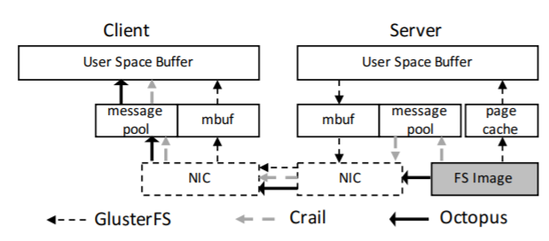
Design - Shared Persistent Memory Pool
Octopus reduces the number of times files are copied to 4 copies.
File System | copies
GlusterFS | 7
Crail | 5
Octopus | 4
Source:Octopus paper
Notes:
As we saw in earlier results of MemGluster, the low performance could be attributed to the DFS being layered on top of a local file system. For a read or write request data is replicated multiple times. Shared pool is exported out allows the data to be accessed by RDMA. Message pool is required as we cannot directly register the user space buffer.

Slide 12
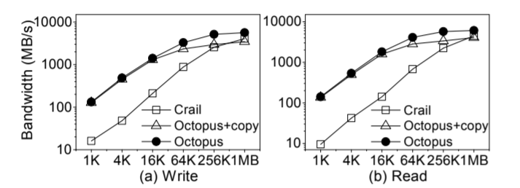
Design - Shared Persistent Memory Pool
Performance comparison with Octopus and Octopus with an extra copy.
Source: Octopus paper
Notes:
To show the impact of copy they perform an expirement by adding one extra copy to the critical path of octopus. As it is visible as the file size increases the bandwidth reduces as large files copied an extra time would increase the time taken to copy.

Slide 13
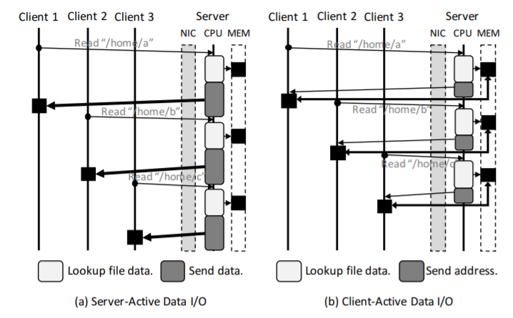
Design - Client Active Data I/O
Server Active Data I/O:
Server responsible for delivering the data to client
CPU bottleneck for servers on fast networks
Client Active Data I/O:
Server returns address of data.
Client directly reads data
Source: Octopus paper

Slide 14
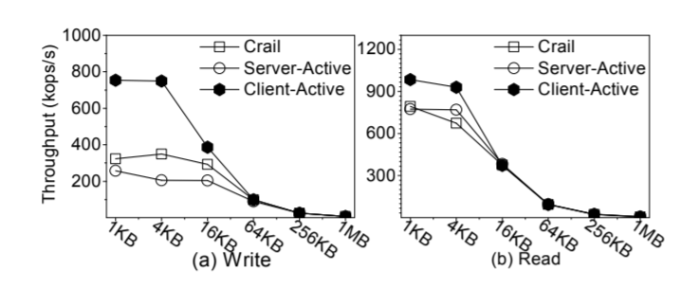
Design - Client Active Data I/O
Source: Octopus paper
Notes:
Client active gives better throughput for smaller sizes due to more being able to be served.
Figure show throughput while varying file size.

Slide 15
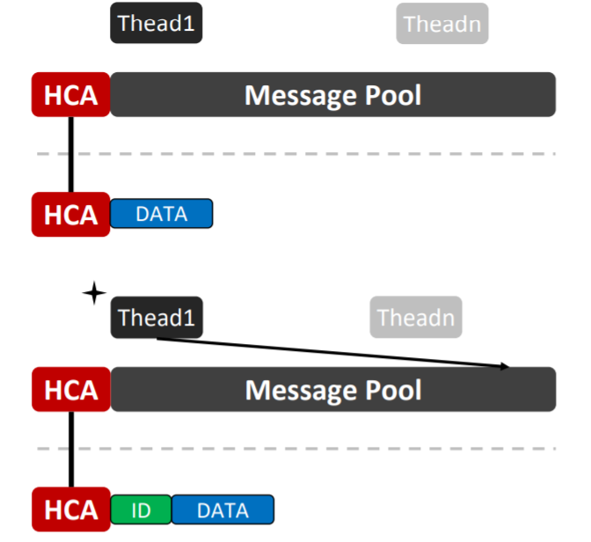
Design - Self Identified metadata RPC
Attaches sender’s identifier with the RDMA write using RDMA write_with_imm
notifies the remote side immediately unlike RDMA write.
attached identifier allows the remote side to locate the new message.
Source:Octopus slides
Notes:
Message based : easy but slow.
Memory based : server has to scan message buffers.
Rdma_write_with_imm : best of both worlds, client attaches id and immediate notification

Slide 16
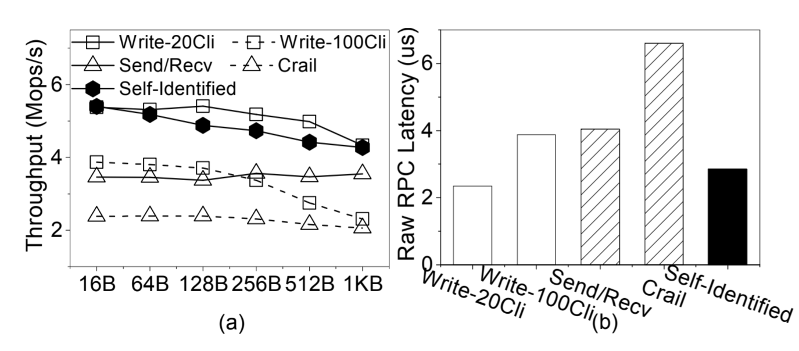
Design - Self Identified metadata RPC
Source: Octopus paper
Notes:
Message based, Memory based and
Crail slowest due to java implementation of jVerbs interface,
They implement message based send recv as well
They implement memory based as well limit the number of client threads to 20 and 100

Slide 17
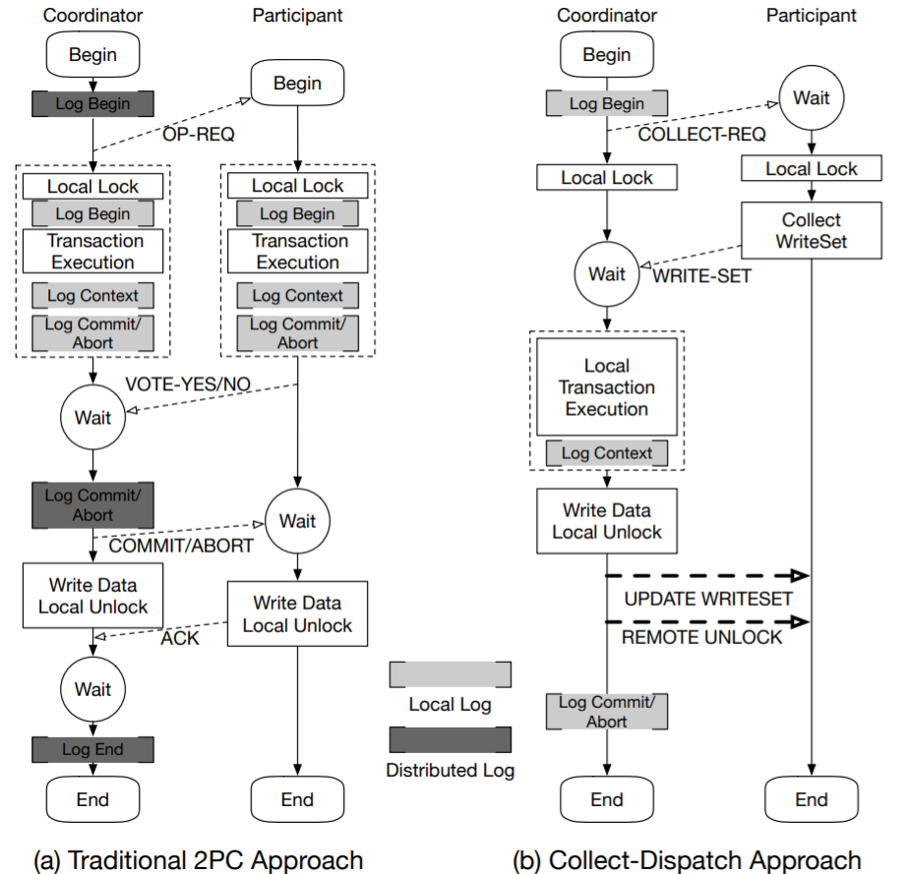
Design - Collect and Dispatch
Distributed transactions used to synchronize metadata operations
Collect and Dispatch makes use of RDMA primitives
reduces the synchronization costs.
Involves 1 RPC, 1 RDMA write and 1 RDMA atomic operation.
Source:Octopus paper
Notes:
In the traditional 2 phase locking you have the coordinator and the participants locking locally and voting about the commit to finalize the commit . The coordinator has to hear back about the participants update and then it decides to commit or not and then notifies the client.

Slide 18
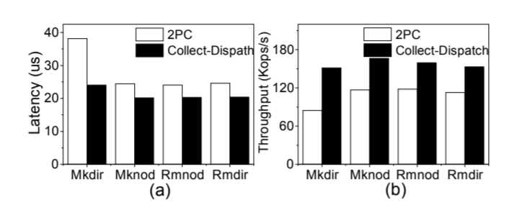
Design - Collect and Dispatch
Source: Octopus paper
Notes:
Comparing Latency and Throughput for 2PC and Collect and dispatch , Collect-Dispatch performs much better.
2PC - 2 RPC Collect Dispatch - 1 RPC + 1 RDMA write + 1 RDMA atomic swap

Slide 19
Evaluation - Platform
5 servers with Intel E5-2680 * 2 with 384 GB of RAM
Clients had the Intel E5-2620 with 16gb of RAM
They were connected using the Mellanox switch.
Evaluated systems were
MemGluster
NVFS
Crail
memHDFS, Alluxio (for big data comparison)
Notes:
MemGluster,
NVFS : HDFS optimized for byte addresability of NVM and RDMA
Crail : is an open sourece DFS from IBM

Slide 20
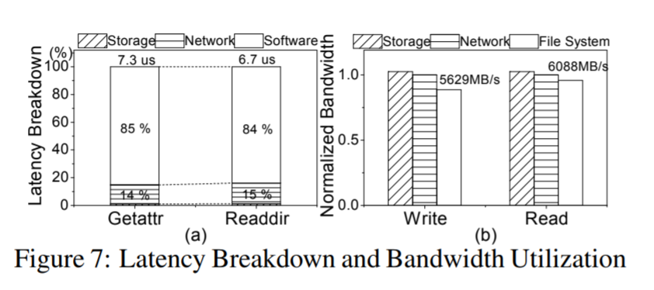
Evaluation - Comparison with Raw Network/Storage
Source: Octopus paper
Notes:
• Software latency is reduced rom 326 us to 6 us compared to memgluster• Achieves read/write bandwidth that approaches the raw storage and network bandwidth
* compare Octopus bandwidth with the raw nw and storage bw.
* s/w latency reduce to arounf 85% of total latency compared to
* BW is comparable to raw network bandwidth

Slide 21
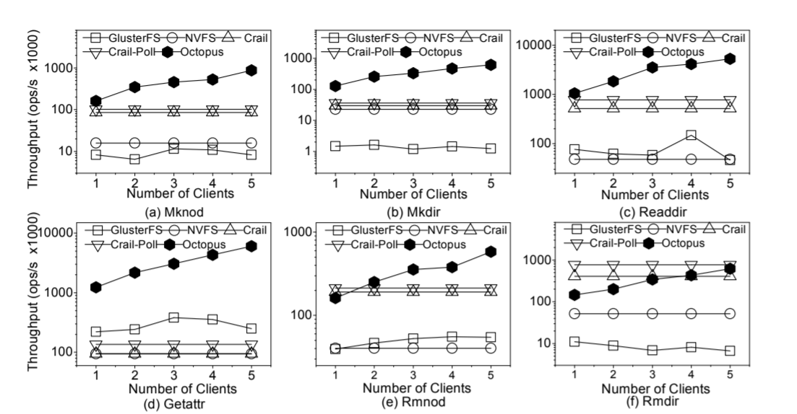
Evaluation - Metadata Operation Performance
Source: Octopus paper
Notes:
Mdtest is used for metadata evaluation.
Figure shows metadata performance wrt IOPS by increasing number of data servers
Octopus performs better than the competition for most of the metadata operations except rm operations where Crail has RDMADataNode without transaction guarantee
Octopus achieves much better scalability

Slide 22
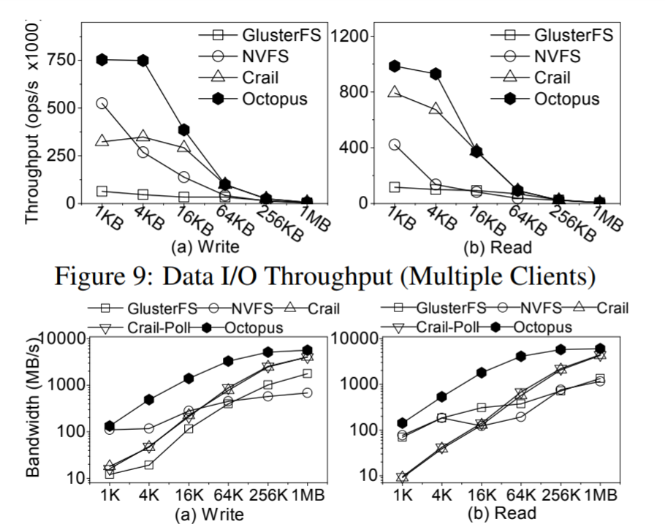
Evaluation - Read/Write Performance
Source: Octopus paper
Single client
Notes:
Fio is used for File IO evaluation.
Concurrent read/write throughput with multiple client
BW is observed by varying size of file
For small sizes octopus achieves much higher tp due to client active and self identified
Nvfs buffer manager prefetches data

Slide 23
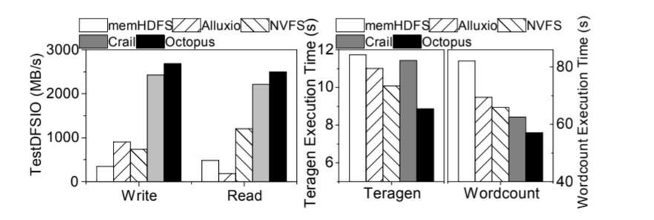
Evaluation - Big Data Performance
Source: Octopus paper
Notes:
Replace HDFS by adding Octopus plugin under hadoop.
TestDFSIO(256kb) : OCtopus has much higher throughput, lower results than fio as Hadoop is connected via JNI
and Teragen Execution times

Slide 24
Conclusion
Modular design comes with severe software bottlenecks (memGluster)
Octopus provides high throughput and low latency
Octopus does not have fault tolerance
Octopus is implemented as a User mode file system

Slide 25
Extra Slides

Slide 26
Opportunities and Challenges provided by new Hardware
NVM
Byte Addressability
Significant Overhead of Data Copies
RDMA
Flexible Programming verbs
Imbalanced CPU processing capacity vs Network I/Os
Notes:
Flexible Programming Verbs: have message semantics and memory semantics.

Slide 27
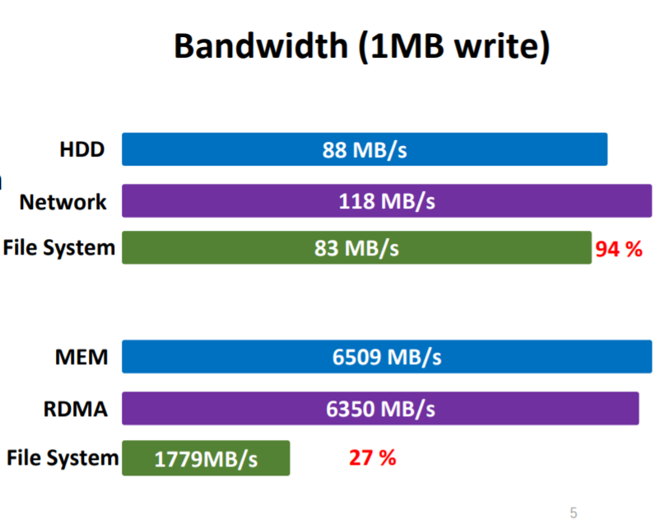
Disadvantages of Modular design
DiskGluster: FileSystem Bandwidth 94% of the system’s bandwidth.
On MemGluster: FileSystem Bandwidth is 27% of system bandwidth.
Bottleneck caused by Software
Source:Octopus slides

Slide 28
Hotpot
Presented by Justin Loew

Slide 29
Pitfalls of Octopus
Slow
No reliability guarantees
No availability guarantees
Hotpot: fast, persistent, reliable

Slide 30
Background
Non-Volatile Memory (NVM)
Persistent RAM
Stick it in a RAM slot, access with native load/store instructions
Distributed Shared Memory (DSM)
Shared global memory space
Data stored on any machine
Access just like local RAM
Distributed Shared Persistent Memory (DSPM)
Hybrid of both of the above.

Slide 31
Overview
Combine DSM caching + replication
Implemented as filesystem in kernel module
Many existing apps just work
Notes:
Hook page fault handler to grab remote pages
Prior PM apps + apps which use mmap-ed files already work.

Slide 32
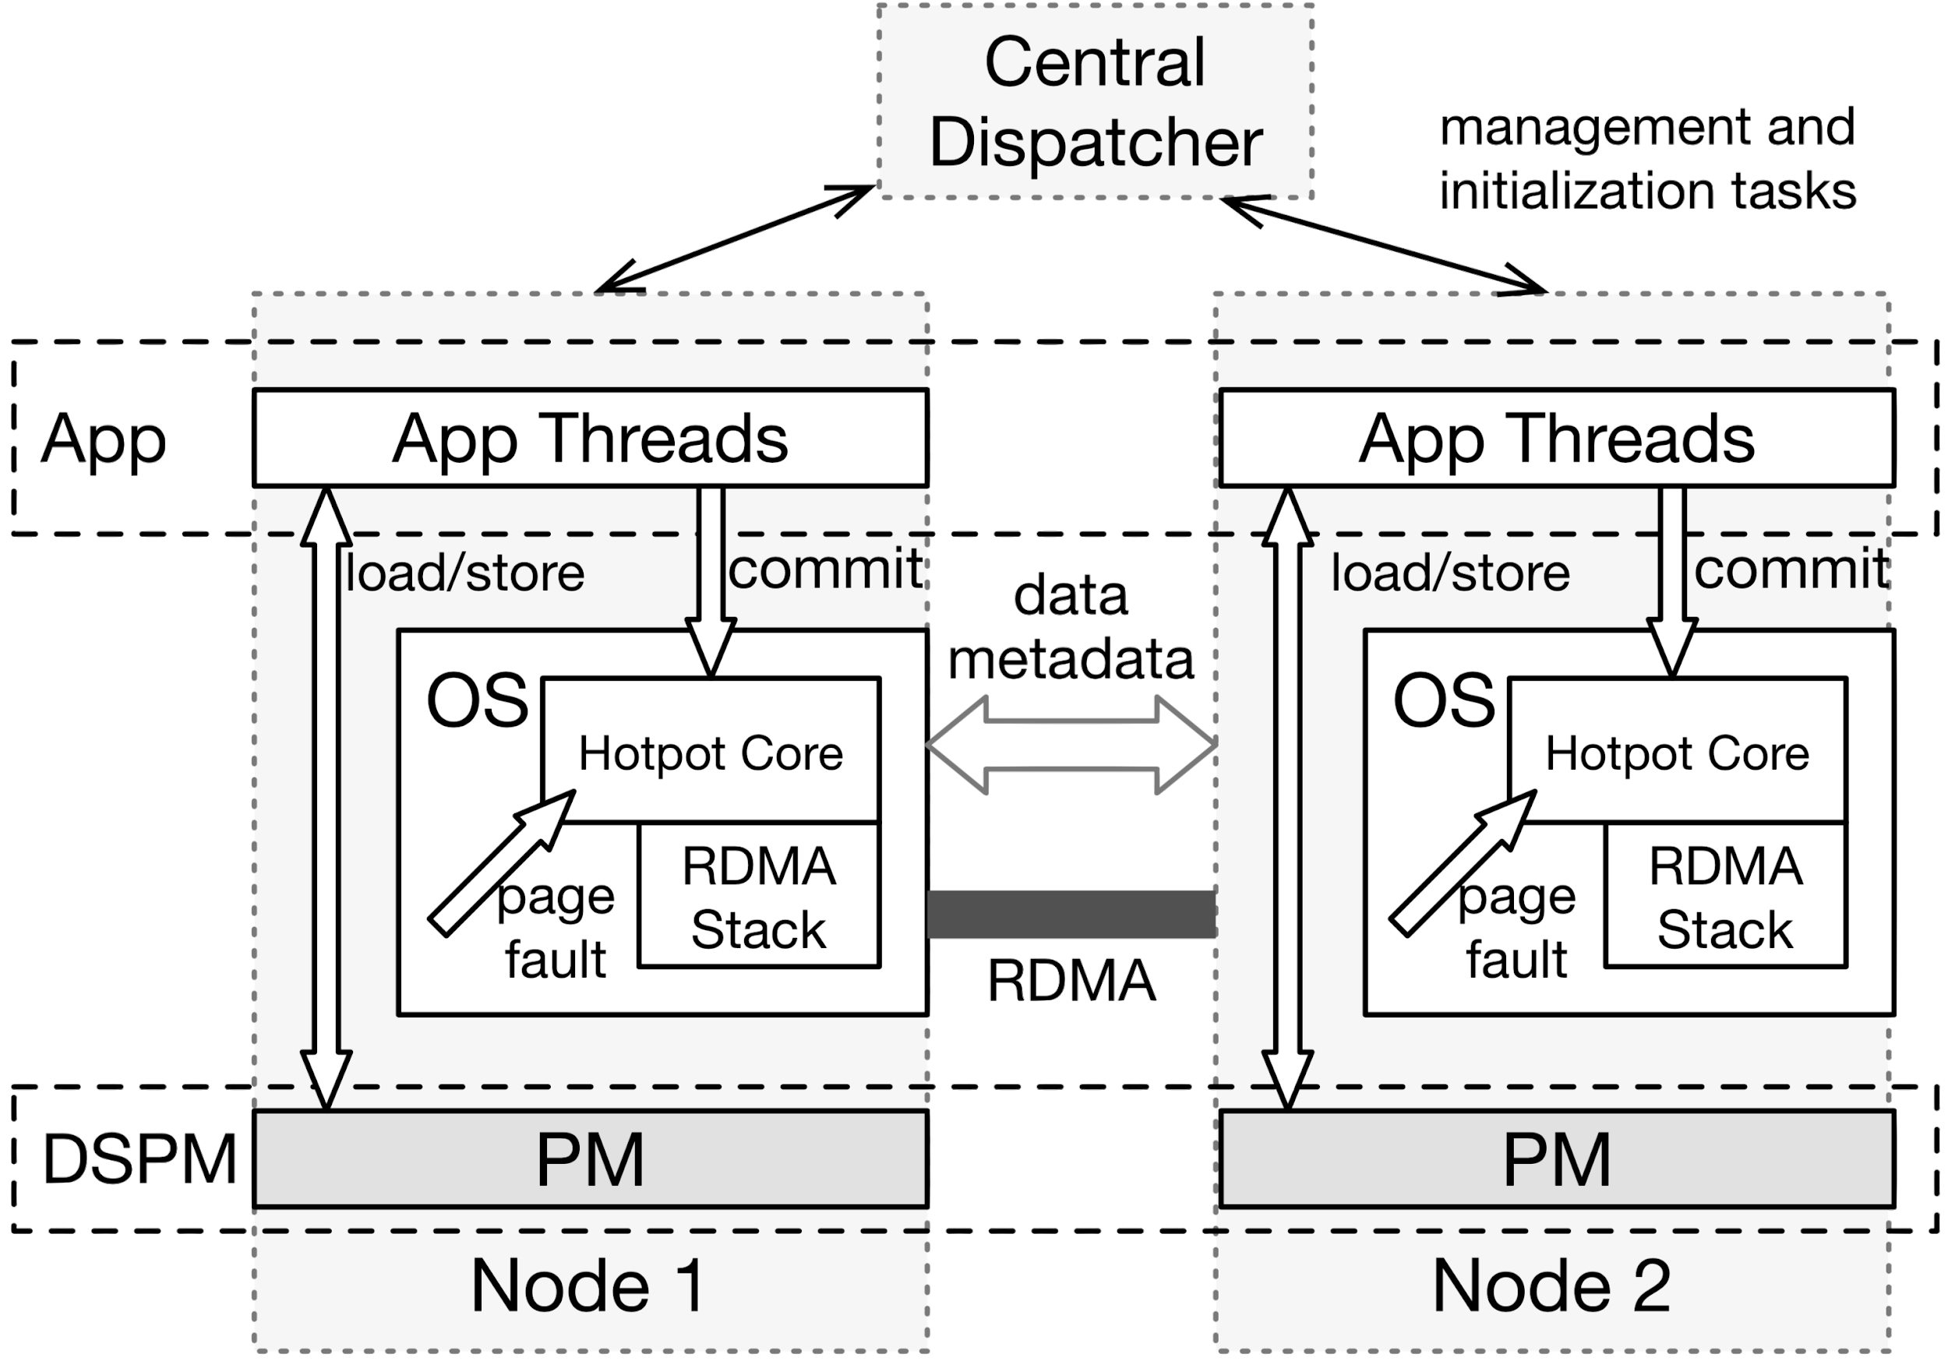
Architecture
Source: Hotpot
Notes:
CD = initialization + management only, not on the critical path

Slide 33
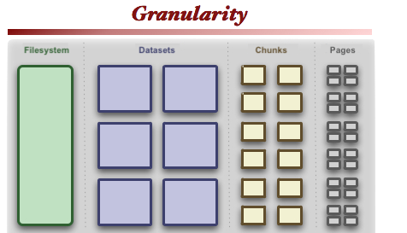
Data Storage
Page - 16kB (set by system)
Chunk - 4MB (configurable # of pages)
Dataset - file (many chunks)
Filesystem - many datasets
kirkk.com (modified)
Notes:
page size determined by system
chunk size configurable

Slide 34
Persistence Model
Owner Node
Holds data, metadata for chunk
Responsible for maintaining n+1 replicas
Location of owner node can change
Data Node - Holds page replicas within chunk
On page fault, fetch from Owner Node
Use cached copies as replicas
Notes:
Page allocation: maintain free list.
To evict local page: evict redundant, committed, never dirty. Use pseudo-LRU & get preferred pages from ON. ON creates add’l replicas async.
At dataset creation, Central Dispatcher assigns initial ONs to chunks, round robin.

Slide 35
Persistence Guarantees
Coherence among cached copies
Recover consistent state
Data reliability & availability under multiple failures
Notes:
Consistent state: guaranteed consistent within each node & between multiple nodes.
Reliability: Always (user-defined) N copies of committed data.

Slide 36
Coherence Model
Need to sync/replicate writes
Cache coherence protocol is expensive
Lazy = good
How to decide what to replicate?
Applications already know best -> commit point
Notes:
Purpose of NVM is speed -> syncing all writes is too slow.
Difficult to sync writes to CPU cache with remote NVMs.
Create commit point when app requests explicit persistence (msync, write, etc.).
A commit can span multiple pages, chunks.

Slide 37
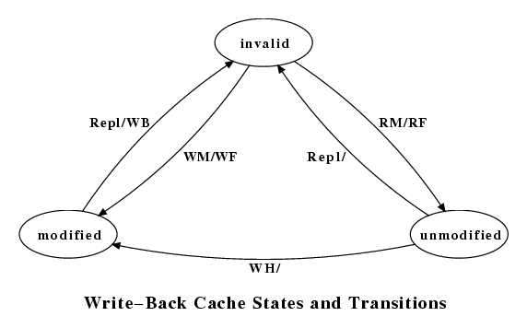
Cache Coherence
Per-page state (set per-node):
Redundant
Committed
Dirty
Per-dataset state (shared globally):
Multiple readers, single writer
Multiple readers, multiple writers
University of Minnesota
Wikimedia
Notes:
Dirty: Use CoW to guarantee existence of replica. Use clflush, mfence to guarantee persistence for writes.
MRSW: guarantee of only one dirty version.
MRMW: multiple versions of dirty data; one committed version.

Slide 38
Fault Tolerance
Record cache coherence state in fixed location
Examine system to reconstruct online state
Keep all writes local
Use shadow paging (metadata & data)
Use multi-phase commit protocols
Notes:
Use native atomics to update index to point to changed shadow copies

Slide 39
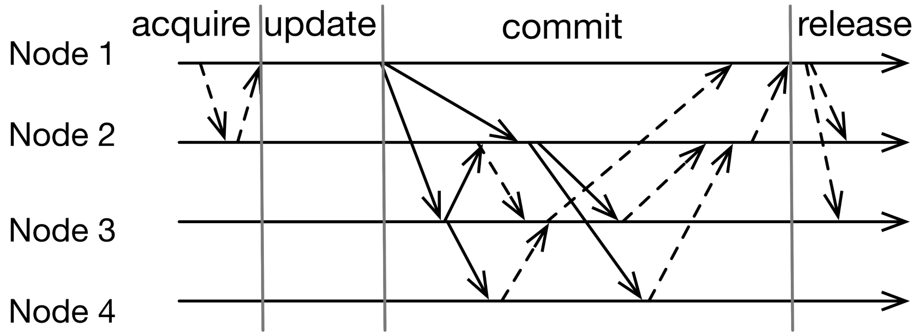
Single Writer Commit Protocol
??
OK
Master
Owner
Owner
Source: Hotpot
Notes:
N1 acquires per-address write perms from master node (MN) before writing. (If busy, reject.) (MN can be Hotpot node, CD, or dedicated node.)
Then commit new data to ONs (replication = 4).
Release write permission to master.

Slide 40
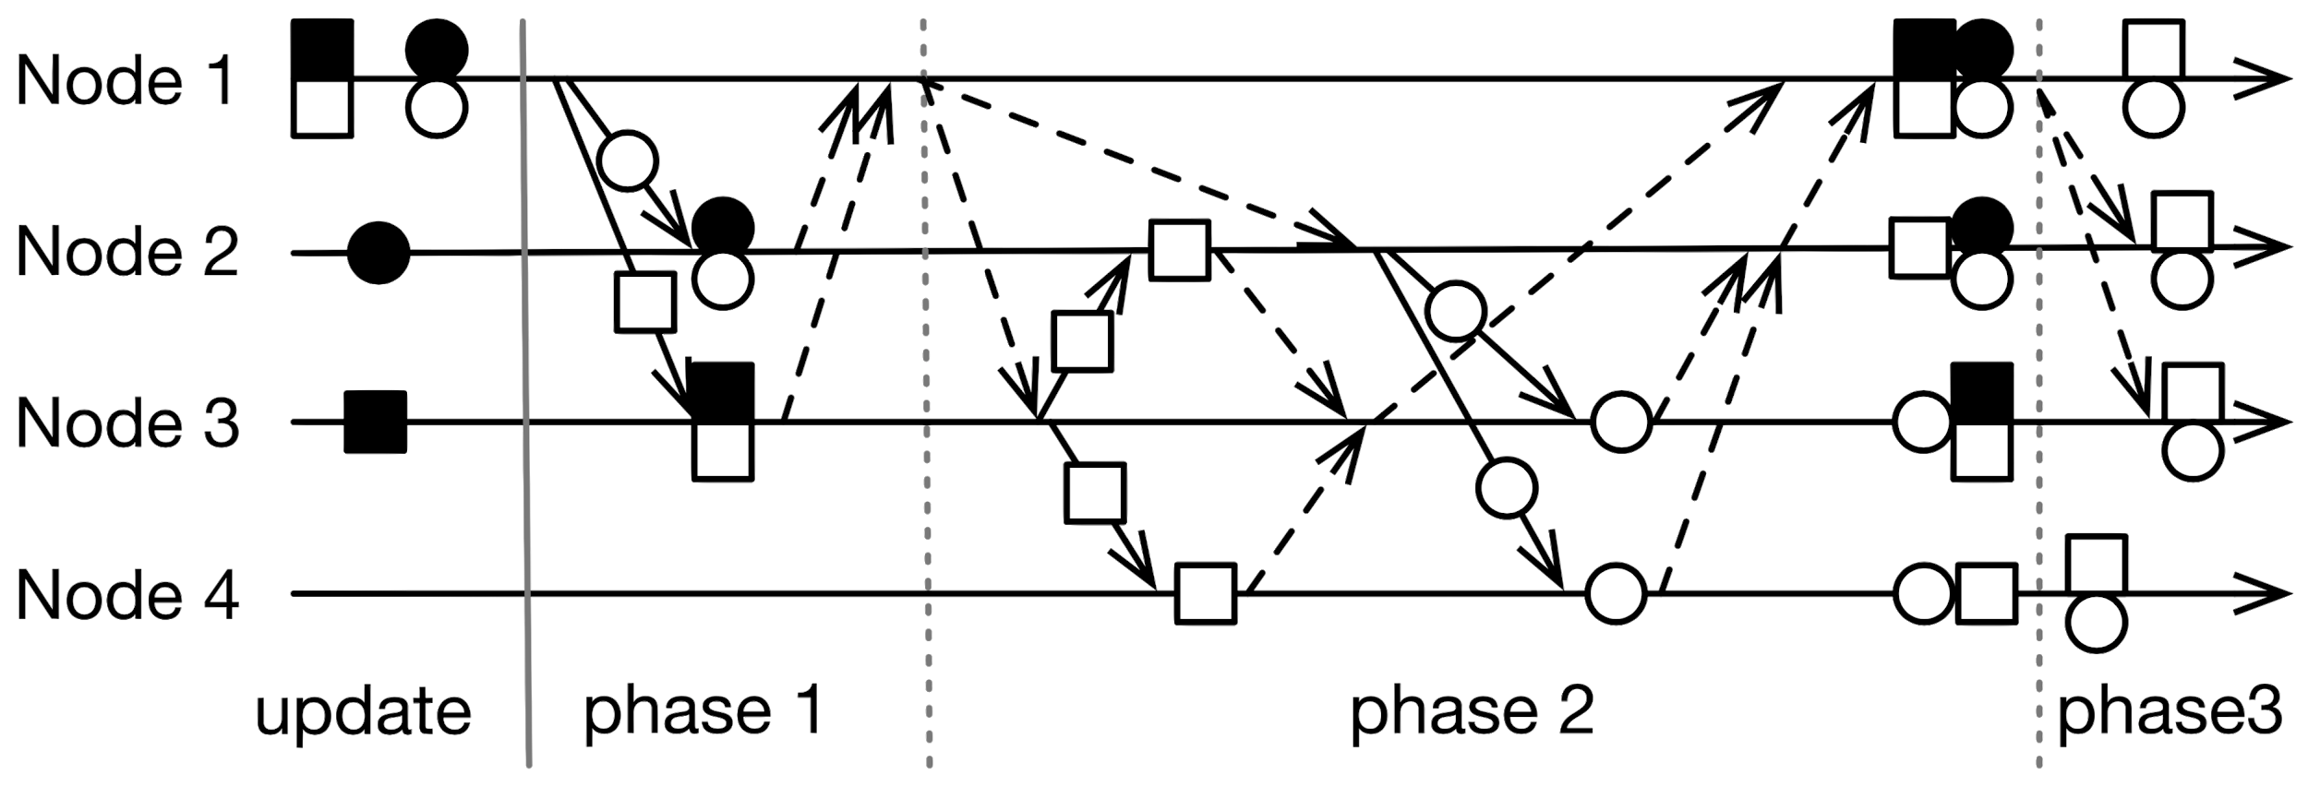
Multiple Writer Commit Protocol
Source: Hotpot
Notes:
P1: Commit node (CN) records addresses of dirty pages, generated unique commit ID (CID), & state of starting phase 1.
ON only accepts commit request if nobody else is committing to those pages.
ON stores new data in persistent redo log.
P2: CN announces start of P2 to ONs.
ONs update DNs (no effect on dirty data). If not enough replicas, ONs choose new nodes to make replicas.
DNs ack to ONs.
ONs copy data from redo log to actual data. (Immediately, for cache coherence & new reads.)
ONs ack to CN.
CN moves to new, committed version.
P3: CN acks to ONs that commit succeeded.
ONs delete redo logs.
Optimization: if only 1 ON, do all this in 1 phase.
Optimization: if ON = CN, use CoW pages as the redo log.
Black shapes = old committed states, white = new (post-update).
Solid arrows = data comm
Dashed arrows = metadata comm
N1 = writer. N2,3 are ONs. Replication degree = 4.

Slide 41
Crash Recovery
Non-commit time
If NVM still accessible & consistent, continue
Otherwise, reconstruct lost data using redundant copies
Lost Data Node chunk: Owner Node replicates as needed
Lost Owner Node chunk: Promote a Data Node chunk to Owner Node chunk; new ON fetches missing pages, recreates metadata; create a new Data Node chunk
Notes:
Can sustain arbitrary number of concurrent with-PM failures
2.3sec to promote 1GB DN chunk to ON

Slide 42
Crash Recovery - Commit Time - Multiple Writer
Source: Hotpot
Notes:
Failure during…
Phase 1: no-PM failure before all ONs create redo logs: undo commit, revert to old committed state, delete redo logs at ONs.
Phase 2: Redo commit by replaying redo logs

Slide 43
Crash Recovery - Commit Time - Single Writer
Source: Hotpot
Notes:
ON failure: MRMW’s phases 1, 2 are combined -> can’t tell if ON has pushed updates to DNs. CN will redo commit from scratch.
CN failure: undo commit; ONs delete redo logs, send old data to DNs.
Simultaneous CN/ON failures not supported during commit.

Slide 44
Interesting Quirks
Need to persist & sync virtual address of each dataset
Need to sync virtual address space across machines
Requires (relatively) homogeneous machines
Limit on usable space:
~2.3EB (theoretical)
~70TB (actual, Intel)

Slide 45
Evaluation - Database Throughput (YCSB)
Tested using DRAM, not NVM
MongoDB (NoSQL) port with memory-mapped files
Run YCSB (key-value store benchmark)
Compare with tmpfs, PMFS, Octopus + FUSE, Mojim, Grappa
Hotpot: 3 nodes, replication = 3
Notes:
tmpfs = single node, DRAM
PMFS = single node, NVM
Octopus = distributed, NVM
Mojim = distributed, NVM, replicated
Grappa = distributed, DRAM, DSM. Moves computation to data instead of fetching data.

Slide 46
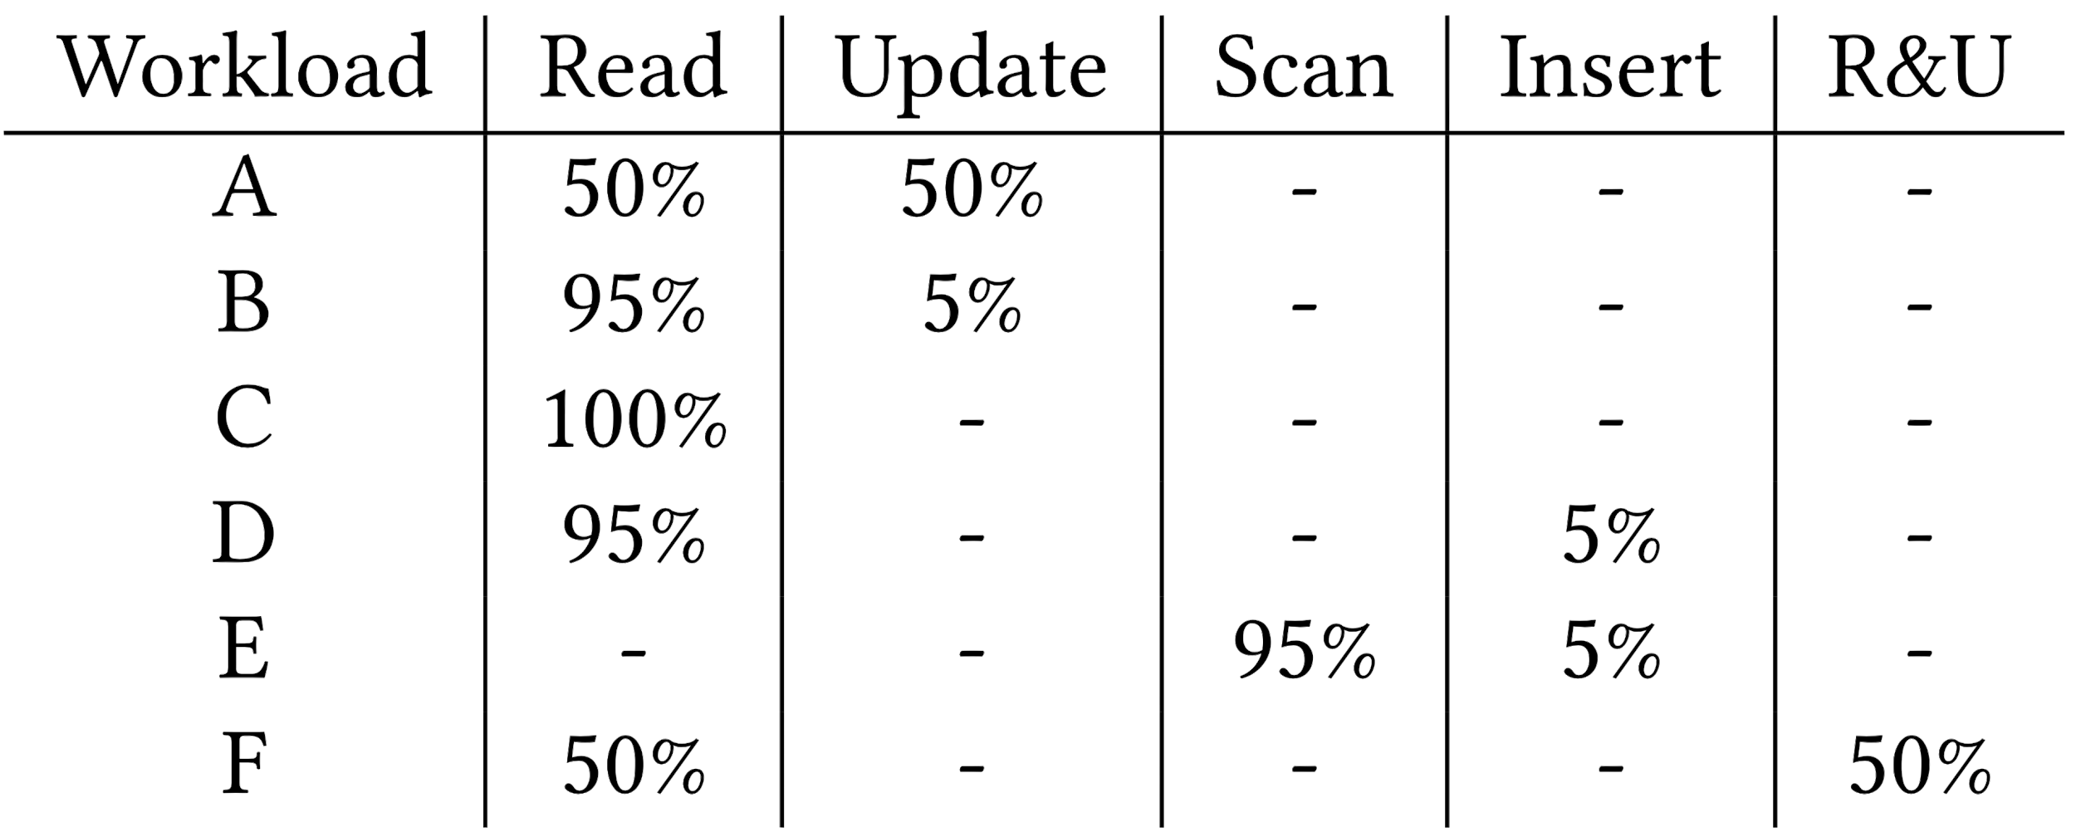
Evaluation - YCSB Results
Higher is better
-J = MongoDB’s JOURNALED (client call returns after data is appended to journal)
-F = MongoDB’s FSYNC_SAFE (client call returns after data is flushed to the backing store; no journaling)
Source: Hotpot

Slide 47
Evaluation - PageRank
Custom graph processing engine
Twitter, LiveJournal datasets
Compare with PowerGraph, Grappa
Notes:
Hotpot: custom graph engine: based on PowerGraph. Gather, apply, scatter (MRSW commit). Vertex-centric, random partitioning, distributes processing load to multiple threads across Hotpot nodes.
Datasets: Twitter (41M verts / 1B dir edges), LiveJournal (4M verts / 34.7M undir edges)

Slide 48
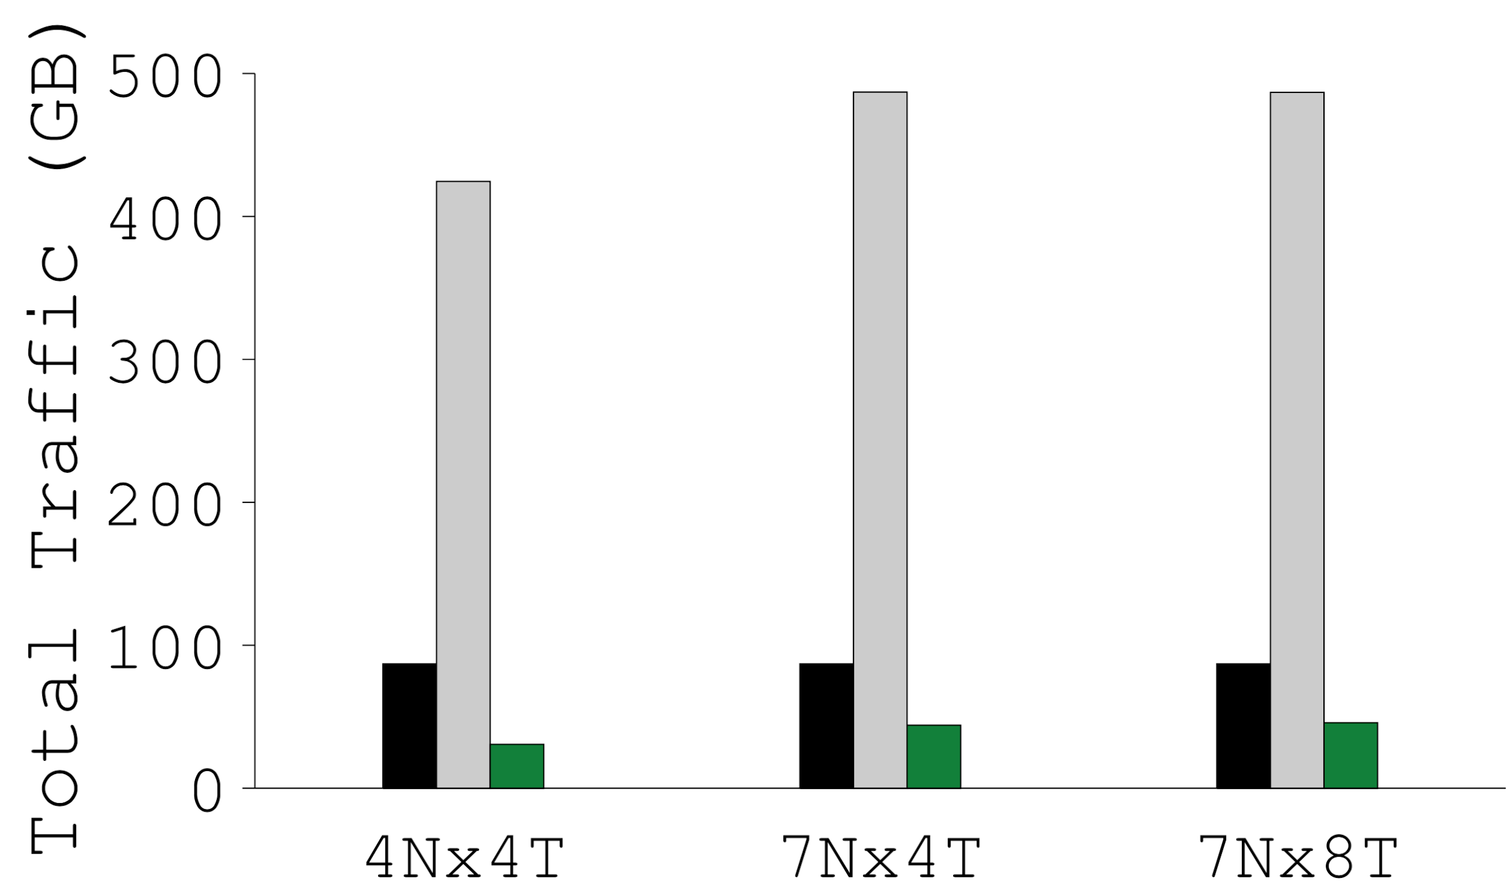
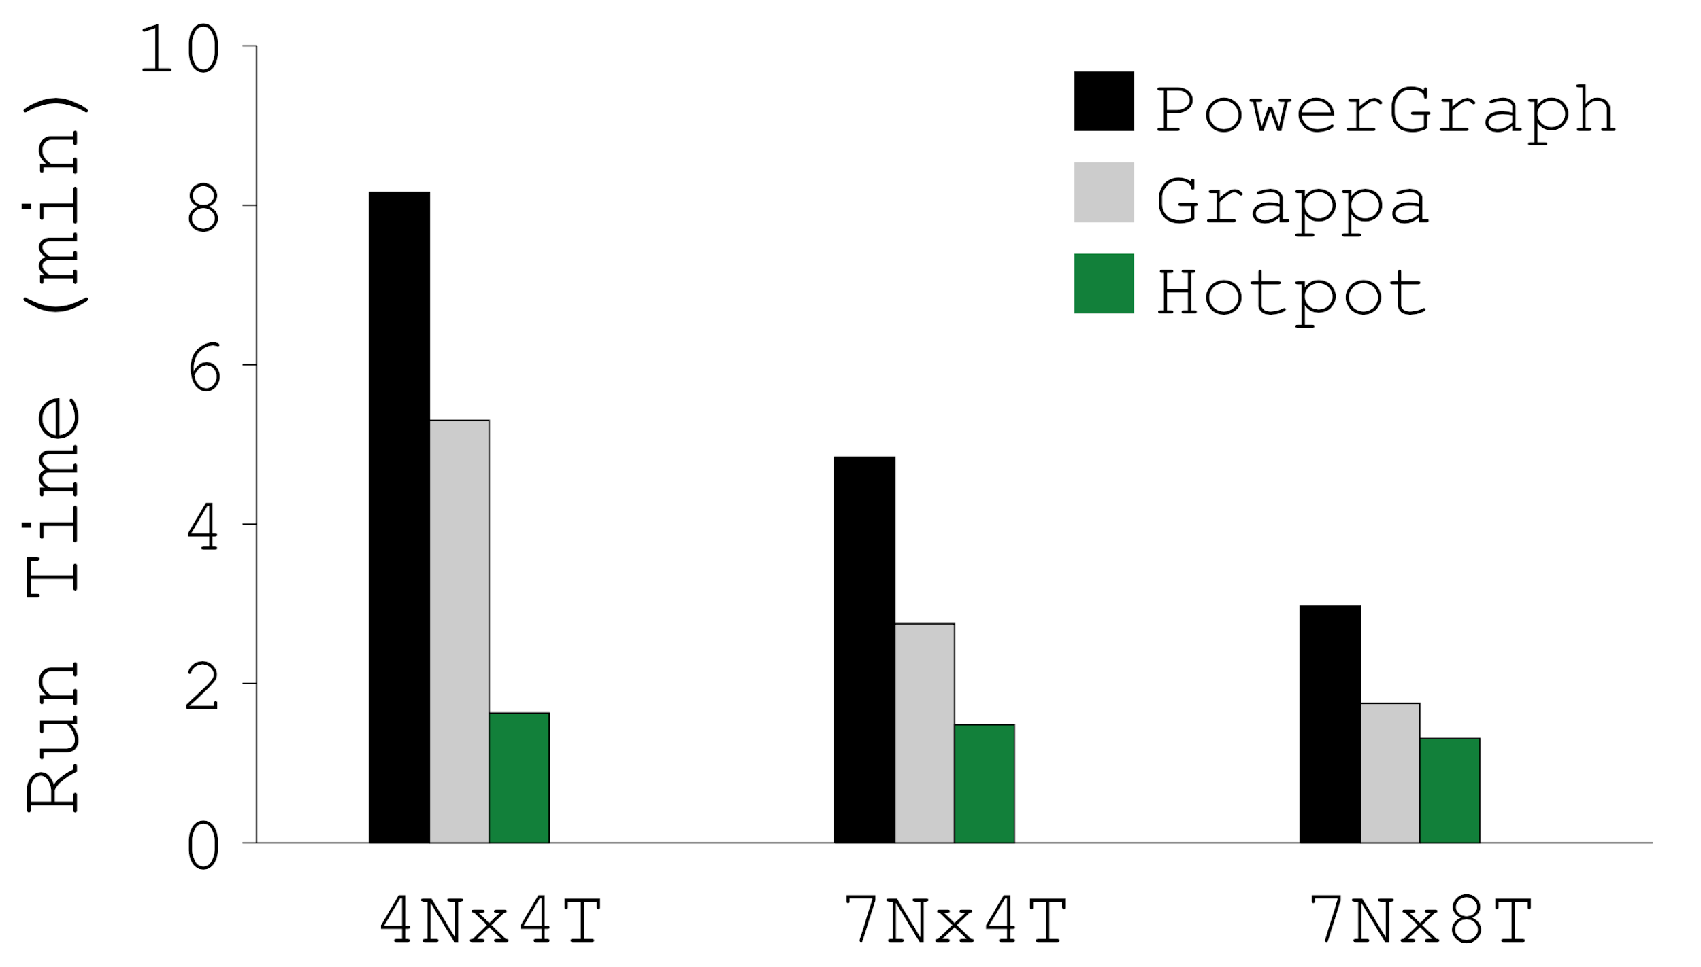
Evaluation - PageRank Results
Run Time
Total Network Traffic
Network Traffic Over Time
Source: Hotpot
Notes:
Graphs are for Twitter data; LiveJournal is similar.
Run Time: Hotpot is faster b/c RDMA network stack has lower latency.
Total Network Traffic: Hotpot only sends dirty pages.
Network Traffic Over Time: trace of 7Nx4T.
Hotpot persists intermediate results for fast restart.
Hotpot: 2.3-5x faster than PowerGraph; 1.3-3.2x faster than Grappa.
PowerGraph: IPoIB; Grappa: custom network stack.

Slide 49
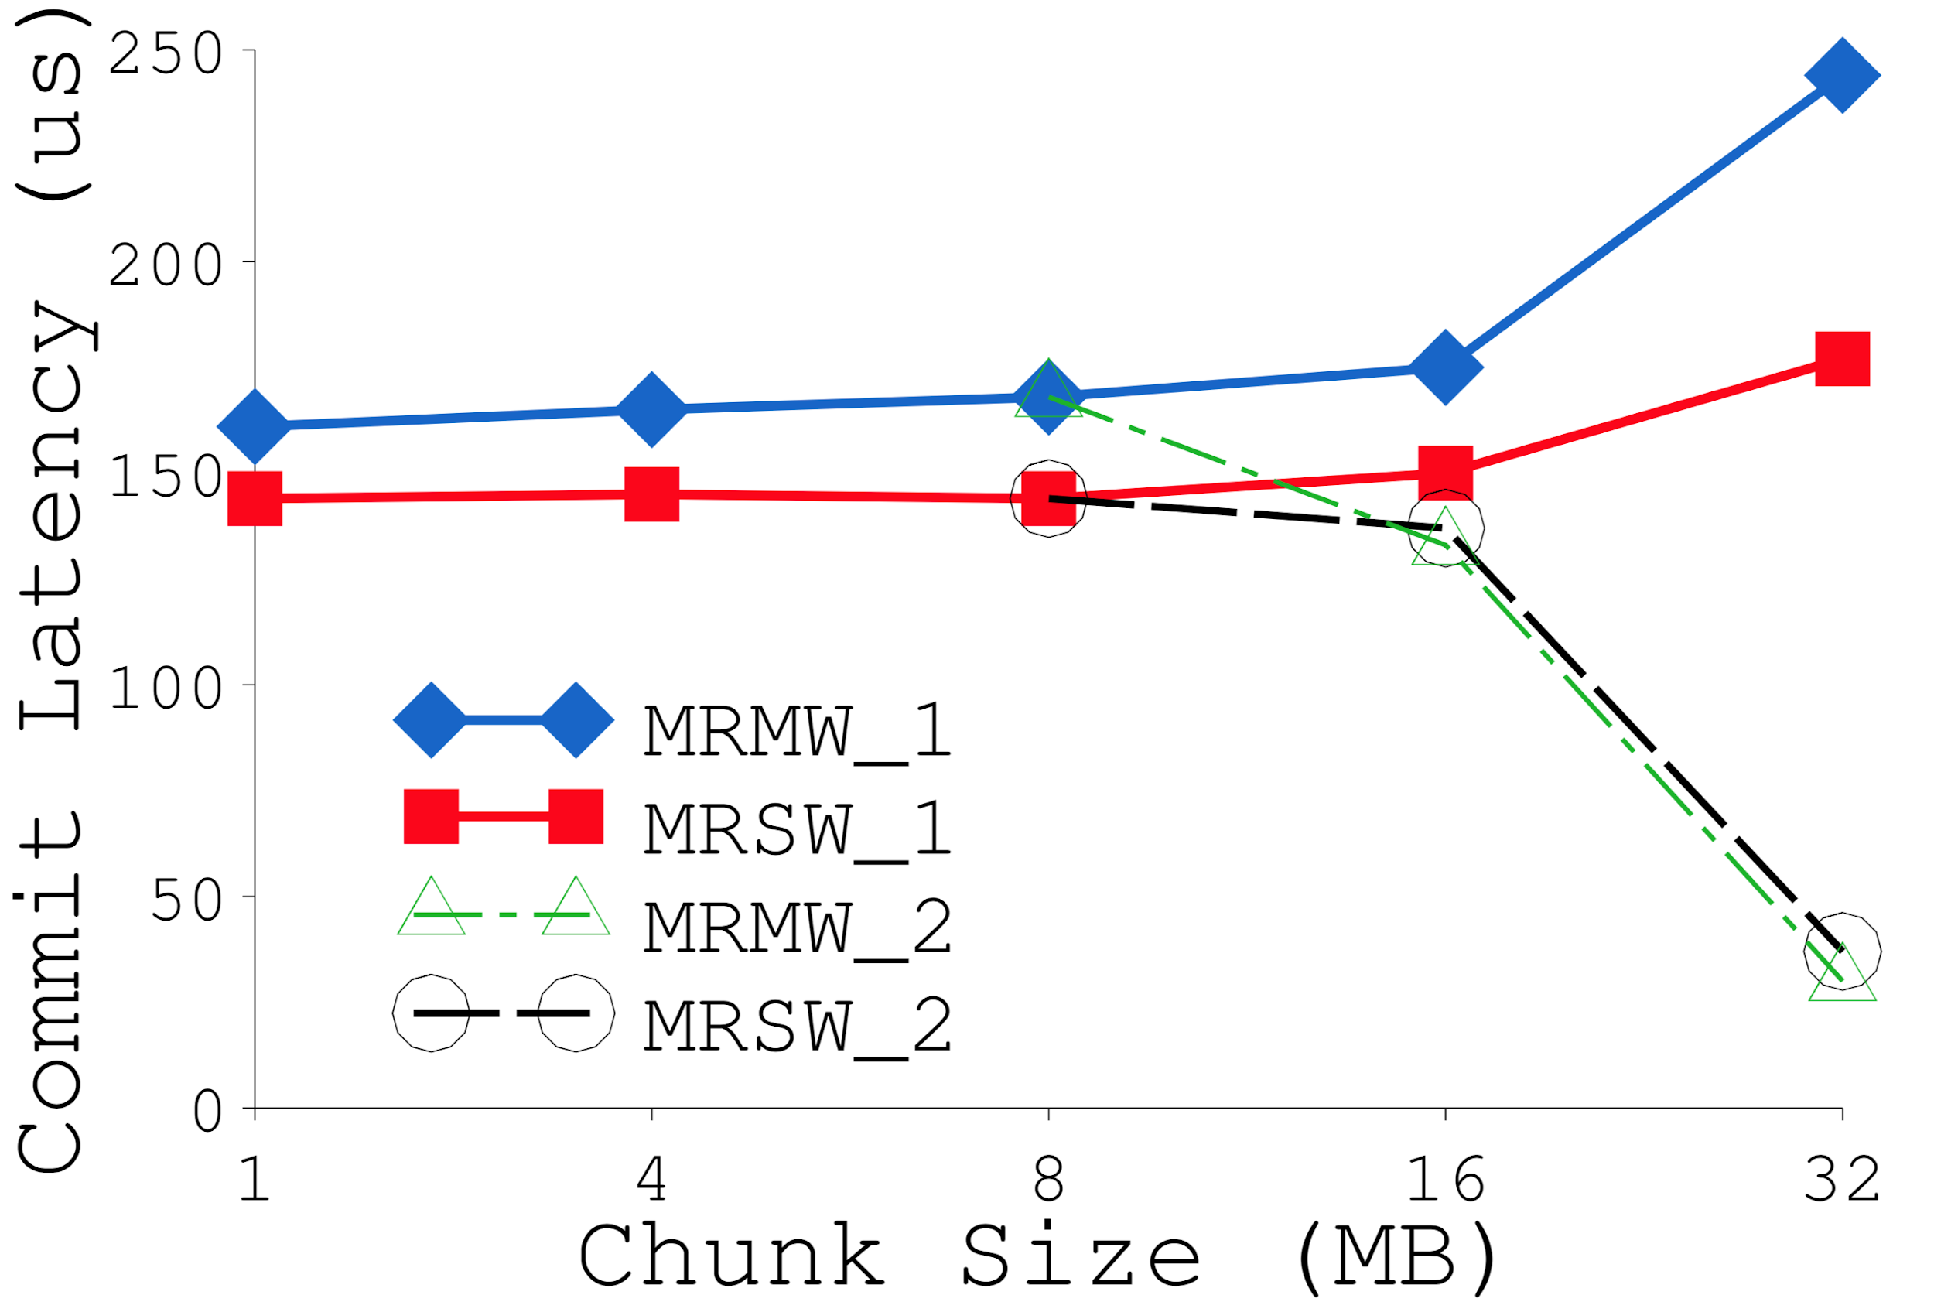
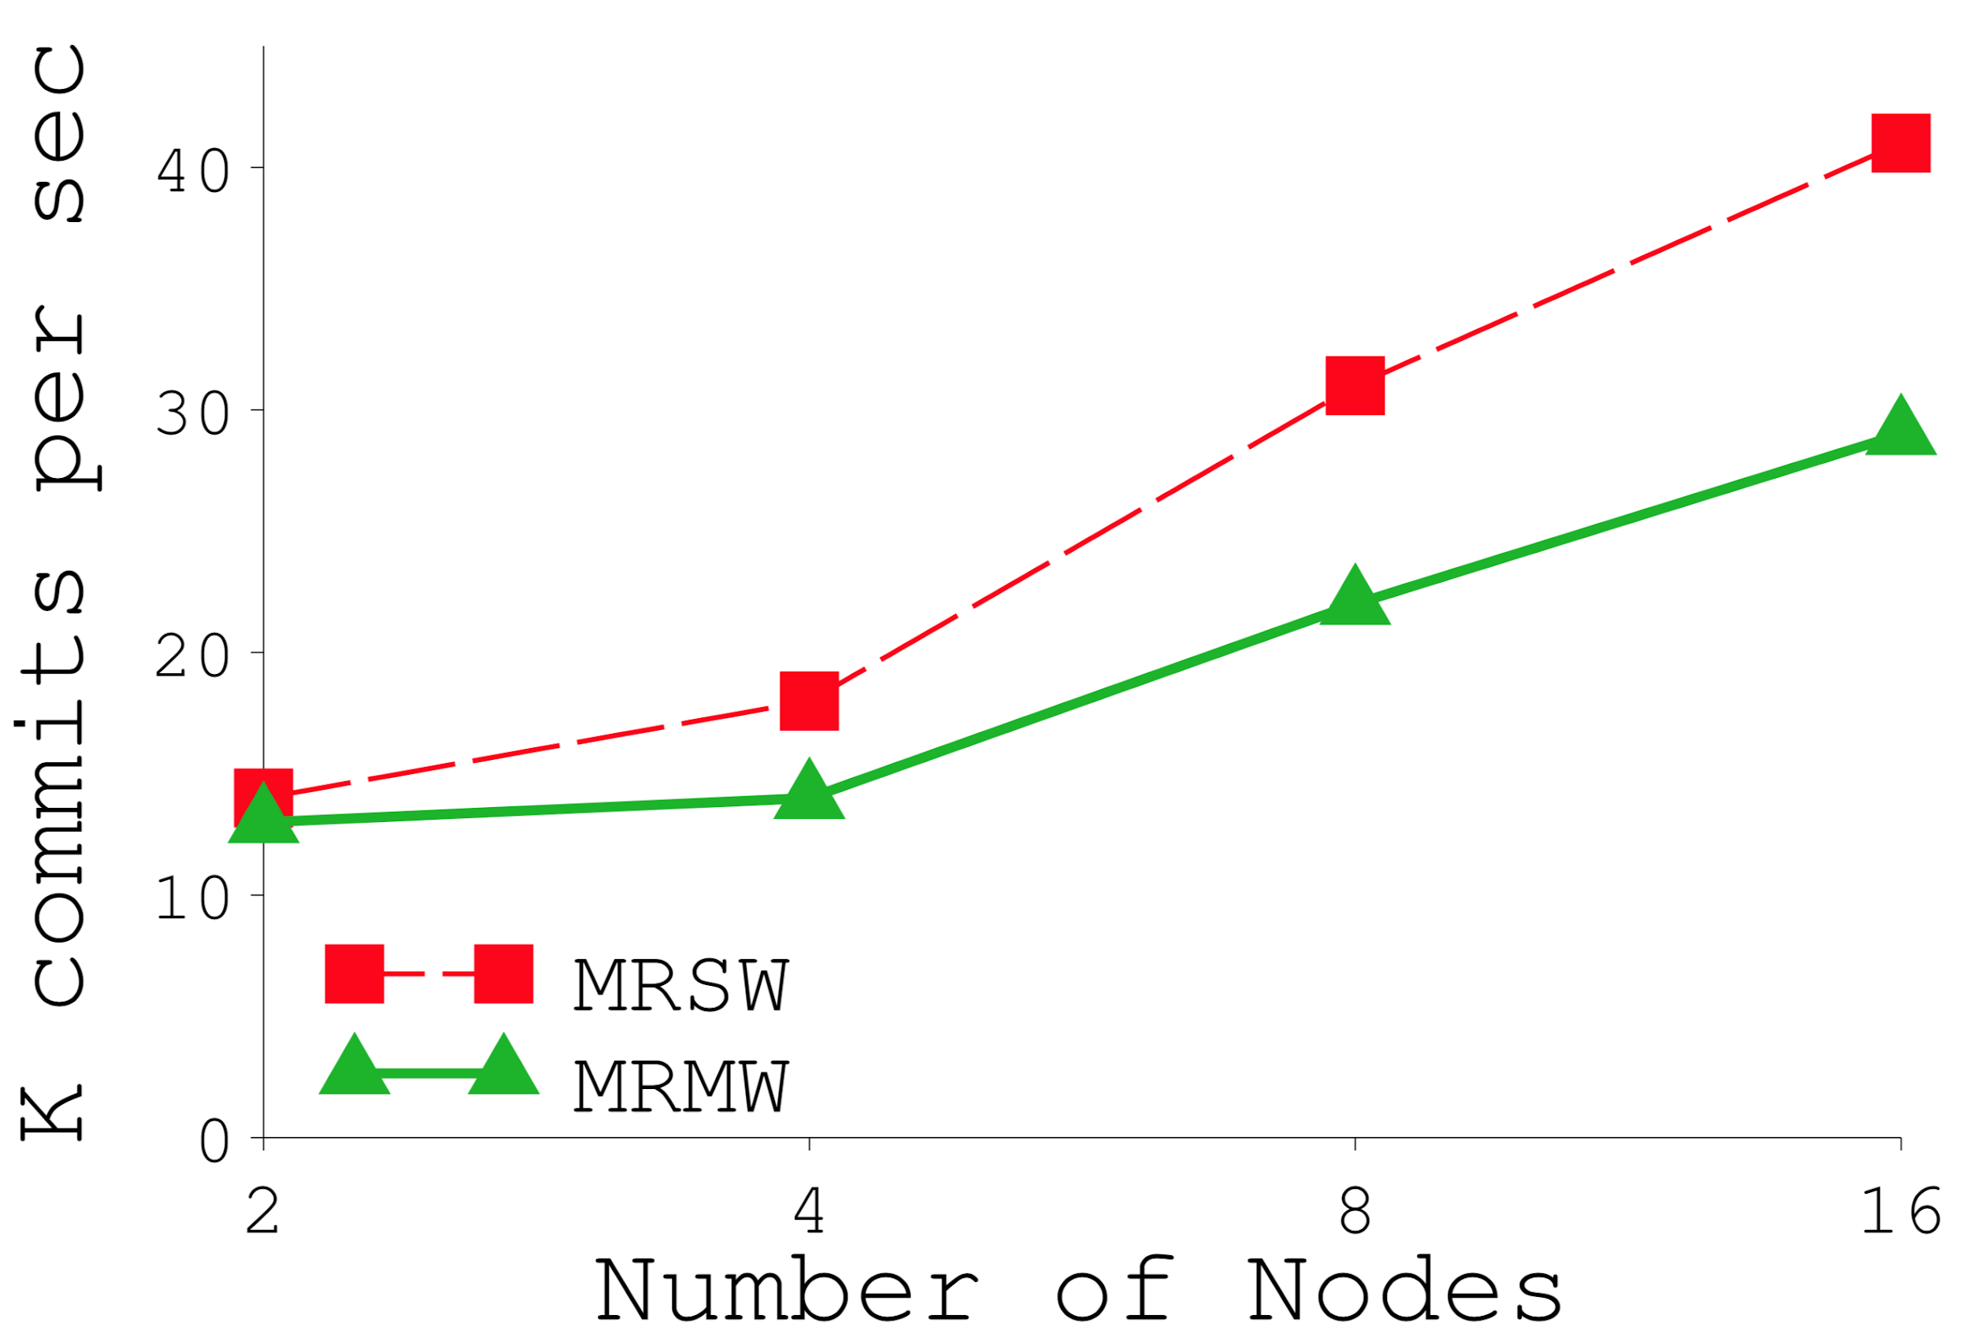
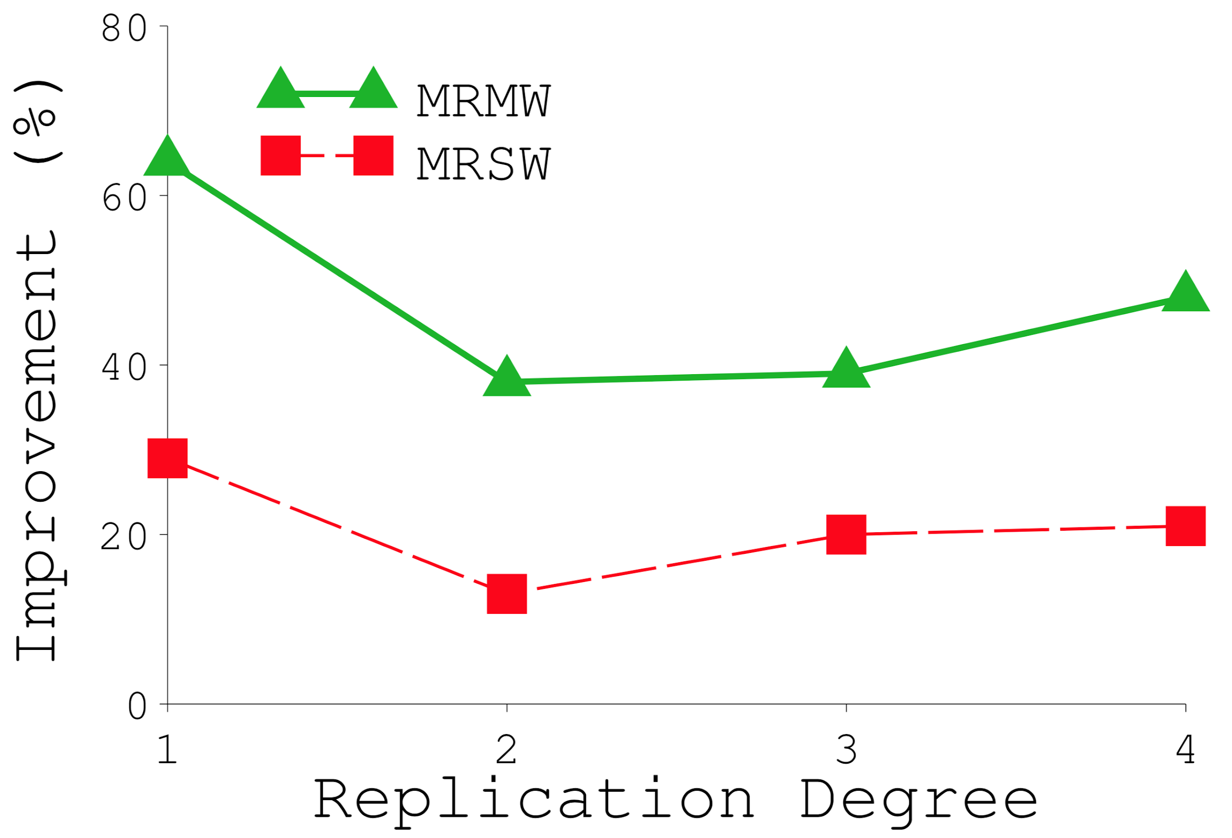
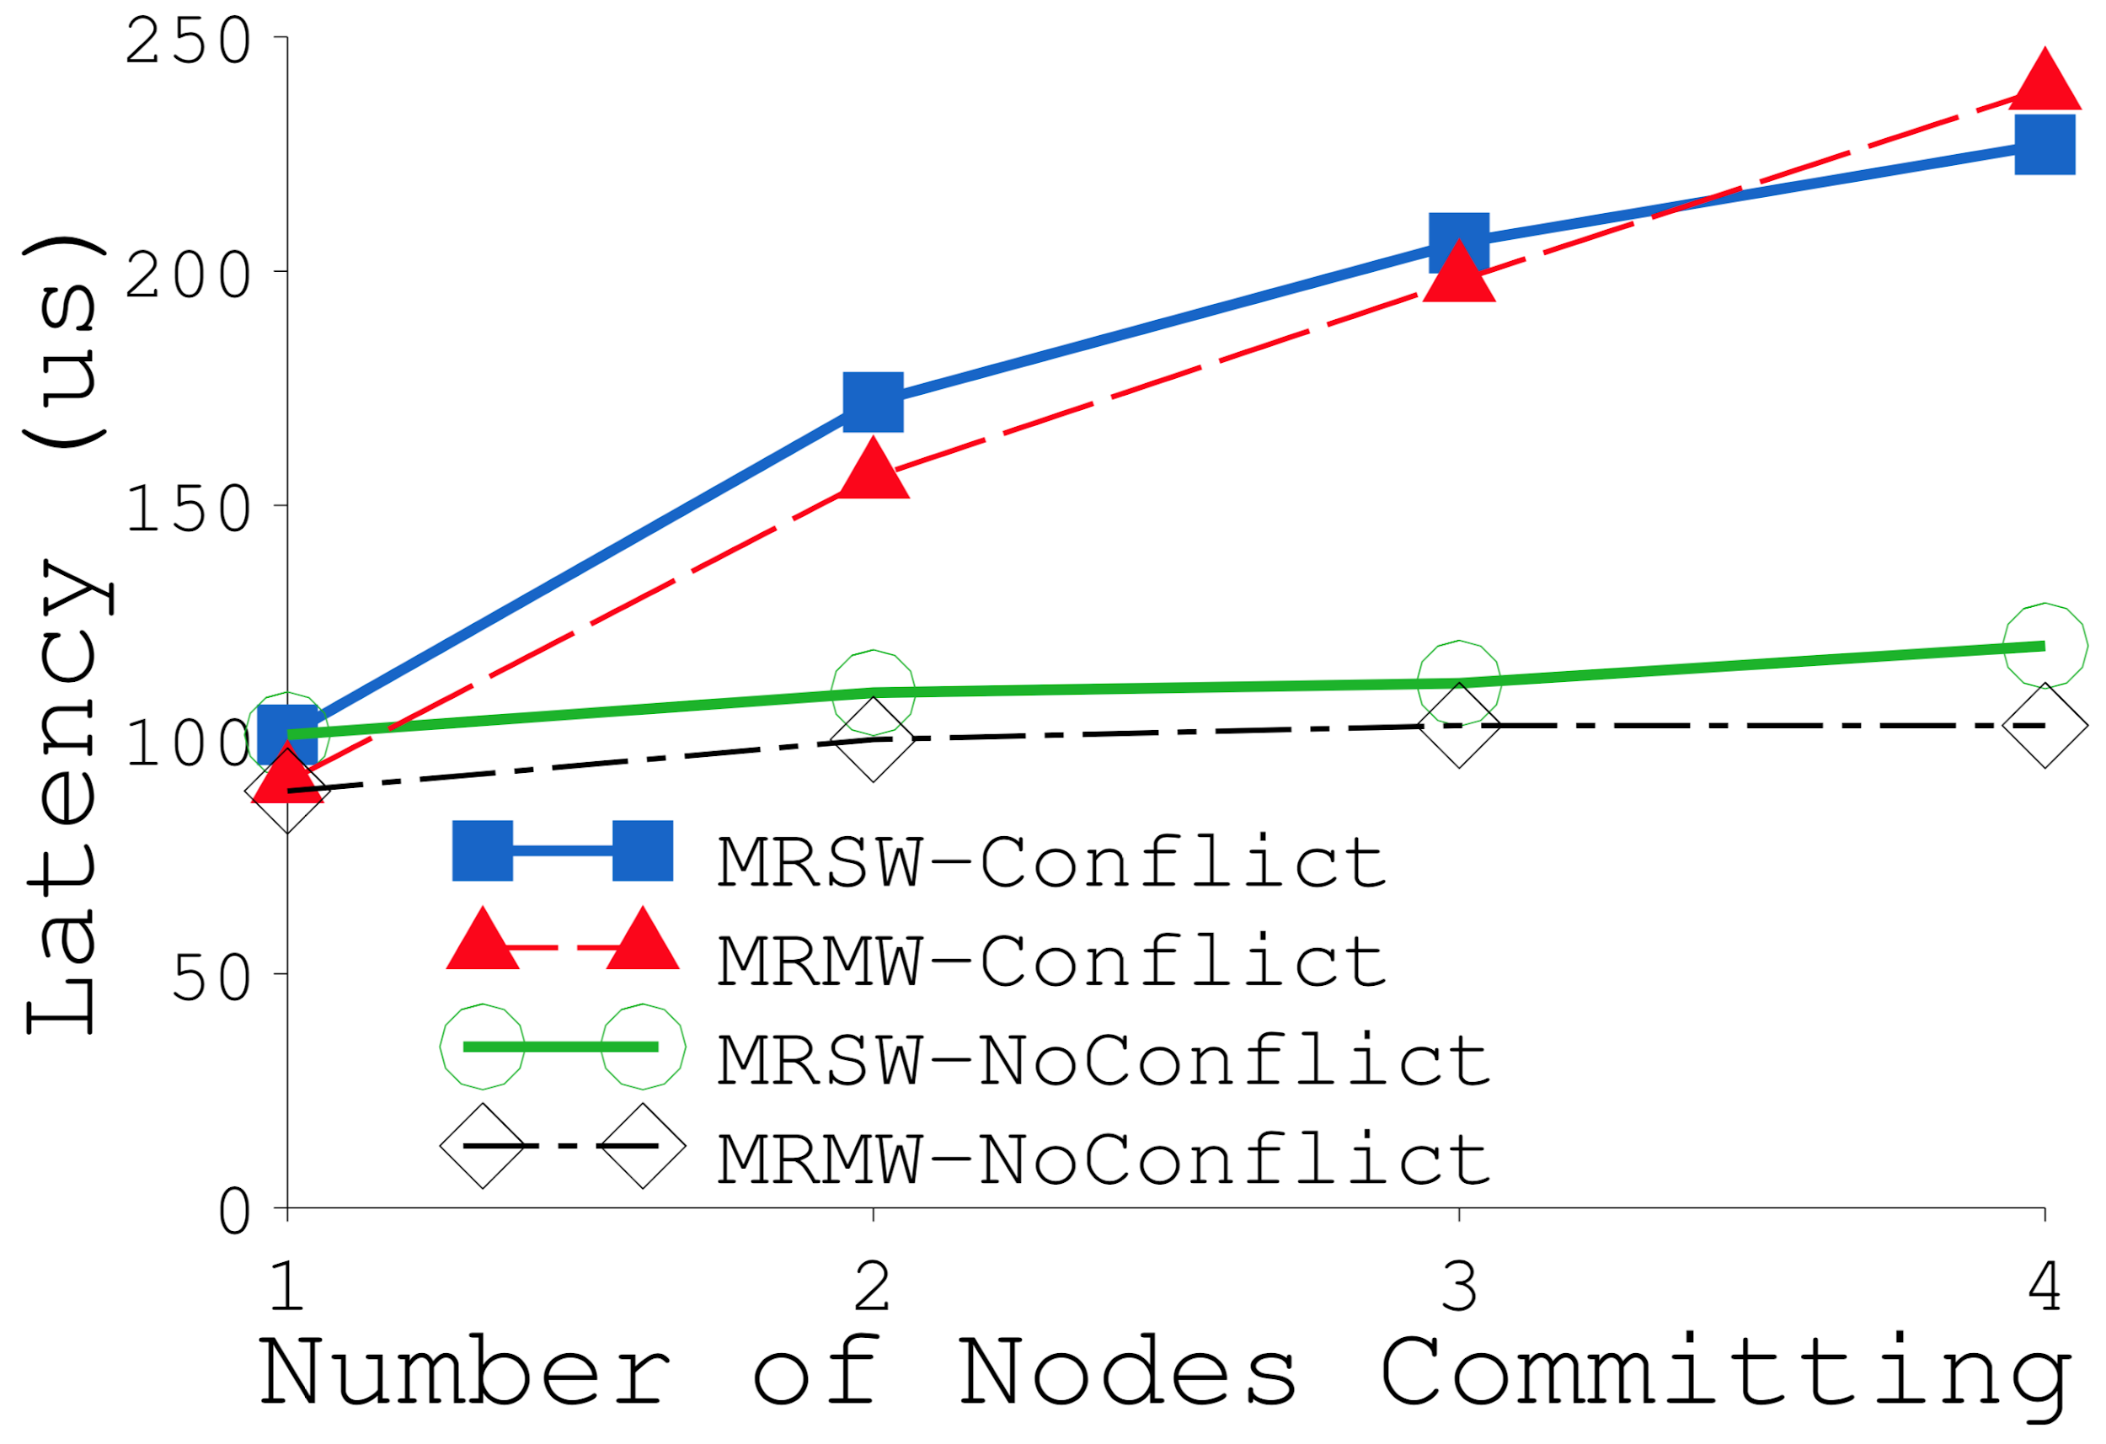
Evaluation - Micro-Benchmarks
Chunk Size Performance
Scalability
Commit Conflict Performance
Owner Node Migration
Source: Hotpot
Notes:
Scalability: commit throughput v # nodes. All nodes concurrently commit 32 random 4KB areas; replication = 1. MRMW is more expensive.
Chunk Size Performance: 1 of 4 nodes commits 32 1KB areas spread evenly in 32MB region; replication = 1.
Commit perf ~const up to 8MB b/c all 4 nodes are owners under round robin. Above 8MB: _1 = remote ON, _2 = CN==ON. Latency goes down for _2 b/c we need to reach out to fewer nodes. Latency goes up for _1 b/c same amount of data goes to fewer nodes. Small chunk size -> better load balancing.
Owner Node Migration: Workload: Zipf distribution to model temporal locality; 4 nodes. Each node issues 100k commits to two locations generated by Zipf.
Big improvement for rep=1 b/c eliminates network. MRMW benefits more b/c MRMW is more expensive/requires more round trips.
Commit Conflict Performance: 4 nodes. Conflict: all CNs commit same 32 seq 1KB areas at same time; sync using thread barrier.
Not pictured: More data or higher replication = longer commit for both MRMW, MRSW.

Slide 50
Conclusion
Hotpot
Kernel-level implementation
Memory-mapped interface
Requires minimal application changes
Data reliability
High availability
Customizable consistency levels

Slide 51
Discussion
Led by Jacob Trueb

Slide 52
Octopus called out by Hotpot’s Related Work
File-based vs Memory-based
Manages file system metadata and data efficiently
Does not provide data reliability and high availability
Were the authors fair in their reference to Octopus?
What could Octopus do to address these reliability and availability claims?
Notes:
“Octopus [57] is a user-level RDMA-based distributed PM file system developed in parallel with Hotpot. Octopus manages file system metadata and data efficiently in a pool of PM-equipped machines. Octopus provides a set of customized file APIs including read and write but not any memory-mapped interfaces. Octopus does not provide data reliability and high availability either. Hotpot’s abstraction is memory-based rather than file-based, and it offers data reliability, availability, and different consistency levels.”
Datasets are a flat filesystem.

Slide 53
Why list requiring NVM as a con in your reviews?

Slide 54
Octopus

Slide 55
Octopus Piazza Topics (34 reviewers)
Confusion
What reduces copying
Why Collect-Dispatch uses fewer RPCs
Novelty of metadata management
Motivation due o to cost of NVM
Collect-Dispatch is faster than 2PC
Uses RDMA verbs to self-identify
Faster than DFSs
Well-designed Evaluations
Hash-based distribution
Fault-tolerance
Lacking implementation details (not true)
https://github.com/thustorage/octopus

Slide 56
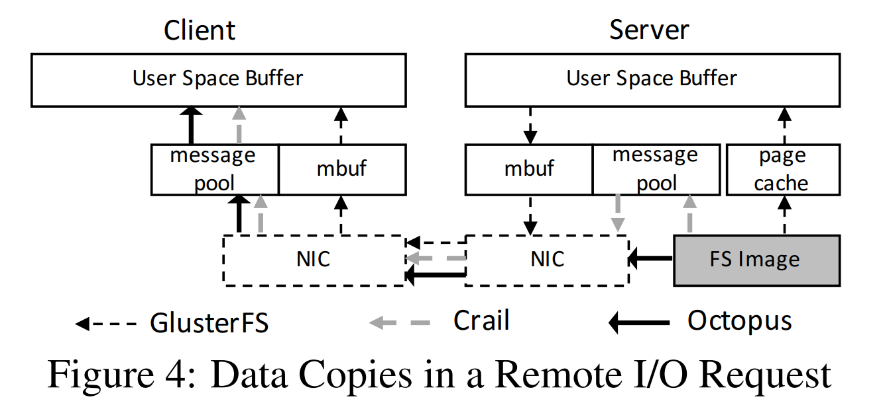
Opinions
Thoughts on proposed changes to the network stack
Octopus, Crail, PASTE
Notes:
Affect the definition of distributed systems.

Slide 57
Drawbacks / TODOs
Designed for
High-Throughput Data I/O
Shared Persistent Memory Pool
Low-Latency Metadata Access
Self-Identified RPC
Collect-Dispatch Transaction
Ignored/Unexplained
Hash-based file distribution
Wear leveling
Metadata/data block placement
Metadata Index Zone (chained hash)
Key: file name hash
Value: file name, inode address in Metadata Zone, chain pointer
Metadata Zone (Bitmapped)
256 byte inodes
Notes:
Ie Hotpot uses hash table bcz of few entries

Slide 58
Hotpot

Slide 59
Hotpot Piazza Topics (12 reviewers)
Unique
Clever use of commit points
Supports mmap’ing
Only a few small changes to the kernel
19K lines, 6.4K for network stack
Central Dispatcher
Sparse Evaluation
Not run on NVM
Use case unclear

Slide 60
Hotpot verifying its existence
Hotpot’s abstraction is memory-based rather than file-based, and it offers data reliability, availability, and different consistency levels.
Hotpot is a DSPM system and lets applications store persistent data. It fetches remote data for both fast local access and data replication.
Hotpot uses a memory-like abstraction and directly stores persistent data in PM.
Hotpot also performs data persistence and replication differently and uses a different network layer in the kernel.
Hotpot is a pure PM-based system that exposes a memory-like interface.
Hotpot is a single-layer system that provides shared memory access, data persistence, and reliability.
Hotpot is a DSPM system that provides a shared-memory abstraction and integrates cache coherence and data replication.
Notes:
DSPM can benefit both
single-node persistent-data applications that want to scale out efficiently
shared-memory applications that want to add durability to their data.

Slide 61
Combining the Distributed Memory and Distributed Storage
What target users would be satisfied/dissatisfied by Hotpot?
Requires
Data Durability
Persistent Naming
Data Reliability
Consistency in and between nodes
Preservation of NVM latency
Approach
Morphable states
Distributed memory caching
Data replication
Commit points
Accurate reliability
User-triggered reliability
Perceived globally-consistent and persistent pointers on page chunks
64-bit addressability
Notes:
In essence, every local copy of data serves two simultaneous purposes. First, applications can access it locally without any network delay. Second, by placing the fetched copy in PM, it can be treated as a persistent replica for data reliability.
Unlike traditional memory-based applications, persistent-data-based applications, DSPM’s targeted type of application, have well-defined data commit points where they specify what data they want to make persistent. When a process in such an application makes data persistent, it usually implies that the data can be visible outside the process (e.g., to other processes or other nodes).

Slide 62
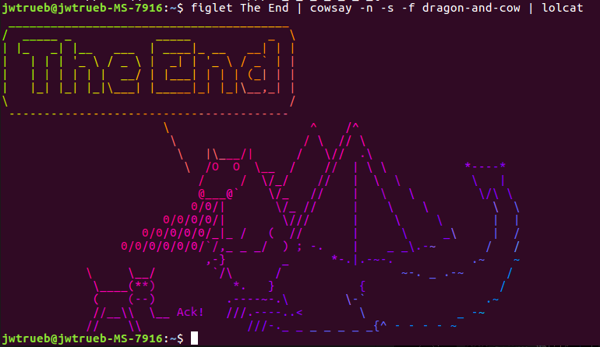
100%

