Slide 1
Curator: Self-Managing Storage For Enterprise Clusters
Presenter: Shiming Song

Slide 2
Background
Today’s cluster storage systems embody significant functionality in order to support the needs of enterprise clusters.
For example,
Automatic recovery and Failure to deal with faults
seamless integration of both solid-state and hard disk drives
…….

Slide 3
Closer examination -> Lots of tasks can run in the background
Benefit:
improve the performance, availability, durability, and cost-efficiency of stored data
What is the system to support engineering to work on these background tasks?
Curator

Slide 4
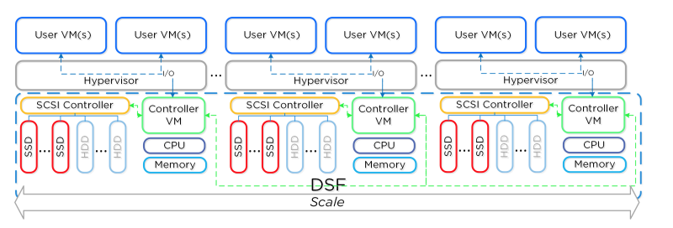
Curator
Curator is the framework and system support for building background tasks.
Distributed key-value Storage System
MapReduce-style framework
Tasks

Slide 5
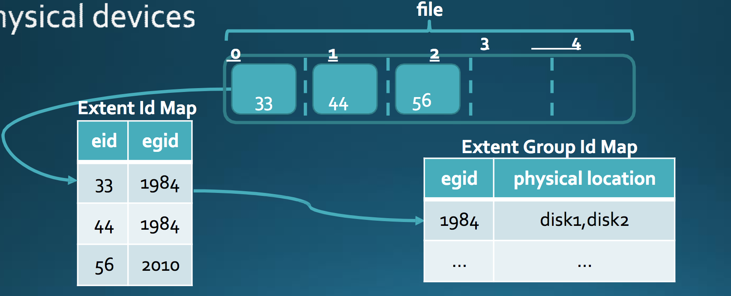
Distributed Storage
Extents: The data in each vDisk block is physically stored on disk in units called extents.
Extent group: Several extents are grouped together into a unit called an extent group.
Distributed key-value storage system example
(reference: the picture is from the original slide)

Slide 6
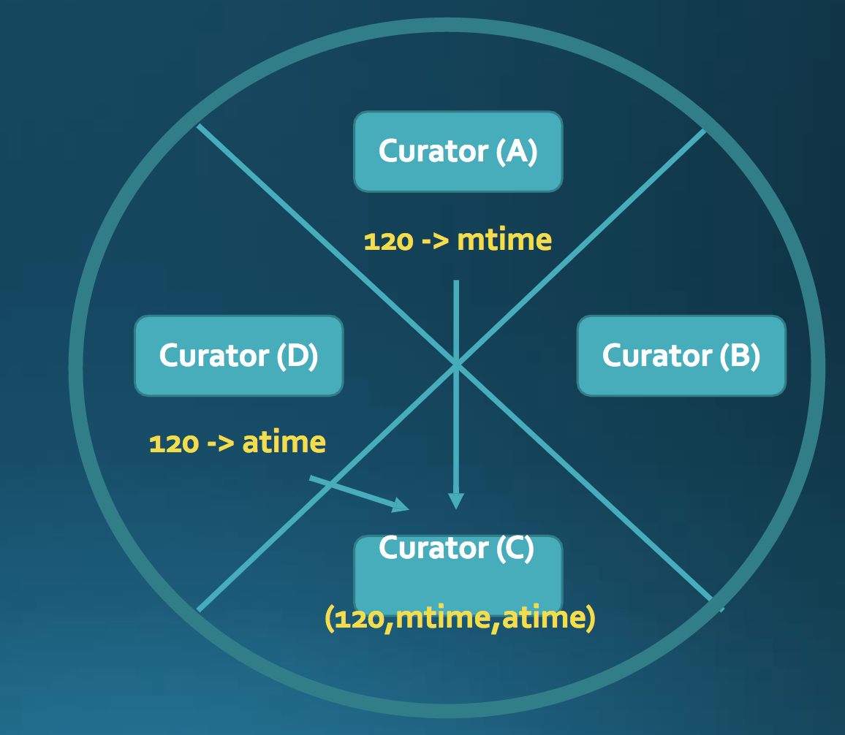
2. MapReduce-style Framework
Map Phrase:
Scan the metadata map and emit and partition the egid
Reduce Phrase:
Reduce based egid and do some operations
Example: Tiering
The tiering example
(reference: the picture is from the original slide)

Slide 7
3. Tasks
Disk Failure/Recovery and Fault tolerance
Tiering (mentioned before)
Disk Balancing
Garbage Collection
Data Removal
Compression
Deduplication
Snapshot Tree Reduction

Slide 8
What is the policy to execute the tasks?
Event-driven policy
For example, when a disk/node fails, a recovery task is executed.
Threshold-based policy
For example, regarding disk balancing,
the mean tier usage > m(35%)
the disk usage spread > threshold s(15%). ( the disk usage spread = disk with maximum usage and the disk with minimum usage within the tier)
Periodic Partial
These tasks only access a subset of the metadata map and are executed every h1 hours. They are grouped based on the metadata table they scan.
Periodic Full
All tasks are executed as part of full scan every h2 hours. The full scan = vDiskBlock, extentID, extentGroupID maps are scanned.

Slide 9
Heterogeneity across and within the cluster, how to solve it?
Reinforcement Learning
Agent interacts with Environment to find the long-term optimal
Agent: tries an action at at a particular state s t , and evaluates its effects in terms of the immediate reward r t+1 it receives and its estimate of the value of the state s t+1 to which it is taken
Pi: long-term policy

Slide 10
Example: Tiering again
st = (cpu,mem,ssd,iops,riops,wiops)t ,
where 0 ≤ cpu ≤ 100 is the CPU usage, 0 ≤ mem ≤ 100 the memory usage, 0 ≤ ssd ≤ 100 the SSD usage, iops ∈ R the total IOPS, riops ∈ R the read IOPS, and wiops ∈ R the write IOPS, all at time step t, where st ∈ S.
actions A = {0,1}∀st ∈ S,
where 0 corresponds to not run, and 1 corresponds to run the task
rt = −latency,
where latency ∈ R is the latency in milliseconds at time step t.

Slide 11
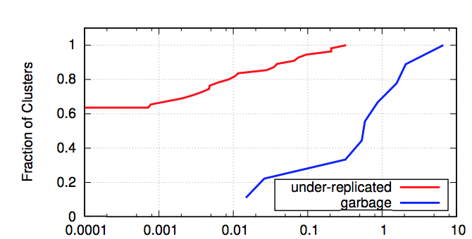
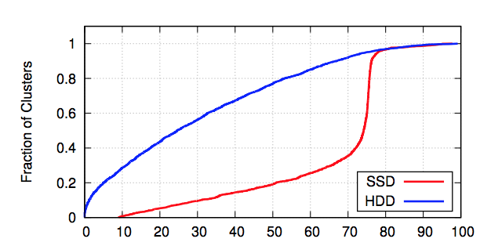
Evaluation:
CDF of SSD and HDD usage
Under-replicated data and garbage data

Slide 12
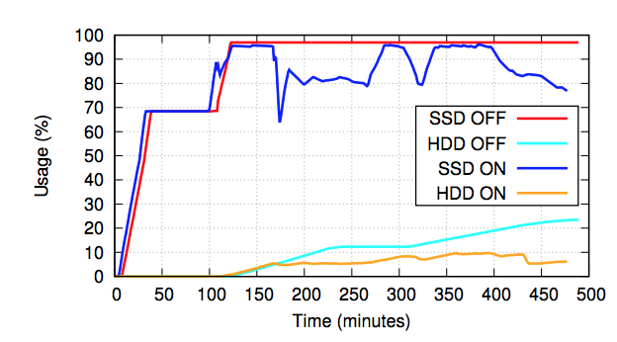
The SSD and HDD usage with Curator on and off

Slide 13
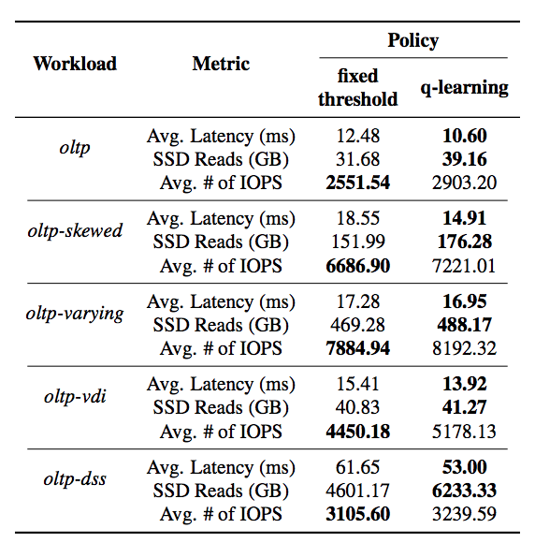
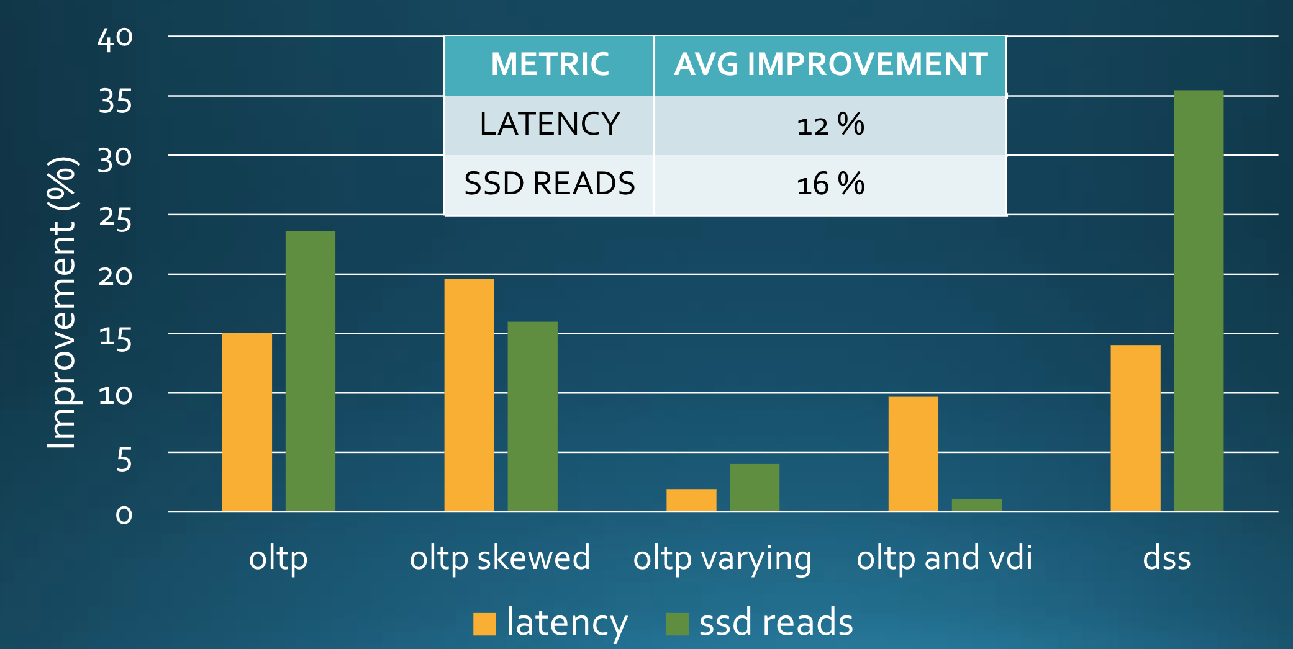
Evaluation for Q-learning
Result summary
Improvement graph after using Q-learning

Slide 14
Conclusion
Curator is the framework and system support for building background tasks.
It used distributed key-value store for metadata and used Mapreduce-style framework to process the metadata.
It can perform lots of tasks in background
It can handle Heterogeneity well by using reinforcement learning.

Slide 15
Thoughts and Discussion
Machine learning method in system area
The evaluation is important

Slide 16
Resource Central: Understanding and Predicting Workloads for Improved Resource Management in Large Cloud Platforms
Microsoft
Presented by Hanyun Xu

Slide 17
Outline
Background and Motivation
Characterization of Azure VM Workload
Resource Central
Evaluation
Conclusion

Slide 18
Background and Motivation

Slide 19
Public Cloud Platform
+ Performance
+ Capacity
+ Reliability
+ Availability
- Cost $$$

Slide 20
Lower Costs Via Resource Management
Pack VMs tightly
Oversubscribe resources
Increase server density
Reduce energy consumption
Reduce management overhead
Scavenge idle resources
Practical challenges:
Complexity and scale
VM performance impact
VM availability impact
Solution: Deeply understand and predict the characteristics of the VM workload
→ Machine Learning

Slide 21
Characterization of Azure VM Workload

Slide 22
Main Azure Characteristics
Azure hosts:
1st-party VMs – internal services, Microsoft dev…
1st-party services offered to 3rd-party customers – Microsoft Office, Skype…
3rd-party VMs – External users’ VM, Adobe…
VM type: IaaS & PaaS
Customers create subscriptions , deploy VMs to regions in deployments
Study: Full VM workload of Azure over 3 months

Slide 23
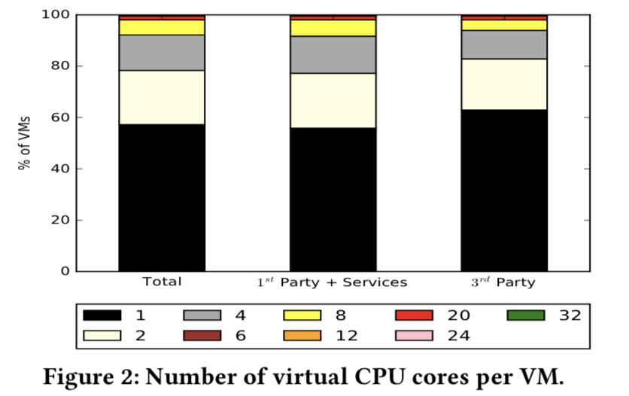
Characterization – VM Size
CPU Cores & Memory
Observations:
Small VMs with scale-out pattern
CPU cores similar to memory
1st and 3rd party are similar
Resource management:
Easier to fill holes

Slide 24
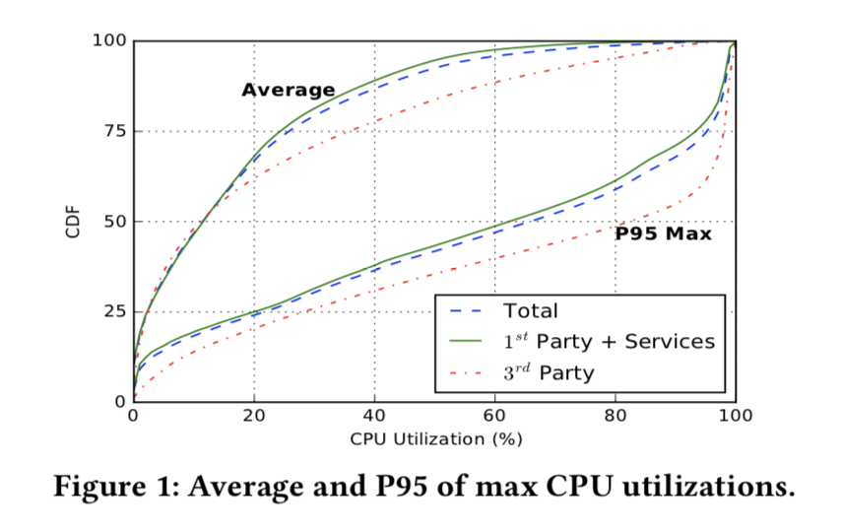
Characterization – VM CPU Utilization
→ Virtual resource usage
Observation
Large % with low average utilization
Large % with high P95 utilization,
esp. 3rd party
Resource management
Hight utilization → may limit packing
Low utilization → oversubscription is possible
95th-percentile
of the maximum
Cumulative
Distribution
Function

Slide 25
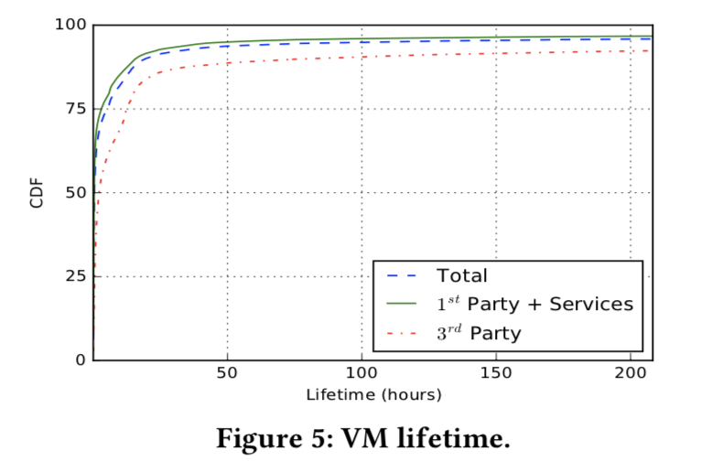
Characterization – VM Lifetime
1st party
Observations:
Short VMs dominate, esp. for 1st party
Non-trivial percentage of long VMs
long VMs = 95% of core hours
Resource Management:
If VM lasts 1 day, it will live much longer
Non-urgent maintenance
VM scheduling
3rd party

Slide 26
Other VM Workload Characteristics
VM type (IaaS vs PaaS)
VM memory size
Maximum deployment size
VM workload class (interactive vs delay-insensitive)
VM inter-arrival times

Slide 27
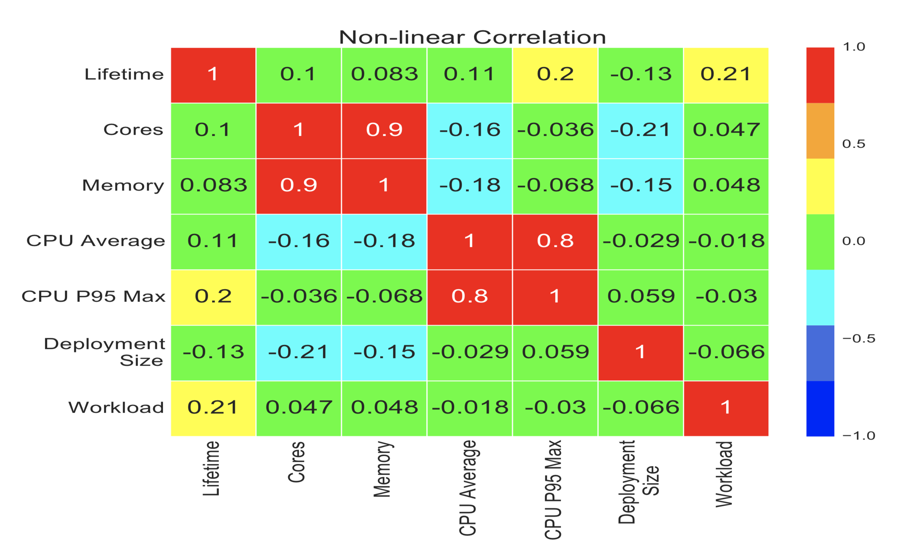
Correlations between metrics
Spearman’s method
heat map
Correlation factor: [-1, 1]
1.0 -- positive relationship
-1.0 – negative relationship
0.0 – no relationship

Slide 28
Resource Central

Slide 29
Resource Central
VM Scheduling
Cluster Selection
Power Oversubscription
Server Maintenance
Recommending VM & deployment sizes
A system for
ingesting VM telemetry
learning from past VM behaviors
producing models to predict
executing the models when requested
RC use-cases:
Platform resource managers
…….

Slide 30
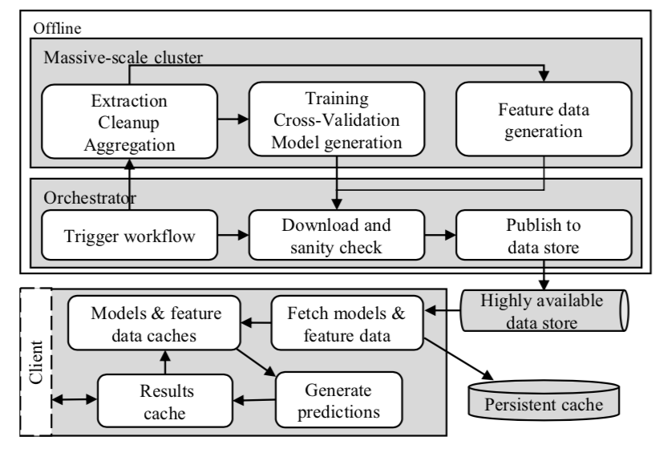
Resource Central Architecture
Design principles:
Off critical performance & availability paths
Simple & based on stable systems
General interface
Status:
Manually used by engineers
In staging for online use
Clients being productized
ML
Data
DDL
Online

Slide 31
Current Machine Learning Models
Metrics | Modeling approaches
CPU utilization | Random Forests
Deployment size in #VMs | Extreme Gradient Boosting Tree
Lifetime | Extreme Gradient Boosting Tree
Workload class | FFT, Extreme Gradient Boosting Tree
Classification algorithms
Formulating these models as classifiers with buckets
Prediction comes with a score

Slide 32
Evaluation

Slide 33
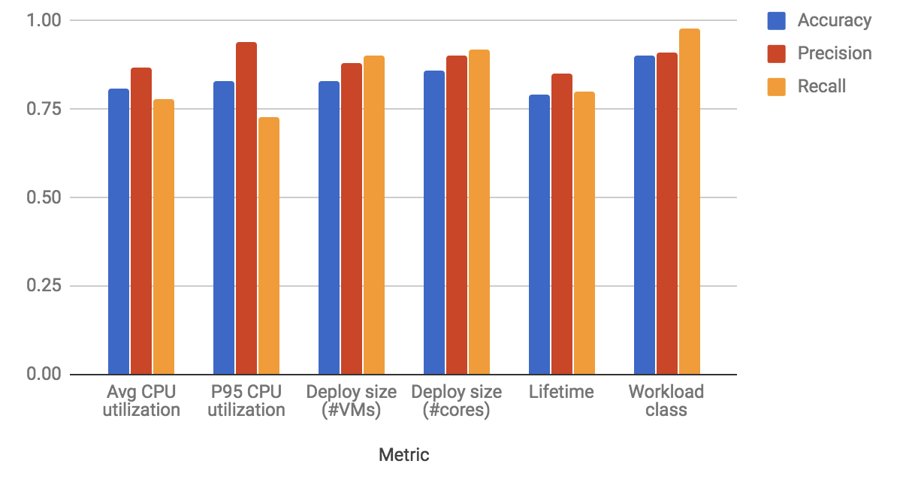
Prediction Quality
Accuracy ≥ 79%
Precision^{θ} ≥ 85%
Recall^{θ} ≥ 73%

Slide 34
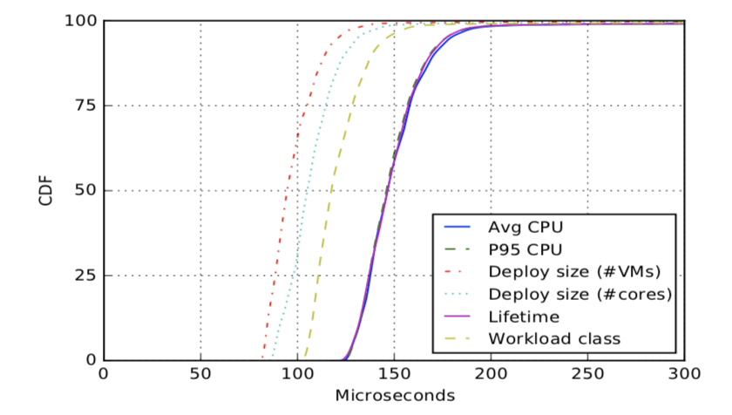
Performance – Model Execution
Low latency
Predictable
99th percentile: 258 μsec max
Latency of model execution for 6 metrics

Slide 35
Case Study: RC-informed VM Scheduling
Goals:
Be conservative. Stick with P95, 1st party loads.
Don’t oversubscribe servers running production VMs.
Oversubscribe other servers up to a percentage over capacity and a max predicted utilization.
Mispredictions:
Only issue is consistent under-prediction.
VM Scheduling system
Hard rule 1
Filters servers out
Hard rule 2 (fit?)
Soft rule 3
Selected server

Slide 36
Case Study: RC-informed CPU Oversubscription
Simulation results
Version | Description | Behavior
Baseline | No oversubscription | Low capacity; many VM allocation failures
Naive | 25% oversub without predictions | No failures; 6x resource exhaustion
RC-informed-soft | 25% oversub with RC predictions | No failures; rare exhaustion
RC-informed-hard | 25% oversub with oracle predictions | No failures; same exhaustion

Slide 37
Conclusion

Slide 38
Conclusion
Understanding cloud workload is key
Resource Central efficiently produces useful predictions
Cloud providers can exploit workload characteristics in resource management using machine learning

Slide 39
Takeaway
Analysis methods like Spearman Correlation, Cumulative distribution function (CDF).
Apply Machine Learning related techniques into Cluster scheduling.
Oversubscribe scientifically to make the most use of resources.
What about other platforms other than Azure?

Slide 40
Cluster Scheduling Discussion
Led by Stephen Skeirik

Slide 41
Curator: Summary of Student Comments
CPU/Resource Overhead
Comparison to other related works
Fault-tolerance/automatic recovery
Monitoring lots of customer data
Q-Learning:
20% Latency improvement!
Data used to pre-train clusters bad… why?
Why RL instead of other (more lightweight) methods?
Paper explains the design of the system well

Slide 42
Curator: Questions
Curator Evaluation
Reported Curator Metrics vs. Curator Cost/Benefit Analysis Cost Benefit Analysis Setup: - 4-node cluster - 4 SSDs and 8 HDDs, total size 1.85 TB SSDs, 13.80 TB HDDs, - CPU clock rate of 115.2 GHz - total memory of 511.6 GiB Curator Metrics: - 50 customer clusters (2.5 months) - 10 internal clusters (3 days)
System enormously complex --- how do individual components interact?
A modified Cassandra (+ Paxos) was used for metadata --- data distributed in ring-like manner Is this optimal?
Curator schedules tasks to be performed on DSF --- how does DSF work?

Slide 43
Curator: Questions
Curator Q-Learning
Not many people mentioned --- policy not used in production Is their evaluation meangingful at all?
What ML models should be considered instead?
Map/Reduce Framework/Metadata Maps
Why did the authors separate the metadata maps?
vdisk/offset -> extentID
extendID -> extentIDGroup
extentIDGroup -> physical disk
Is Map/Reduce useful for this system? Does the paper tell us?
How do task policies help (Event, Threshold, Partial Full)?
How were policies chosen?
Were the policies evaluated?

Slide 44
Resouce Central: Summary of Comments
May not generalize to other systems besides Azure
Extensive amount of data --- which is open-sourced
Prediction accuracy is high
RC system demonstrates utility in oversubscription task

Slide 45
Resouce Central: Questions
Do you think assumption that VM behavior is consistent over various lifetimes is valid?
Main Computation occurs offline --- what are the trade-offs here?
How does this system “react” to change? How long will that take?

Slide 46
Resouce Central: Questions
RC uses 2 months of data for training and evaluation is based on prediction for the next month --- how would data be collected in a live system?
What is the overhead of the data colletion?
RC evaluation is based on buckets of different VM types --- how does that effect the evaluation?

