Slide 1
Wormhole: Reliable Pub-Sub to Support Geo-replicated Internet Services
Authors: Yogeshwer Sharma et al.
Facebook & Cornell University
Presenter: Tianyuan Liu
Reference: https://www.usenix.org/sites/default/files/conference/protected-files/nsdi15_slides_sharma.pdf

Slide 2
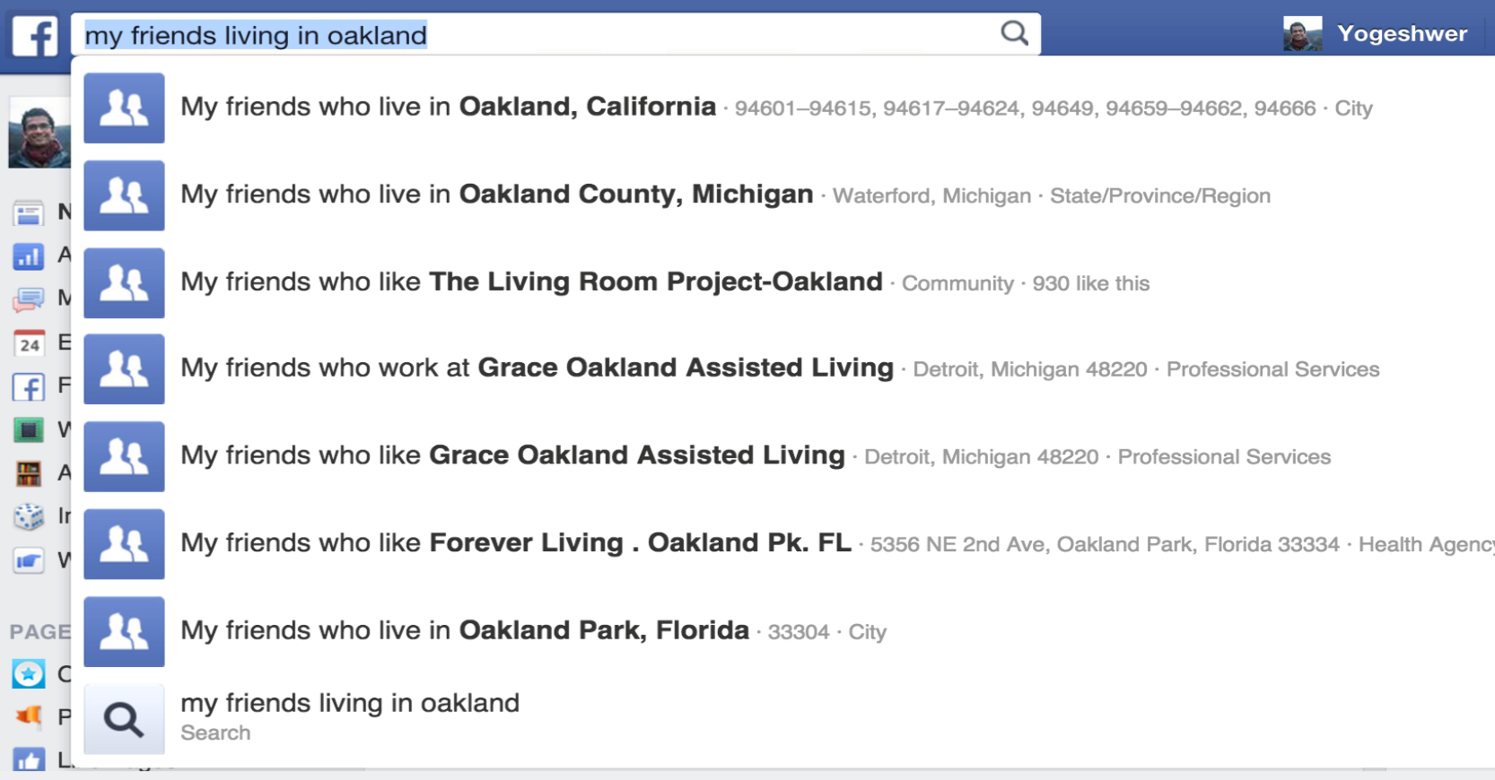
Motivation
Update secondary index services — e.g. Graph Search
1
Notes:
Secondary indices are used to speedup query processing
When primary database is updated, the secondary index needs to be updated

Slide 3
Simple Solution?
{
“name”: “Alice”,
“addr”: “Champaign”,
…
}
MySQL
update
Datastore
pull
Graph Search
Application
2

Slide 4
Simple Solution?
Datastore
HDFS
MySQL
RocksDB
Heterogeneous Datastores
pull?
News Feed
Graph Search
TAO
Application
Various Applications
Difficulty in setting pull intervals
2
Notes:
How could we set the time intervals between two pulls?
If the interval is set too short, it’s gonna put too much work load on the datastore.
If the interval is too long, the data in the applications can be stale.
Heterogeneous datastores: Programmers have to write one query for each database.

Slide 5
Pub-Sub Architecture
Datastore
HDFS
MySQL
RocksDB
tail
Publisher
Pub-Sub
publish
Subscriber
Subscriber
Subscriber
consume
News Feed
Graph Search
TAO
Application
3
Notes:
Publisher tails the updates from datastore, and then sends them to subscribers. Each application consumes the updates.

Slide 6
Heterogeneous Datastores
Datastore
HDFS
MySQL
RocksDB
Txn log
HDFS Tailer
MySQL Tailer
Datastore agnostic updates
Pub-Sub
Publisher
News Feed
Graph Search
TAO
Application
4

Slide 7
Fetch a Data Block
Datastore
Publisher
Txn log
Tailer
12
6 | 7 | 8 | 9 | 10 | 11
12
12
12
12
Subscriber
Subscriber
Subscriber
News Feed
Graph Search
TAO
Application
5
Notes:
Copy into 3 pieces, and send it to the three applications via TCP.

Slide 8
Periodic Question-Ack
Datastore
Publisher
Txn log
6 | 7 | 8 | 9 | 10 | 11
12
Tailer
done(12)?
done(12)?
done(12)?
Subscriber
Subscriber
Subscriber
News Feed
Graph Search
TAO
Application
6

Slide 9
Periodic Question-Ack
Datastore
Publisher
Txn log
6 | 7 | 8 | 9 | 10 | 11
12
Tailer
ack(12)
Subscriber
Subscriber
Subscriber
News Feed
Graph Search
TAO
Application
6

Slide 10
Application Failure & Recovery
Datastore
9
9
Publisher
Txn log
6 | 7 | 8 | 9 | 10 | 11
Tailer
Recovery Tailer
8
9
12
13
Subscriber
Subscriber
Subscriber
News Feed
Graph Search
TAO
Application
7

Slide 11
Application Failure & Recovery
Datastore
Publisher
Txn log
6 | 7 | 8 | 9 | 10 | 11
12
13
Tailer
Recovery Tailer
lead caravan
recovery caravan
Caravan
Dictionary: a group of people, especially traders or pilgrims, traveling together across a desert in Asia or North Africa.
8
Notes:
Wormhole publisher has a singleton lead caravan. The lead caravan sends the most recent updates to fast subscribers.
Wormhole publisher assigns subscribers with similar pace to a caravan so as to catch up the lead caravan.

Slide 12
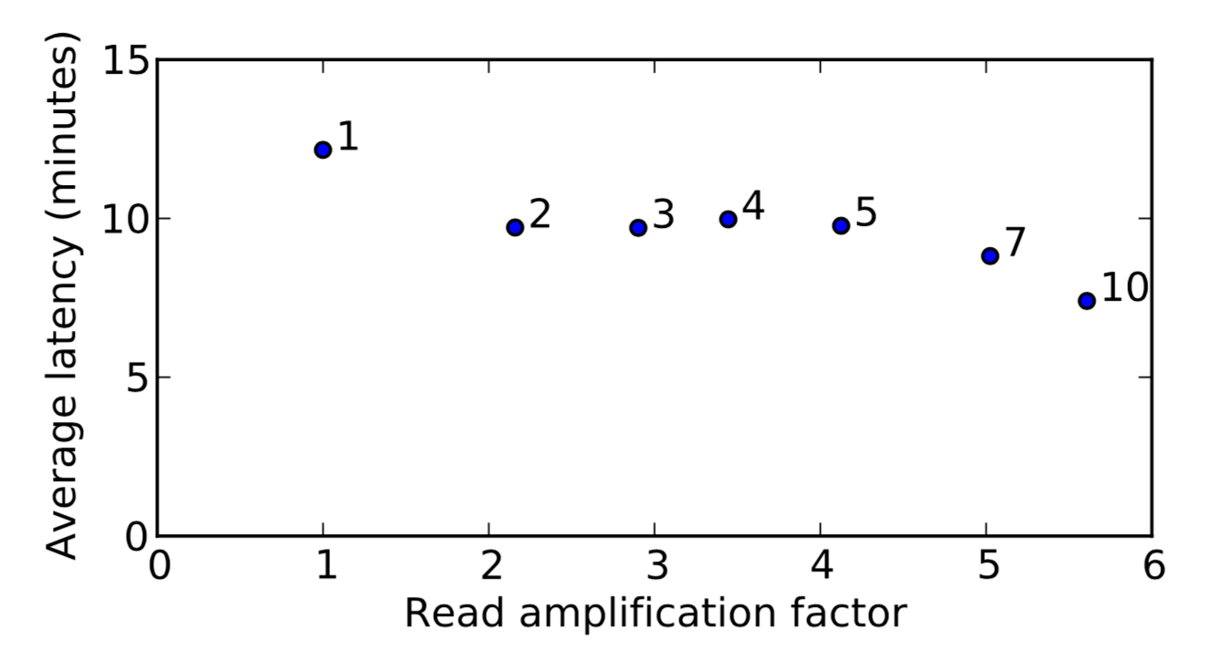
Caravan
Trade-off: latency v.s. recovery I/O load
40% less in latency, 6 times more in I/O load
9
Notes:
The more caravans assigned to a publisher, the higher I/O load is cast on the datastore.
Read amplification factor versus average latency of delivering updates to 10 applications (see text for more explanation). Different data points are for varying number of maximum allowed caravans. The latency is averaged over 10 applications whose datamarkers are scattered evenly across the 20 GBytes of single datastore updates.
The latency can be reduced by around 40% using 10 tailors.

Slide 13
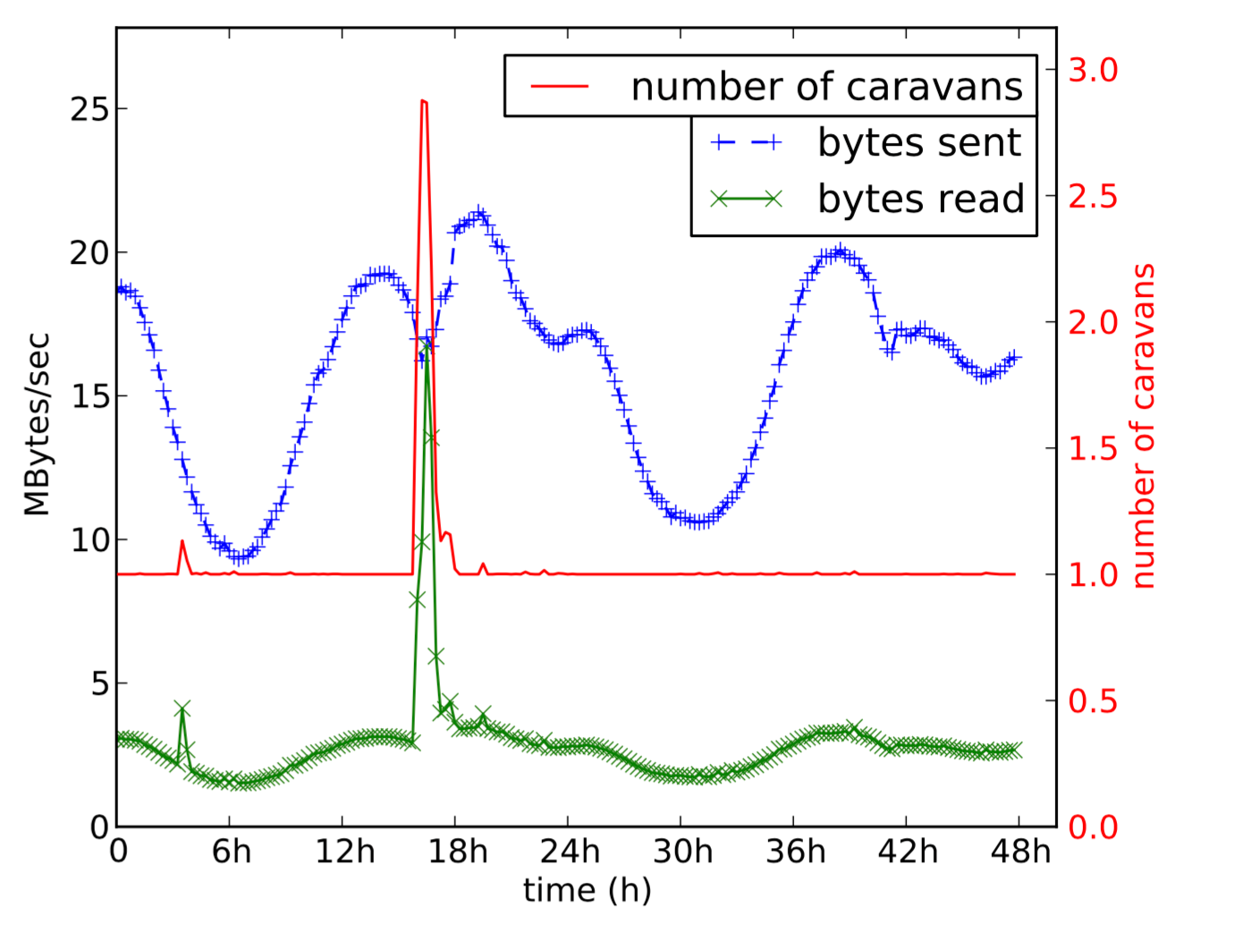
I/O Load
6 applications, read I/O is normally about 1/6
35GB/s in average, peaks at 200GB/s
10
Notes:
The amount of data read from datastores and sent to applications by Wormhole, and the number of caravans used to do so. The number of caravans, which is averaged over one minute intervals and over all involved publishers, can be fractional.
How does read I/O increase by 6 times while only using 3 caravans (2 recovery)?

Slide 14
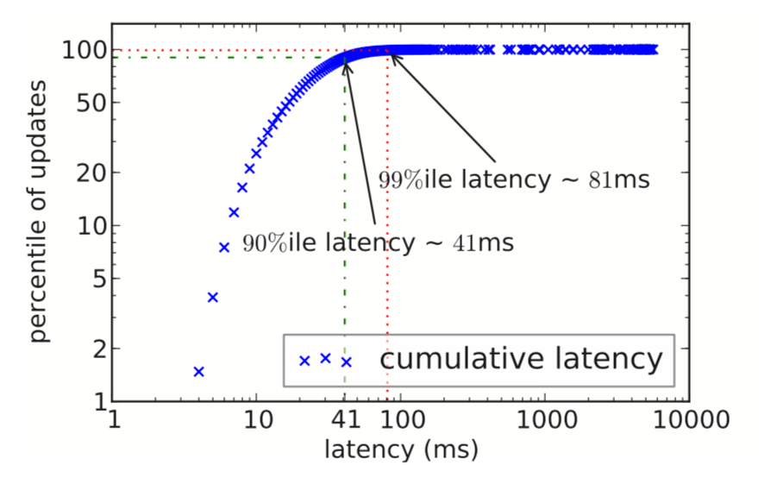
Latency
Production Datastore — 99% within 81ms
11
Notes:
We use the data from one of Face- book’s production deployments: we pick one (random) publisher that is sending updates to a cache invalidation application, and observe it over a period of few hours to get a sample of 50,000 updates.
The average size of updates is 500 bytes.
Note that there is a long tail of updates that can take as long as 5 seconds. This can happens when an update is sent by a non-lead caravan. In such case, it includes the time that the corresponding flow spends waiting to be assigned to a caravan.
Transition: So far we’ve covered publisher failure and application failure, but what if the datastore fails?

Slide 15
Datastore Failure
Datamarkers (file names, offsets) are different on replicas
Datastore-specific positions
{
“f_name”: “aaa.log”,
“offset”: “324”
}
{
“f_name”: “bbb.log”,
“offset”: “408”
}
Mapper
Mapper
{
“seq_num”: “187”,
“index”: “11”
}
Logical position
12
Notes:
The datastores have several replicas
A simple idea is to make data markers global

Slide 16
Datastore Failure
Primary Datastore
Backup Datastore
Publisher
Publisher
Subscriber
App
13
Notes:
The datastores have several replicas
A simple idea is to make data markers global

Slide 17
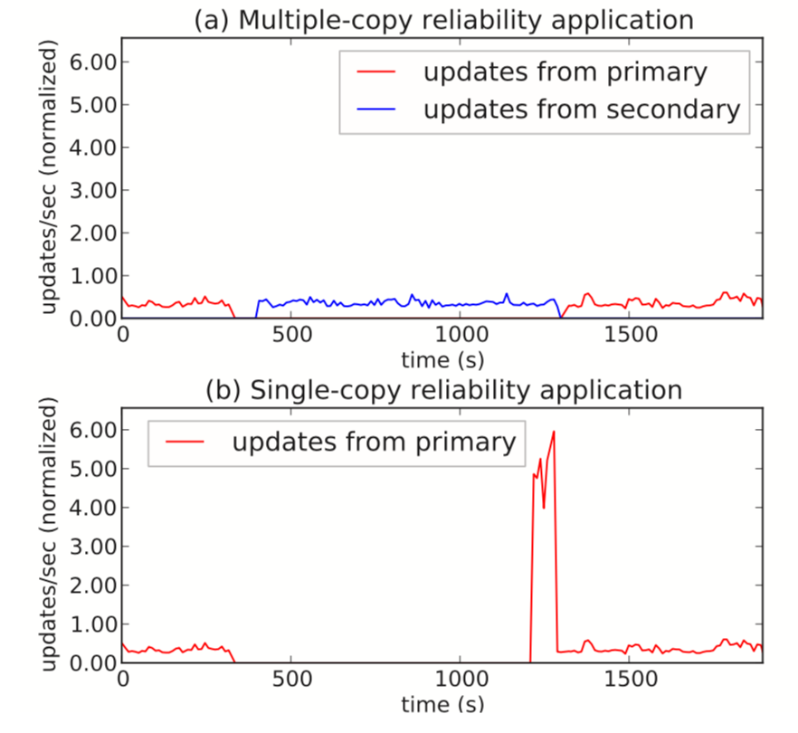
Datastore Failure
14
Notes:
The primary is shut down for 10 mins.

Slide 18
Conclusion
Reliable Pub-Sub system
Real world production
Good transparency
15

Slide 19
Backup
Alternatives:
Broker based systems — extra infrastructure, higher latency
SIENA (wide-area content-based pub-sub) — no support for replica, does not scale
Thealfi (Google) — clients are end-users, not I/O efficient
Kafka (LinkedIn) — open sourced! But not sharded, only peeks at 250MB/s

