Slide 1
Tarcil: Reconciling Scheduling Speed and Quality in Large Shared Clusters Christina Delimitrou, Daniel Sanchez and Christos Kozyrakis
Presented By Shiv Verma
UIUC::CS525

Slide 2
Cluster Scheduling up till now
Approaches either focused on scheduling speed
make fast decisions and reduce scheduling overhead
Usually sampling based and distributed
Eg Sparrow
Or focused on scheduling quality
Make high quality decisions
Usually centralized and sophisticated algorithm based
Eg Quasar

Slide 3
Por que no los dos! Enter Tarcil
Tarcil tries to get both.
Uses sampling to make fast decisions
But sample size changes on the basis of cluster load to statistically ensure scheduling quality
Admission control which queues a job if it is unlikely that the scheduler will find adequate resources
Also uses multiple concurrent schedulers so that scheduling doesn’t become the bottleneck
Microbenchmarks incoming applications to figure out
Their hardware preferences
Tolerance to interference
Interference generation

Slide 4
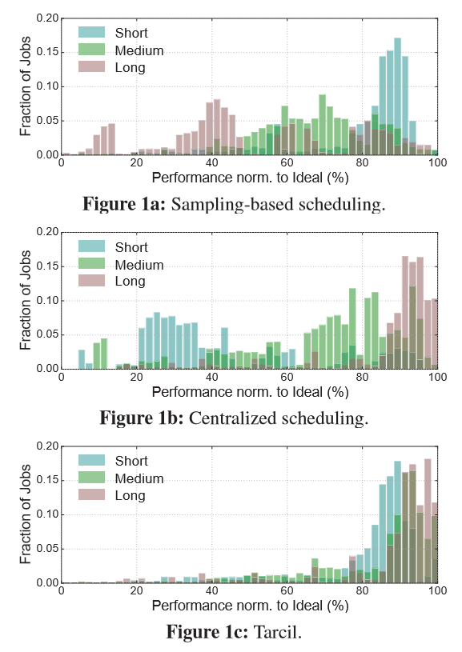
Por que no los dos! Enter Tarcil
Fast sampling based scheduling results in near optimal performance for short jobs, but as job duration increases, the lower quality begins to affect performance
Quality oriented centralized approaches have a high scheduling overhead. Impacts short jobs a lot. Sometimes scheduling delay is longer than actual job duration
Tarcil provides near ideal perfornace for short and long jobs

Slide 5
Tarcil: Heterogeneity and Interference awareness
Just like Quasar, microbenchmark every application to get hardware preferences and interference sensitivity
What exactly is interference?
Applications sharing resources like CPU cycles, cache, etc can interfere with each other
For an incoming job W, let V_{w} = [c₁, c₂, .. c_{n} ] where c_{i} is how much interference W generates on shared resource i.
C₁ is scaled from 0 to 99. There is also t_{i} for interference tolerance.
Usually high tolerance means low interference generation, so for the rest of analysis c_{i} + t_{i} = 99
Reorder V_{w} to V’_{w} in descending order of c_{i} values. Then simply concatenate the vector and put a ‘0.’ at the front to get T_{w} .
Eg: V_{w} = [25, 87] → V’_{w} = [87, 25] → T_{w} = 0.8725

Slide 6
So, what is T_{w} all about?
Similarly get a V_{H} =[C₁, C₂,..., C_{n}] for all other collocated jobs.
Do the same permutation and encoding as for T_{w} to get U_{H} = 1 – T_{H} where T_{H} is V_{H} is the normalized and encoded value from V_{H}.
Q == 1 ➔ perfect assignment.
Q > Tw ➔the resource is utilized suboptimally.
Q < Tw ➔unwanted interference.
match low tolerance jobs with high quality (higher U_{H} ) resource units.

Slide 7
Batching and sample sizes
Tarcil can provide statistical guarantees on the quality (Q) of the allocated resources by changing the sample size(R) with load.
But for very high loads the sample size can grow way too large. So they cap the sample size and implements admission control at high loads.
If a job needs multiple cores (say m) then Tarcil samples (R x M) resource units.
Will account for locality too if the user wants it to.

Slide 8
Tarcil architecture
If the local monitor notices that job performance is deviating from what was expected, then it will notify the responsible scheduling agent, which might perform a migration if needed.
The cluster states are kept consistent through OCC.

Slide 9
Evaluation
Which sample size is the best?
Sample size 8 used here on out as the low load sample size.
Notes:
64 takes extra long to sample because of collisions amongst schedulers when size is too large.
Scheduling is too difficult under high load for low sample sizes.

Slide 10
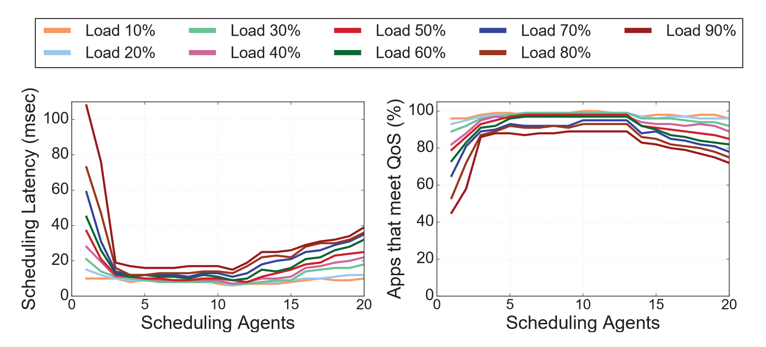
Evaluation
How many schedulers?
For too many schedulers, we see collisions amongst schedulers adversely affecting latency.
For this run 3 schedulers was the best. Meaning a 1:30 (roughly) scheduler to worker ratio is the sweet spot for Tarcil. (its 1:10 for Sparrow)

Slide 11
Tarcil vs others
Some jobs finish early with Quasar but a lot of them experience high scheduling delays (upto 2 seconds)
Sparrow performance degrades first when resident load is introduced. And then again when heterogeneity is introduced. Makes sense because unlike Quasar and Tarcil, sparrow doesn’t account for these things.
Tarcil for all scenarios provides near ideal performance
Notes:
Alright, so now we have some idea on how to tune Tarcil. But how does it compare with other?
.The ideal scheduler corresponds to a system that identiﬁes resources of optimal quality with zero delay.

Slide 12
Effects ON resident load
We saw the effects of resident load. What about the other way around?
Centralized and Tarcil don’t affect the resident memcached load that much.
Sparrow although has an affect on memcached.
This is also why, according to the paper, a naïve solution which routes short jobs to Sparrow and long jobs to Quasar won’t work.

Slide 13
Wrapping up: final comparisons

