Slide 1
State Machine Replication
State Machine Replication through transparent distributed protocols
State Machine Replication through a shared log

Slide 2
Tango: Distributed Data Structures over a Shared Log
Mahesh Balakrishnan, Dahlia Malkhi, Ted Wobber, Ming Wu, Vijayan Prabhakaran Michael Wei, John D. Davis, Sriram Rao, Tao Zou, Aviad Zuck
Microsoft Research
Presented by Faria Kalim

Slide 3
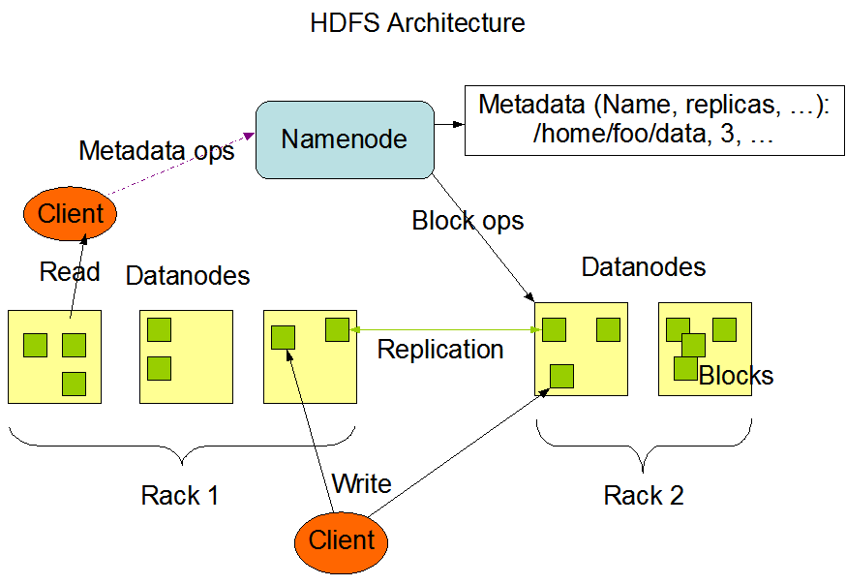
Motivation
Distributed data, but centralized metadata

Slide 4
Motivation
Distributed data, but centralized metadata
Usually in-memory data structures
Require transactional access
Alternatives?
Support transactions but not scalability (conventional databases)
Support limited APIs (eg. Zookeeper)
Implement customized protocols

Slide 5
Problem Statement
How to build a highly available metadata service that provides whatever data abstractions you want?
Contribution
A shared log is a powerful and versatile abstraction.
Tango: A system for building highly available metadata services
Tango object: a class of in-memory data structures built over a durable, fault-tolerant shared log

Slide 6
The Remote Shared Log
The Shared Log API
O = append(V)
V = read(O)
trim(O)
O = check()
Imposes Total Ordering
Fast and Scalable
Clients
Append
Read
Log

Slide 7
CORFU: Clusters of Raw Flash Units
Application
Client
CORFU library
Sequencer
Read
Append
Log

Slide 8
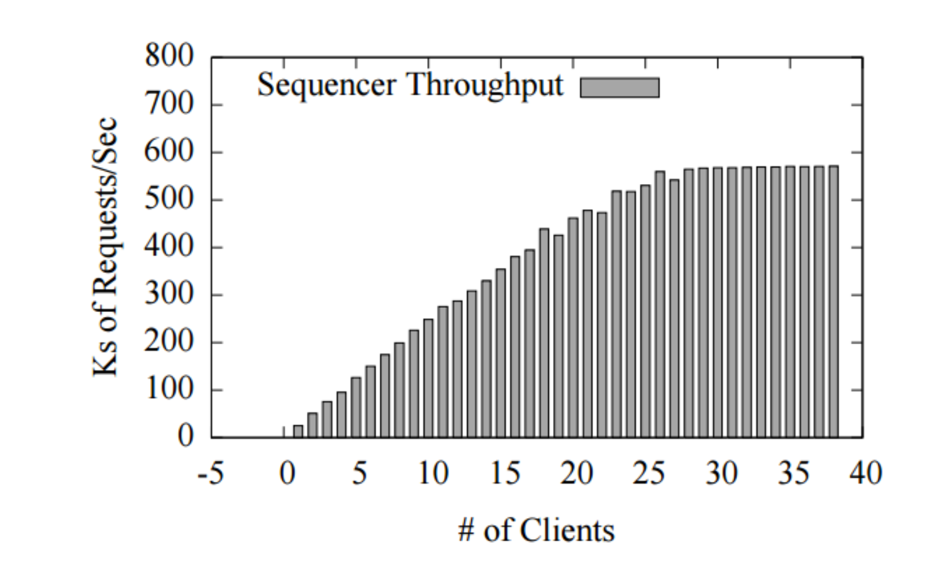
The Sequencer
Not required for safety or liveness.
Fast.

Slide 9
Chain Replication in Corfu
— Resolves contention
Client
— Provides consistency
A
B

Slide 10
Tango Architecture
a Tango object
=
view
in-memory data structure
+
history
ordered updates in shared log
Applications
Properties
Persistence
Elasticity
Availability
Atomicity
Isolation
Tango Runtime
Append
Read

Slide 11
Tango Objects
Easy to use
Easy to build
Scalable and Fast (CORFU)

Slide 12
Tango Objects
Easy to use
Linearizability for single operations
Each operation by a client is visible (or available) instantaneously to all other clients
currowner = ownermap.get (“ledger”)
if (….)
ledger.add(item);

Slide 13
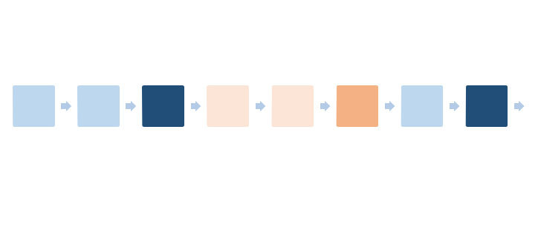
Tango Objects
the execution of a set of operations over multiple items is equivalent to some serial execution (total ordering) of the transactions.
Easy to use
Serializable Transactions
TR.BeginTX();
currowner = ownermap.get (“ledger”);
if (….)
ledger.add(item);
status = TR.EndTX();
Updates by other apps

Slide 14
Tango Objects
Easy to build
API between runtime to object
Upcall, Query and Update helper
API between object and application
Mutators and Accessors

Slide 15
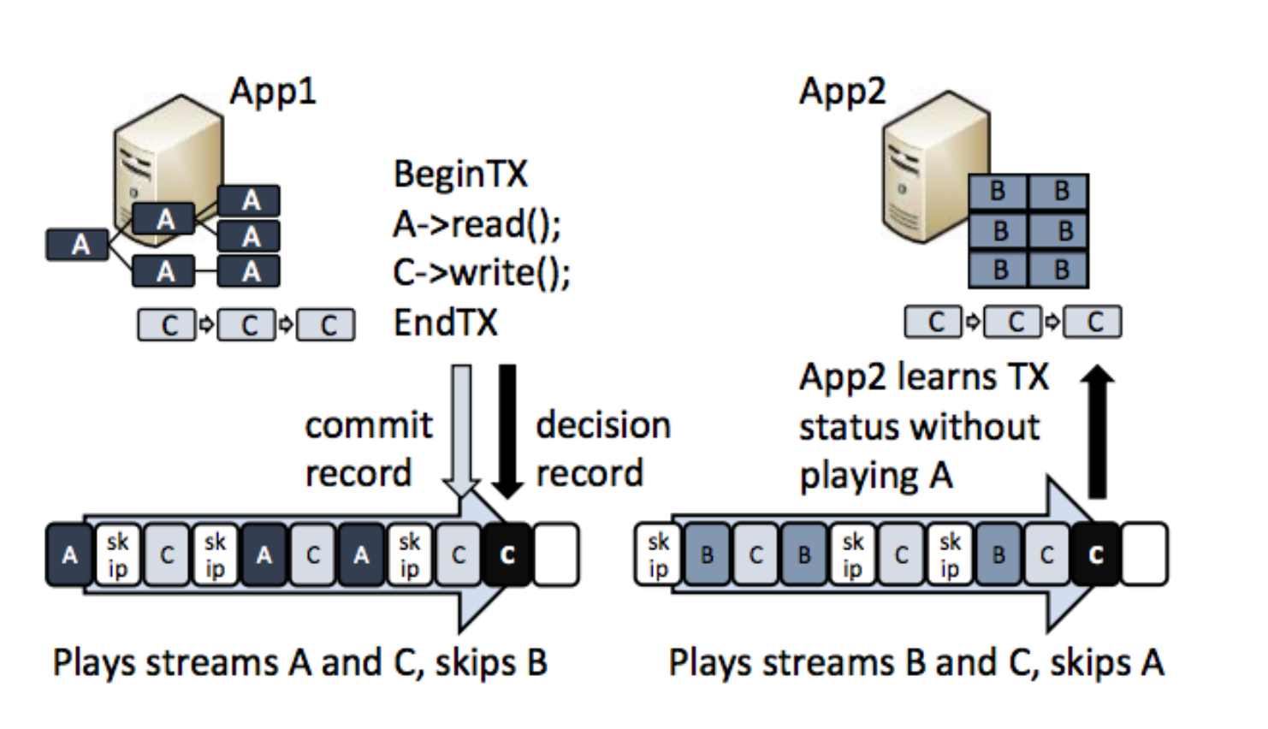
The Stream Abstraction

Slide 16
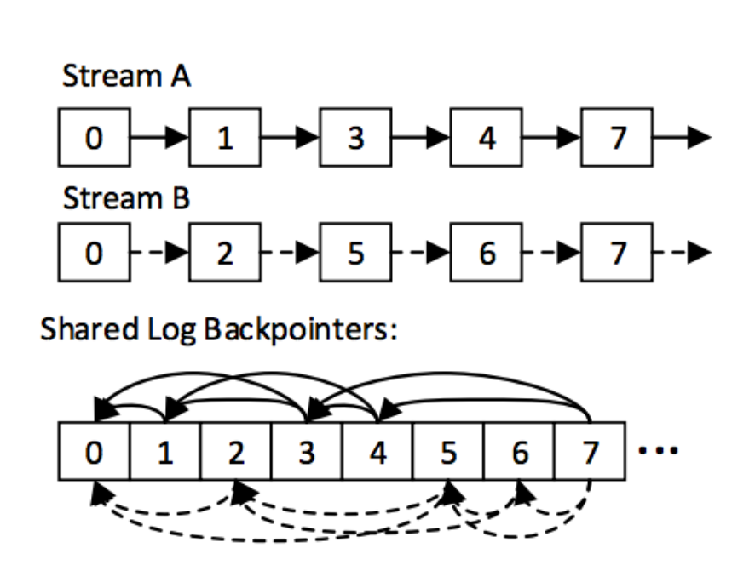
Streams Stored with Backpointers

Slide 17
Evaluation
Single Object Linearizability

Slide 18
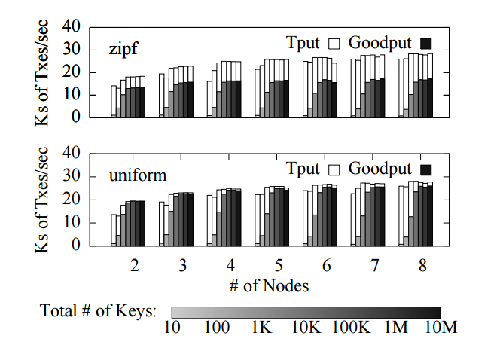
Evaluation
Transactions on a fully replicated TangoMap

Slide 19
Evaluation
Scalability

Slide 20
Takeaways
Pros
A durable, iterable total order (i.e., a shared log) is a unifying abstraction for distributed systems, subsuming the roles of many distributed protocols
It is possible to impose a total order at speeds exceeding the I/O capacity of any single machine
A total order is useful even when individual nodes consume a subsequence of it
Cons
Evaluation without the sequencer: how much would the performance decrease?
How affordable is the SSD cluster?

Slide 21
Backup Slides

Slide 22
Conclusion
Tango allows users to build highly available, persistent and strongly consistent metadata services easily
Provides data structures backed by a shared log
The data structures are easy to use and build
The shared log provides consistency, persistence, elasticity, atomicity and isolation

Slide 23
Evaluation Setup
20Gbps between top of the rack switches, Gb per node
36 8-core machines in 2 racks
Half the nodes (evenly divided across racks) equipped with 2 Intel X25V SSDs each.
18-node CORFU deployment
CORFU sequencer on a powerful, 32-core machine in separate rack.
Other 18 nodes used as clients, running applications and benchmarks that operate on Tango objects

Slide 24
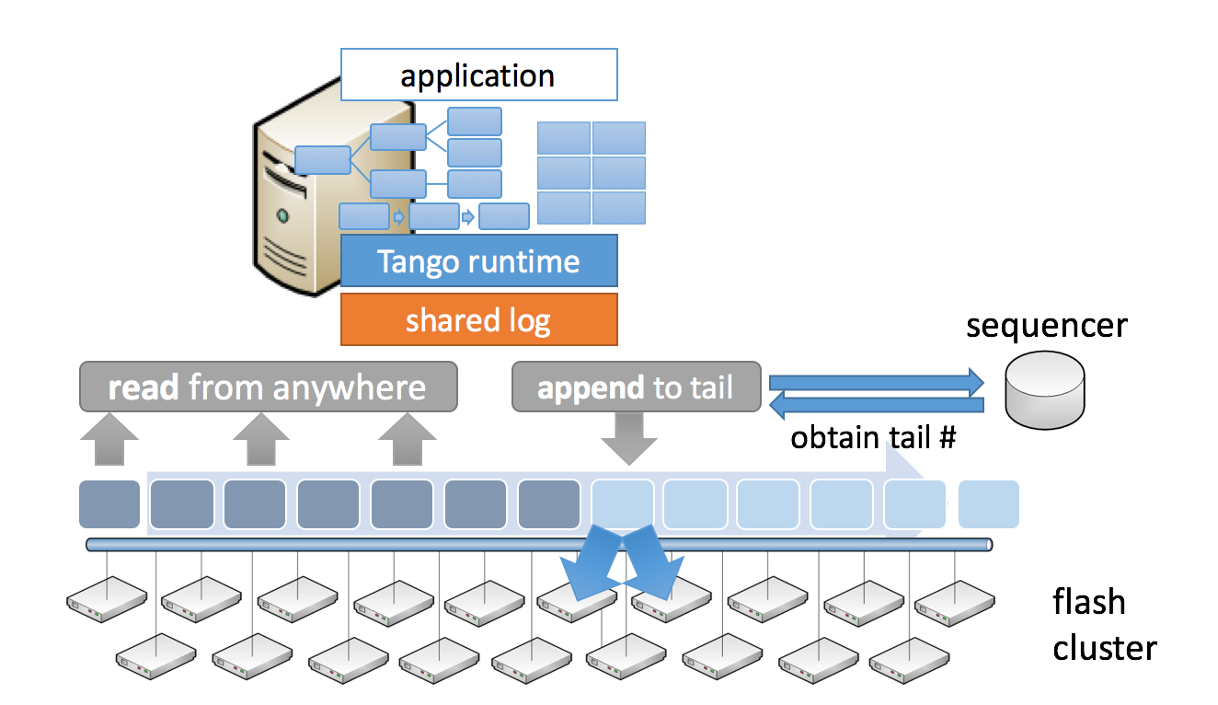
Tango Objects
Scalable and Fast
CORFU decentralized shared log
Reads scale linearly with number of flash drives
600K/s appends (limited by sequencer speed)

Slide 25
Use Cases
Replicate State
Index State

Slide 26
Other Use Cases
Partitioning State
Sharing State

Slide 27
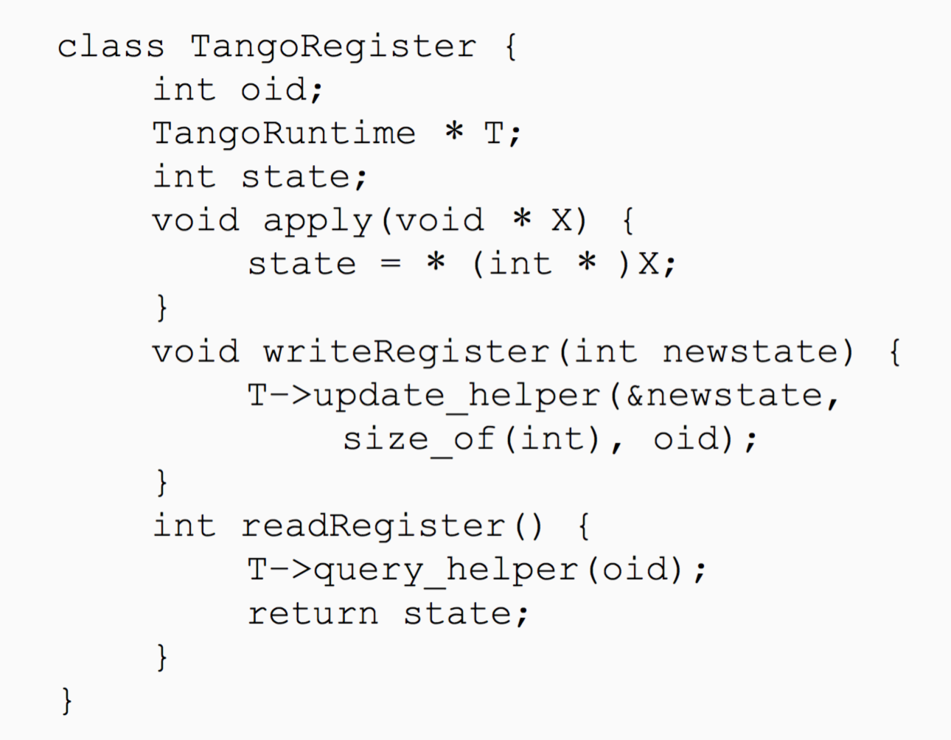
Code

