Slide 1
TAG: a Tiny AGgregation service for ad-hoc sensor networks Authors: Samuel Madden, Michael J. Franklin, Joseph M. Hellerstein, Wei Hong
Presenter: Mingwei Hu

Slide 2
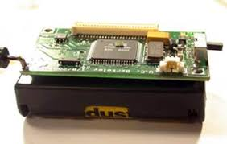
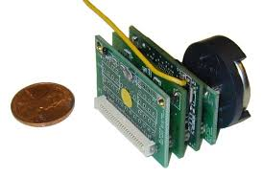
Motivation
Smart Sensors
Devices that measure real world phenomena (temperature, buildings movement in earthquake, …)
Wireless, battery powered, full-fledged computers
Motes
Smart sensor developed in UC Berkeley
TinyOS: ease the deployment of motes in ad-hoc networks
Ad-hoc networks: networks not relying on pre-existing infrastructures(routers, access point)
Sensors replace routers to identify other devices, adapting to topology change
Notes:
Recent technology advances used for measuing and collecting all kinds of environmental data, such as …
They are typically battery powered deployed in wireless environment, and can work as independent computers.
One example of them is Motes
It uses TinyOS operating system to facility deployment in ad-hoc networks
Which is a type network that does not have pre-existing infrastructures(routers, access point)
In such networks, sensors participate in routing themselves to determine the network topology which can change dynamically.

Slide 3
Motivation
Challenges working with smart sensors
Limited power supply while needs long lived deployment & zero maintenance
Power consumptions dominated by transmitting/receiving messages(communication)
Users have to write low level and error-prune code to collect and aggregate data from the network
Goals:
Have more power-conserving algorithm to reduce radio communication
Provide a high-level programming abstraction to hide low level details
Notes:
Working with SS has some challenges
As most of them are powered by portable batteries->have limit power supply, but at the same time we want …
It’s found that majority of the power is consumed by communication including.., this implies that computation is preferred than communication.
From a user’s point of view, have to write low level code to develop application for collecting and aggregating data
In order for ss to better meet our needs…

Slide 4
Tiny Aggregation (TAG)
Provides a SQL-like declarative languages for data collection and aggregation
Intelligent execution of aggregation queries to save time and power
In network aggregation: calculates aggregation in each node as data flows through it
Users inject query into a storage-rich basestation(root)
Notes:
In order to achieve these goals, the paper proposes a technique call TAG
TAG provides a simple and SQL-like interface to hide low level details
To reduce power consumption, it distributes and executes aggregation queries in an intelligent way
Aggregation is calculated as data flows through nodes(sensors)

Slide 5
Background: Ad-Hoc Routing Algorithm
A routing tree is needed for sensor to route data
A root is assigned with level 0. Root broadcasts message {id,level} to other nodes in its range
Upon receiving a message, a sensor (without level) will update its level and parent node, and does the broadcast again
Algorithm ends when all nodes have a level
root
D
C
A
organize
A
B
root
B
E
C
D
E
Notes:
In order for TAG to achieve in network aggregation and for sensors to route data, it needs to have two capabilities.
First, TAG must be able deliver query to all the sensors in the network.
At least one route must exist from any sensor to the root where the aggregation is collected.
One way to achieve this is to organize sensors nodes into a tree-like topology

Slide 6
Query Model
A SQL-style query syntax
Example: microphone sensor network for monitoring volume
Sensors#id | volume | floor | room
0 | 10 | 2 | 1
1 | 20 | 2 | 2
Notes:
In order for users to write declarative query, a SQL-style query syntax is adopted
This will return all the rooms on the 6 floor with an average volume greater than a certain threshold.

Slide 7
Query Model
SELECT clause:
Specifies an arbitrary expression over one or more aggregation attributes
WHERE clause:
Filters out individual tuple before aggregation
GROUP BY clause:
Partitions tuples based on a given attributes
HAVING clause:
Remove group not satisfying predicates

Slide 8
Query Model
Output of TAG queries: stream of values
Allow users to understand how the network behaves over time
Each record consists of one <group id, aggregate value> pair per group
Each group is time-stamped
Readings used to calculate an aggregate all belong to the same time-interval epoch
EPOCH DURATION also specifies the amount of time devices wait before sending samples to other devices
Notes:
The primary difference between TAG queries and SQL queries is that the output of a TAG query is a stream of values, rather than a single aggregate value
Secondly, it has this EPOCH DURATION field that …..
In these stream values, each record consists of one group id, aggregate value pair per group. Each group is time-stamped and the readings used to compute an aggregate record all belong to the same time interval, or epoch.

Slide 9
Aggregates—Implementation
Implemented using three functions:
Merging function: <z> = f(<x>,<y>):
<x> and <y> : partial states computed over one or more sensors
Example: AVERAGE aggregate:
Partial state in form: <sum ,count>
F(<S1,C1>,<S2,C2>) = <S1+S2,C1+C2>
Initializer i: Used to initialize a state record for a single sensor value
AVERAGE: initializer I returns <x,1> for single value x
Evaluator: computes the actual value of the aggregate (S/C for AVERAGE)
Notes:
In TAG each aggregate is implemented with three other functions

Slide 10
Aggregates—Classification
SQL supports 5 aggregates: COUNT, MIN, MAX, SUM, and AVERAGE
Want TAG to support more
Classification of aggregate functions and how dimensions of each classification affect TAG performance
Four dimensions proposed:
Duplicate Sensitive
Exemplary(E), Summary(S)
Monotonic
Partial State
Notes:
After we know how to implement a aggregate function, we want to see what kind of aggregates can be expressed in tag
To answer this question, we first look at SQL. And it turns out that it only supports 5:..
And obviously we want TAG to support more
An solution to that is to give a generic classification of aggregate function and show how dimensions of each classification affects TAG’s performance.
Duplicate sensitive: it determines whether or not aggregates can be affected by duplicate readings from a single device
Exemplary aggregates return one or more representative values from the set of all values
Summary aggregates compute some property over all values
monotonic aggregates determines whether some predicates (such as HAVING) can be applied in network
Partial state: relates to the amount of state required for each partial state record which is inversely related to TAG’s performance

Slide 11
Aggregates—Classification
Distributive: Size of partial records is the same as the size of the final aggregate
Algebraic: partial state records are not aggregates, but of constant size
Holistic: non-constant partial state size; cannot perform aggregation on partial states
Unique: Similar to holistic, except that amount of states is proportional to the number of distinct values

Slide 12
In Network Aggregates—Tiny Aggregation
TAG consists of two phases:
Distribution: aggregate queries pushed down to the network from the root
Collection: aggregate values are routed up from children to parents
Parents need to wait until they heard from their children before routing aggregate up for the current epoch.
Solution: Subdivide epoch s.t. children are required to delivered their partial state records during a parent-specified time interval
root
value
query
A
B
query
value
C
D
E
Notes:
Now let’s now talk about the algorithm for in network aggregates
Since our goal is to reduce network communication, Parents need to wait until they heard from their children before routing aggregate for the current epoch.
One solution for this is to having the parent subdivide epoch s.t. children are required to delivered their partial state records during a parent-specified time interval. Parents also has to ensure that they have enough time to combine appregate and propagate it to its own parent

Slide 13
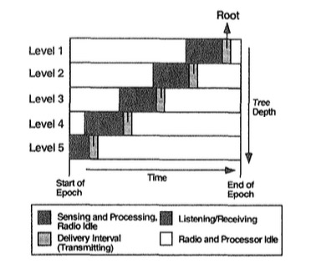
In Network Aggregates—Tiny Aggregation
For a node p, upon receiving a request r to aggregate:
Synchronize clock
Choose sender as its parent
Examine r (contains interval when sender expects to hear back from p)
Set delivery interval for its children
Forward query to children
Upon receiving message from its children:
Computes a partial state record from child values it receives
During transmission interval, p propagates the aggregates up the network
Notes:
On receiving query from parent:
A node will do the following things after receiving a request to aggregate
…
According to the interval in r, p will set delivery interval for its children : this interval is slightly before the time its parent expects to see p’s partial state record
One receiving aggregates from child
Using this algorithm, aggregate value will flow up back interval by interval. Eventually, a complete aggregate arrives at root.

Slide 14
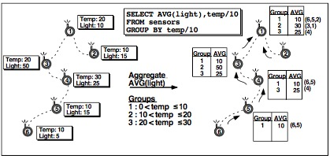
In Network Aggregates—Grouping
Partial state records aggregated similar to Tiny aggregation, except each record has a group id
On receiving an aggregate from a child:
Combines two values if node in same group as the child
Otherwise store the value of the child’s group and forward it during next epoch
Notes:
Grouping basic technique: push the expression down with the query, ask nodes to choose the group they belong to, and then, as answers flow back, update aggregate values in the appropriate groups.

Slide 15
Advantage of TAG
Tolerates disconnections and loss.
Each node is required to transmit a single message per epoch
Dividing time into epoch gives a convenience idling mechanism
Notes:
When loss happens because of device running out of power. We can include information about queries in partial state records, tha t way lost nodes can reconnect by listening to other node’s state records as they flow up the tree.
The second benefit, obviously, is a reduction in communication. Because each node is required to transmit a single message per epoch.
The way it divides time into epoch gives a convenience idling mechanism. This is shown in previous figure where nodes in each level has a certain period where its completely idle. during these period, the processor can be set into deep sleep mode which further reduces power consumption

Slide 16
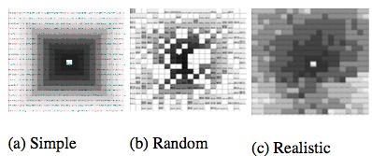
Simulation-based evaluation
Communication model that defines connectivity
Simple, random, and realistic model
Modeling of costs of topology maintenance by sending heartbeats
Able to measure the state required
Notes:
Three communication model:
Simple assumes lossless communication between nodes and their neighbors
Random model
Realistic model that captures the actual behavior of the radio and link layer on TinyOS motes. In this model, the number of hops from a particular node to the root is no longer directly proportional to the geographic distance between the node and the root
each square represents a single device, and shading (in these images) represents the number of radio hops the device is from the root (center); darker is closer.
The simulation also models cost of maintainence. This is achieved by having each node send heartbeat message to indicate that its still alive
The simulation is not able to measure number of CPU instructions executed in each sensor. But it measures the total bytes transmitted in each algorithm based on size of the data structure allocated in each sensor

Slide 17
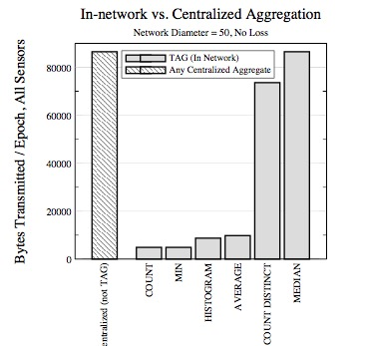
TAG performance
Notes:
Here it shows performance measure on a sensor network with 2500 nodes
It shows difference between .. And .. For different aggregate functions
Count and max aggregates functions have least amount of bytes transmitted. Whereas there is significant performance improvement on median aggregate
In general in network aggregation can reduce communication costs by a significant amount

Slide 18
Optimization
Taking advance of shared channel
Sensor node can snoop on the network traffic to find aggregate request it missed
Snooping reduces number of messages sent
Hypothesis testing
Each node can have a guess to value of a aggregate
Decides whether contributing its reading and the readings of its children will affect the value of the aggregate
Snooping: nodes suppress their local aggregates if they hear other aggregates that invalidate their own
Notes:
Snoop on the network traffic to see what aggregate it missed
Example: max aggregate: if a node hears a peer reporting a maximum value greater than its local maximum, it does not need to send its own value
HT: idea is that each node …
There are a couple of ways to obtain this value:
Snooping
HT EXAMPLE: the root of the network seeking an exemplary sensor value, such as a MIN, might compute the minimum sensor value over the highest levels of the subtree, and then ssue a new request asking for values less than that value over the whole tree.

Slide 19
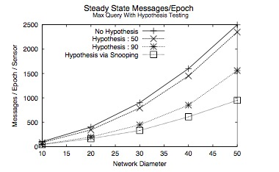
Optimization
Notes:
This shows the performance of using Hypothesis testing on MAX aggregate on sensor network over the range [0..100]
performance savings are nearly two-fold for a hypothesis of 90. snooping beat the other approaches by offering a nearly three-fold performance increase over the no-hypothesis case. This is because experiment has densely packed simple node distribution, most devices have three or more neighbors to snoop on, so there few nodes that actually transmit

Slide 20
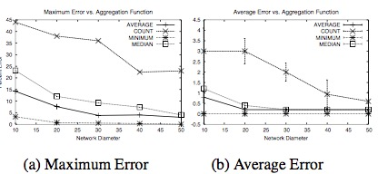
Improving Tolerance to Loss
Monitor quality of links to neighbor
By tracking the proportion of the packets received from each neighbor
Assume parent fails if hasn’t heard from it for a certain period of time
Pick a new parent according to the link quality
Notes:
There are several ways to mitigate loss in the network such as message dropped and node failure
The example monitors effect of a single loss. With sensors reading uniformly chosen from [1..1000] . It randomly select a node to disable. It measures the maximum temporary deviation from the true value of the aggregate that the loss caused in the perceived aggregate value at the root during any epoch. It runs the experiment 100 times and report the average
Result shows that some aggregate functions are more sensitive to loss than others. For example, COUNT is most sensitive to network loss.This is because if a node that connects the root to a large portion of the network is lost, the temporary error will be very high.
Compared to COUNT, MIN is the least sensitive to loss.

Slide 21
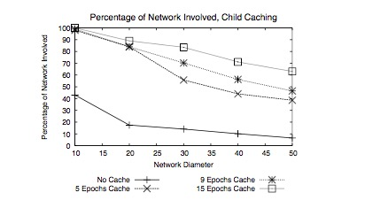
Improving Tolerance to Loss
Child Cache
Parents remember the partial state records their children reported for some number of rounds
Use previous values when new values aren’t available
Notes:
Another method is child cache
Drawback1 : caching tends to temporally smear the aggregate values that are computed and it is undesirable for some workloads.
Drawback2 : uses memory used for group storage
Expepriment: allocate a fixed size buffer at each node and measure the average number of devices involved in the aggregation
Experiment shows that using child cache, there is an increase in number of nodes counted in any aggregates.

Slide 22
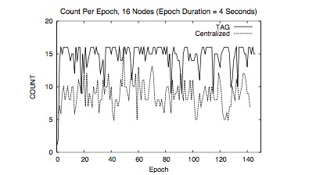
Prototype Implementation
16 sixteen in a tree of depth 4, computing a COUNT aggregate over 150 4-second epochs (a 10 minute run.) . No child cache.
The centralized approach required 4685 messages, whereas TAG required just 2330
Notes:
Finally the prototype imlpementation include…
Experiemnt shows that there is huge reduction in communications using TAG. And also TAG has better aggregate quality

Slide 23
Conclusion
In network aggregation offers an order of magnitude reduction in bandwidth consumption compared to centralized aggregation
The declarative query enables users to use in network aggregation with having to write low-level code

Slide 24
Thoughts
The simulation focuses too much on message communication but does not measure the CPU usage
Prototype implementation does not implement any optimization or caching
Prototype implementation only includes 16 sensors
Notes:
The simulation focus too much on message communication but does not measure the CPU usage which is also highly related to power consumption
..
Too few sensors, not realistic

Slide 25
Questions?

