Slide 1
Succinct: Enabling Queries on Compressed Data
Rachit Agarwal, Anurag Khandelwal, and Ion Stoica, University of California, Berkeley, NSDI 2015
Presented by: Bhargav Mangipudi
Presentation uses images and graphs from the original paper and Berkeley AMPLab website
Notes:
NSDI - Networked Systems Design and Implementation USENIX conference

Slide 2
Motivation
High-performance data stores are efficient for storing and retrieving data using primary keys but do not perform well at interactive queries on values (e.g. secondary indexes).
Creating secondary indexes helps with interactive queries but they have very high memory overhead (about 8x original data size).
Using data scans for secondary attributes does not have a memory overhead but can lead to substantial latency due to immensity of data to be processed.
Succinct is a distributed data store that aims to perform efficiently on interactive queries on large data - providing memory efficiency close to data scans and latency close to indexes.
Notes:
Compression techniques have been tried before but they mostly suffer from degraded throughput since data needs to be decompressed even for simple queries

Slide 3
Motivation - continued
Succinct uses two key ideas:
Input data is stored in an entropy-compressed representation to reduce memory consumption.
All queries are executed directly on the compressed representation.
Thus, Succinct is able to support queries like random access, count, search, range and wildcard queries natively without storing indexes (or significant overhead); after the compressed data structure is created.
Succinct is implemented to work on flat (unstructured) text files. The main idea of their implementation is to store all suffixes in a file efficiently so that data queries can be executed with minimal overhead.

Slide 4
Succinct Interface
Succinct supports the following operations over flat (unstructured) text files -
f = compress(file)
append(f, buffer)
buffer = extract(f, offset, len)
cnt = count(f, str)
[offset1, …] = search(f, str)
[offset1, …] = rangesearch(f, str1, str2)
[(offset1, len1), …] = wildcardsearch(f, prefix, suffix, distance)
Note: delete and update operations are missing from the standard CRUD functionality
Notes:
Delete is supported as a deferred deletion approach by marking keys as tombstoned.
Update is currently just a delete followed by an append.

Slide 5
Handling semi-structured data
Succinct handles semi-structured data like multi-attribute key-value information, NoSQL document stores etc by transforming them to flat files using special delimiter symbols in the file and a mapping from key to its offset in the flat file.
Example: Searching along attribute A2 below is equivalent to searching for keys that match search(<value>•) in the flat file representation.
Notes:
In fact, evaluation uses this NoSQL interface implementation to compare against other systems.

Slide 6
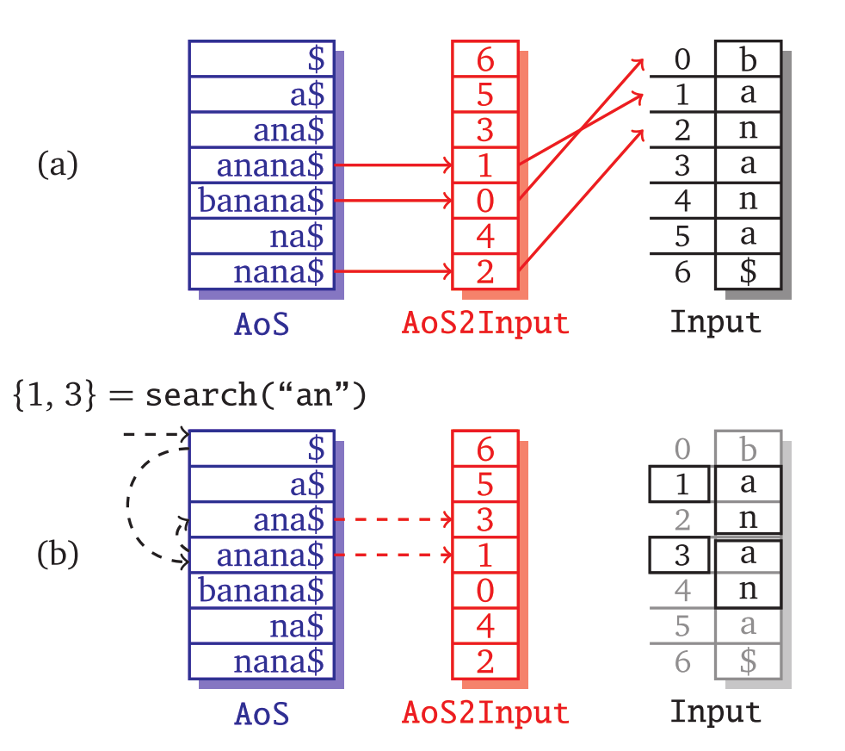
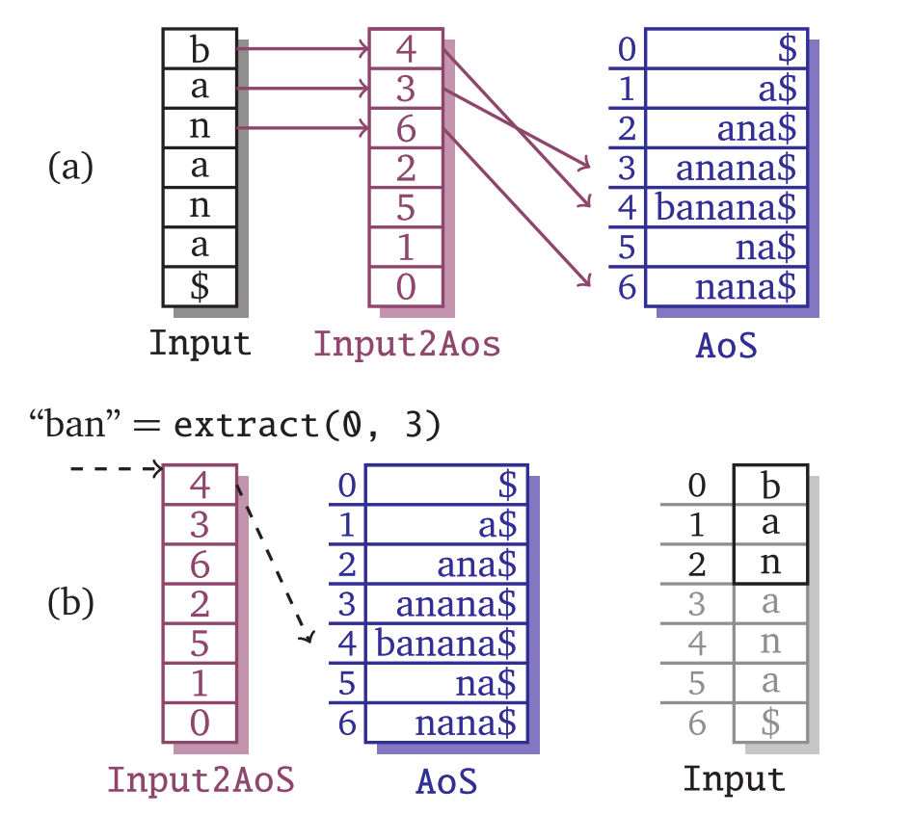
Succinct Data Structures
AoS - Lexicographically Sorted Array of Suffixes
AoS2Input - Index from AoS entry to position in file for the corresponding suffix’s start character.
Input2AoS - Inverted Index from position in file to corresponding suffix.
Notes:
Lexicographically Sorted Array of Suffixes

Slide 7
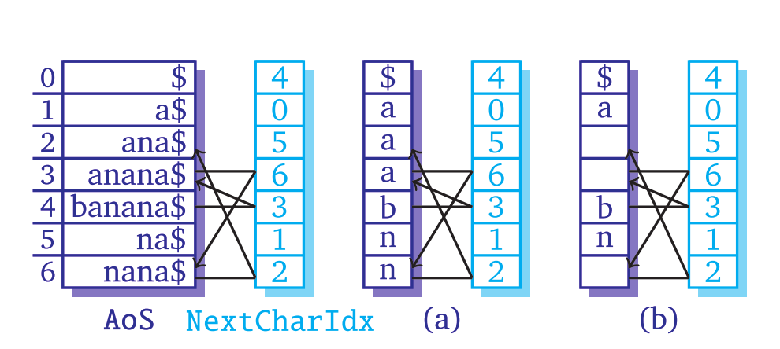
NextCharIdx Optimization
Original AoS array takes O(n^2) space. This is a lot of memory (larger than the input size) and can be further optimized.
AoS is compressed to a single character per suffix and a next character index linking the character to the next character of the suffix.
NextCharIdx optimization leads to O(n log(n)) space at the expense of increased processing for some operations.
Since the final mapping (NextCharIdx in Figure b) is always increasing integers, the size can be further reduced by using compression techniques like run-length encoding.
Notes:
Explain by using pointers the space utilization

Slide 8
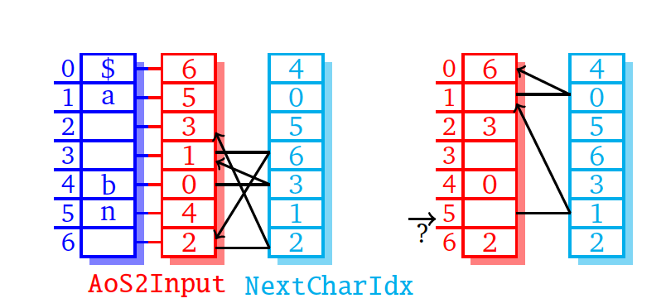
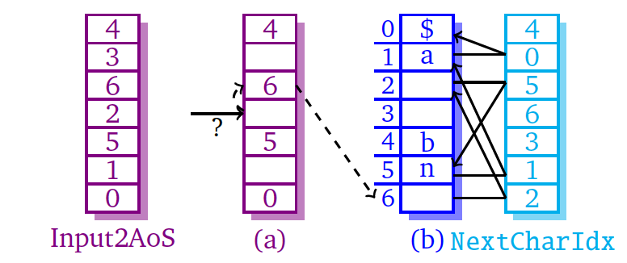
Advanced memory compression techniques
Sampling of AoS2Input and Input2AoS to reduce memory consumption
Further optimizations include 2-D representation of NextCharIdx and using Skewed Wavelet Tree data structured to achieve 1.25-3x more gain in space consumption.
Notes:
Since AoS2Input stores locations of suffixes in AoS, NextCharIdx maps AoS2Input values to next larger value.
That is, NextCharIdx[idx] stores the AoS2Input index that stores AoS2Input[idx]+1; (right) only a few sampled values need be stored; unsampled values can be computed on the fly.
For instance, starting AoS2Input[5] and following pointers twice, we get the next larger sampled value 6. Since each pointer increases value by 1, the desired value is 6−2 =4.
Reducing the space usage of Input2AoS. (a) only a few sampled values need be stored; (b) extract functionality is achieved using sampled values and NextCharIdx.
For instance, to execute extract(3, 3), we find the next smaller sampled index (Input2AoS[2]) and corresponding suffix and removing extra characters from the start.
After all optimizations, Succinct is able to store compressed data in less memory than the original input size.

Slide 9
Querying on Compressed Data
f = compress(file)
append(f, buffer)
>> These operations involve creating the compressed versions of AoS (NextCharIdx optimization) plus the AoS2Input and Input2AoS indexes for suffix entries.
buffer = extract(f, offset, len)
>> Extract is implemented by directly using the Input2AoS index to find the corresponding starting character and following along NextCharIdx up to len places to retrieve the text.
[offset1, …] = search(f, str)
cnt = count(f, str)
>> Search uses a binary search on the sorted AoS representation to get the bounds for suffixes starting with the given str. Count is a logical extension of search operation.

Slide 10
Querying on Compressed Data - continued
[offset1, …] = rangesearch(f, str1, str2)
>> Since AoS stores suffixes in a sorted manner, rangesearch is achieved by doing binary-search for min-bound of str1 and max-bound of str2 and returning offsets that are between the two positions found.
[(offset1, len1), …] = wildcardsearch(f, prefix, suffix, distance)
>> First find the offsets of all prefix and suffix occurrences, and return all possible combinations such that the difference between the suffix and prefix offsets is positive and no larger than distance.

Slide 11
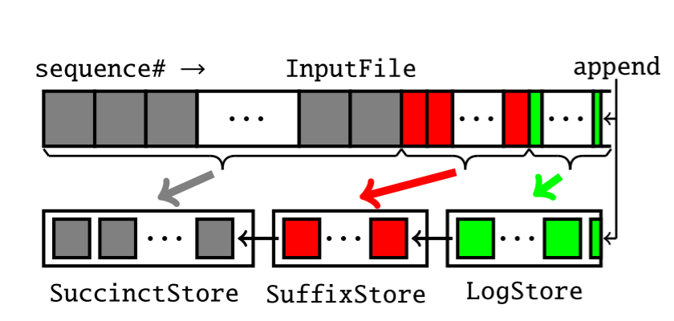
Succinct Multi-Store Design
Succinct uses a write-friendly multi-store design to achieve higher throughput and better utilization of resources.
Chaining three different data stores enables staggering data flow into the system towards a compressed representation.
Data flows from the LogStore → SuffixStore → SuccinctStore. SuccinctStore is the final entropy-compressed representation of all input data.

Slide 12
LogStore
Entry point for all “appends” in the system.
LogStore maintains the records in main memory and is optimized for data appends (write) and data scans (search, extract queries)
LogStore data is partitioned into multiple partitions to promote parallel searches.
Caveat: Simple partitioning data causes problems with queries that are across partition boundaries. To handle this, the partitions made have *reasonable* overlapping content. (Reasonable = 1Mb default)
Notes:
LogStore executes an extract operation by reading data starting at the offset specified at the request.
Search operation involves doing a data scan over all partitions and aggregating results.
Some more optimizations can be added to improve performance.

Slide 13
SuffixStore
Intermediate layer between LogStore and SuccinctStore.
Accumulates data from LogStore and stores them before initializing compression (and moving compressed data to SuccinctStore)
Use the uncompressed suffix array data structures to enable queries on data stored in this region.
Also performs compression of the data and makes it ready to be moved to SuccinctStore. (Mergesort across partitions)
Notes:
LogStore was using data scans and inverted index but Suffix Store creates the suffix array datastructures and keeps them in-memory.

Slide 14
SuccinctStore
Immutable store that contains entropy-compressed representation of the data.
Designed for memory efficiency and for enabling queries on the compressed representation.
Data structures in this layer are only updated when SuffixStore is sufficiently filled and data has been compressed.
Several optimizations are made to reduce the memory consumption.
Trade-off between memory efficiency and query latency.

Slide 15
Succinct Multi-Store Summary
The three stores serve different purposes and use different configurations:
LogStore has a latency bottleneck as all queries are over indexes and data scans.
SuffixStore has a memory bottleneck as it has to serve queries using uncompressed suffix data structures.
SuccinctStore has a tradeoff between latency and memory-efficiency using some tunable parameter.
Next, we need a way to co-ordinate the data/queries across the three stores.

Slide 16
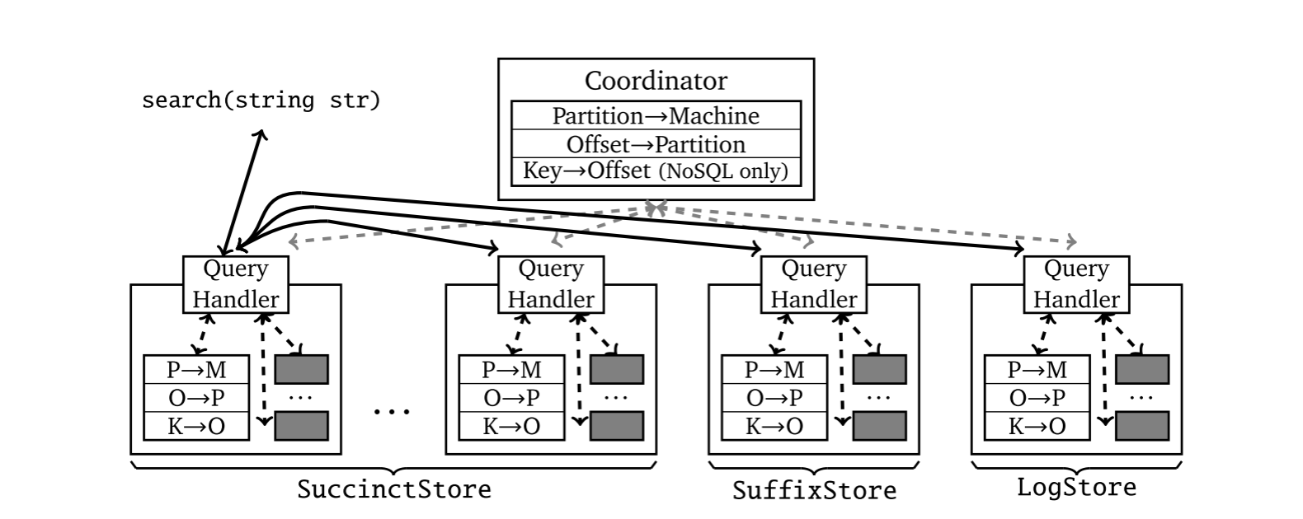
Succinct E2E architecture
A typical Succinct cluster has ONE node for LogStore, ONE node for SuffixStore and the REST of the nodes are used as SuccinctStore. There is a special Coordinator node that is used for query routing and member management.
Notes:
Each Query Handler runs multiple tasks to search all local partitions in parallel, then aggregates the results, and sends these results back to the initiator.
Extract is handled by one server only as data is key-partioned.
Search needs to be sent to all servers and aggregated.

Slide 17
Evaluation
All evaluations are performed by using Succinct as a NoSQL implementation.
Compared against open-source and industrial systems with following features:
Secondary indexes: MongoDB, Cassandra
Hyperspace hashing: HyperDex
In-memory data scans: DB-X
Use two multi-attribute record datasets from Conviva customers. Use workload patterns that are similar to YCSB.
Experimentation performed on Amazon EC2 instances with 15GB RAM, 4-core machines.
Notes:
SmallVal Dataset - 140 bytes per record
LargeVal Dataset - 1300 bytes per record
YCSB - Yahoo Cloud Serving Benchmark

Slide 18
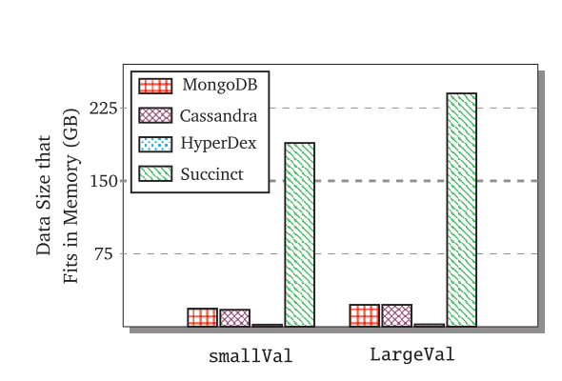
Evaluation - Memory Footprint
Graph represents the amount of input data (uncompressed) that can be held in memory by each of the data stores across the entire cluster (10 machines).
Succinct stores 10-11x more input data than other data stores.
Notes:
This is their prime contribution. Handling large amounts of data in-memory. Note that the total RAM of the cluster here is 150 Gb. Succinct is able to store 242 Gb of input data while other stores choke at 23 Gb.

Slide 19
Evaluation - Throughput
Throughput is evaluated over four different workload patterns and across the two datasets.
Workload A: 100% Reads
Workload B: 95% Reads, 5% Appends
Workload C: 100% Search
Workload D: 95% Search, 5% Appends
Notes:
Workload query patterns are comparable to the YCSB - Yahoo Cloud Serving Benchmark.

Slide 20
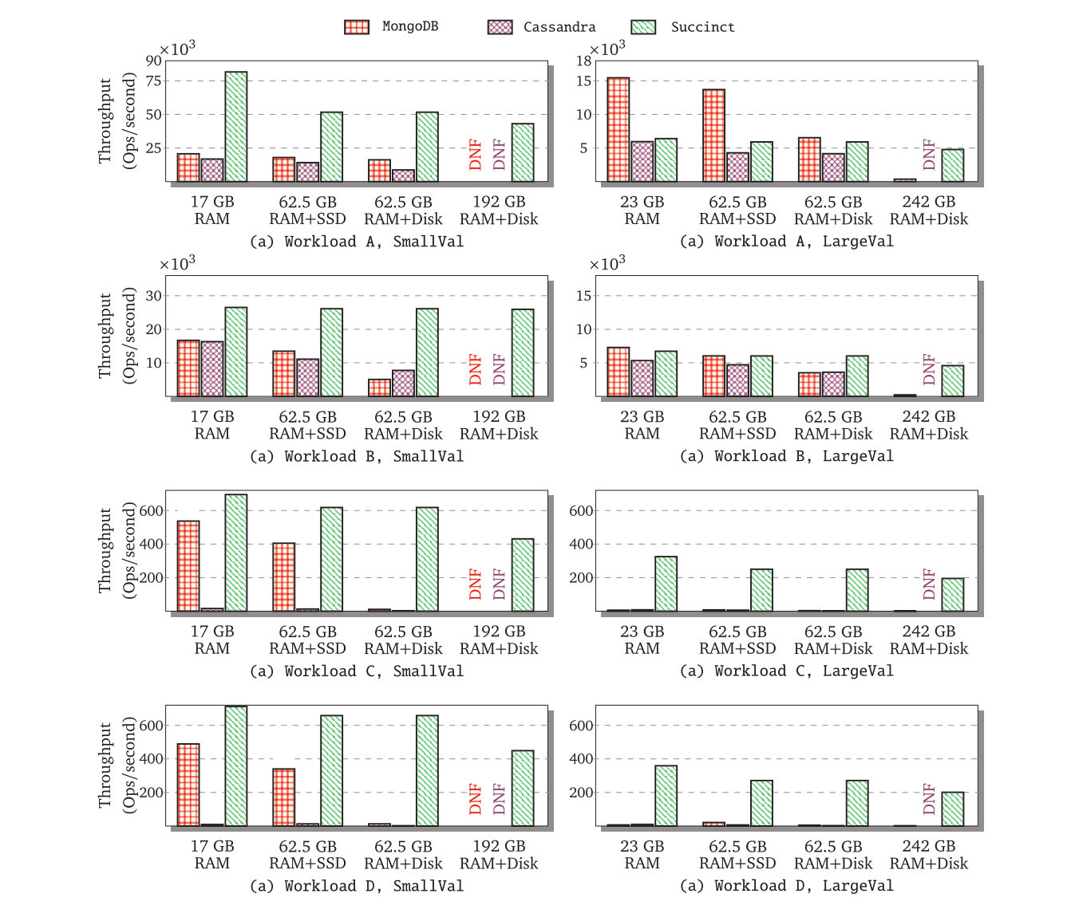
Workload A: 100% Reads
Succinct’s throughput is significantly better than others for the SmallVal dataset.
For the LargeVal dataset, since record size is larger, the extract operation in Succinct causes a latency degradation and results in lower throughput values.
Notes:
For MongoDB, the routing server becomes a throughput bottleneck; for Cassandra, the throughput is lower because more queries are exe- cuted off-disk.
Talk about DNF.

Slide 21
Workload B: 95% Reads, 5% Appends
Throughput values are lower than Workload A due to the overhead caused by appends.
Succinct’s throughput is consistent even if more data is being stored in the system.

Slide 22
Workload C: 100% Search
Search operation has lower overall throughput than read. This trend is seen across all data stores.
For SmallVal dataset, MongoDB uses the in-memory index to achieve good relative performance.
For LargeVal dataset, the indexes do not fit in memory and throughput is heavily degraded.

Slide 23
Workload D: 95% Search, 5% Appends
For MongoDB, appends cause reduction in throughput due to the added cost of updating indexes after each write.
Succinct is relatively unaffected by increasing the size of the dataset as appends are handled by the LogStore first and then propagated to more efficient system.
Notes:
Another important thing to notice is that Succinct performance is consistent for a given workload across cluster configuration.
Also, the scale of top two graphs is different from the bottom ones.

Slide 24
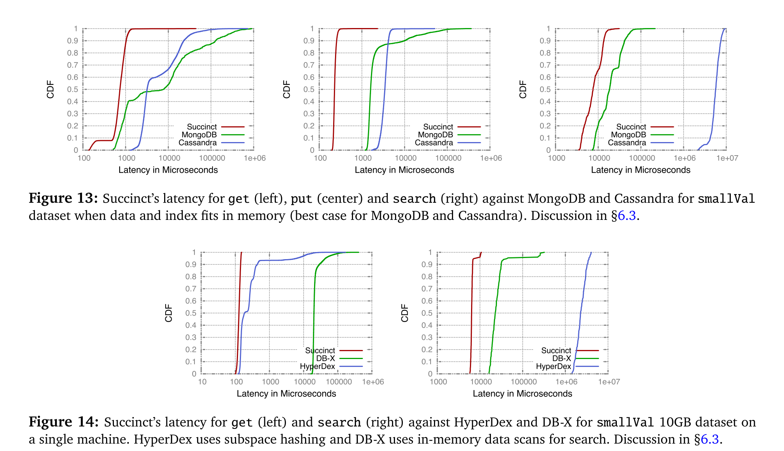
Evaluation - Latency
Notes:
All systems store data and index in-memory only. Also note that they only evaluate this on the SmallVal dataset only. Succinct should perform worse on larger records.

Slide 25
Evaluation - Sequential Throughput
On evaluating their system over sequential extract requests of varying sizes of reads, Succinct is able to achieve a constant throughput of 13Mbps, using a single core single thread implementation.
For applications that require large number of sequential reads, Succinct can overcome this limitation by keeping the original uncompressed data to support sequential reads, of course at the cost of halving the amount of data that Succinct pushes into main memory.

Slide 26
Conclusion
Succinct is a distributed data store that:
Stores an entropy-compressed representation of data using less memory than the input data (about 0.4x original input size).
Performs random access, search, count, range query, wildcard search, ... operations directly on compressed representation.
Avoids data scans and data de-compression costs leading to a lower latency on queries.
This enables the system to store and serve 10-11x more data in-memory than other popular open-source storage systems.
Notes:
No Indexes - Primary or Secondary
Random access and free-form search
No decompression for the supported operations. May require decompression for special use-cases.

Slide 27
Updates on Succinct (after the NSDI’15 paper)
SuccinctX - Work on fast and efficient RegEx matching.
Succinct Spark - Integration with Apache Spark. Succinct Spark: Queries on Compressed RDDs
Blowfish (NSDI’16) publication which builds upon Succinct’s ideas. A distributed data store that admits a smooth tradeoff between storage and performance for point queries.

Slide 28
Personal Thoughts
Innovative approach to store input data in space size less than the original data’s size and still be able to perform all query operations.
Does not support in-place updates which might be a big deterrent for using this system in most real-world production scenarios.
Real-world use-case not specified prominently in the paper.
Does not talk about redundancy, fault-tolerance and other aspects of distributed data stores. Implementing these is left as future work.

Slide 29
Questions?

