Slide 1
State Machine Replication
State Machine Replication through transparent distributed protocols
State Machine Replication through a shared log

Slide 2
Paxos Made Transparent
Heming Cui, Rui Gu, Cheng Liu, Tianyu Chenx, and Junfeng Yang
Presented by Hassan Shahid Khan

Slide 3
Motivation
Server
High availability
Fault-resistance
Network
Client
Client
Client

Slide 4
State Machine Replication (SMR)
Replica
Replica
Model program as ‘state machine’
- States – program data
- Transitions – deterministic executions of the program under input requests
Ensure correct replicas step through the same sequence of state transitions
Need distributed consensus (PAXOS?) to ensure same sequence of input requests to all replicas
Network
Client
Client
Client

Slide 5
Some problems with SMR systems
Cannot handle ‘multi-threaded’ programs (which most server programs are!)
- Sources of non-determinism: thread interleaving, scheduling, environment variables etc.
Narrowly defined consensus interfaces and require program modification.
- Often tailor-made to fit requirements – e.g Chubby – a locking service.

Slide 6
Solution: CRANE (Correctly ReplicAting Nondeterministic Executions)
A ‘transparent’ SMR system.
Focus on functionality (not replication) – run any program on top of CRANE without any modification.

Slide 7
Contributions
Chooses a socket-level consensus interface (POSIX Socket API).
To have consensus on the same sequence of socket calls – implements PAXOS.
CRANE architecture: one primary replica, all others are backups.

Slide 8
Contributions
Handles application level non-determinism via deterministic multithreading (DMT)
Based on PARROT [SOSP ‘13] (Schedules pthread synchronizations)
Maintains a logical time that advances deterministically on each thread’s synchronization operation. DMT serializes synchronization operations to make the execution deterministic.
Thread 1
Thread 2
0: Lock(X)
1: Lock(Y)
2: Unlock(X)
4: Unlock(Y)

Slide 9
Is PAXOS + DMT enough to keep replicas in sync?
No! Physical time that each client request arrives at different replicas may be different – causing the execution to diverge!
Example:
Web Server with two replicas – primary and backup replica
Suppose two clients simultaneously send HTTP PUT and GET requests (on url: “a.php”)

Slide 10
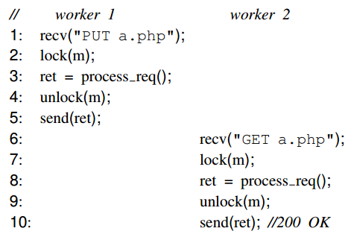
Example – Primary Replica
There is a large difference between the arrival time of input requests
Thread 1
Thread 2
1
2
Primary
P
G
DMT
delay

Slide 11
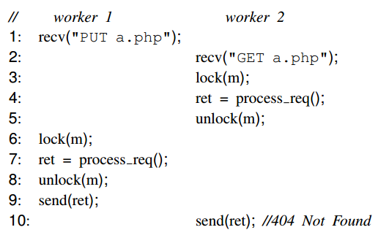
Example – Backup Replica
There is a small difference between the arrival time of input requests
Thread 1
Thread 2
1
2
Backup
P
G
DMT

Slide 12
Need to agree upon a ‘logical admission time’
Observation: Traffic is bursty!
If requests arrive in a burst, because we already ordered the sequence of requests – their admission time is deterministic!

Slide 13
Time-bubbling
Wtimeout – delay threshold (100us)
Nclock – logical clock ticks (1000)
1
2
Primary
P
G
P
G
G
DMT
Global Sequence of socket calls
P
G
P
G
G
1
2
Backup
P
G
G
P
P
G
G
DMT

Slide 14
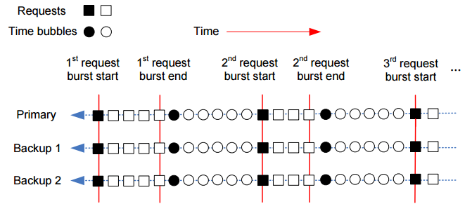
Time-bubbling
Take-away: You get consistent DMT schedules across all replicas!

Slide 15
Checkpointing & Recovery
Storage checkpointing [file-system incl. installation + working dir]:
LXC (Linux Containers)
Process state checkpointing [memory + register state]:
CRIU (Checkpoint/Restore In Userspace)
Only does this when server is idle (no alive connections) because of TCP stack state

Slide 16
Evaluation
Setup: 3 replica machines, each with 12 cores (with HT), 64 gb memory
Five multi-threaded server programs tested:
Web servers: Apache, Mongoose
Database server: MySQL
Anti-virus server: ClamAV
Multimedia server: MediaTomb
None of the programs required any modification to run with CRANE

Slide 17
Performance Overhead
DMT
Mean overhead for CRANE is 34%

Slide 18
Time-bubbling Overhead
Ratio of time bubbles inserted in all PAXOS consensus requests
Per 1000 requests

Slide 19
Handling Failures
Primary killed:
Leader election invoked, which took 1.97 s
One backup killed:
Incurred negligible performance overhead as long as other replicas remained consistent.

Slide 20
Final thoughts
General-purpose – suited for programs with low pthread sync operations.
Limited by the POSIX Socket API and use of the pthreads library
Does not detail overhead if replicas > 3
Does not cover all sources of non-determinism. Does not make IPC deterministic

Slide 21
CRANE Architecture (backup)

Slide 22
Checkpoint & Recovery Performance (backup)

