Slide 1
Implementing Declarative Overlays
Boon Thau Loo, Petros Maniatis, Tyson Condie, Timothy Roscoe, Joseph M. Hellerstein, Ion Stoica

Slide 2
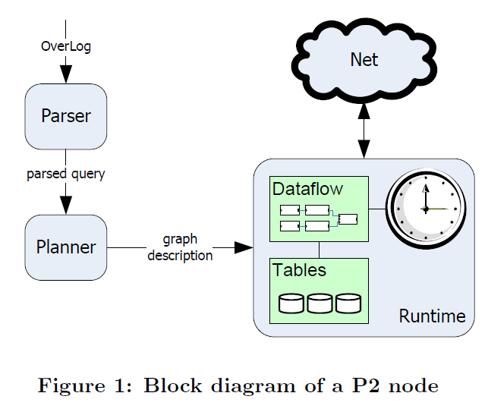
Recap
P2
Declarative language Overlog
Concise and reusable
Executes in a dataflow architecture

Slide 3
Pros
Easy to manage (tradeoff between complexity and performance)
Less code to write
Code reuse
Fair maintenance traffic
Rapid prototyping
Dataflow Scoping, Typing, Encapsulation & Reuse

Slide 4
Cons
Bad performance on high churn
Lacks evaluation to networks other than Chord
Planner cannot handle all constructs of Overlog
No formal language grammar specification
Overlog high learning curve
In memory tables
Concurrency, Security

Slide 5
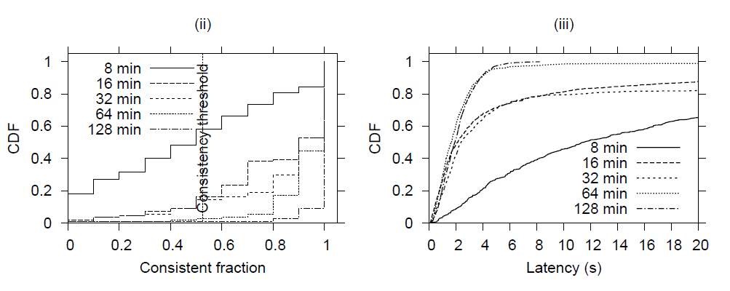
Performance

Slide 6
Question
The authors claim that a fuller exploration of P2’s networking subsystem and its high-level specification is ongoing and beyond the scope of the paper. What would such a specification entail?

Slide 7
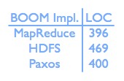
How has P2 developed since its publication?
Dedalus, 09
BOOM-MR, BOOM-FS
9 month design cycle
Competitive
R/Overlog, 09
Overlog adapated for use in replication system
Improved parser, concurrent execution
Compiles Overlog to Java

Slide 8
Question
Does a concise language contributes to less bugs and easier development? More LOC->more bugs?

Slide 9
Q&A

