Slide 1
Online Parameter Optimization for Elastic Data Stream Processing Thomas Heinze, Lars Roediger, Yuanzhen Ji, Zbigniew Jerzak (SAP SE) Andreas Meister (University of Magdeburg) Christof Fetzer (TU Dresden)
Presented by Rohit Mukerji
February 18, 2016

Slide 2
Data Stream Processing Engines
Processes queries using directed acyclic graph structure (DAG)
Are used in order to process large amounts of data in real time compared to batch processing done in Hadoop
i.e. Apache Storm

Slide 3
Motivation
1) Major problem in today’s cloud systems is low utilization of the entire system
Results in high cost for user and low energy efficiency for cloud
Average cloud utilization is only 30%; users reserve 80%
2) Knowledge of the system is required in order to manually set parameters
lack of understanding results in conservative parameter settings, which results in low usage of the system

Slide 4
Proposition
Want to build an elastic data stream processing system which allows to trade off monetary cost against the offered quality of service (latency)
Elastic: system that automatically scales in or out based on workload needs

Slide 5
Architecture
Notes:
-Distributed Data Stream Engine contains a centralized management unit which dynamically allocates and removing hosts as well as assigning operators to particular hosts. The system supports primitive relational algebra operators (selection, projection, join, and aggregation)
-Online profiler determines the frequency of triggering the parameter optimization. It monitors changes of the workload pattern based on the overall CPU load using an adaptive window (which I will talk about later)
-If a change of the workload pattern is detected, the optimization component is triggered using an up to date short-term history of current load characteristics (more details to come)
-parameter optimization is used to find the parameter configuration for the scaling strategy, which (1) minimizes the monetary cost the user needs to pay and (2) ensures a good quality of service i.e. low latency

Slide 6
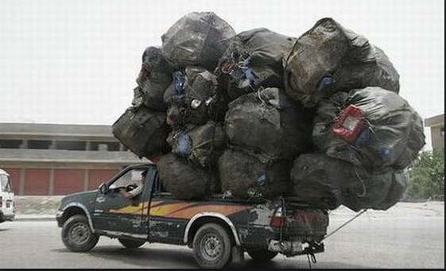
Threshold-Based Scaling
3 factors are considered when deciding to scale
CPU
Network
Memory Consumption
Actions are triggered when a host is marked as
overloaded and under-loaded
Notes:
Overloaded: If the upper threshold is exceeded at a host for d successive measurements, the host is marked as overloaded. Then operators are sent to other hosts using a subset algorithm. Picks a subset of operators that do not exceed the threshold, in addition, no other subset has a larger summed load and still satisfies the threshold at the originally overloaded host.
Underloaded: if measurements fall below lower threshold for d consecutive measurements. Manager looks for least burdened host and sends operators to that host, and the original host is cancelled. If operators cannot be moved without overloading other hosts, then the moving stops.
Certain actions are taken to prevent too frequent scaling decisions: (1) after each scaling decision the affected host is not touched for a certain period of time, called the grace period g, (2) scaling decisions are only made after d↑ or d↓ consecutive violations of the threshold, and (3) the load to move for a scaling out decision is chosen to reduce the host load at least 10% below the upper threshold thres↑

Slide 7
Online Parameter Optimization
Parameters p include, lower threshold and duration, upper threshold and duration,
grace period g, bin packing variant bin
Notes:
Utils is an input to this, which is basically the short-term utilization history.
Cost function calculates cost of the system with the current system parameters p
Search algorithm tries to find a new configuration p* with lowest cost cost(p*). If p* is “better” than p then the system adapts.

Slide 8
Cost Function - Calculate the monetary costs for a parameter configuration, where the best configuration is marked by a minimal cost value
Utils: how much each operator utilizes
a host at a given time
Assign: the assignment of operators to
a host at a given time
Certain parameters, e.g., the grace period
and the threshold du-ration, do not have
any influence on the scaling behavior if
the cost for a single utilization snapshot
is calculated. The system uses the last k (a number decided by the online profiler) snapshots when calculating cost
Notes:
The cost is calculated in a “pay as you go manner”, and the charge is fixed price pv for a particular time interval t. The total cost cost(p) us determined by summing up the number of intervals per virtual machine. In the example above, the total cost is (3+3 +2) * pv = 6 * pv

Slide 9
Latency-Aware Cost Function
Minimizing cost alone isn’t enough, we want to also ensure good performance by providing a low-latency system.
We define a latency function as follows:
lat(q_{l} , t_{j}) = latency for query q_{l} at time t_{j} and the system latency at time t_{j} is measured as the average latency of all currently running queries
We adjust our cost function as follows:
Notes:
Cost function analysis:
-MAX is a constant which is larger than the maximum expected cost of any configuration. A configuration without any latency violation is preferred to one that does even when the one with latency violation does have a lower cost. No valid configuration means choose the one with lowest number of violations.

Slide 10
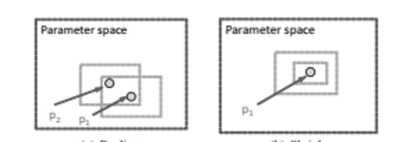
Search Algorithm
Goal : find the best parameter configuration p* with the minimal cost given the current time series of operator utilizations
Uses Random Recursive Search (RRS) Algorithm
Realign sub-phase
Shrink sub-phase
Notes:
-Search problem is not differentiable so standard optimization algorithms such as gradient descent will not work. In addition, the algorithm cannot be too slow otherwise the latency of the system will increase.
-Use Random Recursive Search and the underlying assumption is that efficiency of classical random sampling decreases with an increasing sample size. Exploration – the complete search space is searched for a best possible solution. Exploitation – search only the “promising areas” that were found in the exploration phase
During the exploration phase:
-Realign sub-phase: if a new better solution has been found during the exploration phase the sample space is moved towards this new best solution.
-Shrink sub-phase: if no better solution has been found the size of the sample space is reduced
The exploitation phase terminates when the size of the area is below a certain threshold. Which will then trigger another exploration phase (hence recursive)

Slide 11
Online Profiler
Responsible for deciding when to trigger the optimization as well as the size of the utilization history to be used as an input
Need just the right window size; use an adaptive window size strategy
Consider CPU usage of various hosts
Good metric as it indicates how “busy” a host is and the rate at which input is coming in
Idea:
The size of the window increases as long as the observed metrics do not change significantly
If a significant change is detected, elements from the end of the window (oldest elements) are removed until the variance of the window is small again
Notes:
The window is divided into “chunks” and the variance of each chunk is calculated. If the variances differ less than a particular threshold e for all combinations of chunks, then no need to call for parameter optimization. Otherwise, the online parameter optimization is triggered
There is also a delta parameter involved in the adaptive window algorithm. A smaller delta value = less frequent parameter optimizations and greater delta value = more triggering of parameter optimization

Slide 12
Evaluation
Some Questions to consider:
1. Does the online parameter optimization improve the trade-off between monetary cost and latency violations compared to state of the art solutions?
2. Can we influence the results of our parameter optimization by the latency threshold?
3. Does the online parameter optimization solution scale with an increasing operator count and history size?

Slide 13
Testing Input and Environment
3 Sources of Data Streams:
Frankfurt Stock Exchange
Twitter Feeds
Energy Data from DEBS
Challenge in 2014
Run in private shared cloud
environment with up to
12 client hosts and one manager
host. Each host has 2 cores and 4GB
RAM.
Notes:
To compute cost of running our data stream engine, the pricing scheme is the same of Amazon Kinesis’s pricing scheme. Only difference is instead of a per hour billing rate, a per minute billing rate is used in order to capture in finer detail when the system scales in or out (which takes only seconds), and just overall, the system behavior is better captured.
Each experiment is run for 90 seconds with 2500 measured points.

Slide 14
Average Processing Latency of Different Approaches
The end-to-end latency is measured, which is the measured time between an event enters
the query and leaves the query at the sink. A value of 3 seconds is used as the upper threshold.
Based on the results, the average processing latency is not influenced by different strategies.

Slide 15
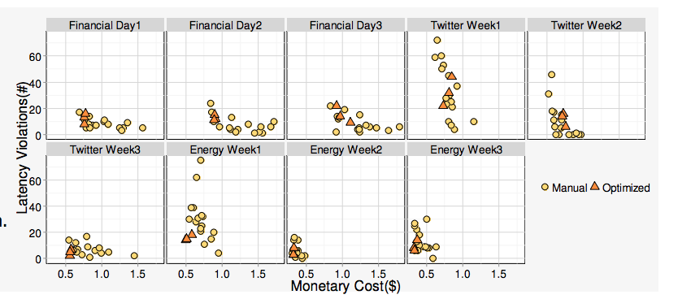
Vs. The Baseline (Manual Parameter Setting)
Naïve Strategy: use the median result of all measured configurations for each workload to illustrate the
expected results for an unexperienced user.
Top 3 Per Workload: Determine the best 3 configurations per workload for all 16 scenarios and average
the results
Notes:
16 different combinations of parameter thresholds for the lowerbound and the upperbound are used. Don’t want lowerbound and upperbound to be close to each other, otherwise lots of rescaling and moving of operators and thus, an increase in latency
Vs. Baseline: Cost reduced by an average of 10%, and the number of latency violations increases by an average of 3. In addition, the results of parameter optimization vary a lot less (the measured cost only varies by 10%, and the maximum latency violation count is only 2 times the minimal violation count). Thus, the parameter optimization performs at least as well as the baseline.

Slide 16
Parameter Optimization vs. Other Methods
Notes:
Reinforcement Learning (machine learning algorithm) - how software agents ought to take actions in an environment so as to maximize some notion of cumulative reward. 3 parameters: the utilization target, learning rate, and importance.
Vs. Reinforcement Learning: cost is around the same as parameter optimization, however, the latency violations are a lot higher in most cases (an average of 14 more). Thus, parameter optimization achieves a better tradeoff between latency violations and monetary costs as compared to reinforcement learning.

Slide 17
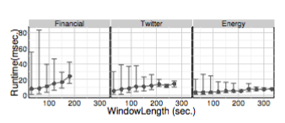
Does the proposed solution scale?
The cost function is the most important thing to consider when discussing scalability
Deals with two metrics: the number of placed operators and the length of the utilization history
If the window size is increased by a factor of 6, from 30 seconds to 180 seconds, the average
runtime only increases by a factor of 2.5, 1.4 or 3.0 for energy, Twitter or financial work-loads
respectively
Notes:
If the window size is increased by a factor of 6, from 30 seconds to 180 seconds, the average runtime only increases by a factor of 2.5, 1.4, or 3.0 for the energy, Twitter or financial workloads respectively.
Similar results can be observed if we compare for a fixed window size the runtimes for different query counts: The runtime for increasing the number of queries from 10 for the energy use case to 35 queries for the financial use case, results only in a runtime increase by in a factor of 1.8 in average over all window sizes.
Overall, we can say that the proposed model scales linearly when considering the length of the utilization history and the number of queries.

Slide 18
Summary/Results
The parameter optimization version performs better than the baseline (manually tuned configuration) and the reinforcement learning in terms of the trade off between monetary cost and speed.
The proposed solution is scalable
Does not require knowledge to use because the system adjusts on its own to different workloads
Can be reused modularly without any modification

Slide 19
Thoughts
Central Management Component is a single point of failure. Also paper did not touch upon what happens if the online profiler were to fail as well
This system cannot handle load bursts i.e. when the magnitude of the workload sharply increases in a short duration of time.
During operator movements, the processing of incoming events is stopped to avoid any loss of information. This increases the latency of the system and can perhaps be solved by creating a temporary host.
Overall, more tests could have been conducted as this will give concrete evidence whether or not the proposed system does indeed perform well.

Slide 20
Thank You

