Slide 1
Minimizing Commit Latency of Transactions in Geo-Replicated Data Stores
Paper Authors: Faisal Nawab, Vaibhav Arora, Divyakant Argrawal, Amr El Abbadi University of California, Santa Barbara
Presenter: Stefan Dao

Slide 2
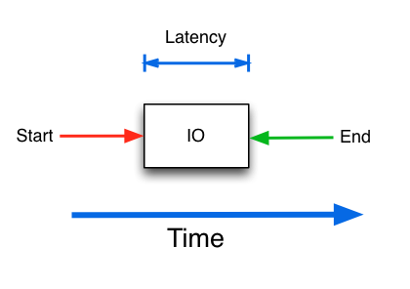
Latency
Definition: Time interval between stimulation and response
Why is it important?
Low latency means more $$$
Notes:
What is latency?
Costs of latency? Amazon 100ms = 1%, high speed trading – 5ms means millions of $$, transatlantic cable = $300 million for 6ms

Slide 3
Datacenters Challenges
DCs must be resilient to disruptions
Solution? Replication…but it’s expensive!
Replication
High level of consistency
More sent messages
Higher latency!

Slide 4
Related Work
Cassandra, Dynamo (Geo-replication)
Megastore, Paxos-CP (Serializability)
Message Futures (Low Latency)
Spanner, Orbe, GentleRain (Clock Synchronization)
RAMCloud (Distributed Shared Log)
Notes:
Some Datacenters and their key attribute
Message Futures also uses a distributed shared log

Slide 5
Helios
Serializable Transactions
Geo-replicated
Low latency
Loosely Synchronized Clocks
Log Replication
Notes:
Serializable – Able to achieve the same outcome if transactions submitted serially
Geo-replicated – tolerates failure
Clock synchronization – helps with conflict detection.
Log-structured stores with log replication
Low latency – lower bound

Slide 6
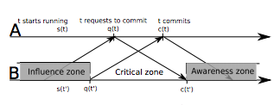
Lower-Bound on Commit Latency
Commit Latency (L_{x})
Summation of latencies between datacenters must be greater than or equal to round trip time (RTT)
Notes:
Influence zone (t can see everything here)
Critical zone (Any commits here
Awareness zone (when B knows about t)
Assumptions:
Infinite compute power
Symmetric communication
Arbitrary Read-Writes
Knowledge – knows every transaction up till current time – RTT/2
Commity latency - fixed

Slide 7
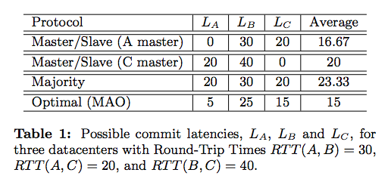
Optimal Latency
Minimum Average Optimal latency (MAO)
Linear equation to minimize L_{A}
Subject to L_{A} + L_{B} > RTT(A,B)
L_{A} > 0

Slide 8
Helios Cont.
N x N time table
Ex. T_{A}[B, C] = t₁
Commit offsets
Ex. (co_{A}^{B})
Knowledge Timestamps (kts)
kts_{t}^{B} = q(t) + co_{A}^{B}
Notes:
T_{A}[B, C] = Tau, A knows that datacenter B knows events at C up until t_1
Commit offset value for every single datacenter pair
Tunable parameter
Optimal assignment - Calculated using the RTT and the commit latency
To ensure nothing is committed in the critical zone, (co_AB + co_BA) >= 0

Slide 9
Helios Algorithm (Commit Request)
Transaction T
Check for conflicts
PT Pool
EPT Pool
Read Set
Notes:
Check preparing transactions pool and EPT for conflicts

Slide 10
Helios Algorithm (Commit Request)
PT Pool
EPT Pool
Transaction T
Check if overwritten
Read Set
Notes:
Check self’s readset

Slide 11
Helios Algorithm (Commit Request)
PT Pool
EPT Pool
Add to PTPool
Read Set
Transaction T
Get t.kts^{t} of all datacenters
Notes:
Appends to logA at the end and sends

Slide 12
Helios Algorithm (Log Processing)
Transaction T
Check for conflicts (and not local)
PT Pool
EPT Pool
Data Store
Time Tables
Notes:
If local, already has knowledge of transaction and skips

Slide 13
Helios Algorithm (Log Processing)
PT Pool
Transaction T
If T is preparing, append
EPT Pool
Data Store
Time Tables
Notes:
External Preparing Transaction Pool – If preparing, it’s new to A

Slide 14
Helios Algorithm (Log Processing)
PT Pool
Either way, remove from EPT Pool
EPT Pool
Transaction T
Data Store
If T is finished and committed, write to datastore
Time Tables
Notes:
Type is finished – Exists in EPT pool already
If the committed flag is set, it’ll write to the datastore
Remove from EPT Pool

Slide 15
Helios Algorithm (Log Processing)
PT Pool
EPT Pool
Data Store
Update time tables with timestamp
Transaction T
Time Tables

Slide 16
Helios Algorithm (Committing Preparing Transactions)
PT Pool
Transaction T
Data Store
If time > t.kts, commit and log the commit

Slide 17
Liveness of Helios
We want our system to be robust to failures!
How?
Allow up to f failures within the system
Wait on commits for f responses
Utilizes time-based invalidation (Grace Time)
Invalidates transactions after GT
Grace Time has tradeoffs…
Increased latency
Small Grace Time vs Large Grace Time
Notes:
If A “commits” transactions but fails, another datacenter B can propogate the information
When a datacenter fails, A can get information about failed B from C
The grace time gives us guarantees that while a datacenter A is down, B and C are safe to commit

Slide 18
Liveness Cont.
B
A
C

Slide 19
Liveness Cont.
B
A
C

Slide 20
Liveness Cont.
B
A
Helios-1 : A needs confirmation from C before it can commit
C

Slide 21
Liveness Cont.
Transactions from B before failure are invalidated
B
A
C

Slide 22
Evaluation
Paper evaluates the following:
How does Helios perform relative to existing systems (latency, throughput, abort rate)? (Message Futures, Replicated Commit, 2PC/Paxos)
What are the effects of poor clock synchronization?
What are the effects of poor RTT estimation?
Notes:
Utilizes Amazon Elastic Compute Cloud

Slide 23
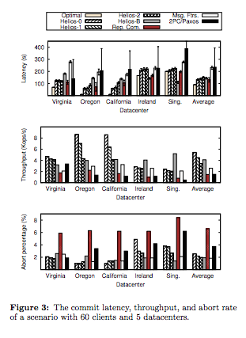
Evaluation
Experiment Setup
60 clients with 5 distinctly geo-located datacenters
Running regular instances of Helios
Notes:
Look at average to see trends.
For latency, only replicated commit performs better than Helios. Increasing fault tolerance increases latency. Other algorithms have high latency
Throughput – Helios performed better than all the existing systems, even with fault tolerance
Abort percentage – Msg Futures has lowest abort percentage but Helios performed within a percentage point similar

Slide 24
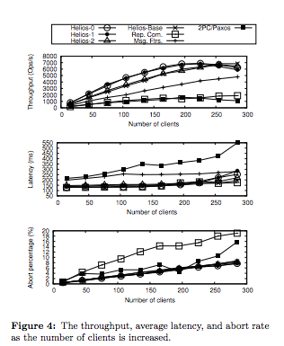
Evaluation
Experiment Setup
Increasing number of clients to see the effects on throughput, latency, and abort percentage of each system
Notes:
-Very good throughput as clients increase – peaks around 225
Latency is good as number of clients increases – starts to spike up around 250 clients but still beats out other systems except Replicated Commit
Abort percentage increases with number of clients linearly but doesn’t ever spike

Slide 25
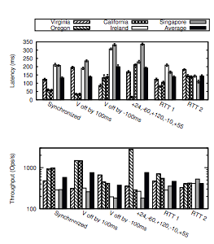
Evaluation
Experiment Setup
Vary clock Virginia datacenter by -100/+100 ms
Vary clock on each datacenter by set amount
Notes:
V off (unsynchronized clocks)
Ahead by 100 ms (causes other datacenters to improve in latency)
Behind by 100ms (Virginia at advantage – increases average latency)
Altered each datacenter (increased latency by about 60ms)
RTT estimation errors (increased and decreased latency expectations. Second one was no latency)
Off by about 4.5 – 9%
Throughput
Virginia off by 100 ms increased throughput
Virginia off by -100ms decreased throughput
Varying clock increased throughput

Slide 26
My Thoughts!
Paper was very easy to follow
Thoughtful experimentation!
Utilized Zipf distribution for data store access. Addressed issues such as scalability
In terms of latency…not the best system but performs well overall

Slide 27
Discussion: Minimizing Commit Latency of Transactions in Geo-Replicated Data Stores
Scribed by Jen-Yang Wen

Slide 28
Summary
Feature:
Low latency serializable transactions on geo-replicated data stores
Technique:
Timestamps by local loosely synchronized clocks
Shared Log
Optimizing average commit latency by linear programming
Configurable f-resilient
Evaluation:
On Amazon AWS with 5 geo-replicated data centers

Slide 29
Discussion
Pros:
High performance
Novel theory, proof, and protocol
Flexibility
Separate serializability from liveness
Able to manual tuning parameters
Evaluation on AWS geo-replicated systems
Use shared log for higher stability
Extensive analysis
Well organized
Notes:
In descending order as times mentioned on piazza

Slide 30
Discussion
Pros:
High performance
Novel theory, proof, and protocol
Flexibility
Separate serializability from liveness
Able to manual tuning parameters
Evaluation on AWS geo-replicated systems
Use shared log for higher stability
Extensive analysis
Well organized
Cons:
Irrealistic assumptions
Performance sensitive to clock sync.
Not the best in all the three evaluation aspects
Experiment only over 10 mins
Proof not formal
Liveness and commit latency tradeoff
Tedious configuration process
No test under failure
Focus on average, not tail latency
Storage overhead of the full copy shared logs
Limited discussion on Grace Time/ f-value
Notes:
In descending order as times mentioned on piazza

Slide 31
Questions
A quick poll: Does the “Proof of lower-bound “ seem formal to you?
Different servers have different commit speed, a good idea?
It would be interesting to see how multiple applications running on cloud platform and requiring different average commit latencies can be handled.
Any additional questions or comments?
Notes:
Q1: Too trivial, Tautology?
Q2: Depend on usecase
Q3: Seperate log, seperate parameters

