Slide 1
Ivy: A Read/Write Peer-to-Peer File System
Authors: Muthitacharoen Athicha, Robert Morris, Thomer M. Gil, and Benjie Chen
Presented by Saurabh Jha

Slide 2
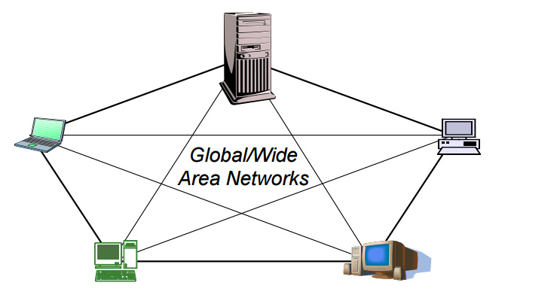
Introduction - P2P Storage Systems
Enables programs to store and access remote files exactly as they do local ones
Goal: Build a Distributed File System on P2P model
Allow users to share storage or files easily and arbitrarily
The focus of this talk
Ivy – A Read/Write Peer-to-Peer File Systems

Slide 3
Outline
Introduction
Motivation for P2P DFS
Challenges in building P2P DFS
Ivy
Introduction
Design
Semantics
Experiments / Evaluation
Pros/Cons
Discussion

Slide 4
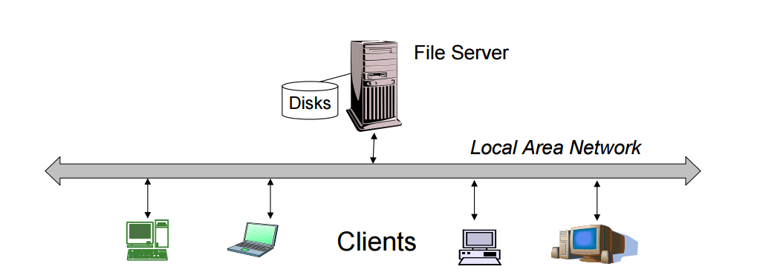
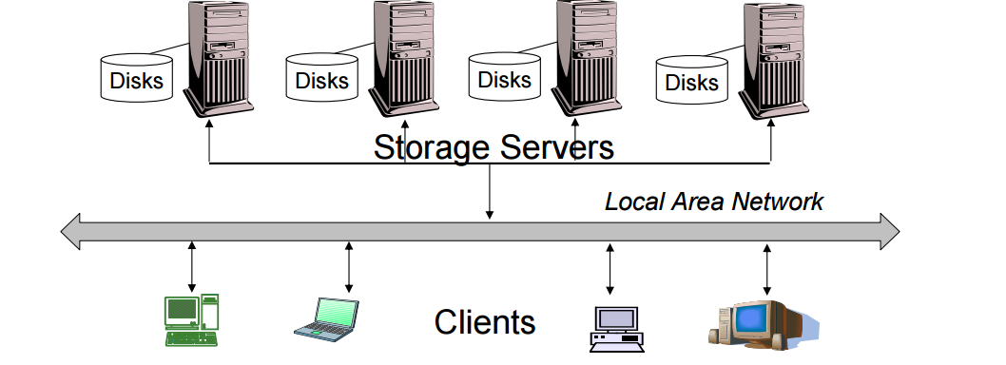
Motivation
Client Server Model
Cluster of Servers Model
P2P Model
- Dedicated
- Too many design considerations
+ Scalable and Trusted
- Too many design considerations
- Hard to achieve popular file semantics
+ Not dedicated
- Single Point of Failure
- Server performance bottleneck
+ Easy to setup
Model | Examples of File Systems
Client Server Model | NFS, CIFS, AFS etc.
Cluster of Servers | ZebraFS, xFS, Lustre etc.
P2P | CFS, Ivy etc.

Slide 5
Challenges in Designing P2P Systems
Peer issues
Decentralization
Churn
Trust
Accounting
Difficult with multiple shared writers
Difficult with churn and partitioning
Difficult with trusted partners gone rogue
File issues
Consistency/Integrity
Persistence
Security
Transparency
Difficult to provide popular NFS like semantics for accessing files

Slide 6
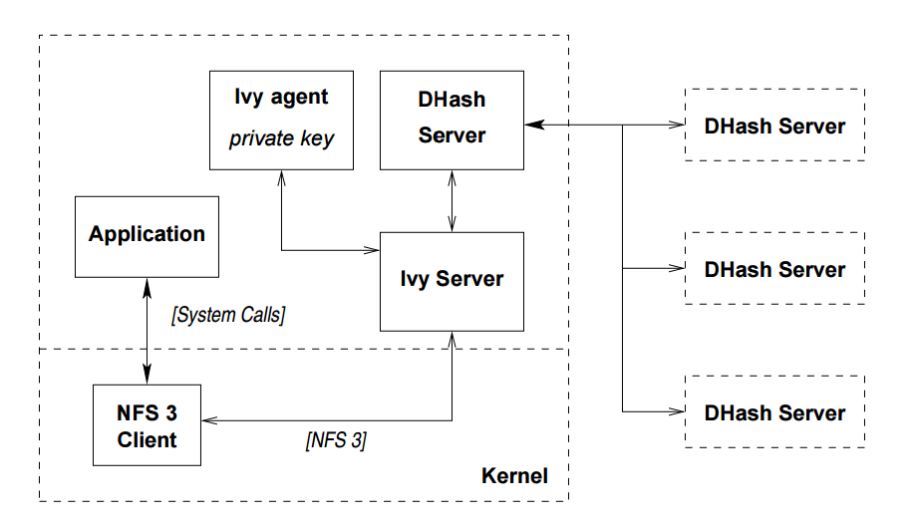
Ivy
Solves Trust Issues
Handles P2P Part
A multi-user read/write P2P file system
Log-based file system
Logs stored in DHash distributed hash table
Allows transparent access to files using NFS interface
Users do not have to trust each other
Allows to operate under partitioning
Consistency and conflict resolution semantics defined
Close to Open consistency of file data
Figure - Ivy Software Architecture
NFS File Operation Semantics

Slide 7
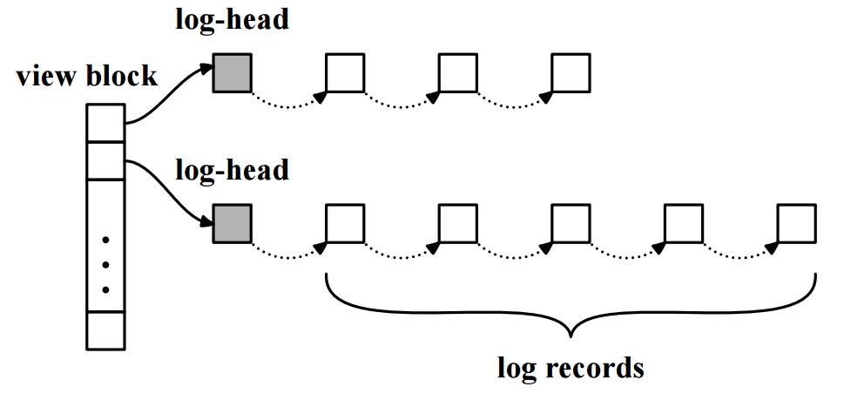
Design
Ivy uses set of logs
One per participant
Linked list of immutable records
Both metadata and data
Owner appends own log only but can read all of them
Each file system has its own view block
Created by participants or a new participant joins this view block
View block is essentially a data structure pointing to all log heads
log-head points to most recent log record
Maintain private snapshot of the system
Figure – Example Ivy View and Logs

Slide 8
Supporting File System Operations
Table - Log Types
A participant consult all logs to find relevant information
Ivy uses version vector to order and create a consistent view of the file system
Concurrent versions are resolved by ordering public keys

Slide 9
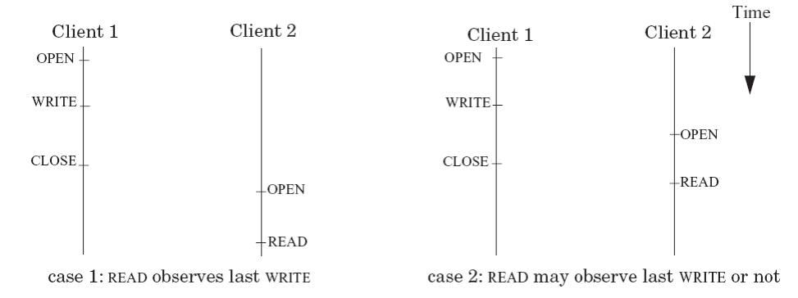
Cache Consistency
An update operation of one Ivy participant is visible to another almost immediately except during partitioning
The immutable nature of logs helps provide better consistency model than NFS
Provides close-to-open consistency for file data
Caches file blocks along with version vector
Use this cached version to serve future requests if no change in the log heads

Slide 10
Updates
Concurrent Updates
Concurrent updates are ordered using public keys
When the write is complete [close()], participants agree on this order or the application manually resolves it
Lack of serialization (as offered by centralized file system) can create conflicting views and unintended operations
Exclusive creation of directories except during partitioning
Partitioned Updates
Ivy not aware of partitions, hence conflicting updates can be made
Relies on DHash servers to make sure that updates are available to each peer [Not Guaranteed though!]
Healing ensures that meta-data structure is consistent. May lead to lost updates.

Slide 11
Experiments
Uses Modified Andrew Benchmark (MAB) for evaluation
Create dir hierarchy, Copy files, Walk directory while reading attr for each file, read files, compile files into programs
Experiment Configuration
Mode
Single Node
WAN
Parameters (varying)
# Participants
# Concurrent Writers
Snapshot interval

Slide 12
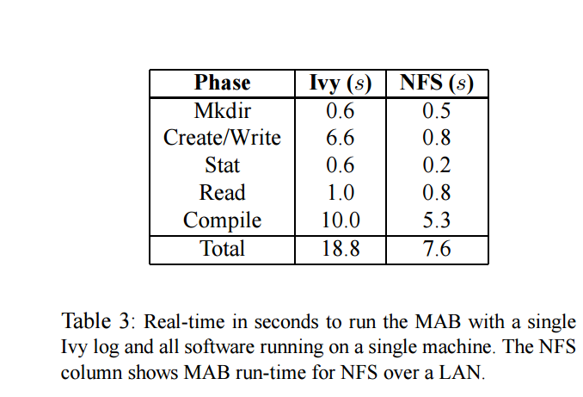
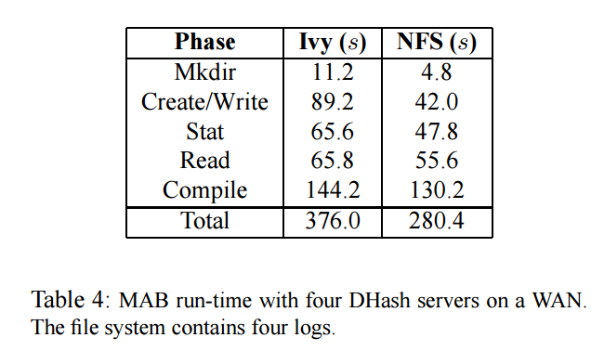
Evaluation
~ 3X Slower
Single Node
WAN
386 NFS RPCs
508 Log Updates taking 7.2 seconds
Inserts 8.8MB for 1.6 MB data
1 NFS requests causes 3 log head fetches
Total Fetches: 3346
Performance decreases
due to increased number of rtts’

Slide 13
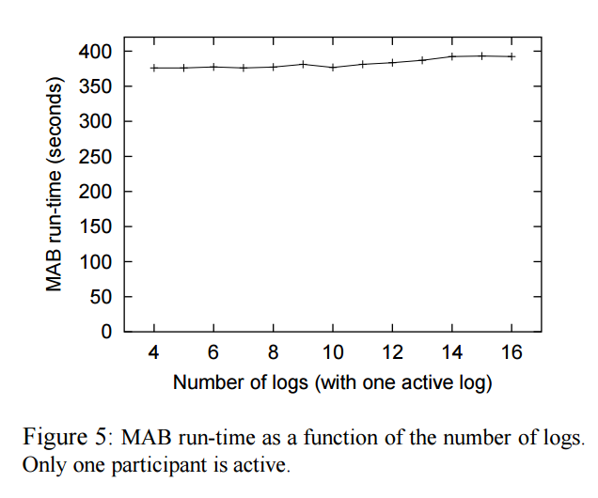
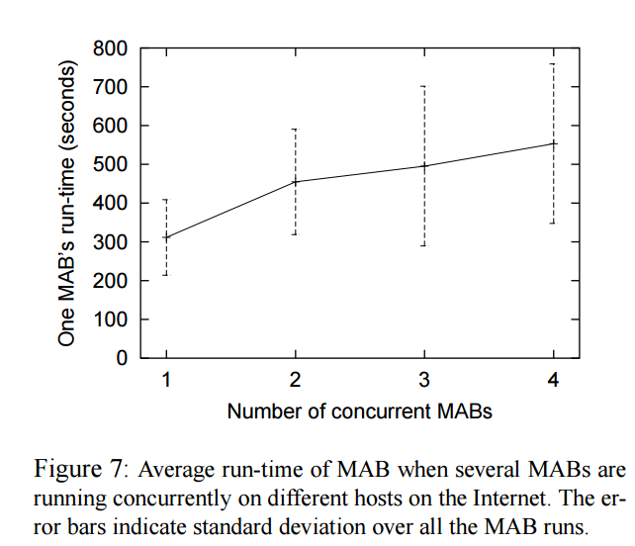
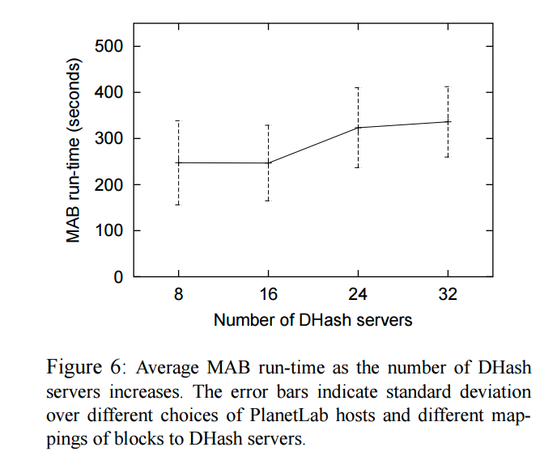
Evaluation
Many Logs/ One Writer
Many DHash Servers
Many Writers
Little Impact: Logs are fetched in parallel
Runtime growth due to increase in chord #packets used to coordinate to DHash servers
Runtime growth due to increased number of log heads and cost of fetching

Slide 14
Pros
NFS like semantic, fully functional with existing OS’es
No need for dedicated servers
Provision for security, recovery and integrity
Defined useful semantics
No locks !

Slide 15
Cons
Huge Storage Requirement - Immutable and append on only logs
What happens when participants run out of storage
May be not, storage is cheap!
2 – 3 X slower, would you be really using it ?
CVS
Manual conflict resolutions!
Scalability Issues
Work more focused on showing the possibility of concept through implementation rather than design itself.
Some choices are arbitrary

Slide 16
Discussion: How did Ivy handle these challenges?
Peer issues
Decentralization
Churn
Trust
Accounting
Transparency
Unanswered Question
No model to show the impact of node to node latency
How does churn rate affect file system performance
How to detect rogue agents?
How much should each peer contribute?
Manual conflict resolution, can there be some abstraction?

Slide 17
Comparison of P2P Storage Systems

