Slide 1
Interruptible Tasks
Treating Memory Pressure As Interrupts for Highly Scalable Data-Parallel Programs
Lu Fang, Khanh Nguyen, Guoqing Xu, Brian Demsky, Shan Lu
Presenter: Xiang Li

Slide 2
Introduction
Problem: Memory Pressure - huge garbage collection burden, out of memory errors
Goal: a general, multi-platform solution
Product: Interruptible Tasks (ITasks) - new type of data-parallel tasks that can be interrupted upon memory pressure—with part or all of their used memory reclaimed—and resumed when the pressure goes away

Slide 3
Individual Node Memory Pressure
The execution pushes the heap limit soon after it starts and the systems struggles to find memory to allocate new objects throughout the execution.
Memory problems lead to excessive GC effort and out-of-memory errors, significantly hurting system performance and scalability.
No existing technique can systematically address the individual node memory pressure problem.

Slide 4
Practical Solutions: Manual Tuning
Manual tuning of framework parameters.
Example: reduce input size for each task and/or degree of parallelism.
Difficult, impossible to find a general configuration when considering data skewness and different behaviors of the tasks.

Slide 5
Practical Solutions: Automated Tools
Develop automated tuning tools:
YARN, Mesos, Starfish: try to allocate resources by predicting a task’s future resource usage based on its past utilization.
However, the memory behaviors are difficult to predict: YARN schedules a task in StackOverflow to process a long post on a node, which incurs huge memory consumption where other tasks are already running, based on the observation that a “normal” task did not take much memory in the past.
Out-of-core computations: framework-specific

Slide 6
Real World Memory Problems
Hot Keys: some particular keys have large numbers of associated values
Large Intermediate Results: intermediate data in large Java collections which have non-trivial space overhead, cached in the memory
Recommend solutions in StackOverflow:
Configuration Tuning: change framework parameters - labor intensive
Skew Fixing: find all long sentences in the dataset and break into short sentences - impossible to be general

Slide 7
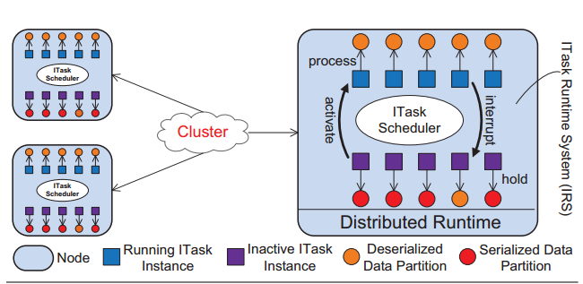
ITasks: Architecture

Slide 8
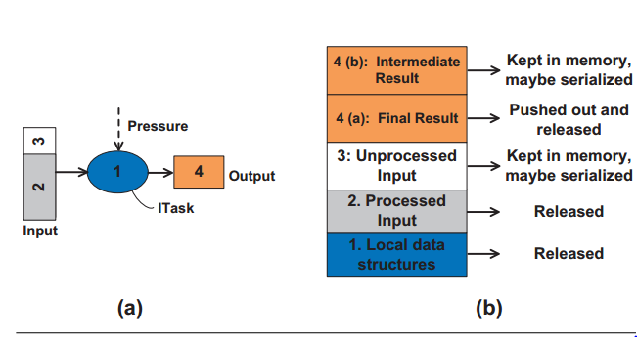
ITasks: Execution
When the system detects memory pressure, a selected task is interrupted, with part or all of its consumed memory reclaimed. This process is repeated until the pressure disappears.
Stay in memory and wait to be aggregated until all intermediate results for the same input are produced
Lazily Serialized: serialize if needed
Pushed to the next operator in the pipeline immediately
Lazily Serialized
Keep in memory and serialize it when needed
Safe to discard when the corresponding thread is terminated

Slide 9
ITasks: Timing
We want to interrupt a task when the overall memory pressure comes and when its execution arrives at a safe state.
Two factors:
per-process system memory availability
- avoid unnecessary interrupts: uses long and useless GC as indicator
per-thread/task data processing status
- terminating by recording minimum local info of execution: understand data processing status

Slide 10
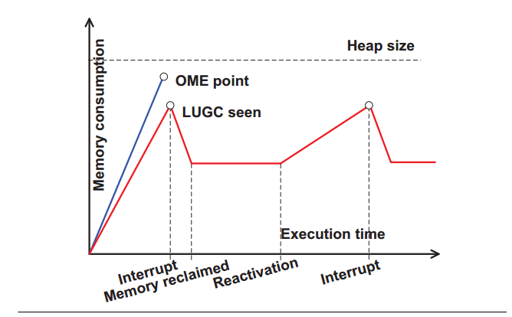
ITasks: Comparison

Slide 11
ITasks: Programming Model
Adjustments to original code:
Implement the DataPartition interface: wrap around the framework’s existing data representation (k-v buffer)
Make the original task’s Java class inherit the ITask abstract class and implements its four abstract methods (initialize(), interrupt(), cleanup(), process())
Glue code to specify the input-output relationships between data partitions and ITasks.

Slide 12
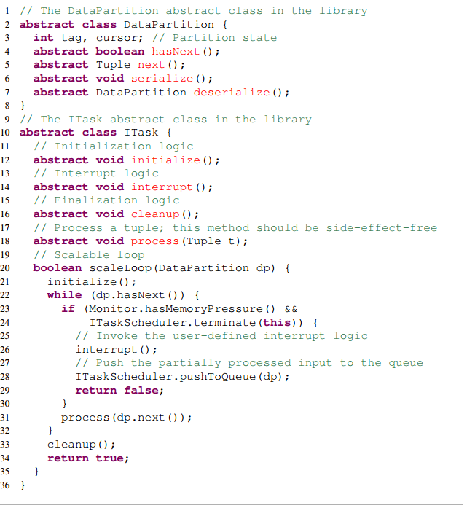
ITasks: Programming Model
tag specifies how partial results should be aggregated, cursor marks the boundary between the processed and unprocessed parts of the input
loads the input and creates local (auxiliary) data structures before starting data processing
specifies the interrupt handling logic
contains the finalization logic when the entire input is processed
implements the main data processing logic
scaleLoop iterates over the input data tuples and invokes the process method to process a tuple in each iteration.
It checks memory availability at the beginning of each iteration, ensuring that interrupts can only occur at safe points (i.e., not in the middle of processing a tuple).

Slide 13
Dataflow Semantics
An ITask will be invoked as long as:
There exists a DataPartition object in the partition queue
The cursor of the partition does not point to the end
Example:
ITaskB is now a successor of ITasksA
Whenever a DataPartitionB is produced by ITaskA, it can be immediately processed by ITaskB

Slide 14
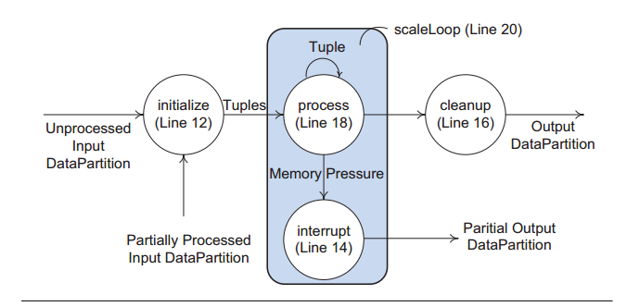
ITasks: Dataflow of an Execution
Entire input is processed; finalize
Determined by IRS
Interrupted, pushed into partition queue
The state machine of ITask execution

Slide 15
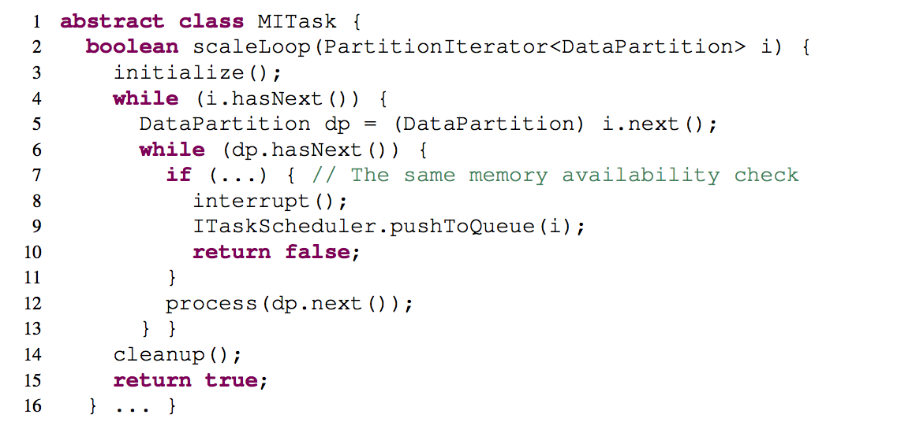
MITask: ITask with Multiple Inputs
The use of tags
each instance (thread) of an MITask is created to process a set of DataPartition objects that have the same tag
multiple MITask instances can be launched in parallel to process different groups of data partitions with distinct tags
a special iterator PartitionIterator is used to iterate over partitions: a lazy, out-of-core iterator that does not need all partitions to be simultaneously present in memory; a partition on disk is loaded only if it is about to be visited.

Slide 16
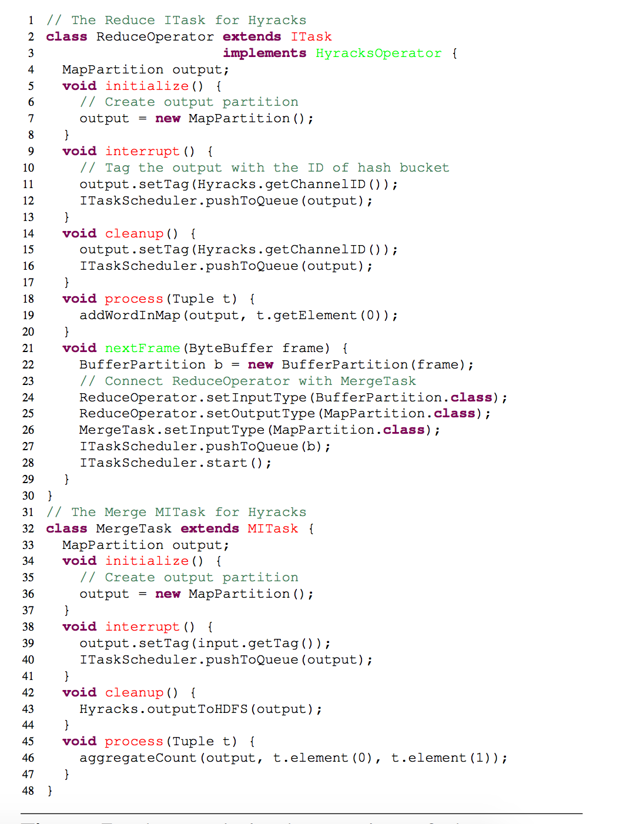
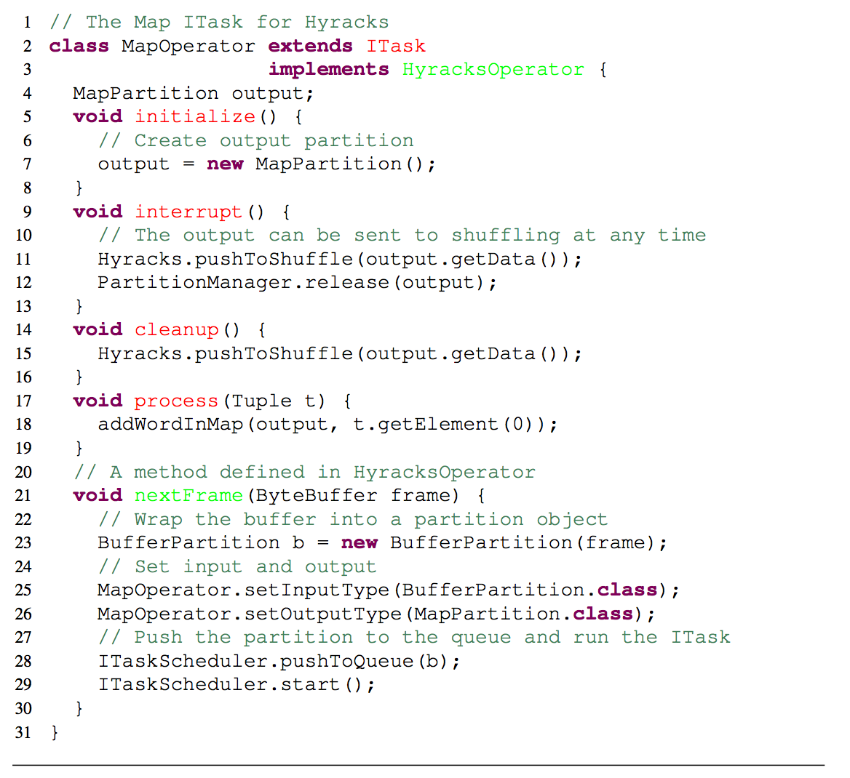
ITasks in Existing Frameworks
Hyracks

Slide 17
ITasks in Existing Frameworks: Hyracks
Map thread: the output can be directly sent to shuffling
Reduce thread: the output needs to be tagged with the hash bucket ID for Merge task
Merge thread: the output needs to be tagged for Merge again

Slide 18
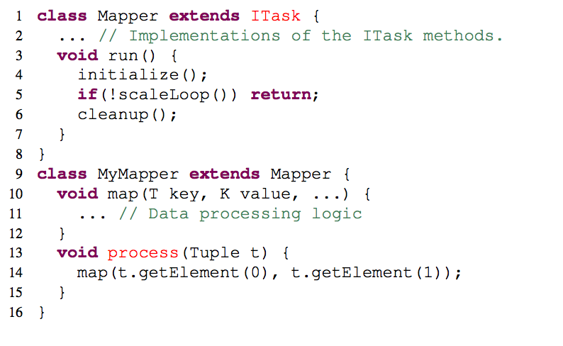
ITasks in Existing Frameworks: Hadoop
Let Mapper and Reducer extend ITask, so that all user defined tasks automatically become ITasks.
The run method in Mapper/Reduce invoke the ITask state machine; its original functionality is moved into the ScaleLoop method.

Slide 19
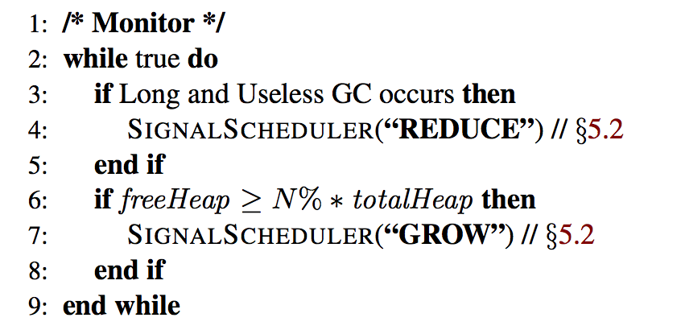
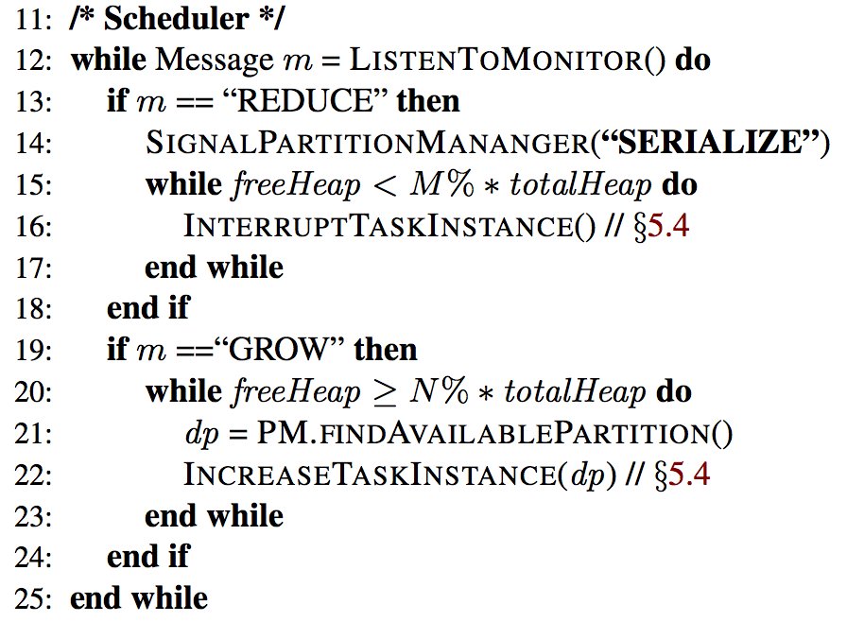
ITask Runtime System (IRS)
Warm-up phase:
Initially one thread is created, as the task executes the system gradually increases the number of threads until it reaches optimal execution point.
Three components:
Monitor
When to interrupt or reactivate an ITask
IRS monitors the global memory usage and notifies the scheduler of the system’s memory availability
2. Partition Manager
When to serialize or deserialize data partitions
Keeps track of each partition’s latest serialization and deserialization timestamps to avoid thrashing.
Priority in of partitions in memory: Temporal Locality Rule and Finish Line Rule
3. Scheduler
Which ITask to interrupt or reactive
Selection of ITask to interrupt: MITask First Rule, Finish Line Rule, Speed Rule
Run ITask: Spatial Locality Rule, Finish Line Rule

Slide 20
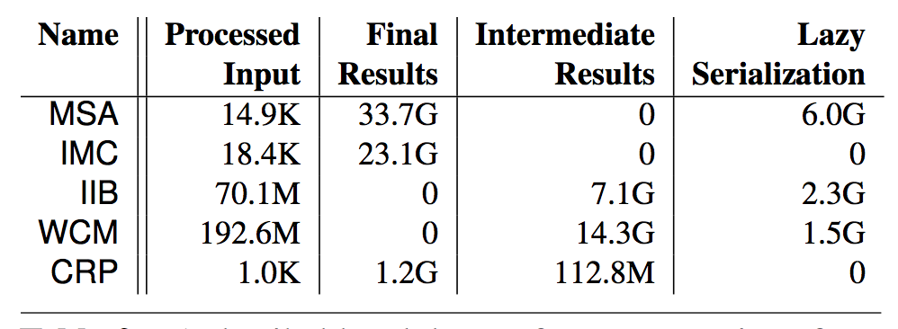
Evaluation
Hadoop performance comparisons

Slide 21
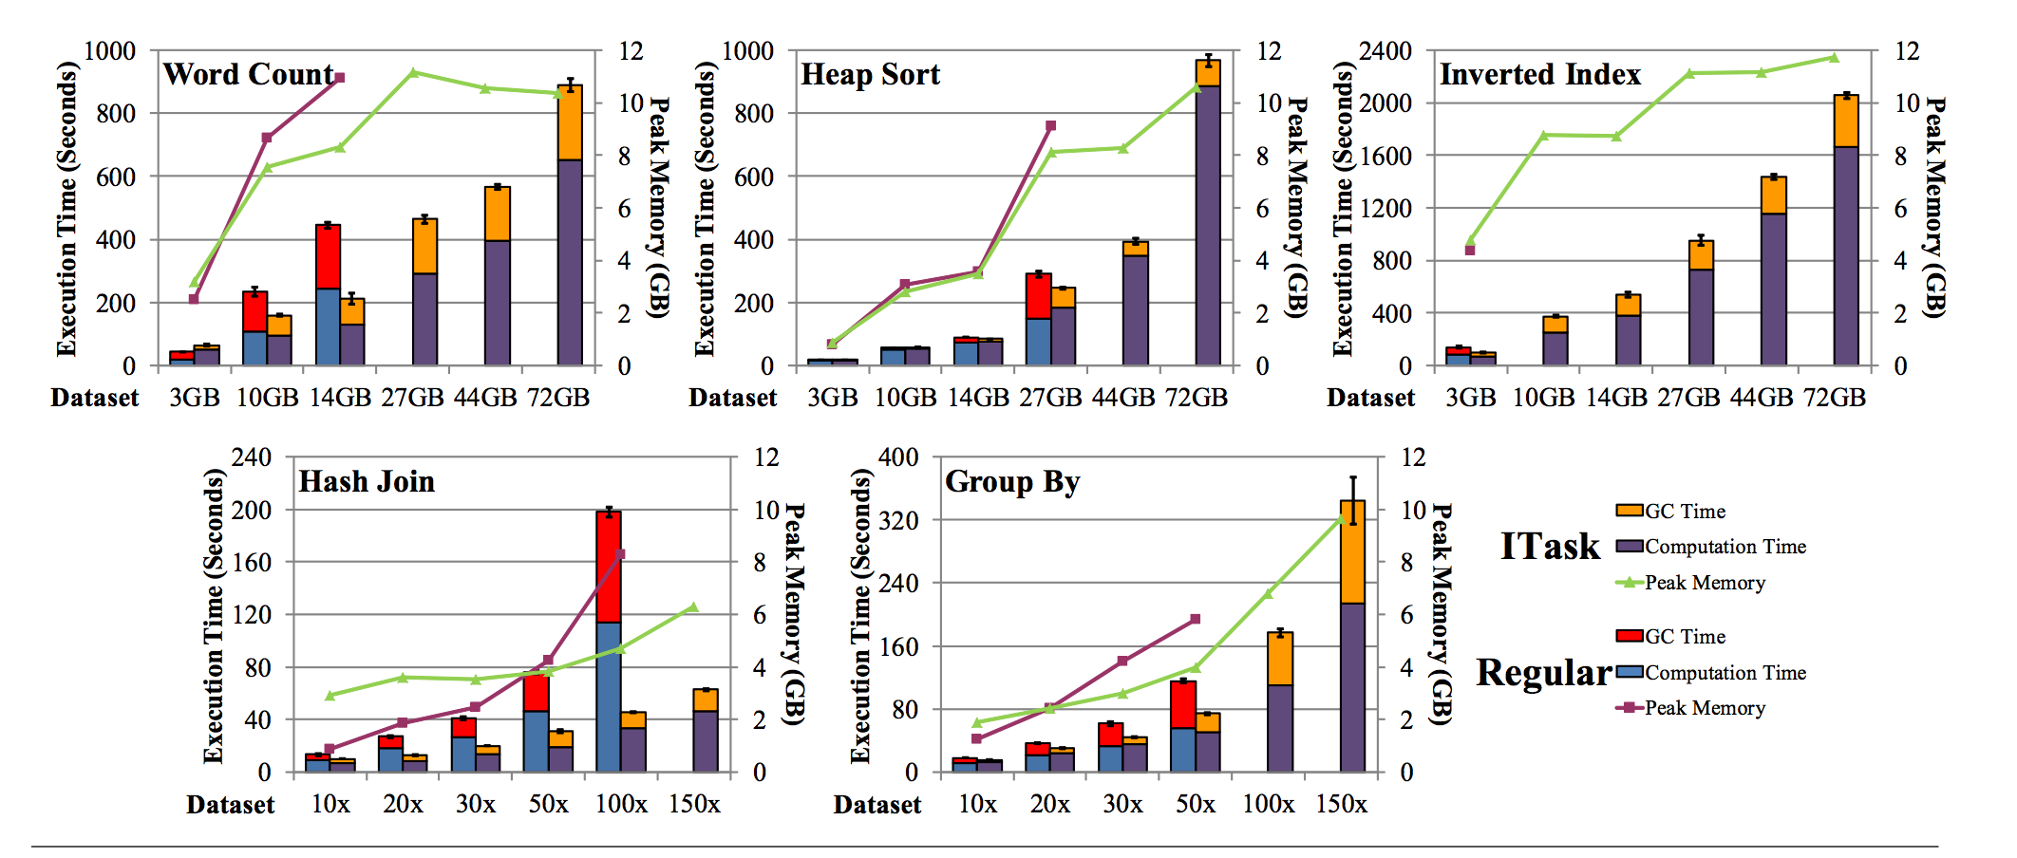
Evaluation
Hyrack performance comparisons

Slide 22
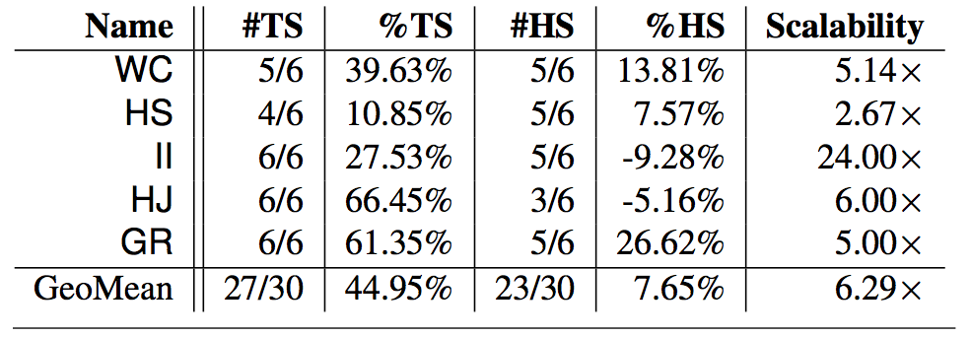
Evaluation
Hyrack performance comparisons

Slide 23
Conclusions
ITasks can be easily integrated into a distributed framework and interact seamlessly with the rest of the framework
The runtime is effective at reducing memory usage, thereby significantly improving the performance and scalability of a variety of data-parallel systems

Slide 24
References
L. Fang, K. Nguyen, G. Xu, B. Demsky, and S. Lu. Interruptable tasks: Treating memory pressure as interrupts for highly scalable data-parallel programs. In SOSP, 2015.

