Slide 1
A Tale of Two Erasure Codes in HDFS
Thomas McKenna
March 3, 2016
Notes:
ECE Main Slide

Slide 2
What are Erasure Codes?
A technique used to recover lost or corrupt data
FEC – Forward Error Correction
Parity to recover data (e.g. RAID 5)
Less space used than replication
Notes:
Erasure Codes are a way of recovering data when only some of the data is lost.
FEC
* Allows the DFS to recreate without recomputing the data

Slide 3
How Parity Works
Each set of blocks create a parity block
A lost block can be calculated from other blocks and the parity
Each block needs to be accessed.
1
0
0
1
1
1

Slide 4
Terminology
Skew, Hot, Cold
Degraded Reads, Reconstruction
Encoding, Decoding, Upcoding, Downcoding
PC, RS, LRC
Notes:
Skew, Hot, Cold
Hot is data that is accessed a lot. Cold is data that is not accessed a lot
Skew describes how most data is Cold
Degraded Reads, Reconstruction DIFFERENT
Degraded Reads – Read of a lost block that must first be reconstructed – Ideal if FAST for hot blocks
Reconstruction – Periodic reconstruction of blocks using parity
Encoding, Decoding, Upcoding, Downcoding
Encode – Code the data so it is safe
Decode – Use Coding to repair lost data
Upcoding – Convert from high overhead to low overhead
Downcoding – Convert to high overhead, fast reconstruction
PC, RS, LRC
PC – Product Codes
RS – Reed Solomon
LRC - Local Reconstruction Codes

Slide 5
Motivation and Observation
Lots of Skew
High ratio of cold to hot data
Want fast recovery of hot data
Want very low overhead
98% failures are single block, 1.87% are 2 blocks
Erasure Codes allow for a tradeoff of overhead vs reconstruction time

Slide 6
Current Techniques
Redundancy is popular
Fast reconstruction
Requires a lot of storage overhead
Lower mean time to failure
Single erasure code systems
Have to be tuned for low overhead OR fast reconstruction
Inefficient when compared to dual EC system
Low overhead means lots of network transfers
Notes:
Redundancy:
3x the storage requirement is not scalable
compared to the codes we will see its MTBF is lower
Single
Inefficient on the mostly COLD data we see
Use less parity per block or conversely more blocks per parity block
Requires you to fetch all of the data blocks during reconstruction

Slide 7
Solution is HACFS
Adaptively code the data
Cold data has low over head (higher reconstruction time)
Hot data has fast reconstruction time (high overhead)
Limit the total overhead ratio
Replication ~3x
Single EC ~1.5
Double EC ~1.5

Slide 8
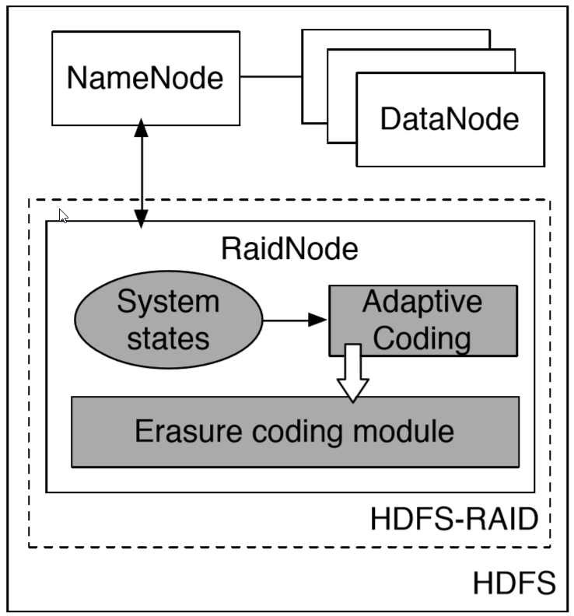
Construction of HACFS
Built on HDFS
RAID Module
Keeps State
Up/Down Codes
No two blocks on same disk
MapReduce all the things
Notes:
HDFS – Hadoop Distributed File System
State – file size, modification time, read count, encoding
Dynamically changes coding scheme up/down
Uses HDFS to ensure that no two blocks are on the same disk.
Low parity that can only survive one block loss can lose a whole disk
In reality, Erasure codes can be tuned to handle arbitrary number of failures
MapReduce
Scalable

Slide 9
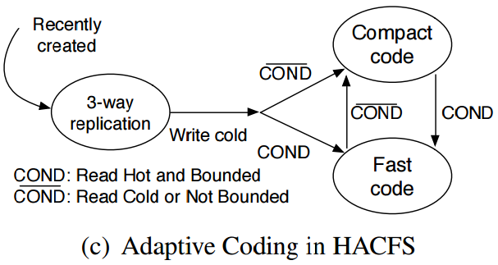
How Up/Down Coding works
System uses state to determine best coding
Amount fast coded bounded by total ratio
Periodically downs Cold and ups Hot data
Notes:
Upon data entering the system it is 3-way replicated for durability and fast degraded read
When the system detects “write cold” UNLIKE SINGLE EC
Checks state of read HOT/COLD
We can see the up/down coding from two codes.

Slide 10
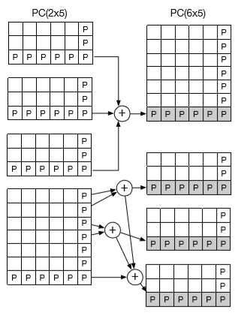
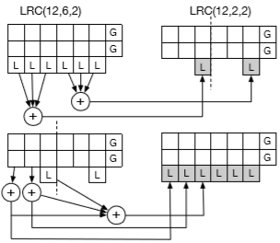
Mechanics of Up/Down Coding
Others?
Notes:
LEFT – PC
Only needs to access Parity blocks to construct new parity scheme
Only requires XOR operations
No Data transmitted (compared to 6-10 data blocks for reconstruction)
RIGHT – LRC
Local parity can be constructed relatively easily – 6 reads
Global parity would require fetching all the data blocks
Code Collapsing LRCfast → LRCcomp
Most failure modes only require reading the Local parity
Reconstruction is fast because of smaller Galois field compared to RS
Others
Paper specifies that other (modern) EC schemes can be up and down coded efficiently
Does not show how it is done or any other information other than: “we have done it”

Slide 11
When data is lost
On a client read – Degraded read
The client fetches data and parity
Reconstructs lost data and uses as return from read
Does not commit reconstructed data
Periodic Job
Same as client but stores reconstructed data
Prioritizes Hot reconstruction
Notes:
Client
Does not store data because data loss is usually transient (node reboot)
Periodic
Prioritize Hot reconstruction to reduce number of Degraded Reads during recovery period

Slide 12
Testing Setup
Use Load data from Facebook
Production/real world loads
Network and IO sensitive MapReduce job
Fault injection
Simulate failure of block, disk, and node
Notes:
Presume that the loads from facebook used in this test match those used in development of LRC
Pretty full coverage of fault injection

Slide 13
Performance
Bounded overhead
On average better degraded read performance because of fast hot data reconstruction’
Note: Percent improvement HACFS over others. More positive better.
Notes:
Bounded overhead is an important consideration
For instance in every case it has more overhead then azure – But unproportionally beats azure in reconstruction time and latency.

Slide 14
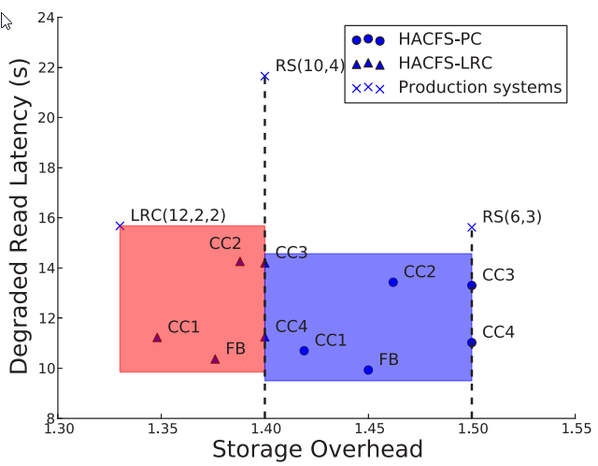
More Performance (Read Latency)
HACFS latency is better for any given overhead
Claims based on RS
Notes:
Red is higher percentage of Reads to hot data, encoded with fastcode
The really striking performance increases claimed are with respect to RS coding
We already know that LRC beats the pants off of RS

Slide 15
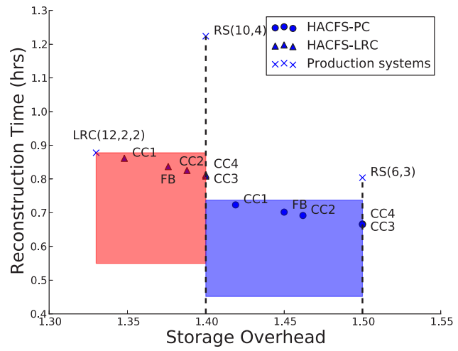
More Performance (Reconstruction)
Note about LRC
Cost of parity recovery larger than data recovery
Global reconstruction more expensive then RS
Reed-Soloman
Both versions of PC and LRC reconstruct faster than RS

Slide 16
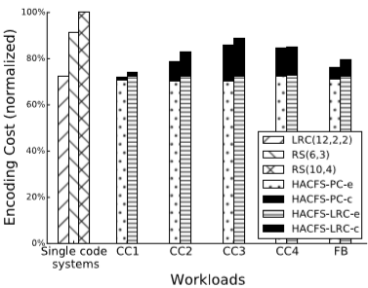
More Performance (Costs)
Similar construction costs to LRC
CC3 high % hot data and hot reads
Churn and lots of conversion
Clarification: (black) ‘c’ is for conversion,
(white) ‘e’ is for encoding
Notes:
NOT a performance metric cared about. So simply meeting others is good enough.

Slide 17
Related Work
Other systems have optimal overhead but poor recovery time (like RS)
Some systems achieve fast recovery time at the cost of encoding time
Tiered Storage Systems

Slide 18
Thoughts
It would have been nice to see:
PC and LRC vs HACFS-PC and HACFS-LRC
Latency vs overhead curves instead of points
A lot of things in paper needed more explanation and clarity

