Slide 1
Experiences from a Decade of TinyOS Development
Philip Levis
Stanford University
Presented by Tuo Yu
Notes:
As this title implies, this is actually not a typical research paper. Instead, this paper is a summary of experience.

Slide 2
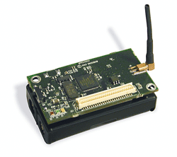
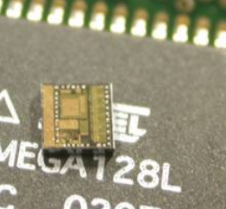
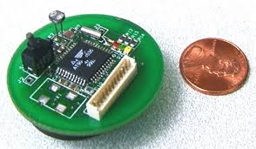
Sensor Nodes
A sensor node can:
- Gather sensory information
- Perform some processing
- Communicate with other connected nodes
A Sensor Node contains:
- Hardware
- Operating System
- Applications
[1] Indranil Gupta, “CS 525 Advanced Distributed Systems Spring 2016,” UIUC, 2016
Notes:
Before talking about TinyOS, let’s have a brief review about sensor nodes.
As we have learnt before, a sensor node is able to measure data, process data, and communicate with other nodes.
It usually consists of hardware, OS and upper-layer applications.

Slide 3
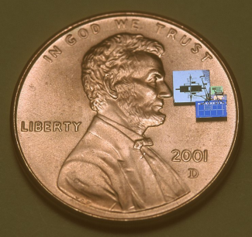
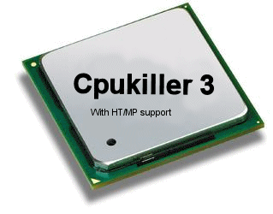
Sensor Nodes - Hardware
Features:
Small Size
- few mm to a few inches
Limited processing
- MHz clock, MB flash, KB RAM
Limited power
- Mica: 7-10 days at full blast
Failure prone nodes and links
[1] Indranil Gupta, “CS 525 Advanced Distributed Systems Spring 2016,” UIUC, 2016
Notes:
The features of a sensor node’s hardware are quite different from those of a normal computer.
While its size can be really small, its processing speed is limited. Only MHz clock is available, and the size of RAM is only several KB (kilobyte)
Another main problem is the limited battery capacity. Because of the restricted battery size, the sensor would work for only a few days. Some functions such as wireless transmission will significantly shortened the lifetime of the sensor.
Moreover, the sensor nodes are easy to fail, and due to the unstable wireless link, sometimes even the connection to the node would be unavailable.
---------------------------
Sensor(s) to convert a different energy form to an electrical impulse e.g., to measure temperature
Microprocessor
Communications link e.g., wireless
Power source e.g., battery

Slide 4
Sensor Nodes - OS
Main issues:
- Energy Efficiency
- Limited Resources (size of RAM/ROM)
- Difficult In-the-field Debugging
Notes:
So when we come to the OS layer, the designer need to handle these issues.
The system has to be Energy Efficient.
The resources such as RAM and Rom are limited
And it is difficult to debug the system in the field.
Currently TinyOS has done a good job handling these problems.

Slide 5
TinyOS
An operating system designed for embedded devices in sensor networks.
- Use a C dialect called nesC.
- Used in numerous commercial products.
Emerged from UC Berkeley in 2000
Approximately 35,000 downloads per year
Development transitioned into Arch Rock, Stanford, and Moteiv
Developing v2.2
v2.x
v1.x
Pre-1.0
v2.1.2 (Latest official version)
Notes:
Tiny OS firstly emerged from Berkeley in 2000. After four major revisions, it has been used in many platforms, and by 2012, TinyOS has around 25,000 downloads per year. The TinyOS developers chose to design and use a C dialect named nesC.
The paper was published in 2012 so the author didn’t mention that the latest official version is 2.1.2. It seems that the authors are developing 2.2 now.
it has evolved to use a C dialect
called nesC, has gone through four major revisions,
supports tens of sensor network platforms, and has approximately
25,000 downloads per year

Slide 6
Motivation
Examine how TinyOS evolved over the past decade.
Examine how technical and social decisions
encouraged or restricted the growth of TinyOS.
Summarize the lessons learned from the development of the TinyOS.
Notes:
Let’s come back to the paper. The motivation is to examine how TinyOS evolved over the past decade, and examine how technical and social decisions have impacted the growth of TinyOS.
For other developers, the author also summarize some lessons he learned during these years.

Slide 7
Basic Principles
Two Basic Principles Driving TinyOS:
Minimization Principle
Prevention Principle
Notes:
Driven by the unique issues of Sensor nodes’ hardware, the design of TinyOS mainly follows two principles: Minimization and Prevention.
Let’s look at these principles one by one.

Slide 8
Minimization Principle
Energy:
Using more hardware resources means consuming more power both when awake and when asleep.
Sensor
“Every bit transmitted brings a sensor node one moment closer to death.”[2]
Transmission
www.chrismadden.co.uk
[2] G. Pottie. Casting the Wireless Sensor Net. MIT Technology Review, July 2003.
Notes:
The Minimization Principle focuses on energy and cost.
For energy, as I have introduced before, using more hardware resources means consuming more power both when awake and when asleep.

Slide 9
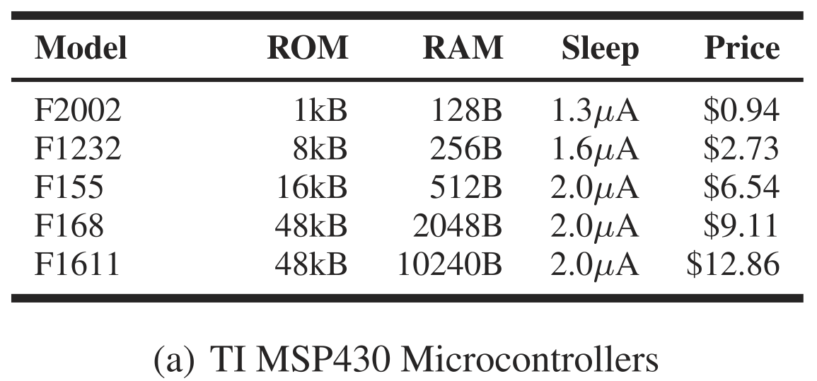
Minimization Principle
Energy:
- Since nodes sleep almost all of the time, even small sleep power draws are significant.
Dominated
platforms !
[3] Levis, Philip. "Experiences from a decade of TinyOS development." InPresented as part of the 10th USENIX Symposium on Operating Systems Design and Implementation (OSDI 12), pp. 207-220. 2012.
Notes:
We should note that, since nodes would keep sleeping almost all of the time, even small sleep power is significant. As shown in the table, the processor dominated platforms mainly because of its low sleep current.

Slide 10
Minimization Principle
Cost:
For large scale or commercial use, devices with lower performance but cheaper price are preferred.
RAM is generally the most limiting resource.
E.g. In mica/mica2, applications often hit RAM limits before ROM.
TinyOS software should use as few hardware resources as possible.
Notes:
One the other hand, for large scale use, users usually prefer cheaper nodes even if their performance is not outstanding.
In this case, RAM is generally the most limiting resource. Say, in mica, applications often hit RAM limits before ROM.
All these factors drive TinyOS to use as few hardware resources as possible.

Slide 11
Prevention Principle
In-the-field debugging of sensor networks is difficult.
- Traditional debugging techniques are precluded because of limited resources and energy.
- Sometimes per-node access is not supported.
- Unknown input.
Bugs should be prevented through software structure.
Notes:
The other principle is Prevention.
Generally speaking, the In-the-field debugging for sensor nodes is difficult.
For instance, due to the limited RAM and ROM, it is hard to keep extensive logging. Many sensor networks even do not support TCP connection or other per-node access.
Moreover, it is hard to debug a node since the input is unknown.
So the Prevention Principle means that Bugs should be prevented through software structure.

Slide 12
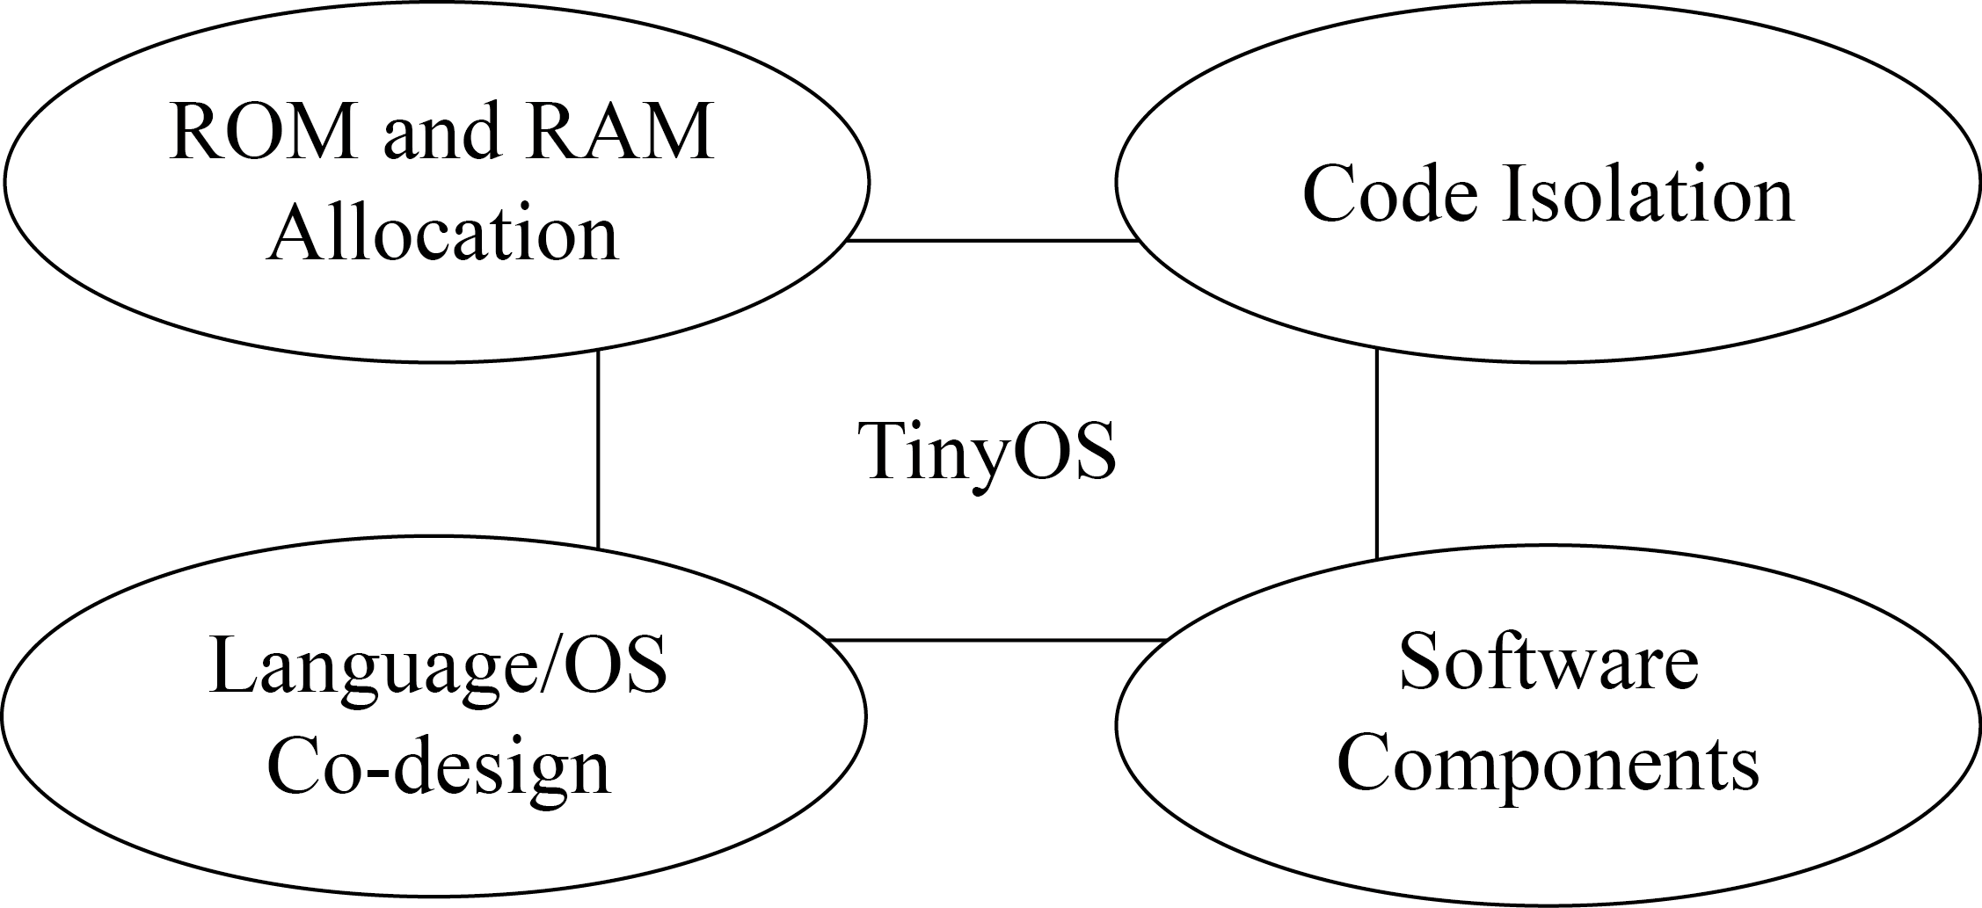
Solutions of TinyOS
“Push what are traditionally dynamic, run-time operations into static, compile-time ones.”
Approaches:
Notes:
Following these two principles, the designer proposed to Push what are traditionally dynamic, run-time operations into static, compile-time ones.
Doing so allows TinyOS to have near-optimal RAM overhead and enables large and dependable software systems.
The author introduced the approach of tinyOS in four aspects.
ROM and RAM Allocation
- Code Isolation
- Language/OS Co-design
- Software Components

Slide 13
ROM and RAM Allocation
Minimize ROM: inlining and dead code elimination.
Minimize RAM: make system calls require as little RAM state as possible.
TinyOS programs generally require a 10:1 ratio of ROM:RAM ratio.
Notes:
For ROM and RAM Allocation, TinyOS Minimizes ROM using the method of inlining and dead code elimination.
RAM occupation is minimized by making system calls require as little RAM state as possible.
In this way, ROM:RAM ratio required by TinyOS is around 10:1.

Slide 14
Example of Timer Service
Optimal timer structure size: 10 bytes for 32-bit timer.
TinyOS 1.0:
Allocate a fixed array of private timer structures.
Timer
array
. . .
?
?
?
Component 1
Component 2
Component 3
Notes:
In TinyOS 1.0, a fixed array of private timer structures is allocated.
So how the components access the array?

Slide 15
Example of Timer Service
TinyOS 1.0:
unsigned int unique(char *identifier)
- Identifier: given string, such as “Timer”, ”A”.
- Return: a unique integer in 0 to n−1
n: number of times unique is invoked with the string.
- The compiler evaluates unique at compile time.
Notes:
A function named unique is used to help distinguish different timers.
The input to this function is a string. For example, the string timer. Each time unique is invoked with the string “timer”,
it returns a unique integer in the range of 0 to n−1, where n is the number of times unique is invoked with the string timer.
The compiler evaluates unique at compile time, so that the value of n can be determined.
HilTimerMilliC组件中声明了这一句：
provides interface Timer[uint8_t id];
表明它可以提供256 个Timer 接口的不同实例，每一个实例对应一个uint8_t 值！
简化：直接说提前计算、分配所需空间

Slide 16
Example of Timer Service
A0 = unique("A");
A1 = unique("A");
A2 = unique("A");
B0 = unique("B");
B1 = unique("B");
B2 = unique("B");
B3 = unique("B");
A0 = 1;
A1 = 0;
A2 = 2;
B0 = 2;
B1 = 3;
B2 = 1;
B3 = 0;
(n=3)
Compile time
(n=4)
Notes:
Let’s look at an example.
Say two sets of values are set to be equal to the return value of unique with string A and B.
At compile time, these values will be replaced by random but unique numbers.
For instance, the unique is invoked with string A by 3 times, therefore n is 3, and the return value ranges from 0 to 2.
For A0 to A2, each value can get a unique random number.

Slide 17
Example of Timer Service
TinyOS 1.0:
- A component allocates a key with unique and passed this key in all calls to the timer system.
Timer
array
. . .
Unique(“A”)
Returns Key=1
Unique(“A”)
Returns Key=0
Unique(“A”)
Returns Key=2
Component 1
Component 2
Component 3
Notes:
Therefore, A component can allocate a key with unique and passed this key in all calls to the timer system.
As shown in this example, all the three applications can get a unique timer with the keys returned by the function unique.
However, to prevent overflow, the timer array is made safely large, which wastes more RAM.

Slide 18
Example of Timer Service
TinyOS 1.0:
- Programs made the timer array safely large so that the array is not pasted. Stable but waste more RAM.
Timer
array
. . .
Safely large !
Notes:
Therefore, A component can allocate a key with unique and passed this key in all calls to the timer system.
As shown in this example, all the three applications can get a unique timer with the function unique.
However, to prevent overflow, the timer array is made safely large, which wastes more RAM.

Slide 19
Example of Timer Service
TinyOS 1.1:
unsigned int uniqueCount(char *identifier)
- Identifier: given string s, such as “Timer”, “A”.
- Return: the number of calls to unique with the string.
A0 = unique(“A");
A1 = unique(“A");
A2 = unique(“A");
AC = uniqueCount (“A");
Compile time
A0 = 2;
A1 = 0;
A2 = 1;
AC = 3;
Notes:
In tinyOS 1.1, this problem is nearly perfectly solved.
A new function named uniqueCount is used. It returns the number of calls to unique with the given string.
For instance, if unique is invoked by three times with string “time”, then the return value of uniquecount is 3.

Slide 20
Example of Timer Service
TinyOS 1.1:
- The timer service can declare an array of timer state:
timer_state_t timers[uniqueCount(“A")];
- Elide run-time array boundary checks, reducing code size.
- Achieve optimal timer size: 10 bytes for each timer.
uniqueCount(“A")
Size determined in compile time !
Timer array
Component 1
Component 2
Component 3
Notes:
Therefore, The timer service can determine the size of the timer array with the help of unqiuecount.
So the components can access the array with the unique values safely.
In this way, the code for run-time array boundary checks can be elided, and the optimal timer structure size is achieved.

Slide 21
Isolation
TinyOS 1.x:
In many cases multiple components share a single memory resource (TinyOS 1.1).
Components
Post task/request
Fixed-size task/transmission queue
Notes:
The second approach is the isolation.
The isolation here means that each component’s interactions to an underlying shared resource should be completely independent.
In the early version of tinyOS, In many cases multiple components share a single memory resource.
For instance, multiple components would share the same transmission queue. The request are send to the queue independently.

Slide 22
Isolation
TinyOS 1.x:
In many cases multiple components share a single memory resource (TinyOS 1.1).
Usually need to re-invoke the component to repost the task/request.
Components
FULL!
Fixed-size task/transmission queue
Fail
- Global, shared memory pools are too dangerous for robust software and violate the bug prevention principle.
Notes:
However, once the queue is full, the new transmission request fails. To repost the request, the component usually need to be re-invoked.
This problem would even lead to unidentifiable [,ʌnaɪ'dɛntɪfaɪəbl] bugs, which are really frustrating in the platforms where debugging is not easy.
The author concludes that Global, shared memory pools are too dangerous for robust software and violated the bug prevention principle.

Slide 23
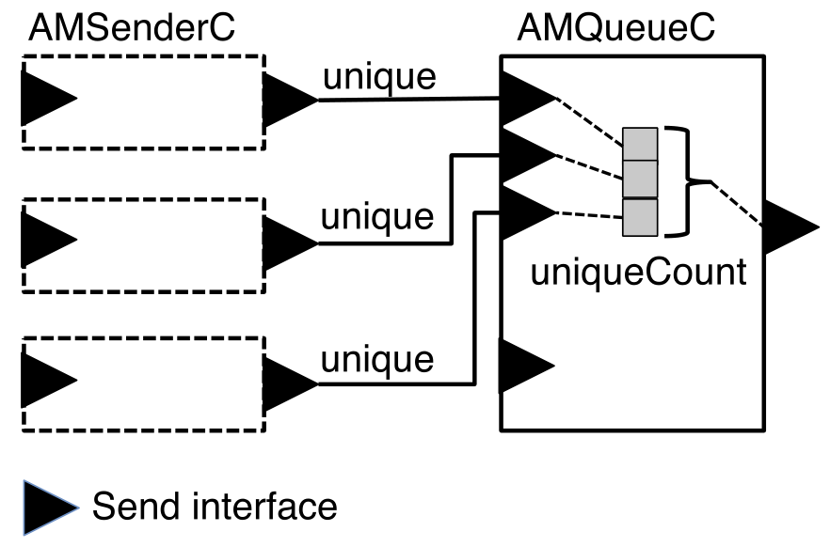
Isolation
TinyOS 2.x:
Accomplish “Static Virtualization” at compile-time.
Programs
Accept !
Need retry !
Need retry !
Make each component’s interactions to an underlying shared resource completely independent.
When a component tries to send a packet, the queue checks if the corresponding client’s entry in the queue is occupied.
Notes:
Let’s take an example of packets transmission.
To send a link layer packet, a program needs to instantiate an AMSenderC component. Through which the request is sent to the AMQueueC.
The queue checks if the corresponding program’s entry in the queue is occupied. If not, it accepts the packet for transmission;
if so, it tells the caller to retry.
Therefore, each component’s interactions to an underlying shared resource are completely independent.

Slide 24
Language/OS Co-design
NesC
- A C dialect, co-evolved with TinyOS.
Two-edged sword:
Gave the project tremendous flexibility to achieve system design goals (minimization and prevention).
Each stage of this evolution moves nesC further from C and raises the barrier to entry.
- Some hobbyists and researchers began to use Arduino and Contiki, which are simpler and easier to use.
Notes:
The third approach is the Language/OS Co-design, which means that NesC co-evolved with TinyOS.
Language evolution is actually a two-edged sword.
The advantage is that, it is much easier for OS developer to achieve the design goals, say, minimization and prevention.
The drawback is that, the evolution of nesC makes it harder and harder for new developers to understand, which raises the barrier to entry.
Say, it added a lot of new features such as Static Virtualization and components, which enlarged the gap between NesC and C language.
One consequence is that more and more users are attracted by other products such as Arduino and Contiki, which are easier for beginners to use.

Slide 25
Lessons Learned (Good)
Good language extensions (NesC)
Lessons Learned (Bad)
NesC raises the barrier to entry
Notes:
The author summarized the lessons that can be learned during the evolution of tinyOS.
There are good lessons and bad lessons.
For the good ones,
NesC has benefited the development of TinyOS by providing more flexibility.
Software Components provided clean, reusable interfaces, as well as good data privacy.
It is really helpful to promote your software among other research groups who might find the system useful.
Commercial participants contribute a lot when they join the community later.
Writing documentation is worth the long-term time savings in answering questions.

Slide 26
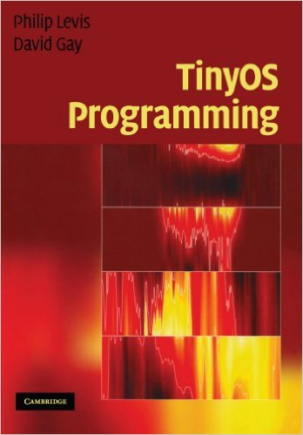
Language/OS Co-design
NesC
- A C dialect, co-evolved with TinyOS.
Update:
Current version of TinyOS includes a threads library which allows programmers to write applications in C, rather than nesC, reducing the barrier to entry.
The core OS is still in nesC.
(http://tinyos.stanford.edu/tinyos-wiki/)

Slide 27
Software Components
Component
- A module specifying a set of methods and internal storage, OR
- A configuration, a set of other components wired by specified methods.[1]
- Provide data privacy.
- Allow code re-use.
Fine-grained components
- Small component is easy to verify and debug.
- Easy to extend or modify in a small way.
[1] Indranil Gupta, “CS 525 Advanced Distributed Systems Spring 2016,” UIUC, 2016
Notes:
One key design in TinyOS is the concept of Components.
As what we have learned in this class before, A Component is either a module ['mɑdʒul] specifying a set of methods and internal storage, or A configuration which is a set of components wired by specified methods.
The use of components Provides data privacy and Allows code re-use.
Previously, the designer of TinyOS prefer to use Fine-grained components, because they are easy to verify and debug, and can be extended by modifying small piece of codes.
(~like a Java static class).

Slide 28
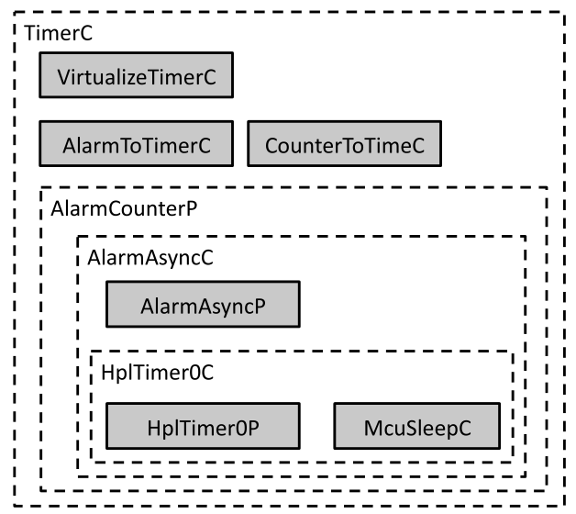
Software Components
Drawbacks of fine-grained components
- So many tiny pieces of functionality spread across files.
- Hard to track and understand.
Notes:
However, the designers did not foresee the drawbacks of fine-grained components. As illustrated in this figure, the functions of TimerC are spread across a lot of tiny files, which makes it hard to track and understand the way that this component works.

Slide 29
Lessons Learned (Good)
Good language extensions (NesC)
Good software components design
Lessons Learned (Bad)
NesC raises the barrier to entry
Fine-grained components increase structural complexity
Notes:
The author summarized the lessons that can be learned during the evolution of tinyOS.
There are good lessons and bad lessons.
For the good ones,
NesC has benefited the development of TinyOS by providing more flexibility.
Software Components provided clean, reusable interfaces, as well as good data privacy.
It is really helpful to promote your software among other research groups who might find the system useful.
Commercial participants contribute a lot when they join the community later.
Writing documentation is worth the long-term time savings in answering questions.

Slide 30
Community Structure
v2.x
v1.x
Pre-1.0
Expanding globally
TU Berlin, Stanford, Moteiv,
Arch Rock, Crossbow,
Rincon Research, Handhelds.
org, Zolertia, Shockfish
Building a community
DARPA NEST project,
UC Berkeley, Intel Labs Berkeley,
TU Berlin, Crossbow, Inc.,
Vanderbilt, UCLA, Harvard.
Research project
UC Berkeley students
Visit students from
UCLA and USC
Notes:
In this paper the author also discussed about the Community Structure of TinyOs.
In this figure we can find that the evolution of the community contains threes stages. Before the first offical version is released, the community mainly consists of college students. In the second stage, some companies joined the community. In the third stage, some early participants left the group. However, more and more companies started to take part in. The community is expanding globally.
Three stage

Slide 31
Community Structure
Industry vs Academia
Industrial contributions constitute some of the most critical components of TinyOS.
Irreconcilable tension
- Academia: modify existing codes and establish a design which would minimize future maintenance.
- Industry: settle on a “good enough” platform quickly and move on to sell higher-level services.
- Some companies dropped out of participation.
Notes:
One interesting topic during this evolution is the relationship between Industry and Academia [,ækə'dimɪə].
Indeed, the industrial members contributed some of the most critical components of TinyOS.
However, since the development timescale of startups is quite different from that of unversities, Irreconcilable [ɪ'rɛkənsaɪləbl] tension always exists.
For instance, the developers in universities would like to modify existing codes and establish a design which would minimize future maintenance ['mentənəns].
Meanwhile, the startups want to settle on a “good enough” platform quickly and move on to sell higher-level services.
As a result, some of the companies dropped out within nine months.

Slide 32
Lessons Learned (Good)
Good language extensions (NesC)
Good software components design
Late industrial involvement
Lessons Learned (Bad)
NesC raises the barrier to entry
Fine-grained components increase structural complexity
Timescale mismatch during early industrial involvement
Notes:
The author summarized the lessons that can be learned during the evolution of tinyOS.
There are good lessons and bad lessons.
For the good ones,
NesC has benefited the development of TinyOS by providing more flexibility.
Software Components provided clean, reusable interfaces, as well as good data privacy.
It is really helpful to promote your software among other research groups who might find the system useful.
Commercial participants contribute a lot when they join the community later.
Writing documentation is worth the long-term time savings in answering questions.

Slide 33
Lessons Learned (Good)
Good language extensions (NesC)
Good software components design
Late industrial involvement
Promote software to Initial Users
Write diverse documentation
Lessons Learned (Bad)
NesC raises the barrier to entry
Fine-grained components increase structural complexity
Timescale mismatch during early industrial involvement
Project mainly focuses on experts
Only Developer Documentation
Notes:
The author summarized the lessons that can be learned during the evolution of tinyOS.
There are good lessons and bad lessons.
For the good ones,
NesC has benefited the development of TinyOS by providing more flexibility.
Software Components provided clean, reusable interfaces, as well as good data privacy.
It is really helpful to promote your software among other research groups who might find the system useful.
Commercial participants contribute a lot when they join the community later.
Writing documentation is worth the long-term time savings in answering questions.

Slide 34
Conclusion
- Some decisions that seemed sound at the time had significant negative long-term implications.
- The ability for universities to transition research into practical, real-world impact and benefits will remain important and valuable.
- The lessons we learned may help others in the future.
Notes:
In conclusion,
Some decisions that seemed sound at the time had significant negative long-term implications that are hard to foresee.
However, The ability for universities to transition research into practical, real-world products is still important and valuable.
The author also wishes that lessons he have learned may help others developers in the future.

Slide 35
Thank you

