Slide 1
E-Store: Fine-Grained Elastic Partitioning for Distributed Transaction Processing Systems
Jihui Yang
CS525 Advanced Distributed System
March 1, 2016
Notes:
ECE Main Slide

Slide 2
Online transaction processing system
OLTP system is a popular data processing system in today's enterprises. Some examples of OLTP systems include order entry, retail sales, and financial transaction systems
In large applications, efficient OLTP may depend on sophisticated transaction management software and/or database optimization tactics to facilitate the processing of large numbers of concurrent updates to an OLTP-oriented database.

Slide 3
Challenges OLTP faces
Many Online transaction processing(OLTP) applications are subject to unpredictable variations in demand.
Important for a back-end Database management system(DBMS) be resilient to load spikes.
Several different workload skew that each require different solutions: Hot Spots, Time-Varying Skew, Load Spikes, The Hockey Stick Effect.
Need to adapt to unanticipated changes in an application’s workload while continuing to guarantee ACID

Slide 4
E-store
Previous work: only been able to migrate large chunks of data
A comprehensive framework that Instead of monitoring and migrating data at the granularity of pre-defined chunks, E-Store dynamically alters chunks by extracting their hot tuples, which are considered as separate “singleton” chunks.
monitor tool for identification
tuple-level access patterns monitoring
two-tier data placement scheme
integrated H-Store DBMS

Slide 5
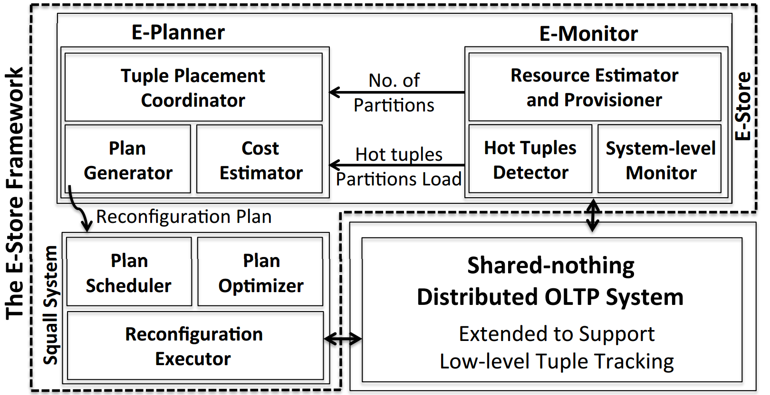
E-Store Framework

Slide 6
E-Monitor: Adaptive partition monitoring
Problem:
1.examine transactions’ access patterns based on recent log activity → delay
2. monitor the usage of individual tuples in every transaction → expensive
Solution: a two-phase monitoring strategy

Slide 7
E-Monitor: Adaptive partition monitoring
Phase 1: Collecting System Level Metrics
Retrieve node utilization from last 60 sec.
Pre-set watermark triggers tuple-level monitoring.
Phase 2: Tuple-Level Monitoring
Find top-k most frequently accessed tuples within time t
Generate a global top-k list. This list is used to build a reconfiguration plan

Slide 8
E-Planner: Provisioning algorithms
Scaling Cluster Size Up/Down?
Two-Tiered Bin Packing
One-Tiered Bin Packing
Both use an integer programming model to generate optimal assignment of tuples to partitions. Time consuming, not practical for real-world deployments

Slide 9
E-Planner: Provisioning algorithms
Scaling Cluster Size Up/Down?
Greedy
First Fit
Greedy Extended
Reasonably high quality partition plans in a much shorter timeframe

Slide 10
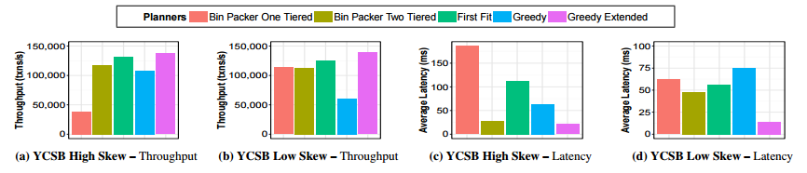
Throughput and Latency

Slide 11
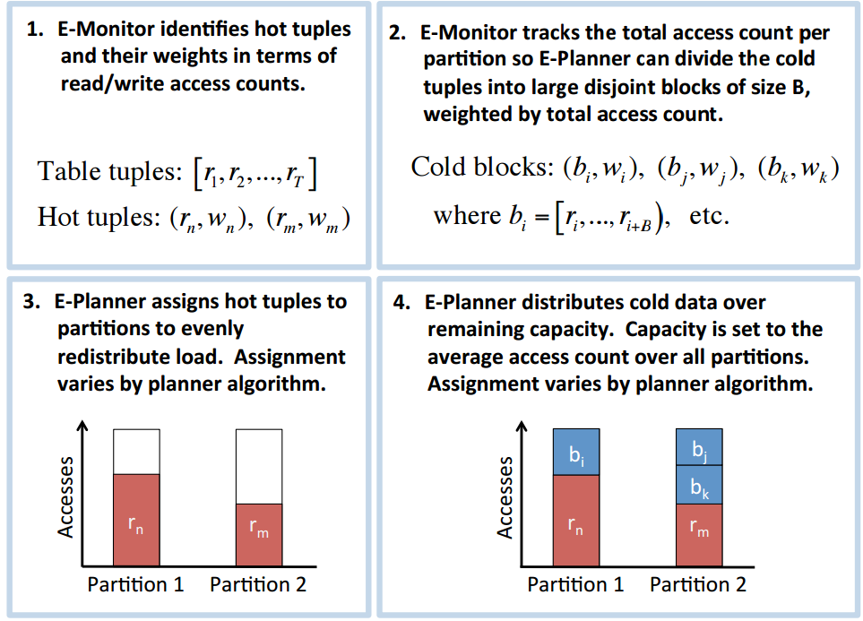
Squall—Data Migration

Slide 12
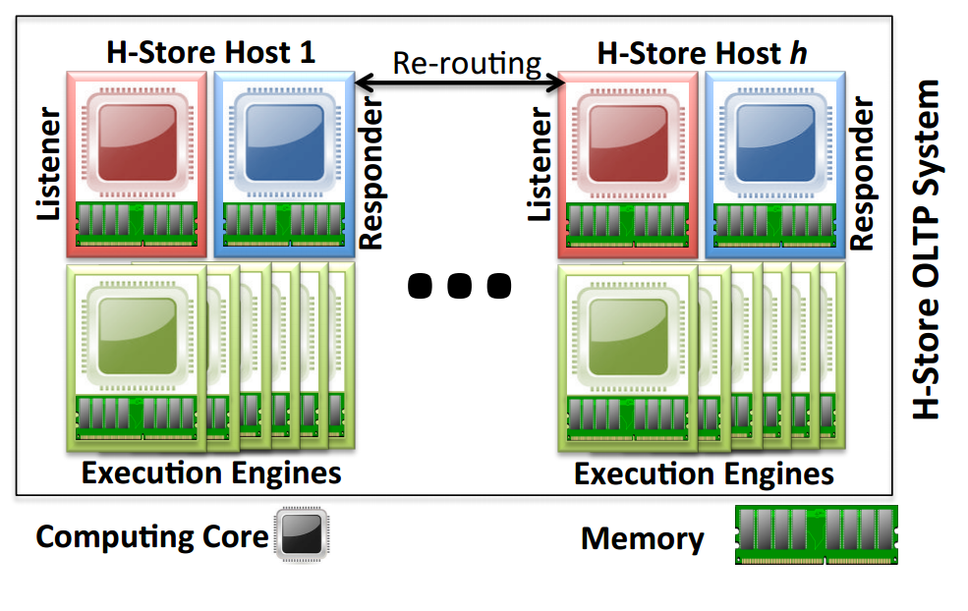
H-Store: a distributed, main-memory DBMS

Slide 13
H-Store
Horizontally partitioned tables, where the tuples of each table are allocated without redundancy to the various nodes managed by H-Store
A client application initiates a transaction by sending a request to any node. Each transaction is routed to one or more partitions and their corresponding servers that contain the data accessed by a transaction.
E-Store assumes all non-replicated tables of an OLTP database form a tree-schema based on foreign key relationships. Although this rules out graph-structured schemas and m-n relationships, it applies to many real-world OLTP applications

Slide 14
Conclusion
E-Store is designed to maintain system performance over a highly variable and diverse load.
E-Monitor identifies load imbalances and tracks for a short time window the most-read or -written “hot” tuples.
E-Planner chooses which data to move and where to place it and generates the reconfiguration plan.
E-Store claims that its elasticity techniques are generic and is adaptable to other shared-nothing DBMSs

Slide 15
Future Thoughts
E-Store designer only talks about CPU utilization. However, reprovisioning algorithm currently do not take the amount of main memory into account when producing reconfiguration plans, and this is left as future work.
Authors claim E-Store is adaptable to other DBMSs, it will be convince only when E-Store is tested on other DBMSs to see if it can achieve high throughput and low latency

Slide 16
  Thank you!
  Any questions?

