Slide 1
Managed Communication and Consistency for Fast Data-Parallel Iterative Analytics
Jinliang Wei Wei Dai Aurick Qiao Qirong Ho Henggang Cui
Gregory R. Ganger Phillip B. Gibbons Garth A. Gibson Eric P. Xing
CMU, Infocomm Research, A*STAR, Intel Labs
Presenter: Xuewei Zhang

Slide 2
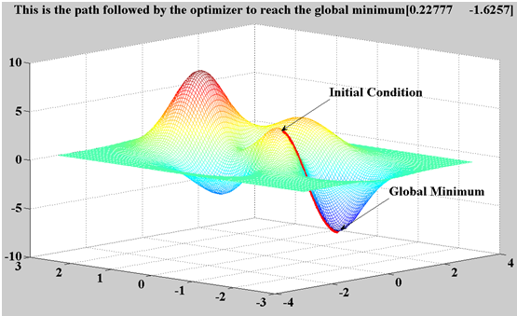
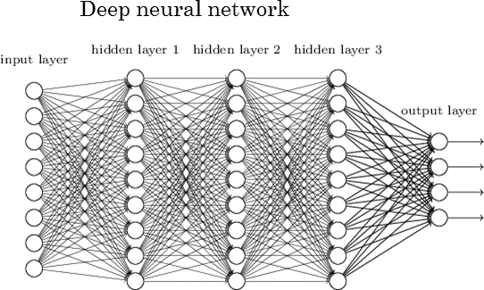
Iteratively Refined Machine Learning Model
Expert-suggested model
Iteratively refining parameters
Stochastic gradient descent
http://bleedingedgemachine.blogspot.com/2012/12/gradient-descent.html
http://www.rsipvision.com/exploring-deep-learning/

Slide 3
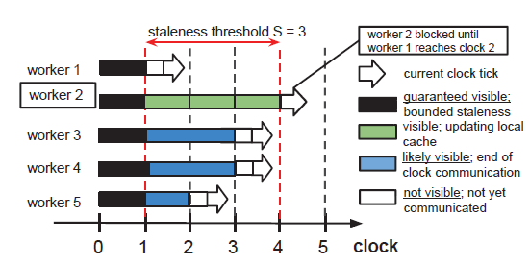
Data Parallelism and Consistency
Data Parallelism
Partition training data across machines
Shared access to model parameters
Bulk Synchronous Parallelization:
MapReduce-like, barrier before each iteration
Total Asynchronous Parallelization:
Out-of-sync
Bounded Staleness Parallelization:
Staleness bounded by threshold

Slide 4
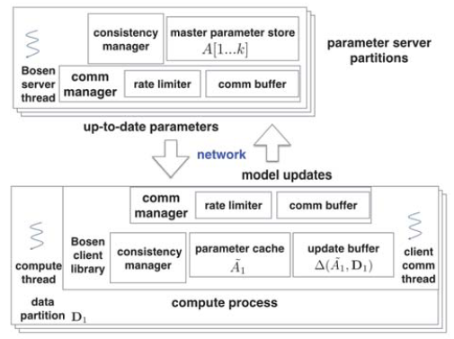
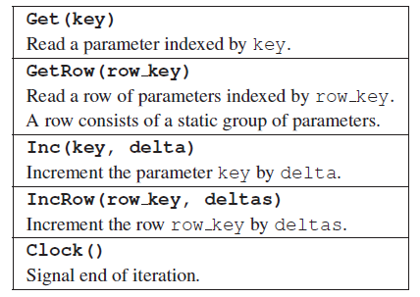
Parameter Server and Bosen API

Slide 5
System Architecture
master copy
worker
threads
communication
threads
parameter cache
hash
partition
concurrent
update buffer
Client
Server

Slide 6
Get()
master copy
worker
threads
communication
threads
parameter cache
push callback queue
pop callback queue
update buffer
Client
Server

Slide 7
Inc()
master copy
worker
threads
communication
threads
parameter cache
update buffer
Client
Server

Slide 8
Clock()
master copy
client
client
clock(iteration t uploaded)
client
client
client
Clients
Server

Slide 9
Clock()
master copy
client
client
clock(iteration, patition downloaded)
client
client
client
Clients
Server

Slide 10
Fault Tolerant
Checkpointing at server
Slow, only do checkpoint after time
Estimation: Ts ~ 20s, Tf ~ 1 year, N ~ 50
Output: 1.4h

Slide 11
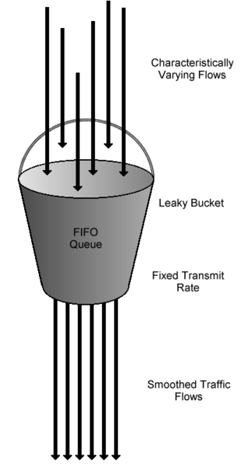
Managed Communication
Band-width driven: leaky bucket model
Network fluctuation
16-bit float
Update Prioritization for rows
Randomized
Round-Robin
Absolute Magnitude
Relative Magnitude
https://en.wikipedia.org/wiki/Leaky_bucket

Slide 12
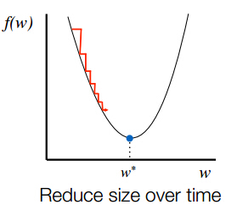
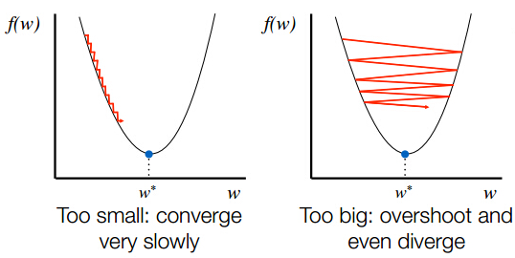
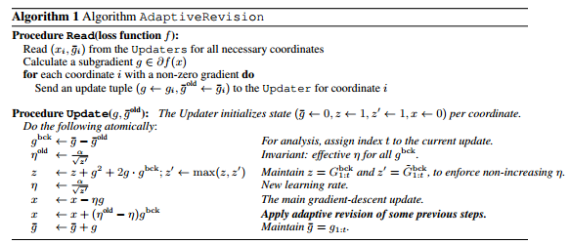
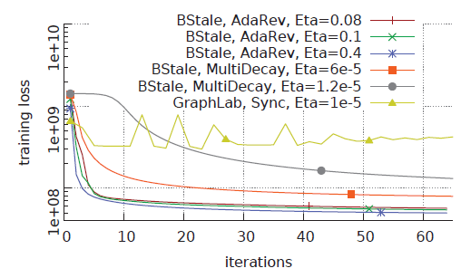
Adaptive Step Size Tuning
Requirement:
1. Iteration ↑ step size↓
2. Delay ↑ step size↓
Adaptive Revision
1. Gradient Change ↑ step size↓
2. Delay ↑ step size↓
3. Iteration ↑ step size↓
Parameter versioning
reduce message load
User-defined stored procedure
apply weight over delay
http://blog.csdn.net/google19890102/article/details/50276775

Slide 13
Evaluation
ML programs:
Matrix Factorization
Multiclass Logistic Regression
Topic Modeling (LDA)
Cluster setup:
PRObE Nome, 16 cores on each machine, 32GB, 1Gb Ether, 20 GB Infiniband
PRObE Susitna, 64 cores on each machine, 128GB, 1GbE, 40GbE

Slide 14
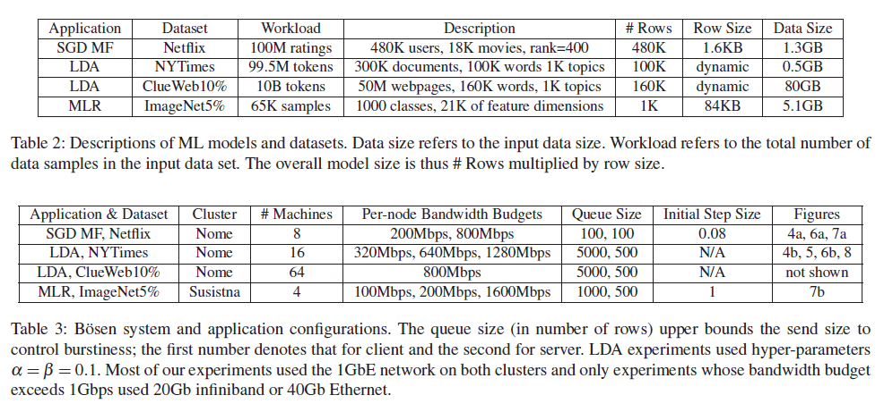
Evaluation

Slide 15
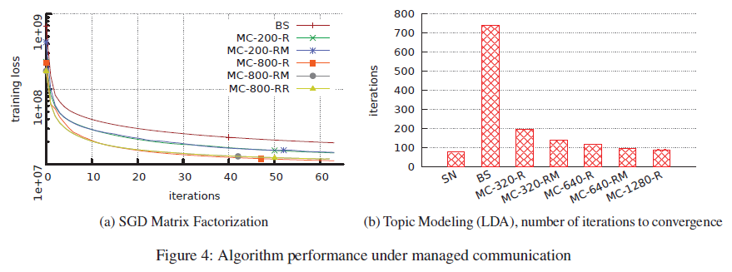
Evaluation
Bandwidth
Prioritization

Slide 16
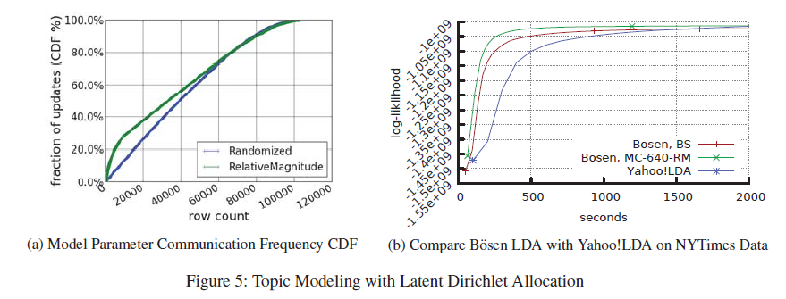
Evaluation
Priority changes frequency
Comparison between TAP

Slide 17
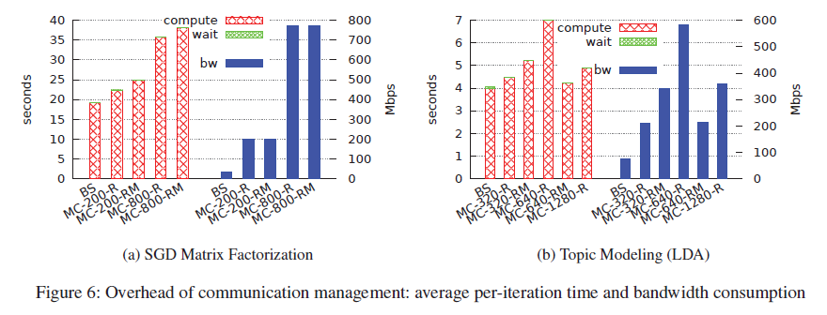
Evaluation
Time/Iteration vs Config
Bandwith vs Config

Slide 18
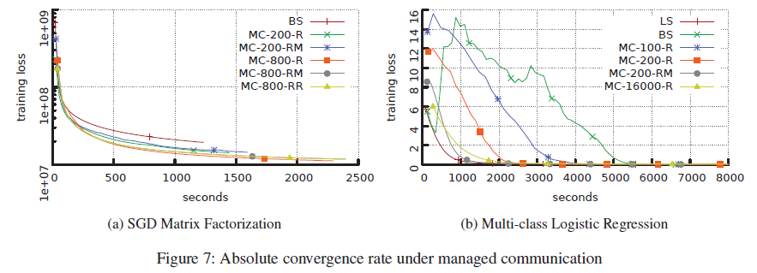
Evaluation
Time vs Config
Randomized:
Convergence TIme:
2.5X, 2.8X
Iteration:
5.3X, 6.1X
Prioritized:
+25%

Slide 19
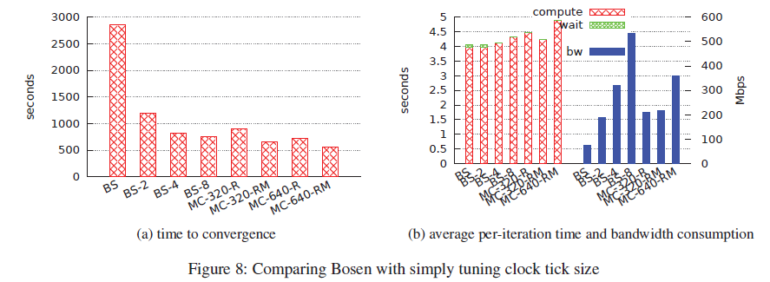
Evaluation
Mini-Batch

