Slide 1
CalvinFS: Consistent WAN Replication and Scalable Metdata Management for Distributed File Systems
Thomas Kao

Slide 2
Background
Scalable solutions provided for data storage, why not file systems?

Slide 3
Motivation
Often bottlenecked by the metadata management layer
Availability susceptible to data center outages
Still provides expected file system semantics

Slide 4
Key Contributions
Distributed database system for scalable metadata management
Strongly consistent geo-replication of file system state

Slide 5
Calvin: Log
Many front end servers
Asynchronously-replicated distributed block store
Small number of “meta-data” log servers
Transaction requests are replicated and appended, in order, by the “meta log”

Slide 6
Calvin: Storage Layer
Knowledge of physical data store organization and actual transaction semantics
Read/write primitives that execute on one node
Placement manager
Multiversion key-value store at each node, plus consistent hashing mechanism

Slide 7
Calvin: Scheduler
Drives local transaction execution
Fully examines transaction before execution
Deterministic locking
Transaction protocol:
No distributed commit protocol
Perform all local reads
Serve remote reads
Collect remote read results
Execute transaction to completion

Slide 8
CalvinFS Architecture
Design Principles:
Main-memory metadata store
Potentially many small files
Scalable read/write throughput
Tolerate slow writes
Linearizable and snapshot reads
Hash-partitioned metadata
Optimize for single-file operations
Components
Block store
Calvin database
Client library

Slide 9
CalvinFS Block Store
Variable-size immutable blocks
1 byte to 10 megabytes
Block storage and placement
Unique ID
Block “buckets”
Global Paxos-replicated config file
Compacts small blocks

Slide 10
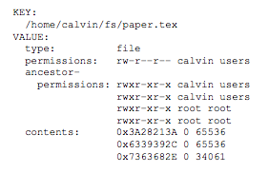
CalvinFS Metadata Management
Key-value store
Key: absolute path of file/directory
Value: entry type, permissions, contents

Slide 11
Metadata Storage Layer
Six transaction types:
Read(path)
Create{File, Dir}(path)
Resize(path, size)
Write(path, file_offset, source, source_offset, num_bytes)
Delete(path)
Edit permissions(path, permissions)

Slide 12
Recursive Operations on Directories
Use OLLP
Analyze phase
Determines affected entries and read/write set
Run phase
Check that read/write set has not grown

Slide 13
Performance: File Counts and Memory Usage
10 million files of varying size per machine
Far less memory used per machine
Handles many more files than HDFS

Slide 14
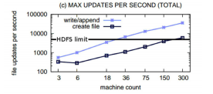
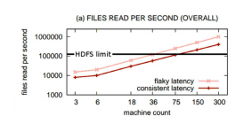
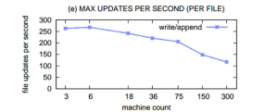
Performance: Throughput
Linear scalability
Sub-linear scalability
Linear scalability

Slide 15
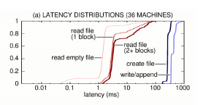
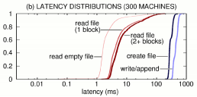
Performance: Latency
Write/append latency dominated by WAN replication

Slide 16
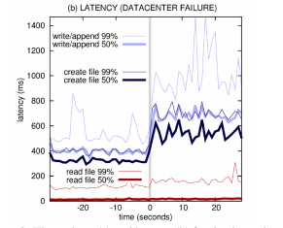
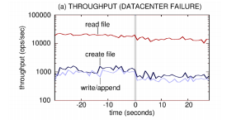
Performance: Fault Tolerance
Able to tolerate outages with little to no hit to availability

Slide 17
Discussion
Pros
Fast metadata management
Deployments are scalable on large clusters
Huge storage capabilities
High throughput of reads and updates
Resistant to datacenter outages
Cons
File creation is distributed transaction, doesn’t scale well
Metadata operations have to recursively modify all entries in affected subtree
File-fragmentation addressed using mechanism that entirely rewrites files

Slide 18
Discussion
Questions
Unlimited number of files?
What about larger files?

