Slide 1
CubicRing
Enabling One-Hop Failure Detection and Recovery for Distributed In-Memory Storage Systems
Yiming Zhang, Chuanxiong Guo, Dongsheng Li, Rui Chu, Haitao Wu, Yongqiang Xiong
Presented by Kirill Varshavskiy
Notes:
CubicRing paper authored by individuals from Microsoft Research Asia.
NSDI 15

Slide 2
Current Systems
Low latency, large scale storage systems with recovery techniques
All data is kept in RAM, backups are on designated backup servers
RAMCloud
  All primary data is kept in RAM, redundant backup on disks
  Backup servers selected randomly for ideal distribution
CMEM
  Creates storage clusters, elastic memory
  One synchronous backup server
Notes:
- Distributed In memory systems
Facebook, gaming, fast retrieval
Modern systems RAM based
A lot of RAM
Failure is common, has to recover quick
RAMCloud Random
CMEM Synchronous Backup

Slide 3
Current System drawbacks
Effective but with several important flaws
Recovery traffic congestion
  On server failure, recovery surges cause
  in-network congestion
False failure detection
  Transient network failures associated with large RTT for heartbeats may cause false positives which start unnecessary recoveries
ToR switch failures
  Top of the Rack (ToR) switches may fail taking out working servers
Data Center
P
Notes:
Recovery storm causes in-network congestion, hot spots
Transient network failures, dropped heartbeats
ToR switch fails, take out working servers, TBs of recovery

Slide 4
Intuition behind the paper
Reducing distance to backup servers improves reliability
One hop communication insures low latency recovery over high speed InfiniBand (or Ethernet) communication
Having a designated recovery mapping provides a coordinated, parallelized recovery
Robustness in heartbeating can prevent false positives
Efficient backup techniques should not significantly impact availability
Notes:
Highly interconnected, low latency
One hop is pretty low latency
Avoid ToR switch fails, interconnect to other switches

Slide 5
Recovery plans
Primary-Recovery-Backup
  Primary servers: keep all data in RAM
  Backup servers: writing backup to disk
  Recovery servers: server to which backups
  will recover a failed primary server
Recovery server stores backup mappings
Each server takes on all three roles in different rings
Data Center
P
P
R
R
B
B
Notes:
Primary, keep data in RAM
Backup, write data to disk
Write and acks
Recovery, healthy server taking on primary role, stores backup mappings
All servers take on all three roles
Problem with RAMCloud – datacenter latency
Tree structure is better

Slide 6
CubicRing: Everything is a hop away
Primary ring, Recovery ring, Backup ring
One hop is a trip from source server to the end server via a designated switch
BCube creates an interconnected system of servers where each server can reach any other in k+1 hops (one more hop than the cube dimension)
Using BCube, all recovery servers are one hop away from the primary server
  Recovery servers are all n-1 servers in level 0 BCube container
  + all immediate switch connections to other BCube containers
All backup servers are one hop from the recovery servers
Notes:
Trip through switch is one hop
Primary to Recovery to Backup, one hop each
CubicRing is underlying system of three rings

Slide 7
Primary Ring
21
22
20
23
13
30
(K,V)
12
31
11
32
10
33
00
03
01
02
Notes:
- Key Value keyspace is split among all primaries
Maintained by global coordinator of MemCube, KV store on top of cubicRing
16 servers

Slide 8
Cubic Ring, Bcube(4,1)
1,0 switch
1,1 switch
1,2 switch
1,3 switch
0,0 switch
0,1 switch
0,2 switch
0,3 switch
00
01
02
03
10
11
12
13
20
21
22
23
30
31
32
33
Notes:
Bcube architecture for 16 servers
Server 12 is primary

Slide 9
Recovery Ring
10
32
02
12
11
22
13
1,0 switch
1,1 switch
1,2 switch
1,3 switch
0,0 switch
0,1 switch
0,2 switch
0,3 switch
00
01
02
03
10
11
12
13
20
21
22
23
30
31
32
33
Notes:
All servers one hop away from 12 are recovery
Create a recovery ring
Primary heartbeats all recoveries

Slide 10
Backup Ring
10
00
01
32
02
12
03
11
22
13
1,0 switch
1,1 switch
1,2 switch
1,3 switch
0,0 switch
0,1 switch
0,2 switch
0,3 switch
00
01
02
03
10
11
12
13
20
21
22
23
30
31
32
33
Notes:
Backups are one hop from recovery

Slide 11
Backup Server Recovery
Traffic
10
00
01
32
02
12
03
11
22
13
1,0 switch
1,1 switch
1,2 switch
1,3 switch
0,0 switch
0,1 switch
0,2 switch
0,3 switch
00
01
02
03
10
11
12
13
20
21
22
23
30
31
32
33
Notes:
Every backup is connected to two recoveries in the tree
Uses all links to push data up
16 primary, 6 recovery, 9 backup

Slide 12
Data Storage Redundancy
Key-Value store using a global coordinator (MemCube)
Global coordinator maintains key space to server mapping in the primary ring
Each primary server maps data subspaces to recovery
servers and recovery servers map their cached sub space
to their backup ring
Every primary server has f backups, one of which is the
dominant copy, used first for backup
Backups are distributed along different failure domains
10
00
01
32
02
12
03
11
22
13
Notes:
When writing to MemCube, primary writes, backup writes to buffer, returns
Primary maps keyspace to recovery cache, so recovery knows where to get backup
Lots of backup servers, f total backups
Dominant used first
n^(k+1) primaries, (n-1)(k+1) recoveries, (n-1)k backups per recovery, each backup on two backup rings, total backups per primary: ( (n-1)^2 k (k+1) ) / 2

Slide 13
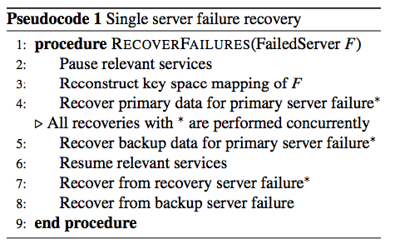
Single Server Failure Recovery
Primary servers heartbeat to recovery servers
  If heartbeat is not received, global coordinator
  pings primary through all other BCube switches,
  failure only if all of the pings failed
  Minimizes false positives due to network failures
  – all paths are one hop
Recover failed server’s roles simultaneously
Can tolerate as least as many failures as there
are servers in the recovery ring
1,0 switch
1,1 switch
1,2 switch
1,3 switch
0,0 switch
0,1 switch
0,2 switch
0,3 switch
00
01
02
03
10
11
12
13
20
21
22
23
30
31
32
33
Notes:
Pause primary keyspace write/read
Concurrently, all three roles of failed server are recovered
Primary functionality first priority, backup/recovery cache can be buffered
Dominant backup concurrently surges data to its recovery, all recoveries surge to one recovery

Slide 14
Recovery Flow
Heartbeats carry bandwidth limits which can be used to determine stragglers and prevent stragglers from being very active in a recovery scenario
Recovery payload is split between recovery servers and their backups, all traffic travels through different links to prevent in-network congestion
All servers overprovision RAM in case of a recovery
(discussed in section 5, proven in Appendix)
P
R
R
R
R
R
R
B
B
B
Notes:
Stragglers learned through heartbeats measurements
All separate recovery links feed to recovered primary
Maximizing data throughput
Recovery servers overprovision RAM to take on recovered data

Slide 15
Evaluation Setup
64 PowerLeader servers
  12 Intel Xeon 2.5GHz cores
  64 GB RAM
  Six 7200 RPM 1TB disks
Five 48 port 10GbE switches
Three setups
  CubicRing organized in BCube(8,1) that runs the MemCube KV store
  64 node tree running RAMCloud
  64 node FatTree running RAMCloud
Notes:
- MemCube on CubicRing using Bcube(8,1)
64 tree, hierarchical
64 node fatree
14 recoveries, 49 backups per server

Slide 16
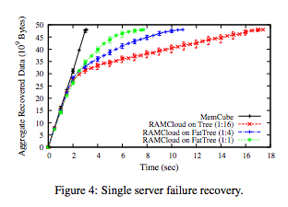
Experimental Data
Each primary server is filled with
48GBs of data
  Max write throughput is 197.6K
  writes per second
A primary server is taken offline
  took 3.1 seconds to recover all
  48 GBs using MemCube
  Aggregate throughput 123.9 GB/sec
  Each recovery server contributes
  about 8.85 GB/sec
Notes:
- Measured over an average of 5 runs (no standard deviation)

Slide 17
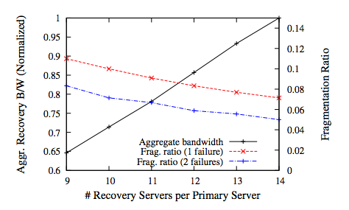
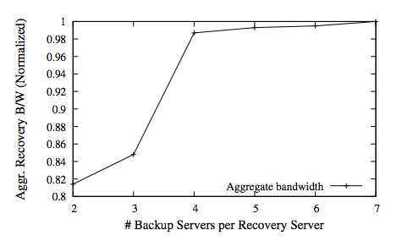
Determining Recovery and Backup Server Number
Increasing the number of recovery servers, linearly increases the aggregate bandwidth, decreases the fragmentation ratio (less locality)
Impact of number of backup servers per recovery server

Slide 18
Thoughts
Would be interesting to look at evaluations for the speed at which backups and recoveries are restored as well as more sizeable failures
Centralized aspect of the global coordinator creates a singular point of failure, how far is it from the architecture?
Lots of recoveries and backups, I wonder if the total backup-ed data can be reduced
Paper uses lots of terms interchangeably, sometimes it is confusing to distinguish the properties of MemCube from CubicRing from BCube
Notes:
Recovery during switch failure
Whether total backed up data can be reduced
Separation of terms
Time to recover all data not just primary data

Slide 19
Thank you!
Questions?

