Slide 1
BlinkDB: Queries with Bounded Errors and Bounded Response Times on Very Large Data
Authored by Sameer Agarwal, et. al.
Presented by Atul Sandur

Slide 2

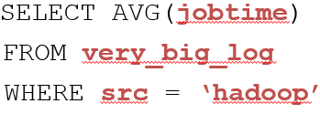
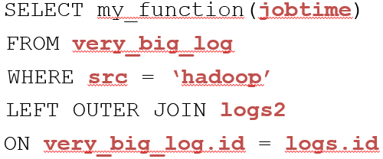
Motivation
Traditional SQL queries
Can we support interactive SQL-like aggregate queries over massive datasets?
Notes:
Are we only talking about relational data or other types where SQL style querying is supported?
AVG, COUNT, SUM, STDEV, PERCENTILE etc could be the aggregates. Could even be user defined functions
FILTERS, GROUP BY clauses
Real world: If you want to update ads on social network based on trends, or determine users affected by poor performance of service provider/location

Slide 3
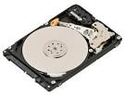

Motivation
100 TB on 1000 machines
½ - 1 Hour
1 - 5 minutes
1 second
?
Query execution on samples of data
Notes:
Uniformly distributed on all the machines

Slide 4
Query Execution on Samples
What is the average latency in the table?
ID | City | Latency
1 | NYC | 30
2 | NYC | 38
3 | SLC | 34
4 | LA | 36
5 | SLC | 37
6 | SF | 28
7 | NYC | 32
8 | NYC | 38
9 | LA | 36
10 | SF | 35
11 | NYC | 38
12 | LA | 34
ID | City | Buff Ratio | Sampling Rate
2 | NYC | 38 | 1/2
3 | SLC | 34 | 1/2
5 | SLC | 37 | 1/2
7 | NYC | 32 | 1/2
8 | NYC | 38 | 1/2
12 | LA | 34 | 1/2
Uniform
Sample
Full data: 34.667
Rate ¼: 32.33 ± 2.18
Rate ½: 35.5 ± 1.02

Slide 5
What is BlinkDB?
A framework built on Apache Hive that …
Creates and maintains a variety of uniform and stratified samples from underlying data (offline)
Returns fast, approximate answers by executing queries on samples of data selected dynamically (online)
Compatible and integrated with Apache Hive, supports Hive’s SQL style query structure
Notes:
Uniform: each tuple has equal probability of representation, Stratified: Biased towards certain parts of the dataset
Sampling can provide big performance gains due to most operations being IO bounded, but also error bars are very low because with 1/10th data you could get 99.98% accuracy at 10x faster.
99.93% accuracy at 100x faster.
Cannot do operators like approximate distinct count, max, min, etc. Anomalies can skew the distribution of sample (like in sum you missed an important sample), correctness comes into play. Can have subset of aggregate queries implemented. Not p-value or false discovery rates.
Can use a prior distribution on each column and then Bayesian generative approach for posterior distribution but the prior can change with new data that comes in.

Slide 6
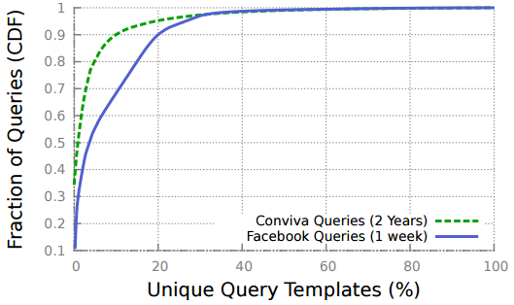
Design considerations
Query-column-set (QCS): Appears in query filtering/groupby clause, data expected to be stable over time
Targets predictable query-column-set (QCS) style workloads
Enables pre-computing samples that generalize to future workloads
Notes:
1st figure shows distribution of QCSs across all queries for Conviva and FB. So real world production workloads are well represented by QCSs. (90% queries covered by 10-20% QCSs)
2nd figure shows incoming queries over time and most QCSs (60%) are seen in 6% of queries.

Slide 7
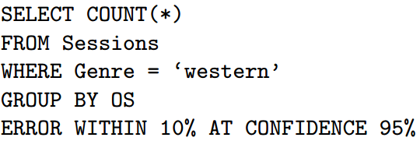
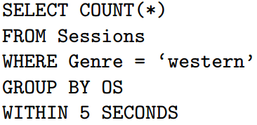
Queries
Supports COUNT, AVG, SUM and QUANTILE
    Relies on closed form error estimation for these aggregates
Can be annotated with error bound/time constraint
Selects appropriate sample type and size

Slide 8
High level architecture
Query with error/latency bound
Query plan
Sample selection module
Updated Query plan
Execute
Uniform
Sample creation module
Table
Stratified on C1
Stratified on C2
Notes:
Samples are stored on disk or cached in memory
- Sample selection module selects the type of sample and size of sample to use for query

Slide 9
Sample creation (uniform)
ID | City | Latency
1 | NYC | 30
2 | NYC | 38
3 | SLC | 34
4 | LA | 36
5 | SLC | 37
6 | SF | 28
7 | NYC | 32
8 | NYC | 38
9 | LA | 36
10 | SF | 35
11 | NYC | 38
12 | LA | 34
ID | City | Latency | Weight
2 | NYC | 38 | 1/3
6 | SF | 28 | 1/3
8 | NYC | 38 | 1/3
12 | LA | 34 | 1/3
4
U
FILTER rand() < 1/3
Adds per-row Weights
(Optional) ORDER BY rand()
3
1
2
Notes:
Sampling operator expects stream of data (random table input to sampler).
Per-row-weights to this random sample used to rescale answer back to generate scaled approx. answer (why?) and quantify error associated with sample.
Can shuffle data from random sample so that any subset of random sample is also random sample (why?). Now use this to get smooth accuracy-latency graphs.
- Central Limit theorem: arithmetic mean of a sufficiently large number of iterates of independent random variables, each with well defined expected value and well defined variance, will be approximately normally distributed, regardless of underlying distribution.

Slide 10
Sample creation (stratified)
ID | City | Latency
1 | NYC | 34
2 | NYC | 32
3 | SF | 36
4 | NYC | 28
5 | NYC | 37
6 | SF | 33
7 | NYC | 31
8 | NYC | 30
9 | SF | 32
10 | SF | 34
11 | NYC | 35
12 | SF | 36
4
City | Count | Ratio
NYC | 7 | 2/7
SF | 5 | 2/5
S₂
JOIN
S₂
S₁
SPLIT
GROUP
3
1
2
Notes:
After join, all tuples in original table associated with corresponding ratio.
- Do we need N or the total number of rows in original table? This seems to be required for closed form approximation implementation of aggregates like average. How do you get that?

Slide 11
Sample creation (stratified)
4
ID | City | Data | Weight
2 | NYC | 32 | 2/7
8 | NYC | 30 | 2/7
6 | SF | 33 | 2/5
12 | SF | 36 | 2/5
U
S₂
S₂
S₁
3
1
2
Notes:
U generates weighted stratified sample from the joined table.
Can do this insertion of sampling operators to parts of the query plan by determining functional dependencies (?).

Slide 12
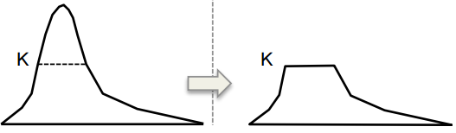
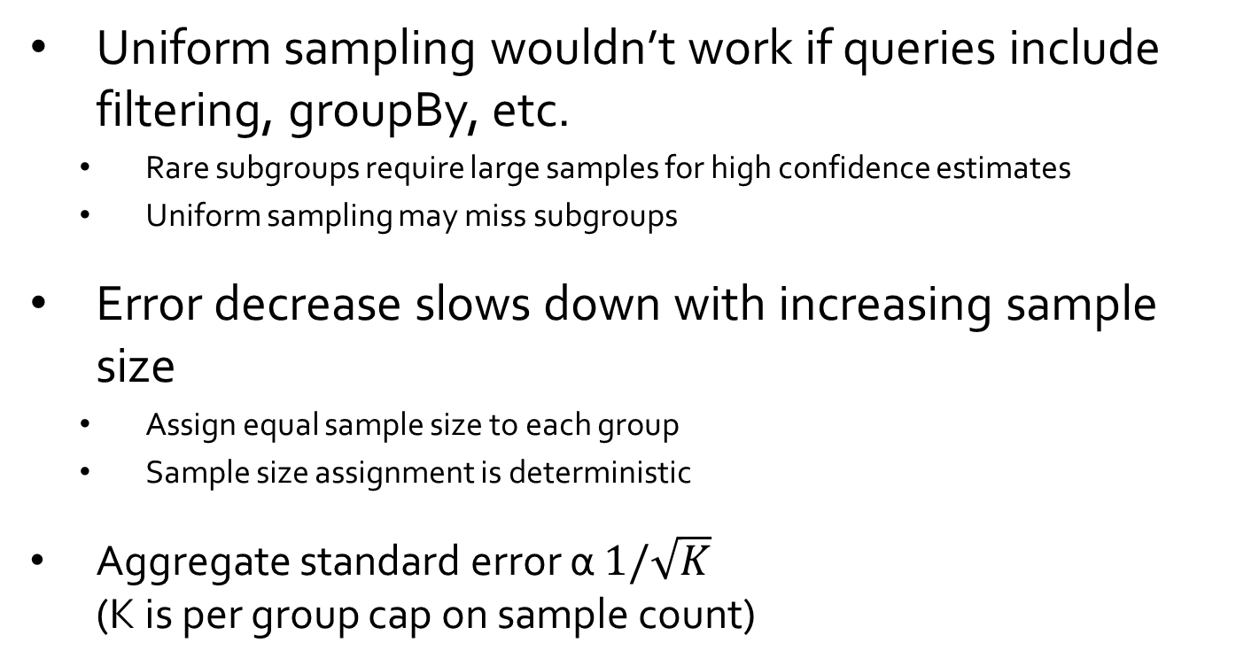
Sample creation (stratified)
Uniform sampling wouldn’t work if queries include filtering, groupBy, etc.
    Rare subgroups require large samples for high confidence estimates
    Uniform sampling may miss subgroups
Error decrease slows down with increasing sample size
    Assign equal sample size to each group
    Sample size assignment is deterministic
Aggregate standard error α $1/\sqrt{K}$
(K is per group cap on sample count)
Stratified sample size per group
Notes:
Aggregate errors in queries with rare subgroups depend on size of the rare subgroup in original data. But why so, when we care about error of all aggregates (rare or otherwise) equally.
Error decreases at decreasing rate as sample size increases so best choice is to simply assign equal sample size to each group.
Stratified sampling ensures rare subgroups are sufficiently represented
Red line is per x, how many tuples are there.

Slide 13
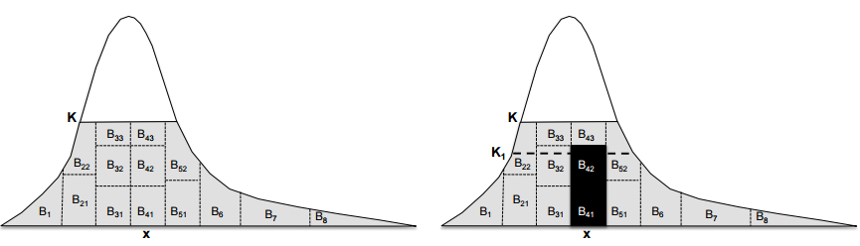
Sample creation for multiple queries
Multiple queries sharing QCS, different values of n (#rows to satisfy query)
    Sample depends on n (error/time bound) and selectivity of query
Requires maintaining one sample per family of stratified samples S_{n}
Sample for multiple queries with shared QCS
Notes:
Aggregate errors in queries with rare subgroups depend on size of the rare subgroup in original data. But why so, when we care about error of all aggregates (rare or otherwise) equally.
Error decreases at decreasing rate as sample size increases so best choice is to simply assign equal sample size to each group.
‘n’ is the number of rows we read to satisfy query based on error/latency constraints
Only use the most common

Slide 14
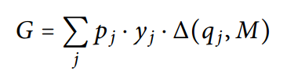


Sample creation (optimization)
Multi-dimensional stratified samples
Objective function
Weighted sum of coverage of QCSs of historical queries
Storage cost for the samples
Constraints
Sample’s coverage probability for query QCS
Notes:
How to choose QCS’s on which to build stratified samples?
Each stratified sample on different QCS can be used to improve query accuracy/latency, especially when table has small groups for particular column set
Each sample has cost and #potential samples exponential in #columns
Consider sparsity of data (#groups whose size in T is less than M), workload (probability of seeing q_j QCS in future queries, based on history) and storage cost (cost with storing S(phi, K)
Size of optimization problem can blow up, so use heuristics like only column sets that appeared in the past or eliminating those that are unrealistic.

Slide 15
Sample selection (runtime)
Selecting the sample type
    Query’s column-set is subset of stratified sample QCS? Select, else
    Run query across all samples to pick ones with high selectivity
Selecting sample size
    Error-Latency profile by running query on smaller samples
    Project profile for larger sample sizes
    Error profile
      Estimate query selectivity, sample variance, input data distribution
      Use standard closed form statistical error estimate
    Latency profile:
      Assumes latency scales linearly with input size
Notes:
Each stratified sample on different QCS can be used to improve query accuracy/latency, especially when table has small groups for particular column set
Each sample has cost and #potential samples exponential in #columns
Consider sparsity of data, workload and storage cost
Uniform sample is picked when there is no groupy or where filter.
Query selectivity is #rows selected by Q to number of rows read by Q. Intuition is that response time of Q increases with #rows it reads, while error decreases with #rows Q’s where/groupby clause selects
Error profile: variance/error depends on 1/sqrt(n) where n is rows selected by Q from sample of size N. So need to run query.
Error profile: sample variance for SUM/AVG and input data distribution for QUANTILES
Bias correction by using effective sampling rate for each group
For handling inaccurate samples and stale samples:
If sample has higher than average aggregate on column by chance, multiple dependent queries will propagate this error. So periodically update samples
If original data changed, samples need to update. Rerun every time a change is detected in underlying data distribution.
1)

Slide 16
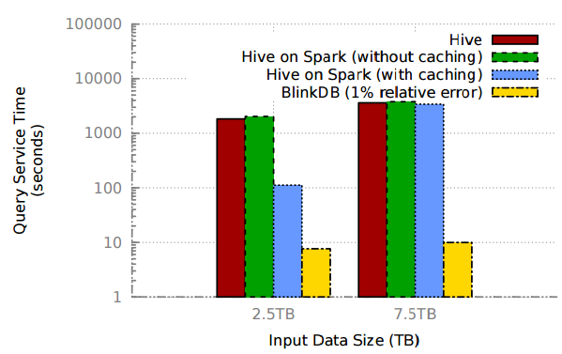
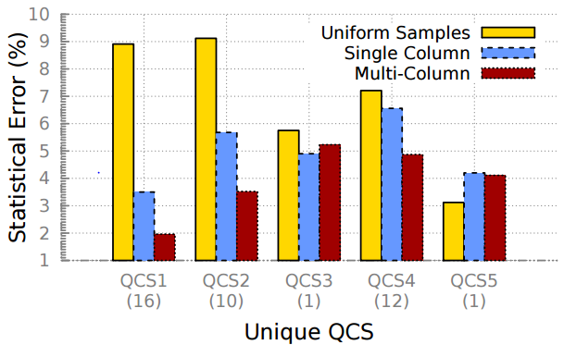
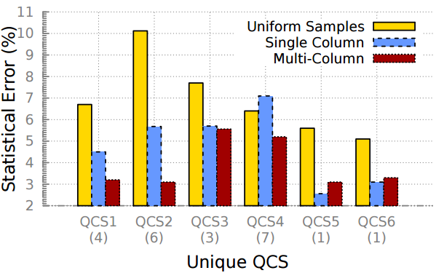
Evaluation
BlinkDB vs. No sampling
Conviva error comparison
Expected error minimized
TPC-H error comparison
Notes:
First diagram is BlinkDB vs. no sampling
Hive on Spark basically uses Resilient Distributed Dataset (RDD) structure for processing like MapReduce in Hive. SQL queries can be transformed to operate on RDDs
Hive on Spark- Spark user benefits, greater Hive adoption, performance (Hive queries with multiple reducer stages will run faster).
Each query was run 10 times and average reported here.
BlinkDB gains of the order of 10-200x.
For Conviva/TPC-H, there is multi-column which is restricted to 3 columns.
Optimized for common QCSs, and expected error minimized not per query error.
Conviva dataset – 17 TB, 5.5 billion rows, 104 columns: information about video streams viewed by internet users
TPC-H: 1 TB, 6 QCS
100 Amazon instances, 75 TB disk utilization, 6 TB of RAM cache

Slide 17
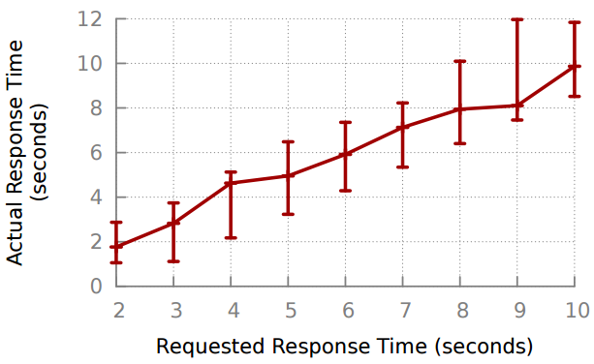
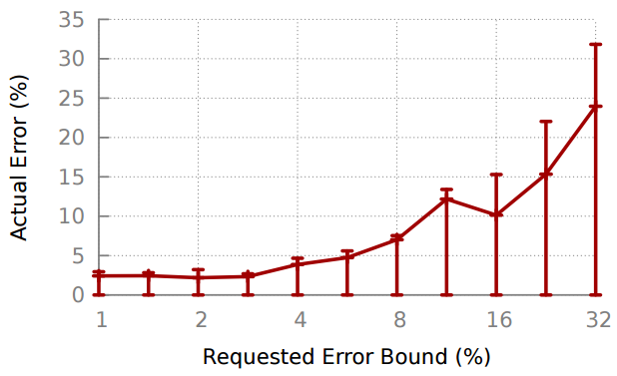
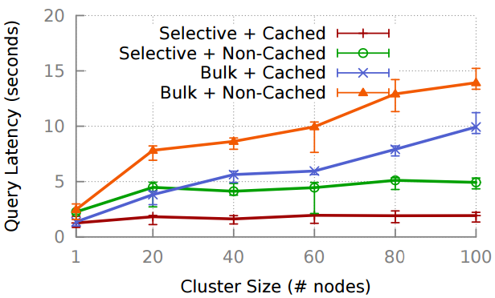
Evaluation
Response time bounds
Relative error bounds
Smaller sample sizes
Low communication cost
Scaleup
Notes:
Smaller sample size causes higher error rates variance.
For relative error bound, the minimum is 0 because there could be queries running for long enough without a time constraint OR error is very close to 0 and is due to being able to find samples with high selectivity and low variance.

Slide 18
Conclusion
Sampling based approximate query engine that supports query error and response time constraints
Uses multi-dimensional stratified sampling with runtime sample selection strategy
Can answer queries within 2 seconds on upto 17 TB of data with 90-98% accuracy

Slide 19
Thoughts
Novel concepts introduced with grounding in statistics/sampling theory to build upon
Can be integrated to existing query processing frameworks like Hive & Shark
Follow up work such as supporting more generic aggregates and UDFs
Potentially crucial aspects not addressed properly: M and K values are fixed, optimization space could be huge (heuristics unclear), sample replacement period, etc.
What if ELP estimates are not accurate? And do we verify error estimates, query feasibility?
Notes:
Novel: Multi-dimensional stratified sampling, sample creation based on historical data, dynamic sample selection

Slide 20
Thank you!

Slide 21
Extra slides

Slide 22
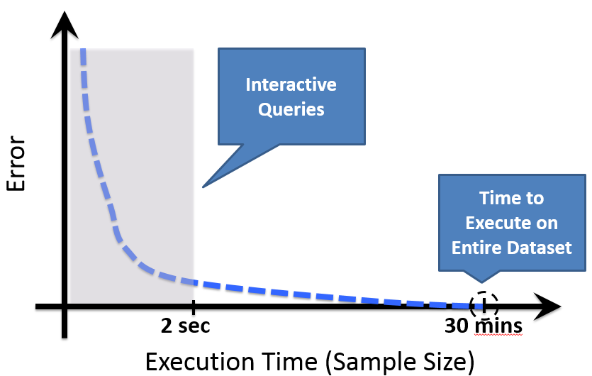
Speed/Accuracy Trade-off
Enable exploring speed-accuracy tradeoff curve for performance
Real time analysis
Pre-existing noise from data collection already
Notes:
Example: Average RTT of client apps suffering outage: accuracy of 95% in 5 seconds than wait for half hour
The y-axis value at 30 minutes need not be 0 error because of noise in data collection and instead be some positive value

Slide 23
Apache Hive
Built on top of Hadoop to query/manage large datasets
Imposes structure on variety of data formats
SQL-like query language, can be extended to write UDF’s
Batch jobs over large sets with scalability, extensibility, fault tolerance and loose coupling with input formats
Notes:
- Queries are translated to map-reduce jobs implemented in distributed fashion

Slide 24
BlinkDB Architecture
Command-line Shell
Thrift/JDBC
Meta
store
Driver
SQL Parser
Query Optimizer
Physical Plan
SerDes, UDFs
Execution
Hadoop/Spark/Presto
Hadoop Storage (e.g., HDFS, Hbase, Presto)

Slide 25
Error Estimation
Closed Form Aggregate Functions
  Central Limit Theorem
  Applicable to AVG, COUNT, SUM, VARIANCE and STDEV

Slide 26
Error Estimation
Closed Form Aggregate Functions
  Central Limit Theorem
  Applicable to AVG, COUNT, SUM, VARIANCE and STDEV

