Slide 1
Centiman: Elastic, High Performance Optimistic
Concurrency Control by Watermarking
Authors: Bailu Ding, Lucja Kot, Alan Demers, Johannes Gehrke
Presenter: Monika
Notes:
Hello everyone, I’m Monika and today we will be discussing high performance distributed transaction processing system Centiman.

Slide 2
Transactions
Transaction are a series of operations executed by client which either
  commits all its operations at server
    Commit = reflect updates on server-side objects
  Or aborts and has no effect on server
Notes:
So transactions are a series of operations which either commit all the operations or abort all of them showing no affect on the server.

Slide 3
Acid Properties for transactions
Atomicity
Consistency
Isolation
Durability
Notes:
Transaction satisfy some important properties called the ACID properties.
First is atomicity: U either commit whole transaction or abort everything
Consistency: If your transaction starts in a consistent state then, on completion it leaves the server in a consistent state
Isolation: Non –final effects of the transaction must not be visible to other transactions.
Durability: If the transaction commits, all its effects are saved to permanent storage.

Slide 4
Concurrent transactions
Two approaches to prevent isolation from being violated
  Pessimistic
    Prevent transactions from accessing the same object
    Eg: Locks
  Optimistic
    Assume nothing bad will happen
Validator
T0
Update Local X
Validate
Write X
T1
T1
Read X
Validate
T0
Notes:
We cannot let each server execute a specific transaction at any given time as this leads to less throughput and more latency.
Read and write at will. Before committing, each transaction verifies that no other transaction has modified the data it has read

Slide 5
But..
In a distributed environment:
  Clients and/or servers might crash independently
  Transactions could run concurrently, i.e., with multiple clients
  Transactions may be distributed and replicated, i.e., across multiple servers
Notes:
However, things get more complicated in a distributed setting where, clients or servers can crash independently
Multiple clients can run transactions concurrently,
Server data is distributed and replicated to support fault tolerance and availability where ACID properties is not trivial to achieve
And hence, a separate system is needed for transaction processing in cloud that is centiman.

Slide 6
What is Centiman?
Transaction processing system for the cloud
Features:
  ACID guarantees
  Supports transactional guarantees using OCC (Optimistic concurrency control protocol)
  Simple to deploy on any key value store
  Elastic scaling
  Sharded validation
  Only two points of synchronization
    Start of validation
    Point where processor collects all validators outcome
Notes:
Centiman system provides several features which I will introduce here and discuss in detail in next slides.
Elastic scaling: that is depending on loads , the system can scale up and down.
Sharded validation: That is it partitions the validation phase as well.
Synchronization: It requires only two points of synchronization – start of validation (That is, a validator will only process a transaction with timestamp i after it has validated (its portion of) all transactions with timestamp j < i.) and the point where processor collects all the information which is obvious.
writes of a transaction can be propagated to storage asynchronously and interleave with the reads and writes of other transactions. Moreover, the validators never need to communicate with each other.

Slide 7
Centiman Architecture
Global Master
Monitors load, scaling, migration, failure recovery
Validator
Validator
Validator
Transaction Processing system
Client
Success/Failure
Response
Validation Req
Read/Write sets
Issues Txns
Processor
Processor
Client
Gets Respone
  put(key, val, timestamp)
  get(key) -> (val, version)
Responses
Key Value data Store
Storage Nodes
Storage Nodes
Storage Nodes
Notes:
Bottom most layer we have the key value store, which may be may be an external, third-party data store. Its partition and replication are transparent to centiman system.
Next however is our main system ‘Transaction processing system’. This requires get/put API with the mentioned signatures to interact with data store. Each record (key value ) pair is to be associated with timestamp of transaction which has written it.
Global master which takes care of monitoring load, scaling, fault tolerance
Obviously clients which submit transactions to centiman and receive responses from them.
SO the centiman system in detail has two components processors and validators which take care of validation and provide responses to client. We can observe that there is not single validator and the reason we describe in next slides.

Slide 8
Validators and sharded validation
Processor
Processor
{RA1, WA1}
{RZ1, WZ1}
{k1…ki}
{ki…kj}
{kj…kn}
Validator A
Validator B
Validator Z
Partitioning Function
Key Set {k1,..,ki,…kj,...,kn}
Notes:
Assume we have a key set k1.. Kn. Theses are the keys in the key-value data store. Each validator is given a disjoint set of keys to validate based on some partitioning function (hash range based anything). This validator is responsible for those set of keys.
So a processor after generating read, write sets assigns them to the respective validator.
partitioning does not necessarily coincide with the partitioning at the datastore.

Slide 9
Validation (OCC)
12 < i <16
Read a stale value. T15 has the new value. Hence abort!!
Keys {X,W,P,Q,R}
T:15{x,w,q,r}
T:14 {w,q,r}
RS = {(x,12);}
WS = {}
Timestamp: 16
T:13 {w,q,r}
Read Set
{x,value, 12}
T:12 {x,w,q,r}
{y,value, 13}
Write Set
{y,value}
RS = {(y,13);}
WS = { y,z}
Keys {Y,Z,L}
{z,value,}
T:13{y,z}
T:12{y,z,l}
Notes:
Assume we have a transaction with timestamp T=16. With the read and write set as shown in figure. Upon commit, processor sends them validators. We cansider only one validator ie the top one with keys X,W etc. On receiving read set, it checks the read version and check if any transaction with higher timestamp has written that data item. If so, it aborts it, else commits it.

Slide 10
Global master
Monitors system performance
Handles failure recovery of validators
Coordinates Elastic scaling
Notes:
Decides when to perform scaling and/or migration
Decides on the new key space partitioning
In case of validator failure, key space partitioning is adjusted to fit the current validators and elastic scaling mechanism is used.
Failure recovery also follows similar mechanism as scaling descibed in the next slide.
Registers new validator nodes
Informs old validators to send validation requests based both on the old and the new partitioning.
Decides when to switch to new partitioning.
switch over when no disagreement in the validation decisions has occurred for a specific period of time. Alternately, individual validators could notify the master that they have accumulated sufficient state to switch over, e.g. using the watermark as an indicator.

Slide 11
Elasticity
Processor
Processor
Processor
Even
Even
Odd
Odd
Even
Validator
Odd
Validator
Even
Validator
Odd
Validator
Even
Validator
Before Migration
During Migration
After Migration
Notes:
Assume we have a processor which sends the validation requests to a single validator and now the system decides to scale out and send the even keys to one validator and odd keys to another validator.
Click
As mentioned before, the global master sends this change to all the validators and processors that they now have to send the reuests and process the requests based on old and new partitioning.
Click
After some time when the state converges, global master takes the decision to swicth to the new partitioning space.
We can see that this same mechanism can be used for both scaling out and scaling in.
In addition to that, when there is a failure, similar mechanism to scaling in can be used. The only state stored in the validator is write sets and read sets which are constructed as a part of the scaling mechanism.

Slide 12
Failure Recovery
Two kinds of failure
  Processor
  Validator (Already discussed)
Processor failure
  Each node maintains a write ahead log
  Logs :
    Init log entry
    Write set
    Decision to commit/abort
    Completed
Asynchronously!!
Notes:
Only redo logging is required no undo because, we write to the storage only after all the validators have been successful.

Slide 13
Challenges
Read Only transactions:
  Writes are not installed to storage atomically
  Hence, no optimizations for read only transactions
Spurious Aborts
  Remember we do nothing on ABORT!!

Slide 14
Spurious Aborts
T3: R(X), W(X), W(Y)
T4: R(X), W(X)
X
T2
Validator A
X
Validator B
Y
Validator A
X
No conflict. Adds X to write set
T3 > T2; Assumes T4 read a stale value and hence aborts T4 unnecessarily
Conflict Aborts!!
Notes:
Validators do not know the global outcome of the validation; This can lead to unnecesary aborts.
Click
Assume we have a transaction T3, which has the mentioned operations. They are sent to repective validators for validation.
Click
Assume that validator A sends commit reply and validator B an abort. Hence the overall decision is abort hence, no change to key value store state. and the Validator A is not aware of it and puts T3 in its write set.
Click
Another transaction T4 enters and reads the consistent value of X as T2. When validator A sees this version, assumes T4 has read a stale version since the latest version is T3 and aborts it unnecessarily.

Slide 15
Watermark Abstraction
Watermarks are metadata that propagate through the system information about the timestamp of the latest completed transaction.
System associates a read on a record with a watermark
  get(key) = {Value, version, watermark}
Guarantee: all transactions with timestamp i ≤ w have either already installed their writes on r or will never make any writes to r.
T 19
Watermark 15
T 20
Version:10
Watermark:15
T 10
Read X
T 9
Notes:
Completed transaction means either committed or aborted !!

Slide 16
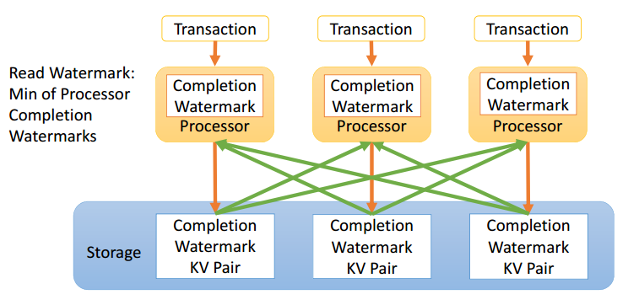
Implementing Watermarks
Each processor P ∈Ƥ maintains a local processor watermark Wp.
Watermark for the system: min(P∈ Ƥ Wp).
This information about Wp is spread using a gossip protocol (asynchronously).

Slide 17
Reducing spurious aborts
The write sets of aborted transactions eventually “age out” and fall below the watermark,
Spurious aborts will only reduce they need not become zero
Check > 15
Watermark 15
T 19
T 20
Version:10
Watermark:15
Aged out
T 10
Read X
T 9
Notes:
Helps in garbage collection as well: It is safe to garbage collect WS(i) once all read watermarks of all in-flight and future transactions will be greater than i.

Slide 18
Bypassing Read Only Transactions
If we ensure that transactions read a consistent snapshot of the database, then they do not require validation.
Snapshot: “Data store is at snapshot ‘i’ if no version of any record with a timestamp j ≤ i will ever be installed in the future, and no version of any record with a timestamp k > i exists in the data store.”
  Transaction can read a snapshot i even if data store is not at snapshot i.
So, if the intersection of the intervals of all read versions is not null, then the transaction read a consistent snapshot
During this interval, this version is the most current
Read(x) = {x,value,v,w}
V
w
Notes:
Transaction can read a snapshot i even if it is not at snapshot i. This is true because, we are concerned with the reads of only that transaction and all the keys.
We can by pass a transaction if we are sure that it read a snapshot of the datastore. So how can we know if it read a snapshot or not.
Consider a get response of key value ‘x’. (value, v, w): v- version it read, w– watermark. By the definition of watermark we can say that [v,w], represents a subset of the time frame during which, the version T read is the most current installed version in the system.
If we obtain a intersecteion of all the read intervals and it is not null we can say that transaction has read a consistent snapshot and hence bypass the validation

Slide 19
Evaluation
The paper investigates the following questions
  How do spurious aborts affect the system with and without watermarks?
  How does the system behave when we scale elastically by adding a new validator?
  How effective is the local check for read-only transactions?
  How well does the system scale and perform under load?
System specifications:
Amazon EC2 m3.xlarge
nodes with 4 vCPUs
15 GiB RAM and
High performance network
System specifications:
20 Amazon EC2 m3.xlarge
nodes with 8 vCPUs
High performance network
50 storage nodes, 50
processors
Notes:
12 Machines. All results are average over three runs.
Last evaluation, they used 108 Machines to load the system.

Slide 20
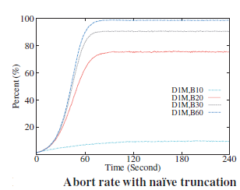
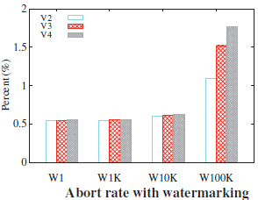
Spurious aborts
Truncation time is 10 sec (B1), 20 sec (B2)…
As time passes, the WriteSets buffers at the
validators become more polluted. The abort
rate therefore increases with time until it
reaches a plateau.
The position of the plateau rises with
increased buffer size, due to a larger
number of spurious conflicts.
Each processor updates its local watermark
every 1 (W1), 1K (W1K), 10K (W10K), and
100K (W100K) transactions.
Watermark-based approach alleviates the
problem, as write sets from aborted
transactions “age out”
Notes:
We use two approaches to compare, one is naïve truncation based approach n other is obviously watermark based.
In the naïve strategy we use different intervals 10, s20 …for truncating the write sets. We observe that the percentage of aborts is as high as 80-90%. The number of aborts increases as the time passes because, the write set gets polluted with an increase in time.
The plateu is increases with increase in time interval as the number of spurious aborts increases.
In the watermar based approach W1, W10K represents after how many transactions is the watermark value updated. As expected with an decrease in the frequency of update, aborts increases. As the validator count increases, aborts increase may be because, it takes more time for the updated watermark to reach validators coz of gossip protocol.

Slide 21
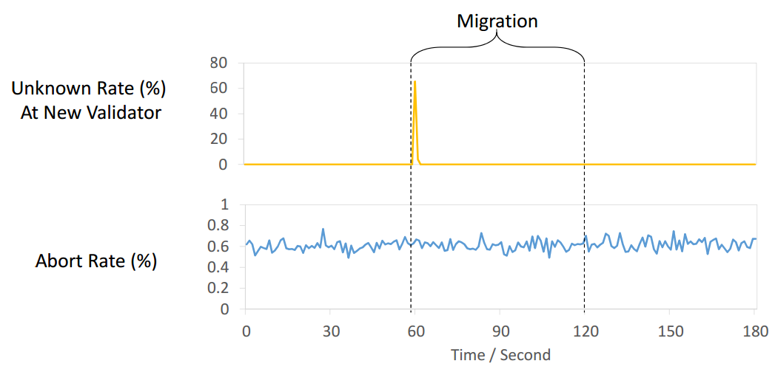
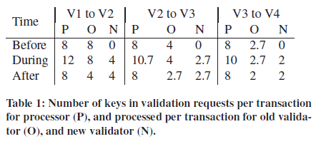
Elastic Scaling
Measures the overhead due to the scaling process.
    Occurs due to duplicate validation requests
    Global synchronization to finalize the switch to the new partitioning
Notes:
During the scaling process, in a transitional period validators operate both under the old and the new partitioning and hence the overhead.
The overhead decreases as the number of validators increases. As is visible from the table due to the sharing of load among validators.
Click
Due to the lack of information, the new validators initially abort all the transactions which gradually reduces and converges with the old validators abort rate.

Slide 22
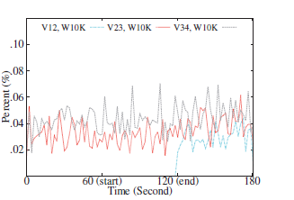
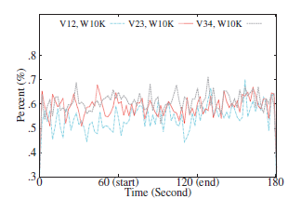
Elastic Scaling (2)
Abort rate and Spurious abort rate:
Spurious Abort Rate
Abort Rate
V12 : Scaling from one validator to 2 validators. Similarly V23, V34
Scaling begins at the 60th second and finishes at the 120th second.
Slight increase in abort rate and spurious abort rate after the scaling is complete
Notes:
We start with either 1, 2, or 3 validators and add a new validator (V12, V23 and V34 respectively).
But the ‘authoritative’ abort rate remaind low because, initially the new validators are not treated as authoritative they are just run to gain the state without exlplicit passing. Both the abort rate and the spurious abort rate increase slightly after the scaling because, the watermark value is not updated at the new validators and hence they start with a very low value.
When we scale from 1 validator to 2 validators, the spurious aborts suddenly appear once the scaling is complete. This is because no spurious aborts are possible with a single validator.

Slide 23
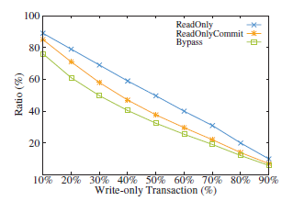
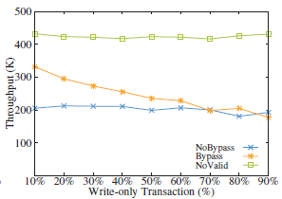
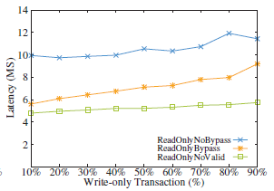
Local check for read only transactions
Notes:
To simplify the analysis, they used a workload that consists of a mix of one-shot read-only and write-only transactions. This is may be because write only transactions always commit and the resultant aborts will only be due to the read only transactions.
By-pass: transaction check locally and only if they fail, it is sent to validation.
Nobypass: All transactions sent to validation.
Novalid: No validation done at all, all read only transactions committed. This shows the overhead of ensuring consistency.
The ReadOnlyCommit line shows what percentage of the read only transactions commit, and the Bypass line shows what percentage of the read-only trans- actions pass the local check and bypass validation.
- A read-only transaction is sent to validators only if it is likely to abort in 30% write only transactions, 60% of transaction which fail the pass actually abort.
Configuration: Each processor node can issue at most 500 transactions concurrently.
The watermarks are updated every 10K transactions.
We run 4 storage nodes, 4 processors, and 2 validators on Amazon EC2 m1.xlarge instances. Each instance has 4 vCPUs, 15GiB memory, and a 1Gb/s network.

Slide 24
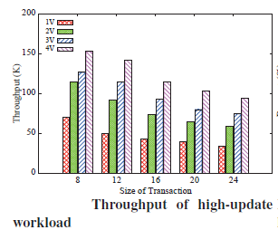
Synthetic data (Throughput)
The throughput of the system increases
sublinearly (Network overhead) with the
number of validator nodes.
For skewed workloads, the throughput is
slightly lower as we see more aborts.
Notes:
the local-check optimization for read-only transactions is turned off, to stress the validator nodes and to simplify the analysis.
stress the validator nodes with a sufficient number of storage and processor nodes (with a maximum of 20 storage nodes and 20 processors).
Value field is considered immaterial.
Why is it sublinear: As the number of validator nodes grows, the cost of conflict checks is shared among them. However, since a transaction can be split to multiple validators, the per-transaction overhead is not reduced linearly. In addition, as we add more processors, each validator node has more network connections, and receives and sends more messages, so the over- head of networking increases.
For skewed workloads, the throughput is slightly lower as we see more aborts.

Slide 25
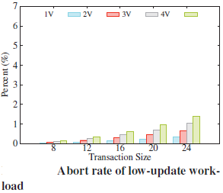
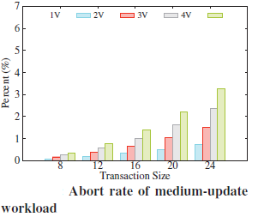
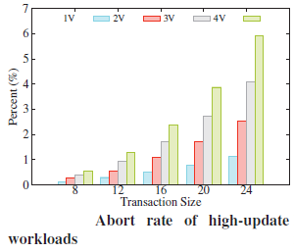
Synthetic data (Abort rate)
The abort rate increases with more validators, mostly due to feeding more concurrent
transactions into the system to stress the validators.
Workloads with larger transactions have higher abort rates.
Notes:
As the size of the transaction increases, each transaction accesses more records and thus has a higher chance of conflicts. Skewed workloads demonstrate similar patterns, but with higher abort rates.

Slide 26
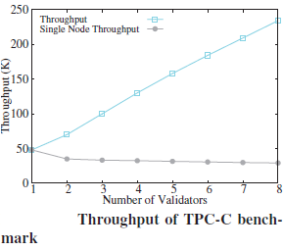
Realistic Benchmarks (TPC-C)
TPC-C Benchmark: High-update workload of medium size transactions
Notes:
108 Machines
Why only read – only check, why no latency?
maximum of 50 storage nodes and 50 processors
watermarks are updated every 10K transactions.
TPC-C: Since all transactions update the database, the local check optimization is not applicable.

Slide 27
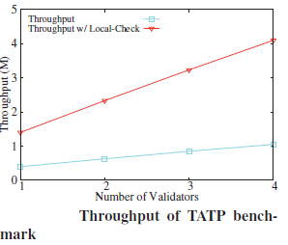
Realistic Benchmarks (TAPT)
Read-heavy, conflict-rare and key-value store like workload.
The local check optimization allows the transactions to by-pass the validation and hence huge change in throughput.
Notes:
Since the read-only transactions in the workload issue one single-row read, all of them bypass validation

Slide 28
My thoughts!!
Simple and clear explanation of concept and its correctness
Validation is sharded and proceeds in parallel
Elastic scaling
Number of aborts if the key value store is slow in processing requests.
Each processor assigns consecutive integers as timestamps, using processor ID’s as timestamps.
No evaluation against other existing distributed transactional systems.
Notes:
If timestamp is smaller than the current version for the record, the request is ignored as the write is stale

Slide 29
References
http://www.cs.cornell.edu/~blding/pub/centiman_talk_socc_2015.pdf
Indy’s slides
http://dl.acm.org/citation.cfm?id=2806837&CFID=556736515&CFTOKEN=67486896

Slide 30
Thank you !!

