Slide 1
When Pipelines Meet Fountain: Fast Data Dissemination in Wireless Sensor Networks
Presenter: Huajie Shao (hshao5)
Author: Wan Du, Jansen Christian Liando, Huanle Zhang, Mo Li
Nanyang Technological University, Singapore
Notes:
Hi, I am going to present a protocol named Pando in wireless sensor networks

Slide 2
Outlines
Background
Motivation
Pando protocol
Evaluation
Conclusion
Notes:
The outline for the presentation

Slide 3
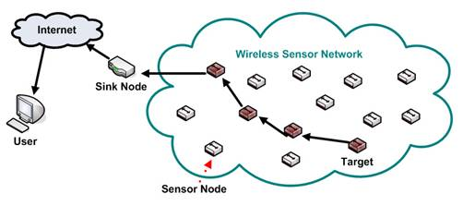
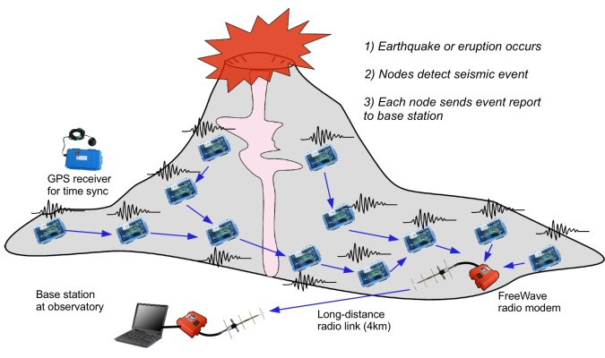
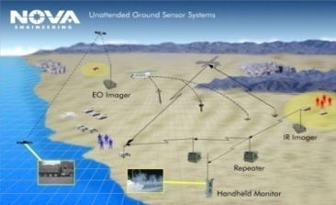
Background
Wireless sensor networks
What is the Data dissemination?
Deliver a bulk of data to all the nodes in a network.
(e.g., modify codes or an application updating profile)
Volcano [G. Werner-Allen et al., EWSN’ 05, OSDI’06]
Notes:
Sensor networks have been widely used in industry, volcano and military application. we may hope to disseminate a large bulk of data to every node in the network, for example, to modify the code or update the application profile. So we need data dissemination

Slide 4
Traditional Protocols
Hop by hop with acknowledgement
overhead and low spatial reuse
Deluge
2004
Limit spatial reuse, without considering
constructive interference
Sprinkler
2007
2013
Splash
constructive interference
Contention-based protocol
Long tail time
Notes:
In the past years, researchers developed several protocols like deluge, sprinkler and splash to disseminate data

Slide 5
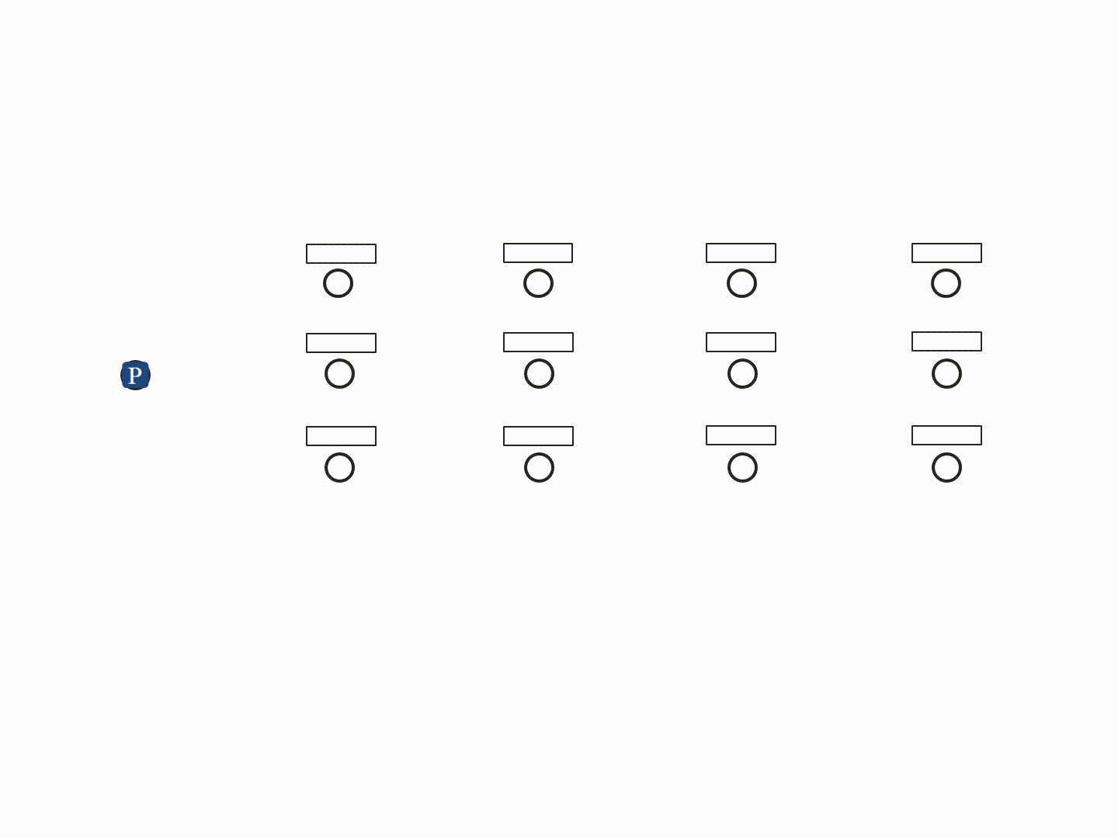
Splash: Constructive interference + Pipelining
One packet is forwarded simultaneously by all nodes at a same layer which interfere constructively with each other
Channel 1
Channel 2
Channel 3
Channel 4
Disseminate data
three rounds
Same data
object twice
500 XOR
Encoded packets
Notes:
What is the constructive interference? They are unreliable. after 3 rounds, some nodes still miss some packets. Splash relies on local recovery to achieve 100% reliability

Slide 6
Long tail problem
Fig 2: The packet reception performance of every node after each round in Splash.
Notes:
Fig. 2 shows the first round

Slide 7
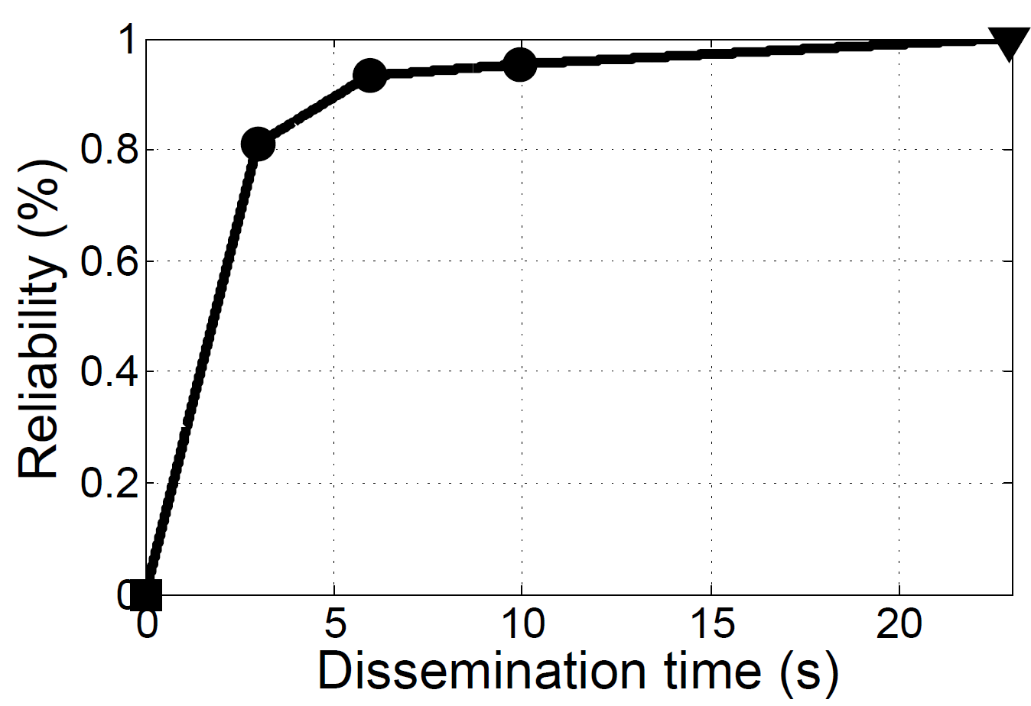
Splash: long tail problem
>80% of total time
duplicate packets
Notes:
Next, we study the relationship between the reliability of data and the dissemination time. In order to improve the reliability, splash uses three rounds to disseminate data. The motivation of this paper is to solve the long tail problem to improve the reliability of data

Slide 8
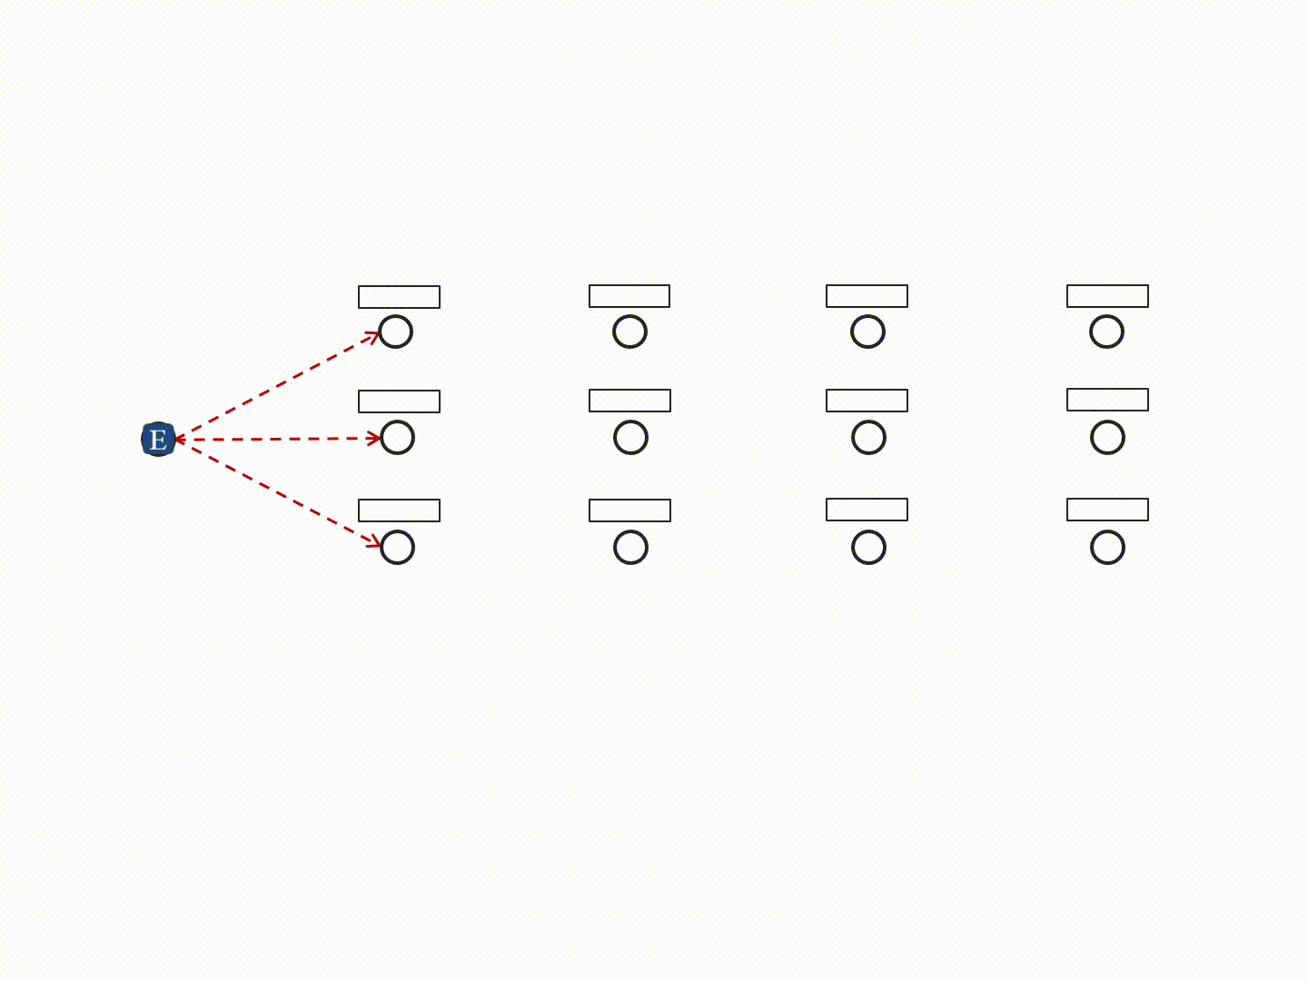
Pando Protocol
Channel 1
Channel 2
Channel 3
Channel 4
Fountain codes: contains novel information of the data object.
Radio-driven coding scheme
Silence-based feedback scheme
Avoid duplicate
retransmission
idle intervals of CPU
Deterministic time.
Acknowledgement of every node
Notes:
With Fountain code, every encoded packet contains…
Now, with Pando, the data dissemination becomes very simple, the sources just keep pumping encoded packets into the network, and every node just accumulate the correctly-received packet until the original data is recovered successfully.
Next, I will introduce these techniques in detail

Slide 9
1) Fountain codes
Original Packets
Encoded Packets
Received Packets
Recovered
Packets
X1
Y1
Y1
X1
X2
Y2
Y2
X2
X3
Y3
Y3
X3
X4
Y4
Y4
X4
Y5
Y5
Y6
ACK
Y6
Gaussian Elimination
Individual packets
Number of packets
Notes:
Fountain codes like LT code, and random linear codes, it can recover the original data based on Gaussian Elimination.
Firstly , the orignal.. will be encoded packet based on some functions, operators “or and”
In the second step,

Slide 10
10
2) Radio-driven coding scheme
1688μs
1688μs
Radio
R1
T1
R2
T2
Rn
Tn
μC
D1
D2
Dn
Accumulative Gaussian Elimination
Notes:
It includes two parts, constant interval of idle CPU. Microcontroller goes into idle mode for a long time that can be used for Fountain encoding and decoding. Microsecond. First of all, write data to TX buffer, after calibration, the nodes begin to decode the data object.

Slide 11
Gaussian Elimination
1) Row operations: Swapping two rows
2) Multiplying a row by a non-zero number,
3) Adding a multiple of one row to another row.
Using these operations a matrix can always be transformed into an upper triangular matrix
Notes:
Use some row operations to transform the matrix into an upper triangular matrix.

Slide 12
3) Silence-based feedback
Original data: 16 packets; Successful decoding: 17 encoded packets.
Source
T1
T2
T3
...
T18
T19
R19
T20
R20
Layer 1
R1
T1
R2
T2
R3
T3
...
R18
T18
R19
T19
R20
Layer 2
R1
T1
R2
T2
R3
...
T17
R18
T18
R19
Layer 3
R1
T1
R2
T2
...
R17
T17
R18
Fig. 5 : Dissemination process of a 16-packet data object in Pando
Generate the encoded packets by its own.
Notes:
It is used to terminate the data dissemination when children nodes could recover the original data object. In Pando, a leaf node will terminate the dissemination process when it successfully recovers the original data objects. If the node could recover the original data object, it will send the acknowledge to the parent nodes. After 2 time slots, 19th detect the silence nodes, it can succeed in recovering the data and terminate dissemination.

Slide 13
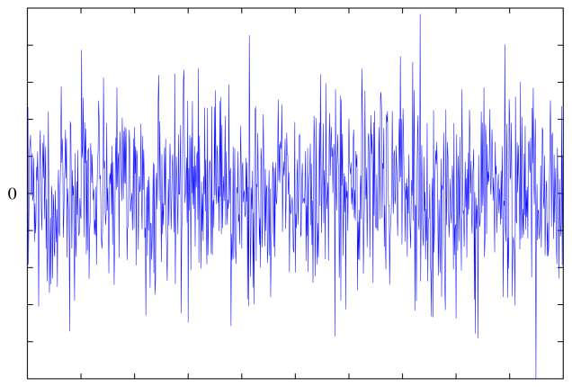
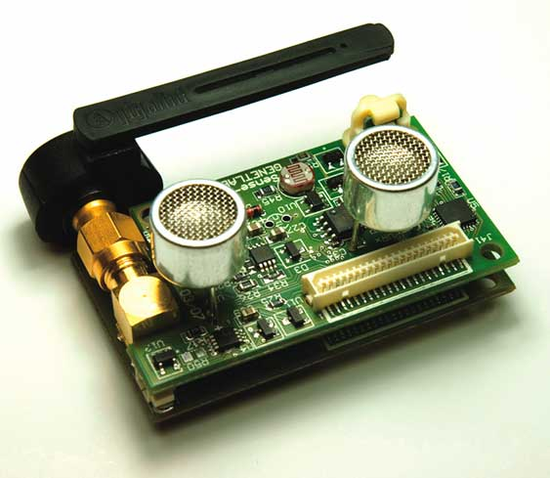
Improve Feedback Scheme
False negative
of channel silence
False positive
of channel silence
Detect M consecutive
silent slots
Notes:
However, the feedback scheme may suffer from some errors. Ambient noise or interference from nearby devices, a node may not detect the channel silence. Dynamically adapt the RSSI threshold of channel
Second is false positive, a node fails to receive a packet, we may interpret this silence as successful decoding. Detect M consecutive time to verify if the node is fine

Slide 14
4) Packet-level adaptation of channel diversity and network density
Figure 6: Packet-level channel allocation
Notes:
In pipelined data dissemination, some nodes may receive poor packets due to bad channel quality and ambient noise. In Pando,the authors adopt the method of allocating every packet with a specific channel. At the beginning, nodes will receive the first packet, Next, they will switch to the channel allocated for next packet.

Slide 15
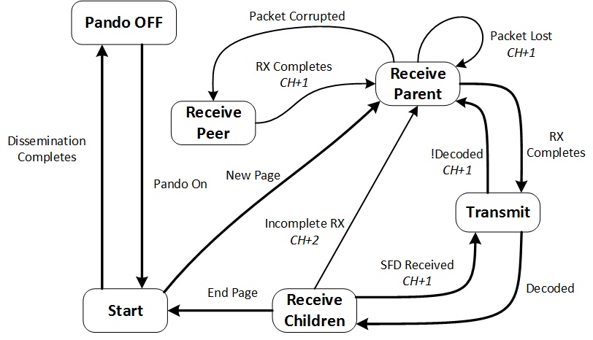
Implementation—state machine
Notes:
Fig. 7 illustrates the state machine of the nodes in Pando. The first step is to wake up the pando protocol, the second step is to disseminate data based on new page, then the parents forward data to its child nodes, then it switches to the next page when the child nodes are silent.

Slide 16
Evaluation -Testbeds
Indriya: 99 TelosB sensor motes
Flocklab: 31 Tmote Sky sensor motes
The packet size is set to 64 bytes
Data object: 32 kBytes
Baselines: Deluge and Splash
Four metrics: reliability, dissemination time, energy consumption and memory cost.
Notes:
Do some experiments on the two testbeds of sensor networks, called Indriya and Flocklab….. Then compare the Pando with two baselines, deluge and splash.

Slide 17
Evaluation: dissemination time
Note that, the authors encounter technical problems for the Deluge protocol.
Notes:
Table 1 and Table 2 show the dissemination time of three protocols on the testbed Indriya. In order to improve the accuracy of the experiment results, the authors do five tests and then got the average time . From this table, we can see that it takes about 11.4 seconds to achieve 100% reliability, whiles Splash requires 40 seconds.

Slide 18
Evaluation: dissemination time
Notes:
It takes Pando 5.7 seconds to disseminate data, while Splash needs about 40.1 seconds and 36.5 seconds.
Improve a lot because the nodes are sparsely deployed.

Slide 19
Reliability of individual node
Figure 8, Reliability of individual nodes achieved by Pando and Splash on Indriya and Flocklab.
Notes:
Figure 8 demonstrates the reliability of individual nodes.

Slide 20
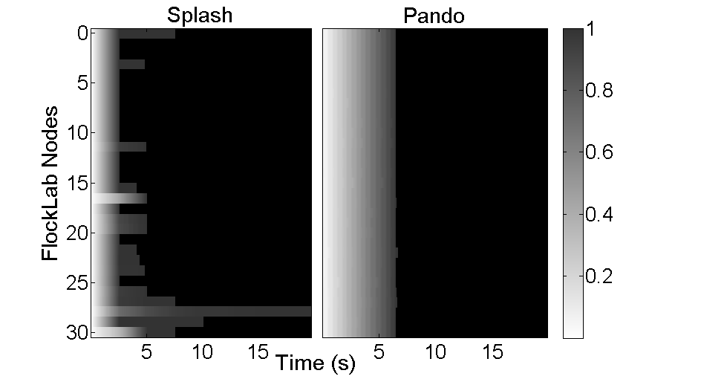
Evaluation – Dissemination time on Flocklab

Slide 21
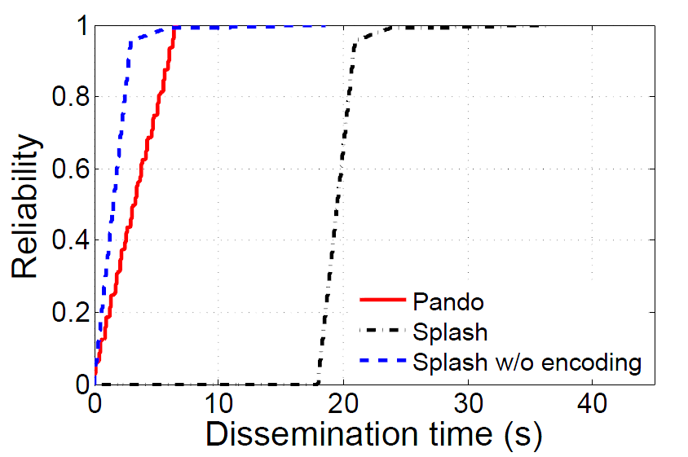
Dissemination time on Flocklab
15 s
29s

Slide 22
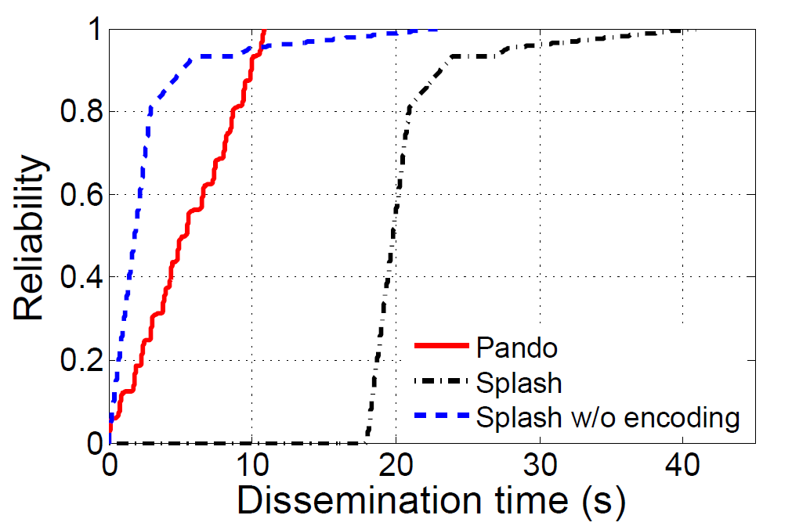
Dissemination time on Indriya
12 s
30s
Notes:
Figure 9 depicts the progress of the average network reliability achieved by Splash and Pando on Indriya and Flocklab respectively

Slide 23
Compared to others
Table 3: Reduction factor of dissemination time over Deluge achieved by the existing data dissemination protocols in wireless sensor networks

Slide 24
Conclusion
This paper presented Pando, a contention-free data dissemination protocol for wireless sensor networks.
Designed a radio-driven coding scheme and adopt Fountain encoding to effectively solve long-tail problem
Designed a novel silence based feedback approach in the one-way pipelines to timely acknowledge the successful recovery of the data object and stop dissemination process.
Applied packet-level adaptation of channel diversity
and network density to boost the dissemination efficiency.
The results show that Pando outperformed other baseline protocols

Slide 25
Thank you very much！Questions?
25

Slide 26
References
Du, Wan, et al. "When Pipelines Meet Fountain: Fast Data Dissemination in Wireless Sensor Networks."
Proceedings of the 13th ACM Conference on Embedded Networked Sensor Systems. ACM, 2015.
http://www.ntu.edu.sg/home/limo/
https://en.wikipedia.org/wiki/Gaussian_elimination

