Slide 1
P2
Declarative overlay implementation
Boyang Chen

Slide 2
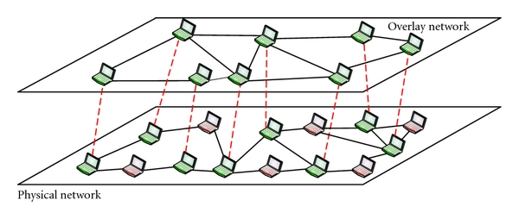
Overlay network
An overlay network is a computer network that is built on top of another network. E.X. file sharing networks maintain neighbor tables to route queries.

Slide 3
The tradition of overlay design
1. Protocol-centric approach
traces its roots to event languages that specify overlay execution via automata for event and message handling. Emphasizing the dynamics of the overlay and its maintenance, but makes it difficult to determine the overlay’s coarse structure and invariant properties.(MACEDON)
2. Structure-centric approach
focusing on a network graph structure, maintained via async messaging. Gloss over details of the actual runtime messaging. Implementing structure-centric overlays often requires a fair bit of engineering, and different implementations of the same overlay can vary significantly in their actual execution (DHT)

Slide 4
Why P2 was invented?
To simplify the process of selecting, implementing, deploying and evolving an overlay network design.
Using a declarative logic language for specifying overlays, and employing a dataflow framework at runtime for maintaining overlays instead of the more conventional finite state machine approach. These innovations together promise two advantages: ease of specification, and sharing/reuse of code.
To merge the two traditional approaches mentioned above.
The interface of P2 is closer in spirit to the structure-centric approach, encouraging the specification of overlays as logical structures with invariants. It also automatically compiles this specification to a dataflow program for managing asynchronous messages(protocol-centric way).

Slide 5
P2’s contribution
A diverse set of overlays can be expressed concisely in a declarative specification language.
such specifications can usefully be executed as overlay maintenance protocols sharing communication, state, and computation
Such overlays have acceptable performance compared to hand-coded implementations
P2 does not aim for performance results as good as optimized C, C++, or Java implementations

Slide 6
The core model: stream and table
soft-state tables
streams of transient tuples

Slide 7
Relational approach to represent network graph
First, structured tables are a simple and natural representation for network state.
neighbor tables are widely used in networks.
tables and relationships between them are easy to represent concisely in a declarative language.
a consistently–named view of all the local tables and messages at different nodes.
The relational abstraction is a natural way to reuse functionality and share routing state among different overlays.

Slide 8
The core language: Overlog
based on the widely-used Datalog query language.
Have the advantage of conciseness, declarativeness.
Neither a pure logic language…
constructs to specify physical distribution properties, continuous queries over streams as well as tables, and deletion of tuples from tables.
Nor a domain-specific language
an adaptation of a powerful query language to a distributed context of data and messages
OverLog rules have the form [<ruleID> <head> :- <body>.]
A Narada mesh implementation as example.

Slide 9
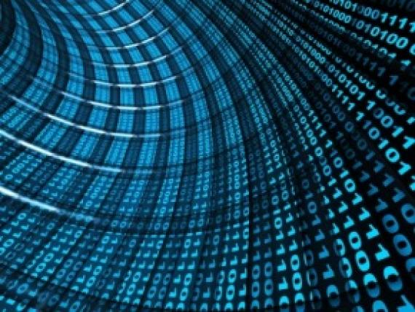
The core language: Overlog
R1 refreshEvent(X) :- periodic(X, E, 3).
R2 refreshSeq(X, NewSeq) :- refreshEvent(X),
sequence(X, Seq), NewSeq := Seq + 1.
R3 sequence(X, NewS) :- refreshSeq(X, NewS).
Sequence -> table, refreshSeq, refreshEvent, periodic -> event/stream data
Whenever see this, then...

Slide 10
The core structure: P2 dataflow
Overlog translating into dataflow graph, similar to Scout, Click and XORP
Use term “element” in Click as a node in a P2 dataflow graph, while as in database query plans, each edge in the graph carries a stream of well structured tuples.
Mix tasks like queuing, (de)multiplexing, and congestion control along with relational database operators like joins and aggregations.
Use datamodel chain together separate elements responsible for socket handling, packet scheduling, congestion control, reliable transmission, data serialization, and dispatch.

Slide 11
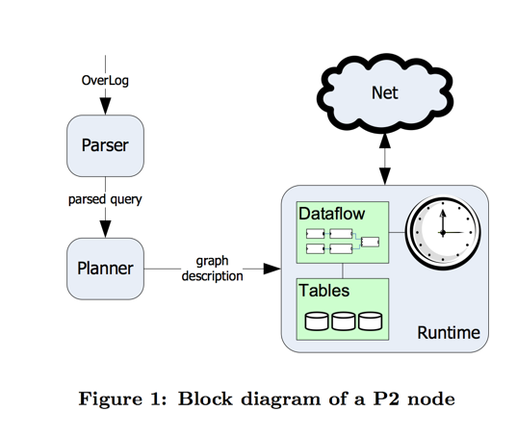
P2 architecture
Runtime plan executor

Slide 12
The structure benefits
Scoping: constrains what needs to be handled in each element implementation, aiding in both specification and comprehension.
In automata, scoping is difficult to both specify correctly and understood once specified.
Typing: all tuples that pass along an edge share the same schema
Automata will handle any type possible passing through the path.
Encapsulation and Reuse: subsets of rules in OverLog programs can be easily extracted and reused in other programs.
Automata subpath is very hard to be extracted and reconfigured.

Slide 13
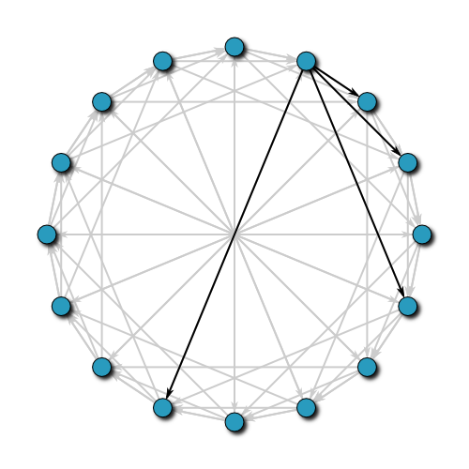
A Chord ring implementation
By Overlog

Slide 14
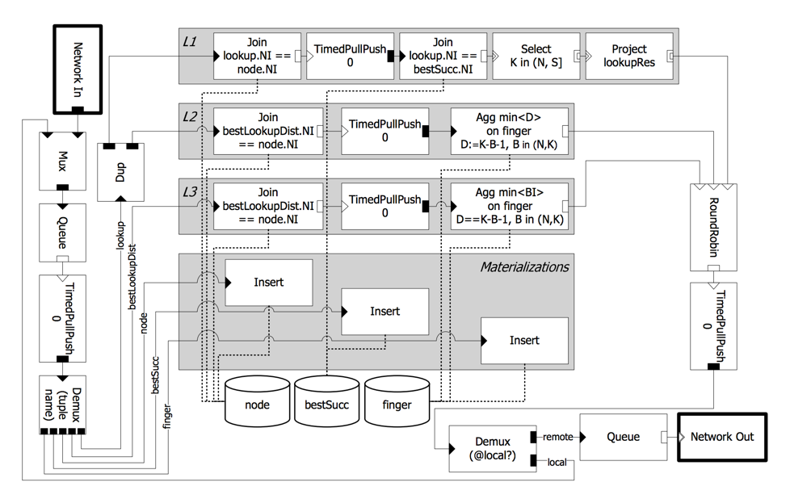
ports are either
triangular (for input) or
rectangular (for output),
black (for push) or
white (for pull),
and doubly lined for agnostic.

Slide 15
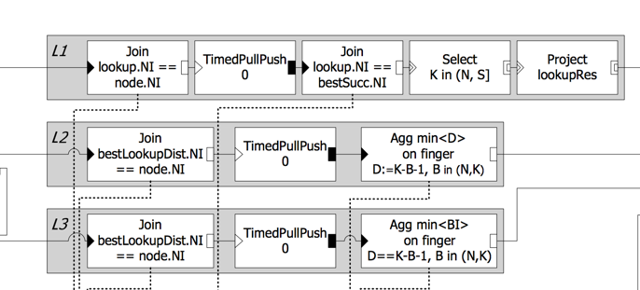
A closer look for rules (around only 15 in total)

Slide 16
A closer look for rules (around only 15 in total)
L1 lookupResults@R(R,K,S,SI,E) :- node@NI(NI,N), lookup@NI(NI,K,R,E), bestSucc@NI(NI,S,SI), K in (N,S].
returns a successful lookup result if the received lookup seeks a key K found between the receiving node’s identifier and that of its best successor
L2 bestLookupDist@NI(NI,K,R,E,min<D>) :- node@NI(NI,N), lookup@NI(NI,K,R,E), finger@NI(NI,_,B,_), D:=K - B - 1, B in (N,K).
finds the minimum distance from the local node’s fingers to K, for every finger node BI whose identifier B lies between the local node’s identifier N and K. T.
L3 lookup@BI(min<BI>,K,R,E) :- node@NI(NI,N), bestLookupDist@NI(NI,K,R,E,D), finger@NI(NI,_,B,BI), D == K - B - 1, B in (N,K).
The first address of a finger with that minimum distance to the key K is chosen in L3 to receive the forwarded lookup.

Slide 18
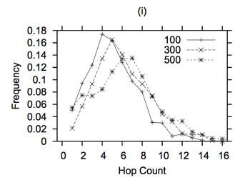
Performance evaluation: feasibility experiment
a uniform workload of DHT “lookup” requests to a static membership of nodes in the overlay, with no nodes joining or leaving

Slide 19
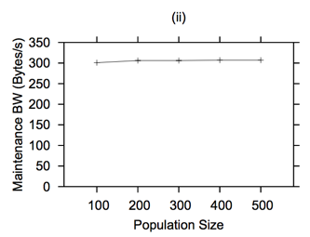
Performance evaluation: feasibility experiment
a uniform workload of DHT “lookup” requests to a static membership of nodes in the overlay, with no nodes joining or leaving

Slide 20
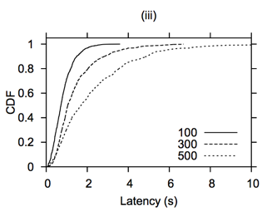
Performance evaluation: feasibility experiment
a uniform workload of DHT “lookup” requests to a static membership of nodes in the overlay, with no nodes joining or leaving

Slide 21
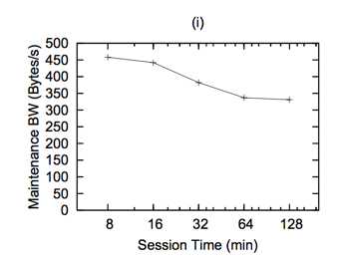
Performance evaluation: handling churn
P2 Chord implementation under varying degrees of membership churn

Slide 22
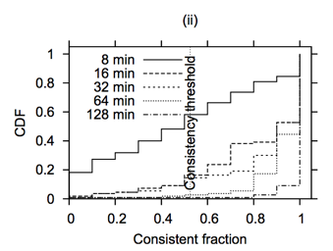
Performance evaluation: handling churn
P2 Chord implementation under varying degrees of membership churn
shows consistency of lookups over time

Slide 23
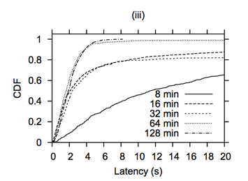
Performance evaluation: handling churn
P2 Chord implementation under varying degrees of membership churn
P2 Chord does respectably under low churn (session times of 64 minutes and above), generating at least 97% consistent lookups, most of which complete within 4 seconds
under high churn (session times of 16 minutes and less), P2 Chord does not perform well, producing only 42% and 84% consistent lookups with high latencies.

Slide 24
Benefit of P2: language and model
Successful conciseness
A succinct implementation automatically translated to a dataflow framework.
Amenable to optimization
Tech used for sharing state, communication, and computation across multiple overlay specifications.
Security insurance
small, simple dataflow elements along with flat state tables implies that we might be able to express security invariants for each element in isolation(for future work)

Slide 25
shortage
Learning curve for imperative language users
If - else - then logic:
C1 joinEvent@NI(NI,E) :- join@NI(NI,E).
C2 joinReq@LI(LI,N,NI,E) :- joinEvent@NI(NI,E), node@NI(NI,N), landmark@NI(NI,LI), LI != "-".
C3 succ@NI(NI,N,NI) :- landmark@NI(NI,LI), joinEvent@NI(NI,_), node@NI(NI,N), LI == "-".

Slide 26
shortage
Redundancy in code structure and very strict syntax rules.
Similar code structure makes it easier to make mistake; Could have a way to reuse some blocks effectively?
Less is strict: a good way to redesign the existing framework but could potentially be confined for future system adaption. Very suitable for intuitive major rule extraction based on given system architecture.

Slide 27
shortage
Runtime speed could not be as good as hard-code version.
P2 does not aim for performance results as good as optimized C, C++, or Java implementations, we could recall.
we do not expect our per-node performance to be as good as a highly-tuned hand-coded implementation, but we would like it to be acceptable.
Don’t forget the external optimization it could work with. (overlays sharing)

Slide 28
Future work
Breadth
Make P2 sufficiently expressive to cover the design space, but will also enable us to start to identify common constructs that can be factored out of particular overlay specifications and shared.
Sharing
The possibility that multiple overlays can execute simultaneously, sharing state, communication, and computation by sharing dataflow subgraphs.
Online distributed debugging
Multi-resolution programming paradigm, allowing the programmer to specify a system as a set of logical rules, which are translated to a dataflow graph and then executed at runtime.

Slide 29
Future work
Security:
Mentioned before, a spontaneous choice to move from system introspection to security assessment
Transport Protocol:
Different applications require different combinations of reliable, in-order, congestion-, and flow-controlled transports, and different levels of control and inspection for each.
Language:
The language is still in adaption for more sophisticated usage. Exploring the extensions in the language that would permit a high-level specification of sharing, transport, debugging, and security logic

Slide 30
Discussion question
What’s your experience in designing large system(not just overlay)? Do you feel more comfortable writing a declarative language over an imperative one for implementation? (Recall writing a SQL db, while comparing the experience with a java server framework)

Slide 31
Discussion opinion
The paper is not taking into the account of its major target: the programmer. What we are doing here is more like a way of introducing a new wrapper to the system, but whether this wrapper could facilitate the customer is unknown. Since the major focus of this project is not performance, more feedback from any real Chord overlay implementation side people should be valuable, or even some experimental implementation competition.

Slide 32
Q&A

Slide 33
Thank you~

