Slide 1
Synopsis diffusion
For Robust Aggregation in Sensor Networks
Suman Nath, Phillip B. Gibbons,
Srinivasan Seshan, Zachary R. Anderson
Presented by Xander Masotto

Slide 2
Motivation
Our goal is to aggregate data collected from sensor nodes
i.e. Count, Sum, Average, Rank
We prefer solutions with:
Low memory usage
Low power consumption
Tolerance of node and communication failures
Aggregating data points in-the-network significantly reduces size of messages, thus saves power

Slide 3
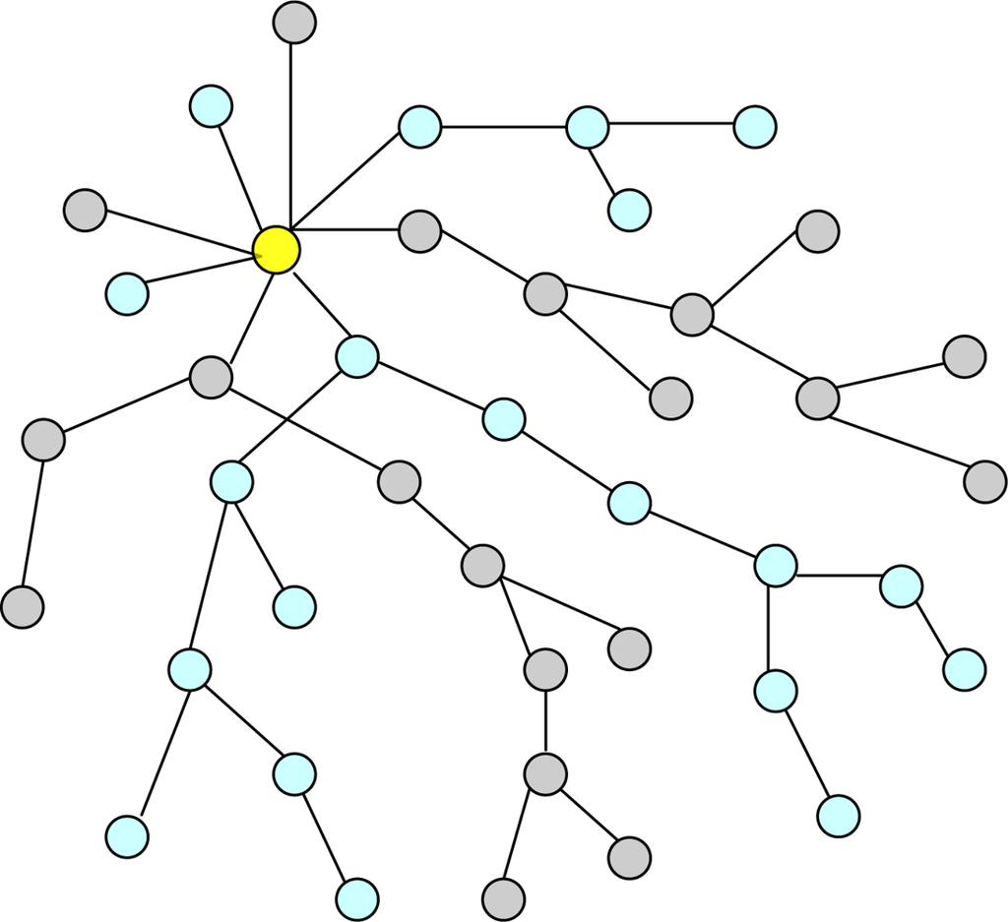
Tree-based Aggregation
Constructs a spanning tree
Provides low power consumption
Avoids double counting

Slide 4
Tree-based Aggregation
Constructs a spanning tree
Provides low power consumption
Avoids double counting
Not fault tolerant; if a node fails, we lose its entire subtree

Slide 5
DAG-based Aggregation
Instead of a tree, let each node have k parents, and send each parent (1/K)th of the sensor information
Reduces the expected error by a factor of K

Slide 6
DAG-based Aggregation
Instead of a tree, let each node have k parents, and send each parent (1/K)th of the sensor information
Reduces the expected error by a factor of K
Can we do better than this?
Every message contributes to the final answer, which means every node/communication failure increases error in the final answer

Slide 7
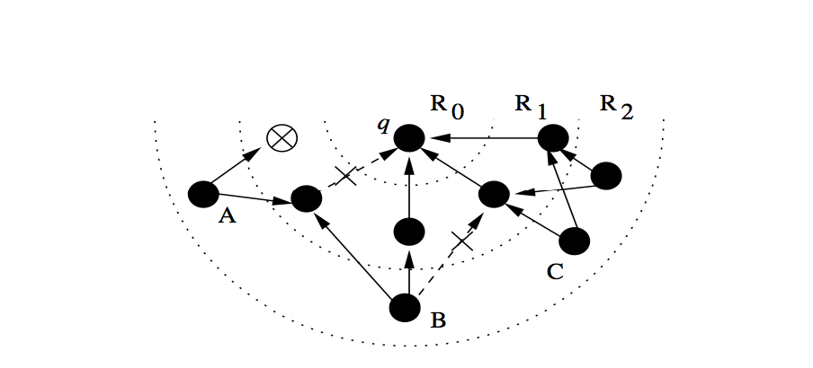
Synopsis Diffusion
Allows sensor readings to have multiple paths to the querying node
This is achieved by using duplicate-tolerant aggregation algorithms

Slide 8
Outline
Definition and analysis of ODI Synopses
Examples of ODI-correct Algorithms
Multi-path Aggregation Topologies
Evaluation

Slide 9
Synopses
Synopses are partially aggregated results that give a summary of the data
Synopses are generated by sensors, then passed between nodes and merged together. At the querying node, a synopsis is translated into a final answer.
SG(sensor) = Synopsis generation
SF(s1, s2) = Synopsis fusion
SE(s) = Synopsis Generation

Slide 10
Synopses
SG(sensor) = {(sensor.id, sensor.value)}
SG(s1, s2) = union(s1, s2)
SG(s) = sum over all values in s
A
{(A, 1)}
{(A,1), (B,2)}
{(B, 2)}
B
{(C, 3)}
{(A,1), (B,2), (C,3)}
Answer: 6
{(B,2), (C,3)}
C

Slide 11
Synopses
SG(sensor) = {(sensor.id, sensor.value)}
SF(s1, s2) = union(s1, s2)
SE(s) = sum over all values in s
A
{(A, 1)}
{(A,1), (B,2)}
{(B, 2)}
B
{(C, 3)}
{(A,1), (B,2), (C,3)}
Answer: 6
{(C,3)}
C

Slide 12
ODI-Correctness
Order and Duplicate Insensitivity
SF(SG*(X), SG*(Y)) = SF(SG*(X), SG*(Y \ X))
Where X and Y are sets of sensors
SG*(X) = SF(SG(x1), SF(SG(x2), …))
An aggregation algorithm is ODI-correct if and only if:
SG() preserves duplicates (same sensor, same synopsis)
SF() is Commutative: SF(s1, s2) = SF(s2, s1)
SF() is Associative: SF(s1, SF(s2, s3)) = SF(SF(s1, s2), s3)
SF() is Idempotent: SF(s, s) = s

Slide 13
ODI-Correct Count
We want to count the number of distinct elements in a multiset M
With each element x, let h(x, j) be the jth bit of its hash
Let SG(sensor) = S({sensor.id})
Let SF(s1, s2) = s1 | s2
ODI-Correct

Slide 14
ODI-Correct Count
What does S(M) tell us about M?
For a given h(x), Pr[min{h(x, j)=1} = i] = (½)^(i+1)
It’s less probable for S(M)[i] to be set when i is large
The more distinct elements, the more hashed values contribute to S(M), and so the more likely that *some* element has a prefix with a lot of zeros

Slide 15
ODI-Correct Count
Fast, since number of iterations follows geometric series with p=1/2, so the expected value is 2
When implemented on a sensor node, additional computation cycles compared to ordinary count are negligible

Slide 16
ODI-Correct Sum
We can easily extend our Count algorithm into summation over integers
Let Expand(id, value) = {(id, 1), (id, 2) … (id, value)}
Let SG(sensor) = S(Expand(sensor.id, sensor.value))
Let SF(s1, s2) = s1 | s2
In practice this is optimized, but basic idea is the same
Can approximate real numbers by using a fixed-point numerical representation

Slide 17
Other Examples
Mean (combine Sum and Count)
Variance (E[X^2] – E[X]^2)
Sampling K elements uniformly
Associate a random number with every distinct value, collect the K largest numbers
Ranking by Frequency
Each synopsis keeps track of top K estimated counts
Counts are estimated using ODI count synopses

Slide 18
Rings Topology
Sensor nodes are divided into Rings
The querying node is exclusively in Ring 0
A node is in Ring i+1 if it first hears about the query from a nodes in Ring i

Slide 19
Rings Topology
Sensor nodes are loosely time synchronized
Divided into epochs, answer produced after each one
Each Ring i is given an allotted time, outer rings first
For a leaf node:
Let s = SG(self)
Broadcast s
For an internal node at Ring i:
Let s = SG(self)
Listen for messages:
If received synopsis s’ from Ring (i+1)
Set s = SF(s, s’)
Broadcast s

Slide 20
Implicit Acks
ODI-correctness provides a mechanism for acknowledgements without actually sending ack messages
sx
X
Y
Z

Slide 21
Implicit Acks
ODI-correctness provides a mechanism for acknowledgements without actually sending ack messages
sy
sy
X
Y
Z
Check whether SF(sx, sy) = sy
If true, then Y effectively received sx

Slide 22
Adaptive Rings Topology
Use implicit acks in order to adjust the topology in order to improve message reliability
Count the number of messages heard from nodes in rings i, i+1, and i+2 over the last W epochs
Count the number of implicit acknowledgements heard from nodes in rings i-1 and i-2 over the last W epochs
If n(i-1) < n(i+1) and n(i-1) < n(i) < n(i+2) then assign itself to ring i+1 with probability p
If n(i+1) < n(i-1) and n(i+1) < n(i) < n(i-2) then assign itself to ring i-1 with probability p

Slide 23
Evaluation
Tested the Sum aggregate on a deployment of 600 sensors randomly placed in a 20ft x 20ft grid
Simulated over 500 epochs:
TAG
TAG2 (value splitting between 2 parents)
RINGS
ADAPTIVE RINGS
FLOOD
Every node broadcasts to all neighbors, run for D+1 steps where D is the max-distance from the query node
Calculate the RMS error:

Slide 24
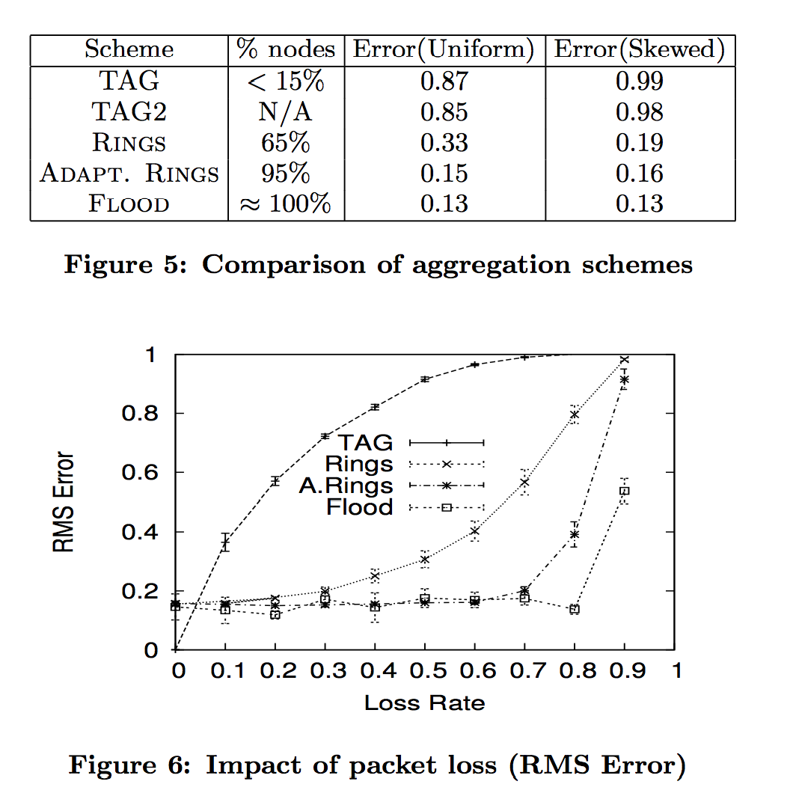

Slide 25
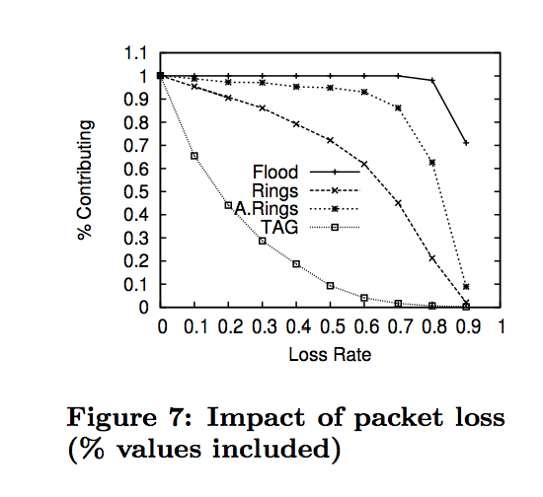

Slide 26
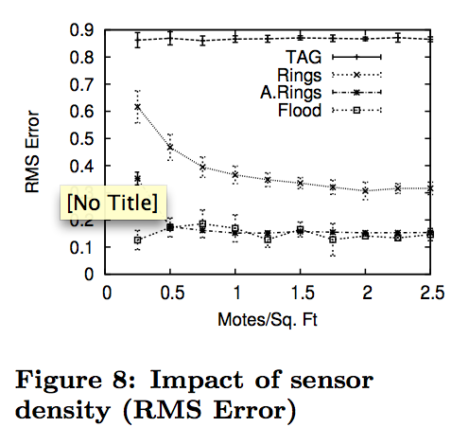

Slide 27
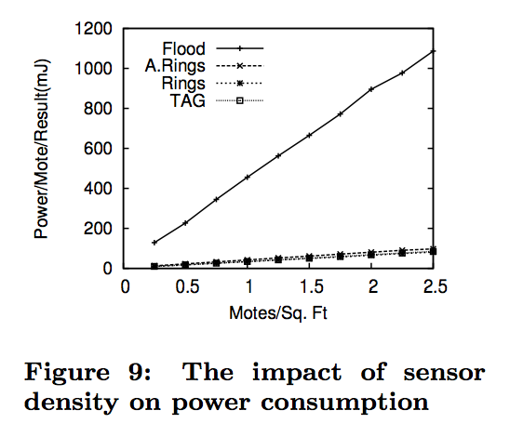

Slide 28
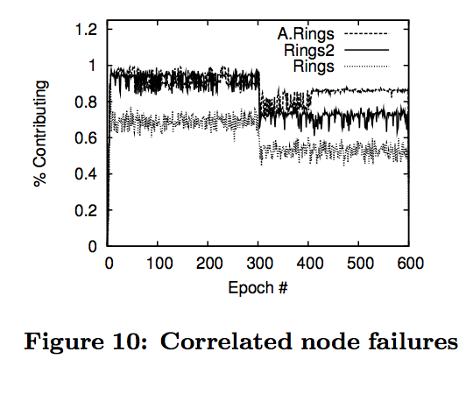

Slide 29
Thoughts
Would be interesting to find ODI-Correct algorithms that work well for floating point data
Replaced communication error with approximation error
Replacing equipment, buying better transmitters, or strategically placing sensors won’t help fundamental limit of accuracy
Was it fair to place nodes randomly?
Is 0.13 an acceptable percent error?
For calculating average, error in numerator and denominator can combine: 1.13 / 0.87 = 1.30
Distribution of error instead of just RMS?
Are there algorithms that can be calculated in single-path topologies that can’t be approximated in multi-path?

