Slide 1
Salt: Combining ACID and BASE in a Distributed Database
Authors (University of Texas Austin): Chao Xie, Chunzhi Su, Manos Kapritsos, Yang Wang, Navid Yaghmazadeh, Lorenzo Alvisi, Prince Mahajan
Presented By:
Sharanya Bathey

Slide 2

The tale of ACID…
Transaction - Basic unit of work in an RDBMS
ACID
  Atomicity: all or nothing
  Consistency: always leave a database in a consistent state
  Isolation: every transaction is completely isolated
  Durability: once committed always recorded
Image Source
Notes:
https://www.google.com/url?sa=i&rct=j&q=&esrc=s&source=images&cd=&cad=rja&uact=8&ved=0CAcQjRw&url=http%3A%2F%2Fwww.reddit.com%2Fr%2FAskReddit%2Fcomments%2Fji5ae%2Fwhat_is_the_top_image_that_comes_out_when_you%2F&ei=qLntVOmJBoGZNsm1g-AC&bvm=bv.86956481,d.cWc&psig=AFQjCNHY7h8oJWktVAhfR6reJuePmaboMw&ust=1424952089120532

Slide 3

The tale of ACID…(Oh No!)
What needs to be done to achieve this abstraction?
  2 Phase Commit
  Locks
What baggage do such abstractions come with?
  Performance is sacrificed
Image Source
Notes:
http://www.dreamstime.com/royalty-free-stock-photo-crazy-cartoon-luggage-image18194065

Slide 4

Rise of BASE…
BASE
  Basically Available - does guarantee availability, in terms of CAP theorem
  Soft State - State of the system may change over time
  Eventually Consistent - data will be consistent at replicas eventually
Image Source
Notes:
http://www.imdb.com/title/tt1345836/

Slide 5

Rise of BASE… (What now?)
Problem?
  Complexity of programming
  Consistency Management
Image Source
Notes:
http://www.vectorstock.com/royalty-free-vector/needle-in-a-haystack-saying-cartoon-vector-1978946

Slide 6
Is there no middle ground?
Pareto Principle - 80-20 Rule
Example:
  Fusion Ticket (open source ticketing application)
  Total of 11 different types of Transactions of which just 2 are performance critical

Slide 7
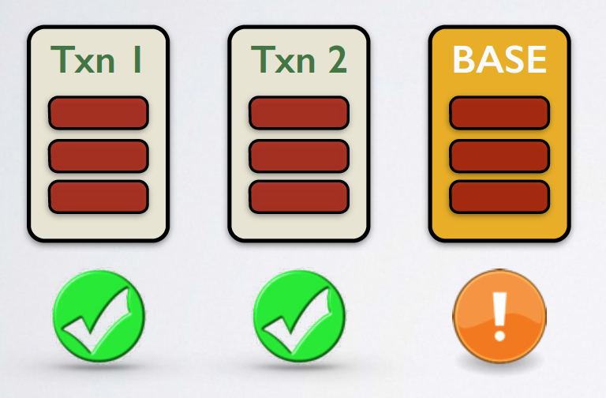
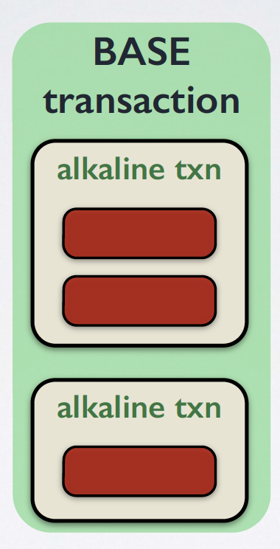
Introducing… BASE transactions
  Manually Identify the key transactions that cause the performance bottleneck
  Base-ify these transactions by breaking the transaction into alkaline sub transactions which are still contained within the same BASE transaction
Notes:
Image Source: https://www.usenix.org/conference/osdi14/technical-sessions/presentation/xie

Slide 8
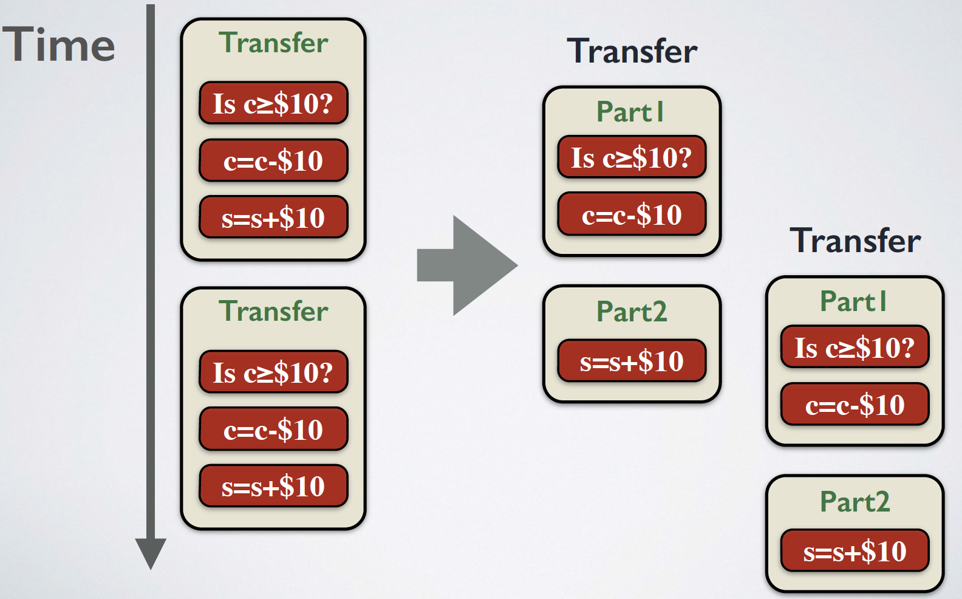
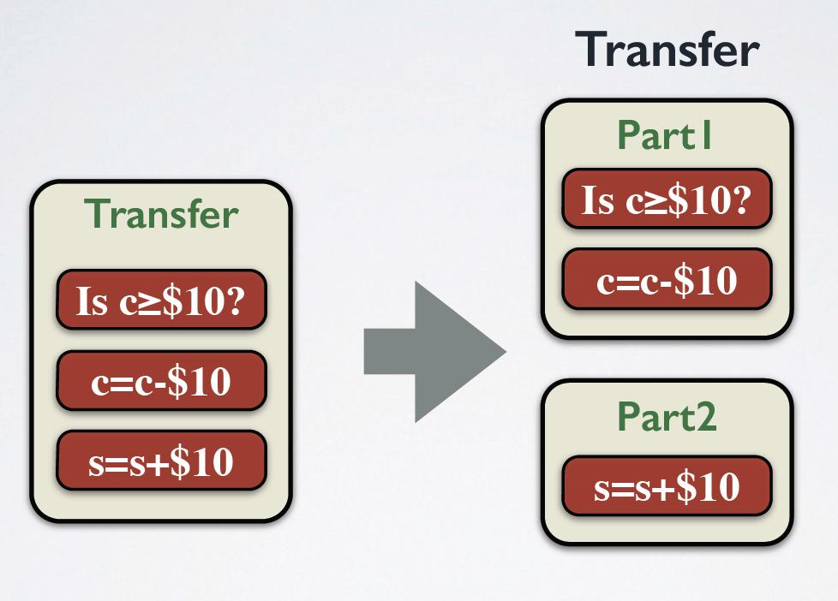
Example of Base-iying an ACID transaction
Base-fied Transaction
Acid Transaction
Notes:
Image Source: https://www.usenix.org/conference/osdi14/technical-sessions/presentation/xie

Slide 9
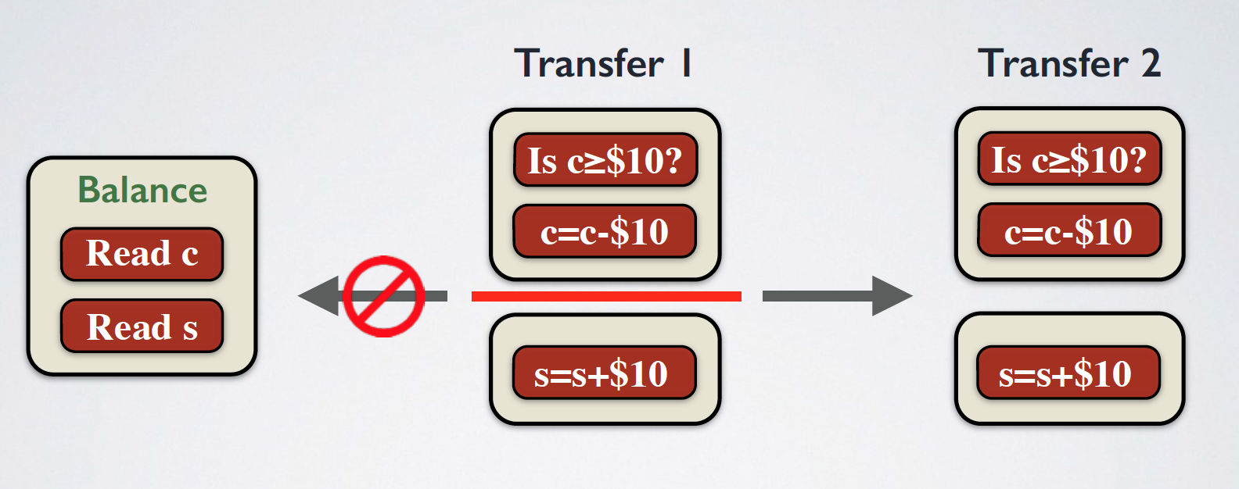
But the problem being?
Base-fied Transactions
Acid Transaction
Notes:
Image Source: https://www.usenix.org/conference/osdi14/technical-sessions/presentation/xie

Slide 10
Solution being? Restrict Interaction
 | ACID | BASE | Alkaline
ACID | No | No | No
BASE | No | Yes* | Yes*
Alkaline | No | Yes* | Yes**
* - intermediate committed state of alkaline sub transactions
** - only read alkaline sub transactions

Slide 11
Base Transactions (Contd…)
Major life events of BASE transactions: Accept & Commit
How does a BASE transaction provide ACID abstraction?
  Atomicity - once accepted will eventually commit
  Consistency - Interactions keep ACID and BASE transactions isolated
  Isolation - SALT Isolation coming up next..
  Durability - Accepted BASE transactions are guaranteed to be durable through logging

Slide 12
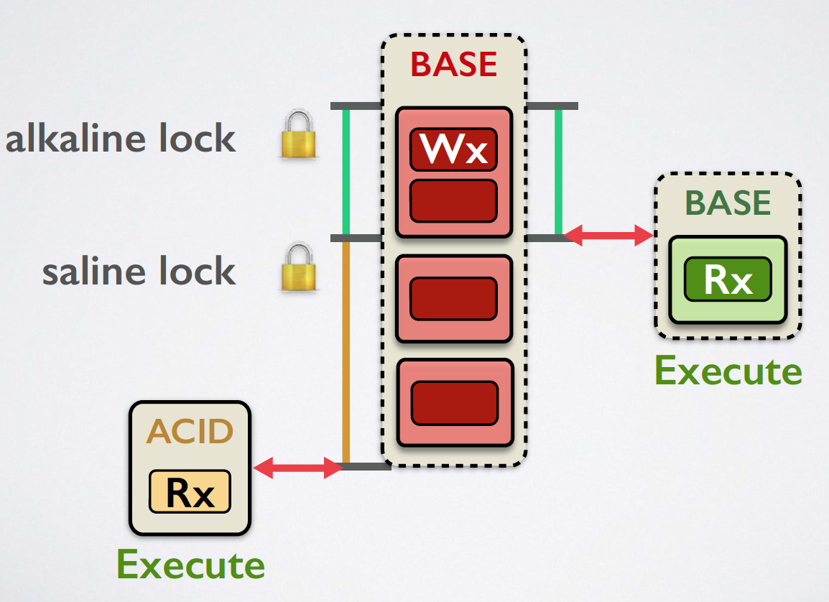
Introducing the MVP – Salt Isolation
Uses Locks - Isolation level chosen is Read Committed
Locks:
  ACID Locks - write with any other operation conflicts
  Alkaline Locks - alkaline sub transactions isolated from ACID and other alkaline sub transactions
  Saline Locks - ACID isolated from BASE, but increased concurrency by exposing intermediate state to of BASE transactions to other BASE transactions
Notes:
Image Source: https://www.usenix.org/conference/osdi14/technical-sessions/presentation/xie

Slide 13
So does it actually work?
Implementation:
  Modified MySQL to allow BASE transactions and Alkaline Sub-transactions
  Allow alkaline and saline locks
Optimizations:
  Early commit - A client that issues a BASE transaction sees the transaction completion when when its first Alkaline sub transaction commits
  Failure recovery - Logging with redo and roll forward
  Transitive dependencies - Per object queue
  Local Transactions
Replication of data was done across 10 partitions and each partition was three-way replicated
Evaluated: Performance Gain, Programming Effort, Contention Ratio
Notes:
Lock conflicts implementation
Control on when lock should be acquired or released
Queue for saline locks to be read.
Logging is done for the entire base transaction logic in order to replay in case of failure

Slide 14
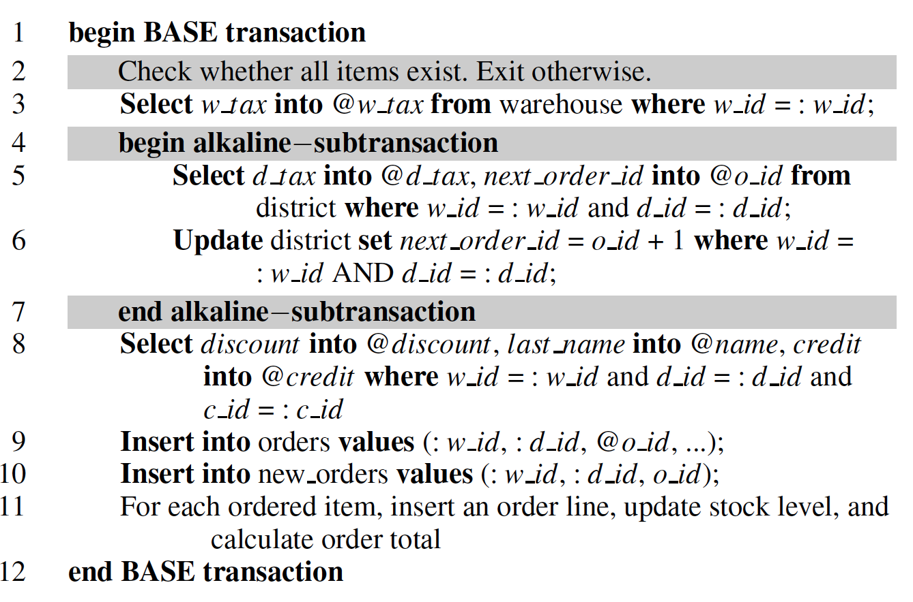
Case Study
Notes:
New-order – most heavily run transaction in TPC-C
New-order 5-6 requires unique order-id
8-9 need not be blocked by this and if it uses ACID then entire transaction is blocked
Other transactions are completely isolated

Slide 15
Applications used for the experiments
TPC-C benchmark : database performance standard
  5 transactions (new-order, payment, stock-level, order-status and delivery)
  New-order and payment are responsible for 43.5% of total number of transactions
Fusion Ticket: open source ticketing application in PHP and MySQL
  Includes several transactions
  Create-order and payment most frequent and performance critical
Micro benchmark:
  Contention ratio
  Contending transaction position
  Read-Write ratio

Slide 16
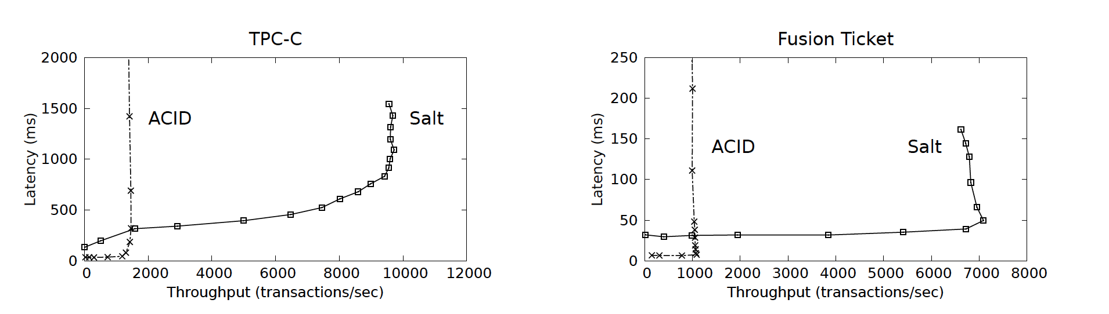
Did Salt win the award? (Yes…)
Base-ify: new-order and payment
Base-ify: Create-order and payment
6.6x higher
6.5x higher

Slide 17
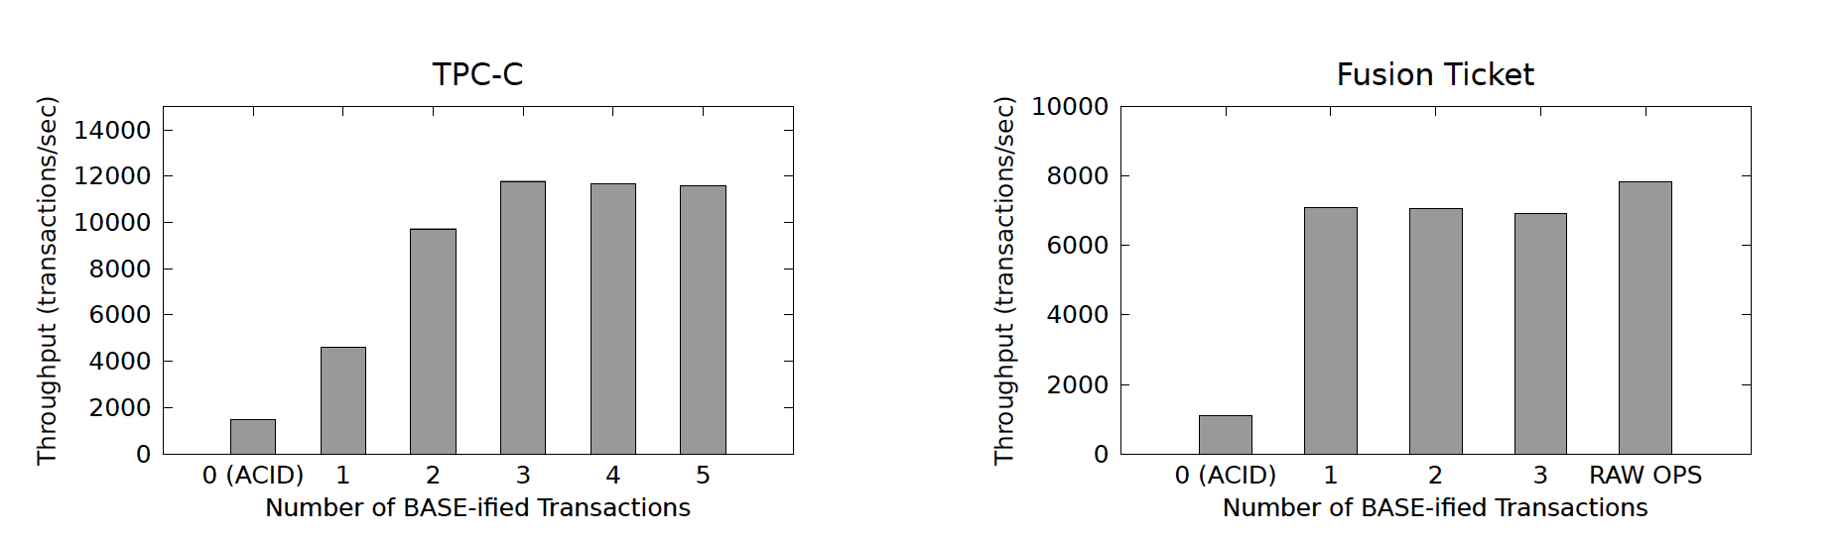
Did Salt win the award? (Contd...)
Performance gain becomes stagnant
Notes:
Exponential increase in cases for every basified transaction

Slide 18
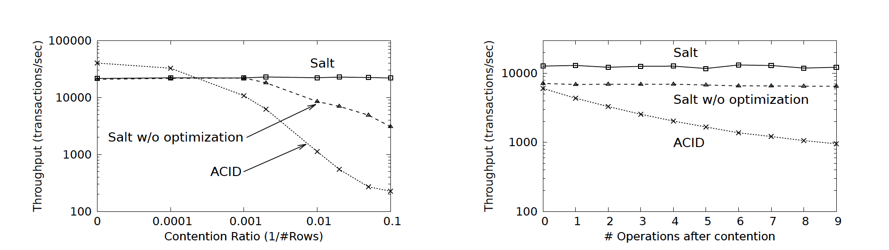
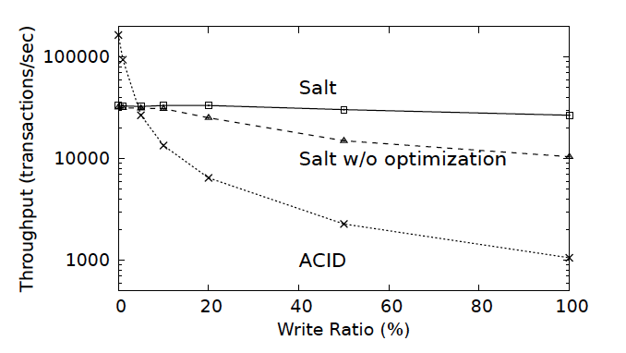
Did Salt win the award? (Contd…)
Notes:
Contention ratio – update 5 transactions out of N (no contention throughput of salt is lower than throughput of ACID due to additional bookkeeping for logging of reads)
No of operations after contention
Read to write ratio

Slide 19
Discussion & Q-A
Pros:
  Performance gain is drastic
  Control in the hands of the programmer
Cons:
  Cassandra allows batching of commands into groups to form transactions called atomic batches
  Leverage the power of MySQL clusters - MySQL does not allow nested transactions and MySQL now has several NoSQL/NewSQL like features
  Programming complexity - the difficulty of identifying the transactions that need to be converted and verifying the correctness is a daunting task

Slide 20
Thank You!

