Slide 1
Project Adam:
Building an Efficient and Scalable
Deep Learning Training System
Trishul Chilimbi, Yutaka Suzue, Johnson Apacible,
and Karthik Kalyanaraman, Microsoft Research
Published in the Proceedings of the 11th USENIX Symposium on Operating Systems Design and Implementation
Presented by Alex Zahdeh
Some figures adapted from OSDI 2014 presentation

Slide 2
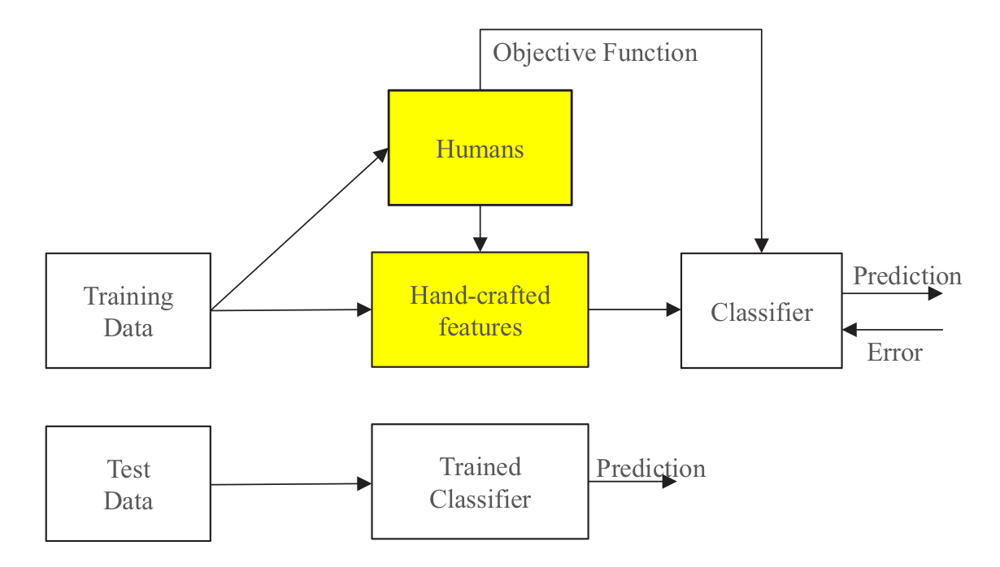
Traditional Machine Learning

Slide 3
Deep Learning
Humans
Objective Function
Data
Deep Learning
Prediction

Slide 4
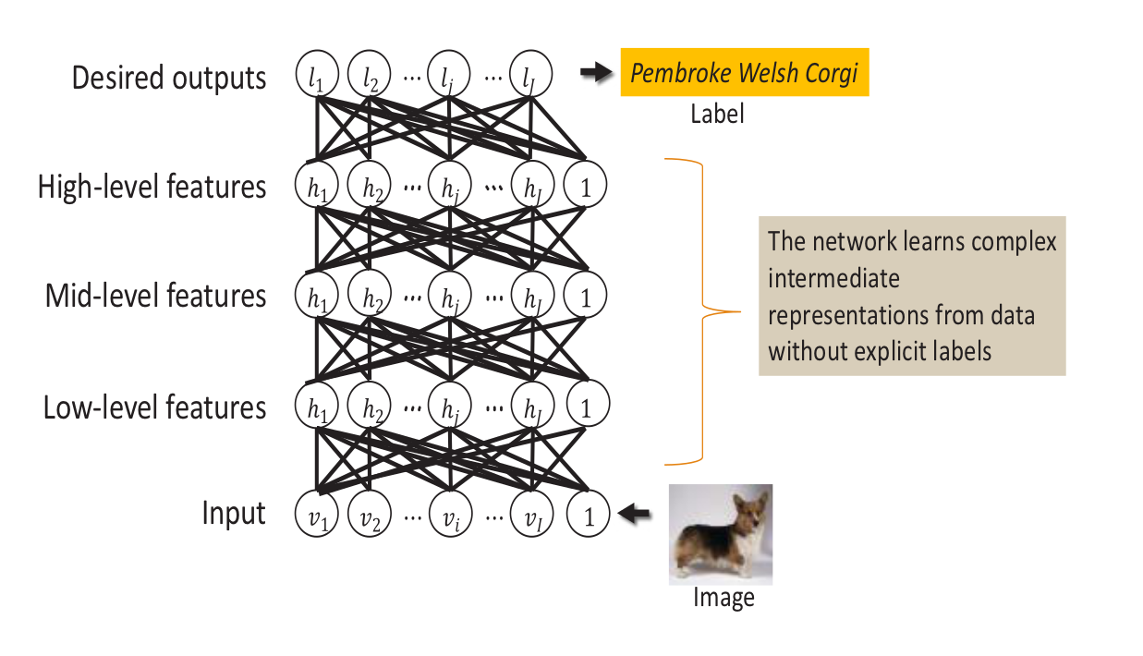
Deep Learning

Slide 5
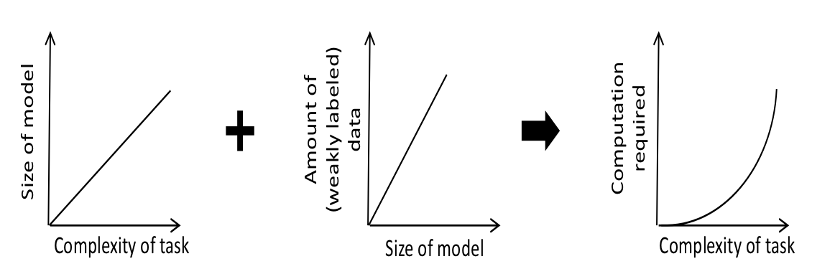
Problem with Deep Learning

Slide 6
Problem with Deep Learning
Current computational needs on the order of petaFLOPS!

Slide 7
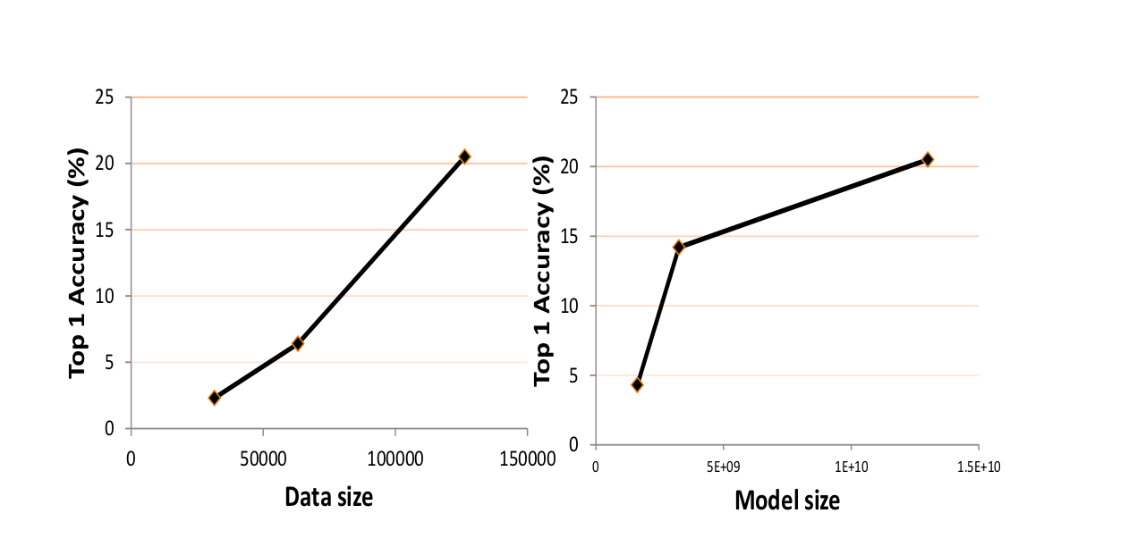
Accuracy scales with data and model size

Slide 8
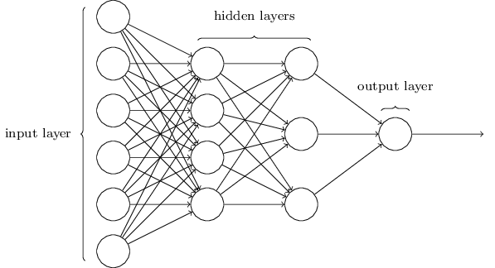
Neural Networks
http://neuralnetworksanddeeplearning.com/images/tikz11.png

Slide 9
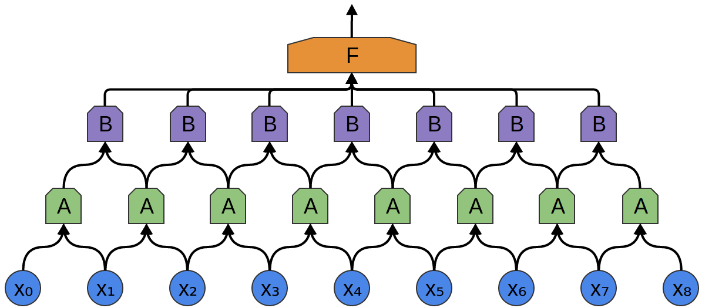
Convolutional Neural Networks
http://colah.github.io/posts/2014-07-Conv-Nets-Modular/img/Conv2-9x5-Conv2Conv2.png

Slide 10
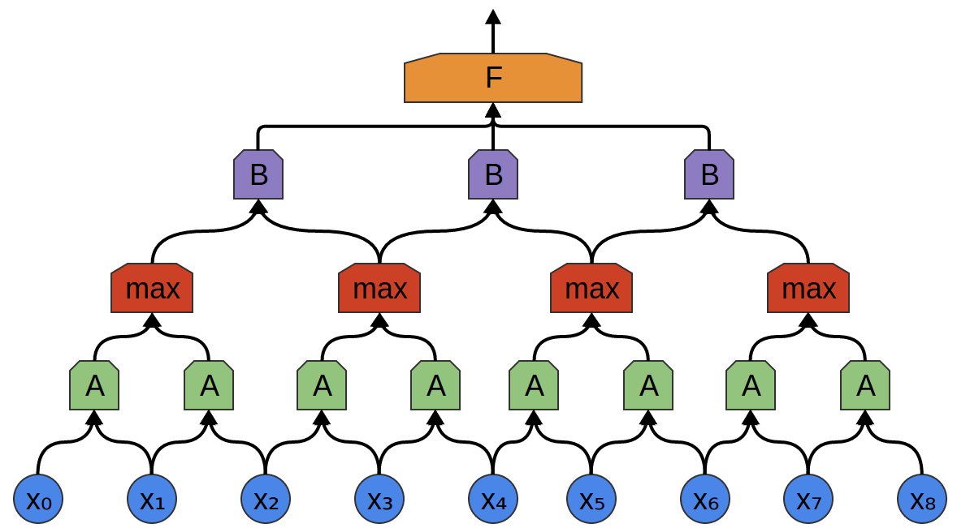
Convolutional Neural Networks with Max Pooling
http://colah.github.io/posts/2014-07-Conv-Nets-Modular/img/Conv-9-Conv2Max2Conv2.png

Slide 11
Neural Network Training (with Stochastic Gradient Descent)
Inputs processed one at a time in random order with three steps:
  Feed-forward evaluation
  Back propagation
  Height updates

Slide 12
Project Adam
Optimizing and balancing both computation and communication for this application through whole system co-design
Achieving high performance and scalability by exploiting the ability of machine learning training to tolerate inconsistencies well
Demonstrating that system efficiency, scaling, and asynchrony all contribute to improvements in trained model accuracy

Slide 13
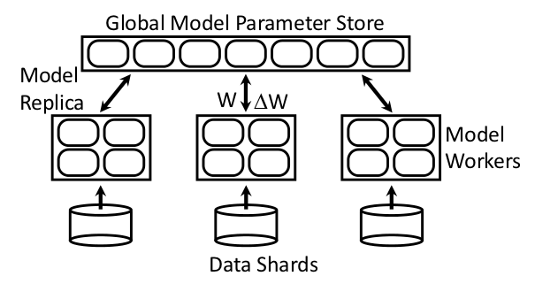
Adam System Architecture
Fast Data Serving
Model Training
Global Parameter Server

Slide 14
Fast Data Serving
Large quantities of data needed (10-100TBs)
Data requires transformation to prevent over-fit
Small set of machines configured separately to perform transformations and serve data
Data servers pre-cache images using nearly all of system memory as a cache
Model training machines fetch data in advance in batches in the background

Slide 15
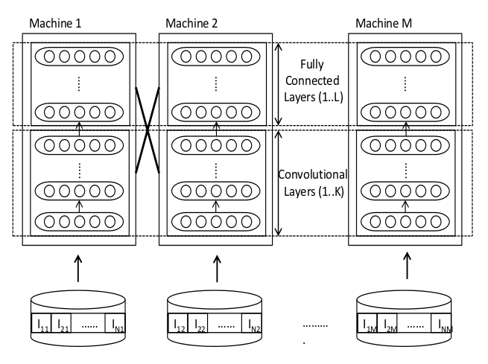
Model Training
Models partitioned vertically to reduce cross machine communication

Slide 16
Multi Threaded Training
Multiple threads on a single machine
Different images assigned to threads that share model weights
Per-thread training context stores activations and weight update values
Training context pre-allocated to avoid heap locks
NUMA Aware

Slide 17
Fast Weight Updates
Weights updated locally without locks
Race condition permitted
  Weight updates are commutative and associative
  Deep neural networks are resilient to small amounts of noise
Important for good scaling

Slide 18
Reducing Memory Copies
Pass pointers rather than copying data for local communication
Custom network library for non local communication
  Exploit knowledge of the static model partitioning to optimize communication
  Reference counting to ensure safety under asynchronous network IO

Slide 19
Memory System Optimizations
Partition so that model layers fit in L3 cache
Optimize computation for cache locality
Forward and Back propagation have different row-major/column-major preferences
  Custom assembly kernels to appropriately pack a block of data so that vector units are fully utilized

Slide 20
Mitigating the Impact of Slow Machines
Allow threads to process multiple images in parallel
Use a dataflow framework to trigger progress on individual images based on arrival of data from remote machines
At end of epoch, only wait for 75% of the model replicas to complete
  Arrived at through empirical observation
  No impact on accuracy

Slide 21
Parameter Server Communication
Two protocols for communicating parameter weight updates
Locally compute and accumulate weight updates and periodically send them to the server
  Works well for convolutional layers since the volume of weights is low due to weight sharing
Send the activation and error gradient vectors to the parameter servers so that weight updates can be computed there
  Needed for fully connected layers due to the volume of weights. This reduces traffic volume from M*N to K*(M+N)

Slide 22
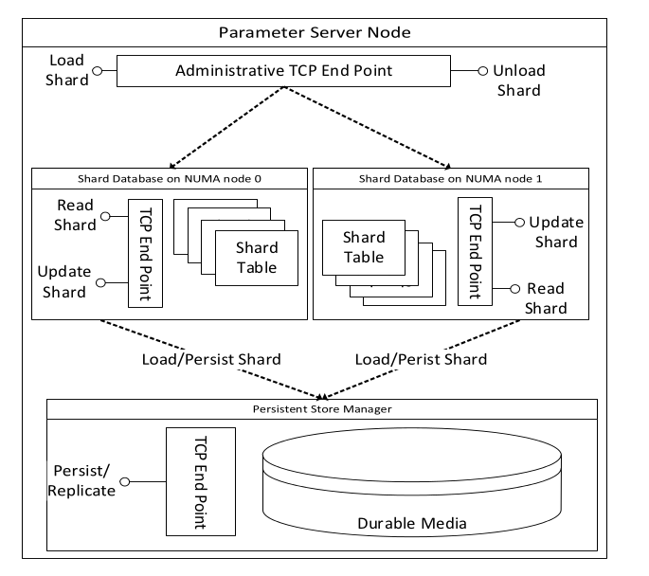
Global Parameter Server
Rate of updates too high for a conventional key value store
Model parameters divided into 1 MB shards
  Improves spatial locality of update processing
Shards hashed into storage buckets distributed equally among parameter servers
  Helps with load balancing

Slide 23
Global Parameter Server Throughput Optimizations
Takes advantage of processor vector instructions
Processing is NUMA aware
Lock free data structures
  Speeds up IO processing
Lock free memory allocation
  Buffers allocated from pools of specified size (powers of 2 from 4KB to 32MB)

Slide 24
Delayed Persistence
Parameter storage modelled as write back cache
  Dirty chunks flushed asynchronously
  Potential data loss tolerable by Deep Neural Networks due to their inherent resilience to noise
  Updates can be recovered if needed by retraining the model
Allows for compression of writes due to additive nature of weight updates
  Store the sum, not the summands
  Can fold in many updates before flushing to storage

Slide 25
Fault Tolerance
Three copies of each parameter shard
  One primary, two secondaries
Parameter Servers controlled by a set of controller machines
  Controller machines form a Paxos cluster
Controller stores the mapping of roles to parameter servers
Clients contact controller to determine request routing
Controller hands out bucket assignments
  Lease to primary, primary lease information to secondaries

Slide 26
Fault Tolerance
Primary accepts requests for parameter updates for all chunks in a bucket
Primary replicates changes to secondaries using 2PC
Secondaries check lease information before committing
Parameter server send heartbeats to secondaries
  In absence of a heartbeat, a secondary intitiates a role change proposal
  Controller elects a secondary as a primary

Slide 27
Communication Isolation
Update processing and durability decoupled
Separate 10Gb NICs are used for each of the paths
  Maximize bandwidth, minimize interference

Slide 28
Evaluation
Visual Object Recognition Benchmarks
System Hardware
Baseline Performance and Accuracy
System Scaling and Accuracy

Slide 29

Visual Object Recognition Benchmarks
MNIST digit recognition
http://cs.nyu.edu/~roweis/data/mnist_train1.jpg

Slide 30
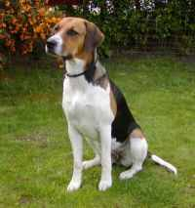
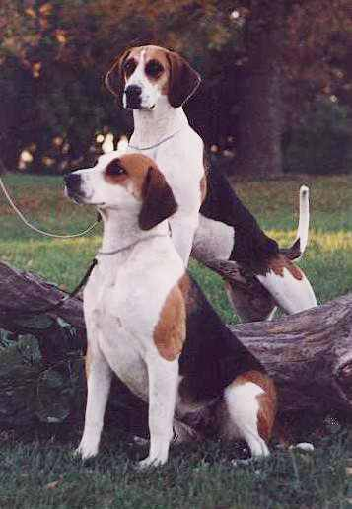
Visual Object Recognition Benchmarks
ImageNet 22k Image Classification
American Foxhound
English Foxhound
http://www.exoticdogs.com/breeds/english-fh/4.jpg
http://www.juvomi.de/hunde/bilder/m/FOXEN01M.jpg

Slide 31
System Hardware
120 HP Proliant servers
Each server has an Intel Xeon E5-2450L processor 16 core, 1.8GHZ
Each server has 98GB of main memory, two 10Gb NICs, one 1 Gb NIC
90 model training machines, 20 parameter servers, 10 image servers
3 racks each of 40 servers, connected by IBM G8264 switches

Slide 32
Baseline Performance and Accuracy
Single model training machine, single parameter server.
Small model on MNIST digit classification task

Slide 33
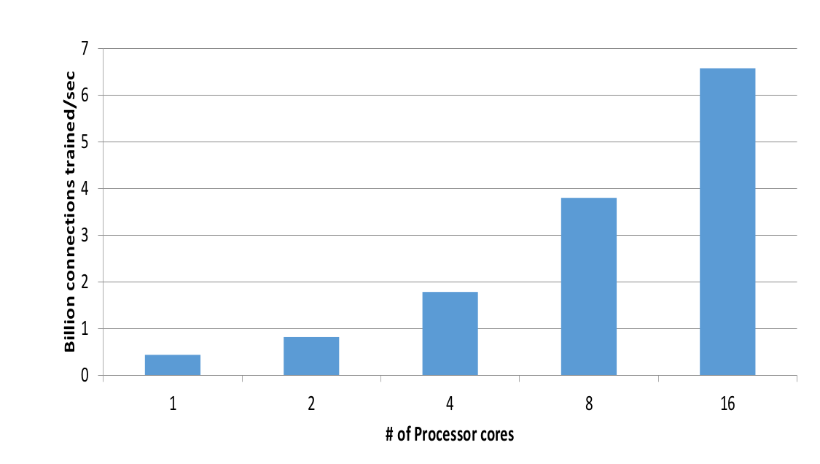
Model Training System Baseline

Slide 34
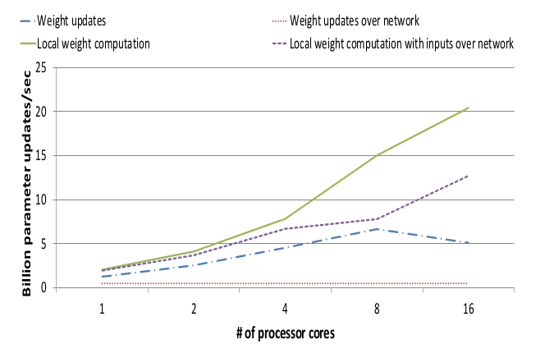
Parameter Server Baseline

Slide 35
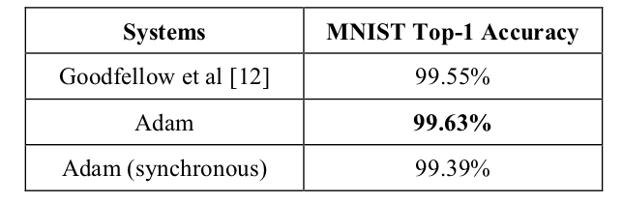
Model Accuracy Baseline

Slide 36
System Scaling and Accuracy
Scaling with Model Workers
Scaling with Model Replicas
Trained Model Accuracy

Slide 37
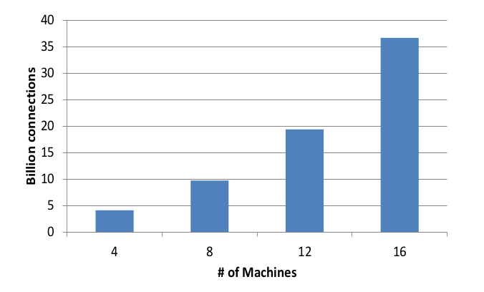
Scaling with Model Workers

Slide 38
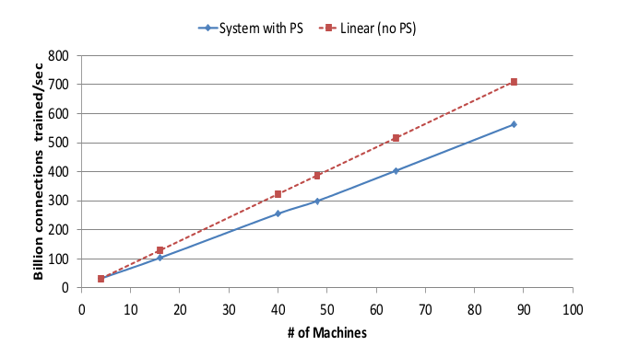
Scaling with Model Replicas

Slide 39
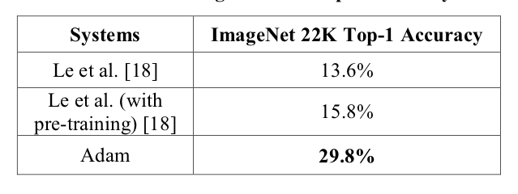
Trained Model Accuracy at Scale

Slide 40
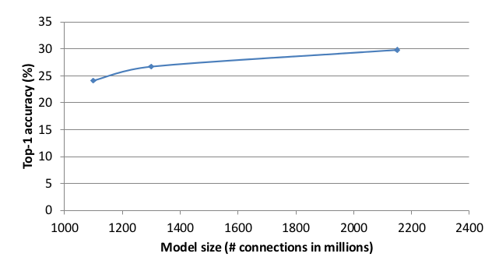
Trained Model Accuracy at Scale

Slide 41
Summary
Pros
World record accuracy on large scale benchmarks
Highly optimized and scalable
Fault tolerant
Cons
Thoroughly optimized for Deep Neural Networks; Unclear if it can be applied to other models

Slide 42
Questions?

