Slide 1
Tales of the Tail: Hardware, OS and Application-level Sources of Tail Latency
Jialin Li, Naveen Kr. Sharma, Dan R. K. Ports and Steven D. Gribble
Presented By: Tejala Thippeswamy

Slide 2
Agenda
Introduction and Background
The Approach
Ideal Latency Distribution
Testbed
Timestamping
Sources of Latencies
Analysis, Mitigation and Measurement
Putting it All Together
Pros Cons and Discussion

Slide 3
Introduction and Background
Latency and its effects:
Latency translates directly to revenue
Amazon found every 100ms of latency cost them 1% in sales
A year-long performance redesign at ShipZilla resulted in a 5 second speed up resulting in a 25% increase in page views, a 7-12% increase in revenue.
“Marissa Mayer shared the results of an experiment conducted at Google where they increased the number of search results per page from 10 to 30, with a corresponding increase in page load times from 400ms to 900ms. The delay caused a 20% drop in traffic.”
Source
Notes:
Latency is bad!! The ideal system is one which has no latency at all!! But this never happens in realistic scenarios. Here are some recorded cases of latency and its effects.

Slide 4
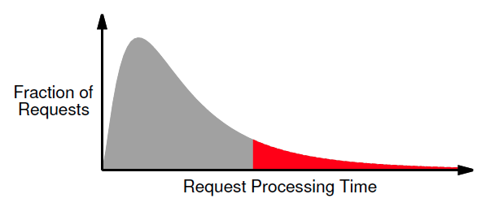
Introduction and Background
System Type: Large scale, parallel and Interactive applications
Objective: Achieve fast response times with low latencies
Tail Latency
In Facebook’s Memcached deployment, median latency is 100μs and the 95th percentile with latency > 1ms
Source
A single user request spawns many more sub-tasks
Overall latency and user request completion depends on the completion of the slowest subtask
Notes:
Latency is the total time recorded by the client after he sends the request and receives the response for it.
A small fraction of requests exceeds the the median latency by orders of magnitude.
It is the upper bound of latency experienced by 99% of the requests.
A single users request does not complete until all of its sub tasks complete

Slide 5
An example
Notes:
Source: presentation by the authors of the papers
Strict latency budgets required to ensure responsiveness

Slide 6
The Approach used
Study the behavior of three servers: RPC-server, Memcached, Nginx
Establish the baseline for ideal latency distribution
Measure the latency distributions observed on the three servers
Identify the major sources contributing to tail-latency
Analyze, quantify and mitigate these factors
Iterate till the measured latency distribution comes as close to the ideal latency distribution

Slide 7
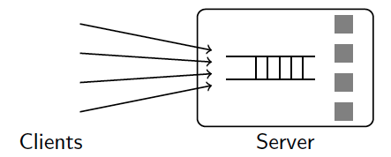
Ideal Latency Distribution
Presumption: uniform with same response time for all requests
Not so in realistic workloads!! – why??
Model the service as a single-queue system - A/S/c queue
Latency Characteristics
Arrival Distributions
Utilizations
Parallel Servers feeding from one queue
Queuing discipline
Notes:
1. Ideal baseline for comparing measured performance.
2.This tail is caused by the queuing delays that are introduced when a burst of requests temporarily exceeds the system’s underlying request processing capacity.
3. clients’ requests are independent and arrive according to an arrival distribution. One or more workers (processors, threads, or processes) at the server retrieve and process requests from the queue according to a predetermined queuing discipline, such as FIFO
4. where A describes the arrival distribution, S is the service time distribution, and c is the number of independent workers.

Slide 8
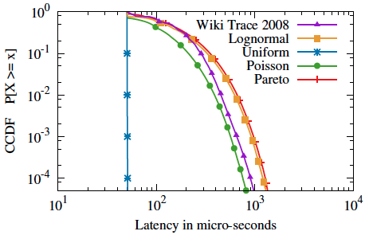
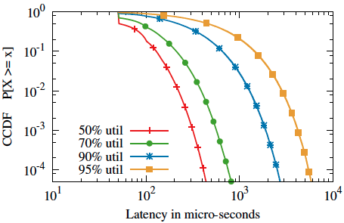
Arrival Distribution Utilization
90%
10x
99%
99%
99.9%
99.99%
a single worker FIFO server
a uniform request processing time of 50μsecs
operated at an average utilization of 70%
CCDF
Notes:
CDF - the probability that a real-valued random variable X with a given probability distribution will be found to have a value less than or equal to x
CCDF - it is useful to study the opposite question and ask how often the random variable is above a particular level.
point (x;y) on the graph implies that y is the fraction of requests that experience a latency of at least x μs.
Arrival distribution:
- Shows the response latency of a single worker FIFO server with a uniform request processing time of 50(mew)secs when operated at an average utilization of 70%
- Each line corresponds to a different request inter-arrival time distribution
the latency is high -> random arrival bursts. If two requests arrive within 50 μs of each other, the second request must be delayed until the first completes and the server becomes available.
Utilization:
Increasing utilization reduces the leeway to handle bursts,
which means that commonly occurring small bursts will build up large queues with long delays

Slide 9
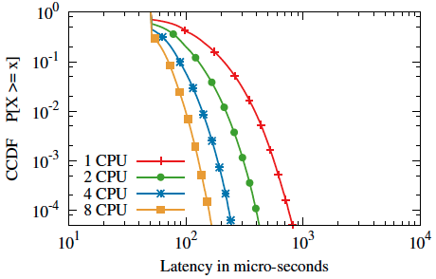
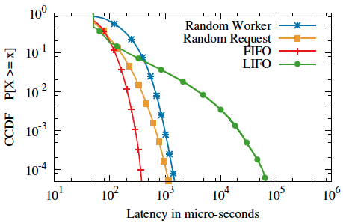
Parallel Servers Queuing discipline
99%
4x
Notes:
Parallel Servers:
- The ideal distribution improves as we change the number of workers (CPUs) at the server, even as we scale up the average request throughput to keep the server utilization constant
- For example, the 99th percentile drops by 4x when running 8 workers instead of 1.
Queuing discipline:
FIFO: Requests are put in a single global FIFO queue at the server and workers pull requests from it.
LIFO: LIFO has worse tail latency than FIFO, but better median latency
Random worker: When requests arrive, they are assigned to a random worker. Each worker has its own FIFO queue.
Random Request: All requests arriving at the server are put in a single queue, and workers pull requests from the queue in random order. Each queued request is equally likely to be processed next, regardless of its arrival time.

Slide 10
Ideal Latency Distribution
Given the application and arrival distribution of the workload,
We can predict the time spent by a request in the server.
Request Processing time estimation
Running server on a single core at 100% utilization
Measure the throughput achieved
Estimate of amortized latency for single request (t)= inverted throughput
Simulating a queuing model (A/S/c) using the measured
Arrival times
Request processing time (t)
In case of Memcached, for a peak throughput at 125,000 requests per second per core the amortized processing time was 8 μs per request.
Notes:
measuring the actual request arrival time series experienced by a server while engaged in an open-loop workload with clients,

Slide 11
Testbed
Applications
RPC Server
Memcached
Nginx
Cluster of standard datacenter machines.
2 x Intel L5640 6 core CPU
24 GB of DRAM
Mellanox 10Gbps NIC
Ubuntu 12.04, Linux Kernel 3.2.0
All servers connected to a single 10 Gbps ToR switch.
One server runs application, and five machines to run workload generating clients.
Workload: Open-loop workloads(Poisson distribution)
Notes:
The clients generate requests as an open-loop Poisson process .
open-loop workloads better represent large scale Internet-driven arrival processes,
and they are known to induce higher degrees of burstiness and therefore can more significantly affect tail latency.
Open loop control systems are those that do not provide feedback of the actual state of the system in order to adjust the system.

Slide 12
Timestamping
Start when a request packet first arrives on the host from the server’s NIC, and end immediately before the OS transfers the response packet back to the NIC
Append a 30-byte buffer to request packet
Write the timestamps to the buffer as it goes through the server.
Circumvent the need for server to log requests.
After TCP/UDP processing
Thread scheduled on CPU
Incoming Server NIC
Outgoing Server NIC
Write()
Read() return
Notes:
To implement this, we modified the Linux kernel source, network drivers, and application protocols to write timestamps into the appended buffer at the right offset.

Slide 13
Sources of Tail Latency
Background Processes
Non-FIFO Scheduling
Multicore
Interrupt Processing
NUMA Effects
Power Saving Optimizations
Discussion focus: Memcached application

Slide 14
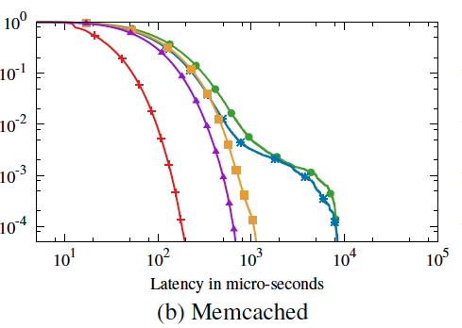
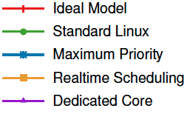
Impact of Background Process
Impact?
Timesharing of server application with background processes(BP)
Wait for the CPU to be available, when blocked by a BPs
The kernel allocates time slices that are a couple of milliseconds
Tail amplification
Fix?
Niceness -20 (Max. Pri.)
Realtime Scheduling
Preemption
Dedicated Core
Notes:
By default, all user level processes have the same priority. As a result, when the kernel schedules a background process, our application has to wait for the core to become available.
Default is nice 0, so both processes get about half of the CPU time each. Now lets renice process 1 to value 10. Result: Process 2 gets a significant higher amount of cpu time as process 1.
-This causes the server process to be scheduled for longer time-slices than other processes on the system, providing a slight improvement in tail latency,
-The difference remains because the server cannot preempt other processes. It must wait for them to finish their time-slice, which is still much larger than an individual request’s processing time.
Making the server process a realtime process allows it to preempt any normal-priority process. This improves the tail latency dramatically, nearly eliminating the effects of background processes
increased context switching overhead and occasional cases where another running process is in a nonpreemptable section of kernel code

Slide 15
Impact of Multicore-Concurrency
Impact?
By default, Memcached statically assigns incoming TCP connections to specific workers
resembles a multi-queue system where each worker has its own request queue.
Fix?
Modify Memcached concurrency model to use a single queue
Switch from TCP to UDP
All threads pull requests from a single UDP socket
Notes:
must follow a single-queue model where any processor can process any request.
However, both Memcached and Nginx statically assign incoming TCP connections to specific workers. multi-queue system where each worker has its own request queue.
One simple way for converting Memcached into a single queue system is by switching the transport layer from TCP to UDP. all worker threads pull messages from a single UDP socket and this naturally follows the single-queue model.

Slide 16
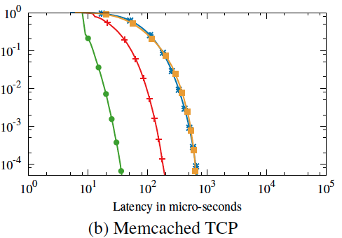
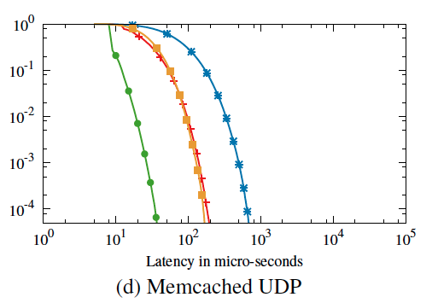
Impact of Multicore-Concurrency

Slide 17
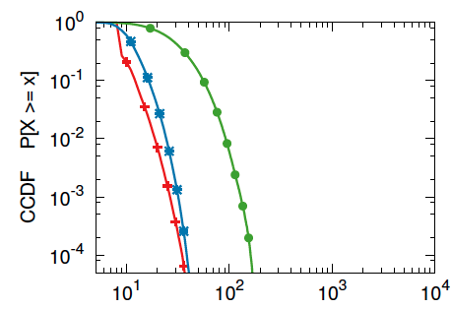
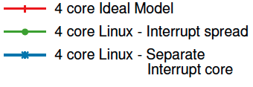
Impact of Interrupt Processing
Impact?
Linux runs the irqbalance daemon which spreads interrupts to the core
Application threads are preempted by incoming interrupts
Introduces context-switching and cache pollution – higher latency
Non - FIFO
Fix?
Dedicated core for interrupt processing – 1 core
Avoid preemption
Ensure FIFO-ness
Notes:
When packets arrive at the NIC,
it interrupts a host CPU to initiate packet processing,
triggering the kernel to receive the packet and
process it through the TCP or UDP stack.
By default, the “irqbalance” daemon is enabled by Linux. At a lower load, “irqbalance” operates in powersave mode and assigns interrupts to one centralized CPU
core. However, as the load goes up, “irqbalance” switches to performance mode and spreads interrupts to all CPUs to keep them at similar utilization.

Slide 18
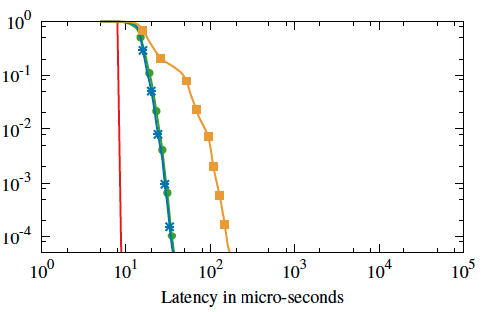
Impact of Power Saving Optimizations
Impact?
CPUs become idle,
they can be placed in an energy saving state -“C-state”. Higher C-state requires a longer wake up time
the clock frequency is reduced to save power
Fix?
Turn off Idle states and CPU frequency scaling
But, comes at the cost of high energy use
Memcached
10% utilization
Notes:
multiple Cstates, each causing more components of the CPU subsystems to be shut down
stops the main internal clock, while the C3 state stops all internal and external clocks
Requests that are executed on a processor in power-saving mode will experience a higher latency than usual because they are delayed while the CPU is reactivated
When the CPU is mostly idle, the operating system reduces the clock frequency to save power. If a CPU-bound request executes while the CPU frequency is reduced, it can take longer time
than usual.
that this does not noticeably affect our null RPC server and Memcached, which require little computation for each request. However, Nginx, which is more CPU-intensive,

Slide 19
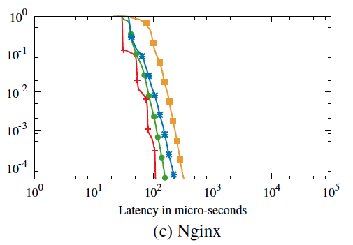
Ngnix

Slide 20
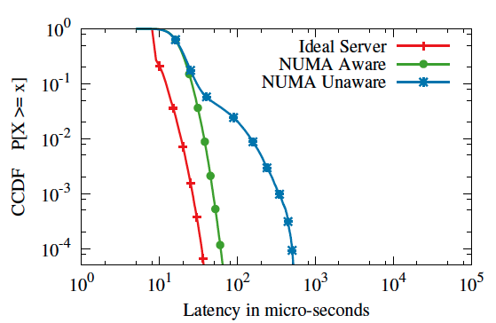
Impact of NUMA Effects
Impact?
On scaling from multiple cores to multiple CPUs – NUMA latency
Increased processing time due to memory accesses across NUMA nodes
Fix?
Run an instance of Mem- cached per NUMA node.
Force each instance to allocate only memory from the same NUMA node
Notes:
This problem is caused in part by Linux’s default NUMA memory allocation policy.
By default, Linux allocates memory from a single NUMA node to a process, until no more memory is available on that node.
half of the Memcached threads must make cross-NUMA-node memory accesses

Slide 21
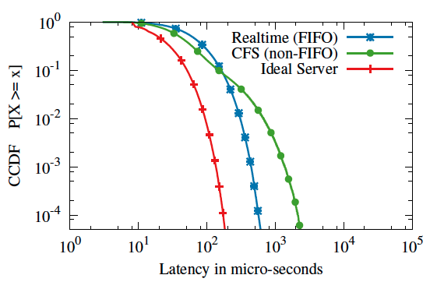
Impact of Queuing Policy
Impact? Threads are scheduled out-of-order by Linux Scheduler, CFS
Fix? Use FIFO scheduler like realtime scheduler
Notes:
The null RPC server relies on the kernel’s scheduler to determine which thread to run next, and therefore which request to process first.
The CFS scheduler chooses which thread to run based on how much CPU time each thread has received in the past, rather than which one became runnable earliest, so requests will not be
processed in the order that they are received
This scheduling policy does not affect the two other applications, because they use event-driven architectures with only a single thread per core.
Linux kernel, which chooses which of the null RPC server’s threads to run using exactly the same policy as CFS, but gives them strictly higher priority over any other process on the system.
We compare this non-FIFO scheduler to Linux’s realtime scheduler, which has both strictly higher priority and FIFO

Slide 22
Putting it all Together
Explored hardware, OS and application-level sources of tail latency
Pin-point sources using finegrained timestaming, and an ideal model
Substantial improvements, close to ideal distributions.
Median latency of Memcached from 100μs to 11μs
99.9th percentile latency of Memcached from 5 ms to 32μs.
Source | Potential way to fix
Background Processes | Use realtime scheduling, or run on dedicate core
Concurrency Architecture | Ensure a global scheduling queue
Interrupt Processing | Use separate interrupt and application cores.
Power Saving Features | Turn off idle states and CPU frequency scaling.
Request Burstiness | Lower average utilization; add parallel workers.

Slide 23
Pros Cons and Discussion
Pro
Timestamping
Identification and the mitigation of the issues
Con
Trade offs mentioned
OS level changes
Evaluation not complete
Workload (CPU bound only?)
Is Preemption a good idea?
What the sweet spot for utilization?
NIC induced delays?
What we should take away from this paper?
Realize that these are possible causes for increased tail latency
Depending upon application requirements and specs choose which cause can be mitigated

Slide 24
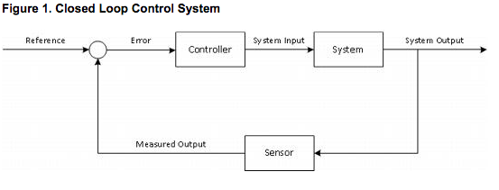
Open loop
Source: http://download3.vmware.com/vcat/vcat31_documentation_center/index.html#page/Cloud%2520Bursting/7%2520Cloud%2520Bursting.2.05.html#wwpID0E0IF0HA
Closed loop

