Slide 1
TAG: a Tiny Aggregation Service for Ad-Hoc Sensor Networks
Samuel Madden, Michael J. Franklin, Joseph Hellerstein, and Wei Hong
Proceedings of the Fifth Symposium on Operating Systems Design and implementation (OSDI ’02), December 9 - 11, 2002, Boston, MA, USA.
Presented by Akash Kapoor

Slide 2
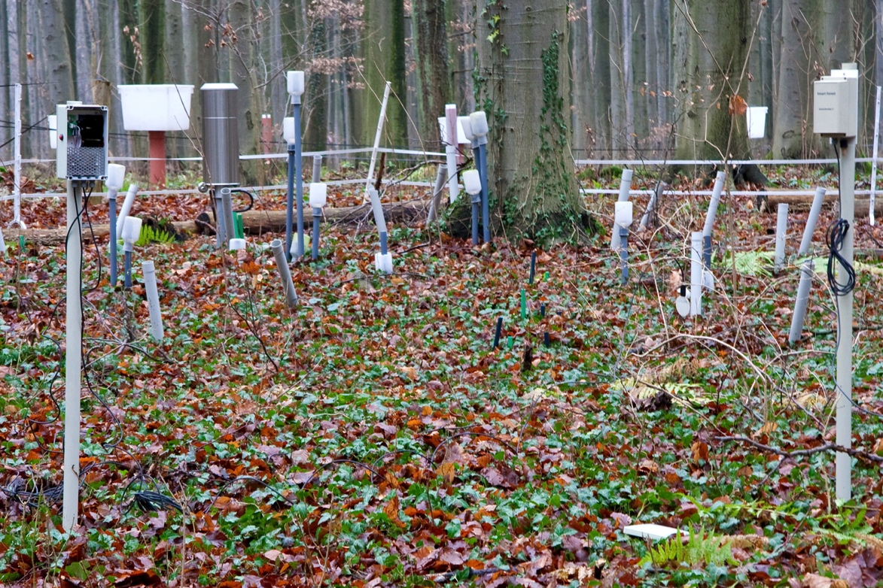
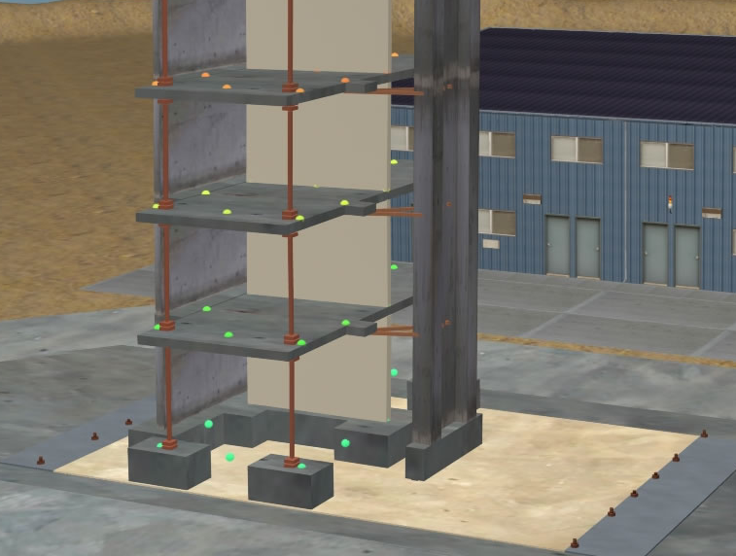
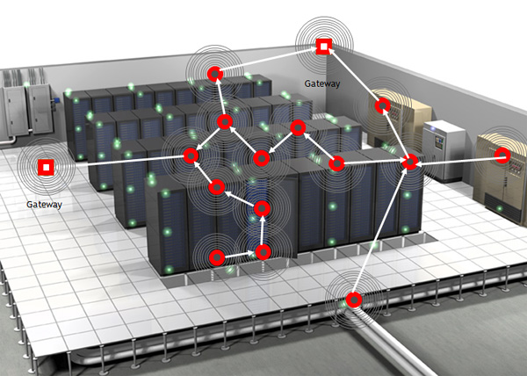
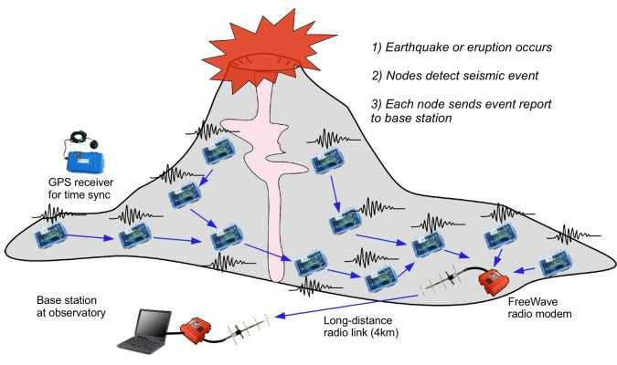
Motivation
Used to monitor and collect data about various phenomenon.
  Wild-life, volcanoes, data centers, CPU temperatures, buildings.
Applications require summary/aggregations rather raw sensor data.
Users may not be well versed with the low-level optimizations.
Important to minimize the power consumption.
How does Tiny AGgregation service help?:
High level language similar to SQL for querying.
Distributes the query in the network.
Queries executed to reduce communication and power.
Enables in-network aggregation of the results.
Order of magnitude reduction in communication compared to centralized approach.

Slide 3
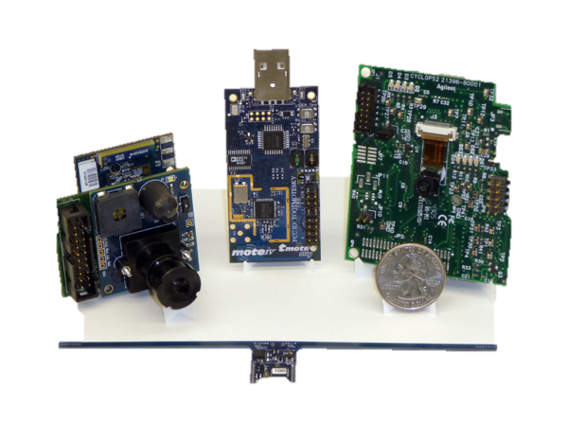
Background
Smart Sensors:
Wireless, Battery powered.
Really small around 2cm x 4cm x 1cm.
Motes by UC Berkeley.
Single-channel half-duplex radio.
Unreliable message delivery.
Battery capabilities on motes:
Small batteries: AA battery packs or coin cells.
Radio communication dominates the battery consumptions on the motes.
  Power consumption: Transmission of single bit ≈ 800 instructions.
Calls for power conserving algorithms.
Notes:
Shared Communication medium leads to high contention.
Shared communication medium: Radio is a broadcast medium so any mote with the hearing distance hears a message even if it is not the intended recipient.
Half-duplex: cannot receive and send at the same time.

Slide 4
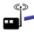
Background
Ad-Hoc Networks:
Dynamic in nature as topology can change.
Identify and route data between devices without prior knowledge.
Tree based routing in Ad-Hoc networks:
Motes arrange themselves as a tree
Node interfacing with the user act as the root.
Root sends this message periodically to adapt to new network changes.
TAG requirements:
Root should be able to propagate a message in the whole network.
A route from a node to the root.
At-most once semantics for message delivery.
Notes:
Tag is Orthogonal to the routing scheme.
Root broadcasts tree-formation message containing its id and level.
A node without an assigned level:
Assigns it’s level = level in the message + 1.
Forwards the message with it’s own id and level.

Slide 5
Query Model
SQL-style query syntax.
  Over a single table, sensors.
  It’s schema is known to the base station.
  Stream of values.
  Each mote has a small catalog of attributes.
  Each sensor is a row in the sensors table.
Example:
  Monitor occupancy of conference rooms of a floor.
  Use the microphones.
SELECT AVG(volume), room
FROM sensors
WHERE floor = 6
GROUP BY room
HAVING AVG(volume) > threshold
EPOCH DURATION 30s

Slide 6
Query Model
WHERE clause:
  Filters out individual sensor readings, locally at mote, before aggregation.
GROUP BY clause:
  Attribute based partitioning of sensor readings.
HAVING clause:
  Suppress groups that do not satisfy the predicates.
EPOCH DURATION:
  Specifies how often the updates must be delivered.
Records:
  Consists of one <group id, aggregate value> pair per group.
  Readings used to compute an aggregate record all belong to the same time interval, or epoch.
SELECT {agg(expr), attrs}
FROM sensors
WHERE {selPreds}
GROUP BY {attr}
HAVING {havingPreds}
EPOCH DURATION i
Notes:
SELECT: expr the name of a single attribute on which to perform the agg. attrs by which the sensor readings are partitioned
GROUP BY: Logically, each reading belongs to exactly one group, and the evaluation of the query is a table of group identifiers and aggregate values.

Slide 7
Aggregates
Aggregates supported by TAG:
SQL supports: MIN, MAX, SUM, AVERAGE, and COUNT
TAG can support a broader set.
Aggregates Implemented using 3 functions:
Merging function f: Merges partial state record.
Initializer i: Instantiates state record for single sensor value.
Evaluator e: Computes actual value from the partial state record.

Slide 8
Aggregates
AVERAGE aggregate:
Each partial state record is of the form <SUM, COUNT>
Merging function f:
  f (<SUM1, COUNT1>, <SUM2, COUNT2>) = <SUM1 + SUM2, COUNT1 + COUNT2>
Initializer i:
  i (sensor_value) = <sensor_value, 1>
Evaluator e:
  e (<SUM, COUNT>) = SUM/COUNT

Slide 9
Aggregates
Aggregates Taxonomy:
Define different dimensions for a general classification of the aggregates functions
  DUPLICATE SENSITIVITY
  EXEMPLARY or SUMMARY
  MONOTONIC
  PARTIAL STATE requirements
 | MAX, MIN | COUNT, SUM | AVERAGE | MEDIAN | COUNT DISTINCT | HISTOGRAM
Duplicate Sensitive | NO | YES | YES | YES | NO | YES
Exemplary, Summary | E | S | S | E | S | S
Monotonic | YES | YES | NO | NO | YES | NO
Partial State | Distributive | Distributive | Algebraic | Holistic | Unique | Content-Sensitive
Notes:
classified aggregates according to their state requirements, tolerance of loss, duplicate sensitivity, and monotonicity.
duplicate sensitive aggregates will change when a duplicate reading is reported.
exemplary aggregates return one or more representative values from the set of all values; unpredictably in the face of loss; not amenable to sampling.
summary aggregates compute some property over all values.
monotonic aggregates determining whether some predicates (such as HAVING) can be applied in network
partial state record performance is inversely related to the amount of intermediate state required per aggregate.
Distributive aggregates: aggregate for the partition of data over which they are computed. Size is the same as the size of the final aggregate.
Algebraic aggregates, the partial state records are not themselves aggregates for the partitions, but are of constant size.
Holistic aggregates, the partial state records are proportional in size to the set of data in the partition. no useful partial aggregation can be done.
Content-Sensitive aggregates, the partial state records are proportional in size to some property of the data values in the partition.

Slide 10
In-Network Aggregation
Aggregation Consists of two phases:
Distribution phase: Queries are pushed down into the network.
Collection Phase: Aggregate values and route them up from children to parent.
Centralized Approach:
Each node sends back the reply to the central node.
The central node processes the data to compute the aggregate.
In-Network Aggregation Approach:
Aggregates are computed within the network.
Only necessary information sent to the parent nodes.
Query
Response
Notes:
Compute aggregates in network. Can lower the number of message transmissions, latency, and power consumption.

Slide 11
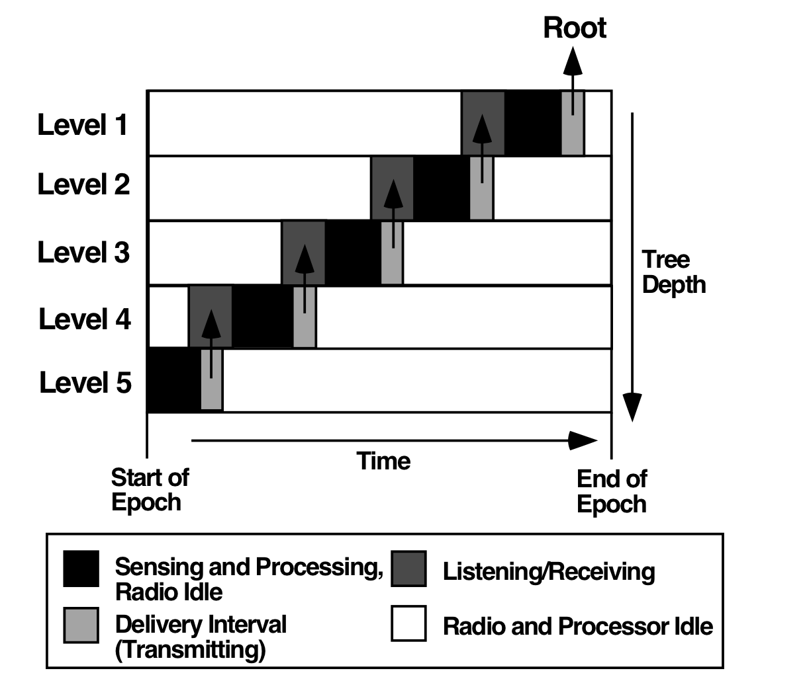
In-Network Aggregation
Simple Tiny aggregation:
Mote p receives request to aggregate with expect reply interval
Synchronizes the clock and choose the sender of message as the parent.
Forwards the request with its own information and modified expected reply interval
Process own reading with child’s partial state record
Reply to parent with the updated partial state record
Notes:
Figure: Each mote listens during the interval specified. Computes a partial state. Finally, during the transmission interval requested by its parent, the mote transmits this partial state record up the network.
epoch, motes are idle and can enter a low power state.
Interval: long enough all of a node’s children can report. Longer intervals consumes energy. Environment specific: density of radio cells and “bushiness” of the network topology.

Slide 12
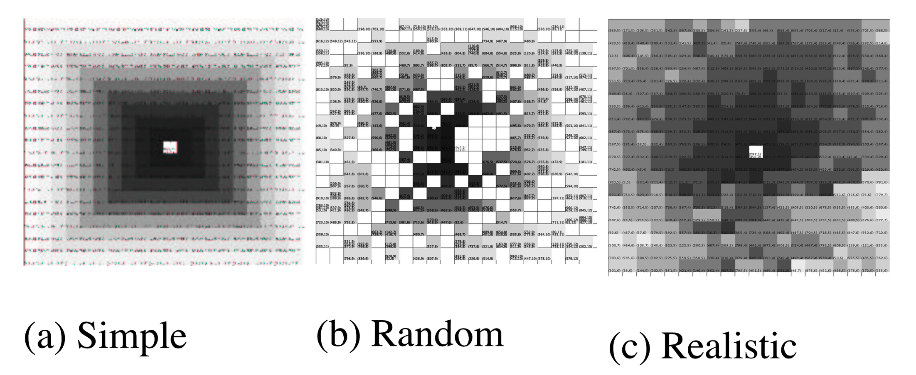
Simulation-Based Evaluation
Simulator set-up:
Java based simulation with time divided into units of epochs.
Doesn’t account for byte-level radio contention or time to send and decode messages.
Models a parallel execution and the costs of topology maintenance
Three communication models
Darker nodes are closer to the roots
Notes:
each square represents a single device, and shading (in these images) represents the number of radio hops the device is from the root (center); darker is closer.
three communications models; 1) a simple model, where nodes have perfect communication with their immediate neighbors
2) a random placement model
3) a realistic model that attempts to capture the actual behavior of the radio and link layer on TinyOS motes. The number of hops from a particular node to the root is no longer directly proportional to the geographic distance between the node and the root, although the two values are still related. Realist loss in data around 20% between adjacent nodes.
Models a parallel execution: Messages sent by nodes during an epoch are delivered in random order during the next epoch.

Slide 13
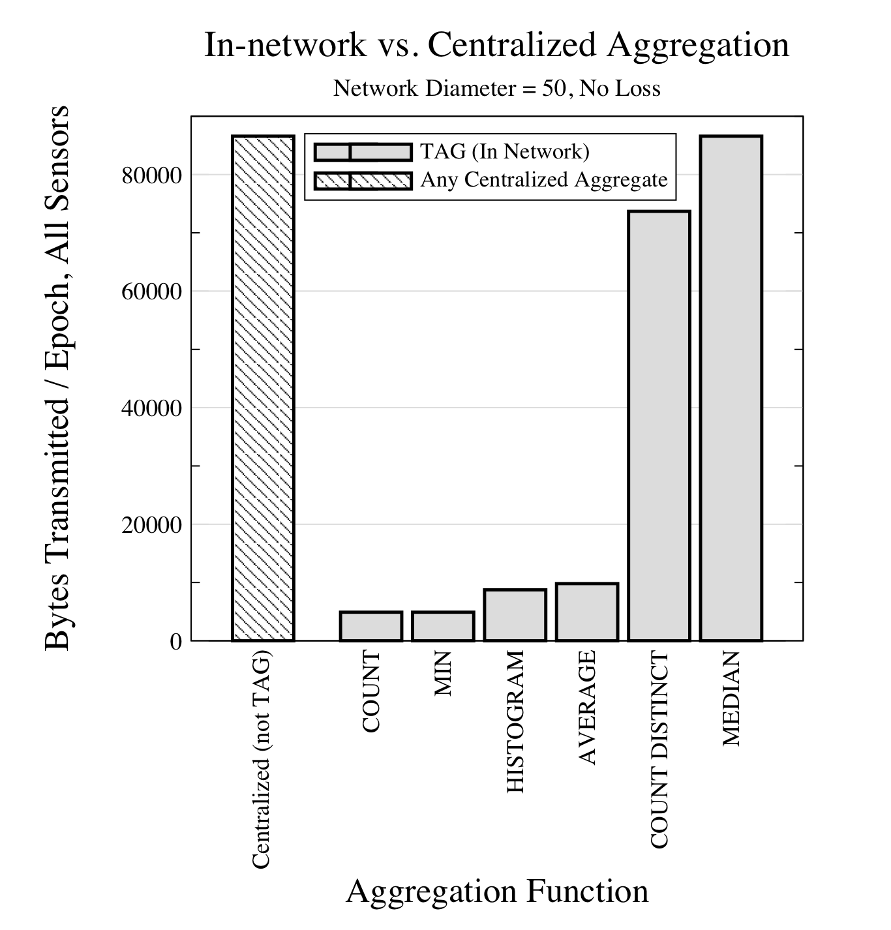
Simulation-Based Evaluation
Cost to flood a request down the tree in not considered.
Don’t benefit. Require more state to compute the aggregation
Extremely low. Only an integer required for the partial state record.
Double as compared to COUNT/MIN. Two integers required for the partial state record.
Notes:
In our 2500 node ( d=50) network, compared this cost to the number of bytes.
represent the steady-state cost to extract an additional aggregate from the network once the query has been propagated; the cost to flood a request down the tree in not considered.
Centralized aggregates have the same communications cost irrespective of the aggregate function, since all data must be routed to the root
distributive aggregates (MAX and COUNT), an algebraic aggregate (AVERAGE), a holistic aggregate (MEDIAN), a content-sensitive aggregate (HISTOGRAM), and a unique aggregate (COUNT DISTINCT)
Benefits of TAG are topology dependent. For single-hop roots no benefit.
motes are arranged in a line : n^2/2 in central whereas only n in TAG

Slide 14
Optimizations
Using the shared channel:
Snoop on the network to look for missed aggregation request messages.
Can snoop at specified time interval to save power.
Hypothesis testing:
The aggregation requests are sent with a guess value.
Motes only respond if their values affect the end value.
Motes can also snoop on the network to check if its local value can affect the end value.

Slide 15
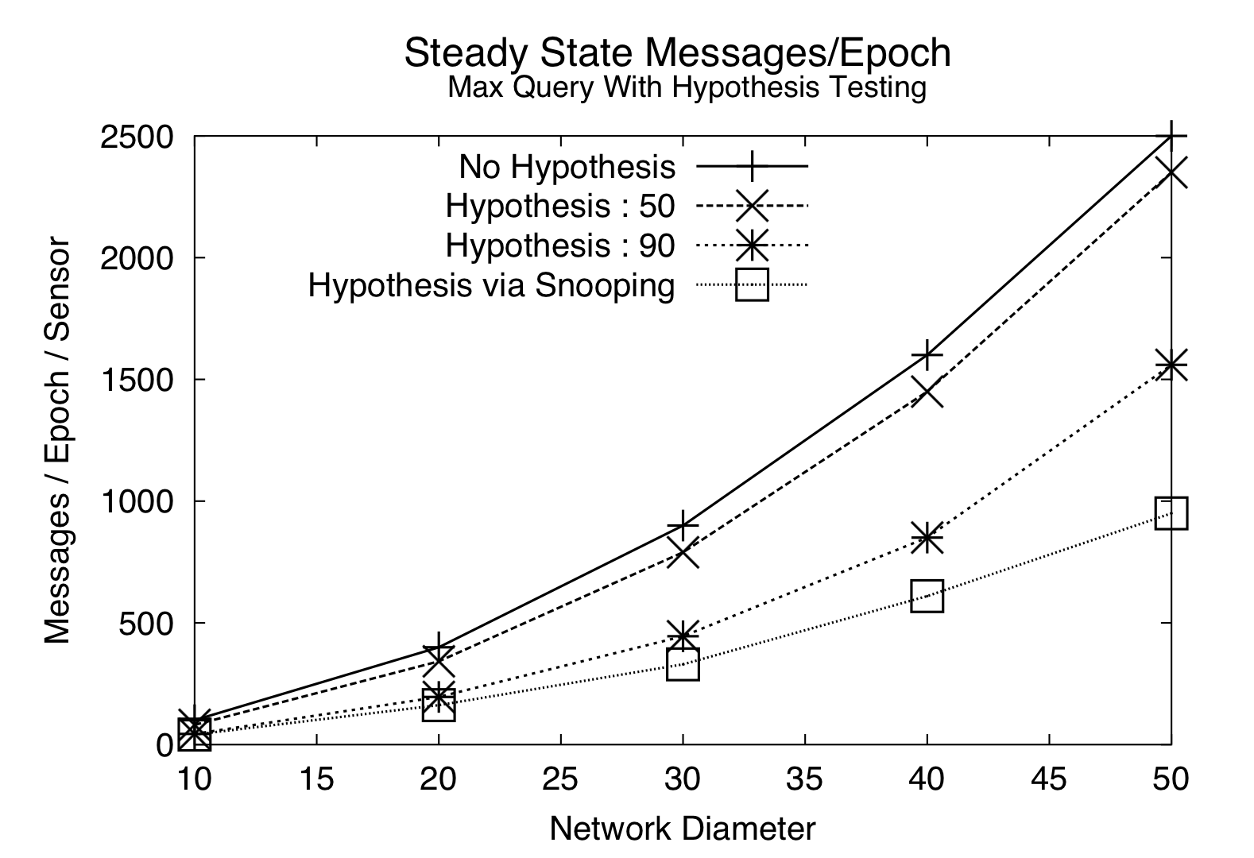
Optimizations
Informed guesses can lead to significant performance gain.
Snooping can further improve the perform especially in packed networks.
Notes:
Measure the benefit of hypothesis testing and snooping for a MAX aggregate. sensor values were uniformly distributed over the range [0..100], and a hypothesis was made at the root.
Ideal communication.
nearly two-fold for a hypothesis of 90.
Snooping approach Effective even in a non-uniform distribution: Three-fold performance increase over the no-hypothesis case. This is because in the densely packed simple node distribution, most devices have three or more neighbors to snoop on, so only about one in four devices will have to transmit.

Slide 16
Tolerating loss
Link Quality monitoring:
Each node monitors the quality of the link to a subset of its neighbors by tracking the proportion of packets received from each neighbor.
If a node n observes weak link to its parent p and better link to p’, chooses p’ as its new parent.
Child caching:
Improve quality of aggregates by remember child’s partial state record for some number of states.
Using available redundancy:
Uses the network topology to Improve quality of aggregates by maintaining multiple parents and sending part of or whole partial state records to each of them
Notes:
Conditions preventing cycle: p’ is as close or closer to the root as p. n is not the parent of p’.

Slide 17
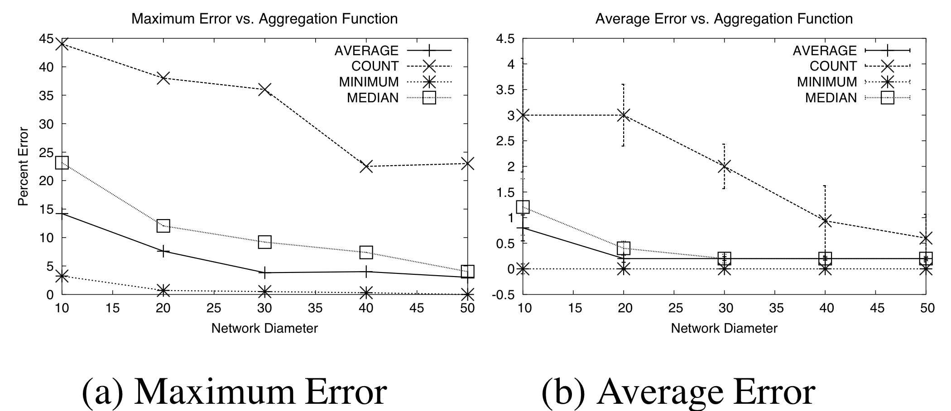
Tolerating loss
Effect of single loss on various aggregate functions
MEDIAN and AVERAGE are somewhat sensitive to variation in number of nodes.
MIN insensitive to loss as several nodes are at the true minimum.
Notes:
simple topology, with sensor readings chosen from the uniform distribution over [1..1000]. Disable random node.. The children temporarily are disconnected.
measured the maximum temporary deviation from the true value of the aggregate that the loss caused in the perceived aggregate value at the root during any epoch.
a single mote going offline causes the entire subtree rooted at the node to be (at least temporarily) disconnected.
MIN is insensitive to loss in this uniform distribution, since several nodes are at or near the true minimum. The error for MEDIAN and AVERAGE is less than COUNT and more than MIN: both are sensitive to the variations in the number of nodes, but not as dramatically as COUNT.
Assumes uniformity of placement (e.g. the devices are not arranged in a line), as the network size increases, the chances of selecting a node that is root of a huge subtree go down, since a larger proportion of the nodes are towards the leaves of the tree.

Slide 18
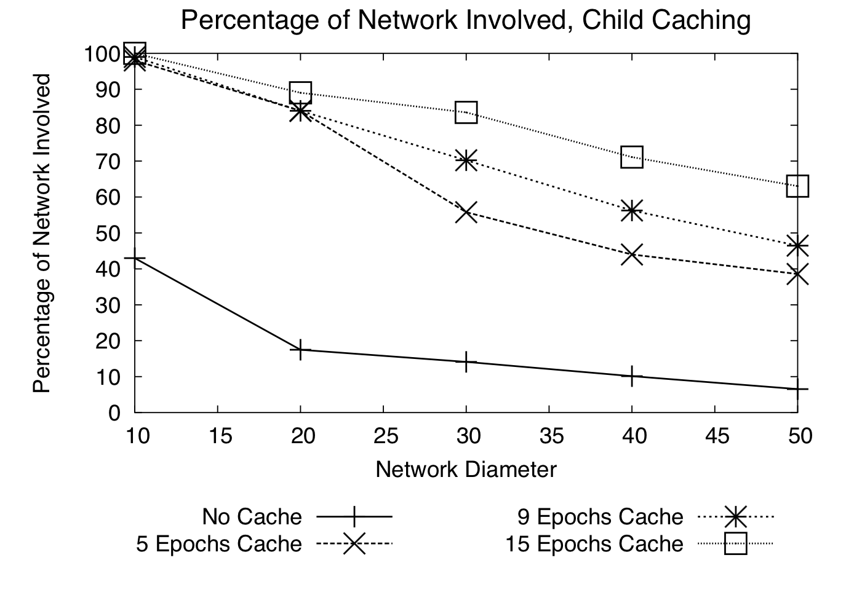
Tolerating loss
Realistic communication
Significant in number of participating nodes.
Without caching TAG or even centralized aggregation not highly tolerant to loss.
Notes:
without some technique to counteract loss, a large number of partial state records will invariably be dropped and not reach the root
Performance falls off as the number of hops between the average node and the root increases, since the probability of loss is compounded by each additional hop
With caching: allocate a fixed size buffer at each node and measure the average number of devices involved in the aggregation

Slide 19
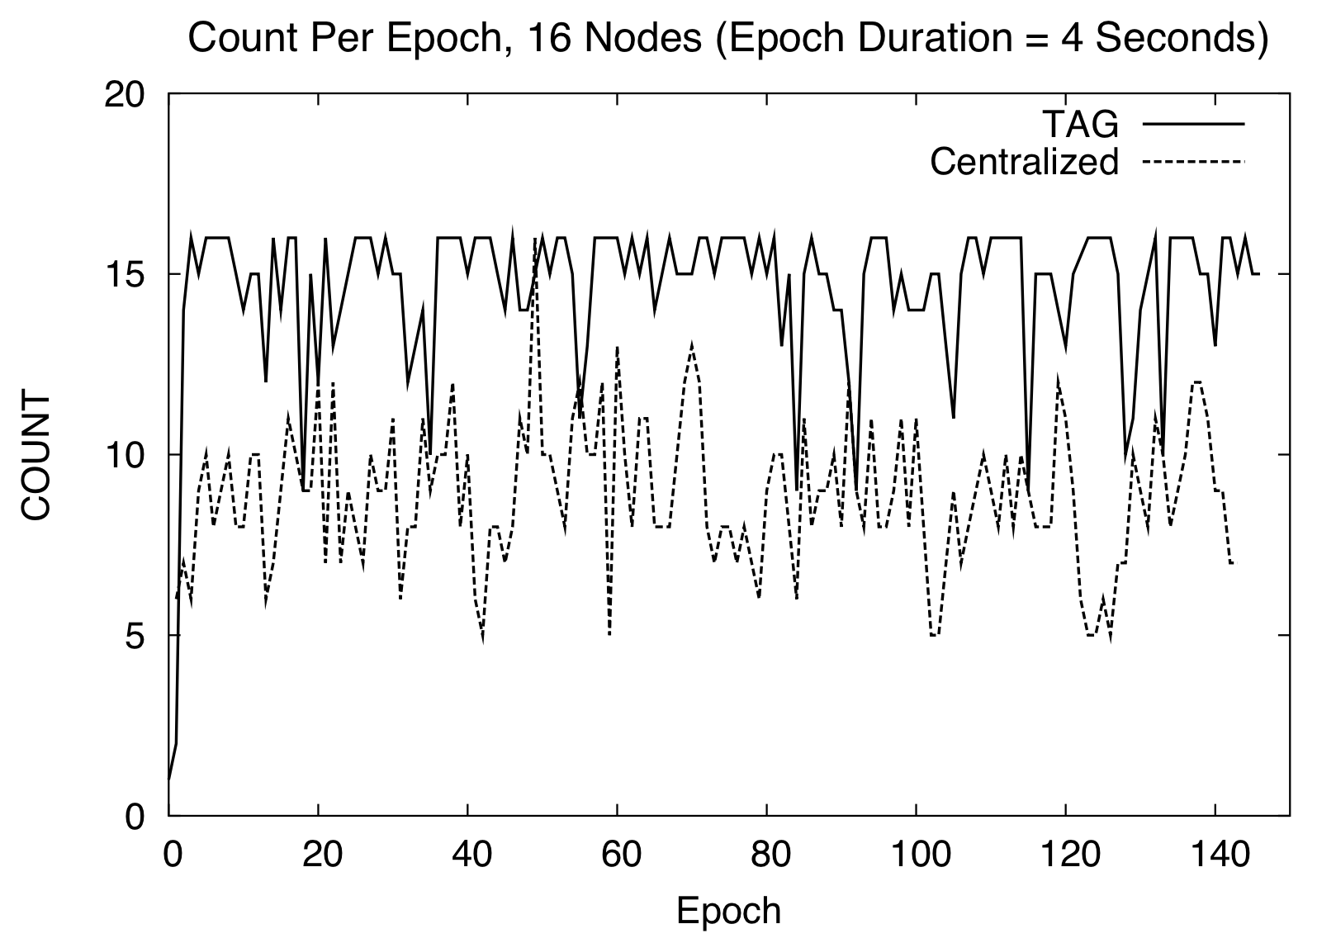
Prototype implementation
Set-up:
Does not include optimizations.
Uses 16 TinyOS Mica motes arranged in a depth four tree.
Better Quality of aggregation
50% reduction communication
Notes:
COUNT aggregate over 150 4-second epochs (a 10 minute run.) No child caching or snooping techniques were used.
Reduced loss of messages due to less radio contention.
prototype network topology had a higher average fanout than the simulated environment, so messages in the centralized case had to be retransmitted fewer times to reach the root.
Per hop loss rates: TAG: 5% CENTRAL: 15%. Central only 45% messages received.

Slide 20
Conclusions
Offers significant reduction in network communication. A node needs to transmit only once per epoch.
Improves the ability to tolerate losses.
Epochs provide a convenient mechanism to put CPU to sleep.
Offers up to an order of magnitude reduction in bandwidth consumption.
Simple declarative query interface

Slide 21
Pros & Cons
Pros:
Offers an order of magnitude reduction in network communication.
Provides mechanisms to tolerate losses and improve quality of aggregates.
SQL-like syntax for query makes it easy to use.
Cons:
The simulation is too simplified as it doesn’t account for power, CPU and other important aspects.
The prototype implementation consisted of merely 16 motes.
It is unclear on what the interval value should be when forwarding the query.
Malicious nodes can corrupt/falsify the aggregates.

Slide 22
Discussion
Evaluation:
  Not a through evaluation.
  Doesn’t consider power consumption, CPU utilization and radio contention in simulated evaluation.
Malicious Nodes can corrupt aggregation values.
Affects of stale caches are not considered.
Tree based topology:
  Require extra communication to form the tree.
  Failure prone.

