Slide 1
CS 525
A Review of Current Routing Protocols for
Ad Hoc Mobile Wireless Networks
Elizabeth M Royer, University of California, Santa Barbara
Chai-Keong Toh, Georgia Institute of Technology
IEEE Personal Communications • April 1999
Presented by: Syeda Persia Aziz
NetID: spaziz2

Slide 2
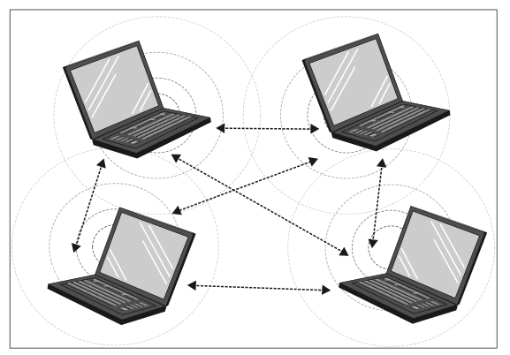
Wireless Ad Hoc Network
Infrastructureless
No fixed gateway
Mobile nodes
Arbitrary and dynamic connection
Every node itself is a router and a host.

Slide 3
Ad Hoc Routing Protocols
Ad Hoc Routing Protocols
Table-Driven
Source-Initiated On-Demand
DSDV
WRP
AODV
DSR
LMR
ABR
CGSR
TORA
SSR
Notes:
Proactive: table driven

Slide 4
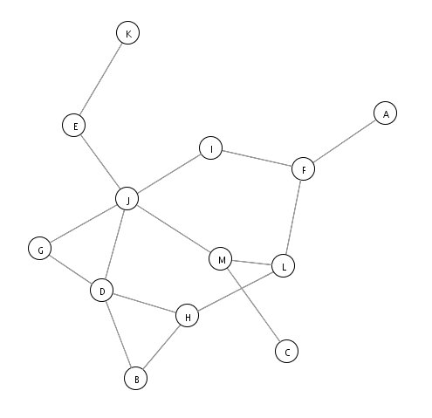
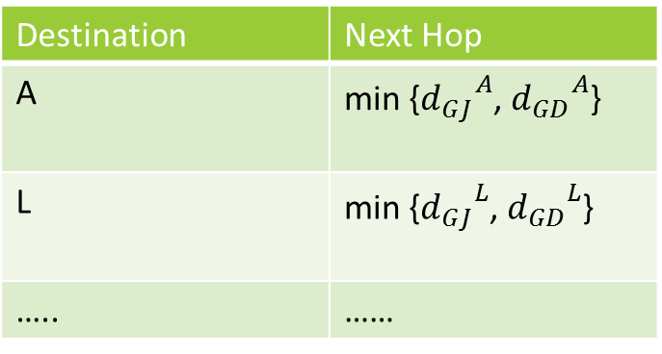
Table Driven Protocols
DSDV : Destination Sequenced Distance-Vector Routing
Bellman-Ford Algorithm
Table: G
D_{G}(A) = min{ cost(G,J) + D_{J}(A), cost(G,D) + D_{D}(A)}
Destination
Destination | Next Hop
A | min {${d_{GJ}}^{A}$, ${d_{GD}}^{A}$}
L | min {${d_{GJ}}^{L}$, ${d_{GD}}^{L}$}
….. | ……
Source
Notes:
The goal of bellman –ford algorithm
Select next hop such that the cost of sending packet to the destination is minimum

Slide 5
D_{x}(y) = min{c(x,y) + D_{y}(y), c(x,z) + D_{z}(y)}
= min{2+0 , 7+1} = 2
D_{x}(z) = min{c(x,y) +
D_{y}(z), c(x,z) + D_{z}(z)}
= min{2+1 , 7+0} = 3
node x table
cost to
cost to
cost to
x y z
x y z
x y z
x
0 2 7
x
0 2 3
x
0 2 3
from
y
∞
∞
∞
from
y
2 0 1
y
from
2 0 1
z
∞
∞
∞
z
7 1 0
z
3 1 0
node y table
cost to
cost to
cost to
x y z
x y z
x y z
y
2
1
x
∞
∞
x
0 2 7
x
0 2 3
z
∞
2 0 1
x
from
y
from
y
2 0 1
y
7
from
2 0 1
z
∞
∞
∞
z
7 1 0
z
3 1 0
node z table
cost to
cost to
cost to
x y z
x y z
x y z
x
∞ ∞ ∞
x
0 2 7
x
0 2 3
from
y
y
2 0 1
from
y
∞
∞
2 0 1
from
∞
z
z
3 1 0
z
3 1 0
7
1
0
time

Slide 6
Count to Infinity Problem
Y table
x y z
DSDV Solves the Count-to-Infinity problem
What will happen if the link cost changes in DV?
x
0 2 3
y
2 0 1
z
3 1 0
y
Y table
x y z
60
x
0 2 3
2
1
y
4 0 1
z
z
3 1 0
x
50
Z table
x y z
x
0 2 3
y
4 0 1
z
5 1 0

Slide 7
Table Driven Protocols
DSDV : Destination Sequenced Distance-Vector Routing
Routing Table:
  Records all of the possible destination in the network and number of hops to each destination
Avoiding Routing Loops
  Sequence number per entry
Reducing size of route updates
  Full dump packet: Transmitted infrequently.
  Incremental packet: Smaller, requires additional table

Slide 8
Table Driven Protocols
CGSR : Clusterhead Gateway Switch Routing
Difference with DSDV
  Addressing
  Cluster-Head to gateway routing
  Cluster member table & Routing table
Cluster Head Selection Algorithm
  Least Cluster Change Algorithm
Tables:
  Cluster member table: destination cluster head
  Routing table: Next hop to reach the selected cluster head
D
S
Cluster Head
Gateway Node
Node

Slide 9
Table Driven Protocols
WRP: Wireless Routing Protocol
Belongs to the class of Path-Finding Algorithm
Ensure reliable message exchange.
Each node maintains four tables
Reduced route setup time
Table | Contents
Distance Table | network view of the neighbors of a node, distance and the penultimate node for a particular destination
Routing table | up-to-date view of the network for all known destinations; distance to a destination node, the previous and next nodes along the route, and is tagged to identify the route's state
Link-Cost table | Cost of relaying messages through each link, number of update periods passed since the last successful update received, used to detect links breaks
Message retransmission list | sequence number, retransmission counter, acknowledgement-required flag vector, list of updates sent

Slide 10
Table Driven Protocols
WRP: Wireless Routing Protocol
Information Exchange:
Propagates only from a node to its neighbors
  Update Message
    Node ID
    Sequence number
    List of updates or acknowledgement to update messages
    Response list of nodes that should send acknowledgement
  Consistency check:
    Checks the predecessor information reported by all neighbors each time it processes an event involving a neighbor k. Thus avoid routing loops
Update message
Update message
Notes:
The reason of response list to is to avoid asking a node for multiple acks for the same update message

Slide 11
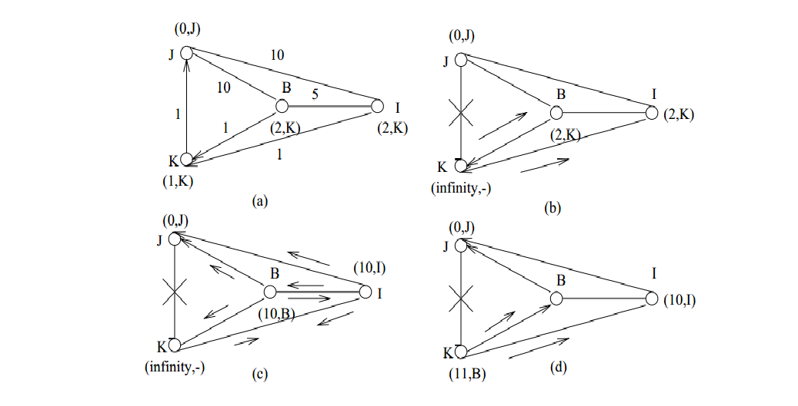

Slide 12
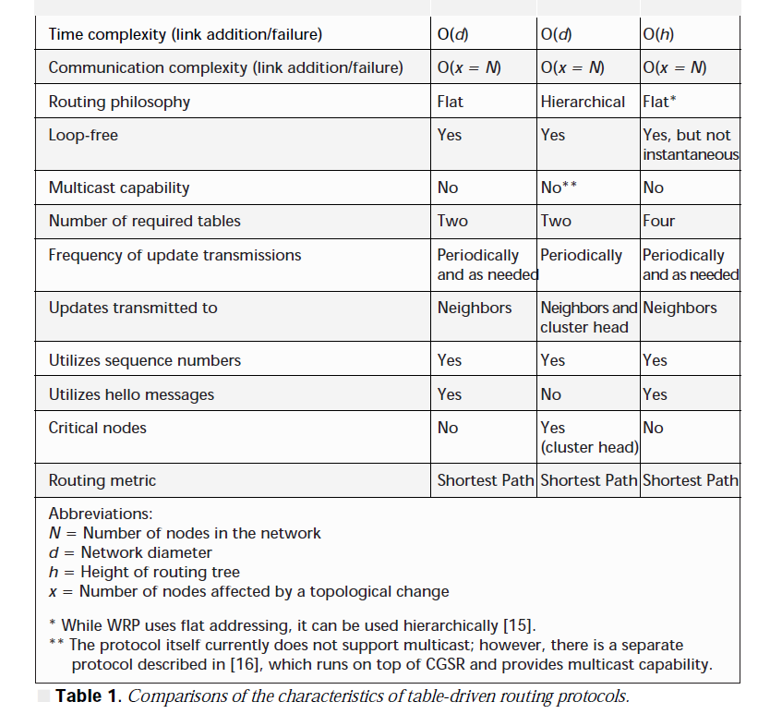
Table-Driven Protocol
Time Complexity: Number of steps needed to perform
Communication Complexity: number of messages needed
(N) Number of Nodes
(d) Network Diameter: The longest distance between nodes in a network
(h) Height of routing tree
All are loop-free
None has multicast- capability
WRP has higher memory requirement
CGSR has critical nodes
All have the same routing metric: Shortest Path
Performance Parameters | DSDV | CGSR | WRP

Slide 13
Source Initiated On-Demand Protocols
Ad Hoc Routing Protocols
Table-Driven
Source-Initiated On-Demand
DSDV
WRP
AODV
DSR
LMR
ABR
CGSR
TORA
SSR
Notes:
Reactive
Routes created only when needed
Route discovery process
Route maintenance

Slide 14
On-Demand Protocols
Ad Hoc On-Demand Distance Vector Routing
Route Discovery
Improvement of DSDV
Reduced number of broadcast
Pure on-demand route acquisition
Use of sequence number
Notes:
RREQ packets propagate through neighbors until either the destination of an intermediate node with fresh enough route to destination is reached.
Each node maintains its own sequence number, broadcast ID per RREQ message sent.
Broadcast ID + IP address = uniquely identifies the RREQ
RREQ= (nodes own sequence number+ broadcast ID + most recent sequence number for the destination)
Intermediate nodes reply to RREQ if it has a destination-sequence number greater than the one contained in the RREQ.

Slide 15
On-Demand Protocols
Ad Hoc On-Demand Distance Vector Routing
Route Reply
RREP
RREP
RREP
RREP
Notes:
Establish reverse path by recording the first copy of the broadcast packet received from neighbor

Slide 16
On-Demand Protocols
Ad Hoc On-Demand Distance Vector Routing
Route Maintenance
Source Node Movement
  Reinitiate route discovery
Intermediate Node movement
  Upstream neighbor notices and propagates link failure notification messages
Hello Messages
  Maintain local connectivity

Slide 17
On-Demand Protocols
Dynamic Source Routing
Route discovery
Source Routing
Mobile nodes maintain route cache
  Continually updated as new routes are learned
Two Phases :
  Route discovery
  Route maintenance
G-J-E
G-J-I
G-J-I-F
G-J
G-J
G
G-J
G-D
G-J-M
G-D
G
G-D-H
G-J-M
G-D
G-D-B

Slide 18
On-Demand Protocols
Dynamic Source Routing
Route Reply
G-J-I-F-A
G-J-I-F-A
G-J-I-F-A
G-J-I-F-A
Notes:
Establish reverse path by recording the first copy of the broadcast packet received from neighbor

Slide 19
On-Demand Protocols
Dynamic Source Routing
Route Maintenance
Route error packets
  Data link layer facing a fatal transmission problem
  Hop in error removed from all the route cache
  All routes containing the erroneous hop truncated
Acknowledgments
  Verify correct operation of the route links
  Passive acknowledgments: hear next hop forwarding
Notes:
When a link is broken → due to movement of nodes or any other reason
The node that discover the failure link will send RouteError to the Source
When the source gets the RouteError Packet it will delete the path from the cache
And will find another route in its cache, if it didn’t find any route it will run RouteRequest again

Slide 20
On-Demand Protocols
TORA: Temporally Ordered Routing Algorithm
Based on Link reversal : Model the problem as a directed graph and reverse the direction of links
Route creation : Reactive
Route maintenance: Proactive
Loop free distributed routing algorithm
Multiple routes for a source/destination pair
  No need to send RREQ until all routes fail
Localization of Control Message
Does not use the shortest path solution
Basic functions:
  Route creation
  Route maintenance
  Route erasure: In case of partition
Notes:
Localizes the control message to a very small set of nodes near the occurrence of a topological change

Slide 21
On-Demand Protocols
Temporally Ordered Routing Algorithm
Mechanism for optimizing routes: routers re-select their heights in order to improve the routing structure.
Control packets:
  query (QRY)
  update (UPD)
  clear (CLR)
  optimization (OPT)
Quintuple Height Metric
  Logical time of link failure
  ID of the node defining the new reference level
  Reflection indicator bit
  Propagation ordering parameter
  Unique ID of the node

Slide 22
On-Demand Protocols
Temporally Ordered Routing Algorithm
Route Request
Height = (_,_,_,_,E)
E
B
D
Height = (0,0,0,0,D)
Height = (_,_,_,_,S)
S
C
F
A
G
Notes:
Timeout mechanism: If a node does not receive the response within a reasonable time, a timer expires

Slide 23
On-Demand Protocols
Temporally Ordered Routing Algorithm
Route Reply
Height = (0,0,0,1,E)
Height = (0,0,0,2,B)
E
B
D
Height = (0,0,0,0,D)
Height = (0,0,0,3,S)
S
C
F
A
G

Slide 24
On-Demand Protocols
Temporally Ordered Routing Algorithm
Route Maintenance
Height = (1,E,0,-1,B)
Height = (1,E,0,-1,E)
E
B
D
Height = (0,0,0,0,D)
S
C
Height = (1,E,0,-1,C)
F
A
G
Notes:
Route erase if network gets partitioned

Slide 25

On-Demand Protocols
Associativity-based routing
Loop-free, deadlock-free, duplicate-free
Routing metric: degree of association stability
Beacon packets
Detect mobility status
Three phases:
  Route discovery
  Route reconstruction
  Route deletion
B_tick++
C
B
B_tick++
B_tick++
D
A
Beacon
Notes:
Beacon packets to signify existence. upon hearing, the neighbor nodes increment the associativity tick

Slide 26
On-Demand Protocols
Associativity-based routing
Route discovery
Steps:
  Broadcast Query
  Intermediate nodes append own address, associativity ticks with neighbors, QOS information
  Successor node keeps only the tick entry concerned with itself and its upstream node; erases all other upstream node neighbors.
  The destination selects the best route and reply back.
B
E
D
S
C
F
A
G
Notes:
Each resultant packets arriving at the destination will contain associativity ticks of the nodes along the route to destination.
Nodes propagating the reply mark their routes as valid while others remain inactive, thus duplicate-packet is avoided

Slide 27
On-Demand Protocols
Associativity-based routing
Route Reconstruction & Deletion
Depends on which node(s) along the route move
  Source Movement: Initiate Route discovery; erase route entries
  Destination movement: performs a local search (LQ packet) in hope of repairing the path. If the local search fails, a ROUTE_ERROR is reported to the source.
Route Deletion: Initiate full broadcast of route-delete message
source
local
searched zone
destination

Slide 28
Signal Stability Routing
Adaptive routing protocol
Route selection : signal strength and location stability
DRP:
  Maintenance of Signal Stability Table (SST) and Routing Table (RT).
  Record strength of Beacon signals
  Receive and process all transmissions
  Send route reply packet
SRP:
  Processes packets by passing up the stack
  Initiate route-search process
  Only forwarded to the next hop if received over strong channel
The destination chooses the first arriving route-search packet
Failed link:
  Send error message
  Initiate route-search process
  Send erase message

Slide 29
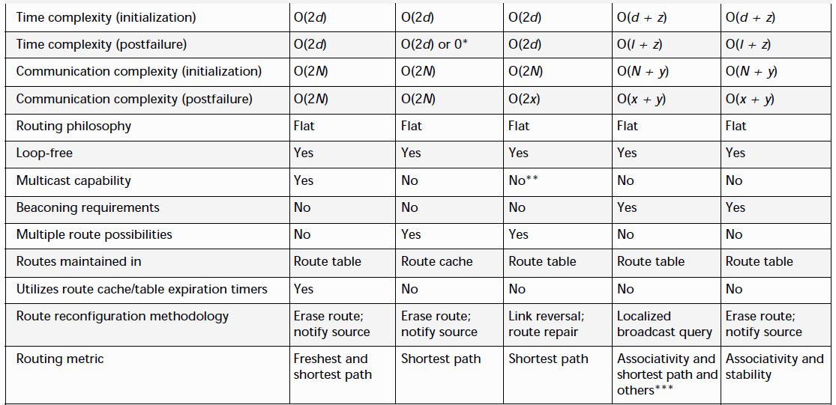
On-Demand Protocols
I: Network Diameter
Y: total number of nodes forming the directed path
z: diameter of the directed path
Performance Parameters | AODV | DSR | TORA | ABR | SSR

Slide 30
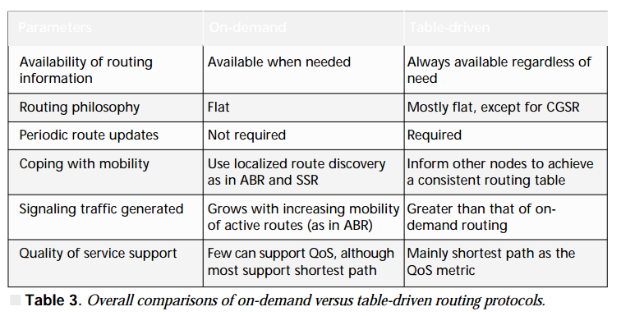
Table-Driven VS On-Demand
Parameter
On-demand
Table-Driven

Slide 31
Discussion
Which routing protocol looks best for VANET?
Feasibility of CGSR, WRP and TORA?
Existing Application?
Hybrid (both proactive and reactive) routing
Security?
Later works:
  Hierarchical State Routing (HSR) protocol
  Source Tree Adaptive Routing Protocol (STAR)
  Optimized Link State Routing (OLSR)
  Global state routing protocol (GSR)
  ……..

Slide 32
Discussion (Piazza) [1.00 PM]
Good explanation
No Experimental data, only theoretical comparison
Short on example application and case study
Short section on “Table-Driven VS On-demand”

