Slide 1
Storage management and caching in PAST
Presented by
Baskar Rethinasabapathi

Slide 2

Peer-to-peer systems
Widely deployed
Napster – not pure p2p, used centralized database of servers
Gnutella
BitTorrent
Primary motivation: File sharing
Problems: Congestion, No good caching mechanism
Notes:
Discuss
How the systems evolved during the same time?
What was the initial motivation?
File sharing
What some popular systems compromise on?
Single point of failure, caching

Slide 3

Peer-to-peer systems
OceanStore – transactional storage, allows updates
FarSite – no content location and routing, traditional filesystem semantics
FreeNet, FreeHaven, Eternity – strong security paradigms
CFS – weak persistence, read-only file sharing, built on Chord
PAST belongs to this class
Primary motivation: p2p archival storage
Notes:
Discuss
-OceanStore provides a global, transactional, persistent storage service that supports serializable updates on widely replicated and nomadic data
distributed directory service is used in FarSite to locate content;
FreeNet, FreeHaven and Eternity are more focused on providing strong anonymity and anti-censorship
CFS is a decentralized, cooperative read-only storage system, intended solely as a file sharing medium
What class of problems does PAST try to address?

Slide 4
How PAST differs?
PAST – large scale, persistent peer-to-peer storage utility
Strong persistence
High availability
Scalability
Security
Notes:
Discuss design motives
Strong persistence - Inserted files are replicated on multiple nodes
Availability - With high probability, the set of nodes over which a file is replicated is diverse in terms of geographic location, ownership, administration, network connectivity etc
Scalability - PAST achieves global storage utilization in excess of 98%
Security - public-key cryptosystem and the cryptographic hash function used in PAST, use of smartcards
Each smartcard’s public key is signed with the smartcard issuer’s private key for certification purposes.
The smartcards generate and verify various certificates used during insert and reclaim operations and they maintain storage quotas

Slide 5
PAST – key design features
File system semantics
  quasi-unique file id
  Quasi-random node id
  No facilities for searching, directory look-up or key distribution
Routing strategy – Pastry
Operations
  fileId = Insert(name, owner-credentials, k, file)
  file = Lookup(fileId)
  Reclaim(fileId, owner-credentials)
Load balancing
Notes:
Discuss the APIs in detail
Quasi-identifiers are pieces of information that are not of themselves unique but can be combined with other quasi-identifiers to create a unique identifier
Provides immutability to files, cannot be inserted multiple times
- assumed that users interact primarily with a conventional filesystem, which acts as a local cache for files stored in PAST
K user specified , number of diverse nodes
Insert - SHA-1 hashcode of the file’s textual name, the client’s public key, and a random salt
(file size times k) is debited against the client’s storage quota

Slide 6
Popular routing schemes
Chord
Pastry
CAN – d-dimensional space
Tapestry
Why Pastry?
Notes:
Apart from being a Microsoft product, how ideal is pastry for PAST?
Better suited for diverge nodes
Log n insert and log n lookup
Main reason: Locality preference, the leafset in pastry are closely located and hence less time to send and receive messages

Slide 7
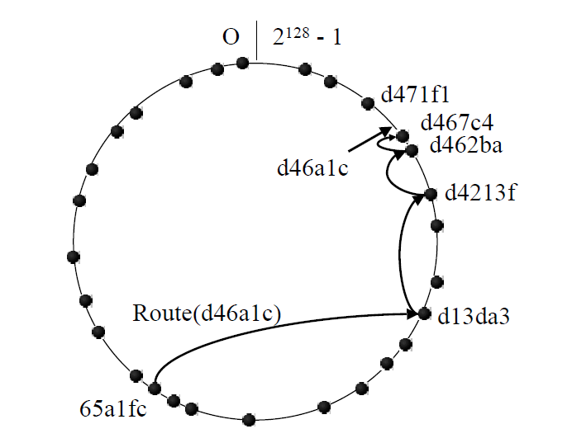
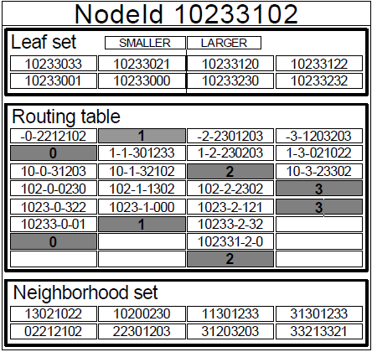
Pastry – some key concepts
Chord like ring
Leaf Set
Prefix matching
log(N) hops
Notes:
Give an example routing to a particular node using the id prefix
-Each Pastry node has a unique, 128-bit nodeId and a routing table
each entry maps a nodeId to the associated node’s IP address
Leafset – numerically closest l/2 smaller and larger ids
Neighbor hood set - not used in routing, but is useful during node addition/recovery
starts by forwarding to a neighbor with the largest matching prefix

Slide 8
Managing the Storage
Design Goal
  rely only on local coordination among nodes with nearby nodeIds
Storage Imbalance - causes
  File size distribution
  Per-node capacity
  File assignment to nodes
Storage Imbalance – strategy
  Replica Diversion
  File Diversion
Notes:
Discuss
Example scenarios of imbalances
When each diversion technique is needed

Slide 9
Diversion in detail
Replica Diversion
  Animation on how nodes A and its leaf B and C handle this scenario
  Policies
    Accepting replicas to local store
    Selecting a node to store a diverted replica
    Deciding when to divert a file to a different nodeId space
File Diversion
Maintaining replicas
  Why is it hard? What are the possible bottlenecks?
Encoding technique
  Reed-Solomon
Notes:
Explain the questions raised in detail
Encoding –brief representation

Slide 10
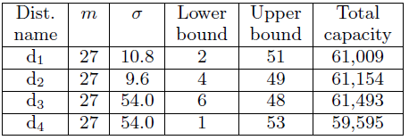
Storage Experiment
NLANR Web proxy logs
File semantics from file systems of authors
Is this the right workload?
Parameters involved
Notes:
Brief the experiment setup
Selecting an appropriate workload to evaluate a system
like PAST is difficult, since workload traces for existing
peer-to-peer systems are not available and relatively little is
known about their characteristics

Slide 11
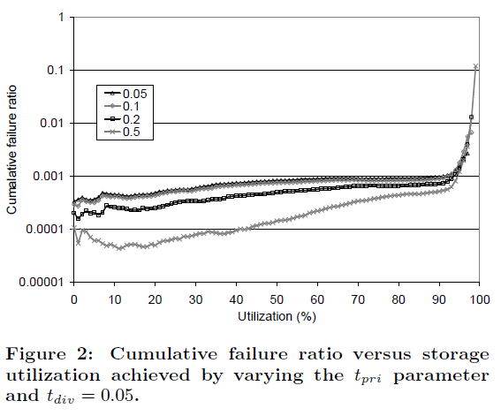
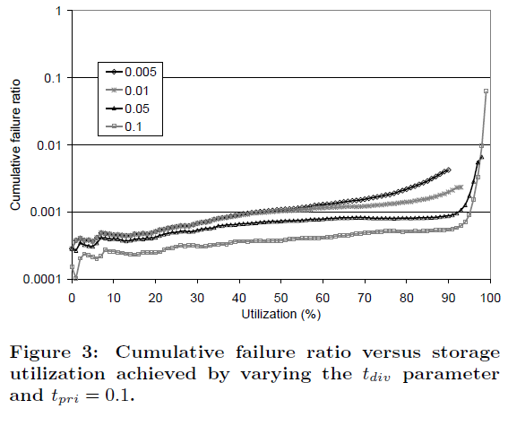
Stats – for insert failures
Eventually, the system reaches full utilization, but large files still contribute to higher ratio of failures
Notes:
Explain the graph
- the ideal threshold for primary and diversion replicas are experimentally achieved by varying them
But works well for small files only
Dataset does not reflect all possible challenges that could arise

Slide 12
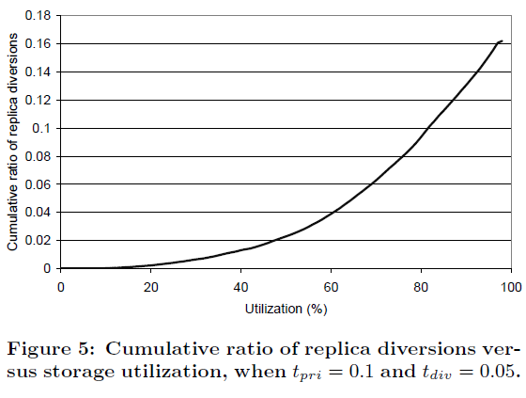
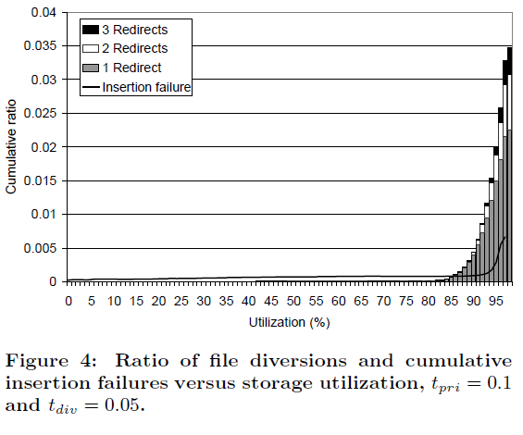
Stats – for diversions
After around 80% utilization, replica redirects increase to atmost 3
Notes:
Explain the graph
- This is pretty straightforward as, higher utilization means many failures and hence more redirects

Slide 13
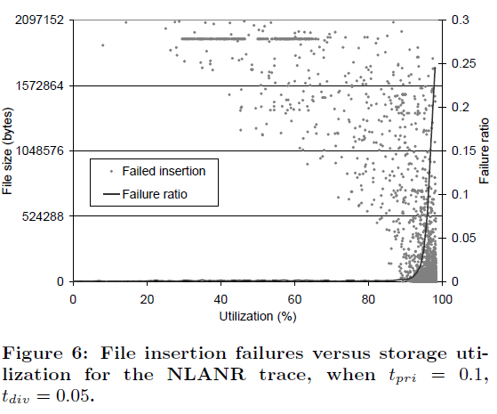
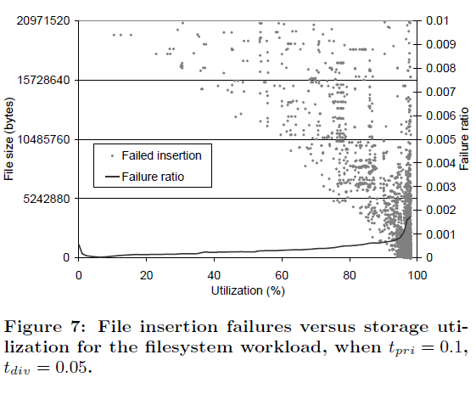
Stats – for insertion failures
Failure rate for large files is always high
Failure rate mostly remains very low till 90%
Notes:
Explain the graph
- How it achieves so good utilization? But not for large files

Slide 14
Caching
Goal
  minimize client access latencies
  maximize the query throughput
  balance the query load
Handling popular files
Cache insertion policy
Cache replacement policy
  Greedy Dual Size Policy
Notes:
Explain GD policy and reason why better than LRU

Slide 15
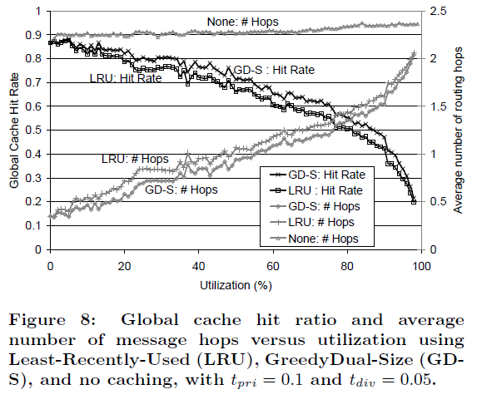
Stats - caching
No caching means more hops for hitting replicas
NLANR traces from clients mapped
to individual PAST nodes
Comparing total routing hops
  GD-S policy vs LRU Policy
Starts performing better than LRU after attaining higher utilization
Notes:
Explain no caching line
Why better than LRU after 80%

Slide 16
Does PAST meet its design goals?
the use of randomization to ensure diversity – pastry - Yes
load balancing – replication strategy – Yes, but not varied dataset to prove
quota system that balances supply and demand of storage in the system
– Yes, good for security as well
Notes:
- Yes but, could have taken a larger dataset

Slide 17
Comments
How good is Pastry’s approach to randomize node ids?
  Network congestion if too physically diverse?
Systems that improve PAST’s primitive file system operations?
Can diversion be done in chunks than entire files?
…
Notes:
- Overall a promising system

