Slide 1
Starfish: A Self-tuning System for Big Data Analytics
Herodotos Herodotou, Harold Lim, Gang Luo, Nedyalko Borisov, Liang Dong, Fatma Bilgen Cetin, Shivnath Babu
Department of Computer Science
Duke University
Presented by Nirupam Roy

Slide 2
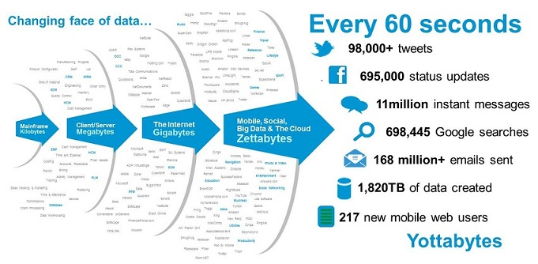
The Growth of Data
Notes:
With the huge per year growth in the gobal data size, now we are entering to the era of yottabytes. Therefore it is important to have a big-data analytics systems that can process information from such a formidable amount of data in an optimal way.

Slide 3
MAD: Features of Ideal Analytics System
Magnetism
-- accept all data
Agility
-- adapt with data,
real-time processing
Depth
-- allow complex analysis
Notes:
In order to achieve the data analysis goal, Researchers have identified three basic features of a successful analytics system. These are magnetism i.e. the ability collect various types of data including unformatted or incomplete ones. The next one is Agility to adapt according to the data evolution and the Depth or ability to perform deep statistical and machine learning based analytics. Collectively called as MAD.

Slide 4
Hadoop is MAD
Magnetism
- Blindly loads data into HDFS.
-- accept all data
- Fine-grained scheduler
- End-to-end data pipeline
- Dynamic node addition/
dropping
Agility
-- adapt with data,
real-time processing
Depth
- Well integrated with
programming languages
-- allow complex analysis
Notes:
Hadoop is equipped with all the features to needed for an ideal data analytics system.

Slide 5
Tuning for Good Performance: Challenges
- Multiple dimensions of performance
-- time, cost, scalability …
- Multiple levels of abstraction
-- job-level, workflow-level, workload-level …
- Tons of Parameters
-- more than 190 parameters in Hadoop.
Notes:
However, setting the correct parameters manually to get optimal performance is not straight forward. Mainly because of the performance can be defined in terms of time, cost or scalability. It requires tuning of the parameters at various abstraction levels like jobs or workflows. And above all there is huge set of controllable parameters which is near impossible to set accurately for each task.

Slide 6
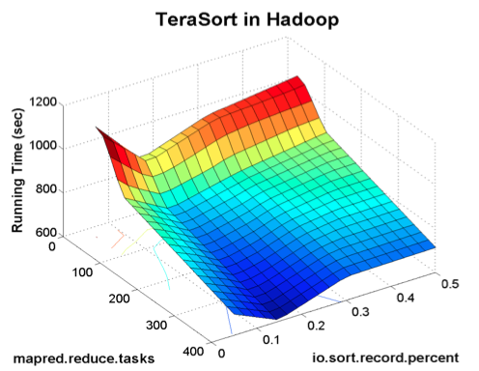
Tuning for Good Performance: Challenges
Thumb rule

Slide 7
Tuning for Good Performance: Challenges
Thumb rule
Notes:
The researches have found that this thumb rule can lead to a performance pretty close the worst case. This experiment reveals the fact that the default rules or the thumb rules may not give optimal result for all scenarios.

Slide 8
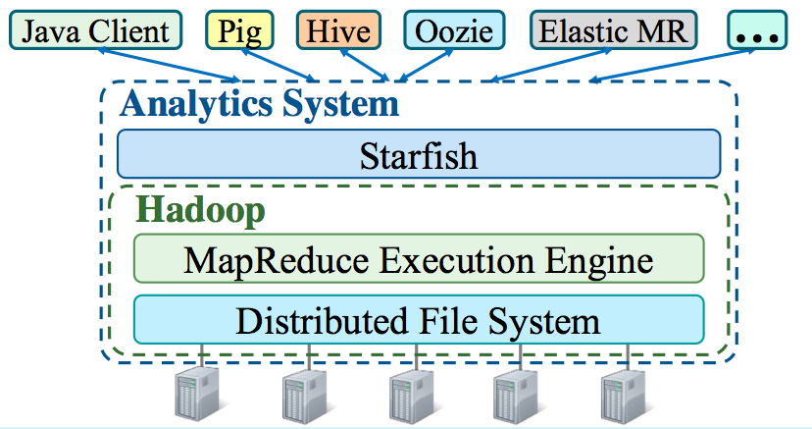
Starfish: A Self-tuning System
- Builds on Hadoop
- Tunes to ‘good’ performance automatically
Notes:
This motivates the authors to come up with a system that build on the top of Hadoop and automatically tunes its parameters for a good overall result for a given task. However, Startfish does not attempt to achieve the peak performance, rather to achieve a reasonable performance without the direct intervention of the user.

Slide 9
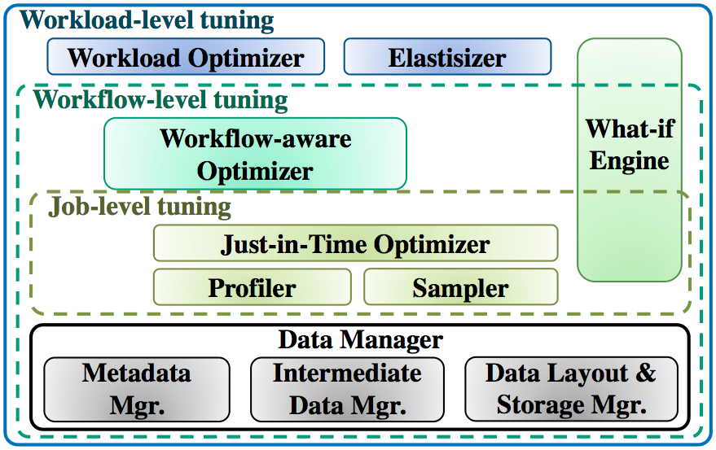
Starfish Architecture
Notes:
Starfish works with all three abstraction of this optimization problem. The workflow level optimizer works with the scheduling policies.

Slide 10
The “What-if” Engine
Learning from previous job profiles
Analytical models to estimate dataflow
Profile of a job (P)
+
New parameter set (S)
Model + simulation based prediction algo.
Predicted performance
Simulating the execution of MR workload
[Ref:] A What-if Engine for Cost-based MapReduce Optimization. H. Herodotou et.al.
Notes:
It takes in account input data d1 and cluster resources r1 using configuration c1.
The What-if Engine uses a Task Scheduler Simulator, along with the job profiles and information on the cluster resources, to simulate the scheduling and execution of map and reduce tasks in hypothetical job J’.

Slide 11
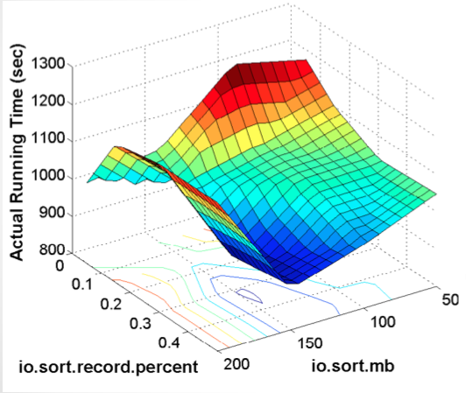
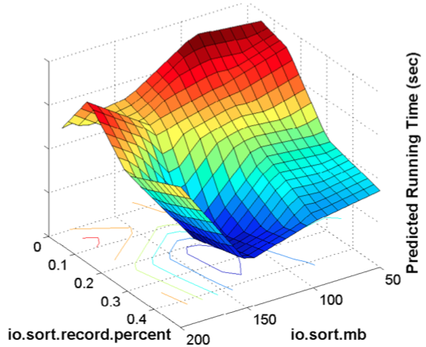
The “What-if” Engine
Ground truth
Estimated by the What-if engine

Slide 12
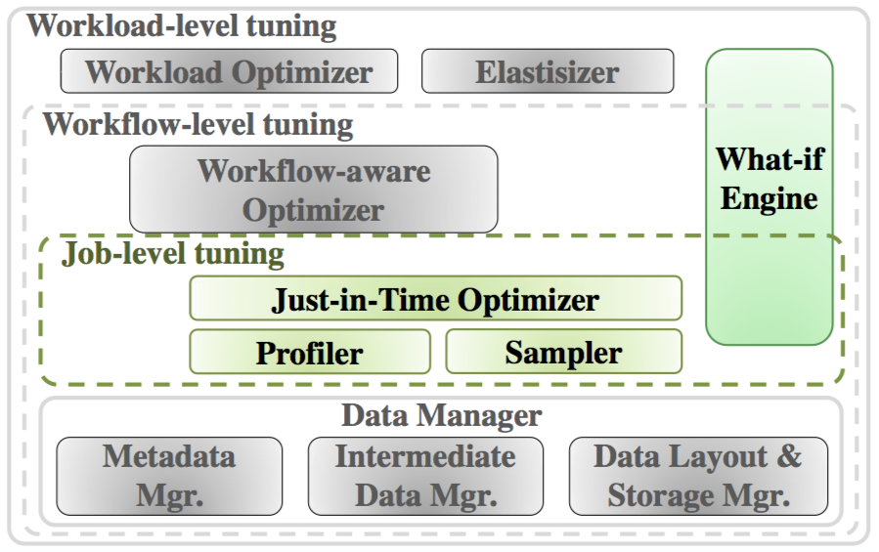
Starfish Architecture: Job Level

Slide 13
Starfish Architecture: Job Level
Just-in-time optimizer
-- Searches the parameter space
Profiler
-- Collects info. on MapReduce job execution through
dynamic instrumentation
-- Reports timings, data size, and resource utilization
Sampler
-- Generates profile statistics from training benchmark
jobs

Slide 14
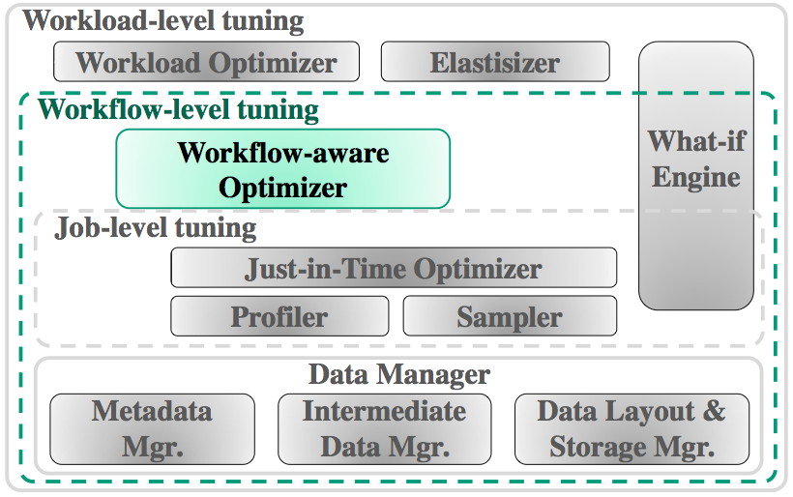
Starfish Architecture: Workflow Level

Slide 15
Starfish Architecture: Workflow Level
Scheduler to balanced distribution of data
-- deals with skewed data, add/drop of nodes,
tradeoff between balanced data v/s data-locality
Block placement policy for data collocation
-- Local-write v/s round-robin
Notes:
The primary concern of the workflow scheduler is to balance the data across the nodes and select appropriate block placement policy. Hadoop does not consider this data balancing by default, therefore as a result of skewness in the data or add/drop of nodes the data can be hugely unbalanced and can create performance issues.

Slide 16
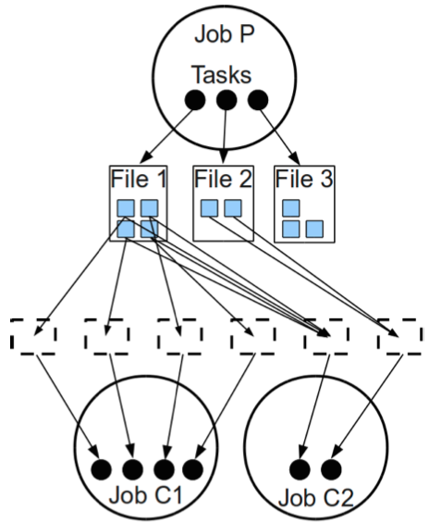
Starfish Architecture: Workflow Level
Producer
Wasted production
Consumer
Notes:
Workflow aware scheduler takes the decision considering the producer consumer relation of the jobs in the workflow. And in this sample example we can see that there is no consumer for file 3. Therefore a simple rule can stop the producer from creating file3. However, there are scenarios where decisions are not so straight forward.

Slide 17
Starfish Architecture: Workflow Level
Block level parallelism
File level parallelism
Notes:
For example, here two jobs have conflicting interests over file 2. To facilitate block level parallelism for C1 all blocks of file should be spread out across nodes, however file level parallelism for C1 needs all blocks to be placed on the same node. It is hard to analytically figure out the optimal distribution strategy. Starfish uses simulation for the decision.

Slide 18
Starfish Architecture: Workflow Level
Workflow Aware Optimizer
Select best data layout and job parameters
Running time?
What-if simulation
Compare cost & benefits
Data layout?
MR job execution
Task scheduling
Block placement
Notes:
Starfish workflow level optimizer works in conjunction with the job level optimization to come up with a good layout of the data for the overall workflow. It iterates over all jobs in the workflow and compares the simulated cost for a particular set of parameters. The search space consists of the –Block placement policy, (local write/roundrobin), number of replicas, size of blocks, and output compression level. One it have all the predictions, it can choose the most suitable one.

Slide 19
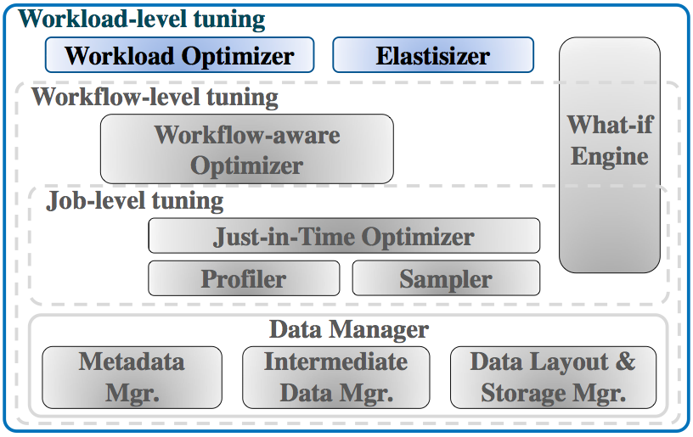
Starfish Architecture: Workload Level

Slide 20
Starfish Architecture: Workload Level
Workload Optimizer
Jumbo operator
Cost based estimation for best optimization
Elastisizer
Determine best cluster and Hadoop configurations
Notes:
Uses jumbo operator to aggregate multiple SPA(select project aggregate) workflows on table in a single map-reduce job, which reduces the load and runtime.
For the pay-as-you-go scenarios, Elastisizer uses the prediction engine to find out the best cluster and configuration for the given workload and user-specified goals.

Slide 21
Starfish: Summary
- Optimizes on different granularities
-- Workload, workflow, job (procedural & declarative)
- Considers different decision points
-- Provisioning, optimization, Scheduling, Data layout
Notes:
Although there are scope for improvements in terms of optimized search over the parameter space and the efficiency of the what-if engine, Starfish can be considered as a stepping stone towards the self-tuning analytics system.

Slide 22
Starfish: Piazza Discussion
Top criticisms (till 1:30pm, 17 reviews):
1) Limited evaluation: 10
2) Not explained well: 7
3) Profiler overhead/better search algo: 5
* What is the effect of wrong prediction?
* What-if engine requires prior knowledge.
Notes:
It mostly evaluated on a single rack Hadoop cluster

Slide 23
Thank you.
http://www.cs.duke.edu/starfish/
Photo courtesy: Starfish group, Duke University

Slide 24
Going MAD with Big Data
Magnetic system
Agile system and Analytics
Deep Analytics
Data Life Cycle Awareness
Elasticity
Robustness

Slide 25
Backup: What-if Engine 1

Slide 26
Backup: What-if Engine 2

