Slide 1
A Self-Configurable Geo-Replicated Cloud Storage System
By: Masoud Saeida Ardekani and
Douglas B. Terry
Presentation By: Chinmay Kulkarni

Slide 2
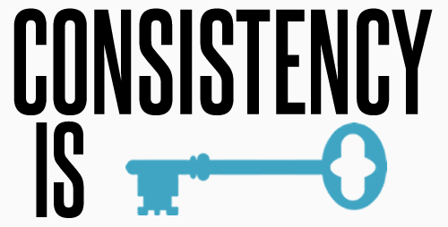
Background:
Geo-Replication: Replicas on servers at multiple locations
Consistency: Strong, Eventual, RMW, Monotonic, etc.
Latency-Consistency Tradeoff
Primary Replicas: Writes and Strongly Consistent Reads. Secondary Replicas: Intermediary Consistency Reads
Pileus is a replicated key-value store that allows users to define their CAP requirements in terms of SLAs
Notes:
-Replication – Improve data reliability, data availability, fault-tolerance, provide backup in case of failures.
-Must ensure Consistency!!
-Primary Replicas → All writes & Strongly consistent Reads.
-Secondary Replicas → Intermediary Consistency Reads.

Slide 3
Brief Overview of Pileus (A “CAP” Cloud):
SLA: Interface between client and cloud service. Wish list. “I want the strongest consistency possible, as long as read operations return in under x ms.”
Clients specify consistency-based SLAs which contain acceptable latencies and a utility (preference/weight)
Monitor replicas of the underlying storage system
Route read operations to servers that can best meet a given consistency-based SLA
Rank | Consistency | Latency(ms) | Utility
1 | Strong | 75 | 1
2 | RMW | 150 | 0.8
3 | Eventual | 750 | 0.05
Table 1: Example of an SLA
Notes:
-Replication – Improve data reliability, data availability, fault-tolerance, provide backup in case of failures.
-Must ensure Consistency!!
-Primary Replicas → All writes & Strongly consistent Reads.
-Secondary Replicas → Intermediary Consistency Reads.

Slide 4
Pileus – Shortcomings:
→ Pre-defined configuration
→ Static
Key issues:
→ Where to place primary and secondary replicas?
→ How many to deploy?
→ Synchronization Period?
Why not dynamically reconfigure replicas?
→ Tuba
Notes:
-Each entry is a SubSLA.
-SLAs are ranked by utility which depends on the application.
-Sometimes lower consistency with low latency is preferred over strong consistency with high latency.
-Ex. FB friends.

Slide 5
Main Contributions of Tuba:
Dynamically, automatically and periodically reconfigure replicas to deliver maximum overall utility to clients
Does this while respecting SLAs, costs and replication constraints
Client can continue to read and write data while reconfiguration is carried out in parallel
Leverage geo-replication for increased locality and availability

Slide 6
Configuration Selection:
Configuration Generator
SLAs
Configuration Service (CS)
Observed Latencies
Configuration $max\left[\frac{Utility}{Cost}\right]$
Hit/Miss Ratios
R/W Ratios
Constraints:
Replication Factor
Location
Sync. Period
Cost in $
Costs:
Data Storage
R/W Operations
Syncing
Cost of reconfiguration
Fig.1 Configuration Selection
Notes:
-Tablet is the granularity of replication (key ranges for key-value stores).
-Config Generator generates all possible configurations → Find util/cost for each and select the highest after pruning acc. To constraints.
-Ex. Of constraint → Set max geo-replication factor of unpopular songs to 1 & that of chartbusters to 3. → Limit sync. Communication betwn. 2ndary and 1ry replicas.

Slide 7
Greedy Choice: Replicate data in ALL datacenters. BUT, there are constraints and cost considerations
Ratios Aggregation for clients in the same locations with the same SLAs → Reduced computation
New configuration is computed based on missed subSLAs and consistency requirements
→ E.g.: missed subSLA for strong consistency –
Add Primary replica near client
Constraint satisfaction
Execute reconfiguration operations

Slide 8
Client can’t read config. Because CS has exclusive lock
Client Execution in Tuba – 2 Modes:
Fast Mode: Client has the latest configuration and holds a lease on the configuration for $(Δ −d) seconds.$
Slow Mode: Client suspects that the configuration has changed
Fig.2 Client Execution Modes

Slide 9
Tuba Implementation Details:
Implemented on top of Microsoft Azure Storage (MAS)
Extension of Pileus (Consistency–based SLAs taken from Pileus)
Tuba = MAS + multi-site geo-replication + automatic reconfiguration
How do clients and the CS communicate?
How are client operations (Read/ Write Operations) carried out?
How are CS reconfiguration operations carried out?

Slide 10
Client-CS Communication:
Clients
CS
Clients use a designated MAS shared container to communicate with the CS
Clients periodically write their observed latencies, Hit-Miss Ratios, SLAs and Read-Write Ratios which the CS reads
CS stores latest configuration and the RiP (Reconfiguration-in-Progress) flag
Tuba allows clients to cache the current configuration of a tablet called a cview
Latencies
Configuration
Hit-Miss, R/W Ratios + SLAs
RiP
Clients
Fig.3 Writes to Shared Container

Slide 11
Client Read Operations:
Send request to replica. Get reply
Is client in fast mode?
Select replica
Yes
Return read data to application
No
Strongly consistent read?
No
Yes
Check: Is replica still primary?
No
Yes
Abort & retry
Fig.4 Client Read Operation
Notes:
Select replica based on latency, cview and SLA

Slide 12
Client Write Operations (Single-Primary Write):
Fast mode interval > Write operation time
Fast mode
Data
Yes
RiP set?
Yes
Slow mode
No
No
Write to primary replica. Get response
Refresh cview
Undo Write & Abort
Yes
Slow mode
Primary replica changed?
Client still in fast mode?
Get lease on config. blob
Write to primary replica
Done
No
No
Done
Yes
Fig.5 Client Single-Primary Write Operation
Notes:
Slow Mode:
Client obtains a non-exclusive lock on the configuration (lease-id), stores lease-id in configuration blob and performs write
If CS obtains exclusive lock on the configuration, no more writes allowed

Slide 13
Client Write Operations (Multi-Primary Write):
Add WiP flag to blob’s metadata at main primary replica
Add WiP flag to blob’s metadata at non-main primary replicas
Etag1 Changed?
Get lease on config. blob
Yes
Abort
No
Main primary replica always holds the truth! i.e. the latest data.
ETag1
ETags
Write to blob on main primary site
Clear WiP flag at main primary replica
Clear WiP flag at non-main primary replicas
Write to blob on other primary sites
Etags Changed?
Done
No
Yes
Fig.6 Client Multi-Primary Write Operation
Notes:
Etags are used for conditional writes.→ So, if the Etag value at the place to write is the same as it was when the client expressed his intention to write, the client can write to that blob.
Multi-primary write may take longer than Δ sec. to complete, so we acquire lock even If in fast mode.

Slide 14
CS Reconfiguration Operations:
Adjust synchronization period
Add Secondary Replica
Remove Secondary Replica
Change Primary Replica
Add Primary Replica

Slide 15
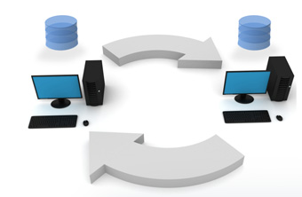
Adjust Synchronization Period (adjust_sync_period):
Defines how often secondary replicas sync with primary replicas
↓ sync period, ↑ freq of sync, ↑ up-to-date secondary replicas, ↑ chance of hitting intermediary consistency read subSLAs
Less costly as compared to adding/moving replicas
No directly observable change for clients
Notes:
-Does not affect latency of read operations with strong or eventual consistency since those are directed towards primary replicas.

Slide 16
Add/Remove Secondary Replica (add/remove_secondary(${site}_{i}$)):
E.g.: Consider an online multiplayer game
Add secondary replica near users (at ${site}_{i}$) during peak times
Will provide better utility in case of this SLA
Can remove the secondary replica once user
traffic goes down to reduce cost
Rank | Consistency | Latency(ms) | Utility
1 | RMW | 40 | 1
2 | Monotonic | 90 | 0.6
3 | Eventual | 450 | 0.01
Table 2: SLA of an online multiplayer game
Notes:
-Does not affect latency of read operations with strong or eventual consistency since those are directed towards primary replicas.

Slide 17
Change/Add Primary Replica (change/add_primary(${site}_{i}$)):
Secondary replica exists at ${site}_{i}$?
Wait Δ seconds so that all clients go to slow mode
Break all client leases and get lease on config. blob
Yes
Make replica WRITE_ONLY
Set RiP flag in config. blob metadata
No
Increase hits on strongly consistent reads based on geographical variation of user traffic.
Wait for safe threshold = max allowed lease time
Create replica at ${site}_{i}$ and sync with primary replica
Make${site}_{i}$the solo primary replica
(if change operation), or add to list of primary replicas (if add)
Install temporary config.
Done
Remove RiP flag
Fig.7 Change/Add Primary Replica
Notes:
- We make the new replica WRITE_ONLY to avoid the case wherein it can never finish synchronizing with the primary replica (that case is when there are concurrent writes going on).
- Write operations can occur concurrently since writes can occur in slow mode too.

Slide 18
Fault-Tolerance in Tuba:
Replica Failure:
→ Rare. Each site is a collection on 3 Azure servers
→ Failed replicas can be removed via reconfiguration operations
→ add_primary(${site}_{i}$),
change_primary(${site}_{i}$),
remove_secondary(${site}_{i}$),
add_secondary(${site}_{i}$)
Client Failure:
→ What if client fails mid-way through a multi-primary write?
→ Recovery process used to complete the writes. Reads from the main primary replica (the truth).

Slide 19
CS Failure:
→ No direct communication between clients and CS
→ If CS fails, clients can still remain in fast mode (provided RiP flag is not set)
→ Even if RiP flag is on, clients can do R/W in slow mode
→ If the RiP flag is on for too long, impatient clients waiting too long in slow mode can clear it
→ RiP off, so CS aborts reconfigurations (incase it was alive and just slow)
→ Changes made to RiP flag are conditional on ETags

Slide 20
Experiments:
WEU
Setup:
→ 3 storage accounts
(SUS, WEU and SEA)
→ Active clients are normally
SEA
SUS
distributed along US West Coast, WEU and Hong Kong
→ Simulate the workload of users in different areas at different times
→ 150 clients at each site (over a 24-hour period)
→ Each tablet accessed by 450 distinct clients everyday
→ Primary replica in SEA and secondary replica in WEU
→ Global replication factor = 2
→ No multi-primary schemes allowed
→ YCSB Workload B (95% Reads and 5% Writes)

Slide 21
Average Overall Utility (AOU):
→ Average utility delivered for all read operations from all clients
Experiments done with no reconfiguration, reconfigurations every 2 hours, every 4 hours and every 6 hours
Tuba with no reconfigurations = Pileus and AOU for 24-hour period is 0.72
With constraints max AOU = 0.92
Rank | Consistency | Latency(ms) | Utility
1 | Strong | 100 | 1
2 | RMW | 100 | 0.7
3 | Eventual | 250 | 0.5
Table 3: SLA Used for Experimentation
 | 6h | 4h | 2h
AOU | 0.76 | 0.81 | 0.85
AOU Improvement % over No reconfiguration | 5 | 12 | 18
AOU Improvement % over Max Achievable AOU | 20 | 45 | 65
Table 4: AOU Observations for Different Reconfiguration Periods

Slide 22
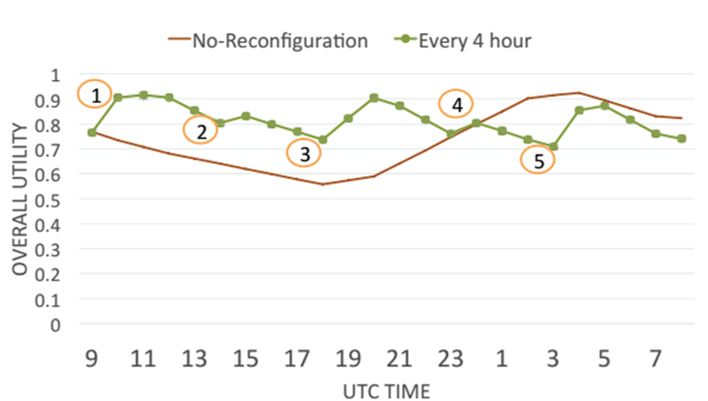
Action | Configuration Pri. Sec. |  | CS Reconfiguration Operation
1 | SEA | WEU | change_primary(WEU)
2 | WEU | SEA | add_secondary(SUS) remove_secondary(SEA)
3 | WEU | SUS | change_primary(SUS)
4 | SUS | WEU | add_secondary(SEA) remove_secondary(WEU)
5 | SUS | SEA | change_primary(SEA)
6 | … | … | ………………………………….
Improvement
Couldn’t predict client behavior
Table 5: Tuba Reconfigurations done
Fig.8 Tuba With a 4-Hour Reconfiguration Period
Notes:
-Explain experiment. Explain each reconfig operation.

Slide 23
Results:
Improvements in hit percentages for strongly consistent reads due to reconfiguration
Reconfiguration done automatically
→ No manual intervention – Faster
→ No need to stop the system
→ Client R/W operations occur in parallel to the reconfiguration operations
Fig.9 Hit Percentage of SubSLAs

Slide 24
Pros/Advantages of Using Tuba:
Dynamically change configurations to handle change in client requests
Change configurations on a per-tablet basis
Client R/W operations can be executed in parallel with reconfiguration
Easily extensible to existing systems that are already using MAS/Pileus
Provides default constraints to avoid aggressive replication
Reduced computation using hit-miss ratio aggregation
Good fault-tolerance (recovery processes, client RiP flag over rides, etc.)

Slide 25
Cons/Future Work:
Scalability Issues since configuration generator generates all possible configurations. At 10,000 clients and 7 storage sites → 170 seconds
Pre-pruning instead of post-pruning based on constraint satisfaction
Make CS proactive instead of reactive. Make reconfigurations by predicting future poor utility → Machine learning methods
For multi-primary operations, the first primary node is the main primary. Choose one so as to reduce overall latency?
Clients keep polling for new configuration. Use Async. messages instead?

Slide 26
Conclusion:
Tuba is a geo-replicated key-value store that can dynamically select optimal configurations of replicas based on consistency-based SLAs, constraints, costs and changing client demands
Successfully uses utility/cost to decide the optimal configuration
Carries out automatic reconfiguration in parallel with client R/W operations
Tuba is extensible: built on top of Microsoft Azure Storage and extends Pileus
Provides increase in consistency. E.g.: With 2-hour reconfigurations, reads that returned strongly consistent data increased by 63%. Overall utility went up by 18%.

Slide 27
Piazza Questions/Discussion Points:
Are there times when system blocks?
→ While adding/changing primary replica, no writes from when CS takes lease on configuration till new configuration is set up
→ But this duration is short (1 RTT from CS to config blob + safe threshold)
No experiments to measure reconfiguration load & failure cases
No SLA validation mechanisms. No constraints → default constraints
Security issues
Client failure → Multiple recovery processes are wasteful

Slide 28
Thanks for listening!
Questions?

