Slide 1
Reservation-based Scheduling: If You’re Late Don’t Blame Us!
Carlo Curinom, Djellel E. Difallahu , Chris Douglasm, Subru Krishnanm, Raghu Ramakrishnanm, Sriram Rao

Slide 2
Background & Motivation
Challenges
Continuously evolving focus on data-driven approaches to conduct businesses
Old characteristic
Single Dimensional → Batch oriented
New characteristic
Multi Dimensional → Batch, ad-hoc, MPI, Gang, graph, stream, etc
Same underlying system, but need to handle a mix of computations
Stringent SLOs for production jobs and minimize latency for best-effort jobs
+
“Improve return on investments (ROI) for cluster infrastructures”

Slide 3
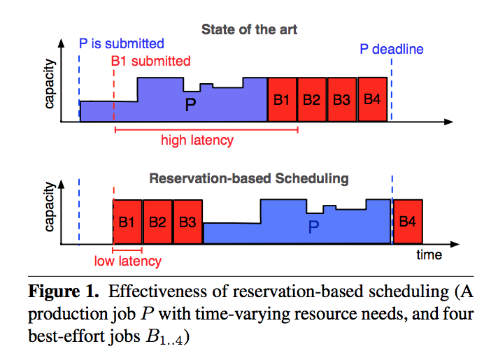
Production & Best Effort Jobs
Production jobs
Periodic workflows
Large and long-running
heavy data lifting
Fewer in number
Business critical
SLA compliance
Best Effort jobs
Ad-hoc job requests
Short lived
Consume less data
Larger in number
Latency is king

Slide 4
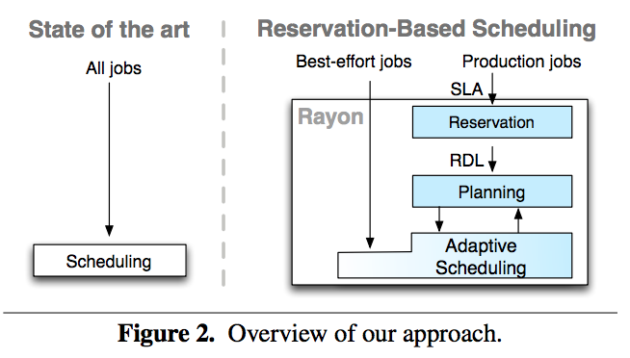
Approach
Reservation-Based Scheduling
Goal:
Delivers time-predictable resources:
Meet production job SLAs
Minimize best effort job latency
Achieve high-cluster utilization
Contributions
Reservation → Determine job resource needs
Planning → Online admission control
Adaptive Scheduling → Assign cluster resources
Implementation → Realize the proposed concepts in a working model

Slide 5
Reservation Reservation Definition Language
Objective:
Allow users to declaratively reserve access to cluster resources
Not available for Best-effort jobs, applies only to
Goals:
R1 – malleability for batch jobs (e.g., MapReduce)
R2 – strict parallelism and continuity for gang jobs (e.g. MPI)
R3 – explicit temporal requirements (e.g., SLAs)
R4 – precedence constraints (dependencies, e.g., Hive, Oozie)
R5 – expose all of the placement flexibility.

Slide 6
RDL Expressions
Expression Type | Expression syntax | Expression semantics
Atomic | atom(b, g, h, l, w) | where b = resource info, g = min, h= max parallel degree, l = lease time, w=work time
Choice | any(e1, . . . , en) | any one expression should be satisfied
Union | all(e1, . . . , en) | all expressions should be satisfied
Dependency | order(e1, . . . , en) | For expression ei all preceding ei+1 should be satisfied
Window | window(e, s, f) | [s, f) is a time interval, s=start, f=finish

Slide 7
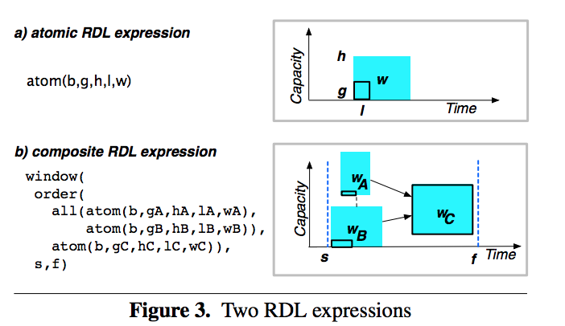
RDL sample definition
Compiling RDL
Parsed and validated, internally represented as an Abstract Syntax Tree - AST
RDL Optimizations
Redundant operator removal
Unification of compatible atomic expressions
Operator re-ordering

Slide 8
Planning Mixed Integer Linear Program
Planning
Decide if the given RDL expression can be accepted
Inputs: Cluster resources, RDL expression
Allocates Plan if possible else reject
Formalizing Planning as an Optimization Problem
Basic Formulation:
Resolves around an objective function
Expressed as a relation with resources
Satisfying different constraints

Slide 9
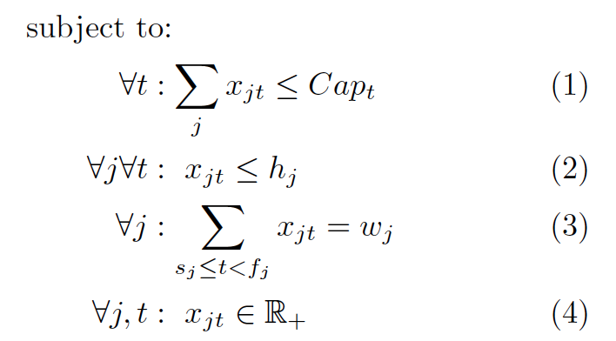
RDL Expressions
Modeling resource & constraints for RDL expressions
Objective Function :
where Xjt = Resource allocated to job j at time t,
Cjt = Cost of assigning capacity to job j at time
Capacity constraint
Parallelism constraint
Demand constraint

Slide 10
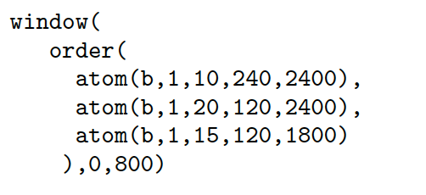
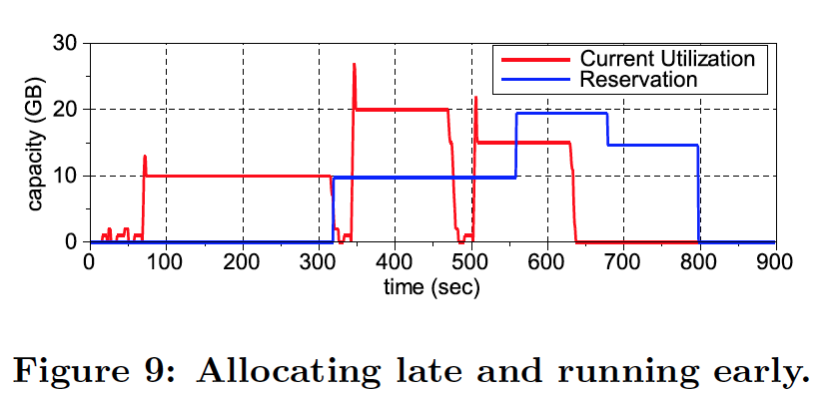
Planning Optimization – Greedy Heuristics
Maximizing objective in two dimensions
Placing single job at a time & no backtracking for previous allocated job(RDL sub-expression)
Place a job close to its deadline
Impacts the job acceptance rate
Scalable & Fast placement

Slide 11
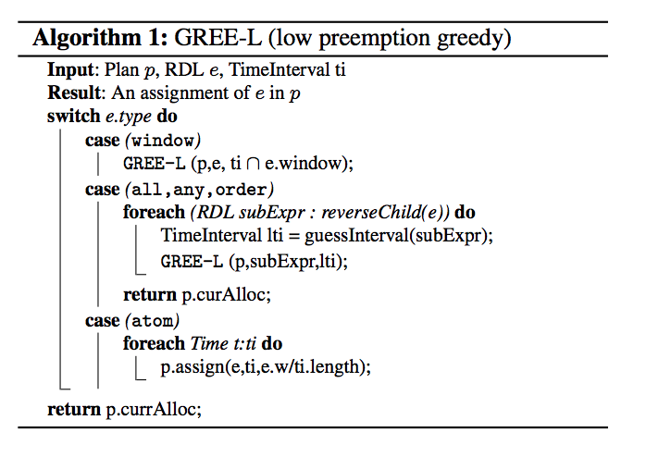
Planning Optimization – Greedy Heuristics

Slide 12
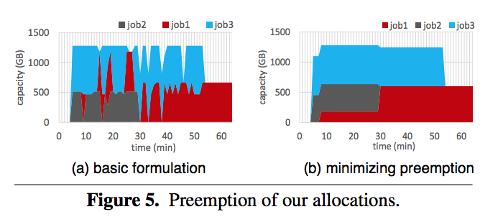
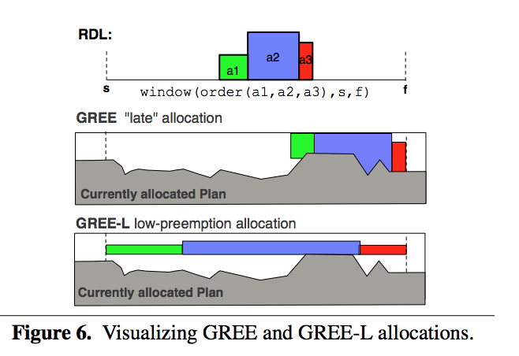
GREE v/s GREE-L
Packed closely, leads to higher pre-emption.
More space for accommodating best effort jobs
Flatly placed. Less pre-emption.
Less space for accommodating best effort jobs

Slide 13
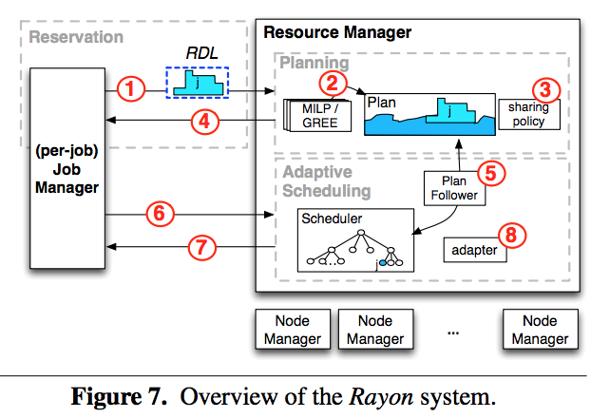
Rayon System Architecture

Slide 14
Experimental Setup
Cluster Setup
256 node cluster – 7 racks, 40 nodes/rack
32 virtual cores, 128GB RAM, 10Gbps NIC, 10 x 3TB - JBOD
Framework
YARN – version 2.x, HDFS – 3x Replication
Workloads: Synthetically generated
Malleable → Map Reduce using SWIM
Gang → Giraph graph computations
Time varying → Pig, Hive, etc
SLAs
Based on inputs from cluster operators

Slide 15
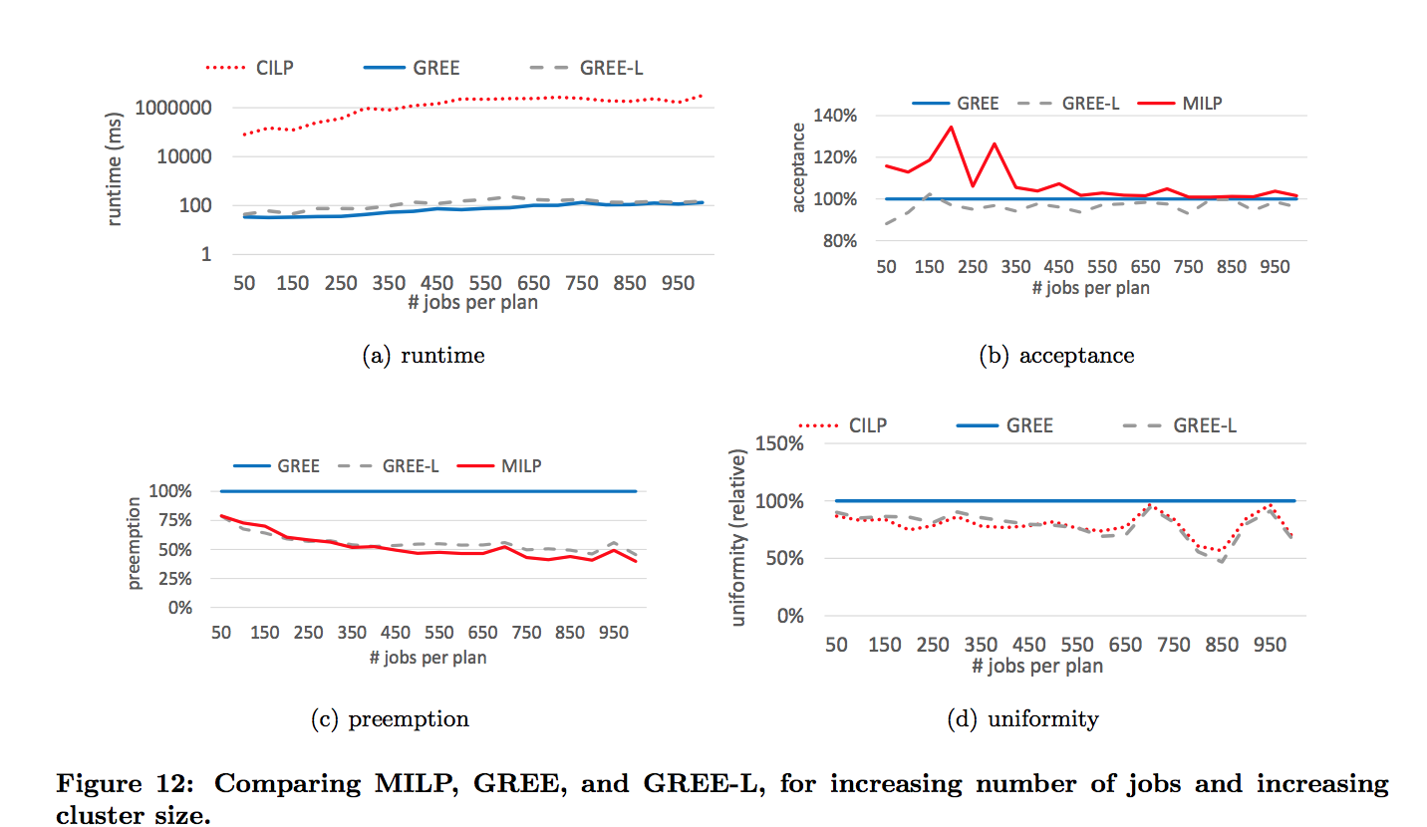
Evaluating Planning

Slide 16
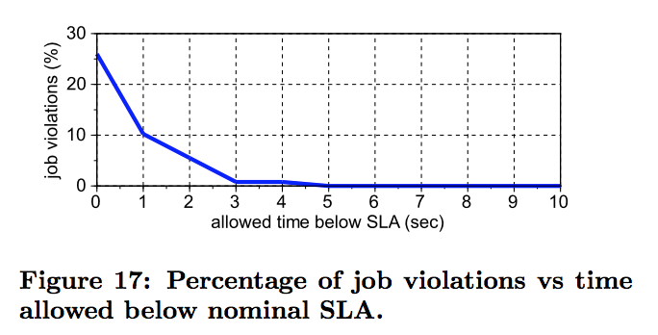
End-to-End Evaluation

Slide 17
Thoughts & Summary
Reservation based approach, helps to plan the cluster utilization in a better way
It also opens up possibility to estimate additional resource acquisition requirements based on the job rejection rate
RDL is simple & easy to learn & use with minimalistic elements
How can we extend the expression language to support cross data-center scheduling?

Slide 18
Questions
?

