Slide 1
Pelican: A Building Block for
Exascale Cold Data Storage
Shobana Balakrishnan, Richard Black, Austin Donnelly, Paul England, Adam Glass,
Dave Harper, and Sergey Legtchenko, Aaron Ogus, Eric Peterson and Antony Rowstron
Microsoft Research

Slide 2
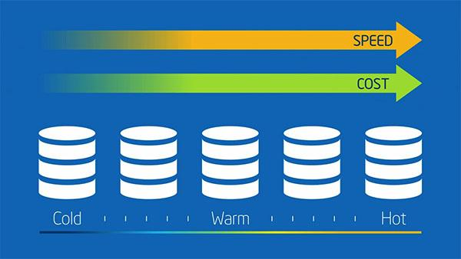
Data in the cloud

Slide 3
The Problem
A significant portion of the data in the cloud is rarely accessed and known as cold data.
Pelican tries to address the need for cost-effective storage of cold data and serves as a basic building block for exabyte scale storage for cold data.

Slide 4
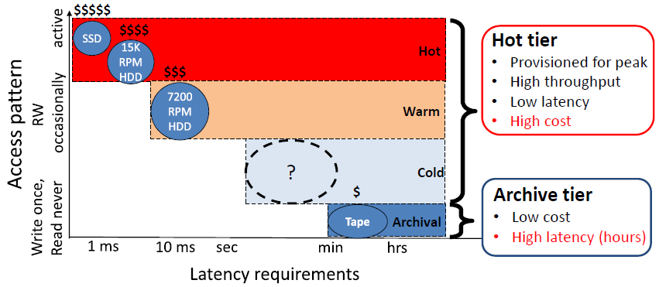
Price versus Latency

Slide 5
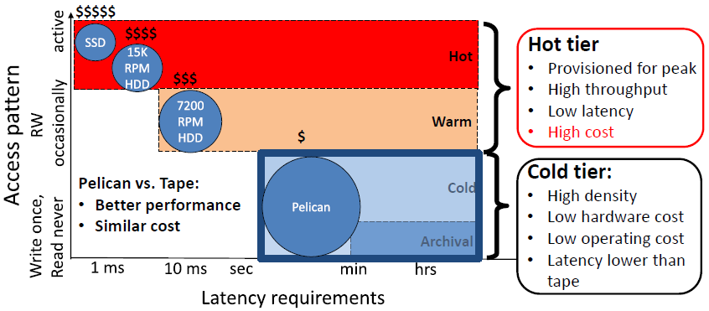
Price versus Latency

Slide 6
Right Provisioning
Provision resources just for the cold data workload:
Disks:
Archival and SMR instead of commodity drives
Power
Cooling
Bandwidth
Servers
Enough for data management instead of 1 server/ 40 disks
Enough for the required workload
Not to keep all disks spinning

Slide 7
Advantages
Benefits of removing unnecessary resources:
High density of storage
Low hardware cost
Low operating cost (capped performance)

Slide 8
Pelican

Slide 9
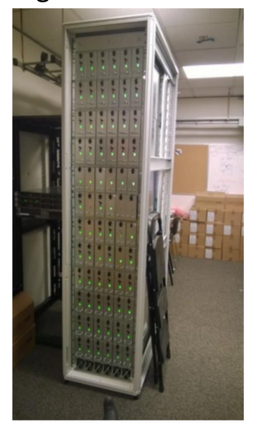
The Pelican Rack
Mechanical, hardware and storage software stack co-designed.
Right-provisioned for cold data workload:
52U rack with 1152 archival class 3.5” SATA disks.
Average size of 4.55 TB to provide a total of 5 PB of storage
It uses 2 servers and no top of the rack switch
Only 8% of the disks are spinning concurrently.
Designed to store blobs which are infrequently accessed.
Notes:
Advantages
• Total cost of ownership comparable to tape
• Lower latency than tape
The challenges of resource limitations managed in software

Slide 10
Resource Domain
Each domain is only provisioned to supply its resource to a subset of disks
Each disk uses resources from a set of resource domains
Domain-conflicting - Disks that are in the same resource domain.
Domain-disjoint - Disks that share no common resource domains.
Pelican domains
Cooling, Power, Vibration Bandwidth
Notes:
domain disjoint disks can move between disk states independently
whereas domain conflicting ones cannot do so as it could lead to over commitment
Resource Domains to be: the categories of things that are being managed

Slide 11
Handling Right-Provisioning
Constraints over sets of active disks:
Hard: power, cooling, failure domains
Soft: bandwidth, vibration
Constraints in Pelican
2 active out of 16 per power domain
1 active out of 12 per cooling domain
1 active out of 2 per vibration domain

Slide 12
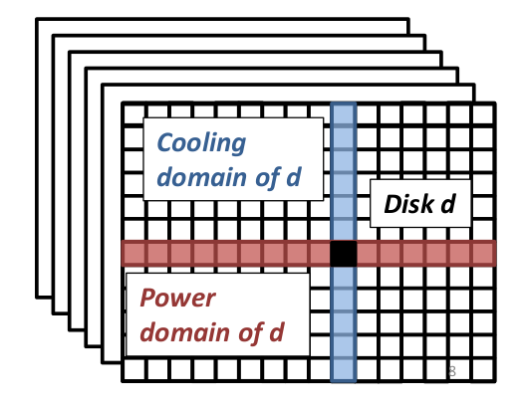
Schematic representation
12
6
16
Notes:
6 8U chassis
each has 12 trays
each tray has 16 disks

Slide 13
Data Layout
Objective - maximize number of requests that can be concurrently serviced while operating within constraints.
Each blob is stored over a set of disks.
It is split into a sequence of 128kB fragments. For each “k” fragments, additional “r” fragments are generated.
The k+r fragments form a stripe
In Pelican they statically partition disks into groups and disks within a group can be concurrently active. Thus they concentrate all conflicts over a few sets of disks.
Notes:
additional fragments contain redundancy information using Cauchy Reed Solomon erasure code
systematic code to allow the input to be regenerated by simple concatenating these fragments

Slide 14
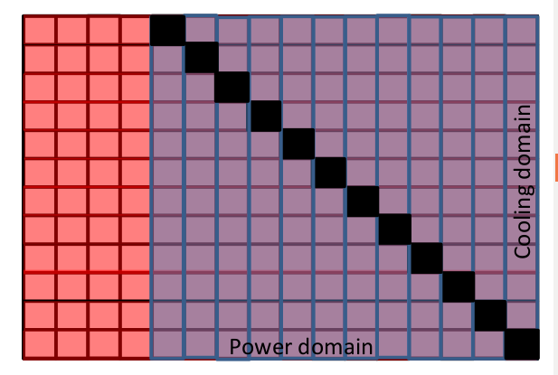
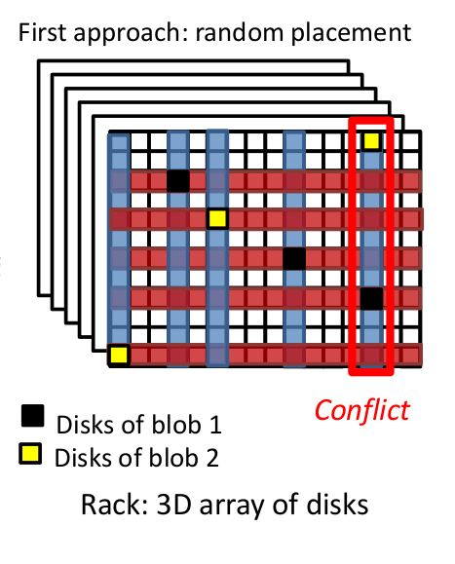
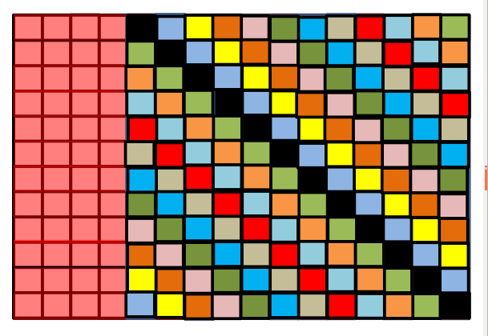
Data Placement

Slide 15
Group Property:
Either fully conflicting
Or fully independent
In Pelican - 48 groups of 24 disks
4 classes of 12 fully-conflicting groups
Blob is stored in one group - Blob is stored over 18 disks (15+3)
Off-Rack metadata called “catalog” holds information about the blob placement

Slide 16
Advantages
Groups encapsulate the constraints and also reduce time to recover from a failed disk.
Since blob is within a group, rebuild operation use disks spinning concurrently.
Simplifies the IO schedulers task.
Probability of conflict is O(n) which is an improvement from random placement O(n²)

Slide 17
IO Scheduler
Traditional disks are optimized to reorder IOs to minimize seek latency.
Pelican - reorder requests in order to minimize the impact of spin up latency.
Four independent schedulers. Each scheduler services requests for its class and reordering happens at a class level.
Each Scheduler uses two queues – one for rebuild operations and one for other operations.
Reordering is done to amortize the group spin up latency over the set of operations.
Rate limiting is done to manage the interference between rebuild and other operations.

Slide 18
Implementation Considerations

Slide 19
Power Up in Standby is used to ensure disks do not spin without the Pelican storage stack managing the constraints.
Group abstraction is exploited to parallelize the boot process.
Initialization is done on the group level.
If there are no user requests then all 4 groups are concurrently initialized
Takes around 3 minutes to initialize the entire rack.
Unexpected spin up disks is prevented by adding a special No Access flag to the Windows Server driver stack.
The BIOS on the server is modified to ensure it can handle all 72 HBA’s.

Slide 20
Evaluation
Comparison against a system organized like Pelican but with full provisioning for power and cooling.
The FP uses the same physical internal topology but disks are never spun down.

Slide 21
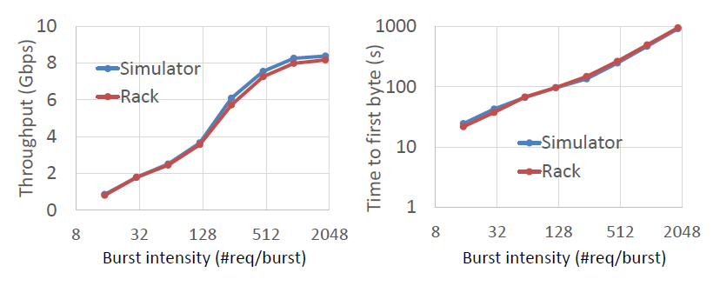
Simulator Cross-Validation
• Burst workload, varying burst intensity
Simulator accurately predicts real system behavior for all metrics.

Slide 22
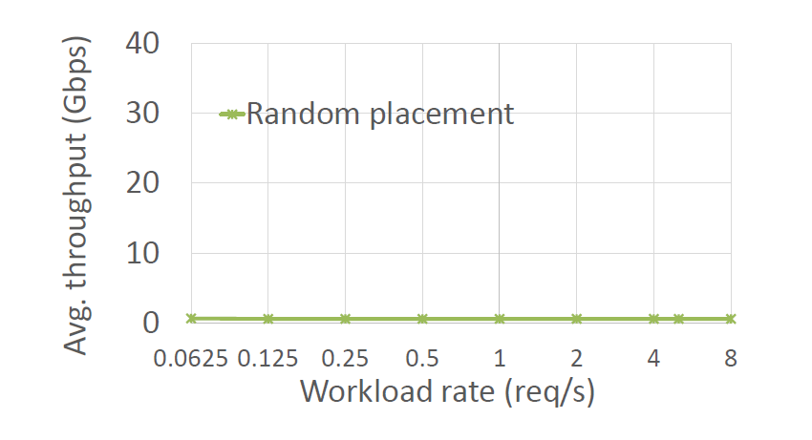
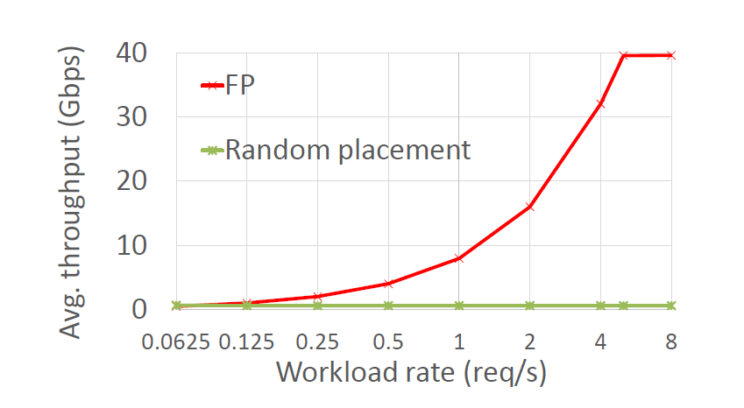
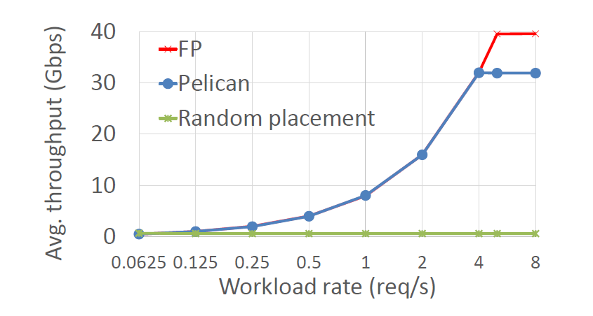
Performance – Rack Throughput

Slide 23
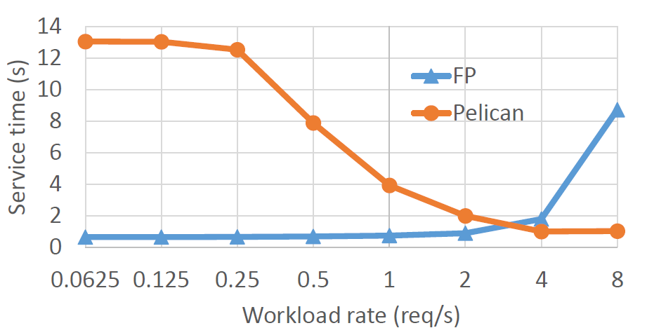
Service Time

Slide 24
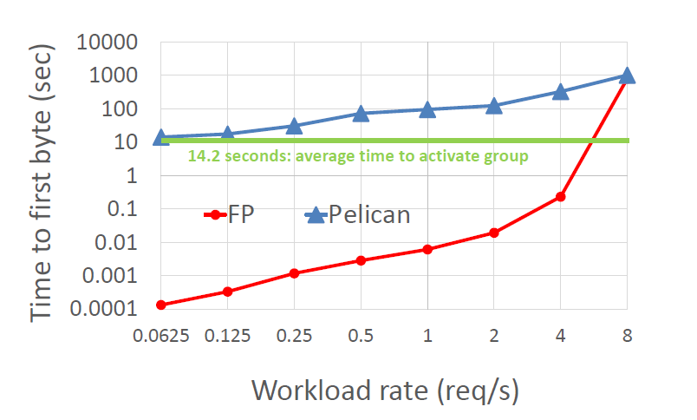
Time to first byte

Slide 25
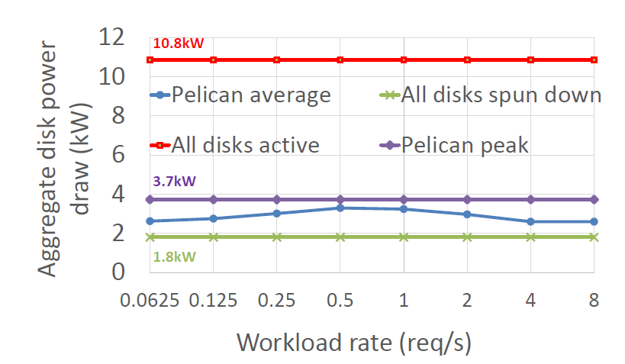
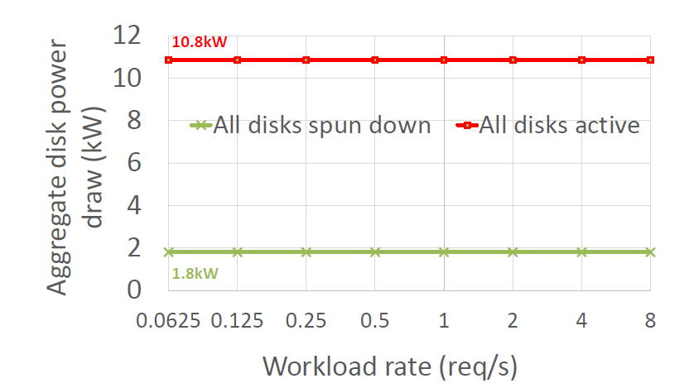
Power Consumption

Slide 26
Scheduler Performance
Rebuild Time
Impact on Client Request

Slide 27
Cost of Fariness
Impact on throughput and latency
Impact on reject rate

Slide 28
Disk Lifetime
Disk statistics as a function of the workload

Slide 29
Pros Cons
Reduced
Cost
Power Consumption
Erasure codes for fault tolerance
Hardware abstraction simplifies IO schedulers work.
Tight constraints – less flexible to changes
Sensitive to hardware changes
No Justification to some of the configuration decisions made.
Not sure if it is an optimal design

Slide 30
Discussion
They claim the values they chose to being a sweet spot in the hardware. How is the performance affected by any changes to this??
More importantly how do we handle for systems of different configurations and hardware.
Automate synthesizing of the Data layout – thoughts?

