Slide 1
Paxos Quorum Leases
Sayed Hadi Hashemi

Slide 2
Background

Slide 3
Setting
Status: Key-Value Storage
Commands: Read / Write / Batch (Read, Write)
Goal: Minimized WAN Delay
Original Paxos
Read: At least 2 RT (more in case of dueling leaders)
Write: At least 2 RT

Slide 4
Paxos
Can we do any better?
Client
Request (CMD)
Result / ACK
Replica 0
Prepare
OK
Accept (CMD)
Accept (OK)
Committed (CMD)
Replica 1
Replica 2
RT
RT

Slide 5
Multi Paxos
Temporary Stable Leader Replica to ignore Prepare (election) phase
Read: 1 RT from the leader
Write is the same as the read
A replica becomes the stable leader by running the prepare phase for a large number of instances at the same time, taking ownership of all of them.
Google’s Megastore
All Replica are leader!
Read: 0 RT from any Replica! (Reading Locally)
Write: At least 1 RT to All Replica

Slide 6
Steady state interaction in Multi-Paxos.
The asynchronous messages are represented as dashed arrows.
Client
Request (CMD)
Result/ACK
Leader
Replica 0
Accept (CMD)
Accept (OK)
Committed (CMD)
Replica 1
Replica 2
RT

Slide 7
Megastore
Client
Request (Read)
Result
Request (Write)
ACK
Replica 0
Accept (OK)
Accept (CMD)
Committed (CMD)
Replica 1
Replica 2
RT

Slide 8
Can we have benefits of the both?
Quorum Leases
Middle ground
Read: Most of the time 0 RT (80% in the experiment), 1 RT otherwise
Write is almost the same as the Multi Paxos

Slide 9
Quorum Leases

Slide 10
Overview
The idea is to have multiple leases for different sets of objects
Each lease is granted to lease holders by a majority of grantors
Read:
Lease holders can read locally while the lease is active
Any one else, use Multi-Paxos
Write:
Notify Lease holders synchronously through Lease Grantors (Majority)

Slide 12
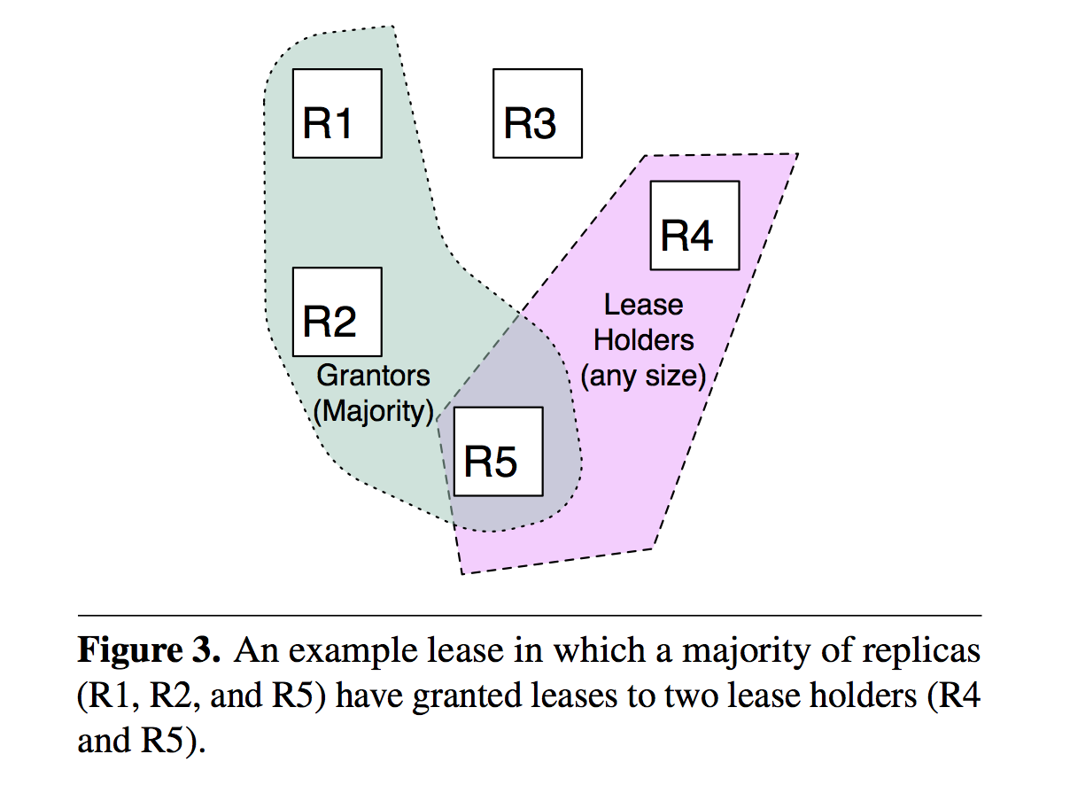

Slide 13
Lease Configuration
Describes the set of granted objects to quorum leases
Replica is added to a lease if it reads an object frequently
Replica is removed from a lease if it fails, or it stop reading an object frequently
Granting and Refreshing leases
|N+1|/2 grantors will activate a lease for a set of holders
Grantor Promise Holder that:
Notify r synchronously before committing any update
Acknowledge “Accept” and “Prepare” for writing with the condition that the proposer must notify r synchronously

Slide 14
Lease Configuration
Describes the set of granted objects to quorum leases
Replica is added to a lease if it reads an object frequently
Replica is removed from a lease if it fails, or it stop reading an object frequently
Steps:
Replicas track the frequency of reads and sends this information to the leader
Leader periodically uses this tracking information to update the lease configuration
Lease Configuration Changes are distributed using another instance of Paxos

Slide 15
Granting and Refreshing leases
Grantor Promise Holder that:
Notify r synchronously before committing any update
Acknowledge “Accept” and “Prepare” for writing with the condition that the proposer must notify r synchronously
Establish:
Guard
send Promise to every other replica
Optional ACK
Renew:
Promise, ACK
Failed Holders
Grace
Lease Configuration
Wait

Slide 16
Grant Lease
T1
T3
T5
t_lease¹
t_guard
t_lease²
Grantor
Guard ACK
Promise ACK
Guard
Promise
Holder
t_guard
t_lease
T2
T4
if Promise ACK has received
if Promise ACK has not received

Slide 17
Grant Renew
t_lease
T1
T3
T5
t_lease¹
t_guard
t_lease²
Grantor
Guard ACK
Promise ACK
Promise ACK
Guard
Promise
Promise
Holder
t_guard
t_lease
t_lease
T2
T4
T6
if Promise ACK has received
if Promise ACK has not received

Slide 18
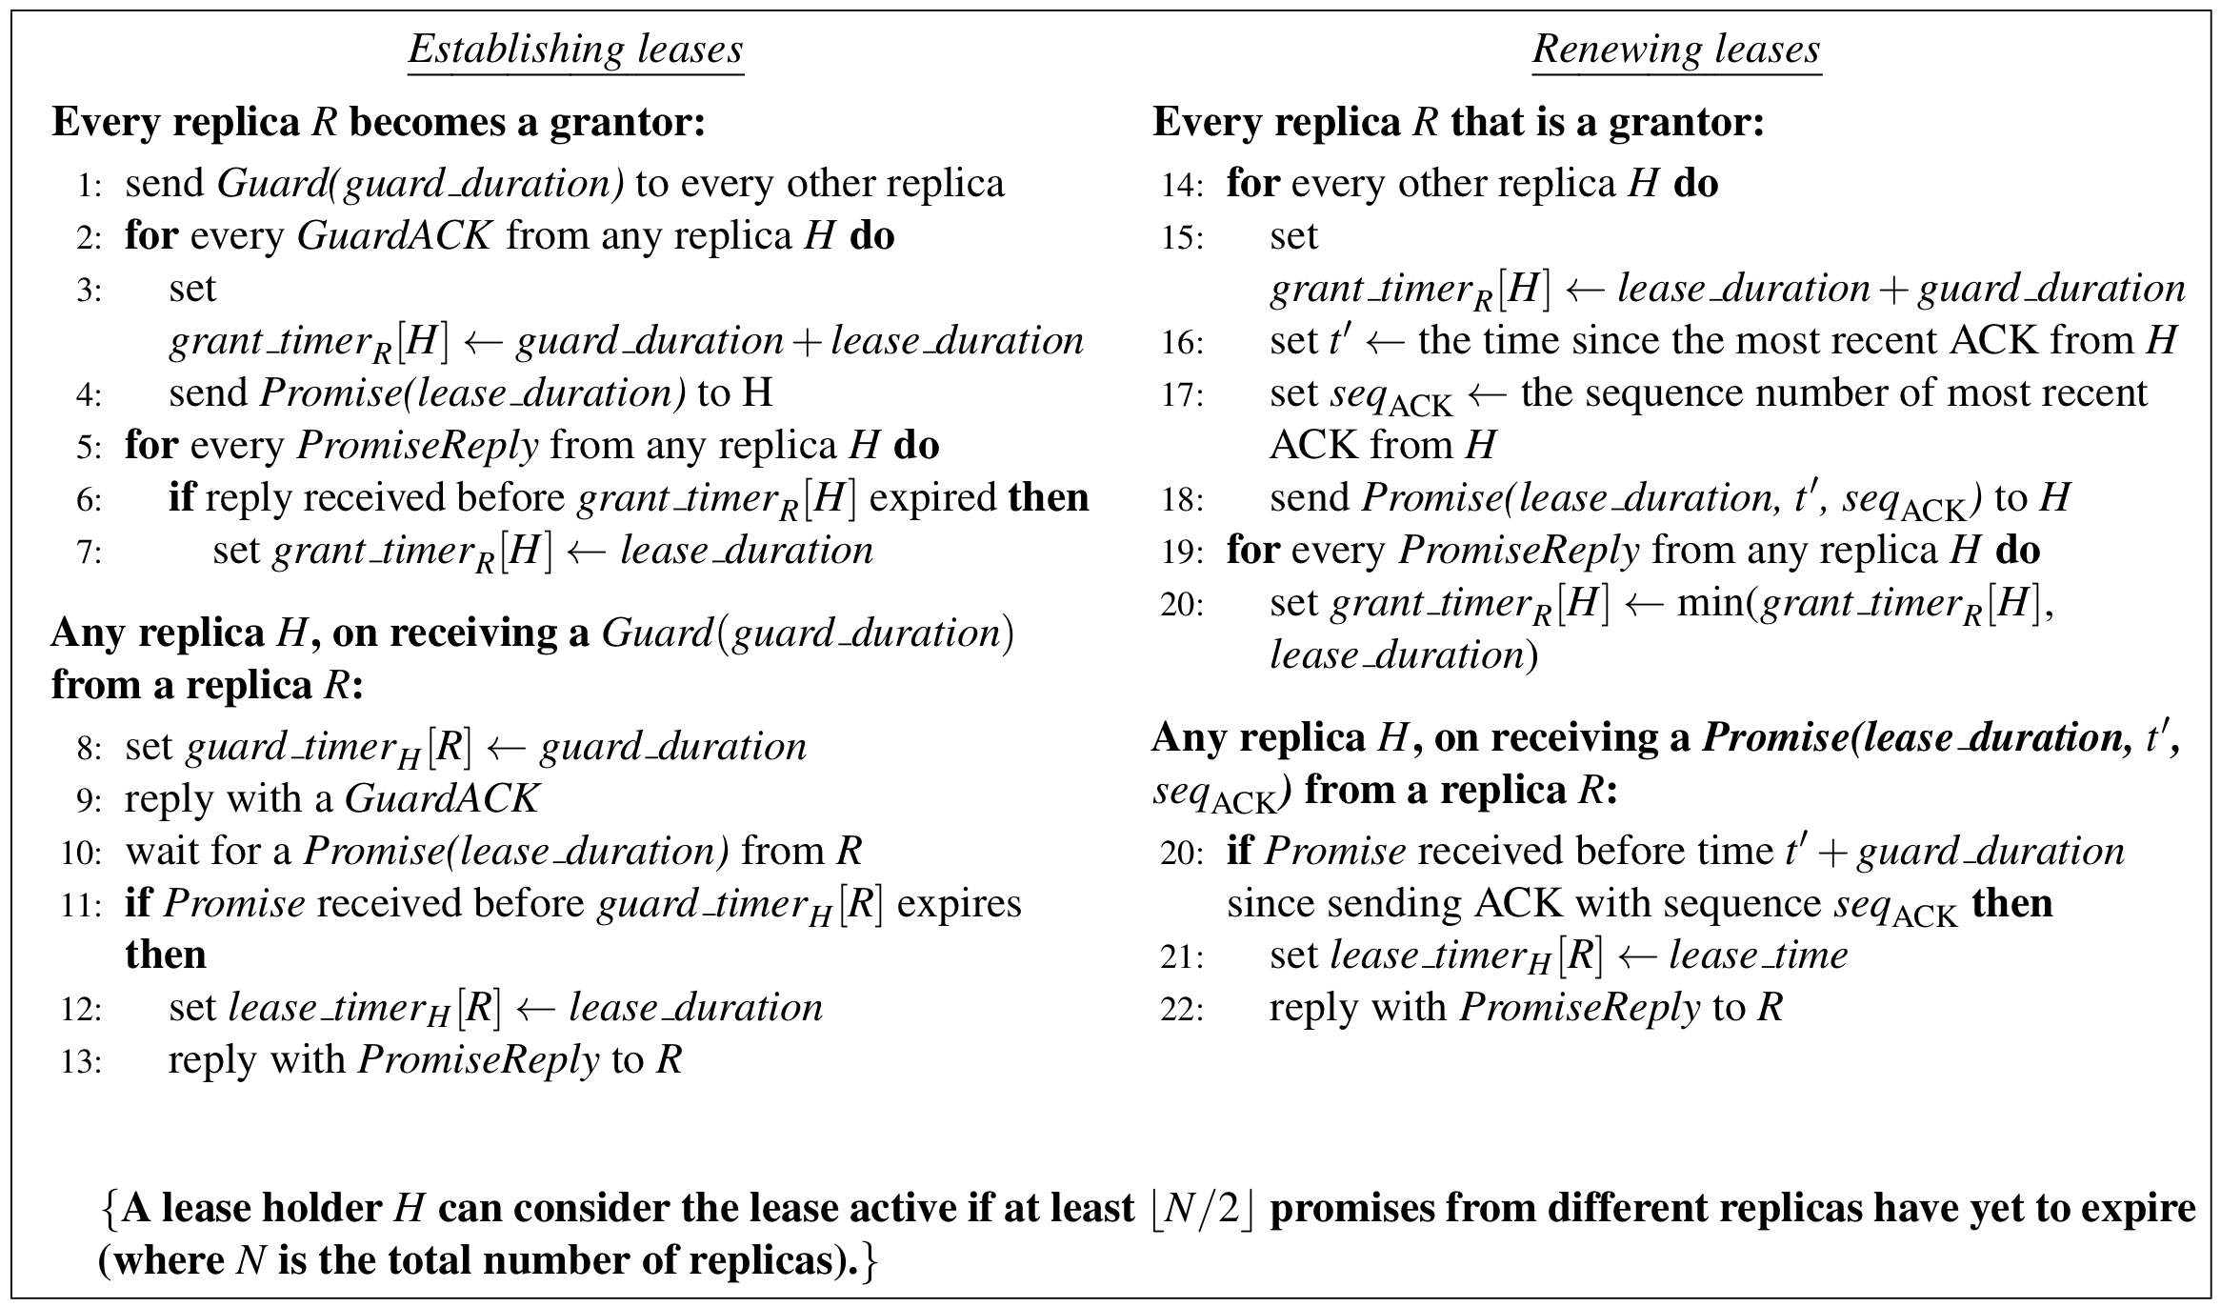

Slide 19
Evaluation

Slide 20
Evaluation
Run implementations of quorum leases, classic leader leases and Megastore-type leases
Geo-distributed Amazon EC2 cluster.
5 Multi-Paxos replicas in Virginia, Northern California, Oregon, Ireland and Japan.
10 Client co-located in each replica
Workload
YCSB key-value workload (Zipf)
Uniform key-value workload

Slide 21
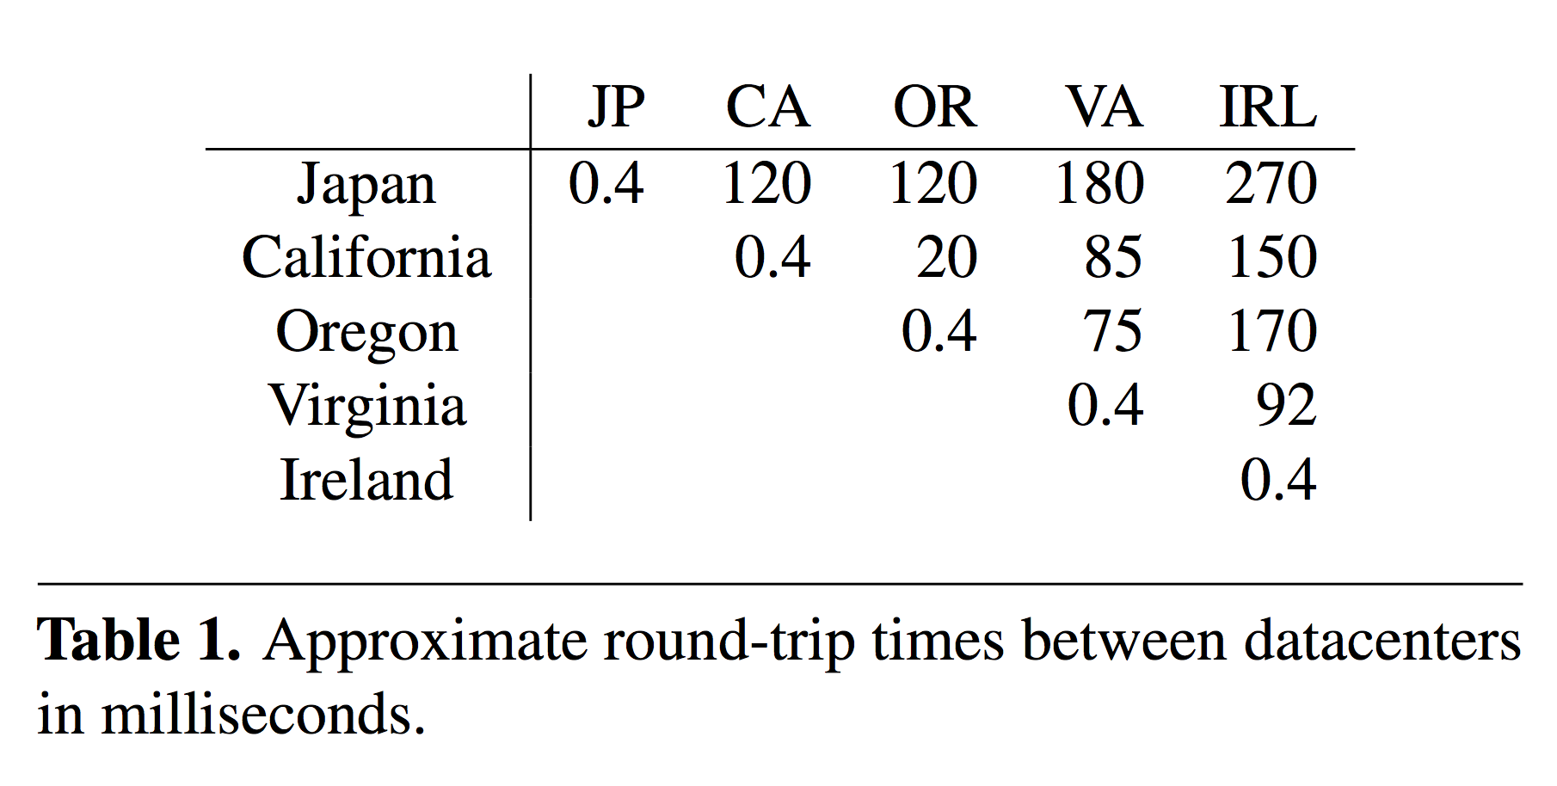
Selects as leader because of Low RTT

Slide 22
Test1: Latency Evaluation
Multi-Paxos Leader: Northern California
Each client sends 10000 request to its co-located replica
Request:
1:1 Read-Write
9:1 Read-Write
Parameters:
lease duration: 2s, renew duration: 500ms, lease configuration update: every 10s

Slide 23
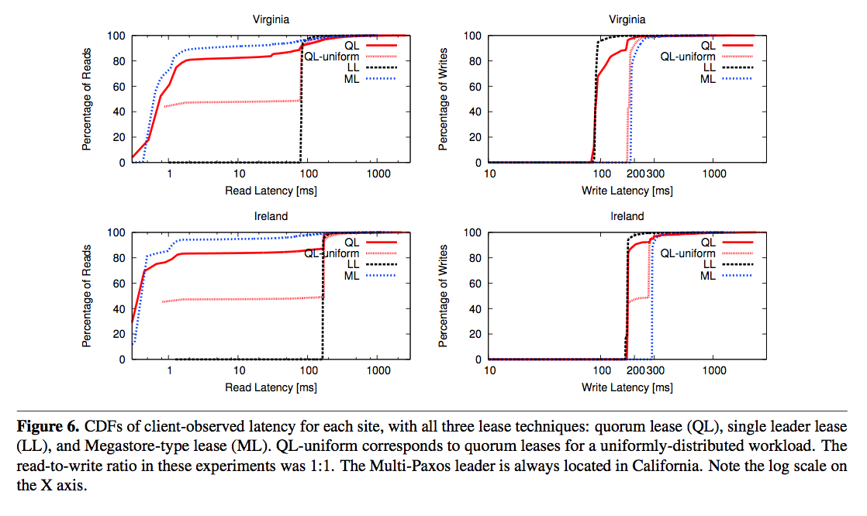
LL is the best in writing, ML in reading

Slide 24
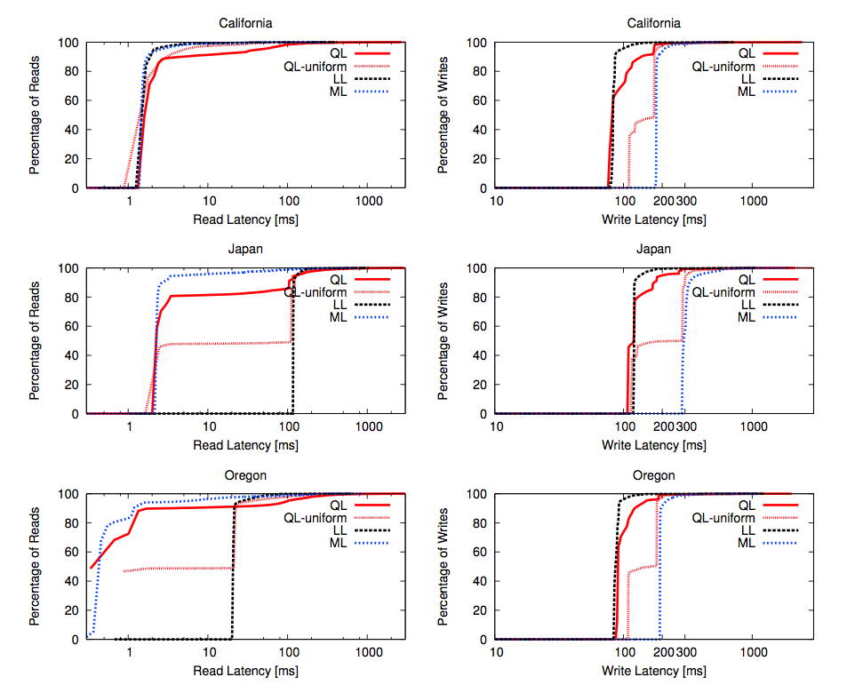

Slide 25
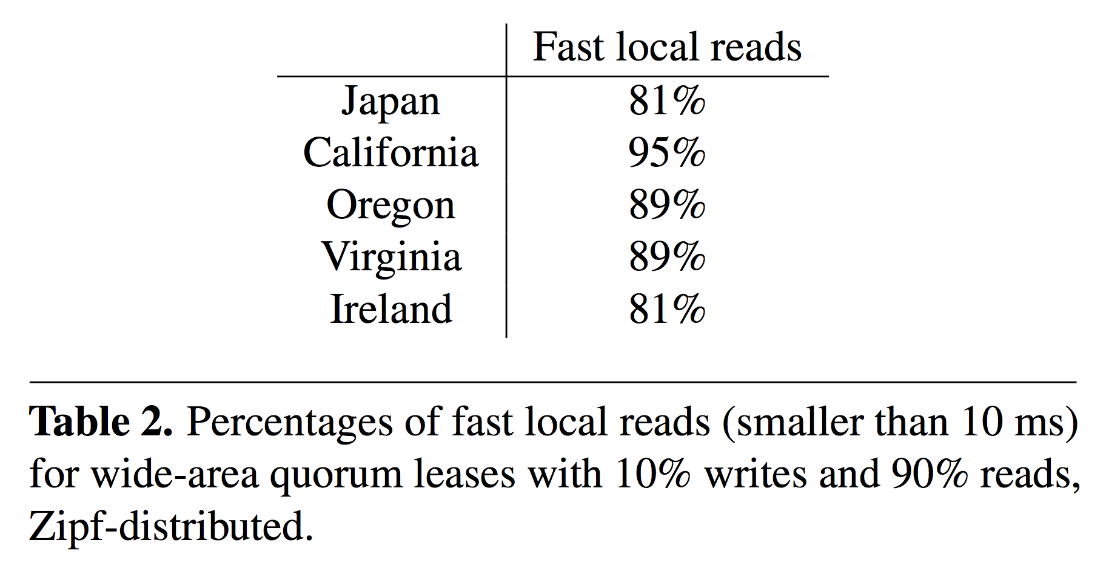

Slide 26
Test2: Recovering from a Replica Failure
Shutdown a (non leader) replica, 10s after starting the test (Lease Configuration Update)
Parameters:
Guard duration: 2s, Grace delay: 5s, lease duration: 2s, renew duration: 500ms, lease configuration update: every 10s
Recover time:
Update + Grace + Guard + Lease

Slide 27
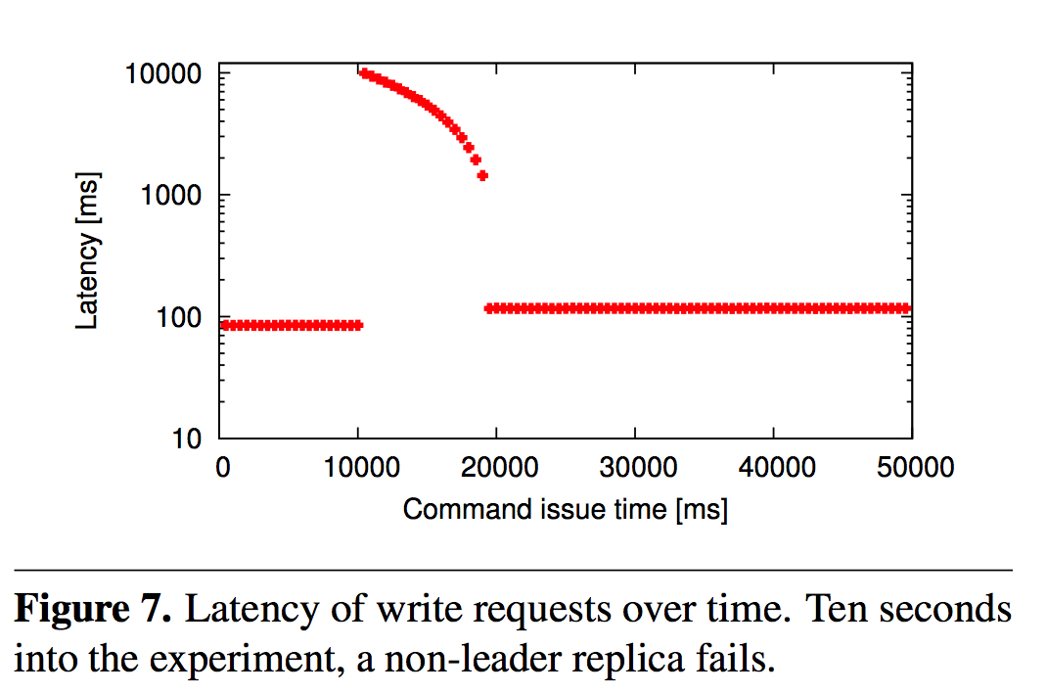

Slide 28
Test3: Throughput in a Cluster
Run in one local cluster (no geo-distributed)
Requests are generated open-loop by one client for each replica
2 Situations:
(1) different objects are popular at different replicas
(2) clients direct their reads uniformly at random across all replicas.
Use batching to commit writes (the leader batches up to 5000 updates at a time)

Slide 29
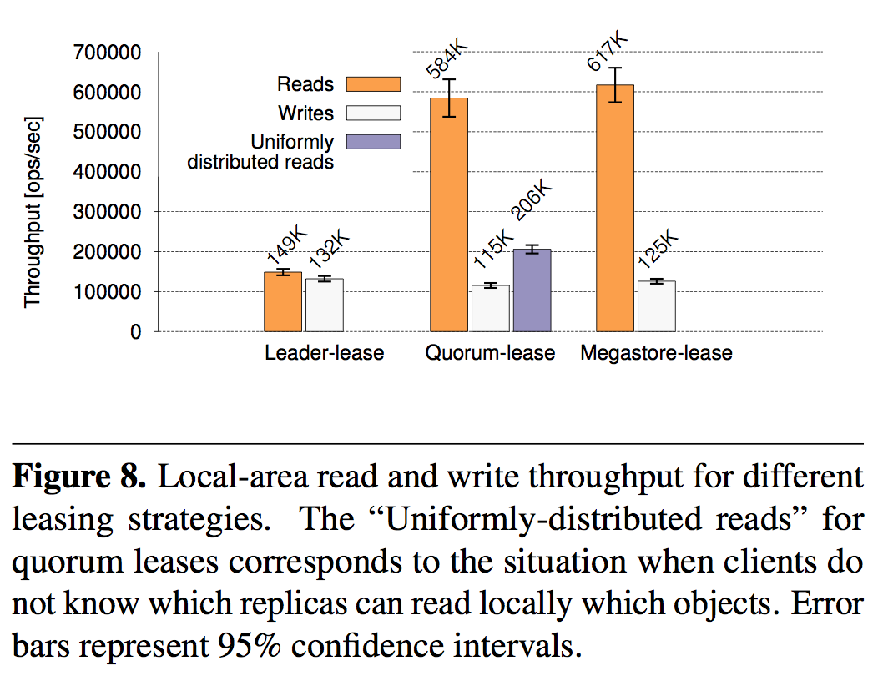

Slide 30
Review

Slide 31
Pro
Strong Consistency
Acceptable Availability
Combine the best of two approaches
Using objects, instead of Replica
Separating “Lease Configuration Updates” than the other operations
Compatibility with Multi-Paxos (or other implementations)

Slide 32
Cons
What is the messaging overhead?
Lease Renewal
Lease Configuration
Experiment
1:1 Read-Write Ratio vs. 9:1
Recovery Time in Practice:
Update + Grace + Guard + Lease
Worse case +20s

Slide 33
Questions?
Thanks for your attention

