Slide 1
Low-Latency Multi-Datacenter Databases using Replicated Commit
Hatem Mahmoud, Faisal Nawab, Alexander Pucher, Divyakant Agrawal, Amr El Abbadi
UCSB
Presented by Ashutosh Dhekne

Slide 2
Main Contributions
Reduce cross data center communication trips
Compare Replicated Commit with Replicated Log
Extensive experimental study for evaluation of the approach
Number of data centers involved
Read vs Write operations
Number of operations per transaction
Data objects in the database
Effect of used shards

Slide 3
2 Phase Commit
Coordinator
Worker1
Worker2
Worker3
Do Work
Prepare
Y
Ready
Y
Y
Do Commit
Y
Y
Y
Complete

Slide 4
Why merge 2PC and Paxos?
Two phase commit is very good for reaching consensus
Agreement is guaranteed – only coordinator decides
Validity is guaranteed – commit happens only if everyone is ready.
Termination is guaranteed – no loops possible
But Failures can wreak havoc
Paxos is good even if failures occur – quorum based, majority wins

Slide 5
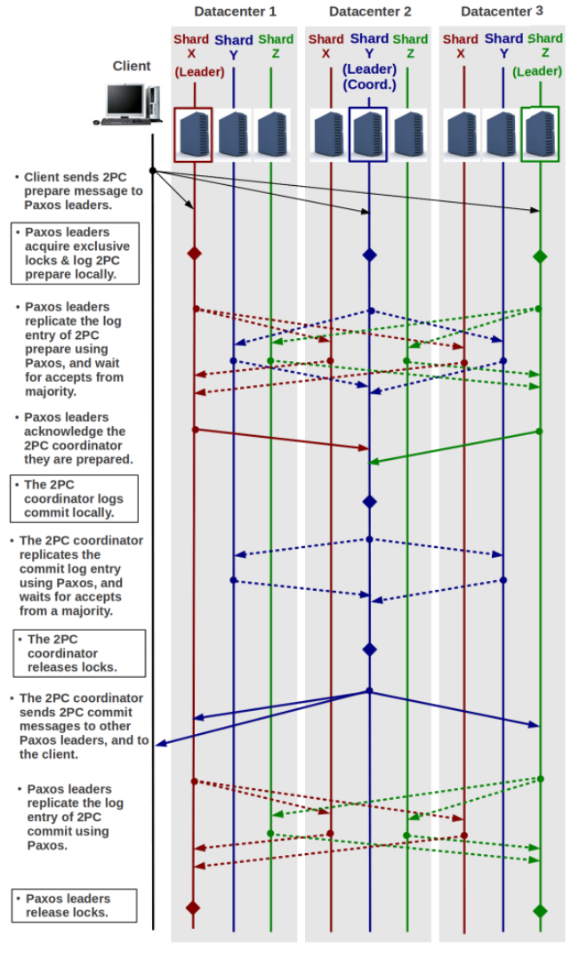
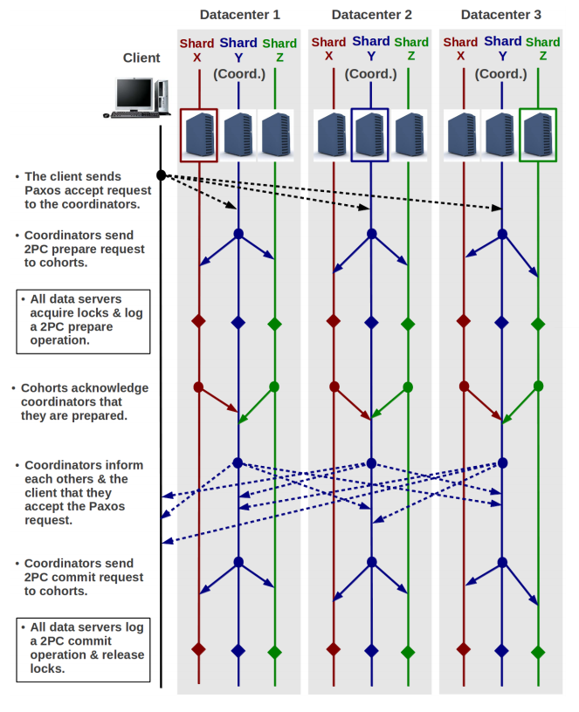
Replicated Log vs Commits

Slide 6
Replicated Log – Step by Step
Client
Datacenter 1
X
Y
Z
Datacenter 2
X
Y
Z
Datacenter 3
X
Y
Z
Paxos
Data
Transaction

Slide 7
Replicated Log – Step by Step
Client
Datacenter 1
X
Y
Z
Datacenter 2
X
Y
Z
Datacenter 3
X
Y
Z
2PC Prepare message to Paxos Leaders

Slide 8
Replicated Log – Step by Step
Client
Datacenter 1
X
Y
Z
Datacenter 2
X
Y
Z
Datacenter 3
X
Y
Z
Acquire exclusive locks and log 2PC Prepare locally

Slide 9
Replicated Log – Step by Step
Client
Datacenter 1
X
Y
Z
Datacenter 2
X
Y
Z
Datacenter 3
X
Y
Z
Leader informs same shard in other datacenters
Those shards reply accept

Slide 10
Replicated Log – Step by Step
Client
Datacenter 1
X
Y
Z
Datacenter 2
X
Y
Z
Datacenter 3
X
Y
Z
All of those messages together

Slide 11
Replicated Log – Step by Step
Client
Datacenter 1
X
Y
Z
Datacenter 2
X
Y
Z
Datacenter 3
X
Y
Z
Paxos leaders know status of their shards in other data centers
Paxos leaders ack the coordinator that they are ready
Y
Y

Slide 12
Replicated Log – Step by Step
Client
Datacenter 1
X
Y
Z
Datacenter 2
X
Y
Z
Datacenter 3
X
Y
Z
Y
Y
Coordinator can now log commit
Then asks it’s peer shards to commit and receives acks

Slide 13
Replicated Log – Step by Step
Client
Datacenter 1
X
Y
Z
Datacenter 2
X
Y
Z
Datacenter 3
X
Y
Z
Coordinator releases lock
Informs other leaders that commit is made

Slide 14
Replicated Log – Step by Step
Client
Datacenter 1
X
Y
Z
Datacenter 2
X
Y
Z
Datacenter 3
X
Y
Z
Other leaders go in another frenzy to intimate their shards on other data centers
Finally, locks are released

Slide 15
Replicated Commit – Step by Step
Client
Datacenter 1
X
Y
Z
Datacenter 2
X
Y
Z
Datacenter 3
X
Y
Z
Paxos accept request to coordinators

Slide 16
Replicated Commit – Step by Step
Client
Datacenter 1
X
Y
Z
Datacenter 2
X
Y
Z
Datacenter 3
X
Y
Z
2PC prepare message is sent to other shards locally

Slide 17
Replicated Commit – Step by Step
Client
Datacenter 1
X
Y
Z
Datacenter 2
X
Y
Z
Datacenter 3
X
Y
Z
All acquire lock and log 2PC prepare message

Slide 18
Replicated Commit – Step by Step
Client
Datacenter 1
X
Y
Z
Datacenter 2
X
Y
Z
Datacenter 3
X
Y
Z
All reply ready to the coordinator

Slide 19
Replicated Commit – Step by Step
Client
Datacenter 1
X
Y
Z
Datacenter 2
X
Y
Z
Datacenter 3
X
Y
Z
All coordinators inform each other and the client.
Client keeps quorum info

Slide 20
Replicated Commit – Step by Step
Client
Datacenter 1
X
Y
Z
Datacenter 2
X
Y
Z
Datacenter 3
X
Y
Z
Commit is sent to all shards locally

Slide 21
Replicated Commit – Step by Step
Client
Datacenter 1
X
Y
Z
Datacenter 2
X
Y
Z
Datacenter 3
X
Y
Z
Finally, locks are released

Slide 22
Replicated Log Vs Replicated Commit
Number of messages – Replicated Log requires a lot of inter-datacenter message transfers
Latency – Network links across the continents are not at speed of light
Access Locality – Messages exchanged locally are very fast
A solution to higher latency – reduce the number of cross datacenter messages
Replicated Commit achieves this

Slide 23
Experiments

Slide 24
Experimental Setup
5 Data centers
2500 transactions
3000 items in the database, 1000 in each shard
3 shards per data center
50 operations per second in each datacenter

Slide 25
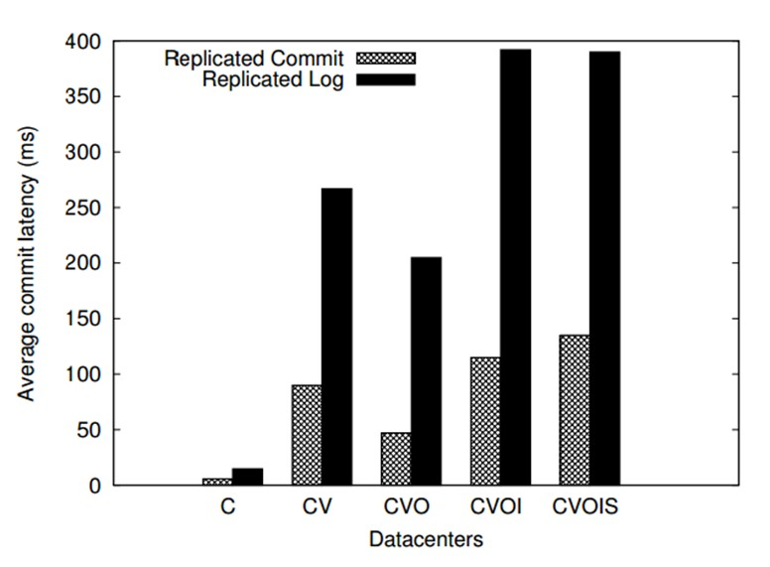
Average Commit Latency – various datacenters
Replicated Commit provides much faster responses than Replicated Logs
Combination of servers from different regions versus combination of servers from same region has large impact

Slide 26
Scalability of Replicated Commit

Slide 27
Scalability of Replicated Commit
Replicated Commit has a very low read latency and comparable other latencies
Replicated Commit supports many more clients than Replicated Log

Slide 28
Changing Database Properties
Increasing number of data objects does not affect Replicated Commit latency
Replicated Commit latency is agnostic of number of shards used

Slide 29
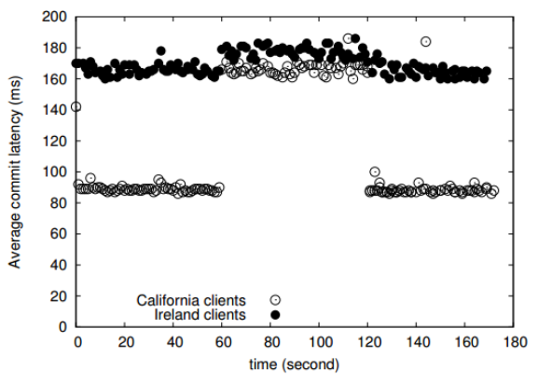
Fault Tolerance
Sudden fault at one of the datacenters
All clients are immediately served by another data center
Latency increases in proportion
Total latency for all clients gets affected possibly because of load
Served by Ireland

Slide 30
Comments
Comparison between SQL and NoSQL is missing
Effect of individual shards failing
What is the tradeoff between Replicated Logs and Replicated Commit?
What are we losing if we adopt Replicated Commit?
Why does everyone not use Replicated Commit?
Comparisons with other techniques discussed in the related work could have bolstered the paper even further.
Intra-datacenter and inter-datacenter protocols are different (physical location knowledge helps the protocol – loss of abstraction)

Slide 31
Discussion

Slide 32
Conclusion
A modified approach to achieving ACID properties in multi-datacenter settings is discussed
Gains with respect to Replicated Logs are proportional to the latency between the servers
More processing is done locally inside a data-center and then consensus is reached

Slide 33
Additional Material

Slide 34
Fault Tolerant Logs
Replica 1
Replica 2
Replica 3
Client App
value
Callback
Callback
Callback
Paxos
Framework
Submit
value
value
value

